Slide 1
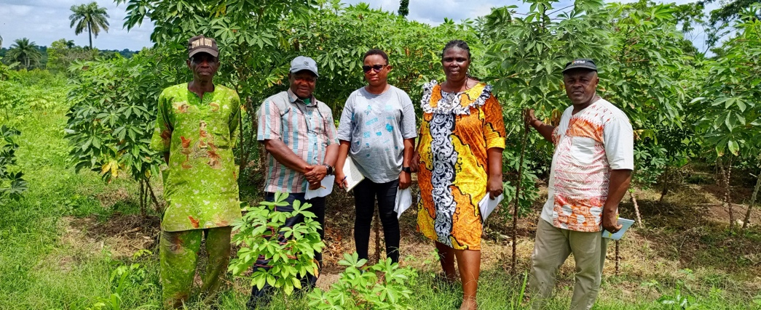
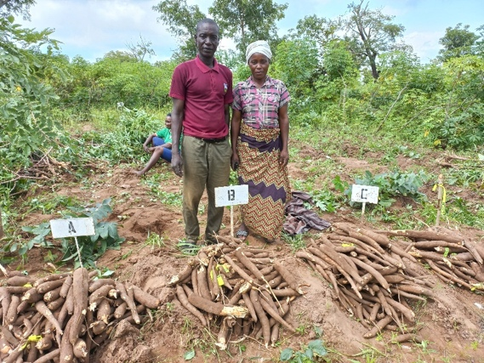
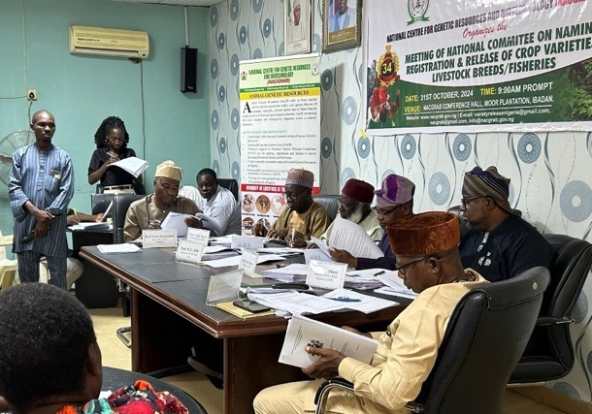
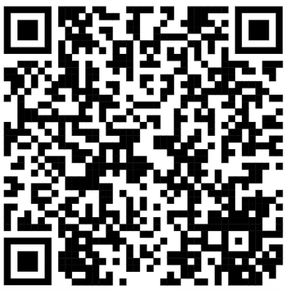
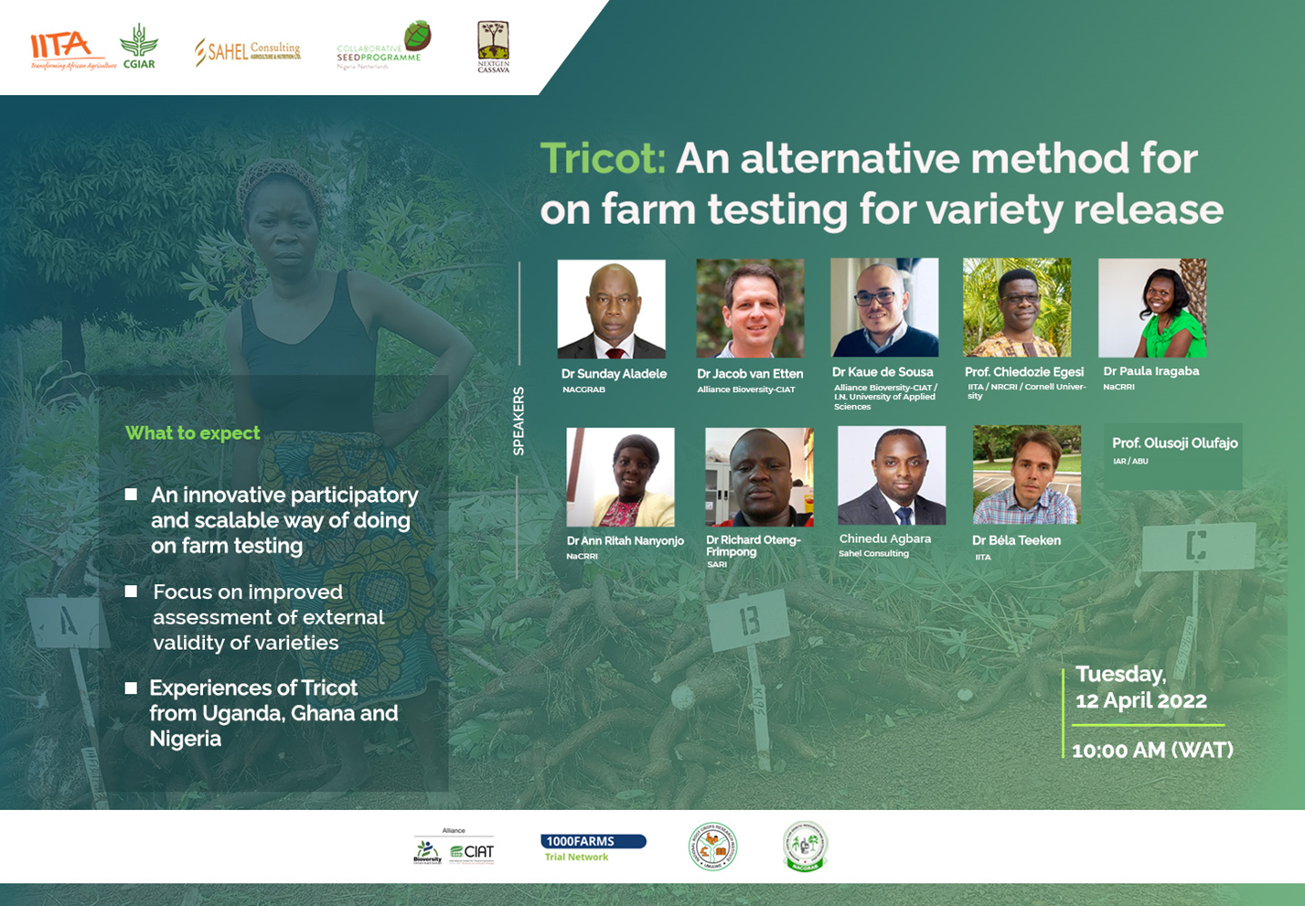
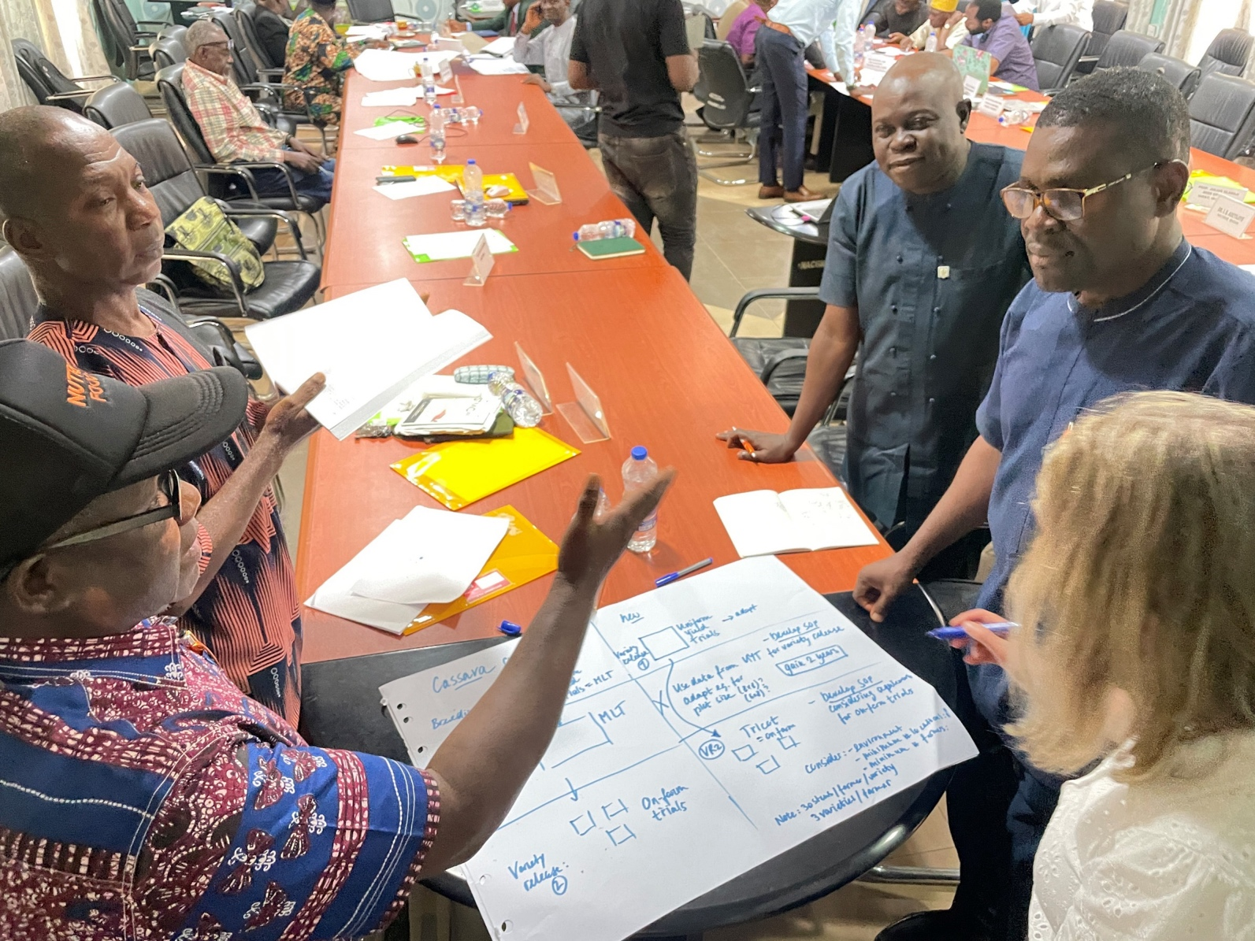
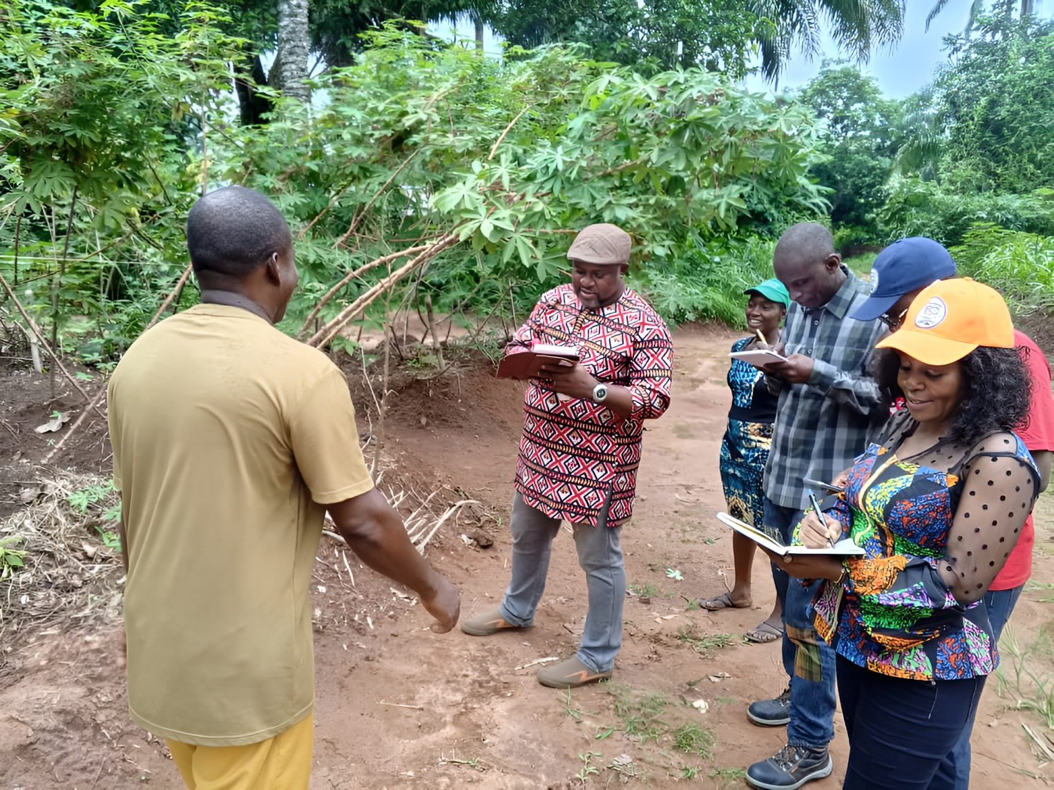
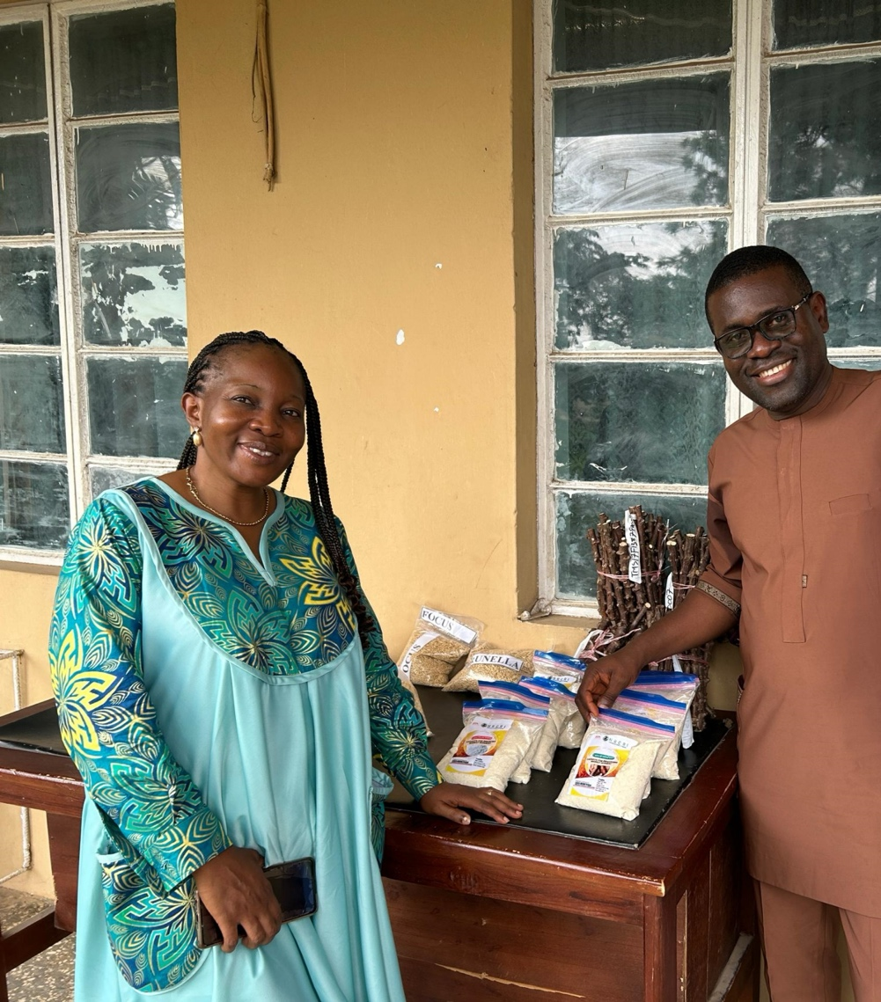
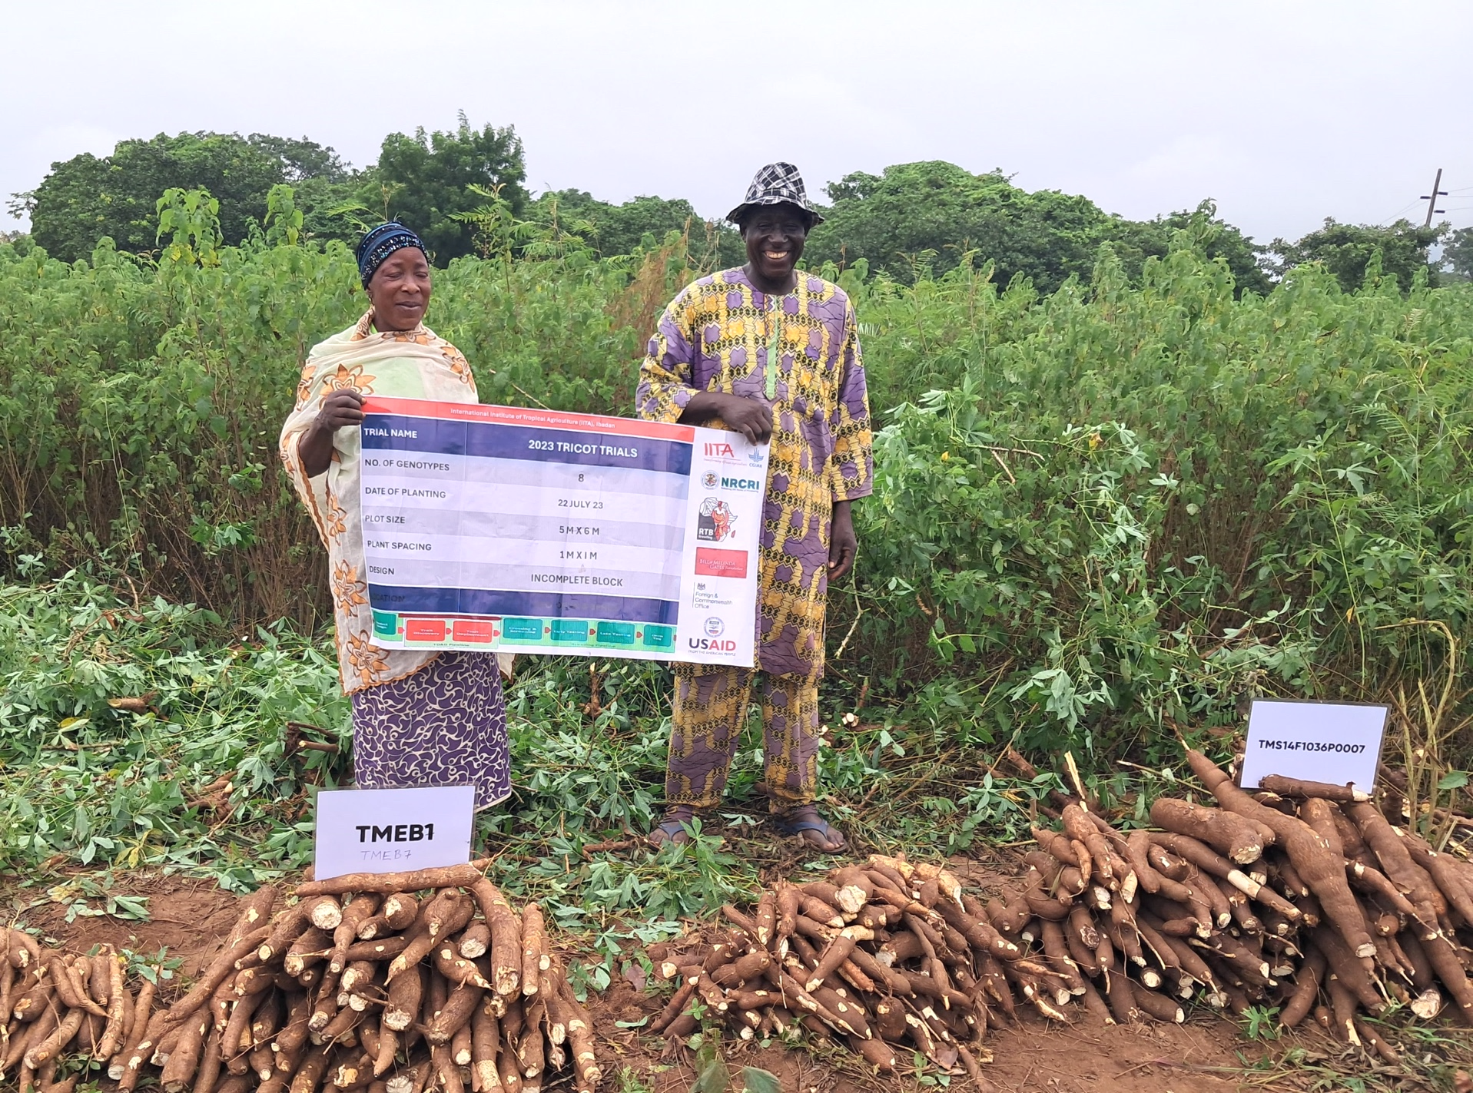








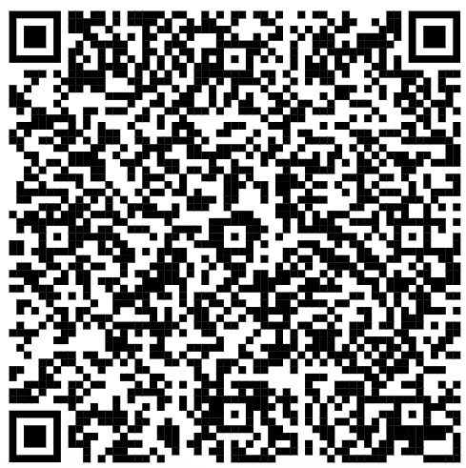




ORCID
0000-0002-3150-1532
Adopting Scalable Participatory Variety Selection (Tricot) for On-Farm Testing in Nigeria: Enhancing Social and Gender Impact in Breeding
Teeken, B.^{1*}, Olaosebikan, O.¹ , Bello, A.¹, Madu, T. ², Okeakpu, F.², Njoku, D.², Adetiloye, I.³, Agbara, C.⁶, de Boef, W.⁵, Thijsen, M.⁵, Onwuka, S.², Okoye, B.² , de Sousa, K.⁴, Ekanem, U.¹, Iluebbey, P.¹, Edughaen, G.¹, Oke, E.¹, Owoade, D.¹, Tufan, H.A.⁷, Cole, S.¹, Parkes, E.¹, Kulakow, P.¹ , Egesi, C.^{1,2,7,} , Rabbi, I.¹
¹IITA, Ibadan, Nigeria
²NRCRI, Umudike, Nigeria
³NVCR, NACGRAB, Ibadan
⁴Bioversity, Montpellier France
⁵Wageningen university and Research
⁶Sahel consulting agriculture and nutrition ltd.
⁷Cornell, Ithaca, USA
Introduction
Tricot is a scaled method for participatory variety selection where farmer participants are not mere respondents but citizen scientist: partners in the research. For good bonding with the varieties and to ease management and to structure data collection, tricot is an incomplete block design where a relatively large number of farmers each individually rank a specific combination of only 3 varieties out of the total number of varieties evaluated.
The joint cassava breeding program of IITA and NRCRI has been adapting and implementing the tricot since 2018 to inquire into trait and variety preferences under real farmer conditions taking into consideration social and gender considerations.
To be able to formally institutionalise the approach within the breeding process the team has been further adapting the approach as an innovative and better way to do on farm testing for variety release assuring optimal systematic feedback from farmers and processors to target social impact.
Figure 1: Tricot online workshop on 12 April 2022 organised with the Nigerian variety release committee. Including tricot use testimonies form Uganda, Ghana, Rwanda and Nigeria
Implementing Tricot: Workshops, Training, and Stakeholder Engagement
In collaboration with the Nigerian seed sector's innovation-focused program and the 1000farms tricot project, an online workshop with the variety release committee was held on April 12, 2022 (Figure 1). The session featured testimonies on tricot implementation from Ghana, Rwanda, Uganda, and Nigeria.
This was followed by a technical tricot training at IITA Ibadan from December 6 to 9, 2022, involving the variety release committee to discuss and adopt the tricot approach for on-farm testing in variety release.
A tricot design incorporating standardized yield measurements was shared and approved for piloting during a CSP meeting (Photo 1). Tricot trials for variety release were conducted with 120 farmers across six states, followed by inspections by the variety release committee (Photo 2).
A stakeholder meeting held in Abuja on October 8-9, 2024, showcased various tricot applications, including cases from One Acre Fund and Bayer. Participants drafted plans for potential collaborations among public breeders, humanitarian NGOs, and the private sector.
Photo 1: The joint IITA and NRCRI cassava breeding team discussing the integration of tricot on-farm testing within the variety release procedure during a collaborative seed program project meeting at NACGRAB, Ibadan 19 June 2023.
Photo 2 & 3 : Inspection of the tricot trials in Osun state by the variety release committee (left) and the NRCRI cassava coordinator Favour Okeakpu - seen left in the photo – next to stemcuttings and food products presented for and released at NACGRAB Ibadan on 31 October 2024 (right).
Outcomes
Scaled on-farm testing using the tricot method has provided cassava breeding programs with valuable insights into farmers' and processors’ trait preferences, capturing critical social and gender-inclusive perspectives. This input informed product profiles and guided variety advancement.
The Nigerian variety release committee recognized the tricot approach as an innovative addition to the variety release process, leading to the successful release of two cassava varieties, ‘Renewed Hope’ and ‘Biggie,’ on October 31, 2024 (Photos 3 & 4).
Tricot has evolved into a versatile, transdisciplinary platform that connects breeding efforts with the socio-cultural, gender, agronomic, climatic, and economic realities of crop users. It offers diverse applications, fostering collaboration among public breeders, the private sector, and humanitarian organizations.
Photo 4: tricot farmers next to the harvested roots from their tricot trial: Labelled are TMEB1 (‘Antiota’) a farmer variety and the released variety ‘Renewed hope’ on the right.

