Slide 1
Co-creating models with Stakeholder
Challenges and Opportunities related to understanding stakeholder priorities and production objectives? Learnings from Agroecology Initiative in Zimbabwe
Adaptation Futures
04.10.2023
CIMMYT contact:
Vimbayi G.P. Chimonyo (v.chimonyo@cgiar.org)

Slide 2
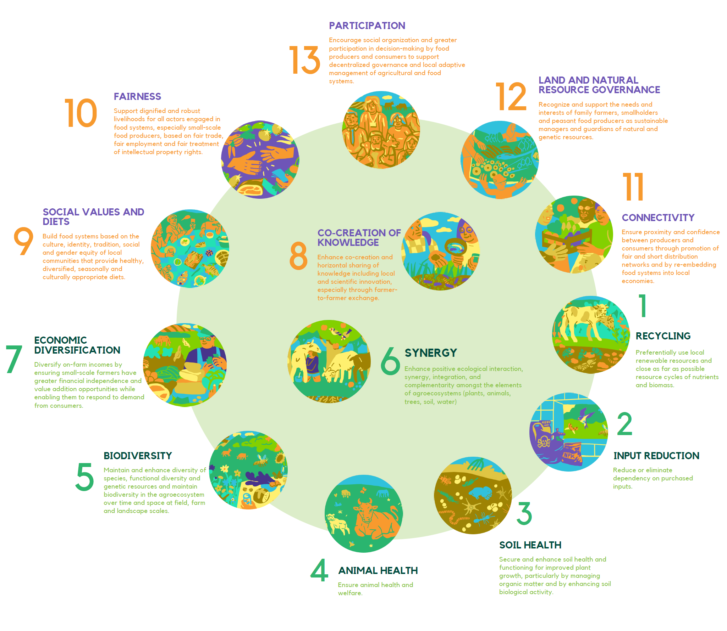
Overview of Agroecology initiative in Zimbabwe - Harnessing nature’s goods and services whilst minimizing adverse environmental impacts and improving knowledge co-creation and inclusive relationships among Food System actors.
Transformational agroecology across food, land and water systems (Agroecological Initiative (AE-I) for short)
The Initiative responds to the call for both more “integrated research and development platforms at multiple scales (local, national, regional/basin, and global) with strong interconnections between these levels and stakeholders
AE-I is designed around agroecological principles across selected components of the food system (food production, business models, policies, and local institutions)
Across 8 countries – Peru, Zimbabwe, Kenya, Burkina Faso, Senegal, Tunisia, Lao, India
Notes:
Targeting the red stars

Slide 3
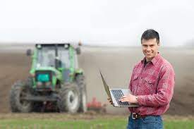
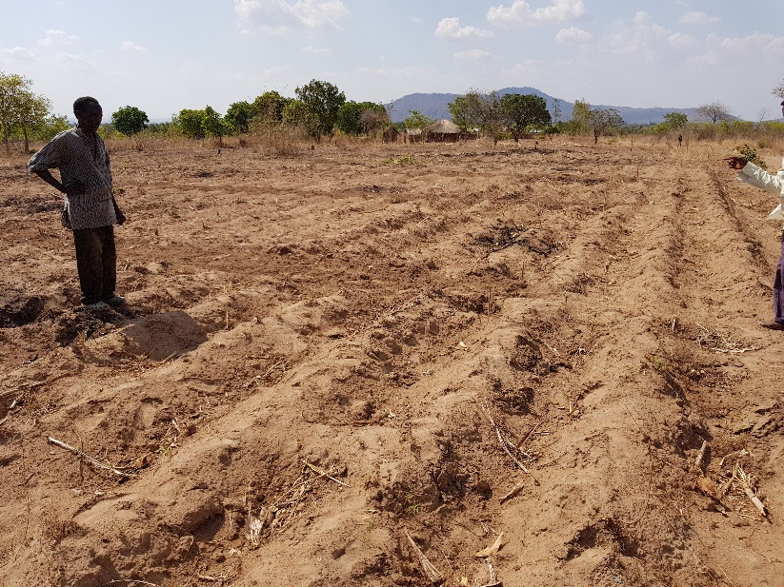
Why participatory crop simulation models and how can they contribute?
Quantify process that could have been hard and cumbersome
Local knowledge integration
Context specific decision support
Empowerment and ownership
Co-learning and capacity building
Adaptability and resilience
Cause and effect
Iterative
Spatial and temporal
Notes:
Model- tool – link with stakeholder

Slide 4
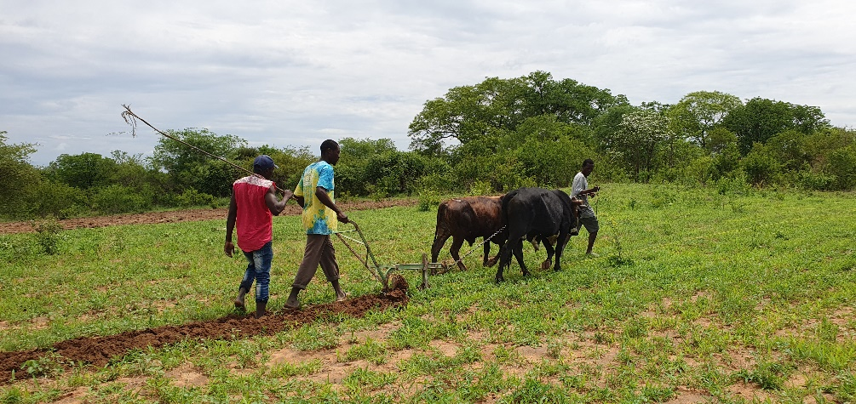
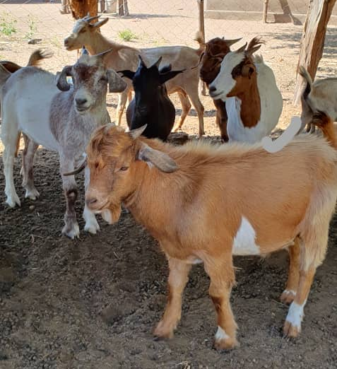
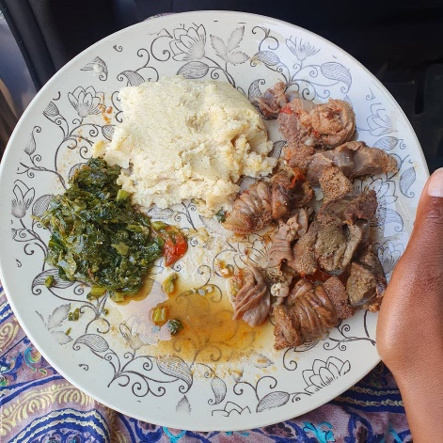
Why is it important to understand smallholder farming priorities and production objectives
“I only need to harvest enough sorghum grain to feed my grand-children, the rest of the food stuff will come from the kid's parents working in town. For year with low rainfall, we really suffer” Mrs Seke in Mbire
“My livestock is my wealth, but I do not have enough pastures for them. If only I could produce enough sorghum biomass so that I can start providing supplementary feed ” Mr Chidhuku in Mbire
“Farming gives me a sense of purpose, if I don’t farm, I die”
Mr Makonde from Murehwa
Relevant research objectives
Increase adoption of research findings
Improved ownership and opportunities for collaboration
Improve trust and engagement
Increase efficiency in resource allocation
Address issues of sustainability
Notes:
We got in to the communities to understand what has work and what isn’t – many technologies introduced but many are failing. Priorities and not fixed – dynamic dependant on prevailing context. Priorities are born out of individuals’ knowledge and skills, aspirations and motivations, attitudes, and risk aversion

Slide 5
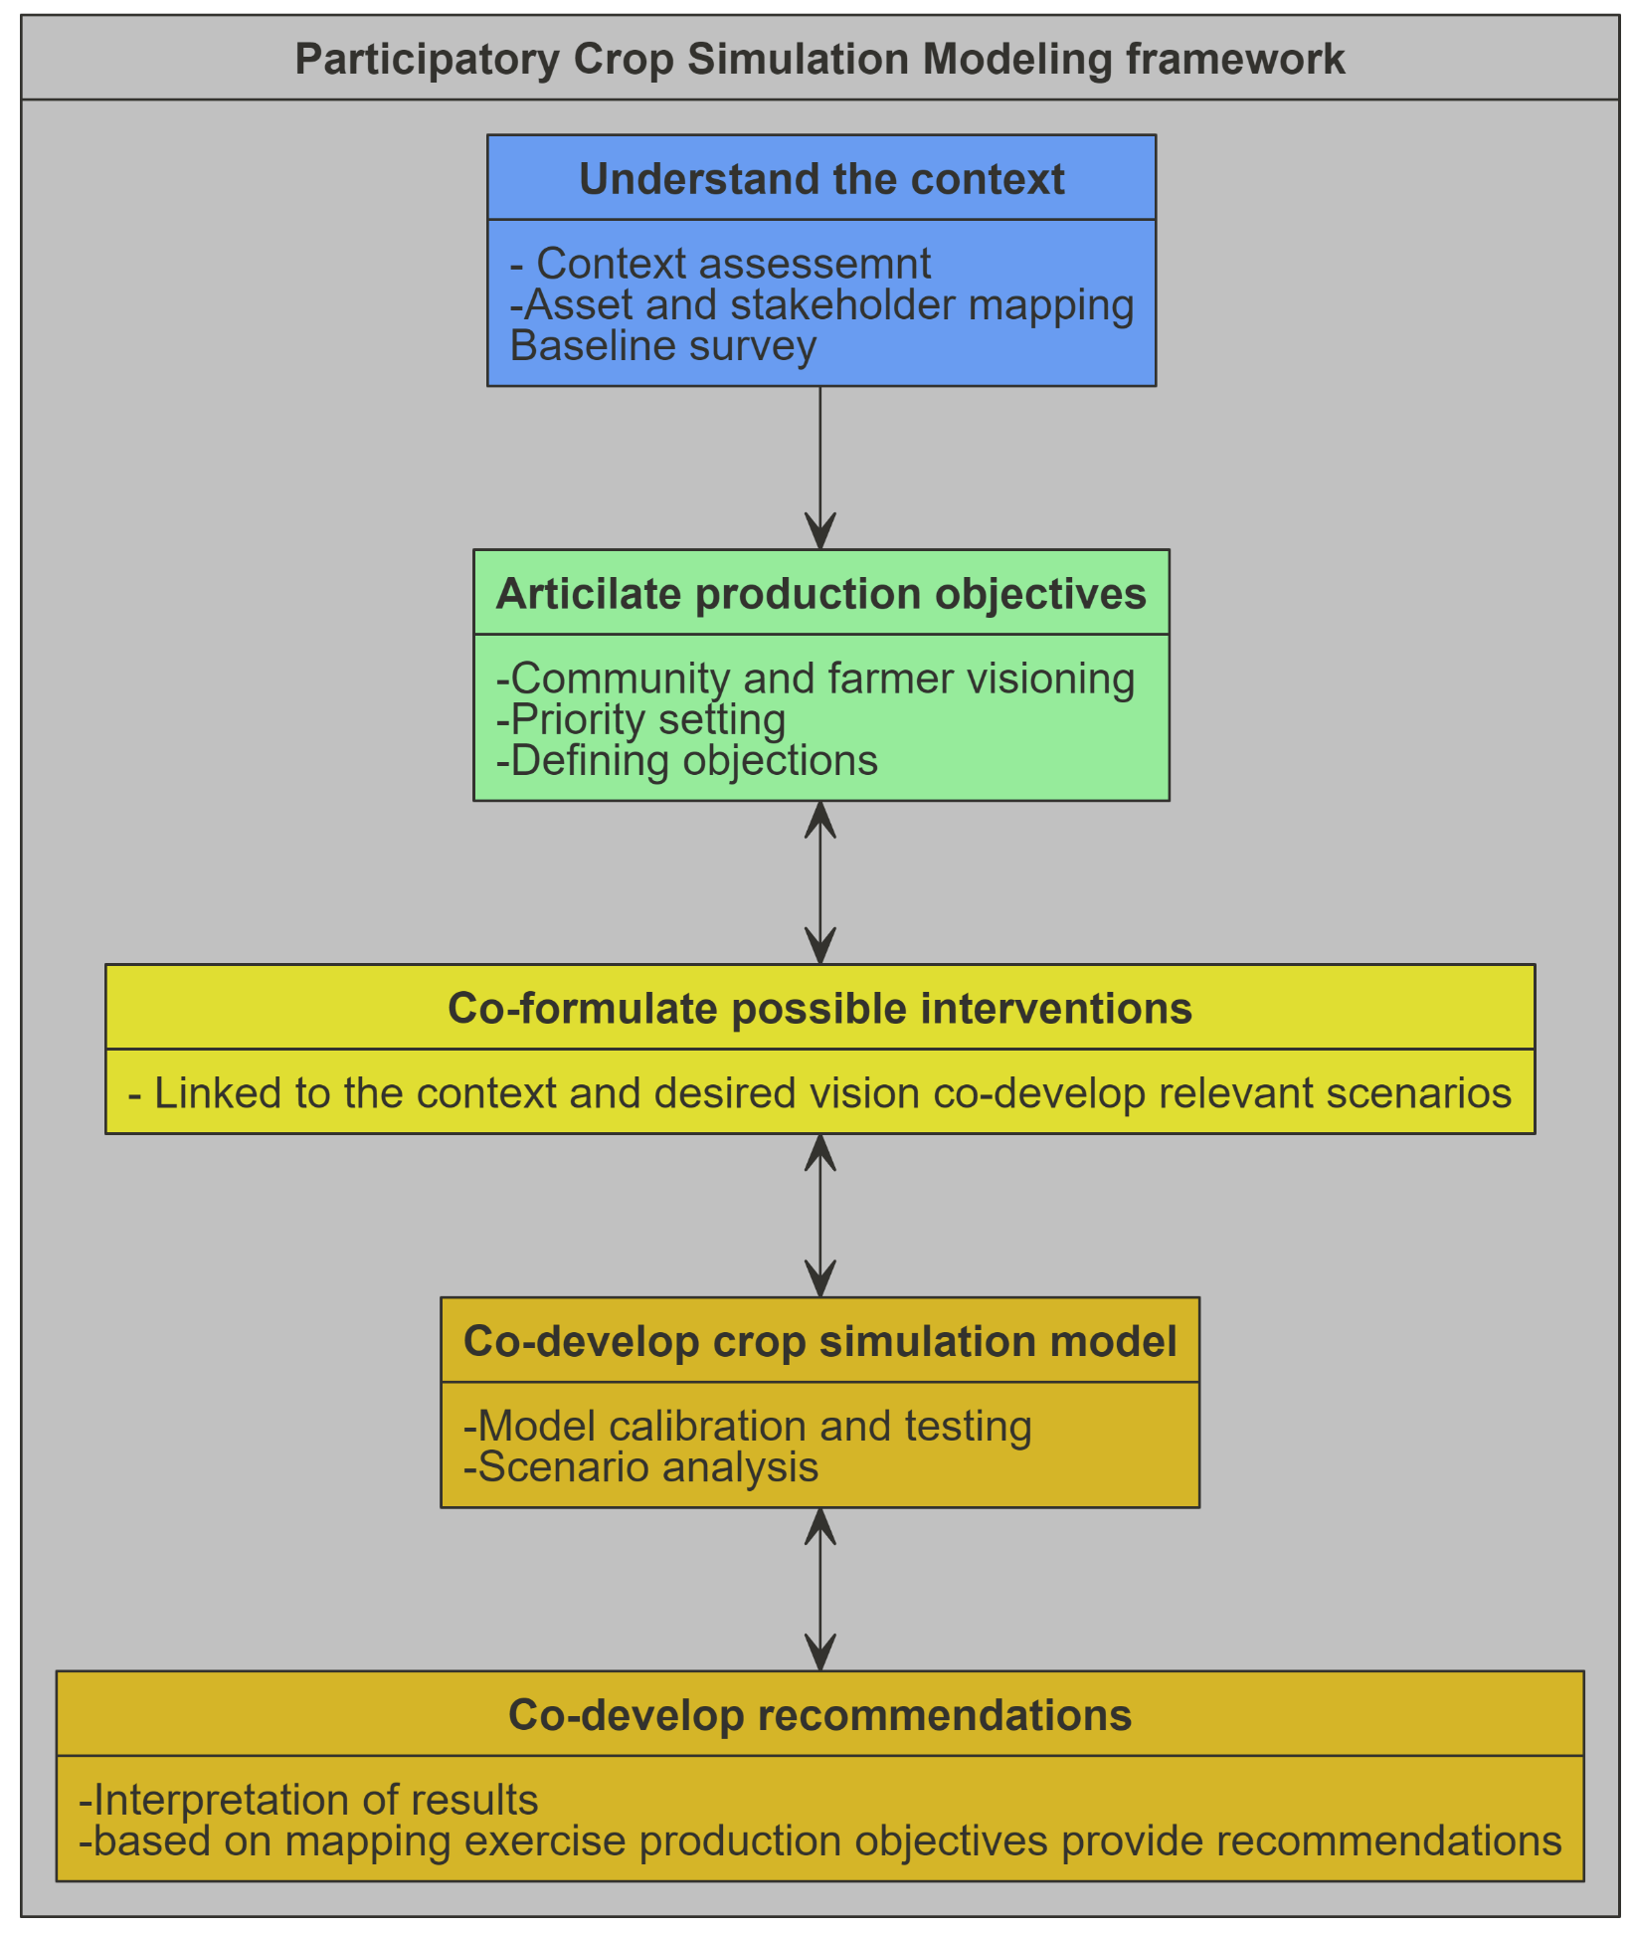
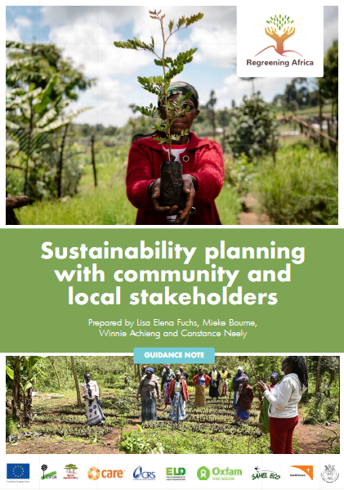
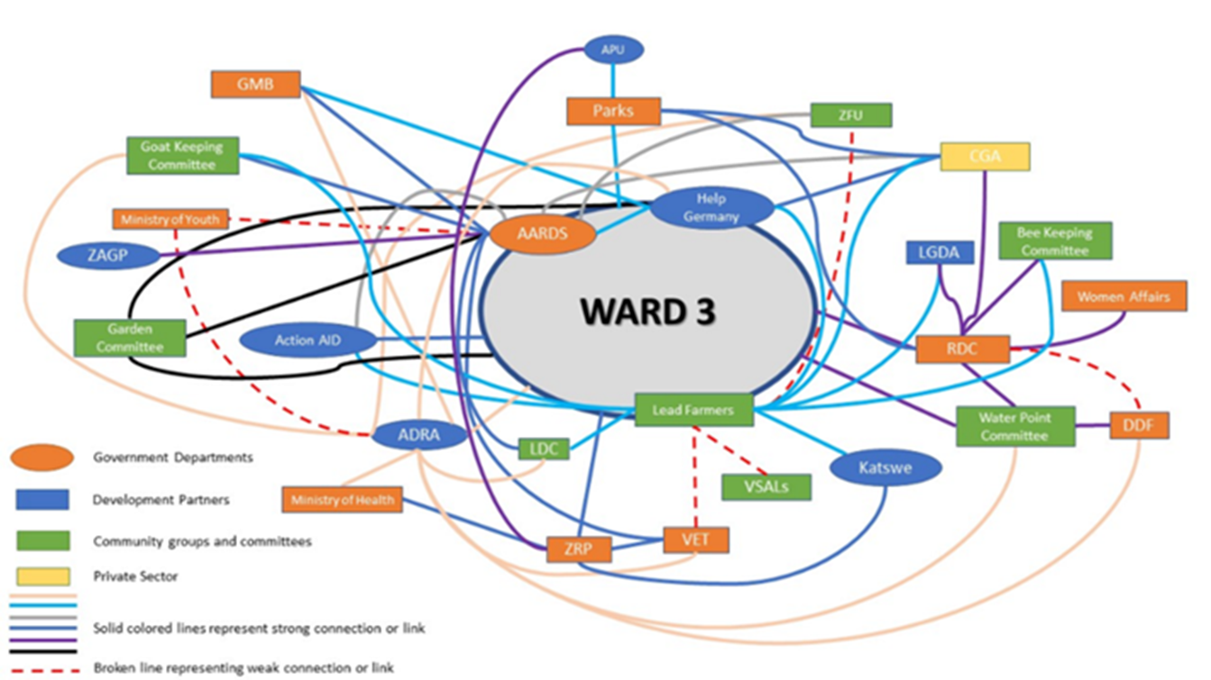
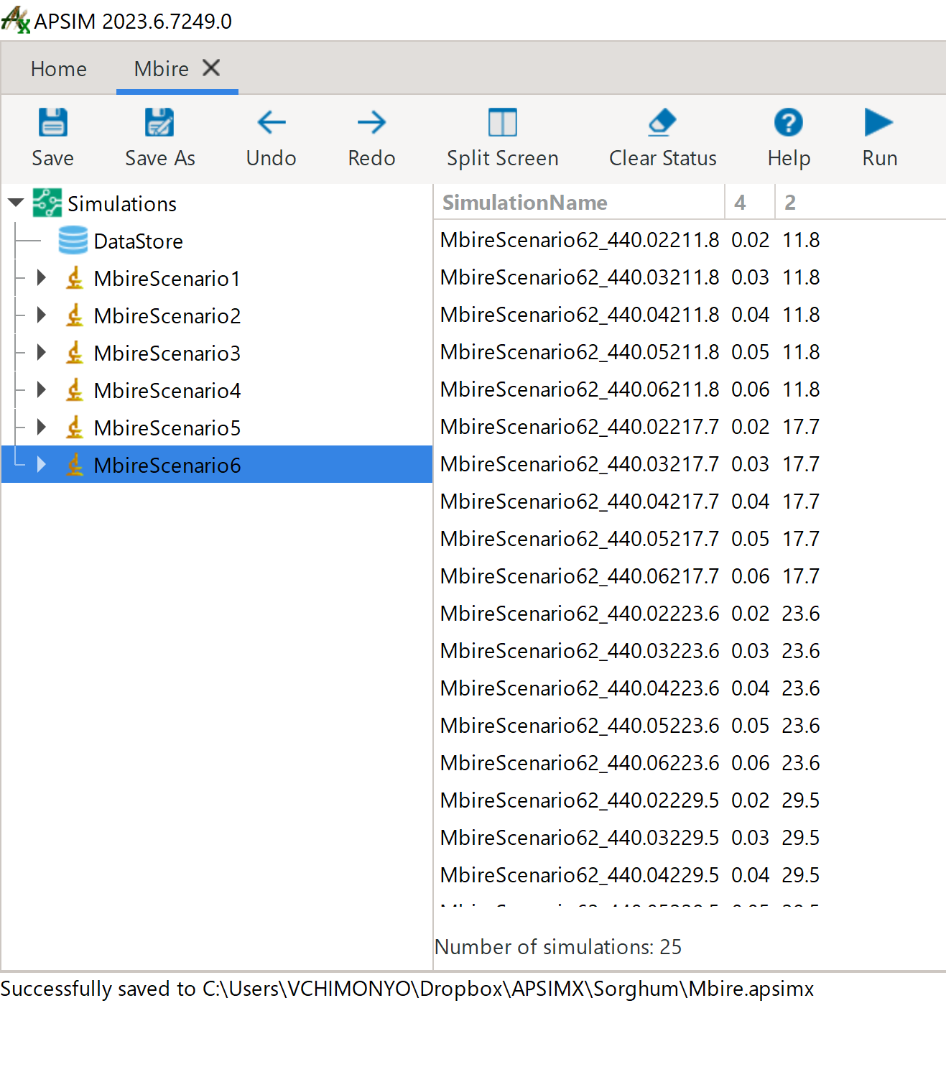
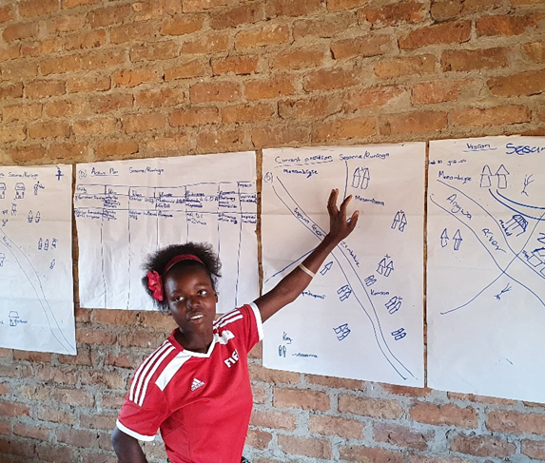
Understanding smallholder farming priorities and production objectives
Notes:
Time consuming and budget, trained facilitators

Slide 6
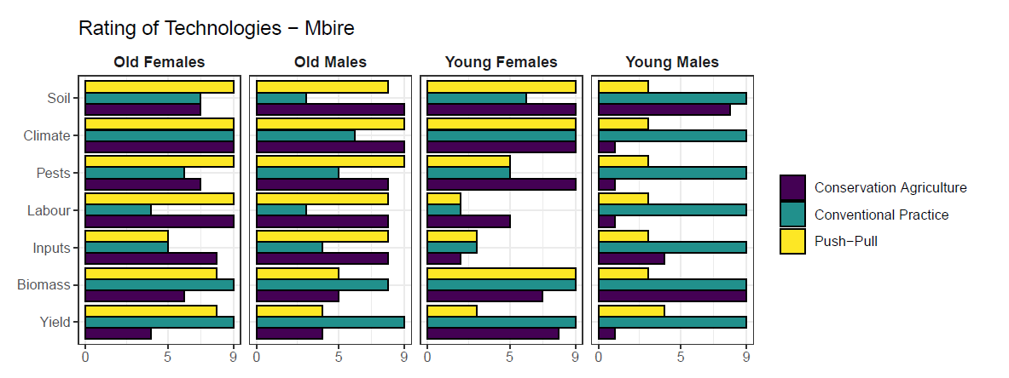
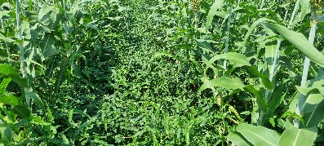
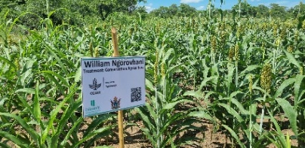
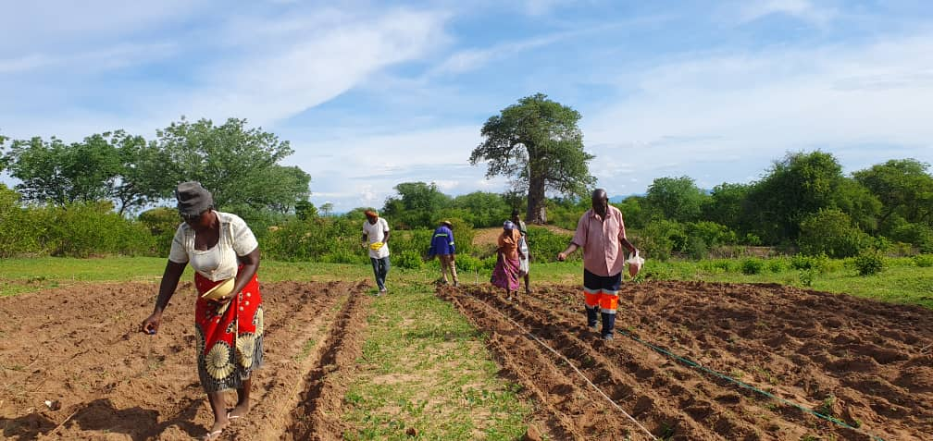
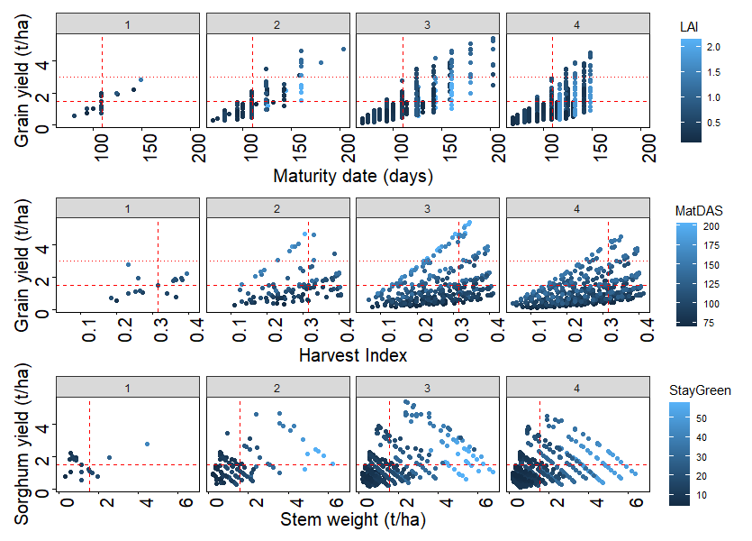

Slide 7
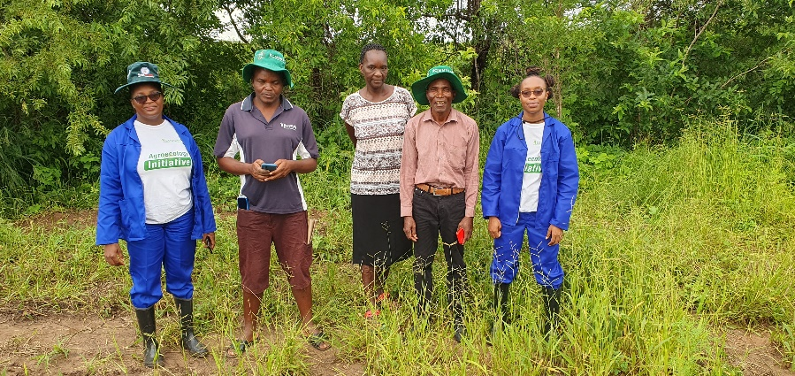
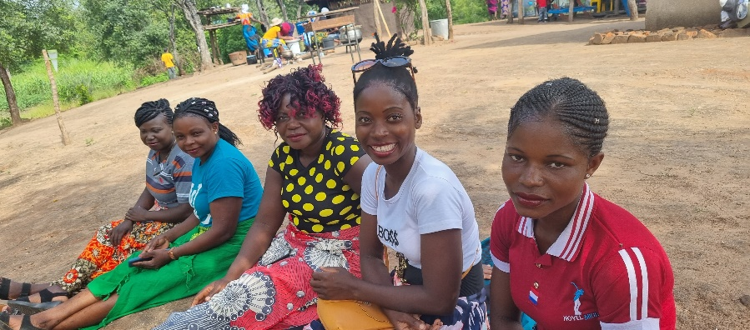
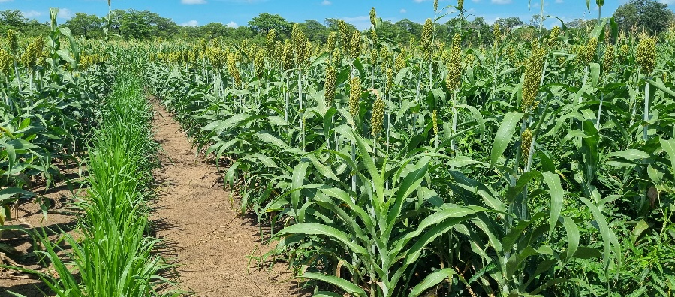
Take home so far!
Trust and collaboration has improved – we still have sceptics
Priorities and production objectives differ – not always about yield
Farmer and Community vision help to articulate and validate research targets – but visions are contextual and scaler
Different transition pathways give you a set of context specific scenarios for analysis – further confounds the simulations – time and capability
Discrete choice experiments – How they prioritise is as important as what they prioritise
Need to link farm components, farms and landscapes to better assess agroecological outcomes
Do we want farmer to be modelers or to understand the results better

Slide 8



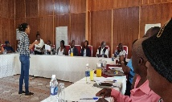

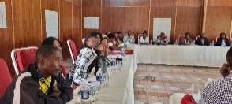

v.chimonyo@cgiar.org
@vgpchimonyo
#AgroecologyInitiative

