Slide 1

TH4.1: Gender transformative approaches for equality in food systems:
Emerging methodological insights
Presented by Dr. Cynthia McDougall, WorldFish/FISH
c.mcdougall@cgiar.org
cynthia.mcdougall@sei.org
On behalf of the
CGIAR GENDER Platform Working Group on
Gender Transformative Approaches (GTA)
Cultivating Equality Conference
October 14, 2021

Slide 2
Members of the GTA Methods Working Group of the CGIAR GENDER Platform: Cynthia McDougall, Marlène Elias, Steven Cole, Dina Najjar, Jemimah Njuki, Gundula Fischer, Ana Maria Paez-Valencia, Alessandra Galie, Humphrey Jumba
GTA Working Paper consultants: Desiree Zwank, Johana Simao, Karen Diop
Coordination by: Anna Patel
Methods Module co-leads: Hazel Malapit, Elizabeth Bryan
The scope of the GTA Methods Working Group is to synthesize and identify key issues or insights relating to gender transformative methods and tools, including at scale.
Working Paper methodology: Semi-structured interviews with CGIAR researchers (n=5); literature review; iterative reflection and improvement; external review
Outputs: GTA Working Paper (in review) & curated set of resources on the GENDER Platform website
This presentation draws on this DRAFT Working Paper as well as other emerging resources, processes and insights including from the UN Food Systems Summit GTA Cluster

Slide 3
The problem: The (too) slow road to gender equality

Slide 4
Persistent (intersectional) gender inequalities in food systems…
From slow progress towards SDG 5 preCOVID…to now worsened gap
  exacerbated intersectional gender inequalities, including gender division of unpaid care work, lost employment, GBV
Growing recognition that inequalities stem from underlying, structural barriers
“Another generation of women will have to wait for gender parity, according to the World Economic Forum’s Global Gender Gap Report 2021. As the impact of the COVID-19 pandemic continues to be felt, closing the global gender gap has increased by a generation from 99.5 years to 135.6 years”.
(World Economic Forum, 2021)

Slide 5
Limits of gender approaches to date…
benefits only women directly involved in a project (not beyond)
effects on empowerment or gender equality may dissipate or reverse after projects end
some strategies may (unintentionally) reinforce gender stereotypes or barriers
may have uncounted perverse outcomes, such as increased women’s (already high) unpaid workload, backlash or violence
Why so slow?
Because of nature of mainstream gender approaches to date…
Going around barriers
Focus on women only
Agency only
‘Empowerment lite’ (Cornwall, 2018)
McDougall et al., forthcoming in 2021

Slide 6
Gender transformative approaches (GTA) as an emerging trajectory

Slide 7

1. More explicit feminist roots, power…
From
Perspectives and methodologies that
Recognize (make visible) patriarchy
Promote gender equality
Empowering processes
Allow for complexity, intersection of gender, race, class, religion, sexuality, disability… that are critical to understanding agency, power relations and structures
Value the expertise and knowledge of women, girls and marginalized groups
Recognize & challenge researchers’ own positionality, bias
Power in (society)
(Zwank et al., forthcoming)

Slide 8
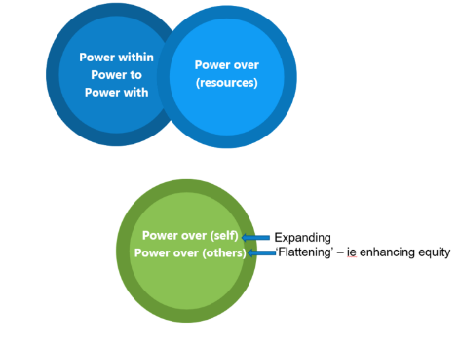
1. More explicit feminist roots, power…
To engaging with
Perspectives and methodologies that
Recognize (make visible) patriarchy
Promote gender equality
Empowering processes
Allow for complexity, intersection of gender, race, class, religion, sexuality, disability… that are critical to understanding agency, power relations and structures
Value the expertise and knowledge of women, girls and marginalized groups
Recognize & challenge researchers’ own positionality, bias
Power in (society)
(Zwank et al., forthcoming)
(see McDougall & Ojha, 2021)

Slide 9

2. Changing Depth
‘Shallow’
approaches
What women do (roles), skills…

Slide 10
2. Changing Depth
‘Shallow’
approaches
What women do (roles), skills…
Power relations between people
‘Deeper’
approaches
GTA
How society says women and men should behave (‘rules of the game’)
How society values people of different genders

Slide 11
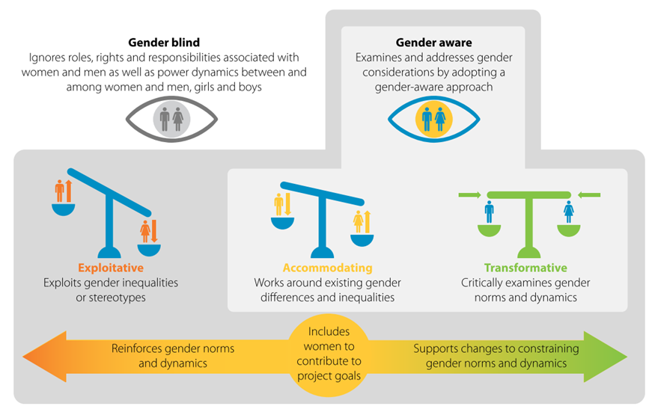
3. Project gender continuum: accommodative to transformative
Source: Kleiber et al., 2019; adapted from IGWG, 2017

Slide 12
3. Project gender continuum: accommodative to transformative
Local focus…
Q1. What do we know about methods addressing constraining norms at local scales?
(‘Development projects’)
Q2. Is it enough to engage with norms at local scales?
(What else)
Source: Kleiber et al., 2019; adapted from IGWG, 2017

Slide 13
Project & program GTA methods up to community scale: What do we know?

Slide 14
Q1. Local scale GTA methods: what do we know?
  Overall:
  Growing focus on norms
  GTA @Household, group and/or community scale
  Proliferation of GTA methods packages
Gap:
The absence of intersectionality is a significant barrier to understanding complexity of wider sociological issues, such as power dynamics, institutions or the influence of culture.
Mixed degree of explicit intersectionality amongst GTA methods.
“Reality is never binary. While no tool can ever fully reflect the complexity of a given environment or context, efforts towards intersectionality allow for a more complete and accurate picture of reality.”
(Zwank et al. forthcoming)

Slide 15
Insights by Project cycle lens
Formative GTA methods: Understanding norms and dynamics
Requirement Analysis
SCOPING & DESIGN
Methods for measuring GTC: Assessing type and degree of change in norms & dynamics
ME&L
Iterations, Demo & Feedback
Catalytic methods: Sparking and building change in norms & dynamics
IMPLEMENTATION

Slide 16
Phase 1 Formative GTA methods
Formative GTA methods
Requirement Analysis
What? Understanding gender and social norms
and dynamics
For what? Informs design of GTA strategies (next stage)….
SCOPING & DESIGN
Examples:
GENNOVATE Methods
https://gennovate.org/
ME&L
Characteristics
Qualitative, exploratory to surface norms and dynamics
Indirect in nature (vignettes)
Value in being led by next stage facilitators, by ‘staff’
Missing: ethnographic, observation?
Iterations, Demo & Feedback
IMPLEMENTATION

Slide 17
Phase 2 Catalytic GTA methods
What? Methods and tools to spark reflexivity, awareness, ideas and commitment for change in norms & dynamics
For what? Co-creating possibilities and momentum for change with women and men
Formative GTA methods
Requirement Analysis
Examples:
Nurturing Connections
SILCs + GTA
Community Conversations (w/ action)
GALs
Moving Forward Together
Journeys of Transformation
Household methodologies
Action research with community theatre
SCOPING & DESIGN
ME&L
Catalytic methods
Core characteristics
Engage men, boys together with women, girls (all genders): co-agents of change
Address underlying social norms, attitudes and behaviours that perpetuate inequalities
Safe spaces & facilitated dialogue: trust, ownership, visioning, motivation and behaviour change ideas
Require critical reflection to surface ‘invisible’ (naturalized) dynamics
Reflection-action-reflection cycles: social and experiential learning (PAR, AR, PAL…)
Requires time
Iterations, Demo & Feedback
Tips
Engage influential norm holders, such as traditional leaders
Embed with practical development areas (e.g., livelihoods), not stand alone
Adapt to context
Champions and examples
IMPLEMENTATION

Slide 18
Phase 3 Measuring transformative change…
Methods for measuring transformative change
What? Methods to assess change in gender norms & dynamics (what, direction, who, why)
For what? Track, measure, learn, inform, improve, report…
Formative GTA methods
Requirement Analysis
Examples:
Gender attitude scales, such as Gender Equitable Men Scales (GEM)
Adapted women’s empowerment indices measures (to include change in norms)
Participatory monitoring
SCOPING & DESIGN
ME&L
Characteristics?
A spectrum, with multiple decisions to be made…
Iterations, Demo & Feedback
IMPLEMENTATION

Slide 19
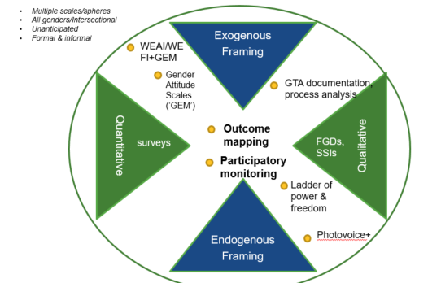
…Phase 3 Measuring gender transformative change
Requirement Analysis
….multiple decisions to be made…
Type: Qualitative, quantitative, mixed
Whose framing: Exogenous-endogenous
DESIGN
ME&L
Iterations, Demo & Feedback
IMPLEMENTATION
McDougall, 2019

Slide 20
…Phase 3 Measuring gender transformative change
Requirement Analysis
….multiple decisions to be made…
Type: Qualitative, quantitative, mixed
Whose framing: Exogenous-endogenous
DESIGN
ME&L
Which framing: Agency-Relations-Structures vs Types of power vs?
Breadth: Specific (attitudes) to wide (norms, agency, relations)
Range: Intended vs/and unintended
Iterations, Demo & Feedback
IMPLEMENTATION
McDougall, 2019

Slide 21
All 3 phases:
Value in engaging coherently with GTA across all 3 phases for strengthening fit, effectiveness and learning
Requirement Analysis
Design document & prototype
SCOPING & DESIGN
ME&L
E.g.,
Social Analysis and Action in Food and Nutrition Security (Mekuria et al. 2015)
PAR + GTA (BCC/drama) case (Cole et al.2020)
Production & Technical Support
Iterations, Demo & Feedback
IMPLEMENTATION
Iterations, Demo & Feedback

Slide 22
4. Beyond projects and programs, beyond local:
GTA methods @scale?

Slide 23
Q2. Is engaging just up to local scale sufficient?
Society
Groups
Household
Individual
Community
Markets
State
Short answer: No
Yes, critical and important to reach more communities (scale out)
But addressing structural barriers in food systems, will require engaging with constraints at multiple scales (scaling up)
Why? We need a social tipping point towards equality

Slide 24
Beyond community: Emerging strategies @ scale
Digital and educational messaging
E.g., children’s television
Society
Groups
Household
Individual
Community
Markets
State
Feminist policies (and budgets)
Including land, care infrastructure
Changing gender blind data systems
Breaking the cycle of invisibility
Transforming financial services
“Making banks more woman-able, not women more bank-able”

Slide 25
Beyond community:
Foundations for change
FIG. X Multidimensions and applicable of GTAs
Society
Groups
Household
Individual
Community
Markets
State
“The foundation for GTA is to question “those doing the development”. Working on development practitioners' mentalities, behaviors and capacities and organizational norms, cultures, capacities and practices is indeed the first step to produce change. Professionals designing, implementing and measuring gender-transformative change need to transform themselves first…”.
  (Zwank et al. forthcoming)
Transforming development and R4D organizations
“Making development and R4D organizations and innovation processes themselves more inclusive, equitable, empowering (feminist research approaches)
…. not women more ‘participated’ or studied”

Slide 26
Foundations for change: strategies
Some key elements can help achieve an enabling environment within organizations:
  Courageous leadership and human resources commitment to question norms and foster change within the organization.
  Facilitated capacity building & change processes over time; instead of training, processes that use GTA pedagogies, especially self- and shared reflection.
  Challenge gender in the organization and programming as purely technocratic.
  Engage an intersectional lens, going beyond the women/men dichotomy to engage with ethnicity, race, ability, gender identity, sexual orientation…
E.g.,
Deep structure (Joseph et al. 2011)
Roadmap for Gender Mainstreaming in Member-based Organizations (Trias)

Slide 27
5. Emerging Lessons

Slide 28
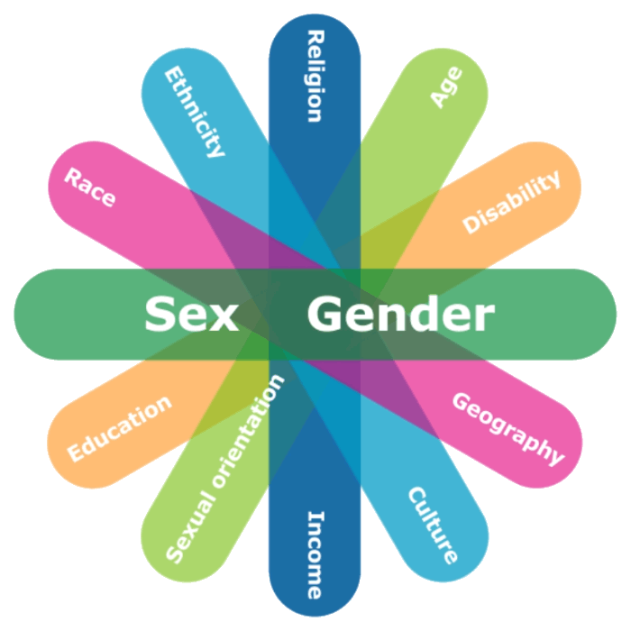

1. GTA is a meaningful shift in trajectory (feminist, deepening) of approach:
Don’t lose potency by watering it down to mean everything…
2. Need to systematize intersectionality:
Processes: engage most marginalized actors
Analysis: Overlapping category analysis (eg gender AND age)
Range: More on class, ability, other key identities
Frameworks and methods: Easier systems to apply throughout
Society
Groups
Community
Markets
State
HH
3. GTA up to community scales:
Embed in all 3 phases
Refine ME&L
Value in pluralism – but common core…
4. Design around principles and mechanisms, more than specific GTA tools:
          men & women as co-agents of change
          processes spark awareness and motivation via reflexivity
          reflection-action-reflection
          time and capacities
5. GTA @higher & foundational scales: emerging & needed!
Social tipping point

Slide 29





Thank You
In partnership with

Slide 30
Resources drawn on for this presentation
Zwank et al. (Forthcoming in 2021). Gender transformative approaches for agriculture and food systems transformation: A methods compendium. CGIAR GENDER Platform Working Paper. Nairobi: CGIAR.
and…
Cole, S. M., Kaminski, A. M., McDougall, C., Kefi, A. S., Marinda, P. A., Maliko, M., & Mtonga, J. (2020). Gender accommodative versus transformative approaches: a comparative assessment within a post-harvest fish loss reduction intervention. Gender, Technology and Development, 24(1), 48-65.
Cornwall, A. (2018). Beyond “empowerment lite”: Women’s empowerment, neoliberal development and global justice. cadernos pagu.
FAO, IFAD and WFP. (2020). Gender transformative approaches for food security, improved nutrition and sustainable agriculture – A compendium of fifteen good practices. Rome.
Hillenbrand E, Karim N, Mohanraj P and Wu D. (2015). Measuring gender transformative change: A review of literature and promising practices. CARE USA. Working Paper. https://www.care.org/news-and-stories/resources/measuring-gender-transformative-change-a-review-of-literature-and-promising-practices/
[IGWG] Interagency Gender Working Group. 2017. Programmatic Guidance: Gender Integration Continuum. Accessed 20 December 2017. www.igwg.org/training/programmatic-guidance ; http://www.igwg.org/wp-content/uploads/2017/05/Gender-Continuum-PowerPoint_final.pdf
Joseph, T., Gouws, A., & Parpart, J. (2011). A Transformative Approach to Gender Mainstreaming. Changing the Deep Structure of Organizations. Kvinder KØN & 8 FORSKNING NR. 1 2011. 8-22. 10.7146/kkf.v0i1.28051.
Kleiber D, Cohen P, Gomese C and McDougall C. (2019). Gender-integrated research for development in Pacific coastal fisheries. Penang, Malaysia: CGIAR Research Program on Fish Agri-Food Systems. Program Brief: FISH-2019-02. https://digitalarchive.worldfishcenter.org/bitstream/handle/20.500.12348/2826/FISH-2019-02.pdf
Lau, J., Ruano-Chamorro, C., Lawless, S. and C. McDougall. (In press). Gender transformative approaches for advancing gender equality in coral reef social-ecological systems: Good practice and technical brief. CARE International.
Lawless, S., Lau, J., Ruano-Chamorro, C., Corcoran, E., Cohen, P., and C. McDougall. (In press). Advancing gender equality for equitable livelihoods in coral reef social-ecological systems: Policy Brief. CARE International.
McDougall, C., L. Badstue, A. Mulema, G. Fischer, D. Najar, R. Pyburn, M. Elias, D. Joshi, A.Vos. “Toward structural change: Gender Transformative Approaches”. Chapter 10 in R. Pyburn and A. van Eerdewjk (eds.) (In press). Advancing gender equality through agricultural and environmental research: past, present and future. IFPRI, Washington, DC.
McDougall, C and H. Ojha. “How does adaptive collaborative management leverage changes in power? Insights from social theory” Chapter 8 in C.J.P. Colfer, R.Prabhu and A. Larson (eds.) (In press). Adaptive Collaborative Management of Forest Landscapes: Villagers, Bureaucrats and Civil Society. London: Earthscan
Mekuria, F., Sprinkel, A., & Cowan, E. (2015). Social Analysis and Action Global Implementation Manual. 1–77. https://insights.careinternational.org.uk/images/in-practice/Gender-in-the-workplace/SAA.GlobalImplementationManual_FINAL.English.rights-reserved_2018.pdf
Trias: Roadmap to Gender Mainstreaming in Member-based Organizations (Trias). Accessed October 1, 2021: https://www.trias.ngo/en/gender-inclusion-trajectory
UNFSS GTA Cluster. (2021). Gender Transformative Approaches for Equitable and Sustainable Food Systems. GTA Briefing Note. V8, July 9, 2021. Unpublished.
WEF. 2021. Global Gender Gap Report. https://www.weforum.org/reports/ab6795a1-960c-42b2-b3d5-587eccda6023

