Slide 1
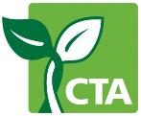
Emerging Issues Influencing Knowledge Management
Unit 7 of the Knowledge management in agriculture and rural development (KM4ARD) course

Slide 2
Overview of Unit 7
Purpose:
Understand what is meant by knowledge creation and knowledge co-creation
Understand key issues around intellectual property rights associated with sharing of content
Understand the concept of open intellectual property regimes
Identify the main types of licensing that are available in Creative Commons
Understand how the local technological context is key to appropriate packaging of knowledge
Identify example of packaging of knowledge using locally appropriate technology

Slide 3
The evolution of the Web
In the beginning: static, read-only, few content creators, vast majority were users consuming content
Social media era: user-generated content
Impact on our work: more collaborative
The Web now harnesses our collective intelligence
Democratisation: anyone has the ability to publish content
Notes:
Trainers notes
Link from last slide:… as we know KM came out of the knowledge economy, and the internet or the web is central to the knowledge economy. In the beginning…
Social media…: some people refer to it as Web 2.0
Democratisation…: this, of course, comes with its own different set of challenges, which we’ll talk about later.

Slide 4
Knowledge creation
Blog: tool for web publishing
Started off as “diary” for one person, now multiple authors
  Interactive, comments from visitors
  Advocacy or crisis use
  Best known platforms: WordPress and Blogger
Microblog: small elements of content e.g. short sentences, images or links
  Changed the way information is consumed
  Empowered citizens act as sources of information which can lead to consequences and influence
  Best known service: Twitter
Notes:
Trainers notes
Link from last slide:… this fact that everyone can publish content we are calling “knowledge creation”. Here is the examples of two tools which allow you to do that.
Blog: Blogging in a crisis, for example: live blogging the crisis in the Ukraine
Microblog: Microblogging leading to consequences example: use of Twitter in the Arab Spring.

Slide 5
Knowledge co-creation
Co-creation: “act of collective creativity that is experienced jointly by two or more people. It is a special case of collaboration where the intent is to create something that is not known in advance” *
Crowdsourcing: process of obtaining content by asking for contributions from a group of people, especially an online community
Best example of co-created and crowd sourced content on the Web: Wikipedia
* http://www.osbr.ca/ojs/index.php/osbr/article/view/1012/973
Notes:
Trainers notes
Link from last slide:… the other notion which has developed with social media is knowledge co-creation, which is defined as…
Crowdsourcing: Crowdsourcing is a subset of co-creation.
Best example…: And Wikipedia is done using a wiki. If your recall, a wiki is a simple web site that can be updated by many users.

Slide 6
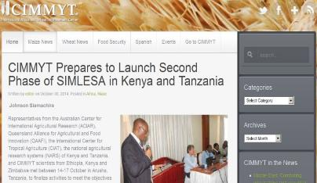
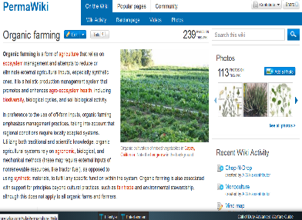
Examples in ARD
CIMMYT blog: news, events, trainings, new publications, plus comments from users http://blog.cimmyt.org
PermaWiki: an encyclopedia on permaculture http://permaculture.
wikia.com
Notes:
Trainers notes
Link from last slide:… here are a couple of examples from ARD…
CIMMYT blog: one of the CGIAR centres, CIMMYT has an active blog where many staff members write articles.
PermaWiki: it is a collaboration between permaculture designers, teachers, activists, project officers to create a public resource on permaculture.

Slide 7
Social media and ARD
Many organisations have not explored social media
Websites: for many still a static marketing tool (“Who we are?” “What we do?”)
Potential for social networking on mobiles: e-extension, for e.g.
Linking social media to agriculture in order to attract youth
Notes:
Link from last slide:… there is a huge potential to use social media for ARD and, although some have started, many organisations…
Potential…: social media application software (apps) have been created for e-extension in several African countries, as well as India, offering free of change information, advice and connecting farmers with each other.
Linking social…: this was a key point from the CTA ICT4Ag conference in 2013. Youth are keen on what they see as “modern” and farming often isn’t see as such. Linking the two would make it seem more “sexy” to youth.

Slide 8
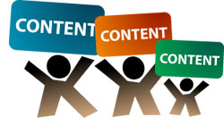
Implications of user-created content
Variable quality: accuracy and quality control
Privacy issues: be careful what you post
Legal issues: regulatory environment still trying to define “fair use”
Loss of control: intellectual property rights
Notes:
Trainers notes
Link from last slide:… so while there is much potential, there are some issues with all this user-generated content, such as…
Variable quality: don’t believe everything you read on the internet!
Privacy…: we find out more and more each day how what you do on the internet can be harmful.
Legal…: we will talk about legal issues in a couple of slides.
Loss of control: this is a huge issue: who owns what? As users of the internet we have been conditioned to believe that everything is free and ideas are openly available for all to see and use.

Slide 9
Intellectual Property Rights (IPR)
Rights given to persons over the creations of their minds giving the creator an exclusive right over the use of his/her creation for a certain period of time
IPR divided into two main areas: copyright and industrial property
1996 “Internet treaties”: the WIPO Copyright Treaty (WCT) and the WIPO Performances and Phonograms Treaty(WPPT)
Still a lot of unexplored areas, for e.g. role of online intermediaries (social networking platforms, Internet Service Providers, etc.)
Notes:
Trainers notes
Link from last slide:… so let’s delve a bit more into intellectual property rights, often referred to as “copyright”. These are rights…
IPR divided…: so copyright is actually only one part of it
Still a lot…: and most Internet users have no idea as to what they can use or not.

Slide 10
Legal frameworks
National: some – but not all - countries have legislation relating to IPR
Regional:
  Specific bodies, for e.g. the African Regional Intellectual Property Organization (ARIPO)
  Within bodies, for e.g. the European Commission's Action Plan on the enforcement of Intellectual Property Rights
International: World Intellectual Property Organization (WIPO) and World Trade Organization (WTO)
Notes:
Trainers notes
Link from last slide:… then there is also the issue of legal frameworks around IPR. There are three different levels, national…
National…: it is also difficult to enforce national internet law, since it is a global network.

Slide 11

Internet Governance Forum
Multi-stakeholder forum for policy dialogue on public policy issues relating to the Internet
Governments, private sector, civil society, including the technical and academic community
All are on equal basis in an open and inclusive process
No negotiated outcomes, the IGF informs policymakers in both the public and private sectors
Yearly meeting
Notes:
Trainers notes
Link from last slide:… then there is also an institution called the Internet Governance Forum, which is a multi-stakeholder…
The IGF is “soft governance” as it stops short of rule-making but has an important role to play in addressing global Internet issues.

Slide 12
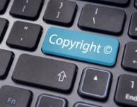
Copyright in the digital age
Copyright: legal protection given to published works, forbidding anyone but the author from publishing or selling them
Established to incentivise creation: currently rewards more the publishers and distributors who take control of copyrights
Millions of citizens are in daily breach of copyright, e.g. for shifting content from one device to another
There are efforts to take this reality into account within legal frameworks
Notes:
Trainers notes
Link from last slide:… so we’ve mentioned copyright but let’s look at what it means today, in this digital age. Copyright is defined as…
Efforts…: The IGF is trying to facilitate a common understanding among policymakers and address risks and challenges that arise.

Slide 13
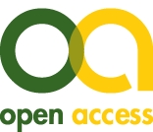
Open access regimes
Open access regimes:
  Free availability permitting any users to read, download, copy, distribute, print, search, or link to the full texts of content
  Two degrees: gratis (free online access) and libre (free online access plus some additional usage rights)
Notes:
Trainers notes
Link from last slide:… in reaction to the tightly controlled publishing world, and building upon the Open Source movement in information technology, open access regimes were created to address some of the issues of publishing content on the internet, giving free availabilty…
Two degrees…: Gratis means “access and use it”. Libre means “access, modify and reuse it”. This was mainly the case in the Open Source movement with code.

Slide 14
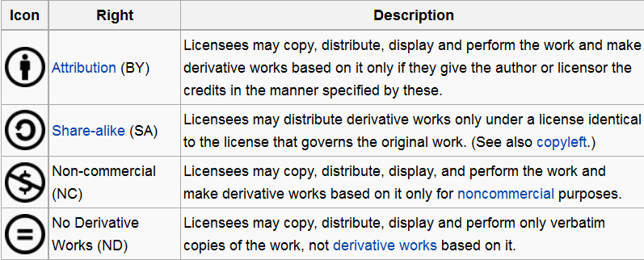
Usage rights: Creative Commons (CC) licenses
All CC licenses grant the "baseline rights“, allowing to retain copyright and retain authorship
There are four conditions:
From http://en.wikipedia.org/wiki/Creative_Commons
Notes:
Trainers notes
Link from last slide:… there is a type of “libre” licences that are more and more used called Creative Commons. All CC licenses…
CC is a non-profit organisation founded on 2001. Creative Commons licenses do not replace copyright, but are based upon it.

Slide 15
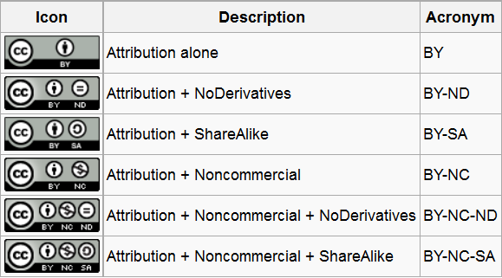
Usage rights: Creative Commons (CC) licenses
In total, 16 combinations (4 X4 conditions) but only 6 are used regularly:
From http://en.wikipedia.org/wiki/Creative_Commons
Notes:
Trainers notes
Link from last slide:… those 4 conditions can be used together, creating in total 16…
Unfortunately, this doesn’t explain much…

Slide 16
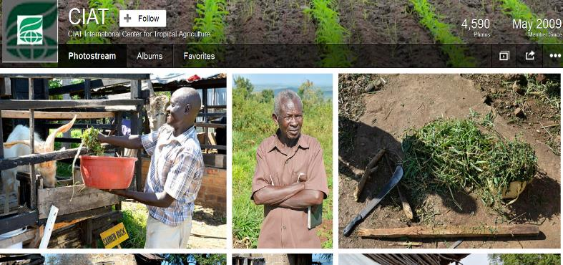
Examples in ARD and development
CIAT Flickr photo sharing –Creative Commons Attribution-Non commercial license
Notes:
Trainers notes
Link from last slide:… here are two examples from ARD and development, first the CIAT Flickr…
This means you can download the shots directly from the site for your own, non-commercial use, provided you remember to credit and let them know when and where you use them.

Slide 17
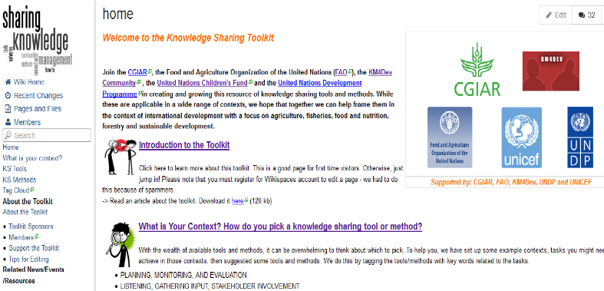
Examples in ARD and development
Contributions to http://www.kstoolkit.org/ are licensed under a Creative Commons Attribution Share-Alike 3.0 License
Notes:
Trainers notes
Link from last slide:… are here is the KS toolkit that we mentioned yesterday. The contributions to…
So this means that you can adapt, and even sell your adaption, as long as you mention the KS Toolkit and keep the same license.

Slide 18
Questions? Comments?

Slide 19
Packaging knowledge
Importance of local context
Web: just one of many instruments to share knowledge
Various issues to consider:
  Access
  Connectivity
  Cost
  Literacy
  Language
  Cultural issues
  Political issues
Notes:
Trainers notes
Link from last slide:… another current issue affecting KM is the actual environment in which we are working and the importance…
Web…: we’ve already talked about packaging knowledge for a specific audience, most of it on the Web. Now the Web may not be the most appropriate technology for many of our stakeholders.

Slide 20
Package into knowledge products
Need to be relevant and sustainable
Radio and television: still the most effective means to reach rural communities to share knowledge with farmers
Web 2.0 and especially mobile have made inroads but still a long way to go
Notes:
Trainers notes
Link from last slide:… the packaging of knowledge needs to be relevant…
The bottom line is consider what is best for each audience.

Slide 21

Example: Participatory Radio - Farm Radio International (FRI)
76 % of farmers have access to radio*
FRI works with radio broadcasters meet the needs of local small-scale farmers and their families in rural communities in 38 African countries
*Sources: ITU 2007 and Farm Radio International 2011
Notes:
Trainers notes
Link from last slide:… here is an example of participatory radio as used by Farm Radio International. Radio is still one on the best ways to reach farmers, as 76%...
This short clip gives an example of one of FRI’s interactive radio program (1 minute 19 secs).

Slide 22
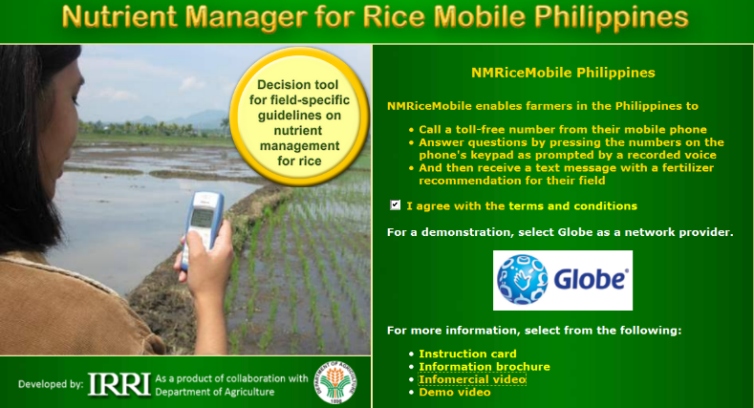
Example: Rice Mobile Philippines
Choose local language to answer questions
Receive fertilizer recommendations vis SMS
Notes:
Trainers notes
Link from last slide:… this example is from Rice Mobile Philippines. Farmers can choose…
This is a service that is available on a regular mobile phone, or on the web.

Slide 23
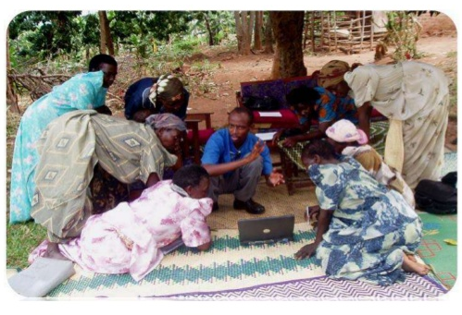
Example: BROSDI (Uganda)
Agricultural knowledge sharing project aimed at women and youth
Bringing it all together: interlinked use of SMS, radio, video, dance, drama, blogs and wikis
Photo: CELAC project, Brosdi Narrative Report 2006.
Notes:
Trainers notes
Link from last slide:… in this last example, BROSDI in Uganda had an agricultural knowledge sharing project…
They were reaching out to a broad audience and used a broad mix of formats.

Slide 24
Questions? Comments?

Slide 25
Reflection and table discussion: creating knowledge in my own context
Take 5 minutes to reflect individually on the various ways of creating, co-creating and packaging knowledge… in your context:
  Which could work best?
  Which would be more challenging?
  Are there opportunities for innovation?
At your table, share your reflections with others and discuss what you are already doing and what you could possibly do in the future? (25 minutes)
Plenary debrief (15 minutes)
Notes:
Trainers notes
Link from last slide:… let’s take some time to reflect and discuss creating knowledge on our own context…
See Unit 7 Exercise notes

Slide 26
Credits
This learning material was prepared by Lucie Lamoureux for CTA.
The Technical Centre for Agricultural and Rural Cooperation (CTA) is a joint international institution of the African, Caribbean and Pacific (ACP) Group of States and the European Union (EU). CTA operates under the framework of the Cotonou Agreement and is funded by the EU. For more information on CTA, visit www.cta.int
Disclaimer
This work has been made with the financial assistance of CTA. However, it remains under the sole responsibility of its author and never reflects CTA's nor the European Union's opinions or statements whatsoever. The user should make his/her own evaluation as to the appropriateness of any statements, argumentations, experimental technique or methods as described herein.
Copyright notice
Reproduction and the dissemination of these modules and supporting materials is encouraged under the terms of the Creative Commons Attribution License (https://creativecommons.org/licenses/by/4.0/legalcode), provided that appropriate acknowledgement is made:
  – of CTA's copyright, in accordance with the license Creative Commons 4.0, by including the name and the title of the article or chapter,
  – and that CTA's or the EU's endorsement of authors' views, products or services is not implied in any way, by including the disclaimer.
March 2015

