Slide 1
Restoration of Livestock Services in Conflict and Drought Affected Areas of Ethiopia-RESTORE Project
GEWADO AYLEDO
Ethiopian Veterinary Association-EVA
Public-Private-Partnership for delivery of veterinary services
Review and validation of PPP models for scaling out
ILRIETH campus, Azage Auditorium, Addis Ababa 27 March 2025

Slide 3
Outline
Introduction
PPP Pilot models:
  Project Location and Beneficiaries
  Approach
  Evidence:
  Lessons-Sustainability indicators
  Challenges
  What next?

Slide 4
EU-HEARD: Result-2 (ILRI/EVA component)
01
Pilot the veterinary service rationalization roadmap (VRRM)
02
Develop training materials and implement innovative delivery methods for skill development
3 Major Activities
03
Make available and disseminate resources for animal health knowledge, best practices and research findings.

Slide 5
1) Introduction
High vet graduation: 26 VEEs
Little job opportunities:
  Thousands of graduated Vet and VPPs remain jobless (up to 60%), and the situation worsens (EVA study)
Implementing the VRRM: Useful in supporting job creation for young vets, through public private partnership (PPP).
VP/VPP

Slide 6
2) Project Location, Private partners,
PPP models | Region | Woreda | Services/Diseases | Private service providers
Model I: Private vaccination | Amhara | Banja | Rabies, Anthrax, Black leg | Desalew M. Netsanet S.
 | Oromia | Dire, Negelle | O. & B. Pasteurellosis | woreda drug shop
Model II: Sanitary mandate with woreda private sector partners | Somali | Deghabour | Camel pox, O. Pasteurellosis | Abdulatif Mohammed (Al Nasri Vet Clinic
Model III: Sanitary mandate with regional-woreda-kebele private sector partners | Somali | Hargelle | Camel pox, CCPP Pasteurellosis, Sheep/goat pox, | Kulmiy Agri-cooperative Bilal private vet pharmacy Kebele CAHWs
Model IV: Mobile Vet clinical service | Oromia | Arsi Negelle | Clinical service/treatment, | Nagesso Ukula private clinic
Model V: Clinical service by regional-woreda-kebele privates | Somali | Hargelle | Clinical service | Bilal private vet pharmacy Kebele CAHWs
Model VI: Community-based women vaccinator for NCD control | Amhara | Banja | Newcastle Disease vaccination | Kebele Women vaccinator
Model VII: Strategic community-based endo- and ecto-parasite control by private service providers | Somali | Deghabour | Ectoparasite and Endoparasites control | Kebele Clinic kebele clinic/CAHW
 | Oromia | Dire Inchini | strategic deworming & spraying | woreda Clinic/drug shop
Model VIII: Leasing Kebele AHP to jobless vets | Amhara | AHPs in 5 Sites | Clinical service | private vets in cooperatives

Slide 7
3) Approach/Principles
  Consultative, and community-based approach
  Harmonizing efforts among grantees: E.g. Loan by ACSI/WALQO, Kits and training by ILRI/EVA
  Cost sharing by community- sustainability
  Networking among Private providers-Easy Drugs access
  Gender Responsiveness across PPPs execution
  Capacity building- focus on private actors, women/youth
  Adhere to Government policies

Slide 8
4) Evidence
Key Milestones
  # Animals Treated, Dewormed, Sprayed, and Vaccinated
  #Beneficiary HHs
  # Women/Youth
  #Jobs for privates
  Other supports:
    Starter Kits
    BSE Training-550
    Expert support, feedback, etc.
PPP models | Animals served | HHs benefited | Women-led HHs | Jobs for privates
Model-I Private Vax | 137,393 | 76,952 | 23,963 | 13
Model-II SMC | 86,664 | 6,253 | 1,562 | 23
Model-III SMC | 88,692 | 3,943 | 318 | 27
Model-IV Mobile service | 308,594 | 87,291 | 1,582 | 15
Model- V Clinical Service | 39,426 | 7,439 | 371 | 11
Model-VI NCD vax | 148,770 | 12,749 | 386 | 68 women
Model-VII Strategic control | 300,342 | 79,618 | 1,958 | 32
Model VIII |  |  |  | 10

Slide 9
PPP models | Animals served | HHs benefited | Women-led HHs | Jobs for private VP/VPP | Other supports
Model-I | 137,393 | 76,952 | 23,963 | 13
Model-II | 86,664 | 6,253 | 1,562 | 23
Model-III | 88,692 | 3,943 | 318 | 27
Model-IV | 308,594 | 87,291 | 1,582 | 15
Model- V | 39,426 | 7,439 | 371 | 11
Model-VI | 148,770 | 12,749 | 386 | 68 women
Model-VII | 300,342 | 79,618 | 1,958 | 32
Model VIII | 28,745 | 3,519 | 207 | 10

Slide 10

5) Key Lessons: Sustainability Indicators
(Supported by Mid-and End-term evaluation):
Partnership: A growing link between public and private sectors
Ownership: Strong leadership key to the success of PPPs
Enabling environment: Regional Governments supporting privates
National Guidelines: A national PPP guideline is important for sustainable implementation of PPPs
Market Expansion: PPPs substantially help in income maximization (e.g. Mecha and A/Negelle)
Community-based approach: Effective for Parasite control/Prevention:
Farmers’ Power: Farmers pay, even for those freely provided before:
  100% for NCD vaccination
  Rabies vax: grew from 30% to 80%, and 100% after project exit
  Pastoralists payed 30-60% of vaccination, despite drought

Slide 11
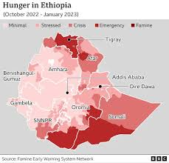
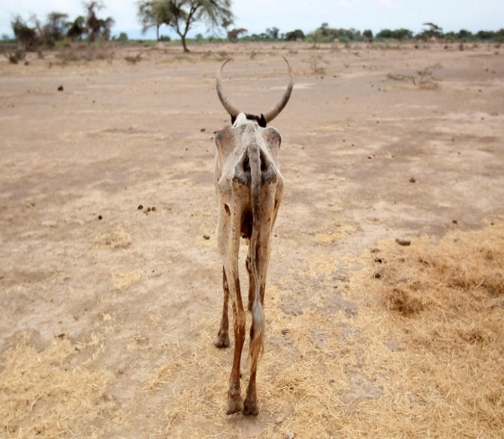
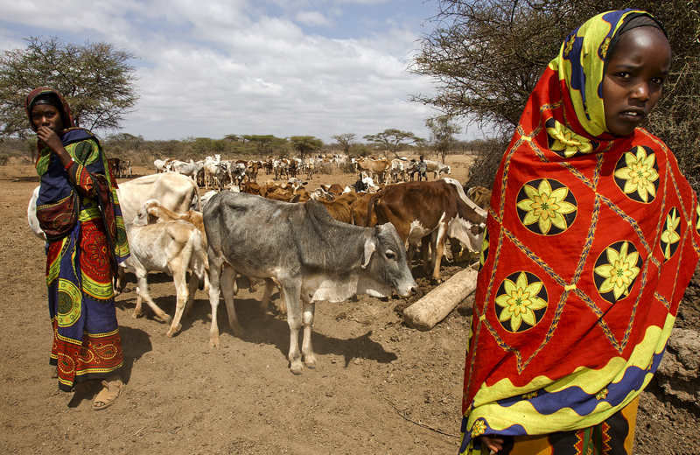
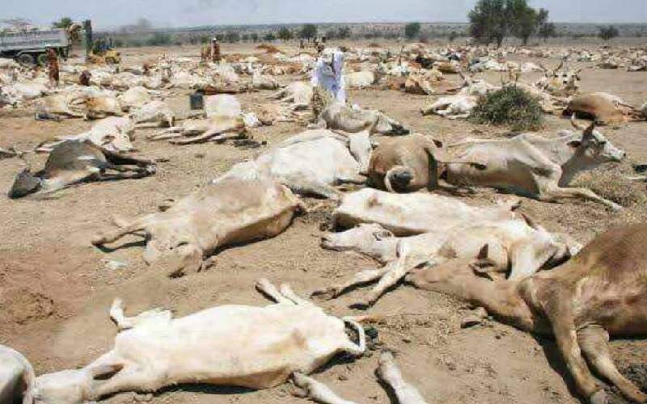
6) Challenges
Drought-Recurrent over years

Slide 12
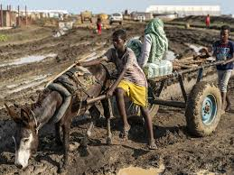
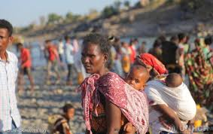


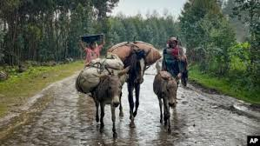
Challenges…
Security/Conflict-some districts
Covid19 pandemic: Impacted field activities.

Slide 13

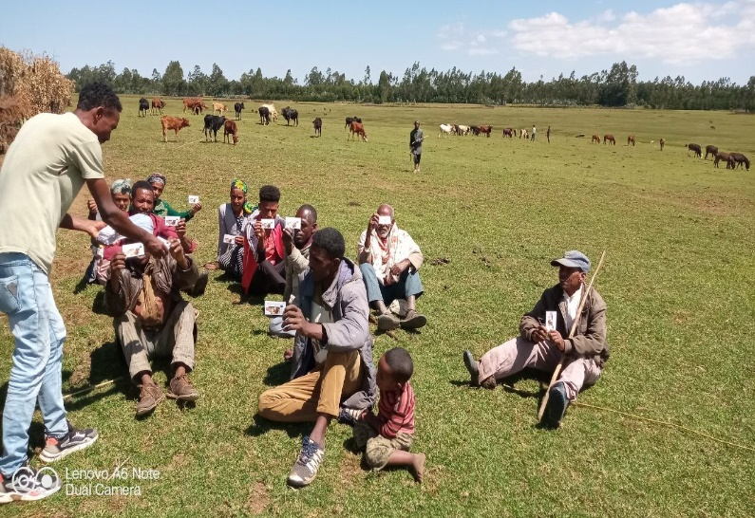

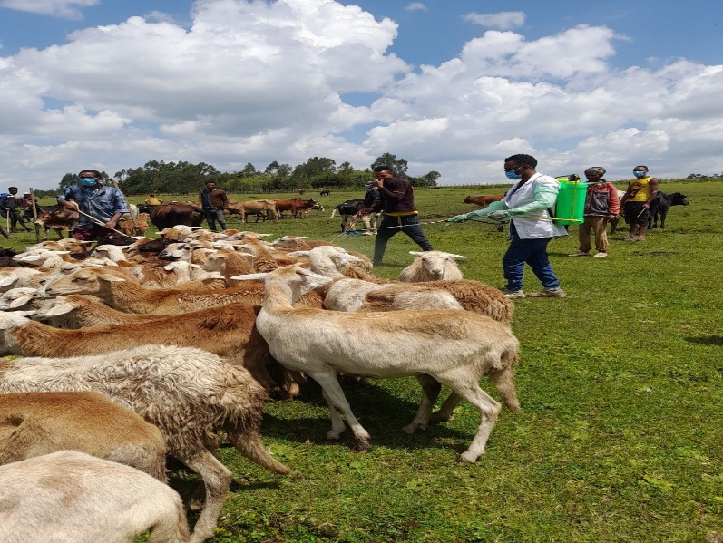
Challenges….
Free service provision: Even for Rx and Vax of List B Diseases- by Government and some NGOs

Slide 14


Recommendations for Scaling Some?

Slide 15
THANK YOU

