Slide 1
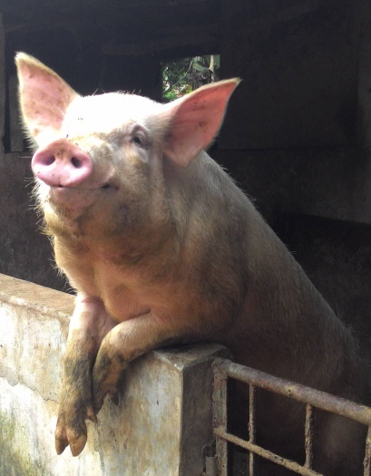
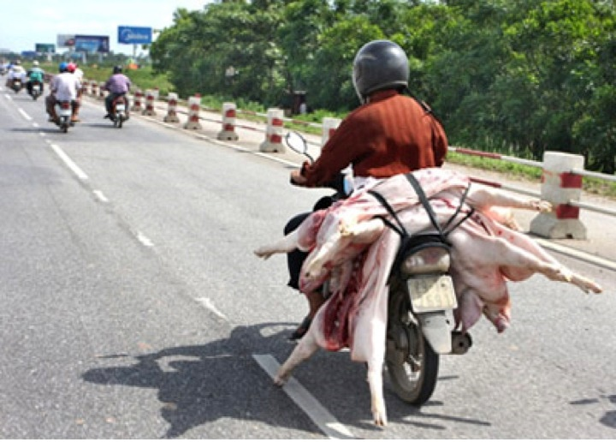
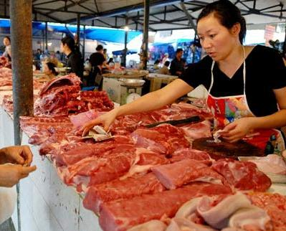
Pork value chain and safety in Vietnam:
from research to interventions
Hung Nguyen and Fred Unger
International Livestock Research Institute
Agriculture, Nutrition and Health Academy Week 2019
Hyderabad, India
24-29 June 2019

Slide 2
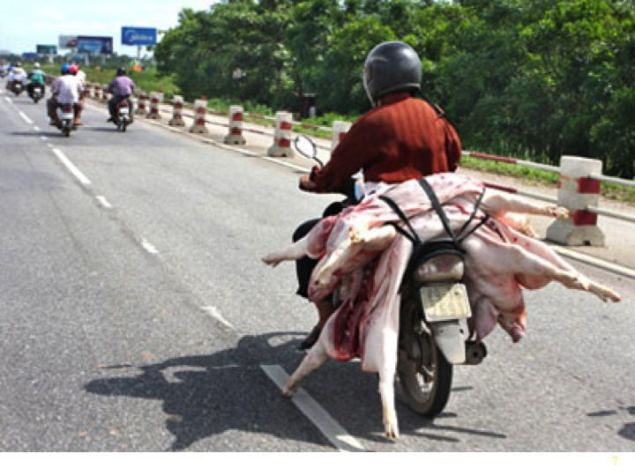
Pork value chain and safety in Vietnam: from research to interventions
Hung Nguyen and Fred Unger, ILRI Vietnam

Slide 3
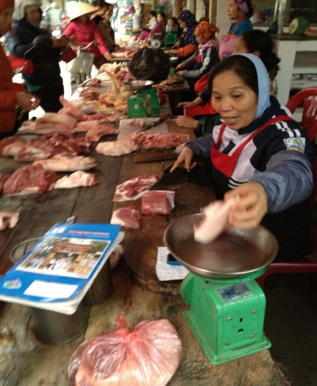

Issue of pork value chain and food safety in Vietnam
Large pig production (30 million heads) mainly produced by smallholders (80%) from 96 million people
Pork is the main ASF (60%) in Vietnamese diet “fresh” pork preferred
Food safety among the most pressing issues, more important than education or health care
Modern food safety legislation but weak enforcement
  Risk perception towards chemical hazards is important, issue of risk communication
  Food exports relatively well managed but deficits in domestic markets.
Nguyen-Viet et al, 2017

Slide 4
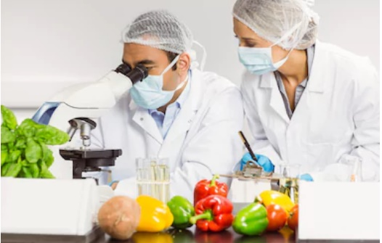
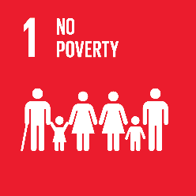
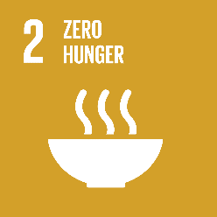
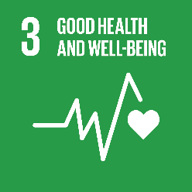

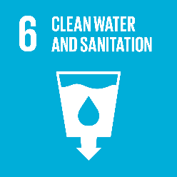

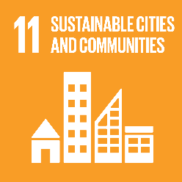
Food safety is integral to the SDGs
Food Safety critical to ACHIEVING the SDGs
Traditional Image of Food Safety
Food safety is integral to:
Food safety (practice) contributes to:
The lack of explicit attention to food safety in the SDGs stems from the low evidence base on the burden of foodborne disease and the overall low awareness of development practitioners about the economic significance of unsafe food.

Slide 5
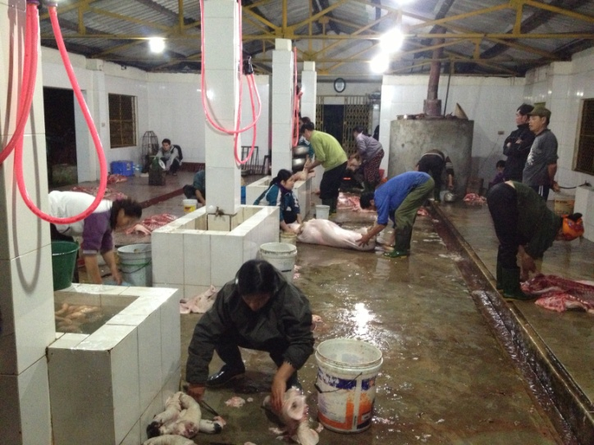
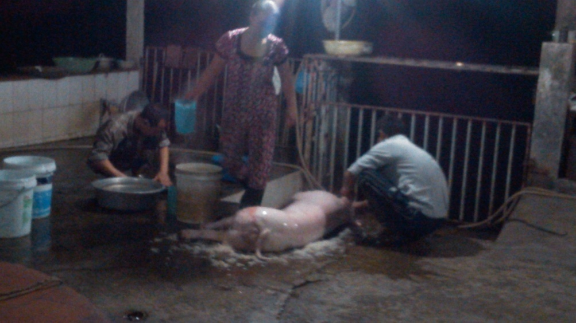
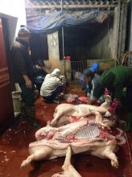
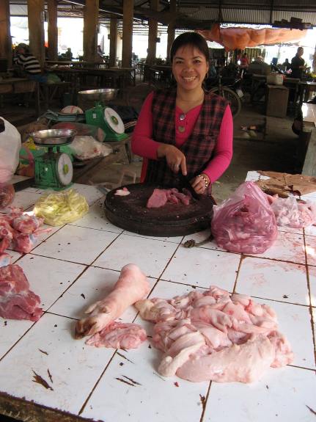

Slide 6
Are there hazards of sufficient likelihood to cause diseases?
No further action
YES
NO
Salmonella, chemicals… along pork value chain
YES
From risk pathways, risk assessment and health assessment
NO
Do control measures exist?
YES
Identified options of intervention for farmers, slaughterhouses…
NO
Safer foods
Is there compliance by actors and other stakeholders
YES
NO
Is there a supportive incentive or solutions to be taken up?
YES
Intervention
Intervention
Intervention

Slide 7
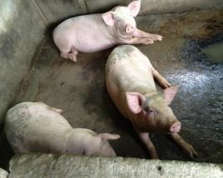
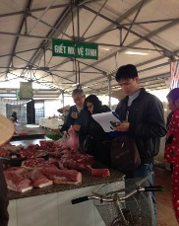
PigRISK: Pork safety in Vietnam (2012-2017)
PigRISK project (2012-2017)
Food safety risk assessment along the pork value chain
Microbial and Chemical Risk Assessment
Salmonella risk pathways developed for producers, slaughterhouse and consumers, quantitative microbial risk assessment (QMRA) risk for consumer
Chemical risk assessment: antibiotic residues, banned chemicals, heavy metals
Farm
Transportation to SH
Slaughterhouse
Retailer
Consumers
Feed in bags, remaining feeds at the cages, environment
Liver
Kidney
Pork
Consumption survey
Sinh Dang et al, 2017

Slide 8
Risk assessment
QMRA for salmonellosis
Age and gender groups | Estimated annual salmonellosis incidence rate (Mean (90% CI)) (%)
Children (under 5 years old) | 11.18 (0 – 45.05)
Adult female (6-60 years old) | 16.41 (0.01 – 53.86)
Adult male (6-60 years old) | 19.29 (0.04 – 59.06)
Elder (over 60 years old) | 20.41 (0.09 – 60.76)
Overall | 17.7 (0.89 – 45.96)
The annual incidence of foodborne salmonellosis in the Asian region including Vietnam was 1% (range 0.2-7%) (Havelaar 2015)
Chemical risk assessment: minimal risks
Dang Xuan Sinh et al, 2017, Hanh Tran et al, 2017

Slide 9
Economic impact of food borne diseases
Costs per treatment episode and per hospitalization day for foodborne diarrhea case were US$ 106.9 and US$ 33.6 respectively.
51.3%: Indirect cost (costs of times to patient, their relatives due to the patient’s illness)
33.8%: Direct medical costs
14.9%: Direct non-medical costs (patient and their relatives)
Hoang Van Minh et al, 2015, JKMS

Slide 10
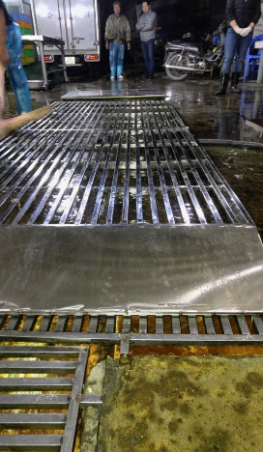
Investments in FS can save lives and $$$
94 million people
Cases of foodborne diseases by Salmonella in pork at 17%: 16 million get sick
Cost $ 107 to treat a case: $ 1,709 million (0.8% GDP)
Intervention to reduce 20% burden: $ 340 million SAVED

Slide 11
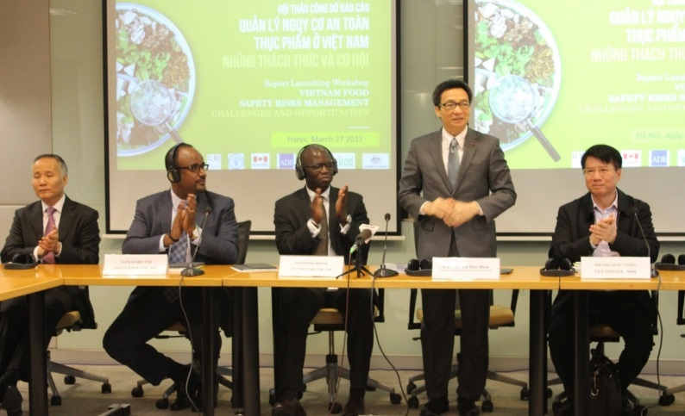




Policy impact: translational research for interventions in modernizing food system
CGIAR/ILRI niche - risk assessment and policy / regulatory analysis for fresh foods in domestic markets
World Bank convenes overall support to government: ILRI led technical works
Upcoming projects based on WB report we led will improve food safety for 20 million people in 4 major cities of Vietnam
Nguyen-Viet et al, 2018

Slide 12
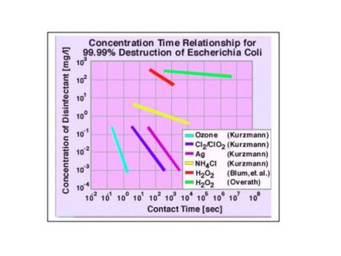
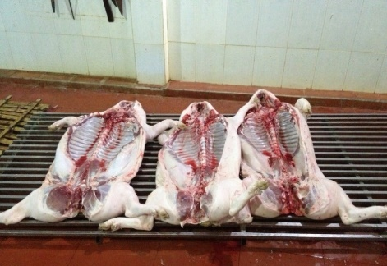
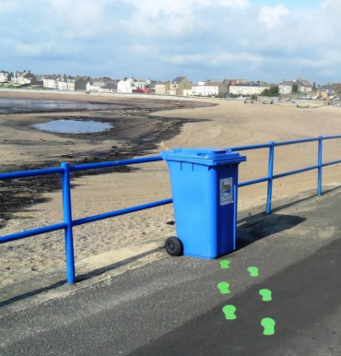
Interventions (Safepork project 2018-2022)
Farm level: Simplified VietGAHP/GAP reduced AMU / AMR
Slaughterhouse: ozone machine, no floor slaughter
Markets: branding, better hygiene
Consumer: reduced cross-contamination, hygiene
Nudges

Slide 13
Take home messages
Huge health burden of foodborne disease
Huge economic burden of foodborne disease
Previous investments not in line with modern understanding
Interventions successful in short term
Long term, wide-reaching impacts likely require
  Training & technology
  Incentives
  Enabling environment

Slide 14
Bibliography
BMGF. 2018. Overview of the Livestock Initiative at the Bill and Melinda Gates Foundation. Seattle, USA. April 2018.
Lowder, S.K., Skoet, J. and Raney, T. 2016. The Number, Size, and Distribution of Farms, Smallholder Farms, and Family Farms Worldwide. World Development 87:16–29.
Philips, M. et al. 2016. Aquaculture Big Numbers. FAO Fisheries and Aquaculture Technical Paper No. 601. Food and Agriculture Organization of the United Nations. Rome, Italy.
Soils for Life: https://www.soilsforlife.org.au/resources/scientific_reports.html
Hung Nguyen-Viet, Tran Thi Tuyet-Hanh, Unger, F., Sinh Dang-Xuan and Grace, D. 2017. Food safety in Vietnam: where we are at and what we can learn from international experiences. Infectious Diseases of Poverty 6: 39. http://hdl.handle.net/10568/79981
Sinh Dang-Xuan, Hung Nguyen-Viet, Meeyam, T., Fries, R., Huong Nguyen-Thanh, Phuc Pham-Duc, Lam, S., Grace, D. and Unger, F. 2016. Food safety perceptions and practices among smallholder pork value chain actors in Hung Yen province, Vietnam. Journal of Food Protection 79(9): 1490–1497. http://hdl.handle.net/10568/77065
Sinh Dang-Xuan, Hung Nguyen-Viet, Unger, F., Phuc Pham-Duc, Grace, D., Ngan Tran-Thi, Barot, M., Ngoc Pham-Thi and Makita, K. 2017. Quantitative risk assessment of human salmonellosis in the smallholder pig value chains in urban of Vietnam. International Journal of Public Health 62(Supplement 1): 93–102. http://hdl.handle.net/10568/77739
Tran Thi Tuyet-Hanh, Dang Xuan Sinh, Pham Duc Phuc, Tran Thi Ngan, Chu Van Tuat, Grace, D., Unger, F. and Hung Nguyen-Viet. 2017. Exposure assessment of chemical hazards in pork meat, liver, and kidney, and health impact implication in Hung Yen and Nghe An provinces, Vietnam. International Journal of Public Health 62(Supplement 1): 75–82. http://hdl.handle.net/10568/77702
Nguyen-Viet, H. et al (2018). Research and training partnership to assist policy and capacity building in improving food safety in Vietnam. Global Food Security

