Slide 1


Willingness to vaccinate and willingness to pay for vaccination against peste des petits ruminants in Linguère, Senegal
Guy Ilboudo^{1*}, Francis Wanyoike², Vesta Blaire Moore³, Karl Rich³, Cheikh Ahmed Tidiane Djigo⁴ and Michel Dione⁵
¹International Livestock Research Institute, Ouagadougou, Burkina Faso
²International Livestock Research Institute, Nairobi, Kenya
³Oklahoma State University, USA
⁴Agronomes et Vétérinaires Sans Frontières, Linguère, Senegal
⁵International Livestock Research Institute, Dakar, Senegal
Peste des petits ruminants Global Research and Expertise Network (PPR-GREN) meeting
Montpellier, France, 7–9 December 2022

Slide 2


Outline
  Introduction
  Methods
  Results
  Conclusion

Slide 3
Introduction
Senegal is engaged in PPR control and eradication
  Implementing a national program since 2018
  Objective: eradicate PPR by 2025
  Annual mass vaccination: XOF 119 ($0.18), XOF 69 ($0.1) subsidized, and XOF 50 ($0.08) paid by the farmers.
  Various partners involved in the campaign especially in Linguère: in the sylvo-pastoral area center
  Few studies conducted to evaluate the participation of the farmers in the vaccination
Study objective: identify the factors that influence the decision of farmers to vaccinate their animals against PPR and their willingness to pay for improved vaccination services.

Slide 4
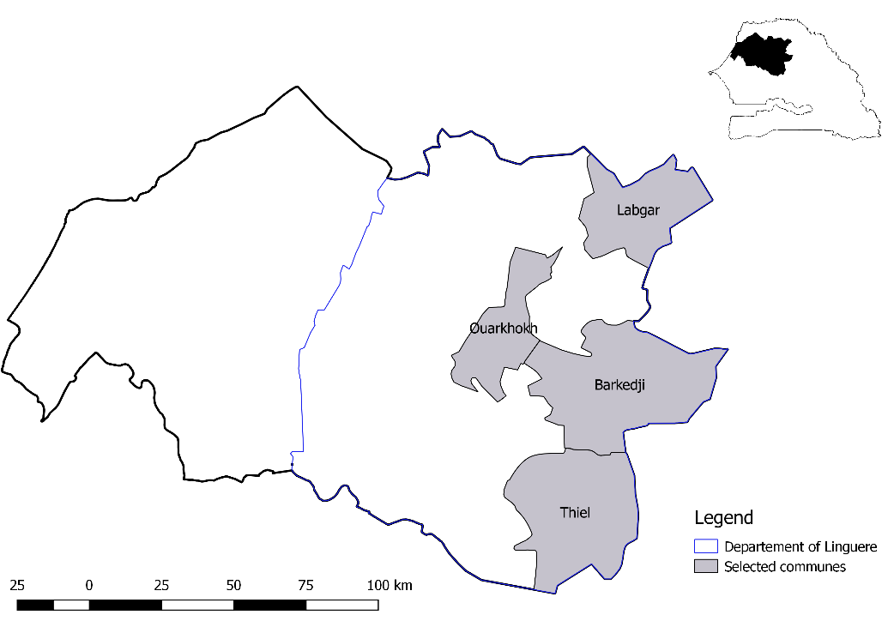
Methods
Cross-sectional study
Study area and sampling
- Region: Louga
- Department: Linguère
- 4 communes selected
- 10 farmers randomly selected per village
-> 200 farmers in total
Figure 1: map of study area

Slide 5
Methods
Discrete choice experiment approach
  Lancaster theory, 1996
  Focused on farmers preferred vaccine attributes and willingness to pay for vaccine options.
  6 attributes identified based on previous studies and expert opinion
  8 choice sets (cards)
  A total of 1600 observed choices
1
Identification of attributes
2
Identification of attribute levels
3
Construction of choice sets
4
Questionnaire designing
5
Data collection

Slide 6
Methods
Choice experiment approach: Attributes and levels
Attributes of vaccination | Option1 | Option2 | Option3
Vaccination site | Vaccination in the parc | Home vaccination | Nothing
Type of vaccine | Thermotolerant vaccine | Thermolabile vaccine
Vaccination strategy | Group vaccination | Individual herd vaccination
PPR vaccine + other services | PPR vaccine + Deworming | PPR vaccine + another vaccine
Nature vaccination | Compulsory vaccination | Elective vaccination
Cost of vaccination | Options: 75, 100, 150, 200, 250 FCFA

Slide 7
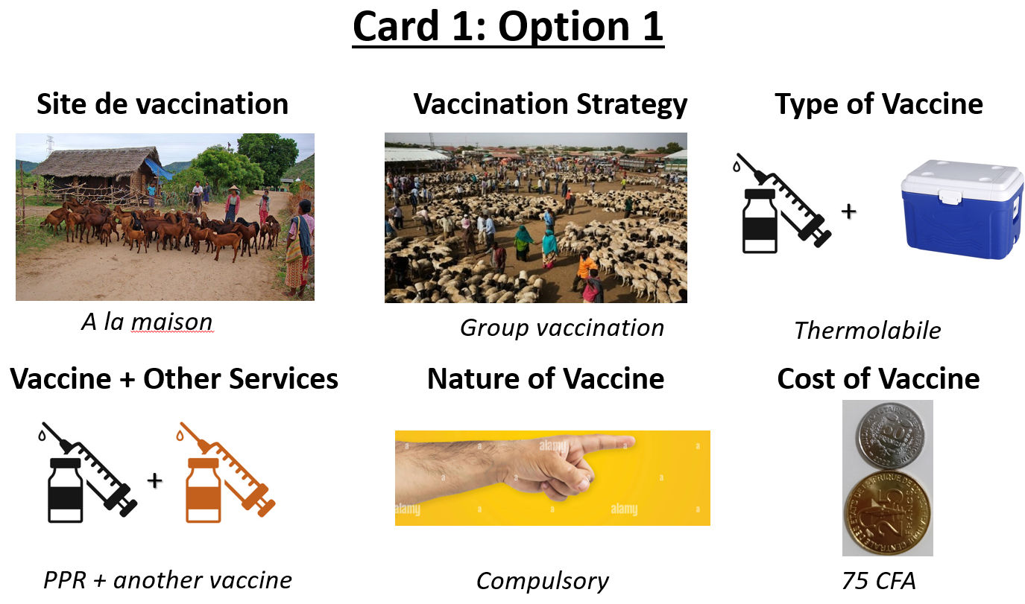
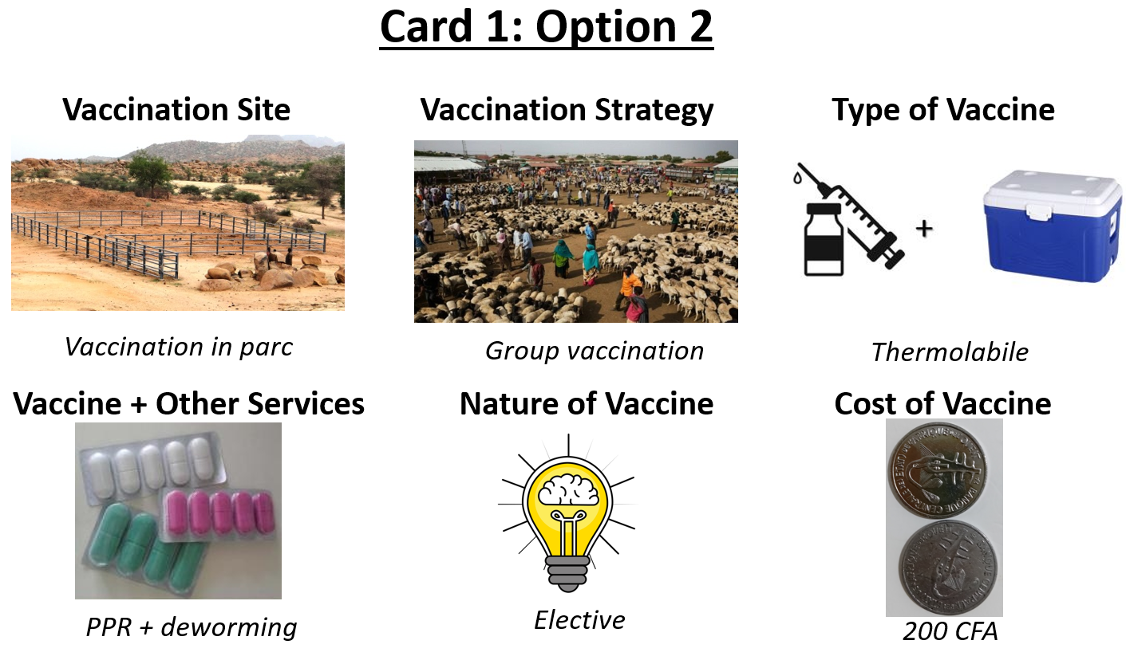
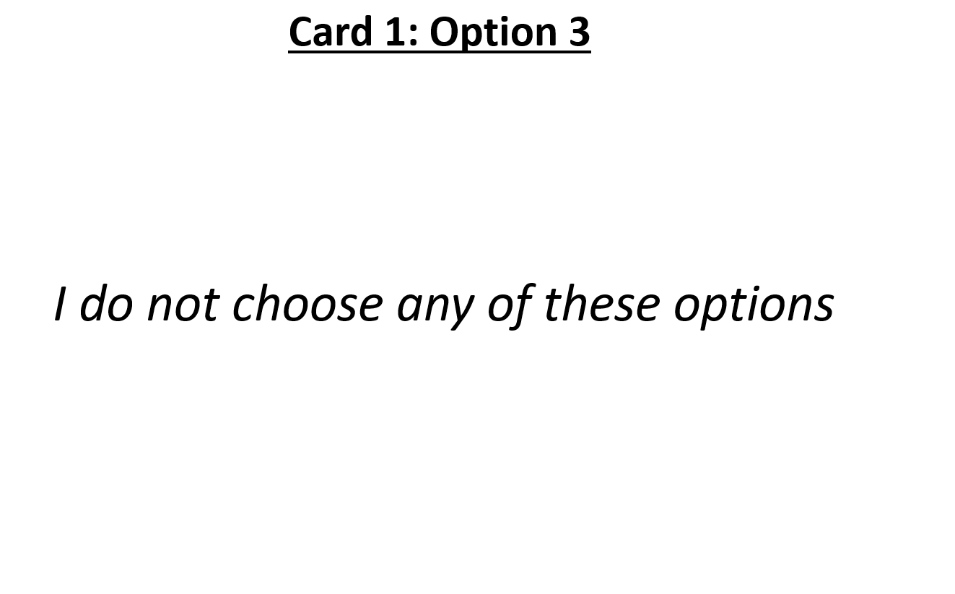
Methods
Choice experiment approach: choice set example
An example of a choice set options

Slide 8
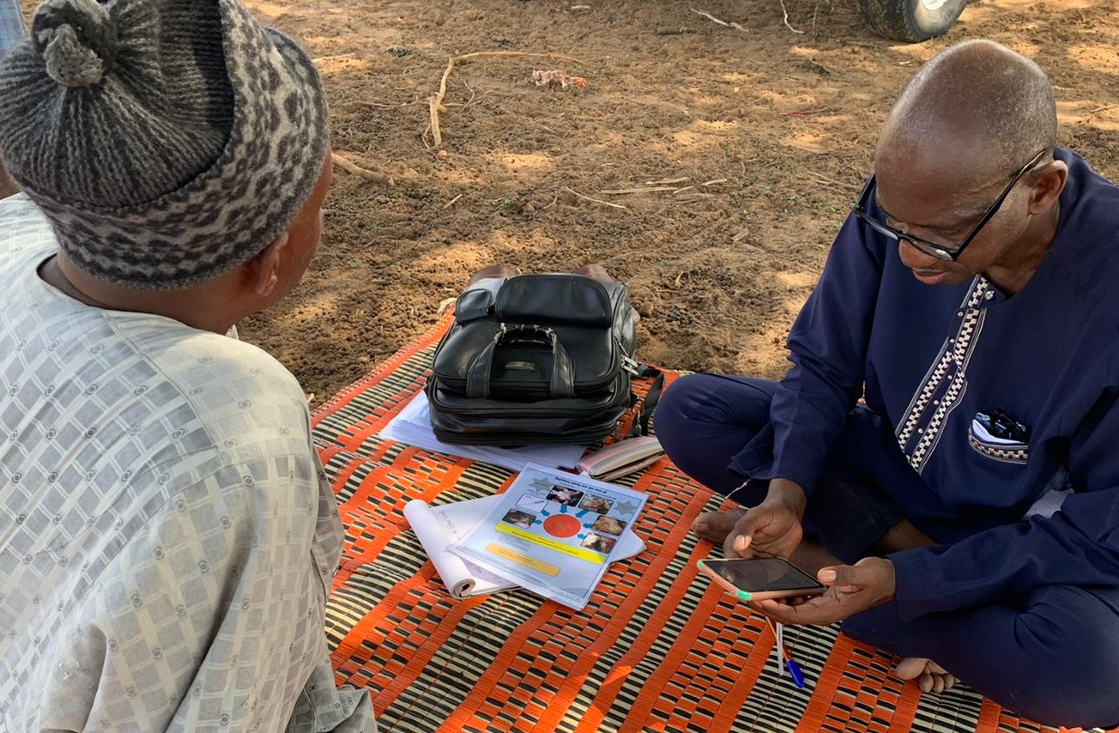
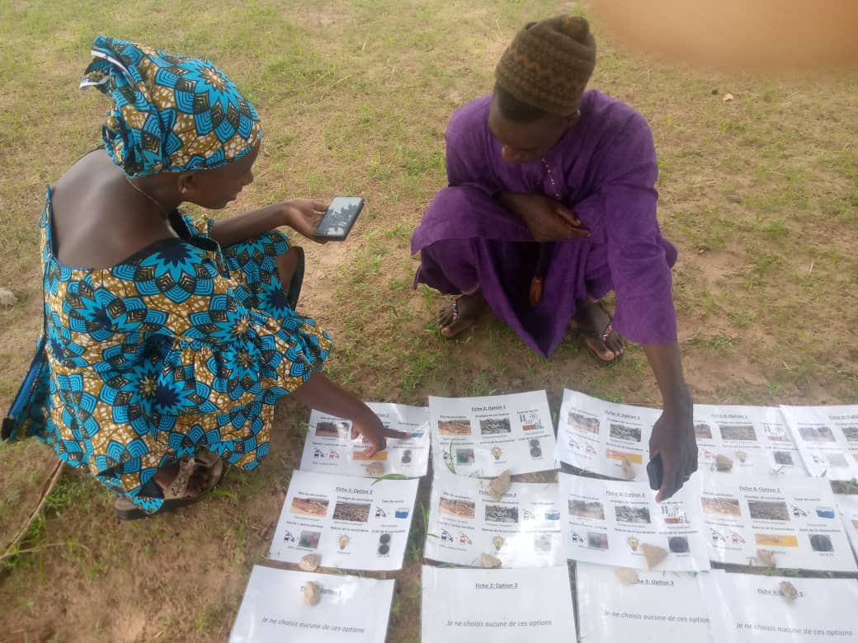
Methods
Data collection
June 2022
4 trained enumerators
Individual face-to-face interview using Open Data Kit (ODK) by phone
Questionnaire
  Socioeconomic aspects
  PPR disease and vaccination characteristics
  Choice cards
Enumerators interviewing the farmers

Slide 9
Methods
Data analysis
  Descriptive analysis using STATA and Excel: tables and figures
  Choice experiment analysis using SPSS: ongoing

Slide 10
Results
Socio-economic data
Items |  | Frequency
Gender
 | Male | 68 (84%)
 | Female | 32 (16%)
Education
 | No level | 125 (62.5)
 | Literacy | 41 (20.5)
 | Primary | 16 (8%)
 | Secondary | 15 (7.5%)
 | University | 3 (1.5%)
Livestock as the main source of income
 | Yes | 171 (85.5%)
 | No | 29 (14.5%)
Species importance in the herd
 | More sheep | 155 (77.5%)
 | More goat | 19 (9.5%)
 | No difference | 26 (13%)

Slide 11
Results
Socio-economic data
Figure 4: Herd size distribution
Figure5: Experience time in small ruminant keeping

Slide 12
Results
PPR occurrence in the herd: morbidity and mortality
Figure 6: distribution of small morbidity due to PPR
Figure 7: distribution of small mortality due to PPR

Slide 13
Results
Various information on PPR occurrence in the herd
Items |  | Frequency
Capability to identify PPR symptoms
 | Yes | 144 (72%)
 | No | 56 (28%)
Main symptoms observed in the herd with 12 past months
 | Fever | 63 (11.35%)
 | Diarrhea and/or cough | 118 (21.26%)
 | Tearing | 107 (19.28%)
 | Discharge from the nose | 112 (20.18%)
 | Oral erosions | 87 (15.68%)
 | Conjunctivitis | 37 (6.67%)
 | None sign presented | 31 (5.59%)
PPR syndrome observed within 12 past months
 | Yes | 130 (65%)
 | No | 70 (35%)

Slide 14
Results
Various information on PPR vaccination
Items |  | Frequency
Already vaccinate the herd against PPR
 | Yes | 122 (61%)
 | No | 78 (39%)
Raison of non-vaccination
 | I have not heard of the PPR vaccination | 62 (51%)
 | I heard about vaccination, but the vaccine was not available to me | 35 (29%)
 | I believe that vaccination has no benefit for my herd | 1 (0.83%)
 | I believe that vaccination could cause problems for my herd | 3 (2.48%)
 | The cost of vaccination is expensive | 1 (0.83%)
 | The traceability of vaccinated animals is too difficult | 1 (0.83%)
 | The current vaccination system does not suit me | 2 (1.65%)
 | The current vaccination period does not suit me (transhumance, wintering, etc.) | 3 (2.48%)
 | I don't believe in it for cultural reasons | 13 (10.74%)

Slide 15
Results
Various information on PPR vaccination
Items |  | Frequency
Preferred frequency for PPR vaccination
 | Every year | 128 (64%)
 | Every 2 years | 14 (7%)
 | Every 3 years | 6 (3%)
 | Lifetime immunity | 47 (23.5%)
 | Other | 5 (2.5%)
Preferred strategy for PPR vaccination
 | Travel to the vaccinator in another locality | 16 (8%)
 | The vaccinator travels to my locality | 182 (91%)
 | Other | 2 (1%)
Preferred animal marking type
 | Paint | 99 (49.5%)
 | Ear notch | 15 (7.5%)
 | Ear tag | 73 (36.5%)
 | None | 3 (1.5%)
 | Other | 10 (5%)
 | Don’t know | 1 (0.5%)

Slide 16
Results
Various information on PPR vaccination
Items |  | Frequency
Preferred vaccinator type
 | Government vaccinator | 122 (61%)
 | Private vaccinator | 5 (2.5%)
 | Community vaccinator | 38 (19%)
 | Whatever | 33 (16.5%)
 | Other | 2 (1%)
Opinion on the mandatory vaccination
 | Good idea | 175 (87.5%)
 | Bad idea | 18 (9%)
 | Don’t know | 7 (3.5%)
Will you tend to vaccinate more if the vaccination includes deworming?
 | Yes | 198 (99%)
 | No | 1 (0.5%)
 | Don’t know | 1 (0.5%)
Will you tend to vaccinate more if the vaccination includes another vaccine
 | Yes | 195 (97.5%)
 | No | 4 (2%)
 | Don’t know | 1 (0.5%)

Slide 17
Results
Socioeconomic factors that influence the decision to vaccinate (n=200)
Figure 8: Main expectations of the farmers in term of improved vaccine

Slide 18
Results
Socioeconomic factors that influence the decision to vaccinate (n=200)
Figure 9: Main factors influencing the decision of farmers to vaccinate

Slide 19
Results
Willingness to pay for vaccination (choice experiment – ongoing)
?

Slide 20
Conclusion – What did we learn ?
  In Linguère,
  Most farmers can clearly identify the PPR syndrome
  Most factors influencing the decision of the farmers to vaccinate are related to the campaign organization
  Some farmers don’t believe that a good vaccine can confer lifetime immunity
  The cost of the vaccine is not always the first concern of the farmers
  A good vaccine for farmers should reduce mortality, increase market value of animals
  An improved vaccination service (deworming and/or combination with other vaccines) can motivate the farmers to vaccinate more

Slide 21
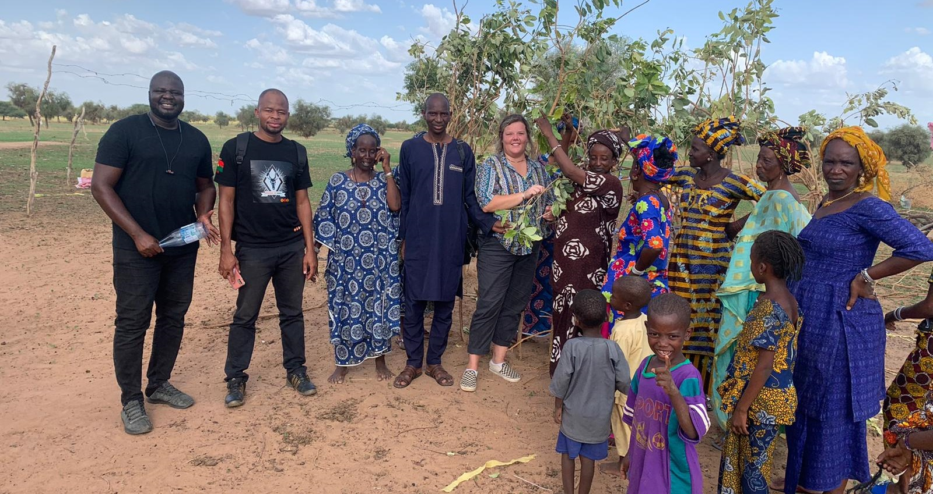
Thanks
Notes:
Thank everyone for your attention

Slide 22







This research was conducted under CRP livestock and the project Epidemiology and Control of peste des petits ruminants (EcoPPR) and continued under the CGIAR Initiative Sustainable Animal Productivity for Livelihoods, Nutrition and Gender (SAPLING). CGIAR research is supported by contributions from the CGIAR Trust Fund. CGIAR is a global research partnership for a food-secure future dedicated to transforming food, land, and water systems in a climate crisis.

Slide 23
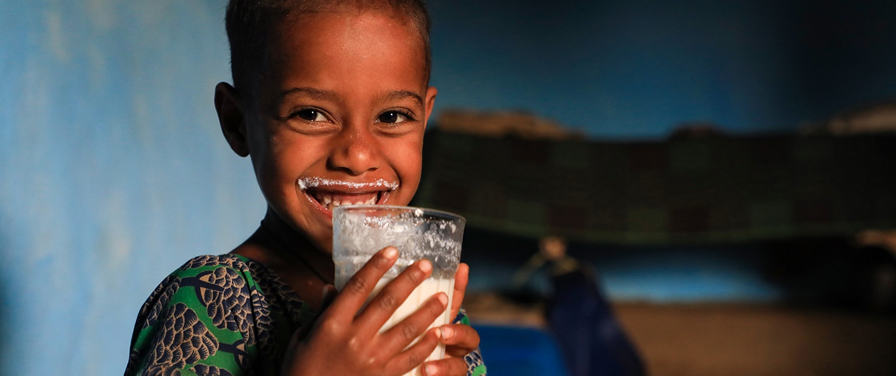
THANK YOU

