Slide 1
Long-term trends of rainfall identify priority zones for targeting climate smart agricultural technologies in East and South Africa
Francis Muthoni (IITA), Vincent Odongo (Wageningen University), Justus Ochieng (WorldVeg) and Irmgard Hoeschle-Zeledon (IITA)
European Geosciences Union General Assembly 2018
Vienna, Austria, 8 -13 April 2018

Slide 2
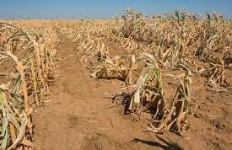
Problem
Rain-fed farming systems experience greater impacts of climate change and variability
Understanding long term trends in rainfall inform future trajectories
  Support evidence-based targeting of climate smart agricultural (CSA) technologies
Detection of spatial-temporal trends for rainfall in Africa hindered by sparse distribution of gauge stations and numerous gaps in gauged data

Slide 3
Objective
Investigate long-term variability and trends (1981 - 2017) in rainfall in East and Southern Africa using remote sensing data
Specific objectives
Validate CHIRPS-v2 satellite rainfall estimate with rain gauge data
Map long-term variability in monthly and annual precipitation
Determine magnitude and significance of monotonic trends in rainfall

Slide 4
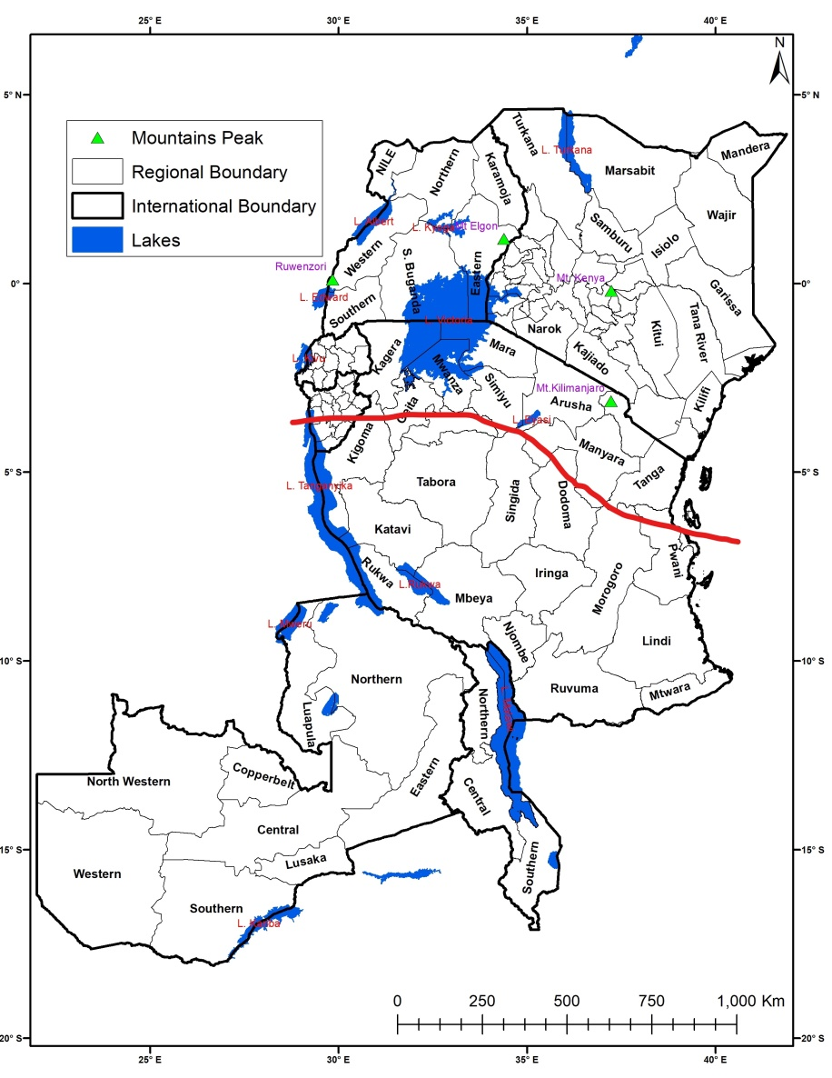
Study Area
Bimodal rainfall pattern
  Long rains – MAM
  Short rains - OND
Unimodal rainfall pattern
  ONDJFMAM months

Slide 5
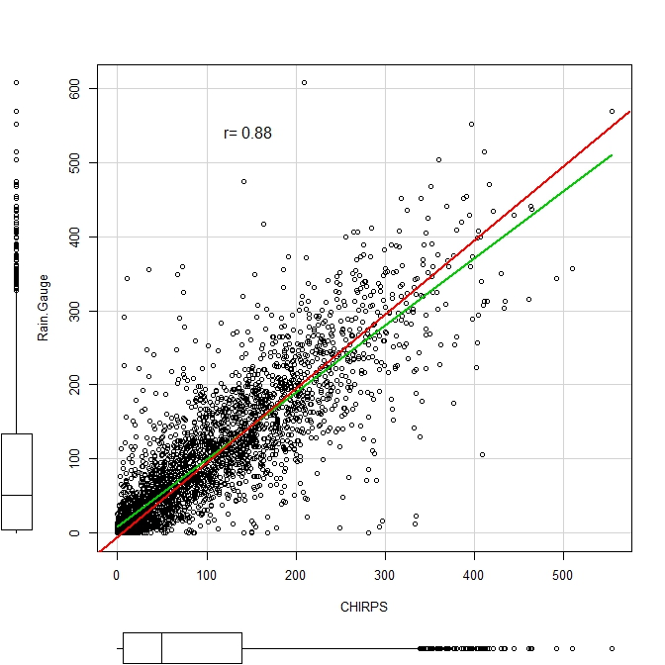
Validating satellite rainfall with gauge data
88% agreement between monthly CHIRPS-v2 and gauge rainfall
CHIRPS-v2 overestimate low intensity & underestimate high intensity
CHIRPS-v2 offer new opportunity for monitoring spatial-temporal variation in droughts and floods in data sparse regions

Slide 6
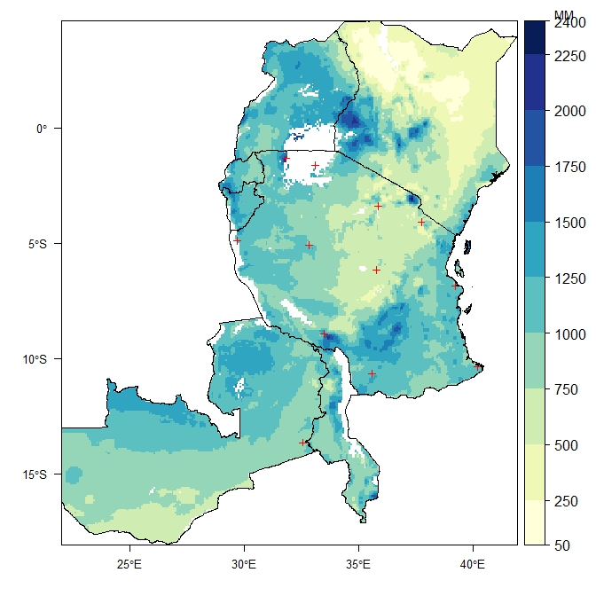
Long-term mean annual rainfall
Annual rainfall reveal high spatial temporal variation with most dry conditions in north and eastern Kenya
Highest annual rainfall values recorded around mountain peaks: Mt. Kilimanjaro, in Tanzania, Mt. Kenya and Aberdare Ranges in Kenya, Mt. Elgon in Uganda

Slide 7
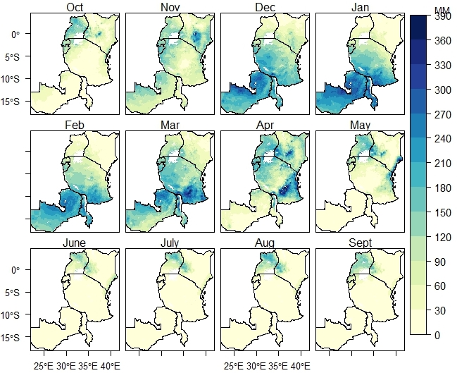
Long-term trends in monthly rainfall
June to September is dry season (<30 mm) except in Uganda and western Kenya
Understanding long term patterns in monthly rainfall inform agro-advisory services on cropping calendar activities

Slide 8
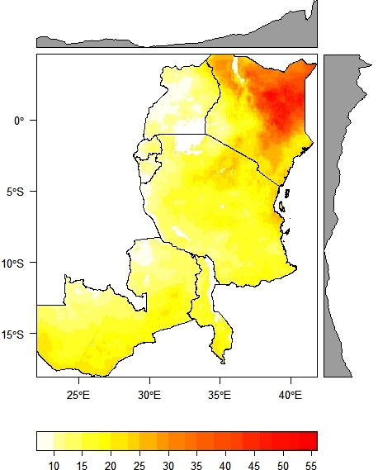
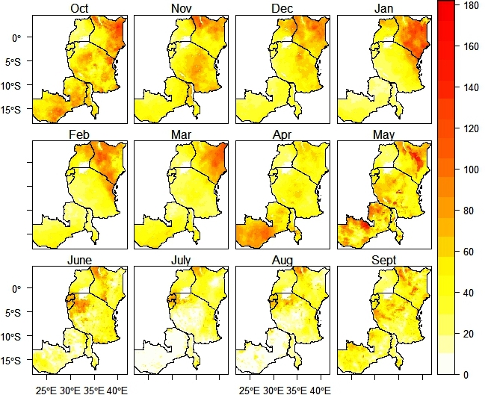
Variability (CV) in annual and monthly rainfall
High seasonality especially in drier regions indicative of frequent extreme events like droughts

Slide 9
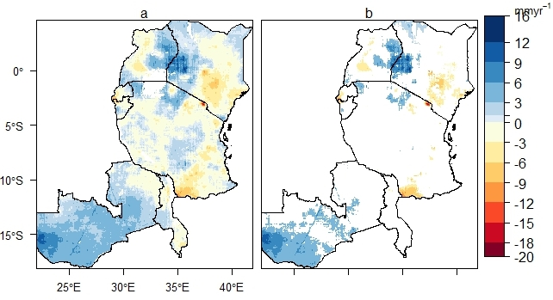
Monotonic trends for annual rainfall
Largest contiguous zones with significant increase in annual rainfall occurred in SW. Zambia and Lake Victoria basin between Kenya and Uganda.
Highest significant decrease in annual rainfall recorded at Mt Kilimanjaro in Tanzania

Slide 10
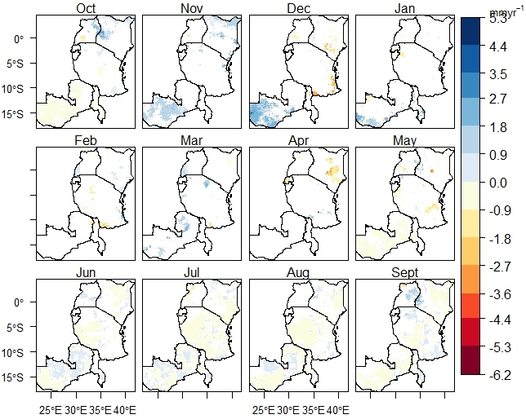
Trends for monthly rainfall
Increasing trend for NDJ rain in South-west Zambia coincide with main planting season
Increase trend in northern Lake Victoria basin in October during short rain season
Pronounced decrease in December and April rains in Central and Southern Kenya
Decrease in JJAS rain reveals more drier seasons in Tanzania and Zambia

Slide 11
Conclusions
  CHIRPs-v2 provide accurate high spatial-temporal resolution data on rainfall distribution patterns in ESA region
  High inter-annual variability in rainfall is indicative of increasing frequency of extreme rainfall events in ESA region
  Annual rainfall in Zambia revealed an increasing trajectory compared to decreasing trajectory in the other 6 countries
  Observed magnitude and direction of rainfall trends provide spatial evidence for targeting appropriate CSA technologies

Slide 12







Enhancing partnership among Africa RISING and NAFAKA Programs for fast tracking delivery and scaling of agricultural technologies in Tanzania
Notes:
ESA Africa

