Slide 1

Improving collaboration between research and the private sector to accelerate livestock innovation for sustainability into use: Setting the scene
Tom Randolph, CGIAR Research Program on Livestock and Shirley Tarawali, ILRI
Introductory presentation at a parallel session, 9th Multi-Stakeholder Partnership Meeting of the Global Agenda for Sustainable Livestock, Manhattan, Kansas, 9-12 September 2019

Slide 2



Introducing Us
Shirley Tarawali
Assistant Director General
Tom Randolph
Director
Research for development: working for better lives through livestock in developing countries and contributing sustainable transformation of smallholder livestock system and the SDGs
Research on livestock health, genetics, feeds and forages; socio-economics, sustainable livestock systems, public health and nutrition
Co-hosted in Nairobi, Kenya and Addis Ababa, Ethiopia
Consolidates CGIAR livestock-related capacity at ILRI, ICARDA, CIAT together with Swedish Agricultural University and GIZ
Targets smallholder households and informal markets to increase access to animal source foods and create added-value and employment for rural and urban poor through livestock.
#LivestockAgenda

Slide 3
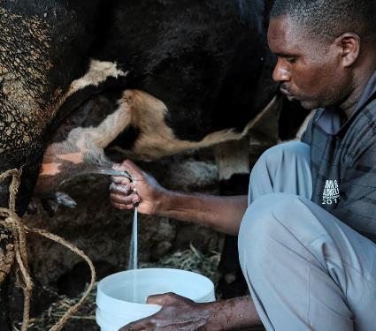
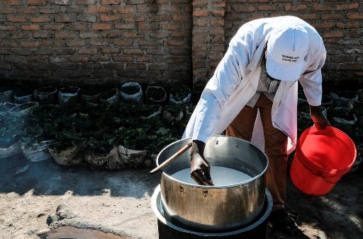
Motivation for this session
The POTENTIAL
Much animal-source food produced in smallholder livestock systems in LMIC
These systems can be key in meeting growing demand and achieving multiple SDGs (see GASL background paper on economic growth and livelihoods)
The private sector – including ‘hidden middle’ – has greatest capacity and reach to support smallholders in increasing productivity and efficiency, including innovation to promote sustainability
#LivestockAgenda

Slide 4
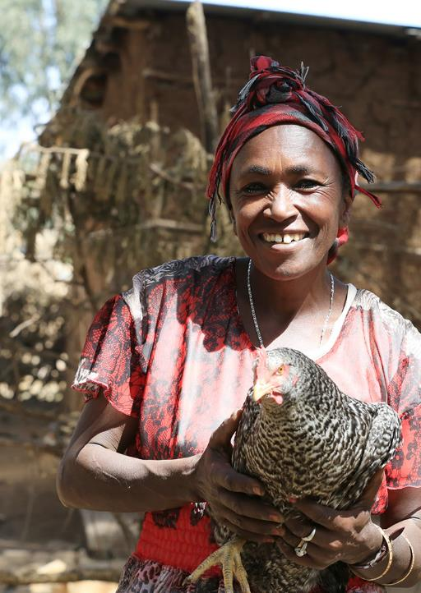
Motivation for this session
The CHALLENGE
Successful transformation will require linking research with private sector, but few, isolated examples of how this works
  Research ‘public good’ innovation may not offer incentives as a ‘private good’ for private sector
  Public-Private Partnership arrangements to create incentives face challenges
#LivestockAgenda

Slide 5
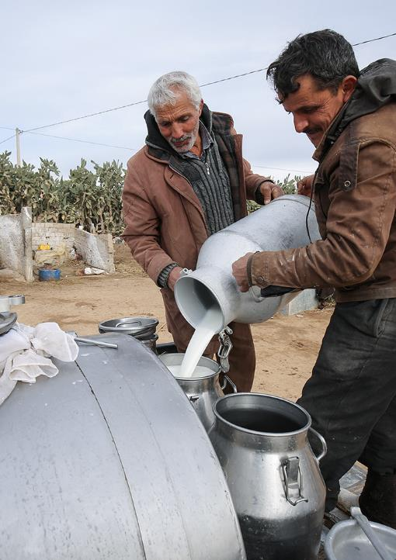
Framing the discussion
Specific subset of Public-Private Partnerships
Delivering innovation from research to enhance inclusive sustainable livestock systems
Demand-pull: private sector responding to opportunities needing innovation
Supply-push: research offering innovation to scale
As individual innovations (technologies, services, institutional arrangements) or as integrated packages
Range of private to public goods
#LivestockAgenda

Slide 6
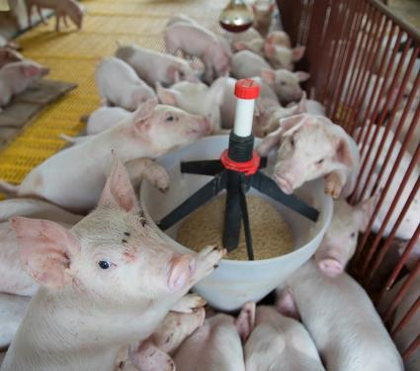
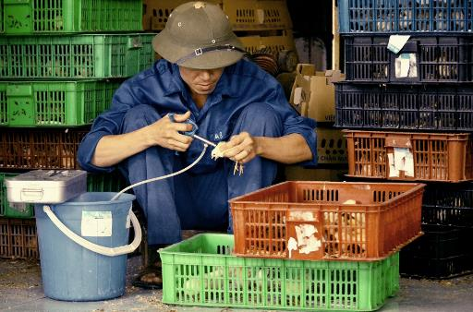
Framing the discussion
PRIVATE SECTOR:
3 main categories to consider
Multi-national companies
National and local commercial companies
Mostly informal small/medium scale enterprises
#LivestockAgenda

Slide 7
Broad lessons learned
Several reviews available (e.g. Rankin et al. FAO (2016). Public-Private Partnerships for Agribusiness Development: A review of international experiences)
Key messages for successful partnership
  Assess motivation of each partner and identify where objectives align
  Define roles
  Co-invest
  Cultivate trust
Seems simple, but tricky in application
  A number of good examples
  But many failed attempts and opportunities missed
GASL: the right place to explore this!
#LivestockAgenda

Slide 8

Flow of the session
We hear real-life examples where it has and hasn’t worked from 6 colleagues representing private sector and research, and their advice ‘gems’
  Margaret Munene, Palmhouse Dairies Ltd.
  Fabiana Villa Alves, EMBRAPA
  John Ellenberger, Land O’Lakes
We ask your help in teasing out key lessons
Then we ask a panel of investors to share their take
  Antonio Rota, IFAD
  Chris Brett, World Bank
Quick synthesis
  Shirley Tarawali, ILRI
Delia Randolph, ILRI
Martin Barasa, VSF-Germany
Sam Thevasagayam, Bill & Melinda Gates Foundation
  Belinda Richardson, Bill & Melinda Gates Foundation
  Andrew Bisson, USAID
  Donald Moore, Global Dairy Platform
WE INVITE YOU TO PARTICIPATE!
Audio capture of our discussions and your MENTI replies

Slide 9


ILRI thanks all donors and organizations which globally support its work through their contributions
to the CGIAR Trust Fund
This presentation is licensed for use under the Creative Commons Attribution 4.0 International Licence.

