Slide 1

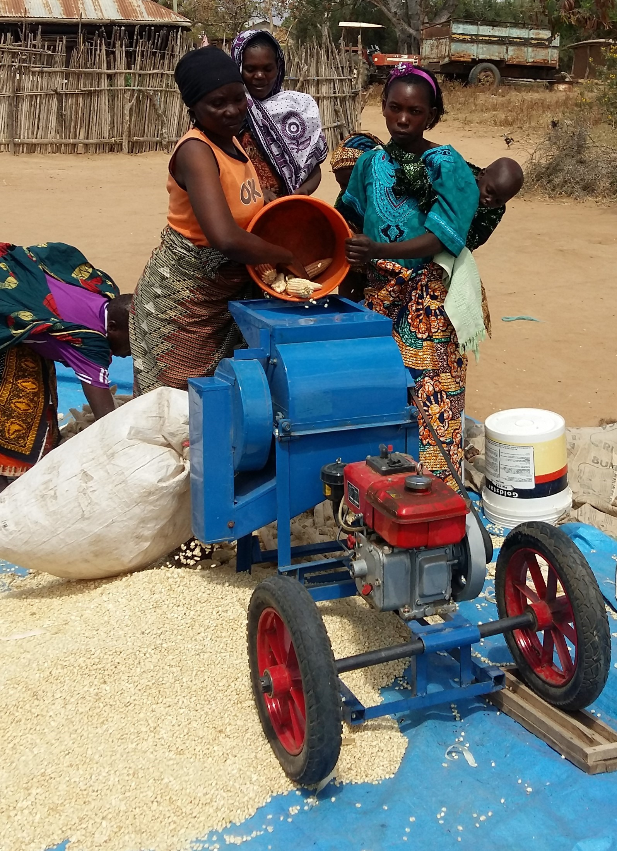
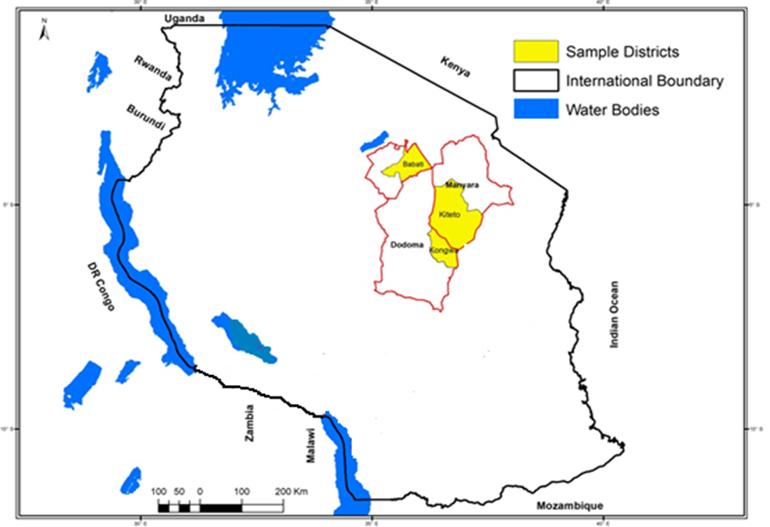






Calling for mechanization: farmers’ willingness to pay for small-scale maize shelling machines in Tanzania
Bekele Hundie Kotu¹, Adebayo Abass¹, Audifas Gaspar¹, Gundula Fischer¹,
Christopher Mutungi¹, Irmgard Hoeschle-Zeledon¹, Mateete Bekunda¹
¹International Institute of Tropical Agriculture
Introduction
Maize shelling is one of the labor-intensive and arduous activities among smallholder farmers in Tanzania. There are possibilities to mechanize maize shelling. This study explores farmers’ willingness to pay (WTP) for small-scale maize shelling machines and identifies factors affecting their WTP.
The study areas and methods
The study was conducted in Babati, Kongwa, and Kiteto districts of Tanzania (Fig. 1). We collected survey data from 400 randomly selected men and women farmers. A diesel-powered machine and an electric-powered machine were considered.
Table 1: Results of regression model and estimated WTPs
Fig. 1: Location of the study areas in Tanzania
We used a double-bound dichotomous choice questionnaire design to collect data (Cameron & Quiggin, 1990) on three business models, namely: (1) the rental service model (RSM), (2) the group ownership model (GOM), and (3) the private ownership model (POM). We used interval regression model to identify the factors affecting farmers’ WTP for maize shelling mechanization under different business models (Cawley, 2008). Based on the results of the regression model, we estimated the mean WTP.
Conclusion
Our results show that several factors affect farmers’ WTP for maize shelling mechanization. The mean WTPs are equal or greater than the market price except in the case of the POM-DM which requires high capital. The three business models could be feasible options to promote mechanization of maize shelling in the areas.
Results
The results of the regression analysis are displayed in Table 1. The columns show results corresponding to the diesel machine (DM) and the electric machine (EM) for alternative business models. Some of the results are:
WTP is lower for households having relatively abundant labor while it is higher for those experiencing higher labor cost
Men are more likely willing to pay than women in the case of private ownership model which requires higher capital
Older people are less likely to pay for shelling machines than young ones
Households having more wealth are more willing to pay in the case of the private and the group business models
References
T.A, & Quiggin, J. (1990). Estimation using contingent valuation data from ‘dichotomous choice with follow up’ questionnaire. J. Env. Econ. & man., 27, 218-34.
Cawley, J. (2008). Contingent valuation analysis of willingness to pay to reduce childhood obesity. Econ. Hum. Biol. 6, 281–292.
We thank farmers and local partners in Africa RISING sites for their contributions to this work. We also acknowledge the support of all donors which globally support the work of the CGIAR centers and their partners through their contributions to the CGIAR system
This poster is licensed for use under the Creative Commons Attribution 4.0 International Licence. September 2019

