Slide 1
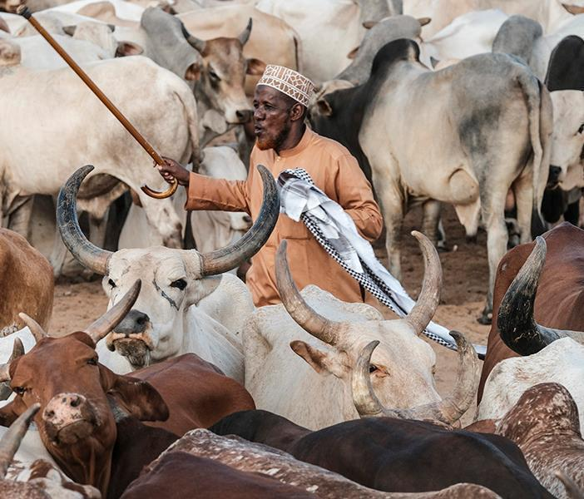
Accelerating uptake of research on sustainable livestock interventions – insights from the CRP
Amos Omore, ILRI
CGIAR Livestock CRP and GASL joint side event on national partnerships for sustainable livestock systems at the 7th All-Africa Conference on Animal Agriculture, Accra, Ghana, 30 July 2019

Slide 2
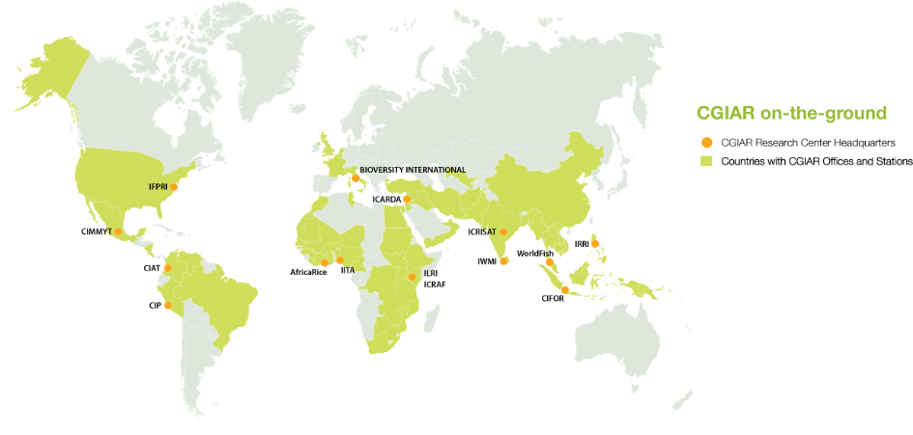
CGIAR on the ground:
15 research centres; over 70 countries

Slide 3
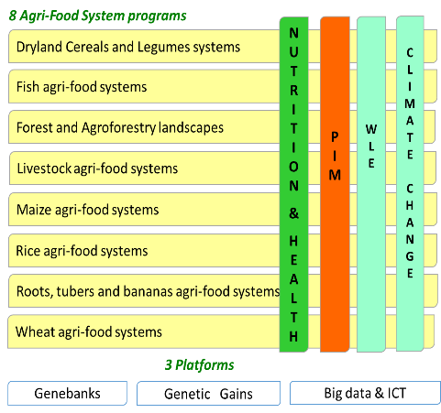
What’s a CGIAR Research Program or CRP?
Genesis
  Feature of CGIAR reform to increase efficiency and improve impact
  Donor funding channeled to CRPs rather than Centres
    Program model attractive
    Focus
    Accountability
4 Global Integrating programs
Features
  High-level themes
  Constitute CG portfolio
  Multi-centre + external partners
  Led by a centre
  A combination of funding from 4 different windows
  CRP proposal reviewed and approved for 3-6 years, but funding allocated annually
Excellence of Breeding
*PIM = Policies, Institutions and Markets
**WLE = Water, Land and Ecosystems
Notes:
Page title minimum of 30 points and maximum
of two lines
Main point 6 point smaller than slide title
Bullet points 4 point less than main point
Font type is Calibri
It is advised in one slide maximum 6 bullets
We recommend you use images on slides
You can change partner logos on front page
You have to duplicate this slide for more inside pages

Slide 4
Livestock CRP
Session focus:
National partnering to ensure sustainability and acceleration of livestock research into use

Slide 5





Brings together 5 partners globally
Covers all livestock research areas; forage genebank
Forage research, esp. breeding; forage-mediated environmental impacts; value chain development; forage genebank
Small ruminants; dryland feed & forages; pastoralist systems; forage genebank
All livestock research areas, with initial focus on herd health
Improving the research-development interface
Notes:
Page title minimum of 30 points and maximum
of two lines
Main point 6 point smaller than slide title
Bullet points 4 point less than main point
Font type is Calibri
It is advised in one slide maximum 6 bullets
We recommend you use images on slides
You can change partner logos on front page
You have to duplicate this slide for more inside pages

Slide 6
The Livestock & Agri-Food Systems CRP
Rationale:
  Rapid increase in demand for animal-source foods in lower-income countries currently supplied mainly by smallholder farmers offers opportunity to:
  Increase productivity and supply sustainably of especially nutritious food
  Increase productivity and income for low-income smallholders
  Strengthen resilience of vulnerable rural populations
Goal and Objectives:
  A well-nourished, equitable and environmentally healthy world through livestock research for development
  Appropriate breeds available, affordable and widely used
  Improve livestock health and health service delivery
  Increase livestock nutrition
  Reduce environmental footprint of livestock production
  Maximize livestock-mediated livelihoods and resilience to risk among smallholder and pastoral producers and their communities, and enhance availability and access to animal-source food for consumers
Notes:
Page title minimum of 30 points and maximum
of two lines
Main point 6 point smaller than slide title
Bullet points 4 point less than main point
Font type is Calibri
It is advised in one slide maximum 6 bullets
We recommend you use images on slides
You can change partner logos on front page
You have to duplicate this slide for more inside pages

Slide 7
Working hypothesis
Challenge of showing impact of livestock research partly because it is difficult to get uptake of piecemeal improvements
Requires step-wise changes in livestock systems, e.g. improved genetics in dairy cattle requires improved health, feeding
New focus on working with development partners to combine livestock research into integrated evidence-based interventions in selected systems and sites ready for scaling up and out by those same and other development partners
Two targets:
  Animal-source food value chain development: facilitating the transition from smallholder livestock keeping and informal markets to more productive and higher-value professional agri-business opportunities for both women and men
  Strengthening resilience of livestock-based livelihoods: Protecting and enhancing other critical roles that livestock play where intensification may not be possible, including as part of crop-livestock and backyard systems

Slide 8
Demonstrating how livestock research can catalyze change in selected countries by targeting integrated interventions
Structured as 5 Flagship Projects:
Targeting 4 priority countries: 3 in Africa
Livestock
genetics
Livestock livelihoods and agri-food systems
Livestock
health
Feeds and forages
Livestock and the environment
Inclusive sustainable intensification (value chains) in Uganda, Ethiopia, Tanzania

Slide 9
The model is underpinned by research-development partnerships
Stylized impact pathway for translating research into large-scale impact in a value chain
Research partners
Attracting investment
PIPELINE
Knowledge partner
Relative degree of involvement
Experiments
Evaluation
Evidence
Assessment
Mobilization
Best bets
Advocacy
Dissemination
Design
Piloting
Year 1 → Year 8-12
Program horizon in a target value chain
Implementing large-scale interventions
Lessons
Context
Development partners
Development partners
Year 1 → Year 8-12
Program horizon in a target value chain
Notes:
Page title minimum of 30 points and maximum
of two lines
Main point 6 point smaller than slide title
Bullet points 4 point less than main point
Font type is Calibri
It is advised in one slide maximum 6 bullets
We recommend you use images on slides
You can change partner logos on front page
You have to duplicate this slide for more inside pages

Slide 10
Sustainability focus in the CRP
Socio-economic sustainability to drive uptake: focus on contractual arrangements for market push-pull for productivity improvements; emphasis on profitability and gender
Environmental sustainability to mitigate potential threats: assessments and waste management strategies; how to address various unintended consequences, threats, trade-offs and options; ensuring technologies are developed with sustainable intensification in mind
Innovation capacity and political sustainability: The multi-stakeholder processes address this within the value chain; but questions on how to enabling national partners to take these forward – both technically and politically..

Slide 11
Enhancing sustainability?
We need to hear from you on how to enhance sustainability of the interventions.
In particular…
Who are the right national partners to help accelerate?
Who are the right national partners to help determine sustainability?
What incentives are required?
But let’s first hear from presenters of case studies on partnering in Uganda, Ethiopia and Tanzania
Notes:
Page title minimum of 30 points and maximumof two lines
Main point 6 point smaller than slide title
Bullet points 4 point less than main point
Font type is Calibri
It is advised in one slide maximum 6 bullets
We recommend you use images on slides
You can change partner logos on front page
You have to duplicate this slide for more inside pages

