Slide 1
Important!
This module is designed to potentially serve a wide variety of audiences (nutritionists and agronomists, policymakers, extension workers, farmers).
Not all of the material will be relevant to all audiences.
Please refer to the accompanying Facilitator’s Guide for guidance on how to adapt these materials to your audience and facilitation best practices.

Slide 2




Legend
Icon | Description
 | Expected Duration, minutes
 | Quick Review/Survey Questions
 | Brainstorming Session
 | Discussion Session
 | Group Activity
 | Animated Slide
 | End of Animation
Xm

Slide 3
Legal
Unless otherwise noted, all images copyrighted to International Potato Centre.
Attribution-NonCommercial-ShareAlike 2.0 Generic (CC BY-NC-SA 2.0)

Slide 4
Everything You Ever Wanted to Know About Sweetpotato
Topic 9: Processing and Utilisation

Slide 5
Introduction
Processing and Utilisation

Slide 6
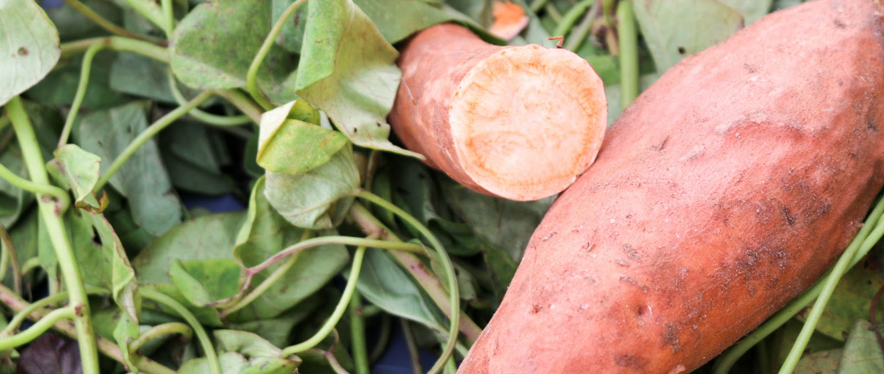
Welcome
During this session, we will cover the many delicious, nutritious and potentially profitable food products which can be prepared from orange-fleshed sweetpotato. The use of sweetpotato as animal feed is also discussed.

Slide 7
How to Process Orange-Fleshed Sweetpotato, Retain the Beta-Carotene Content and Add Value
Unit 1

Slide 8
Objectives
By the end of this unit, you should be able to:
Identify the sweetpotato processing practices that best preserve beta-carotene.
Describe the processes of boiling, steaming, roasting, and drying sweetpotato root.
Discuss the pros and cons of peeling sweetpotato.
Tell how to improve beta-carotene retention within each processing method.
List the three primary orange-fleshed sweetpotato (OFSP) products.
Explain how to add nutritional value to a variety of foods using processed OFSP.

Slide 9
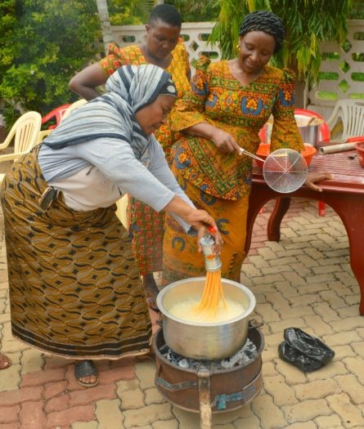
Traditional Methods of Preparing OFSP
Boiling
  Use clean water
  Wash roots
  Peel roots (optional)
  Boil roots until soft

Slide 10
Traditional Methods of Preparing OFSP Cont.
Roasting
  Wash roots and remove moisture
  Wrap in banana leaves and place in ash of fire
  Alternatively, place on grill above charcoal
  Roots can also be roasted in oven
Steaming
  Use clean water
  Wash roots
  Peel roots (optional)
  Wrap roots in banana leaves
  Steam over boiling water until soft

Slide 11
Traditional Methods of Preparing OFSP (cont.)
Drying
  Wash sweetpotato roots and wipe or pre-dry them in the sun to remove external moisture
  Using chipper or slicer cut the roots into thin pieces that dry fast. Alternatively, roots can be sliced by hand. Bigger pieces will take longer to dry.
  Spread pieces on clean surface (e.g., a black plastic sheet or a mosquito mesh) and leave in sun until dry
    Do not dry on the ground, as the roots can get contaminated with dirt
    Total drying time not exceed 3 days
  Pack dried pieces in opaque bags and seal. Store in a clean, cool and dry place with limited sunlight.
  Can mill the dried pieces into flour

Slide 12
Processes Causing Beta-Carotene Loss
Some micronutrients are lost during washing
Micronutrients can also be destroyed through:
  Cooking
  Sun exposure
  Long-term storage
Least to greatest beta-carotene loss:
  Roasting -> boiling -> frying -> steaming -> sun-drying

Slide 13
Methods to Retain Beta-Carotene
Process quickly
  Beta-carotene degrades when exposed to long preparation and high temperatures
  Don’t overboil, over-steam, over-roast or over-dry
Process with the skin
  Peeling isn’t necessary. Skin can also be removed after cooking or when dried
  Processing with skin saves time
Do not store processed OFSP for long periods
  Beta-carotene degrades during storage, particularly after 1 month
  Store in cool, dry place in opaque packaging to protect from sunlight

Slide 14
Added Value of Sweetpotato
Three primary products of OFSP:
  Fresh-grated
  Boiled and mashed (puree)
    OFSP can also be used for cooking porridge
  Flour
    OFSP can replace some wheat flour in commonly consumed food products, such as bread, bakery products, chapati, cakes biscuits, etc.
    OFSP can be mixed with other flours, e.g. roasted soybean, roasted maize, millet, cassava
OFSP is a source of Vitamin A. A single OFSP chapati provides a child a full day’s Vitamin A.
Sweetpotato foliage adds nutrition to a variety of dishes and condiments

Slide 15
What are some of the ways to retain beta-carotene during OFSP processing?
What are the three primary products of OFSP?
Notes:
Answers
Process quickly, process with skin, do not store for long periods
Fresh-grated, boiled or mashed, flour

Slide 16
Key Points
Sweetpotato loses essential beta-carotene both in storage and in processing.
Roasting sweetpotato is the best method for retaining beta-carotene. Sun-drying is the most destructive; between them, listed from best to worst, are boiling, frying, and steaming.
With all methods of preparation, less is more: do not overdry, oversteam, etc. Sometimes OFSP must be sun-dried for the off-season, but using thin slices that can be dried quickly reduces nutrient loss.
Peeling sweetpotatoes is optional; the peel contains dietary fibre, and not peeling saves labour.

Slide 17
Key Points (cont.)
Long storage destroys beta-carotene, even if it is preserved during processing.
If carefully processed, flour made with OFSP adds significant amounts of Vitamin A to many foods, such as doughnuts, breads, and porridges. A single OFSP chapati can provide a child with a full day’s Vitamin A.
Sweetpotato foliage can also add nutrition to a variety of dishes and condiments.

Slide 18
Sweetpotato Flour Versus Grated Sweetpotato or Sweetpotato Puree
Unit 2

Slide 19
Objectives
By the end of this unit, you should be able to:
Compare the processes used to make sweetpotato flour, grated sweetpotato, and sweetpotato puree.
List the uses of these different sweetpotato forms.
Discuss the pros and cons of each form, particularly when used in baked goods.

Slide 20
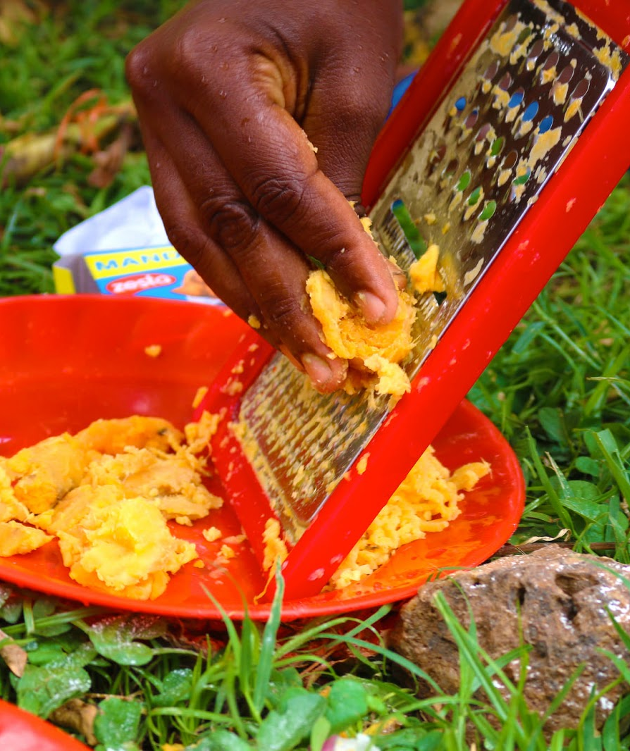
Grated Sweetpotato
Made from raw and grated (shredded) OFSP.
Simple processing: roots are grated
Can be used for bread.

Slide 21
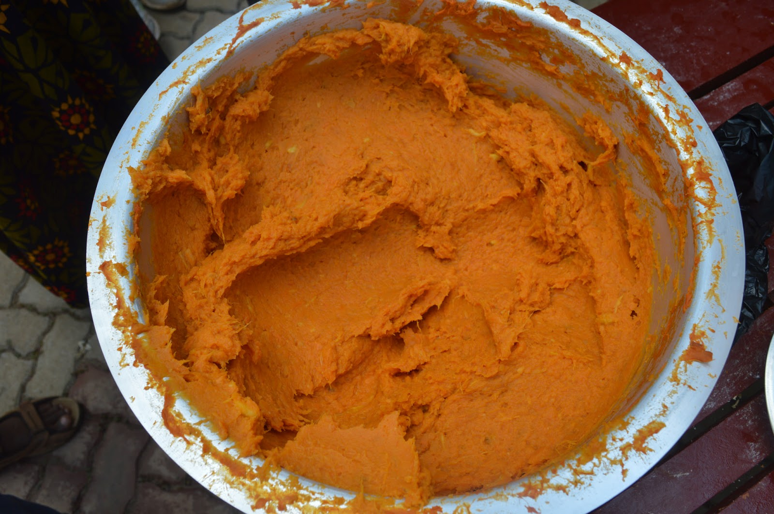
Sweetpotato Puree
Sweet potato roots are first boiled, then mashed into a puree.
Can be used for baking:
  High water content means recipes must be altered
  Baked goods’ taste and texture may change

Slide 22
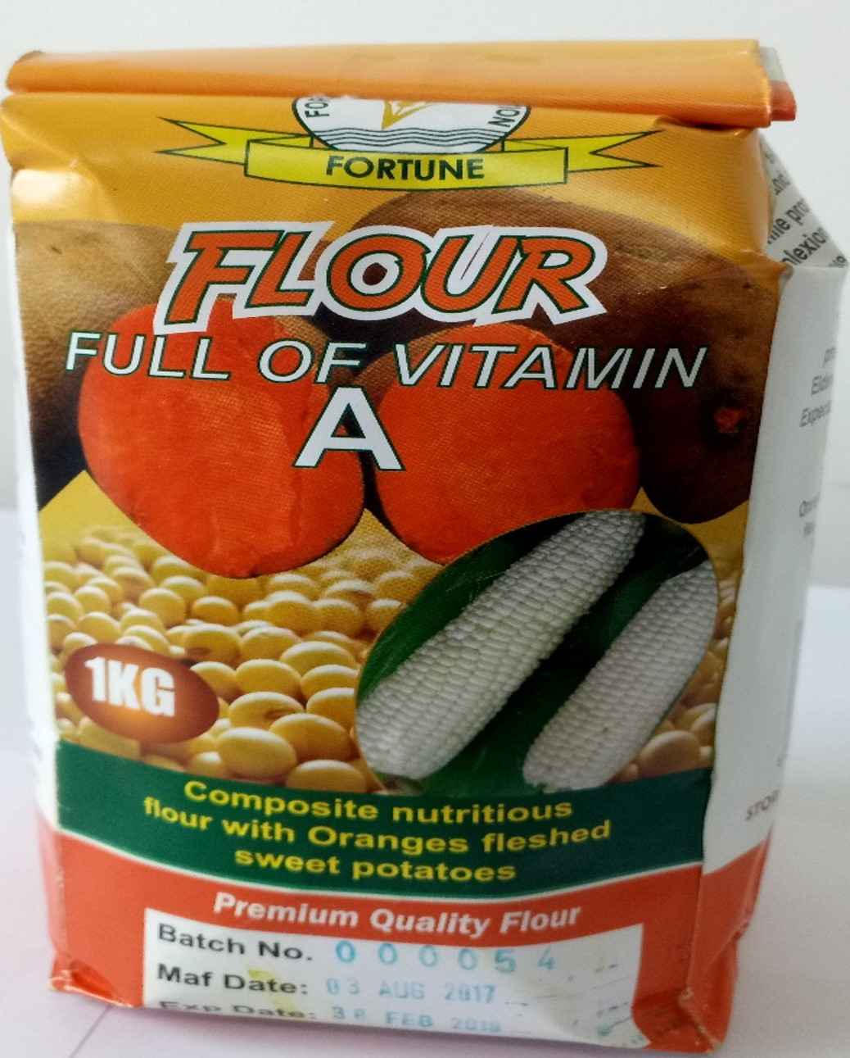
Sweetpotato Flour
To produce flour, sweetpotato roots are going through chipping, drying, storing and milling.
Much beta-carotene is lost during lengthy process making and storing OFSP flour.

Slide 23
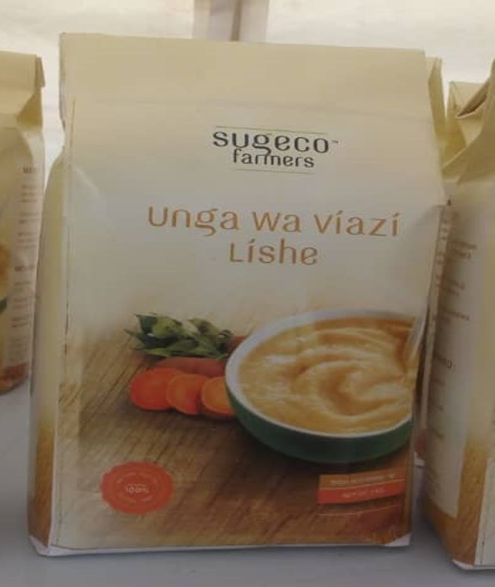
Sweetpotato Flour Cont.
Flour has low water content, vitamin A it contains is concentrated.
Sometimes flour is more nutritious than other processed forms.
Can replace 25-50% wheat flour in recipes for many bakery products without changing texture of product.

Slide 24
Pros and Cons of Processed Sweetpotato
Each case should be considered individually to find the most practical and economically feasible way to use sweetpotato.
Number one factor to consider for selecting a processing method is level of moisture.
Recipe is often the determining factor in deciding how sweetpotato should be processed.

Slide 25
While sweetpotato flour has several advantages that sweetpotato puree and grated sweetpotato do not, what are some disadvantages?
Notes:
Answers
The process of converting sweetpotato into flour is lengthier and more complicated. Beta-carotene is easily lost in the process.

Slide 26
Key Points
Grated sweetpotato is a relatively simple product, as it requires only grating the rinsed fresh root. Sweetpotato puree requires two steps (boiling and mashing), while sweetpotato flour requires chipping, drying, storing, and milling.
Much beta-carotene is lost in the lengthy process of making and storing sweetpotato flour. However, since the flour has a low water content, the vitamin A it contains is concentrated. Therefore, it is sometimes more nutritious than less processed forms of sweetpotato.
Sweetpotato flour can replace 25-50% of the wheat flour in recipes for many profitable and nutritious bakery products without changing the texture of the product.
Sweetpotato puree (mash) can also be used in baking, but its high water content means the recipes must be altered, and the baked goods’ taste and texture may change.

Slide 27
Using Sweetpotato to Add Nutritional Value at the Household Level
Unit 3

Slide 28
Objectives
By the end of this unit, you should be able to:
Explain why rural households should consider adding more sweetpotato products to their diet.
Suggest how sweetpotato can be incorporated into foods.
Name the three types of food that children, infants, and adults should have at every meal.

Slide 29
Emphasising Value for Rural Households
Emphasis on including OFSP in existing diet
OFSP roots contain vitamins A, C, and several B vitamins
Sweetpotato dishes that also include groundnuts supply protein and fats as well.
OFSP is more nutritious and filling than bread.
Children can carry boiled or baked OFSP to school healthy snack.

Slide 30
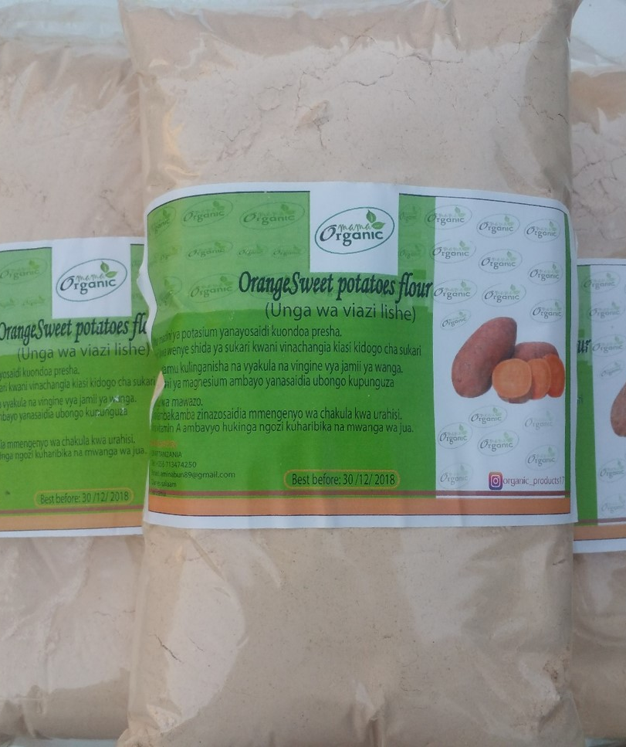
Incorporating Sweetpotato into Foods
Sweetpotato flour can be used in baked products as an ingredient.
Sweetpotato should be prioritised as a breakfast food.
Boiled, fried, and baked sweetpotato can be rotated in the weekly menu.

Slide 31
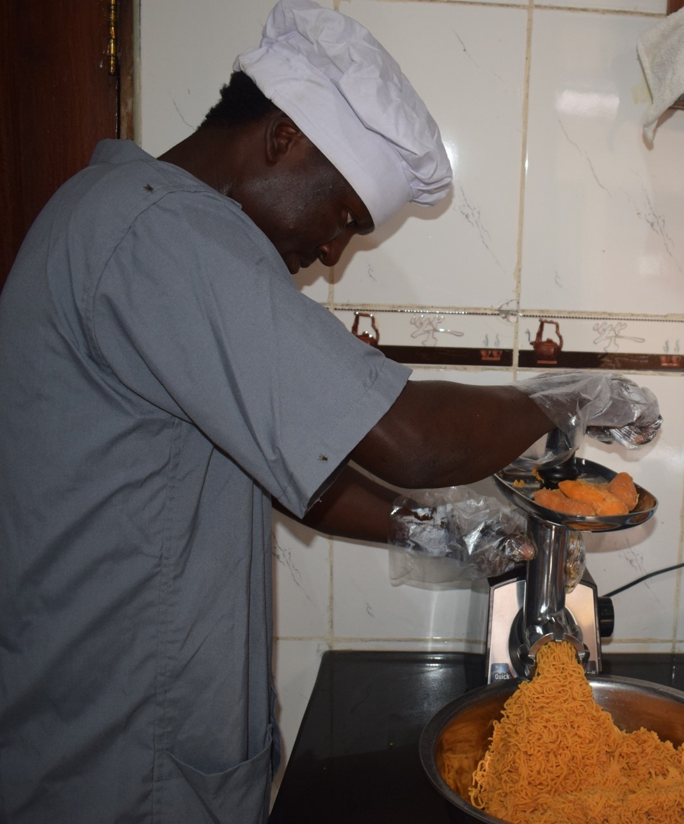
Incorporating Sweetpotato into Foods Cont.
Leaves of sweetpotato plant are valuable as dietary vegetable
  Can be fried with groundnuts, tomatoes, onions
Sweetpotato can be fed to infants at 6 months weaning:
  OFSP-enriched porridge is thick with nutrients

Slide 32
Enriched porridges
Caregivers of infants should be encouraged to prepare enriched porridges, containing:
  Source of energy – carbohydrates and fats (sweetpotato, maize, wheat, cassava)
  Protective food – vitamins and minerals (OFSP, pumpkin, eggs, milk)
  Body building food – proteins (beans, meats, chicken, fish, groundnuts)
Sweetpotato can be consumed by adults, infants, and children.

Slide 33
What are some of the nutritional benefits of sweetpotato for rural households?
What are the advantages of enriched porridges?
Notes:
Answers
OFSP roots contain vitamins A, C, and several B vitamins; Sweetpotato dishes that also include groundnuts supply protein and fats as well; OFSP is more nutritious and filling than bread; Children can carry boiled or baked OFSP to school healthy snack
Source of energy – carbohydrates and fats; Protective food – vitamins and minerals; Body building food – proteins

Slide 34
Key Points
Sweetpotato adds vitamins A, C, and several B vitamins to many dishes. Sweetpotato dishes that also include groundnuts supply protein and fats as well.
Sweetpotato should be prioritised as a breakfast food, as it is more nutritious and filling than wheat bread.
The leaves of the sweetpotato plant are valuable as a dietary vegetable and can be fried with groundnuts, tomatoes, and onions.
At 6 months, infants can be given sweetpotato as a weaning food.
Infants and adults should consume three types of food at each meal: an energy food (fat and carbohydrate), a protective food (micronutrients), and a body building food (proteins).

Slide 35
How to Cook Delicious Sweetpotato Recipes
Unit 4

Slide 36
Objectives
By the end of this unit, you should be able to:
Name the healthiest and less healthy ways of eating sweetpotato.
Explain how to make sweetpotato porridge, mandazi, chapati, mshenye, crisps, drop scones, buns, and other baked goods and dishes, with or without the addition of other flours and cereals.

Slide 37
How to Cook Delicious Sweetpotato Recipes
The healthiest way to eat OFSP is boil and mash.
  Add teaspoon of oil to increase beta-carotene (Vitamin A) absorption
Deep fat fried products (chips, crisps) are much less healthy
Mix sweetpotato in varying proportions with different flours for best results in various recipes.

Slide 38
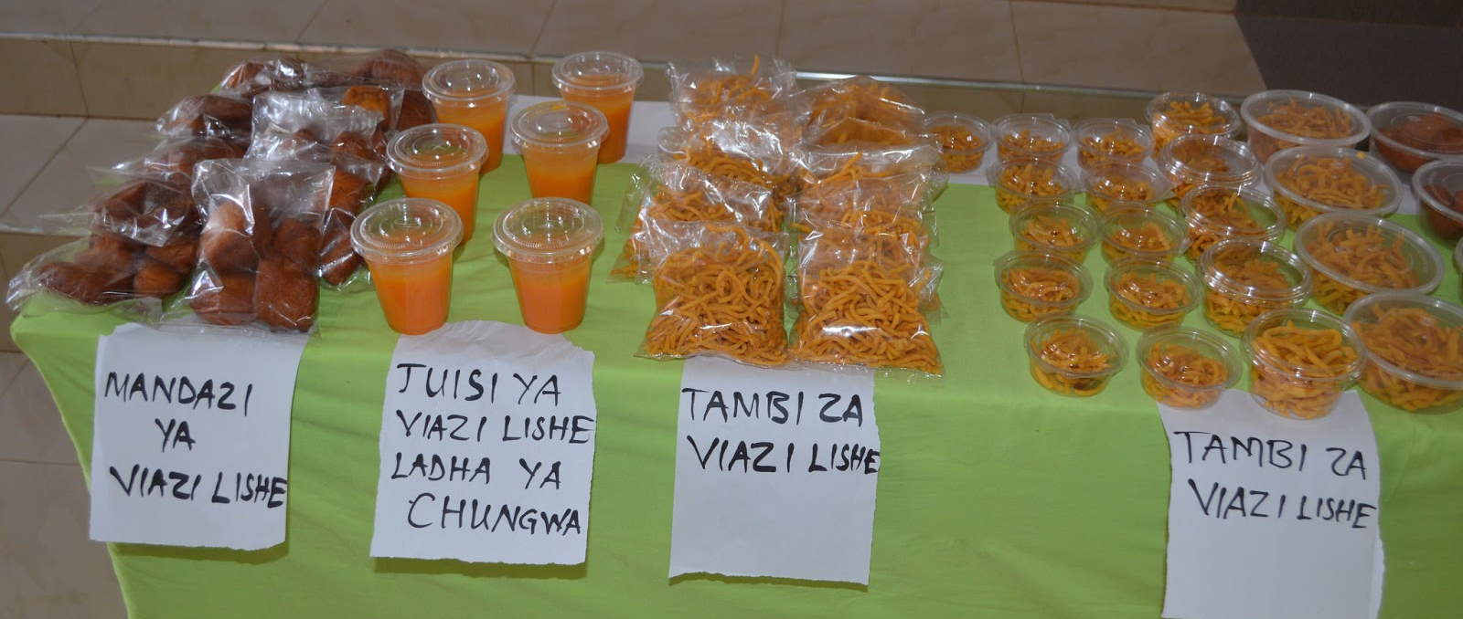
Recipes
See the manual for a multitude of recipes incorporating sweetpotato.

Slide 39
What is the healthiest way to eat sweetpotato?
What is the least healthy way to eat sweetpotato?
Notes:
Answers
Boil and mash
Deep fat fried

Slide 40
Key Points
A small amount of oil in sweetpotato increases beta carotene (Vitamin A) absorption.
Boiled or baked sweetpotato dishes are more nutritious than deep fat-fried sweetpotato foods.
Sweetpotato should be mixed in varying proportions with different flours for the best results in various recipes.

Slide 41
Large-Scale Commercial Processing of Sweetpotato Products
Unit 5

Slide 42
Objectives
By the end of this unit, you should be able to:
List the sweetpotato products that show the most commercial promise in SSA.
Name varieties of processed sweetpotato foods that are popular in different areas around the globe.

Slide 43
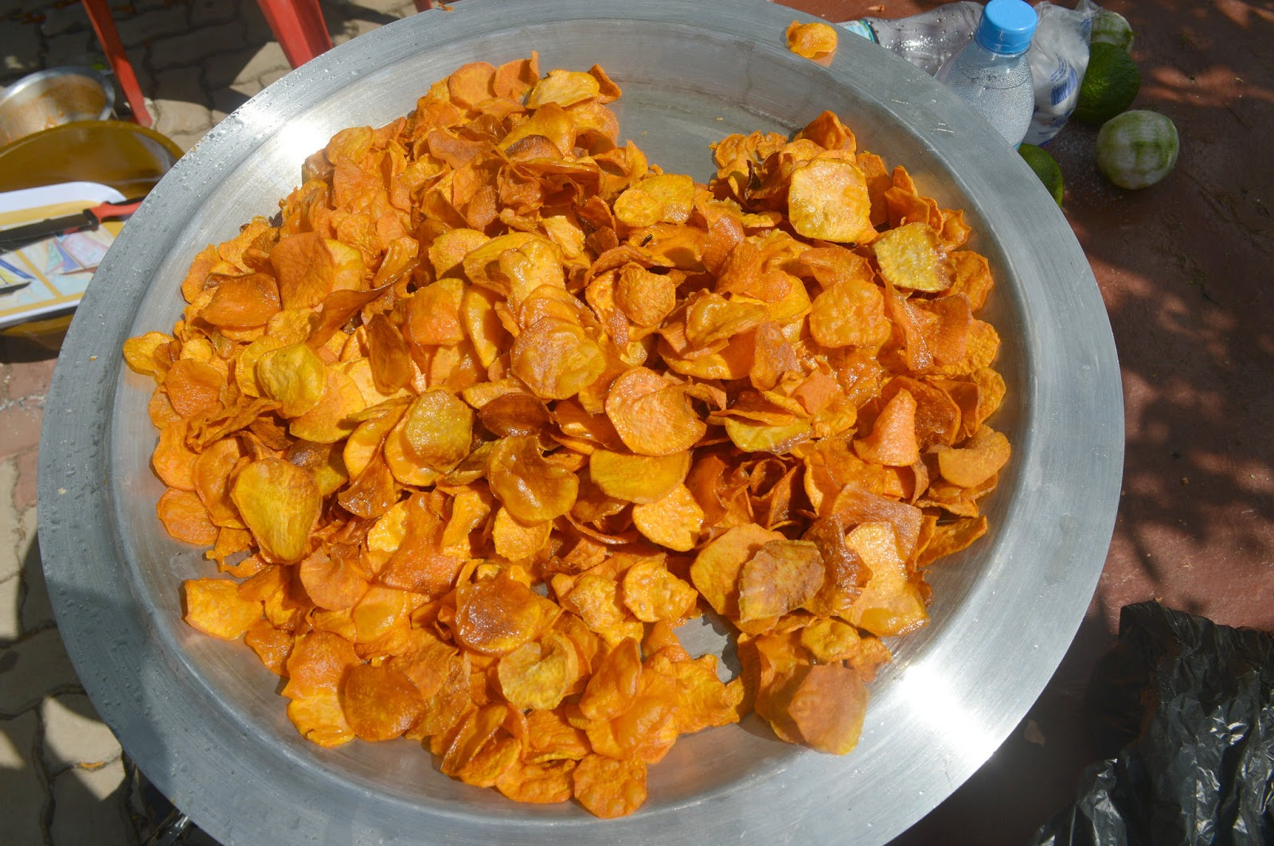
OFSP Products in SSA
OFSP Products with most commercial potential produced in SSA are:
  Fried products: Chips, crisps, chapatis, doughnuts
  Baked products: Breads, biscuits
  Juice

Slide 44
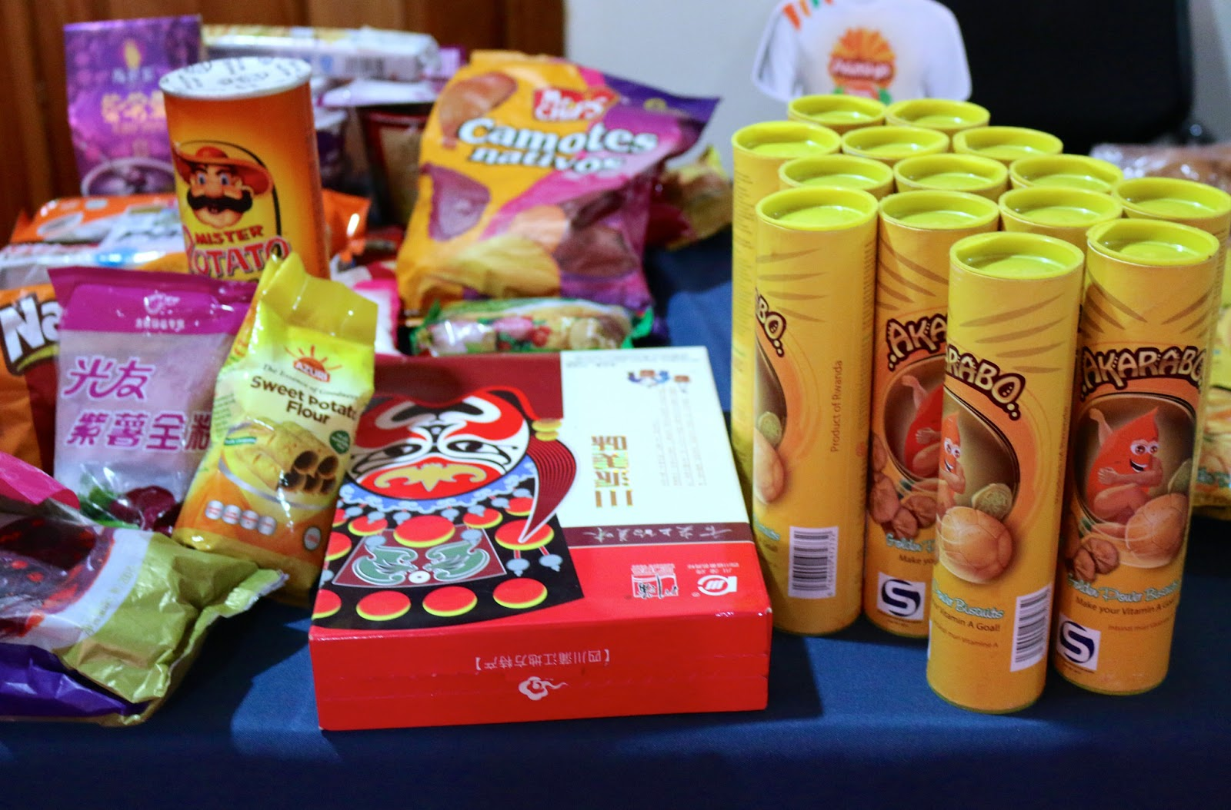
OFSP Production in China
China produces a wide range of commercial sweetpotato products:
  Noodles
  Cornflake cereal
  Dumplings
  Crackers

Slide 45
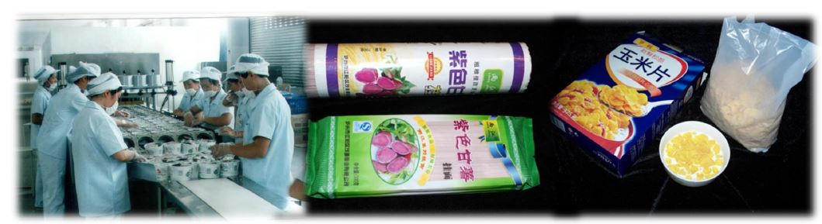
Sweetpotato Production in Other Countries
Rwanda
  Biscuits
  Mandazi
USA
  French fries
    Commercially produced in bulk
  Packaged chips

Slide 46
What are some of the sweetpotato products produced in SSA?
What are some of the sweetpotato products produced in other countries?
Notes:
Answers
Fried products: Chips, crisps, chapatis, doughnuts; Baked products: Breads, biscuits; Juice
China: Noodles, Cornflake cereal, Dumplings, Crackers; Rwanda: Biscuits, Mandazi; USA: French fries, Packaged chips

Slide 47
Key Points
Several promising processed sweetpotato foods now being produced in SSA.
China produces a wide variety of sweetpotato foods and novelties on a large scale.
Sweetpotato French fries are commercially produced in bulk in the USA.

Slide 48
Sweetpotato as Animal Feed
Unit 6

Slide 49
Objectives
By the end of this unit, you should be able to:
Explain the potential for sweetpotato use in animal feed products in Sub-Saharan Africa (SSA).
Describe the best ways to use sweetpotato roots and vines to fulfill livestock nutritional needs.
Explain how to create high-protein silage by fermenting sweetpotato foliage.
List the steps needed to build an improved plastic tube silo.

Slide 50
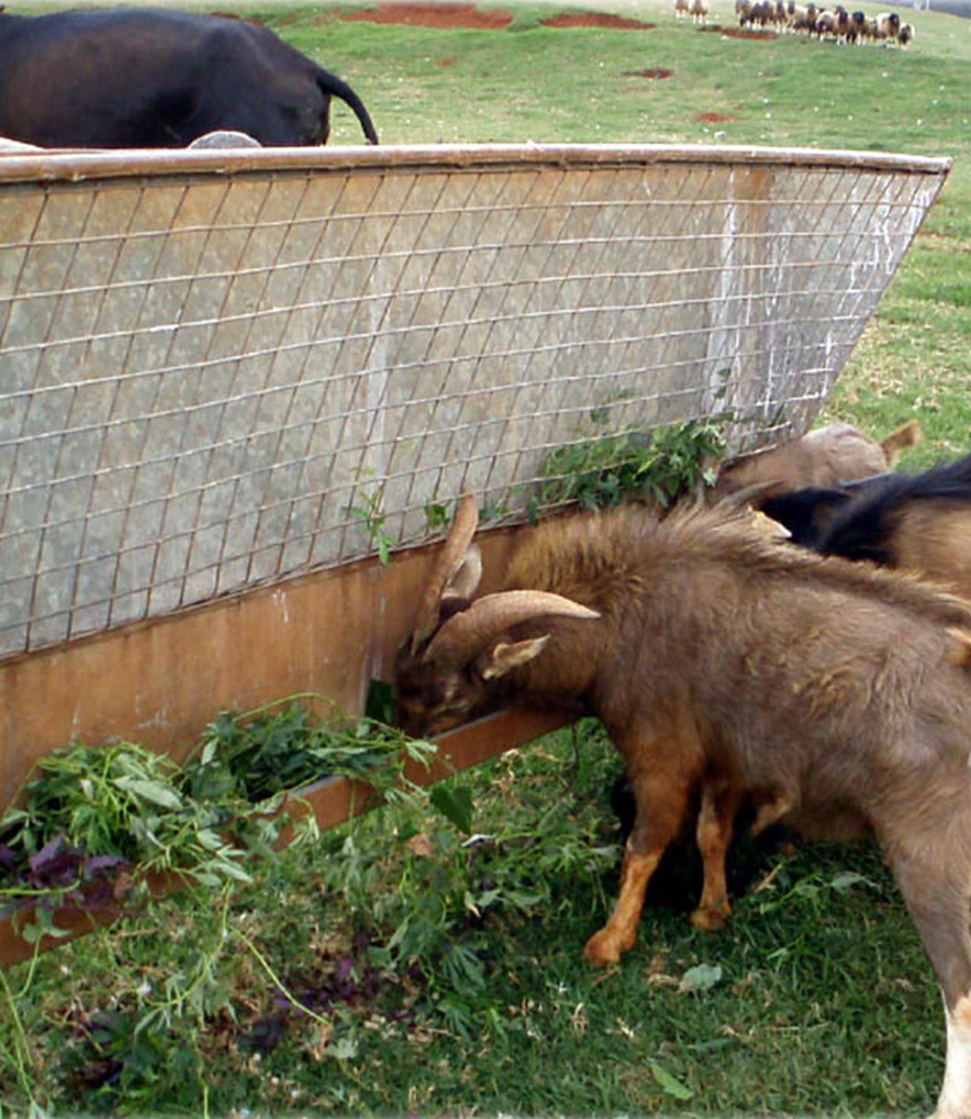
Sweetpotato as Animal Feed
Many parts of the world, sweetpotato already used as animal feed.
In SSA, sweetpotato is reserved for human consumption, which represents an opportunity for feed improvement.

Slide 51
Sweetpotato as Animal Feed Cont.
Roots and vines make nutritious feed for livestock
  Roots usually fed only to pigs
  Also make good feed for other animals, e.g. broiler chickens
  Vine can be cut and dried for hay or simply used as silage due to high water content

Slide 52
Maximising Nutrient Value
Roots should be cooked or dried before feeding.
  This helps with nutrient absorption
  Amino acids can be added to pellet feeds based on sweetpotato root
Vines contain more protein than roots.
Different planting methods are used to emphasise production of sweetpotato foliage for animal feed.

Slide 53
Vine Feed
Vines can be fed:
  Fresh
  Dried
  Fermented
  Made into silage
The most common practice is to feed fresh vines during harvest season.
If the vines are dried and stored as hay or made into silage after harvest the feeding period can be prolonged.
Processing and preserving the vines allows farmers to use them as feed for an extended period.

Slide 54
Vine Fermentation
Made from a mix of:
  Chopped vines
  Rice bran
  Salt
Fermenting usually takes 10 days
Creates high protein feed for cattle and pigs
Low cost process, especially if ensiled with chicken manure
Appropriate containers should be used:
  Provide anaerobic (no oxygen) conditions
  Made of polythene bags and plastic tube silos

Slide 55
Building an Improved Plastic Tube Silo
Step A. Sealing tube and making internal drainage pipe
Step B. Fitting and fixing the drainage pipe
Step C. Making a compacting drum
Step D. Preparing, filling and managing silo
Step E. High quality silage

Slide 56
How could nutrient value of the sweetpotato as animal feed be improved?
What are the different ways vines could be used as animal feed?
Notes:
Answers
Roots should be cooked or dried before feeding; Vines contain more protein than roots; Different planting methods are used to emphasise production of sweetpotato foliage for animal feed
Fresh, Dried, Fermented, Made into silage

Slide 57
Key Points
In many parts of the world, sweetpotato is widely used as animal feed, while in SSA sweetpotato is reserved for human consumption. This represents an opportunity for feed improvement in SSA.
Sweetpotato roots and vines both make nutritious feed for livestock, although roots are usually fed only to pigs, although they also make good feed for other animals such as broiler chickens.
Sweetpotato vine can be cut and dried for hay or used as silage.
Roots should be cooked or dried before feeding to help with nutrient absorption.

Slide 58
Key Points (cont.)
Sweetpotato vines have far more protein than roots, but amino acids can be added to pellet feeds based on sweetpotato root.
Different planting methods are used to emphasize production of sweetpotato foliage for animal feed.
Fermenting vines creates a very high protein feed for cattle and pigs at a low cost, especially if ensiled with chicken manure.
Containers such as polythene bags and plastic tube silos can be constructed to provide anaerobic (no oxygen) conditions for fermenting feed.

Slide 59
Gender and Diversity Aspects of Sweetpotato Processing and Utilisation
Unit 7

Slide 60
Objectives
By the end of this unit, you should be able to:
Discuss gender and diversity issues regarding sweetpotato processing and utilisation.
Explain the link between local culture and food preference.

Slide 61
Gender and Diversity Aspects
Vitamin A consumption and dietary preferences vary by age, gender, workload
Local food culture affects recipe and taste preferences
Practical information needs to get into the right hands:
  Food preparation
    E.g. mothers, women
  Those who control raw materials and influence consumption
    E.g. grandmothers, husbands, wives, traders, community leaders

Slide 62
Key Points
Nutritional requirements vary by age and gender as well as workload.
Some preparations of sweetpotato are more appealing to one group or individual than to another.
Nutritional and processing information needs to be shared with all parties in a community, whatever their level or type of involvement in processing and food preparation.

Slide 63
Substituting Sweetpotato for Wheat Flour in Chapati
In your small groups, using the equipment and ingredients provided, prepare chapatis.
Your facilitator will provide a substitution chart.
You have 2 hours 5 minutes.

Slide 64
Making Sweetpotato Juice
In your small groups, using the equipment and ingredients provided, prepare sweetpotato juice.
You have 45 minutes

Slide 65
Making sweetpotato Fiossis
In your small groups, using the equipment and ingredients provided, prepare sweetpotato fiossis.
You have 45 minutes.

