Slide 1
Important!
This module is designed to potentially serve a wide variety of audiences (nutritionists and agronomists, policymakers, extension workers, farmers).
Not all of the material will be relevant to all audiences.
Please refer to the accompanying Facilitator’s Guide for guidance on how to adapt these materials to your audience and facilitation best practices.

Slide 2




Legend
Icon | Description
 | Expected Duration, minutes
 | Quick Review/Survey Questions
 | Brainstorming Session
 | Discussion Session
 | Group Activity
 | Animated Slide
 | End of Animation
Xm

Slide 3
Legal
Unless otherwise noted, all images copyrighted to International Potato Centre.
Attribution-NonCommercial-ShareAlike 2.0 Generic (CC BY-NC-SA 2.0).

Slide 4
Everything You Ever Wanted to Know About Sweetpotato
Topic 10: Marketing and Entrepreneurship

Slide 5
Introduction
Marketing and Entrepreneurship

Slide 6
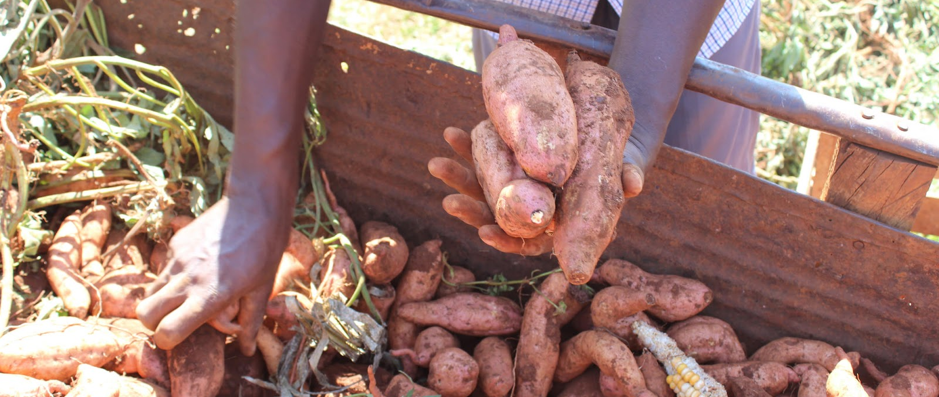
Welcome
During this session, we will examine the concepts of marketing, market orientation, entrepreneurship, and the 5 pillars of marketing (product, price, place, promotion and people), in relation to fresh sweetpotato roots and sweetpotato products.

Slide 7
Marketing of Fresh Sweetpotato Roots in Sub-Saharan Africa
Unit 1

Slide 8
Objectives
By the end of this unit, you should be able to:
Describe sweetpotato supply chains, both locally and internationally, and explain why they are usually short.
Identify the players in the sweetpotato supply chain.
List the characteristics urban consumers in SSA use when choosing sweetpotato.
Explain why consumers fear damaged produce.
Describe unfilled market openings for sweetpotato chips or flour, or for roots kept fresh with economical storage technologies.
Explain barriers to trade and conditions that cause rough handling and product damage.

Slide 9
Supply Chain for Sweetpotato
The Supply chain for sweetpotato is typically short, internationally and in SSA. This is due to:
  Bulkiness of crop
  Short shelf life
  Low value/profitability
Some supply chain variations are:
  Farmers -> traders -> consumers
  Farmers -> consumers
  Traders -> consumers
  Farmer -> agents -> trader -> consumer
    Agents in the field locate sweetpotato and bulk it in convenient location

Slide 10
Marketing of Fresh Sweetpotato Roots in SSA
Urban areas in Southern and Eastern Africa source sweetpotato from different regions for fairly steady supply throughout the year.
Quality and market price vary greatly from harvest season to off-season.
Small farmers may take produce to sell to market traders.
Traders and larger-scale agents may also travel to find produce for sale in urban markets.
In non-Muslim areas, most sourcing done by men, while consumer interaction is typically handled by women.

Slide 11
Preferred Consumer Characteristics
Rural
Urban
Large root size
  Most important
Colour
Taste
Texture
Fibre content
Price
Shape
Freshness
Skin colour
Area or region grown
Damage
Bad taste
  Dirty water could have entered root
Medium size

Slide 12
Unfilled Market Opening
Poor understanding of sweetpotato processing into chips or flour.
Farmers unaware or inexperienced in use of fresh root pit stores.
Lack of technology
Need for immediate food results in little commercial processing.
Increase yearlong availability by:
  Mass processing into chips or flour
  Improved use of pits to keep roots fresh

Slide 13
Barriers to Trade
High costs due to:
  Bulkiness
  Perishability
  Discontinuous and geographically fragmented supply
Transport costs
Taxation
Sweetpotato stuffed in large extended bags
  Difficult to carry
  Causes bruising and damage, which lowers quality and shortens shelf-life
Reliance on traders and neighbours to check market prices
Little sweetpotato exported internationally from SSA

Slide 14
Involving Traders to Build Market and Value Chain
Traders should be trained in OFSP nutrition.
  Create willingness to buy
  Help grow market
Building the value chain to facilitate initial link between consumers and farmers.
Improve handling to increase OFSP value
Involving traders can lead to growth in commercialization of OFSP.

Slide 15
What characteristics of sweetpotato are preferred by rural consumers?
What are some of the barriers to trade?
Notes:
Answers
Large root size; Colour; Taste; Texture; Fibre content; Price; Shape; Freshness
High costs due to Bulkiness, Perishability, Discontinuous and geographically fragmented supply; Transport costs; Taxation; Sweetpotato stuffed in large extended bags makes them Difficult to carry and Causes bruising and damage, which lowers quality and shortens shelf-life; Reliance on traders and neighbours to check market prices

Slide 16
Key Points
Urban areas in Southern and Eastern Africa are able to source sweetpotato from different regions for a fairly steady supply throughout the year. However, quality and market price vary greatly from harvest season to off-season.
Small farmers may take their produce to sell to market traders, but traders and larger-scale agents may also travel to find produce for sale in urban markets.
In non-Muslim areas, most sourcing is done by men while consumer interaction is handled by women.
Consumers prefer medium sized undamaged roots.
Increased mass processing of sweetpotato into chips or flour, or improved use of pits to keep roots fresh, could increase yearlong availability.

Slide 17
Key Points
Barriers along the value chain—such as high transit costs and the expense of transportation—foster poor handling habits, which damage produce; the use of technology to check market prices is in its early stages, and little sweetpotato is exported internationally from SSA.
Traders can help grow the market and build the value chain.

Slide 18
Marketing and Market Orientation
Unit 2

Slide 19
Objectives
By the end of this unit, you should be able to:
Explain the people-related concepts behind marketing and give a few standard definitions.
Define social marketing.
Compare the mindset of businesses with a sales orientation to those with a marketing orientation.
List the five key tasks of managing a market oriented business. Describe the five pillars of the marketing mix.

Slide 20
Marketing Essentials
Meeting the needs and wants of customers
Finding ways provide products or services customers demand.
Business-wide function
Many definitions
  Set of human activities directed at facilitating and accomplishing exchanges
  Management process that identifies, anticipates, and supplies customer requirement efficiently and profitably

Slide 21
Marketing Essentials (cont.)
Social marketing aims to be competitive and improve people’s well-being.
Market analysis helps businesses focus on the right customers and opportunities for their product.
For continued success, a business needs to:
  Stay on top of technology
  Acknowledge market shifts
  Continually work toward meeting people’s changing needs and wants

Slide 22
Contrasting Aspects of Orientation
Sales
Marketing
Chooses a product first
Then tries to sell it
Starting point: Factory/ product
Focus on existing products
Means: Sales and promotion
Goal: Profits based on volume
Bases operations around market desires
Starting point: Client
Focus: Integrated satisfaction
Means: Profits based on needs
Goal: Reaching client

Slide 23
Managing A Market-Oriented Business
Key Tasks
Market research: Collecting information to help businesses understand the dynamics of their chosen markets.
Product development: Meeting needs and attracting target customers.
Marketing mix (5 Pillars): Product, Price, Promotion, Place, People
Market monitoring: Obtaining customer feedback regularly and recognize rapidly changing competitive environment.

Slide 24
What are the key tasks of a market-oriented business?
What are the 5 pillars of the Marketing Mix?
Notes:
Answers
Market research, product development, marketing mix, market monitoring
Produce, price, promotion, place, people

Slide 25
Key Points
Organisations succeed by meeting people’s needs.
A market-oriented business carefully researches people’s drives and desires.
Social marketing aims to both be competitive and to improve people’s well-being.
A sales-oriented organisation chooses a product first and then tries to sell it. A market-oriented organisation bases its operations around the desires of the market.
Market analysis helps businesses focus on the right customers and opportunities for their product. Market research helps businesses understand the dynamics of their chosen markets.
To ensure continued success, a business needs to stay on top of technology and market shifts and continually work toward meeting people’s needs and wants.

Slide 26
Entrepreneurship
Unit 3

Slide 27
Objectives
By the end of this unit, you should be able to:
Define entrepreneurship.
Name the key traits of successful entrepreneurs.
Explain the key behaviors behind successful entrepreneurship.
Describe the role entrepreneurs play in the economy.

Slide 28
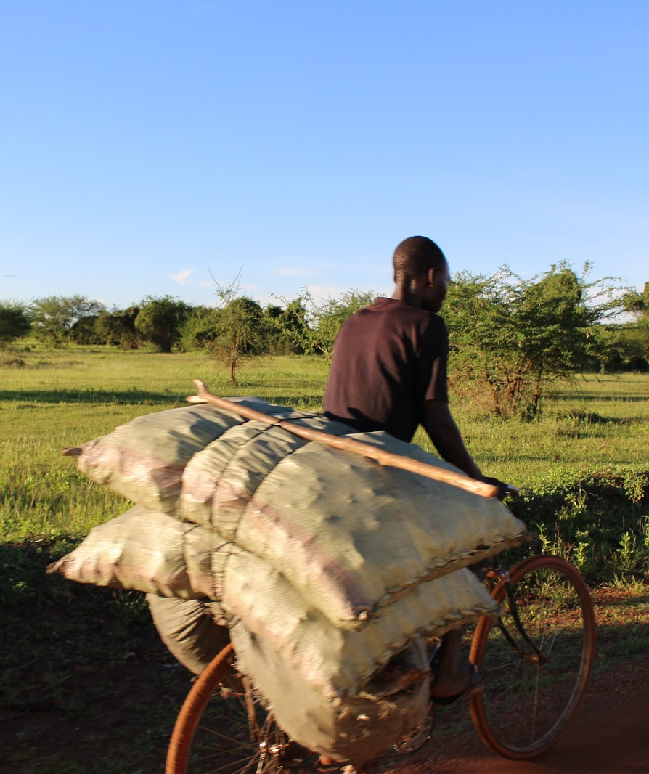
Entrepreneurship
A key engine of economic growth
Process of creating something new with value by:
  Devoting time and effort
  Assuming accompanying risks
  Receiving resulting rewards
Comes with challenges and risks

Slide 29
Traits of successful Entrepreneurs
Motivation: Create drive necessary to get business off the ground and running.
Discipline: You will have to do tasks you may not like
Decision-making:
  Carefully weigh options
  Understand the context, objectives, alternatives, criteria
Resourcefulness:
  Limited funds
  Stepping out of comfort zone
  Enlist family and friends
Building trust: Customers pay more or accept lower quality if they trust you.

Slide 30
Traits of successful Entrepreneurs (cont.)
Ability to adapt:
  Positive attitude and willingness to roll with punches
  Faced with problem, look for solution not place blame
Persuasiveness
  Influence other’s buying decisions
  Easier if you believe it

Slide 31
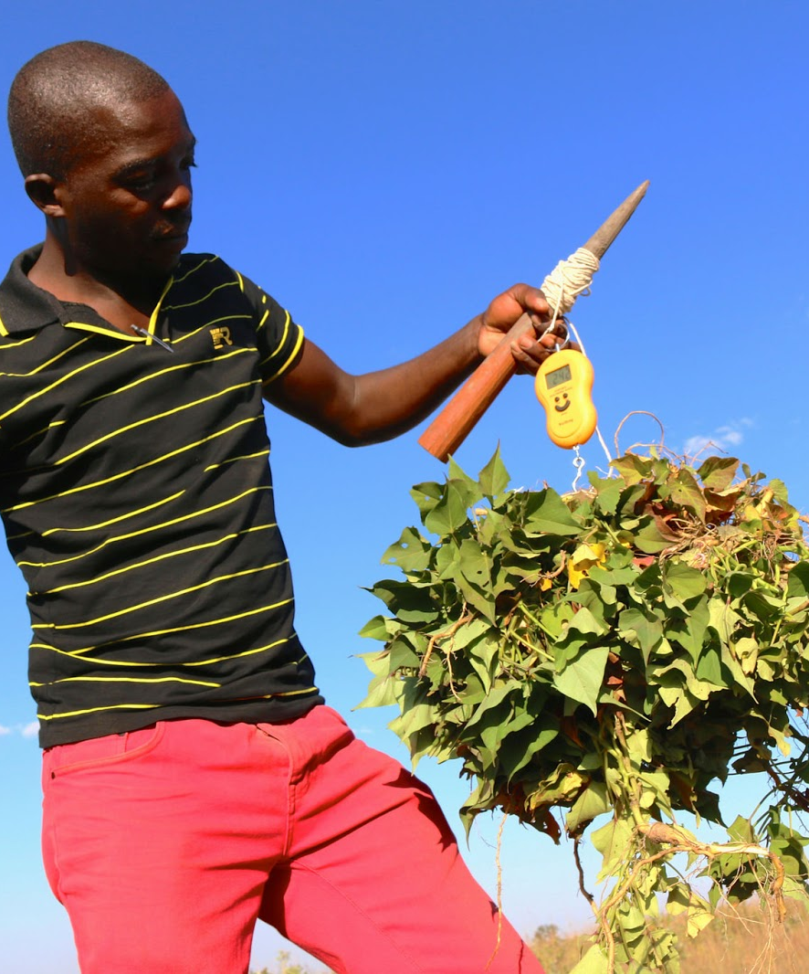
How to Be an Entrepreneur
Do what you love
Know what you want
Be radical
Follow the rules
Manage your time well
Take care of yourself
Find a mentor
Encourage teamwork

Slide 32
Role Entrepreneurs Play in Economy
Major mechanism of economic growth
Factors that contribute to environment enabling or disabling entrepreneurship:
  Culture
  Education
  Societal history
  Finance availability
  Location
  Government policies
  Institutions: NGOs, labour market, etc.

Slide 33
What are some of the traits of successful entrepreneurs?
What are some of the factors that contribute to enabling or hindering entrepreneurship?
Notes:
Answers
Motivation, discipline, decision-making, resourcefulness, building trust, ability to adapt, persuasiveness
Culture; Education; Societal history; Finance availability; Location; Government policies; Institutions: NGOs, labour market, etc.

Slide 34
Key Points
An entrepreneur devotes his or her time, investment, risks, and effort toward creating something valuable and new for consumers.
A good entrepreneur is self-motivated, prepared for unpleasant tasks, hungry (driven), able to make good decisions, resourceful, personable, adaptable, and persuasive.
To be a successful entrepreneur, you should do what you love, be radical but follow the rules, manage your time well, use the Internet, take care of yourself, find a mentor, and use teamwork.
Entrepreneurship is rewarding but risky, and can turn out very badly. However, it is a key engine of economic growth.

Slide 35
Understanding the Five Pillars (5P’s) of Marketing: Product, Price, Place, Promotion, People
Unit 4

Slide 36
Objectives
By the end of this unit, you should be able to:
Understand the five pillars of marketing (5P’s).

Slide 37
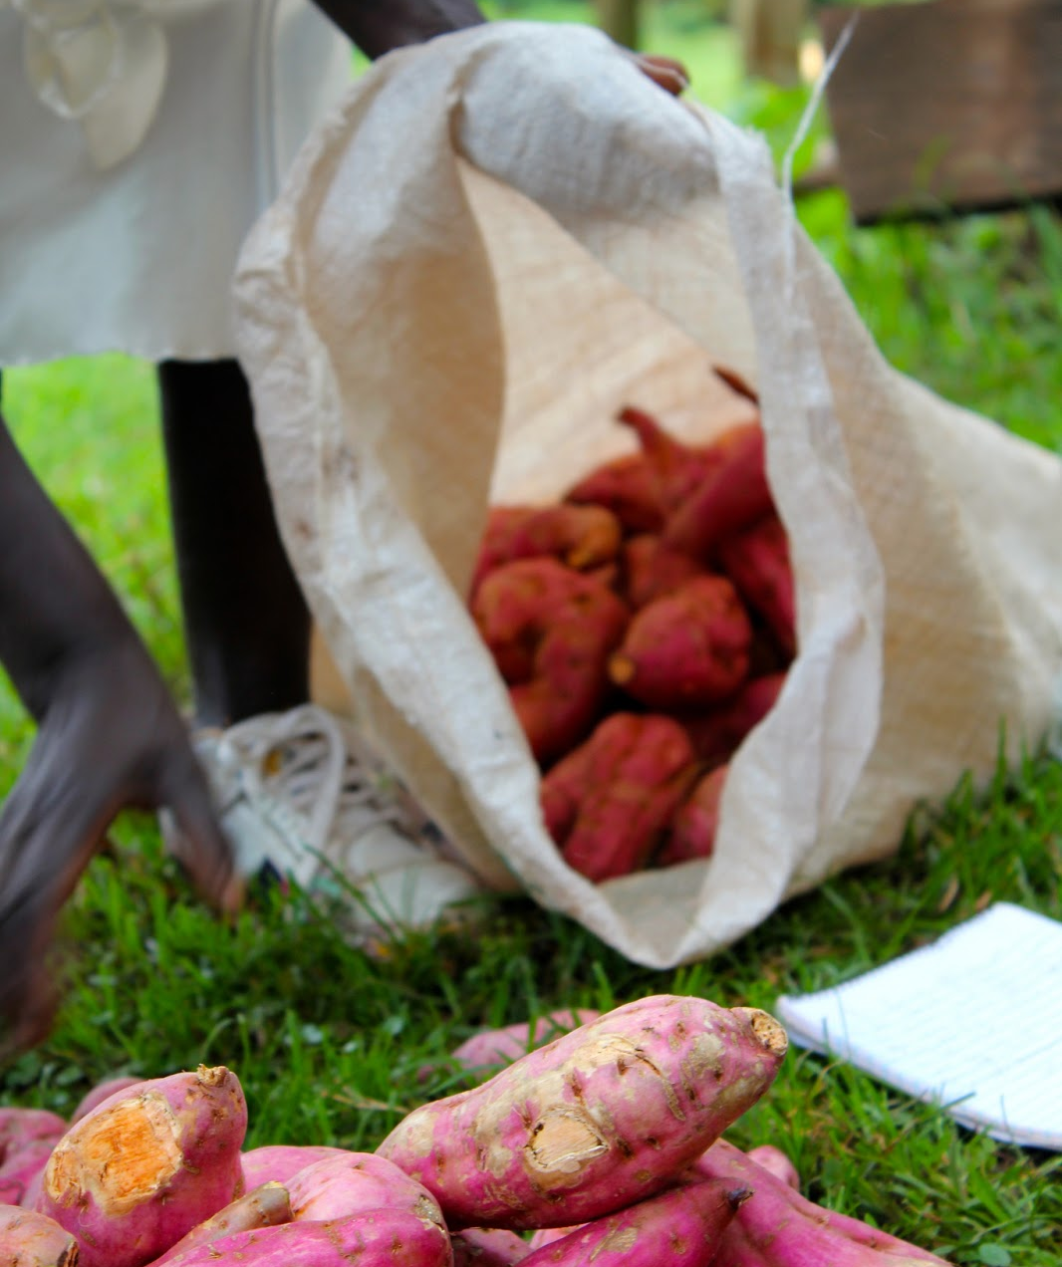
Product
What to sell?
  Tangible, e.g. sweetpotato root, packet of flour
  Intangible service, e.g. agricultural extension advice, nutrition information
  Mix of the two
Product selection is based on meeting customers’ needs and demand.

Slide 38
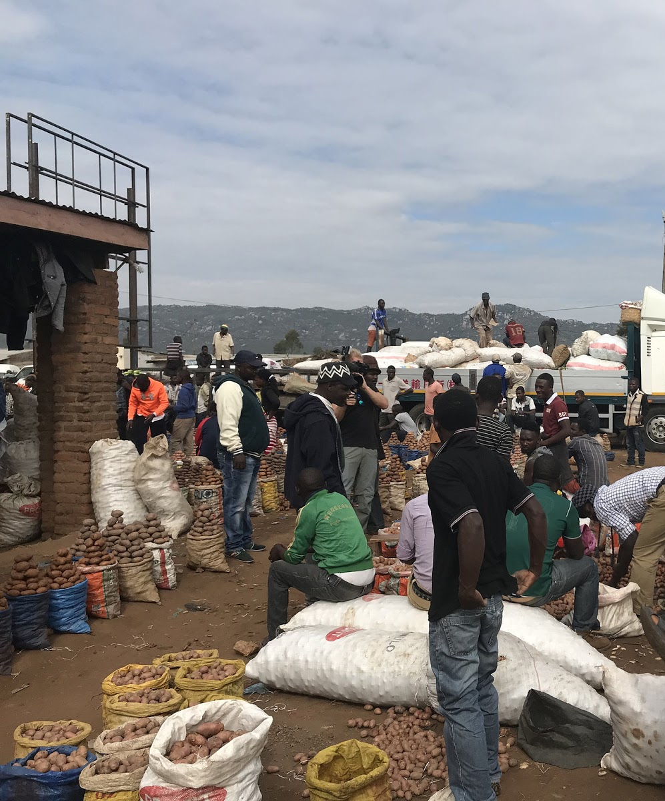
Price
High enough for profit, not too high to struggle with selling.
Adjust based on:
  Production and marketing cost
  Profit margin over cost
  Prices of competing products
Understand seasonal supply and demand.

Slide 39
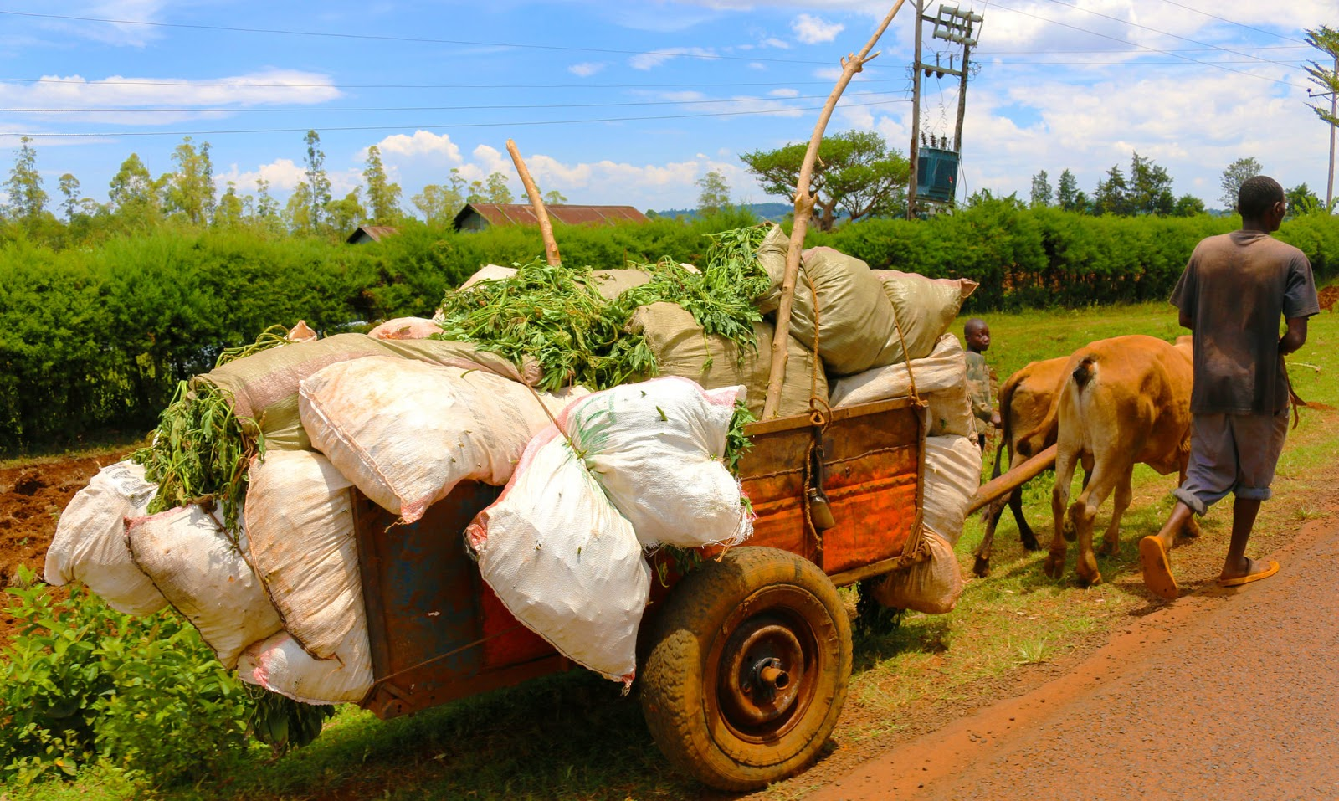
Place
Knowing where to sell is critical
  E.g. physical location, such as urban market, local market, home, farm
Consider transport costs, methods, duration.
Decide whether to work with farmer groups or form farmers’ association to sell bulk.

Slide 40
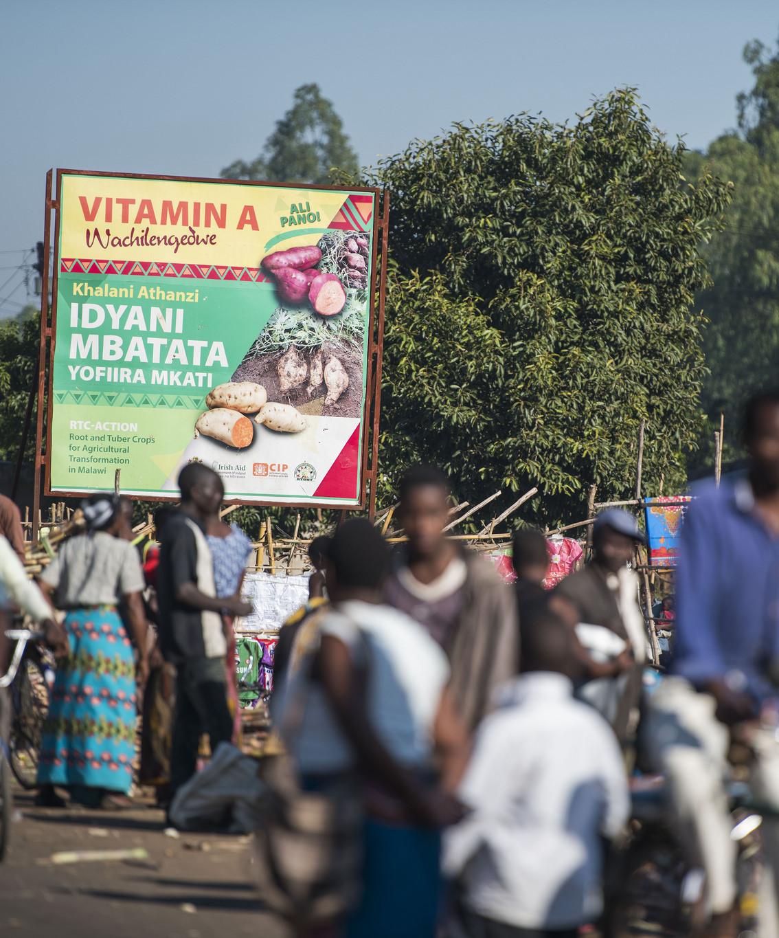
Promotion
Know how to draw attention to product.
Well thought-out promotional activities need not be costly.
Advertising/ promotion placement is important
  Reach target audience at the right time and place
Examples
  Giving out OFSP samples
  Nutritional info pamphlet

Slide 41
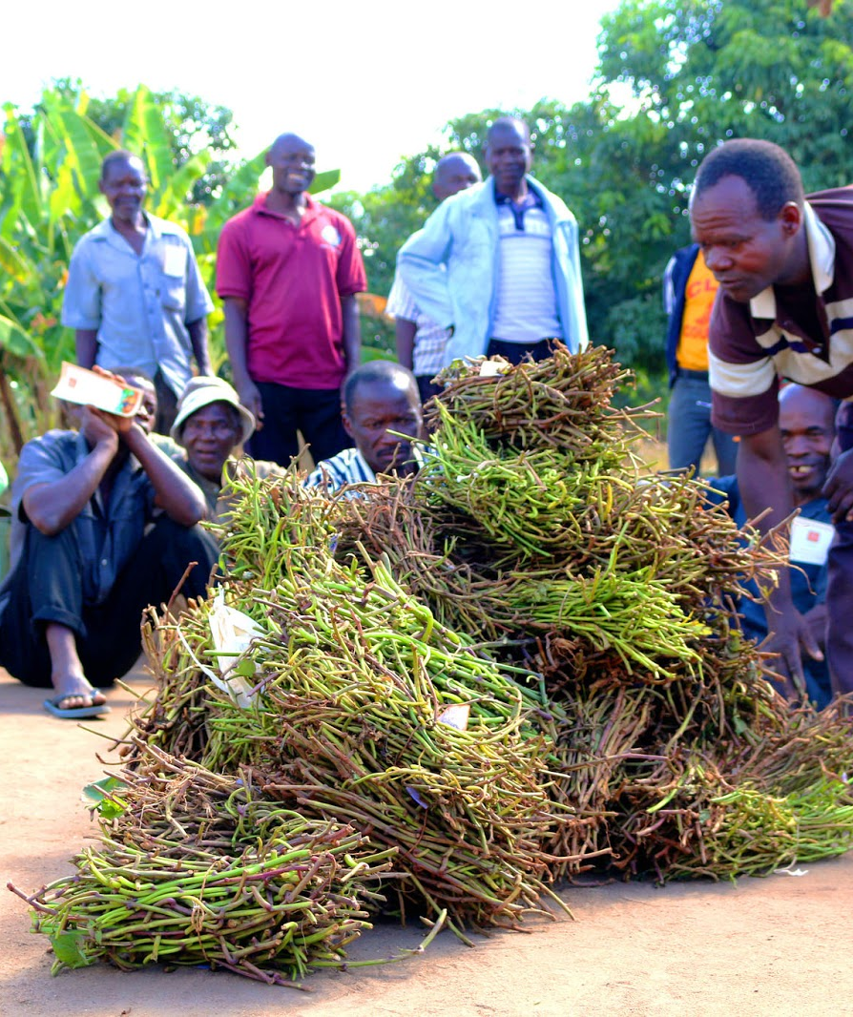
People
Involve the right people in your organization to make it smooth running and successful.
Understand your customers.
Market value chain: Farmers, extensionists, brokers, retailers, wholesalers, processors, consumers

Slide 42
What are the types of products that could be sold to the market?
Who are the people involved in the market chain?
Notes:
Answers
Tangible, intangible (services), mix of the two
Farmers, extensionists, brokers, retailers, wholesalers, processors, consumers

Slide 43
Key Points
Product: The first of the five marketing pillars is product. Every business must choose the right product to sell for their market.
Price: Businesses must choose a price that is high enough to make a profit, but not so high that they struggle to move items.
Place: Knowing where to go to get products to consumers is also critical.
Promotion: Businesses must know how to draw attention to their product. Promotional activities need not be costly; a well thought out promotion can be very cost effective.
People: Often forgotten, the final P involves getting the right people involved in your organization to make it smooth running, pleasant, and successful. From a marketing perspective, the People who are consumers are also important to keep in mind.

Slide 44
Exploring Your Sweetpotato Market Value Chain
Unit 5

Slide 45
Objectives
By the end of this unit, you should be able to:
Name the participants in the sweetpotato field-to-table value chain and describe their roles.
Describe the proper role for a sweetpotato project facilitator in the value chain.
Define market linkage.
Name the main areas where key opportunities to improve the market value chain are usually found.
Explain the Participatory Market Chain Approach (PMCA).

Slide 46
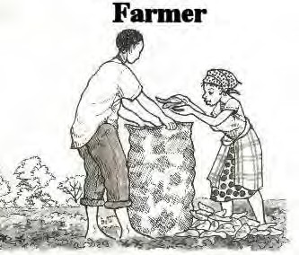
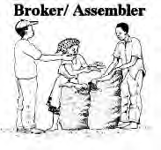
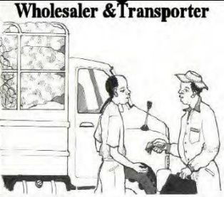
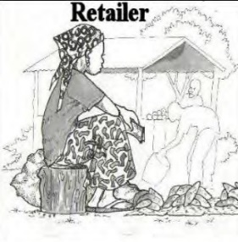
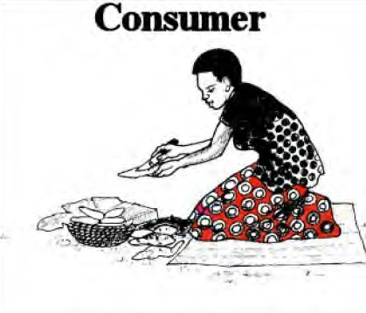
Produces sweetpotato roots (and vines)
Sells to different value chain actors depending on location
Contacts the wholesalers to buy sweetpotato from the area
Distributes empty sacks to farmers and pays harvesters, packers and transporters from farms to trading centres or main roads
Assembles sacks from different farms and areas
Makes payments to farmers
Brings the money for buying sweetpotato
Searches for sweetpotato in districts
Hires truck and organises transportation to town
Distributes sweetpotato to retailers in different markets
Pays market fees for off-loaded sweetpotato Transporter
Brings/ owns trucks or bicycle, usually works with wholesaler or broker
Unpacks the sacks into heaps
Takes sweetpotato close to consumers in different locations like small kiosks in trading centres
Buys sweetpotato for home consumption, or sales as chips

Slide 47
Roles of Different Actors in Value Chain
Farmer
  Produces sweetpotato roots and vines
  Sells to different actors depending on location
Broker/Assembler
  Contacts wholesalers to buy sweetpotato from area
  Distributes empty sacks to farmers
  Pays harvesters, packers, transporters from farms to trading centres or main roads
  Assembles sacks from different farms, areas
  Makes payments to farmers

Slide 48
Roles of Different Actors in Value Chain (cont.)
Wholesaler and transporter
  Brings money for buying sweetpotato
  Searches districts for product
  Hires truck and organizes transportation to town
  Distributes sweetpotato
  Brings/owns truck or bicycle
Retailer
  Unpacks sacks into heaps
  Takes sweetpotato closer to consumers, small kiosks in trading centres
Consumer
  Buys sweetpotato for home consumption or sales as chips

Slide 49
Additional Actors
Other actors may include:
  Agribusiness service providers, e.g. equipment suppliers, banks
  Traders
    Retailers - buy in small volumes
    Wholesalers - buy large volumes
    Brokers - play a linking/negotiating role in return for fee or commission
  Processors/ millers
Relationships in supply chain range in formality, from agreements to alliances to contracts.

Slide 50
Linking in the Value Chain
Market linkage – process of bringing together different actors to improve business.
Scale is not homogenous at any link in the sweetpotato value chain
  Like farmers, some traders are large with a complex organization
  Others are small and work for themselves
Projects aimed at building sweetpotato market value chain need to link and empower the actors rather than inserting themselves into a bulking or selling role.

Slide 51
Key Opportunities to Improve Market Value Chain
Improving production processes
Enhancing postharvest practices, including caring for, storing, and transporting fresh roots and processed sweetpotato.
Coming up with marketing ideas, such as nutritional messaging, pricing and logistics.
Interacting with agribusiness service providers, such as credit providers and advertising firms.

Slide 52
Participatory Market Chain Approach (PMCA)
Three-phase process:
  Phase 1: Get to know different actors
  Phase 2: Analyse potential joint business opportunities
  Phase 3: Implement joint market innovations
    New or improved products
    Technology
PMCA brings different market chain actors, links, together to build trust and improve the product.

Slide 53
Who are the different actors of the market value chain?
What are the three phases of the participatory market chain approach?
Notes:
Answers:
Farmer, broker/assembler, wholesaler, transporter, retailer, consumer, agribusiness service provider, traders, processors/millers
1) Get to know different actors; 2) Analyse potential joint business opportunities 3) Implement join market innovations

Slide 54
Key Points
Typically the sweetpotato value chain begins with the farmer or producer, who sells to a broker/assembler, who sources sweetpotato in the region from farmers’ collection points or roadside points; then the product is passed to wholesalers and transporters, who move the produce to markets, where they finally pass through retailers to the consumer.
“Traders” refers to retailers, brokers, and wholesalers.
Other actors include agribusiness service providers (equipment suppliers, banks), traders, and processors/ millers.
Scale is not homogenous at any link in the sweetpotato value chain: like farmers, some traders are large with a complex organisation, while others are small and work for themselves.

Slide 55
Key Points
Projects aimed at building the sweetpotato market value chain need to help link and empower the actors rather than inserting themselves into a bulking or selling role.
When analysing a sweetpotato market value chain, several specific areas tend to offer good opportunities for market building. These include: production; postharvest practices such caring for, storing, and transporting fresh roots and processed sweetpotato; marketing ideas such as nutritional messaging, and pricing and logistics; and interaction with agribusiness service providers, such as credit providers and advertising firms.
Relationships in the supply chain range in formality from agreements to alliances to contracts.
The Participatory Market Chain Approach (PMCA) is a three-phase process for creating trust and connections between different links in the market value chain.

Slide 56
Why Work as a Group to Market Your Sweetpotato?
Unit 6

Slide 57
Objectives
By the end of this unit, you should be able to:
List the advantages of cooperative sweetpotato marketing.
Explain the problems associated with long-term contracts between farmers and institutions, and suggest ways to improve loyalty.

Slide 58
Advantages to Working As A Group
(5 P’s of Marketing)
Supply larger volumes (product)
Supply sweetpotato consistently (promotion)
Gain a better bargaining position (price)
Build good relationship with traders (people)
Improve the quality of products (product)
Take advantage of extension services (place)
  Typically work only with groups so that they can reach more clients per extension agent.

Slide 59
Problems with Long-term Contracts
Procedures like supplier registration and payment can be extremely slow.
Facilitating contracts between buyers and farmers can be difficult to enforce in Sub-Saharan Africa. To avoid side-selling:
  Buyers need to be willing to pay slightly higher than local market price, if they want farmers to honour contract over time.
  Buyers can also offer additional services to farmers like loans on anticipated sweetotato yield.

Slide 60
What are some of the advantages of working as a cooperative?
What are some of the issues with long-term contracts?
Notes:
Answers
Supply a larger volume (product); Supply sweetpotato consistently (promotion); Gain a better bargaining position (price); Build good relationship with traders (people); Improve the quality of products (product); Take advantage of extension services (place)
Procedures like supplier registration and payment can be extremely slow; Facilitating contracts between buyers and farmers can be difficult to enforce in Sub-Saharan Africa, side-selling can emerge.

Slide 61
Key Points
Working with other farmers to market sweetpotato can help farmers open up sales outlets, as they are able offer large volumes and a steady supply to traders. Cooperation also opens doors to extension services.
Cooperative marketing improves farmers’ bargaining position, relationships with traders, and incentives to provide quality sweetpotatoes.

Slide 62
Can You Make A Profit from Selling Fresh Sweetpotato Roots?
Unit 7

Slide 63
Objectives
By the end of this unit, you should be able to:
List the expenses a farmer must record to calculate whether selling fresh sweetpotato roots can become profitable.
Tell how to calculate farmer profit at a particular selling price.

Slide 64
Training Farmers
Promote record keeping:
  Cost of inputs (purchased vines, chemicals, sacks, etc.)
  Transport costs
  Marketing costs
  How much harvested in kgs
    Amount to sell
    Amount to keep
  How much sold kgs, when, where/to whom, price
  Amount of sweetpotato lost (kgs or number of roots)
  Gross revenue: Total amount harvested (kg) minus total lost (kg) x average sale price
  Add all costs and calculate net return to family labour: Total revenue minus total cost

Slide 65
Farmers Calculate Production Cost (cont.)
Farmers need to calculate production costs to negotiate a profitable price.
Encourage families to produce enough to eat, plus surplus to sell.
Encourage farmers to note any problems during a season.

Slide 66
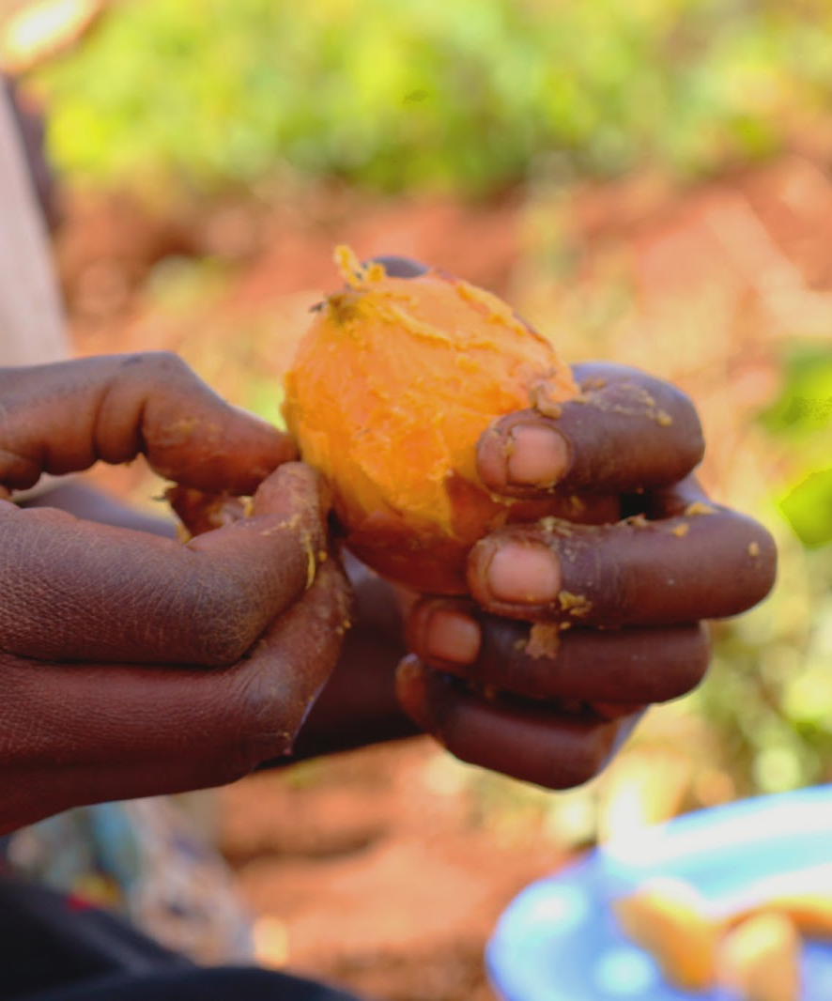
Mozambique Case Study
Found that OFSP generally commanded 15% higher price from consumer than white sweetpotato.
OFSP sold faster than white or yellow sweetpotato.

Slide 67
What are the key areas to cover when training farmers?
What are the key records that farmers are encouraged to keep?
Notes:
Answers
Keeping records, calculating production costs, producing enough to each and sell the surplus, noting problems during a season
Cost of inputs, Transport costs, Marketing costs; How much harvested in kgs; How much sold; Amount of sweetpotato lost; Gross revenue; net return to family labour: Total revenue minus total cost

Slide 68
Key Points
Farmers need to calculate production costs to negotiate a profitable price.
All expenses and crop losses must be calculated against the available selling price to find the return on the family’s labor. Subtract all costs from gross revenue.
A study in Mozambique found that range-fleshed sweetpotato (OFSP) generally commands a 15% higher price from the consumer than white or yellow sweetpotato, but this is not always passed on to the farmer.
Market training should encourage families to produce enough to eat plus a surplus to sell.

Slide 69
When Does It Make Sense to Develop A Processed Product?
Unit 8

Slide 70
Objectives
By the end of this unit, you should be able to:
Describe the processed sweetpotato market in Sub-Saharan Africa (SSA).
List the factors that limit development of processing.
Relate the findings of market studies on sweetpotato products.
Explain the conditions and actions that can make a processed sweetpotato product a profitable venture.

Slide 71
Issues with Processed Products
Currently, there are few processed sweetpotato products marketed in SSA (e.g. chips and flour).
Issues include:
  Unreliability of supply
  Poor quality of product (usually due to poor drying techniques, which remove a lot of beta carotene)
  High labour inputs for washing, peeling and chipping
  Low price compared to fresh roots
  Lack of technology
  Organizational constraints

Slide 72
Market Study Findings
Sweetpotato flour is more expensive than wheat flour.
  Studies show consumers in SSA prefer baked goods made with some sweetpotato flour or puree
  Sweetpotato goods are more nutritious
Finding a target consumer and tailoring products, prices, and packaging to them increases profit chances.
Potential profit-makers are snacks, crackers, cereals, and juice.

Slide 73
What are some of the issues with offering processed products?
What processed sweetpotato products are currently available in SSA?
What are the potential profit-makers in processed sweetpotato products?
Notes:
Answers
Unreliability of supply; Poor quality of product; High labour inputs for washing, peeling and chipping; Low price compared to fresh roots; Lack of technology; Organizational constraints
Chips and flour
Snacks, crackers, cereals and juice

Slide 74
Key Points
Supply, quality, price, technical, and organizational concerns limit the production of processed sweetpotato.
Many processing techniques destroy much of the beta-carotene in sweetpotato; chips fetch a lower price than fresh sweetpotato, and storage losses can harm profitability.
Finding a target consumer and tailoring products, prices, and packaging to them increases the chances for profit.
Sweetpotato flour is more expensive than wheat flour, but studies show that consumers in SSA prefer baked goods made with some sweetpotato flour or puree, and sweetpotato goods are more nutritious.
Snacks, crackers, cereals, and juice are all potential profit-makers.

Slide 75
Gender and Diversity Aspects of Sweetpotato Marketing and Entrepreneurship
Unit 9

Slide 76
Objectives
By the end of this unit, you should be able to:
Describe the gender and diversity issues around sweetpotato marketing and entrepreneurship.

Slide 77
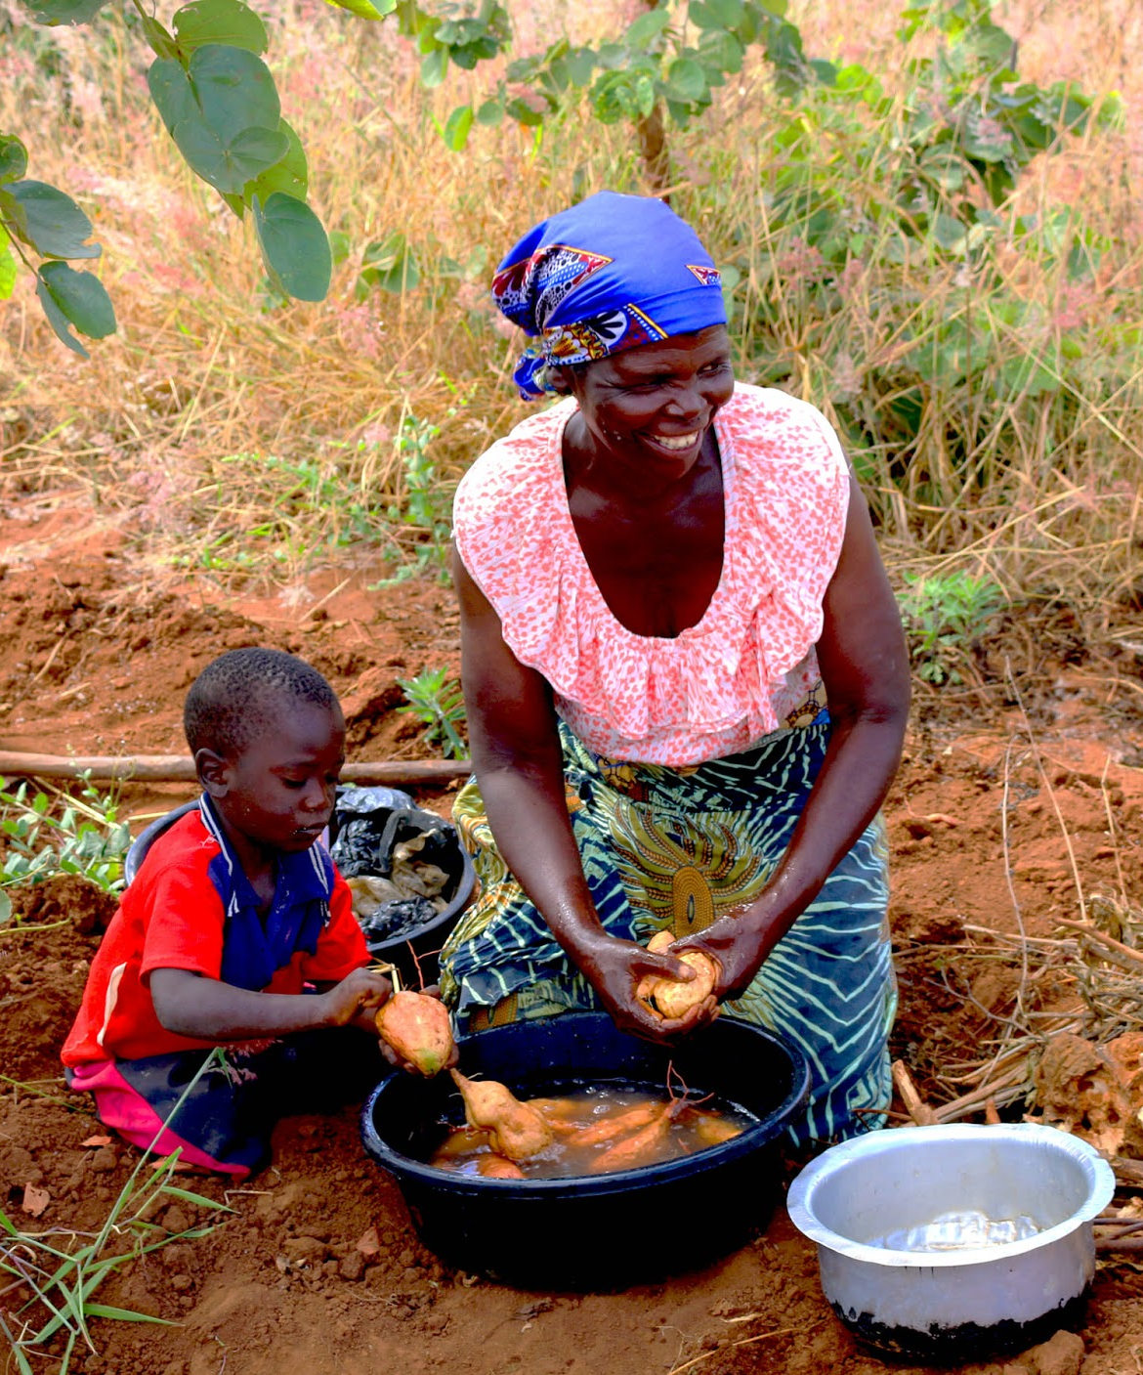
Understanding Different Aspects of the Value Chain
Who is involved
What these players do, how and when
What constraints they face
Who makes decisions
Who reaps what benefits
Decide what type of information to share, who with, and when

Slide 78
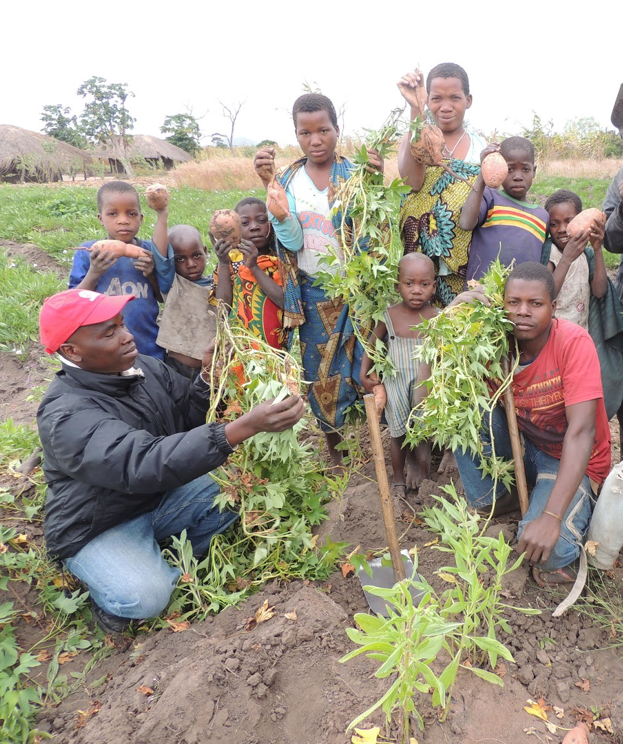
Under-represented Groups
What groups are under-represented, e.g. religious or ethnic groups, poorer populations, women
Why they are under-represented
What constraints this poses
Any potential remedies

Slide 79
Sensitivity Measures
Development workers should be sensitive to male control of the land.
Involve men in decision making even when they are not directly involved in labour.

Slide 80
Before deciding what type of information to share, who with and when, that kind of information should be collected?
Notes:
Answers
Who is involved; What these players do, how and when; What constraints they face; Who makes decisions; Who reaps what benefits

Slide 81
Key Points
Development workers must understand the roles people play in the sweetpotato value chain, including decision makers and beneficiaries.
If some groups are under-represented, advocates should try to find out why and remedy the cause.
Development workers should be sensitive to male control and involve men in decision making even when they are not directly involved in labor.

Slide 82
Market Trip
This activity is designed to be carried out in the field.
Follow the instructions from your facilitator.

Slide 83
Calculating Your Profit Margin
Using the case study provided, work out the profit margins at each stage of the value chain.
You have 45 minutes.

Slide 84
The Five Pillars of Marketing
With the other members of the team, brainstorm the key aspects of marketing.
Roleplay a typical market scene with people buying and selling sweetpotato roots.

