Slide 1
Global Burden of Animal Diseases: Ethiopia case study
Wudu Temesgen¹, Theo Knight-Jones¹, Wondwosen Awoke², Ben Huntington³ and Jonathan Rushton³
¹International Livestock Research Institute; ²Independent consultant; ³University of Liverpool

Slide 2
Outline of the presentation
What is GBADs and what it does
Genesis of GBADs
Ethiopia as GBADs case study country
GBADs activities in Ethiopia
How GBADs can benefit Ethiopia
Set up at ILRI for Ethiopia case study
Summary

Slide 3

1. What is Global Burden of Animal Diseases and what it does?
The Global Burden of Animal Diseases (GBADs) is a research program measuring and understanding the Global Burden of Animal Diseases
The program is inspired by and will build up on the successful human Global Burden of Disease (GBD) studies
GBADs program has a mission “measure to improve” animal health at a local, national and global level
It will create information on the economic burden of livestock diseases to support animal health decision making

Slide 4
What is GBADs and what it does? Cont’d….
It will provide information to assess the importance of different livestock diseases and health problems for different groups, countries and production systems
GBADs has been initiated by the University of Liverpool, with support from the OIE, FAO, ILRI and a group of international collaborating institutions and organizations

Slide 5
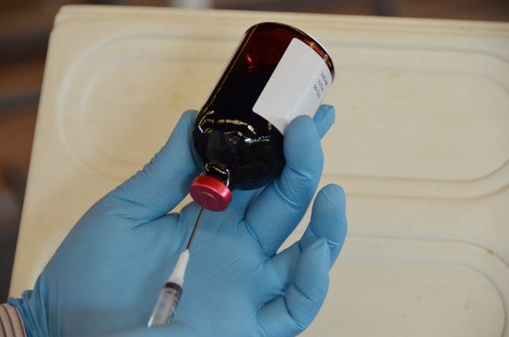
GBADs outcomes
GBADs will:
  provide information for evidence-based investment plans for veterinary services
  allow allocation of resources to key social, economic and environmental problems
  support high quality evaluation of existing animal health investments to insure they are delivering societal outcomes

Slide 6
GBADs outputs
To achieve those outcomes GBADs will produce:
Country, sector and animal disease specific case studies
Best practice guides on population estimates, production system classification and livestock production parameters: a basis for an FAO and FAOSTAT Guide
Estimates of animal disease burden at a global, regional and national level: with an online platform to guide animal health decision-makers
Draft of a best practice standard for the economic assessment of animal health: the basis for a chapter in the OIE Terrestrial Animal Health Code
An education & communication package: the importance of animals in society

Slide 7

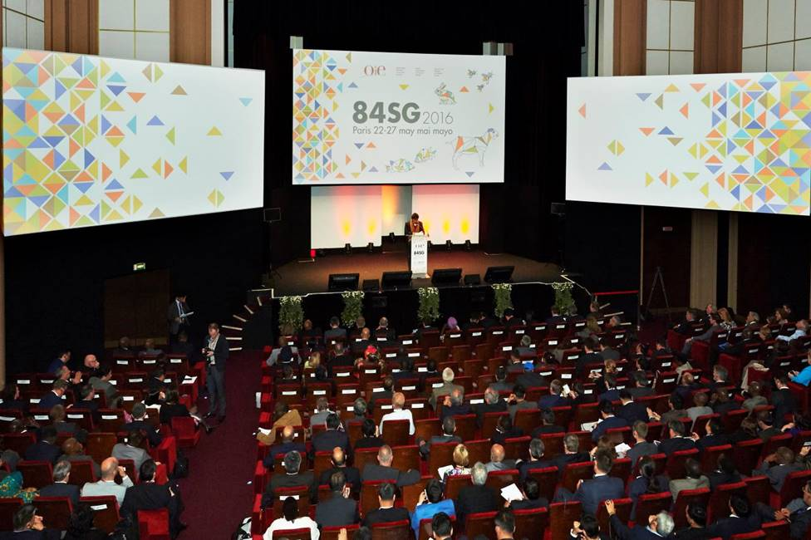
2. Genesis of GBADs
The 2016 OIE GS concluded that:
  Estimates of the impact of animal diseases were of insufficient quality,
  A more systematic process to assess the burden of animal diseases was needed: the birth of GBADs
Subsequently, two workshops were held that led to the development of GBADs

Slide 8
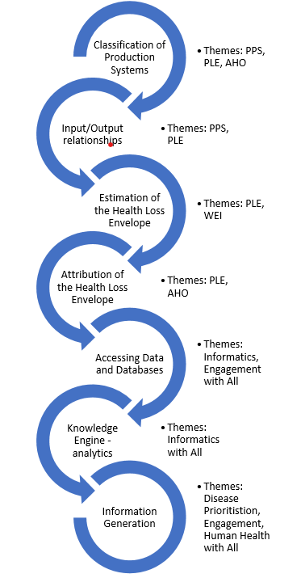
Genesis of GBADs cont’d….
Interchange and synergy between themes
The first was held in March 2018, agreed on the core aspects of the program and formed working groups that developed into core themes including:
  Population and Production Systems(PPS)
  Production Loss and Expenditure (PLE)
  Wider Economic Impacts (WEI)
  Animal health Ontology and Attribution(AHO)
  Human health (HH)
  Informatics
  Disease prioritization (DP)
  Engagement
  Education

Slide 9

Genesis of GBADs cont’d….
At the second workshop the GBADs concept note was presented at the 2019 OIE General Session
Support was received from cooperating international organizations: FAO, ILRI, WHO, WTO, OECD and the World Bank
For the current 2 years phase (January 2021- December 2022) GBADs has been funded by BMGF and FCDO of the UK Government with plans for continuing subsequent phases until 2030

Slide 10
Genesis of GBADs cont’d….
In these two years, GBADs program will validate the approach in specific countries and at global level.
Ethiopia has been selected as one of the first case study countries
The work in Ethiopia consists of specific
  case-studies exploring animal disease burden in the country and
  disease burden prioritisation methodologies with wider global relevance

Slide 11
3. Ethiopia as GBADs case study country
During the development phase of GBADs, desirable criteria for case study country choice were established which include:
  Demonstrate leadership in their region, and a willingness to share information and collaborate.
  Have livestock systems that are representative of the region.
  Possess modern IT resources providing access to data of good quality.
  Have institutions and key actors that have an analytical way of working,
  Exploit the GBADs consortium’s existing in-country links and other specific in-country capacities, such as complementary ongoing programs.

Slide 12
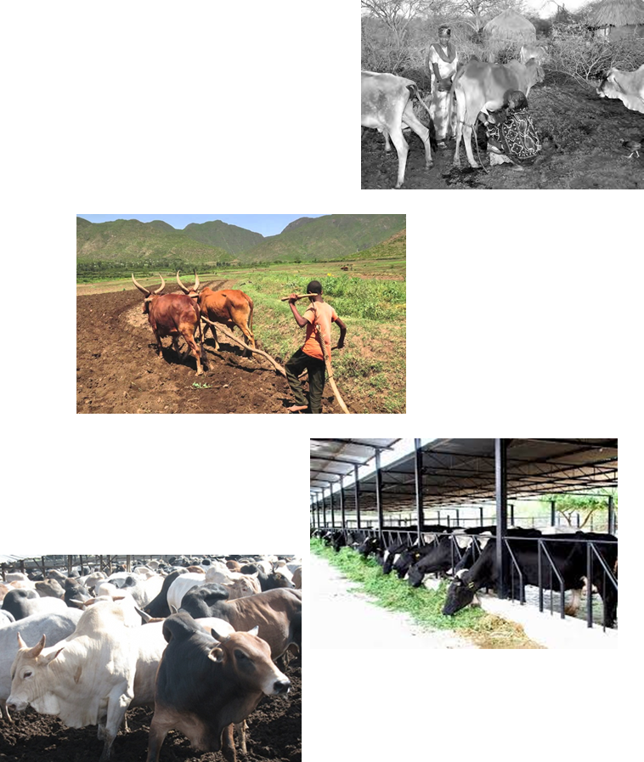
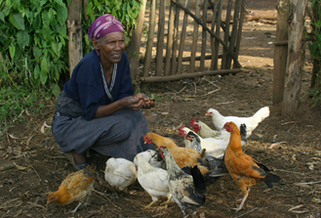
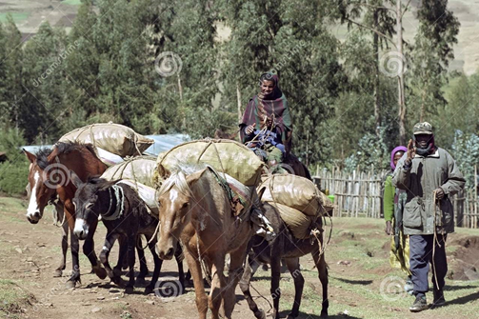
Ethiopia as GBADs case study country cont’d….
Ethiopia fulfils these criteria:
It has the largest human and livestock population in East African region and the largest livestock population in the African continent
Livestock, kept in various types of production systems and sectors, play a prominent role in the Ethiopian economy
National strategic efforts such as past GTPs and associated livestock master plans, and the current 10-year agriculture perspective plan have created a strong political and institutional framework to which the work of the GBADs can be anchored and aligned.

Slide 13
4. GBADs activities in Ethiopia
GBADs major activities in Ethiopia from January 2021-December 2022 will be:
  Meet with key stakeholders; present the GBADs program and the Ethiopian case study; carry out participatory knowledge exchange.
  Seek out and collate available data from Ethiopian production systems for input into GBADs platform.
  Select priority production systems; carry out population estimates.
  Estimate livestock biomass, production and economic value for each system.
  Present data on gender aspects in terms of provision of labour and realisation of benefits.

Slide 14
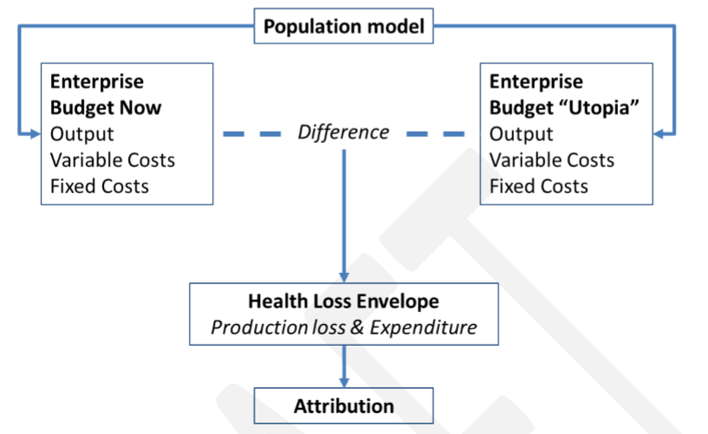
GBADs activities in Ethiopia cont’d….
  Develop analytical framework and conduct analysis to estimate the animal health loss envelope (AHLE)
  Produce an estimate of the AHLE and attribute to causes
  Design and implement capacity development workshops on animal health economics aimed for different stakeholders
  Widen engagement activities to the region and use ILRI’s status as a regional research hub to promote GBADs work

Slide 15
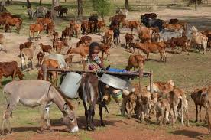
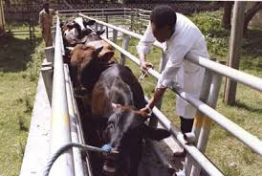
5. How GBADs can benefit Ethiopia cont’d….
In Ethiopia livestock play significant role in the livelihoods of about 65% of the population and contributes up to 19% GDP to the national economy
The country is endemic for a number of livestock diseases which continue to hinder livestock productivity and agricultural development
The annual loss due to mortality ranges from 8–10% for cattle, 12–14% for sheep, 11–13% for goats and 56.9% for poultry and 30-50% morbidity
The livestock diseases have a significant public health, food security and economic impact, affecting the livelihoods and the national economy

Slide 16

How GBADs can benefit Ethiopia cont’d….
Currently data on disease burden are limited to losses associated with individual diseases which do not allow to understand the actual burden of animal diseases and health losses holistically
Policy making for disease control is reliant on incomplete data and without full understanding of livestock disease burdens and priorities
GBADs will generate comprehensive quantitative evidence on the burden of animal diseases and health losses
As a case study Ethiopia will benefit more as information and evidence will be generated on Ethiopia’s situation that can inform important decisions as the national, sector, industry and producer level

Slide 17
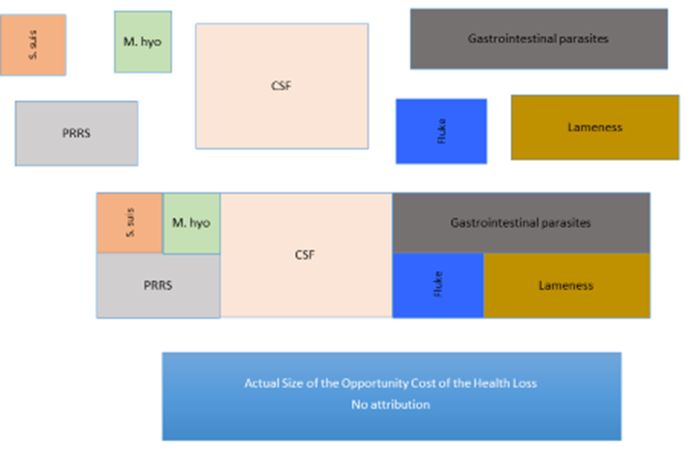
How GBADs can benefit Ethiopia cont’d….
More specifically GBADs in Ethiopia will
  Estimate the burden of livestock diseases nationally, by production system and by sectors
    Useful to identify high burden sectors for interventions
  Estimate the burden to different diseases
    useful input for disease control prioritization
  Refine methods and collect data on livestock population, biomass and productivity
    Useful for planning in the livestock sector

Slide 18
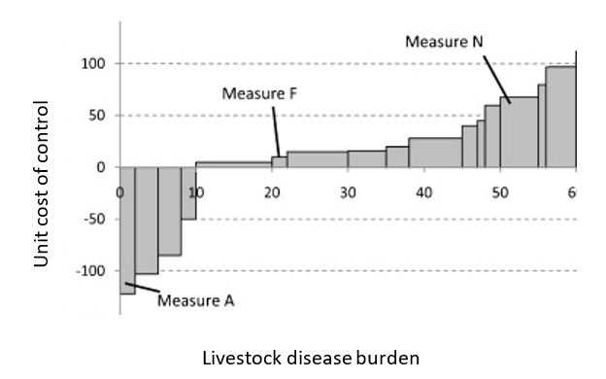
How GBADs can benefit Ethiopia cont’d….
Propose prioritize interventions to reduce disease burden based on cost effectiveness (in subsequent phases?)
Increase technical capacity in animal health economics in the country (potentially establishing an African regional center for animal health economics)
Marginal abatement cost curve

Slide 19
6. Set –up at ILRI for Ethiopia case study
Work in Ethiopia will be led by ILRI and implemented with local partners
ILRI has a strong presence in animal health research in Ethiopia and the Region
ILRI hosts the Ethiopia GBADs team
  Dr. Theo Knight-Jones: lead Ethiopia case study
  Prof. Delia Randolph: lead GBADs disease prioritization theme
  Prof. Wudu Temesgen: support country study, animal health economics
  Dr. Wondwosen Asfaw: stakeholder engagement
  Dr. Kebede Amenu: support disease prioritization theme in GBADs
  Dr. Girma Birhan (a PhD student): supported by The Brooke-GBADs in working equids

Slide 20
Summary
In summary in the coming two years GBADs Ethiopia case study will
Collect and collate data on livestock population and production, and livestock disease epidemiology, production loss and control expenditure
Estimate the livestock population, biomass and economic values of selected production systems (cattle + small ruminant?? + chicken??)
Estimate the animal health burden on selected production systems/sectors
Attribute the estimated burden to different diseases and health losses
Make the information readily available for use by stakeholders
Increase the capacity of policy makers and farmers on the use of economics in animal health decision making

Slide 21
Thank you for your attention!
Comments and Questions?

Slide 22
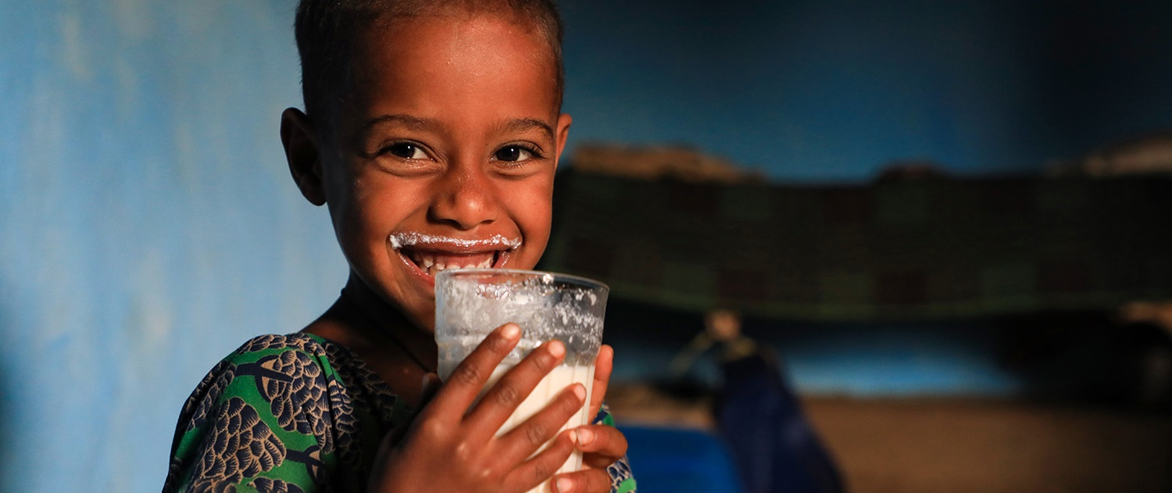
THANK YOU

