Slide 1

Space-time prediction of maize yields in Southern Africa
Francis Muthoni, Christian Thierfelder, Leandro Parente, Chris van Diemen, Tomislav Hengl

Slide 2
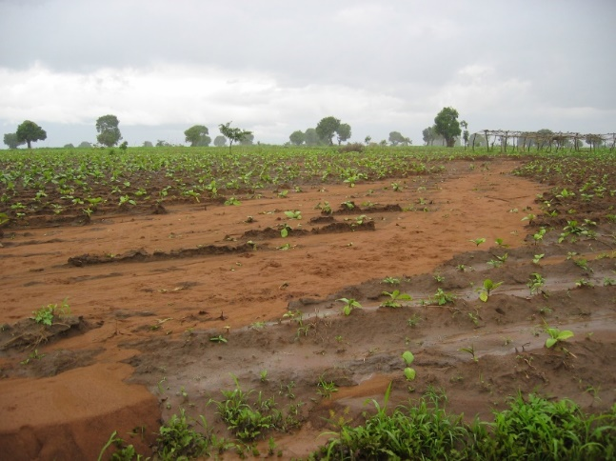
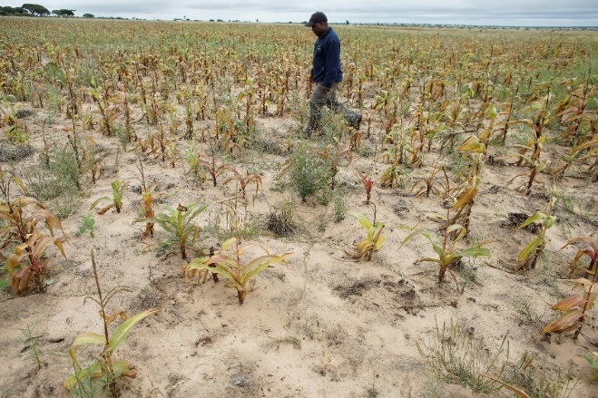
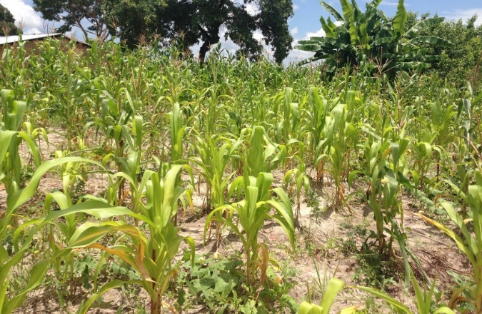
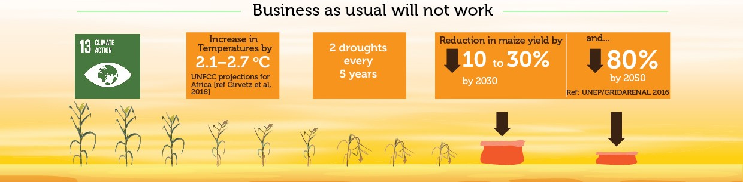
Motivation
Rainfed farming systems in southern Africa are highly vulnerable to climatic shocks and land degradation
Farming practices that increase resilience to shocks needed

Slide 3
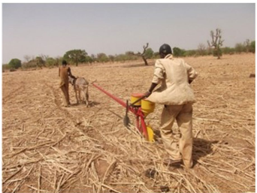
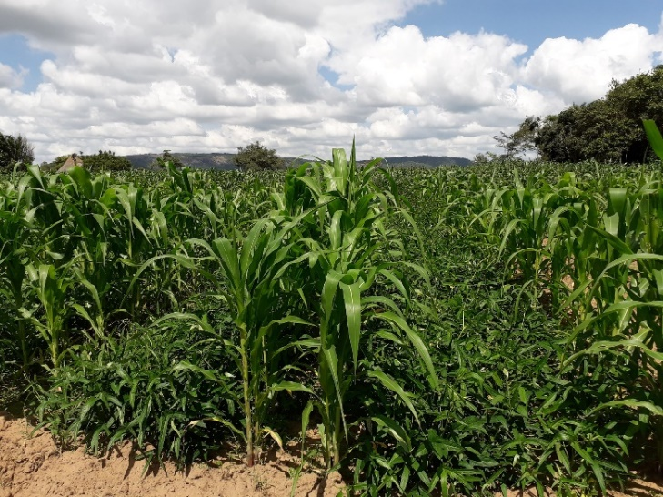
Conservation agriculture (CA) practices
CA is a climate smart farming practice involving 3 principles
Zero or minimum soil disturbance +
Residue retention (mulching)
Crop diversification
(Intercropping, Rotation)
Challenge: Where and when does CA practices fit?

Slide 4
Objectives
      To map the spatial patterns of maize grain yields grown in CA and convectional tillage practices (CP) in southern Africa region
      Research questions:
      What are the biophysical and socioeconomic factors that mostly limit the spatial variation of the maize yields?
      Where and when does CA offer yield gain over CP tillage?

Slide 5
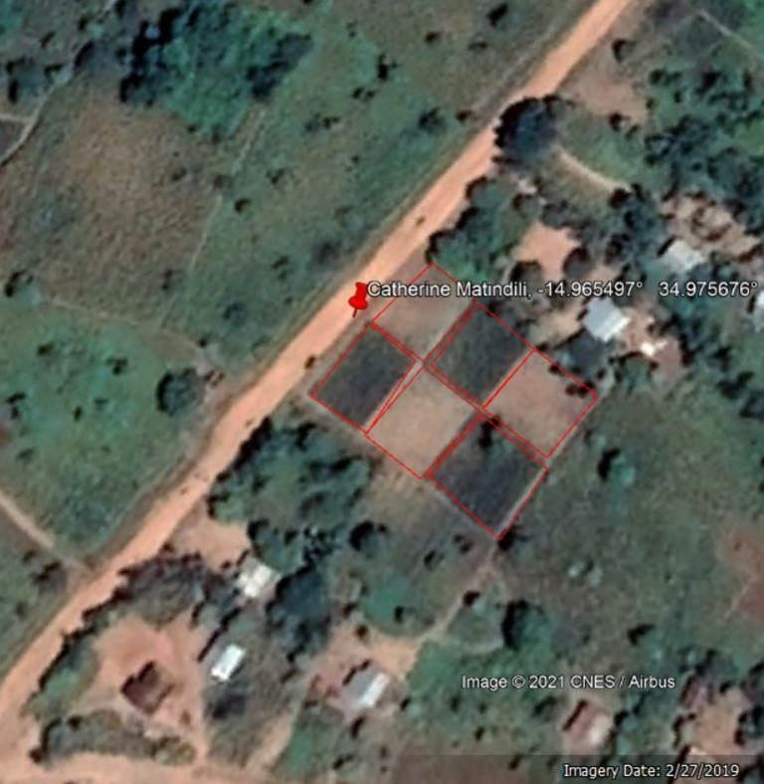
Data: Long-term agronomic trials
CIMMYT’s long-term on-farm CA trials established for 16 growing seasons (2004 – 2020) with 35000+ records
Database with geolocated crop yields and agronomic practices

Slide 6
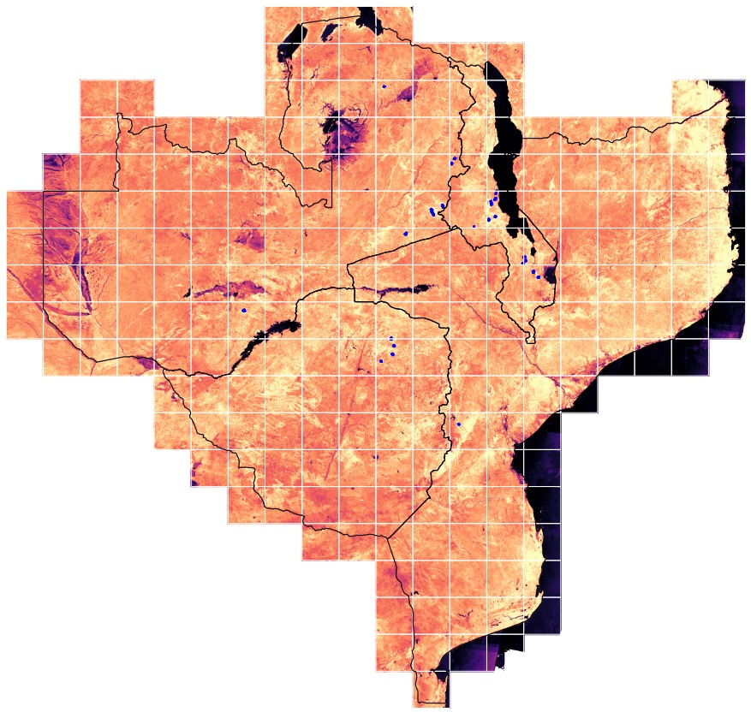
Data: Earth observation (EO)
Utilized multi-source EO data with resolution ranging from 30 m to 5 Km:
  Vegetation indices: Landsat GLAD, MODIS, NDVI, EVI, SAVI, MSAVI, NDWI
  Climate: Monthly precipitation, precipitation anomaly, Tmin, Tmax, ET
  Soil Nutrients: N,P, K, + micro-nutrients
  Soil physical properties: pH, Bulk density, CEC, Silt, sand and Clay
  Terrain: Elevation (DEM), slope
  Socio-economic: Market access, cattle density
Gap filled Landsat ARD
2000-2020 (3TB)

Slide 7

Ensemble ML Model
Fitted an ensemble ML Model based on the Ranger (RF), xgboost and cvglmnet algorithms using Mlr3 R package
Space-time cross-validation strategies
  Districts as space blocks
  Years as time blocks

Slide 8
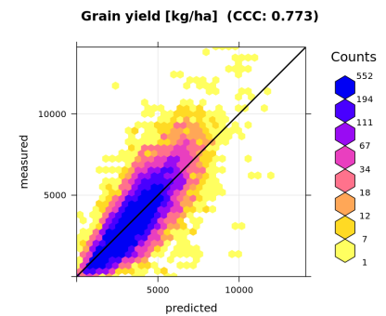
Model accuracy
RF model showed good accuracy in complex farming systems
RMSE = 1250 Kg/ha

Slide 9
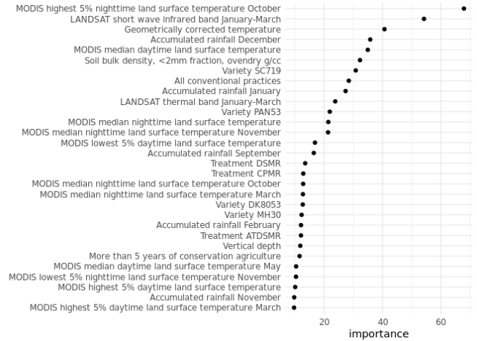
Variable importance
Temperature and rainfall related variables emerged most important for predicting maize yields

Slide 10
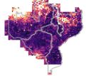

Model uncertanity
Prediction uncertainties higher in northern Zambia and Mozambique where training samples were fewer
  Extrapolation into novel environments problematic
Uncertainties

Slide 11
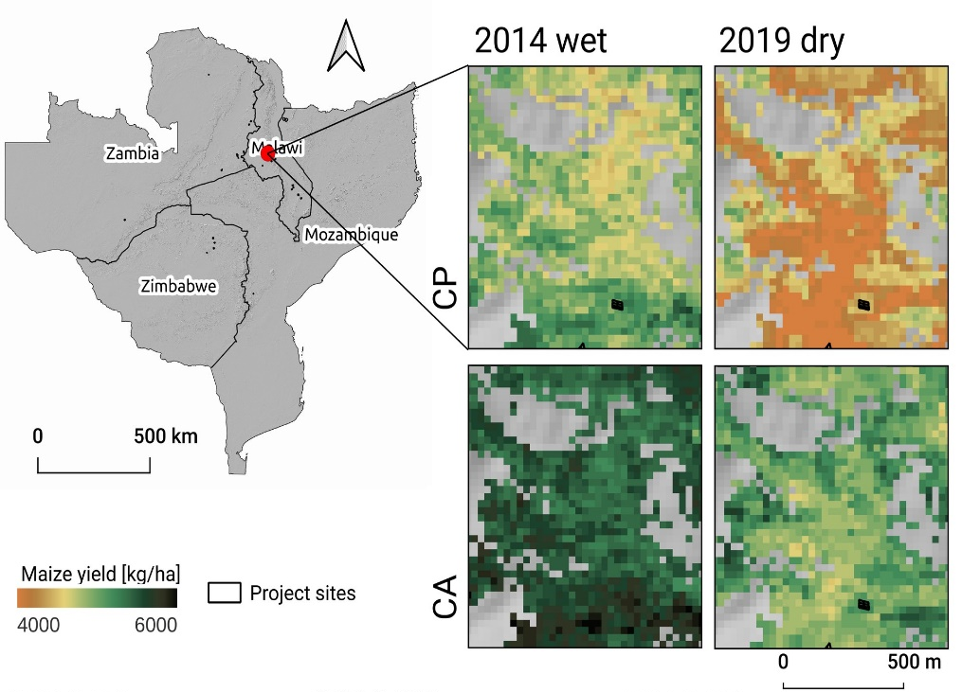
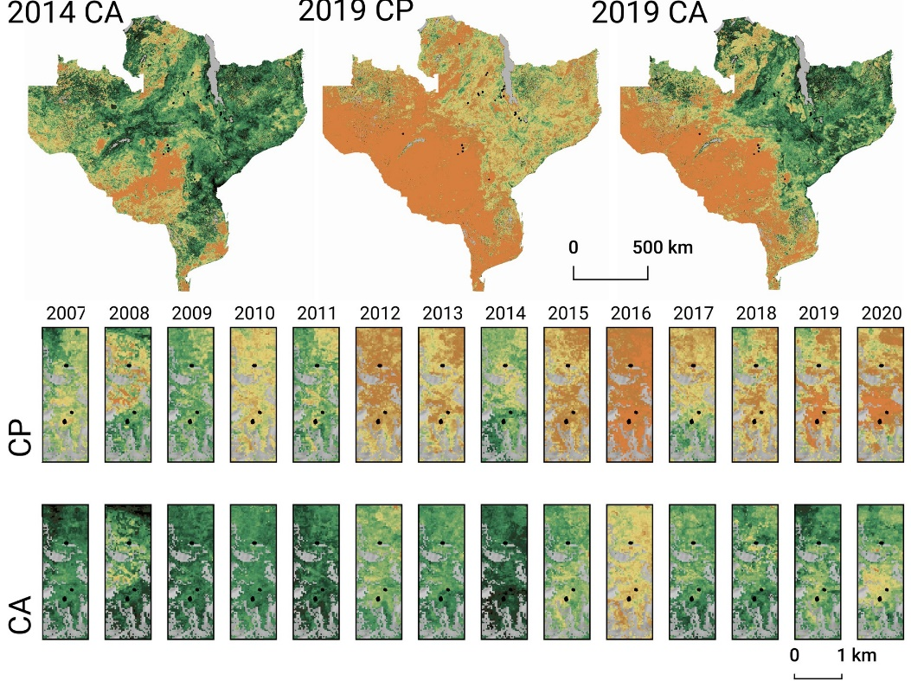
Predicted maize yield
CA returned high maize yields than conventional tillage practice (CP) especially during dry seasons
  CA increases resilience to droughts in rainfed farming systems

Slide 12
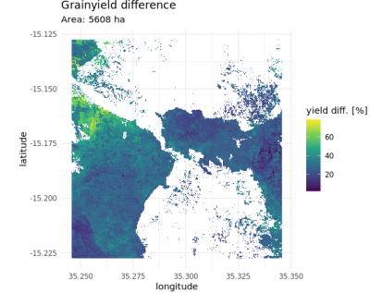
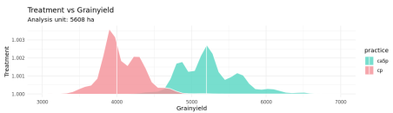
Yield gain (loss) from CA
Areas with over 5 years of CA application returned upto 80% higher yields than CP tillage in Chipeni Malawi

Slide 13
Summary
Demonstrated the application of long-term trials, EO data and ML algorithms to guide policy on scaling out CA as a climate smart farming technology
Yield prediction maps identified locations where increased adoption of CA and complementary technologies can buffer against substantial yield losses in the event of droughts

Slide 14
Thank You

