Slide 1
Advancing waste surveillance through a One Health approach
Ekta Patel and Hung Nguyen-Viet
International Livestock Research Institute
UNEP-led stakeholder engagement on capacity building on sustainable wastewater surveillance for ecosystems and human health in Kenya
Nairobi, 26–27 February 2025

Slide 2

Overview
One Health approach and ILRI’s One Health strategy
ILRI’s role in advancing waste surveillance as a pandemic preparedness response
CGIAR One Health Initiative
Case study: Animal waste surveillance

Slide 3
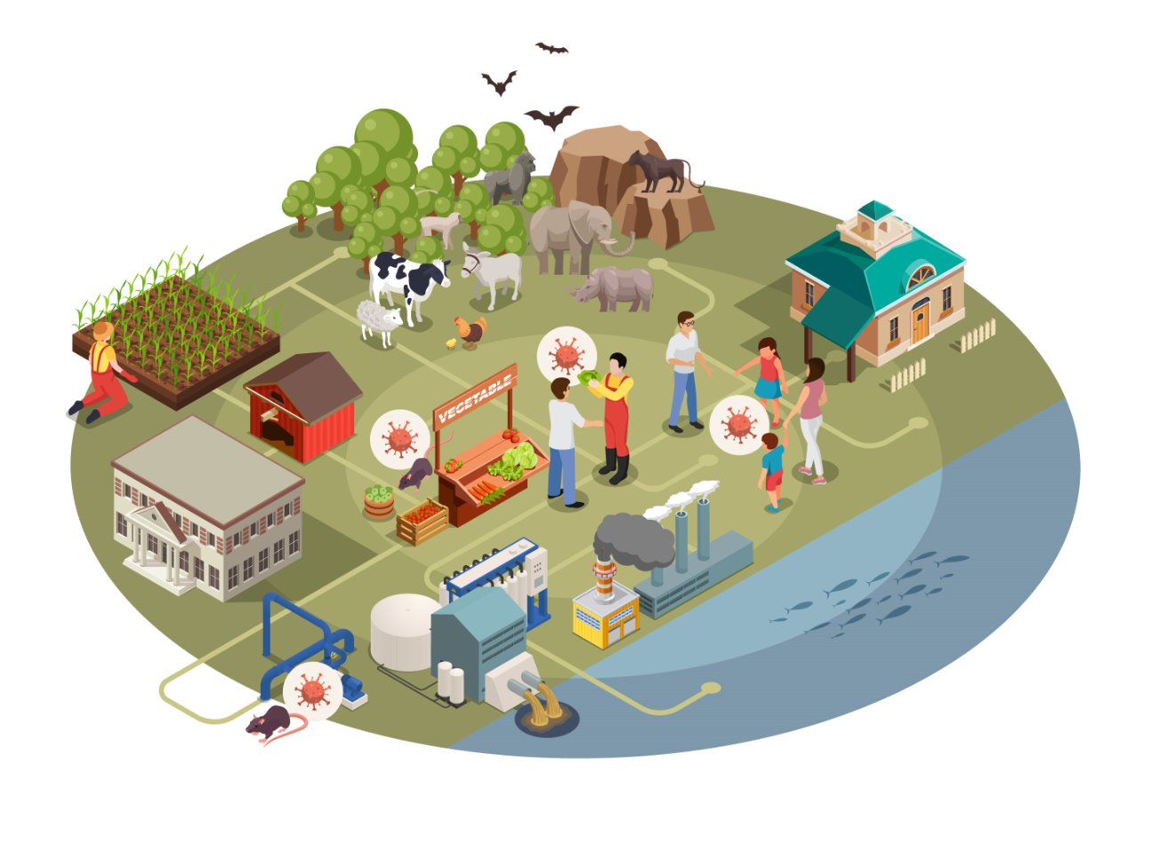

A One Health approach
ANIMAL HEALTH
HUMAN HEALTH
ENVIRONMENTAL
HEALTH
Infographic credit: ILRI/Georges Shouha and Ekta Patel
Notes:
One Health is an approach that recognizes the health of humans, animals, and the environment (including ecosystems) are closely linked and inter-dependent.
The approach mobilizes multiple sectors, disciplines and communities at varying levels of society to work together to foster well-being and tackle threats to health and ecosystems, while addressing the collective need for clean water, energy and air, safe and nutritious food, taking action on climate changes and contributing to sustainable development.

Slide 4
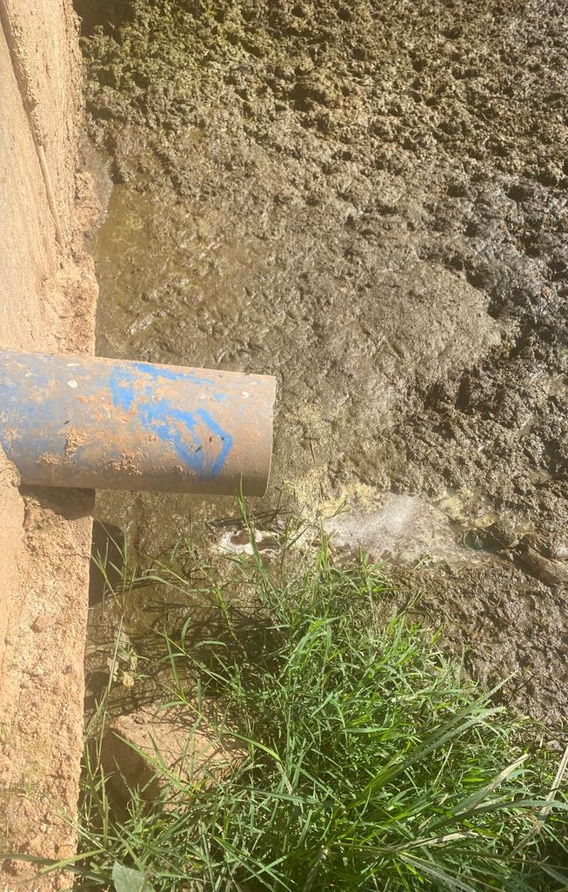
Advancing waste surveillance through a One Health approach
Over 60% of emerging infectious diseases originate from animals at the human-animal-environmental interface. Wastewater holds critical early warning signs for pathogens, antimicrobial resistance and environmental health threats.
A One Health approach ensures integrated solutions, leveraging waste surveillance to protect human, animal and ecosystem health.
Global estimates show that 80% of wastewater flows untreated back into ecosystems, increasing public health risks.
With climate change, urbanization and intensified livestock systems, monitoring waste is essential to prevent the next pandemic and protect food security.

Slide 5
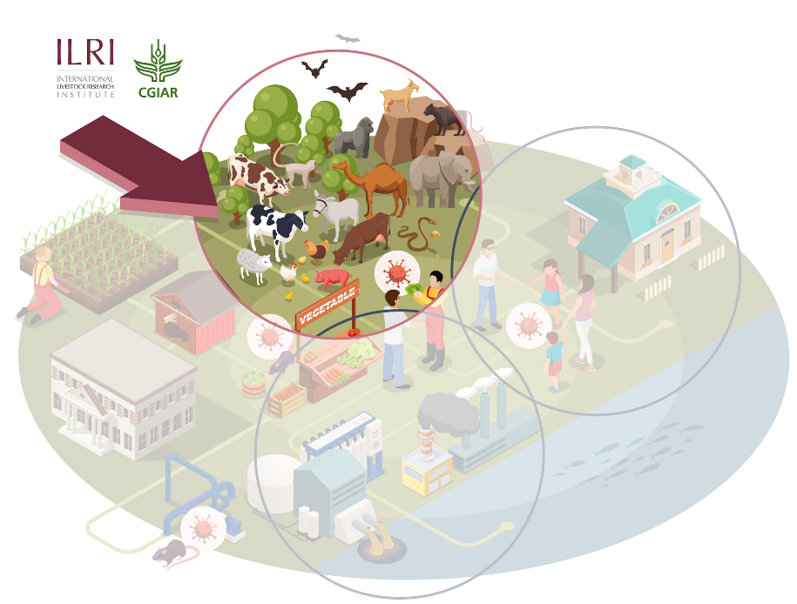
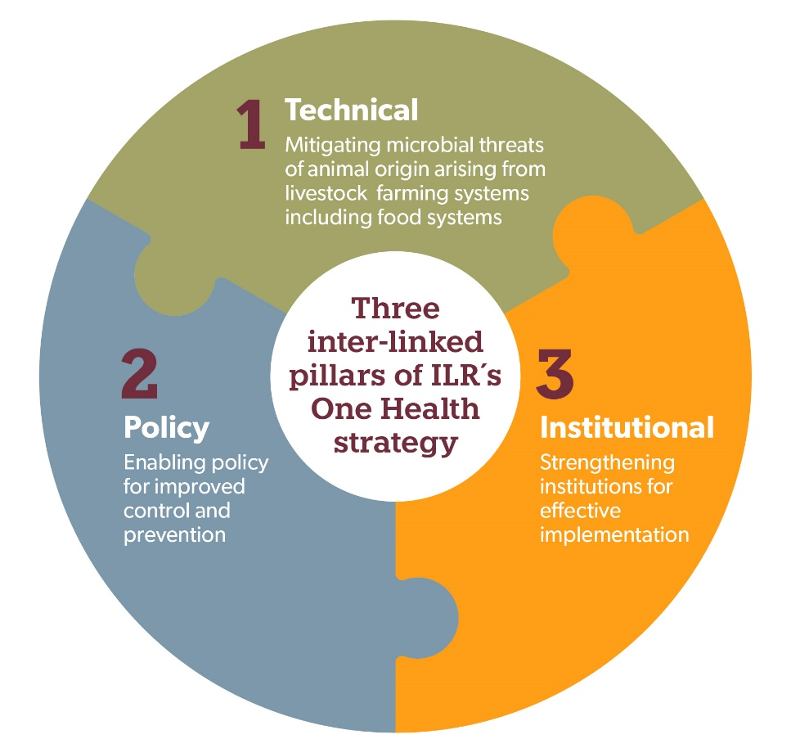
ILRI One Health strategy
ILRI is strategically positioned across LMICs
Operating in these critical zones, we leverage ILRI’s One Health strategy and facilities to drive sustainable change to address global health challenges like zoonoses, food safety and antimicrobial resistance.
A complex ecosystem requires a multifaceted approach to preventing pandemics/epidemics and other microbial threats from animals/environment
Vision
  To improve the lives, livelihoods and well-being of people in the global south by building healthy, sustainable, and resilient systems at the intersection of humans, animals and the environment.
Three thematic areas
  Pandemics, epidemics and endemic zoonoses
  Food-borne diseases
  Antimicrobial resistance
wildlife
Notes:
One Health: key elements: Prepare, Detect, Respond

Slide 6
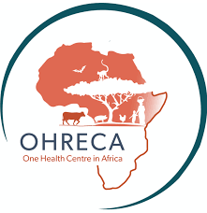
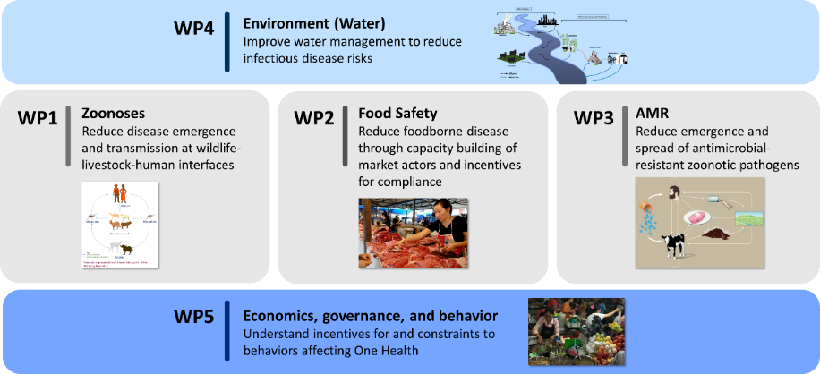

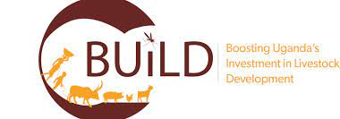
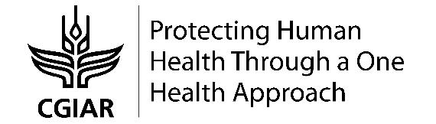

Major projects: One Health science, capacity building and operationalization
ICT4Health Vietnam, Korea MAFRA
Co-Infection, DTRA
Covid-19 genomic surveillance, RF
MoreMilk BMGF
SafePORK, ACIAR, Vietnam
APART, World Bank, India
Fleming Fund, UKAID
SEFASI, Mad-tech, JPIAMR
POLOH Poultry losses and One Health, LSIL
And others…
More on One Health @ILRI: ilri.org/one-health

Slide 7



Highlights of One Health work at ILRI
One Health research to strengthen capacities to control neglected and emerging zoonotic diseases, including COVID-19, in several low- and middle-income countries.
Two decades of holistic One Health diagnosis and interventions in traditional markets and meat/fish processing sectors
Innovative successful approaches based on improving policy, technology and training for market actors, and motivation and incentives for behaviour change.
Cultivating an environment of improved food safety and reduced foodborne diseases benefiting million of consumers.
Interventions to reduce antimicrobial use and resistance
Behavioural nudges for semi-intensive poultry farmers and good animal husbandry practices and vaccination.

Slide 8
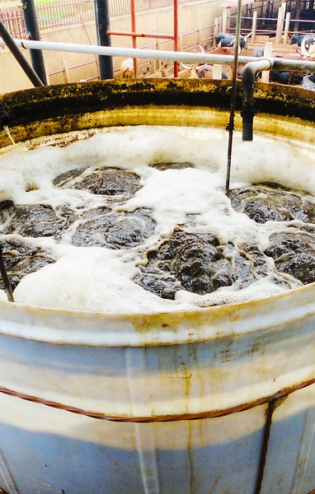
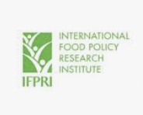
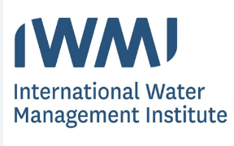

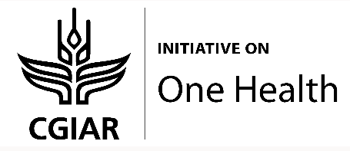
CGIAR Initiative on One Health: Protecting human health through a One Health approach
This initiative aimed to demonstrate how One Health principles and tools integrated into food systems can help reduce and contain zoonotic disease outbreaks, improve food and water safety and reduce anti-microbial resistance, benefiting human, animal and environmental health.
Activities implemented in Bangladesh, Côte d’Ivoire, Ethiopia, India, Kenya, Uganda and Vietnam

Slide 9
CGIAR One Health Initiative
Preventing zoonoses at key interfaces
  Proactive surveillance at wildlife–livestock–human interfaces
  High-risk value chains such as bushmeat/farmed wildlife to pre-empt disease with epidemic/pandemic potential
Addressing antimicrobial resistance risks
  Focus on livestock, aquaculture and crop systems by prompting antimicrobial use, surveillance and advanced research
Reducing the burden of foodborne disease
  Focus on animal-source and other perishable foods, including in informal and traditional food systems.
Improving waste and water management
  Mitigating risks from pollution caused by livestock and aquaculture
  Reducing threats from antimicrobial residues, antimicrobial-resistant bacteria and resistant genes through improved management systems.

Slide 10
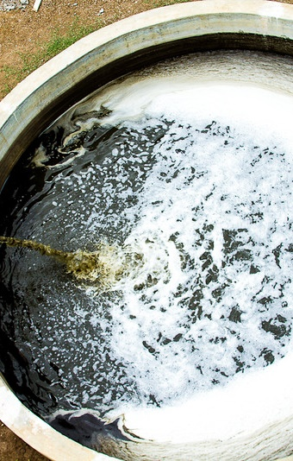
Key achievements from the Initiative
In Ethiopia (Akaki) and India (Song River): Inform national One Health planning processes by providing evidence on the role of water in the transmission of pathogens.
Scientists aim to seek national policy change toward improved waste and water management
Recognition of water in the role of antimicrobial resistance transmission.
Adoption of sustainable practices; encourage livestock farms and waste managers to adopt business models that reduce, reuse and recycle animal waste.

Slide 11

Highlight: animal waste surveillance in western Kenya
The challenge
A major challenge in pandemic preparedness is the early detection of emerging zoonotic threats, especially in environments where humans, animals and ecosystems interact.
Animal waste serves as a reservoir for pathogens and antimicrobial resistance genes, yet it remains an underutilized surveillance tool.
Monitoring waste from livestock, wildlife, and food systems can provide critical early warning signs, helping to prevent spillover events and strengthen global health security.
The solution
Embedding animal waste-based pathogen surveillance into national and global health systems, we can detect risks earlier, prevent spillover, and enhance pandemic resilience
Waste as data source allows us to identify interconnected risks and develop integrated responses
The results/outcomes
Use of rapid detection technologies that are cost-effective
Timely information for interventions

Slide 12
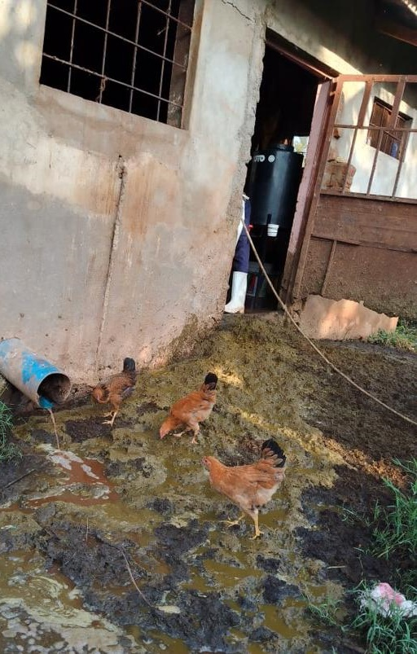
Case study: Animal waste surveillance in Kenya
141 slaughterhouses (ruminant and porcine) selected from six counties: Siaya, Busia, Bungoma, Kakamega, Vihiga and Kisumu
Samples tested with enrichment sequencing technologies, specifically VirCapSeq (GAPP) and Illumina Viral Surveillance (pending)
Results: Preliminary findings and ongoing activities; PhD work for Alice Kiarie

Slide 13

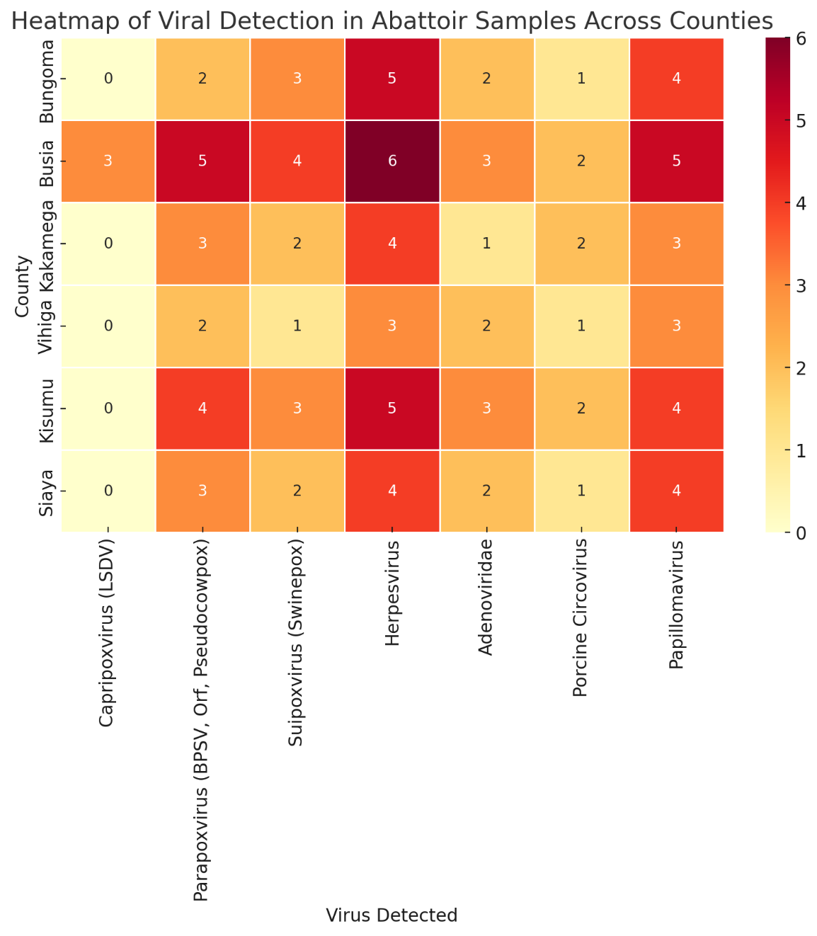
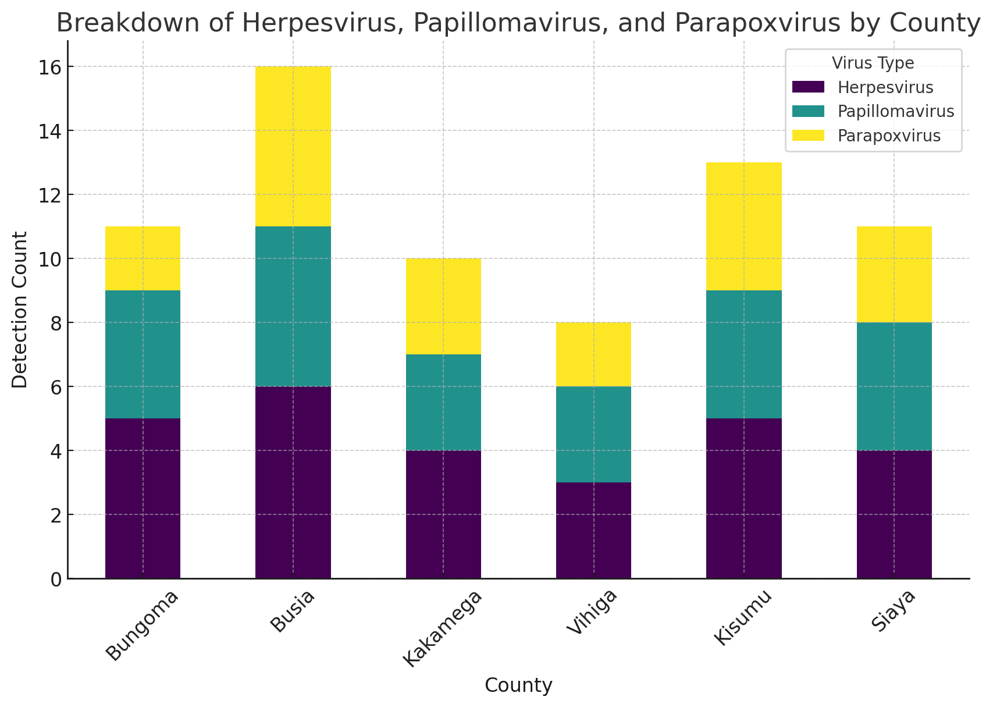
Preliminary findings – PhD thesis work
Notes:
Colour Intensity represents the number of samples tested positive, - darker colours indicate higher number of detections.
Top 2 Key Findings from the Heatmap:
Busia has the highest viral detection levels overall:
Busia shows the darkest color intensity across multiple viruses, suggesting it has the highest number of detections for Herpesvirus, Parapoxvirus, Suipoxvirus, and Papillomavirus compared to other counties.
This suggests Busia's abattoir environment may have higher contamination levels or a greater viral burden in livestock.
Herpesvirus and Parapoxvirus are the most widely detected viruses:
Herpesvirus is found in all counties with consistently high detection counts.
Parapoxvirus also shows a strong presence across all counties, particularly in Busia and Kisumu.
These findings suggest potential occupational and public health risks
Herpesvirus is Widespread Across All Counties:
Detected in all six counties, suggesting high environmental circulation in abattoirs.
Needs further study to determine if specific strains pose a zoonotic risk.
Papillomavirus Detection Raises Occupational Exposure Concerns:
The detection of human-like papillomavirus in multiple counties suggests possible occupational contamination.
Additional sequencing is needed to determine if animal-associated papillomaviruses could impact human health.
Need for Improved Sanitation and Biosecurity in Abattoirs:
The high prevalence of viruses in multiple counties suggests potential biosecurity lapses.
Stronger hygiene measures, proper carcass handling, and worker protective measures can help minimize transmission risks.

Slide 14
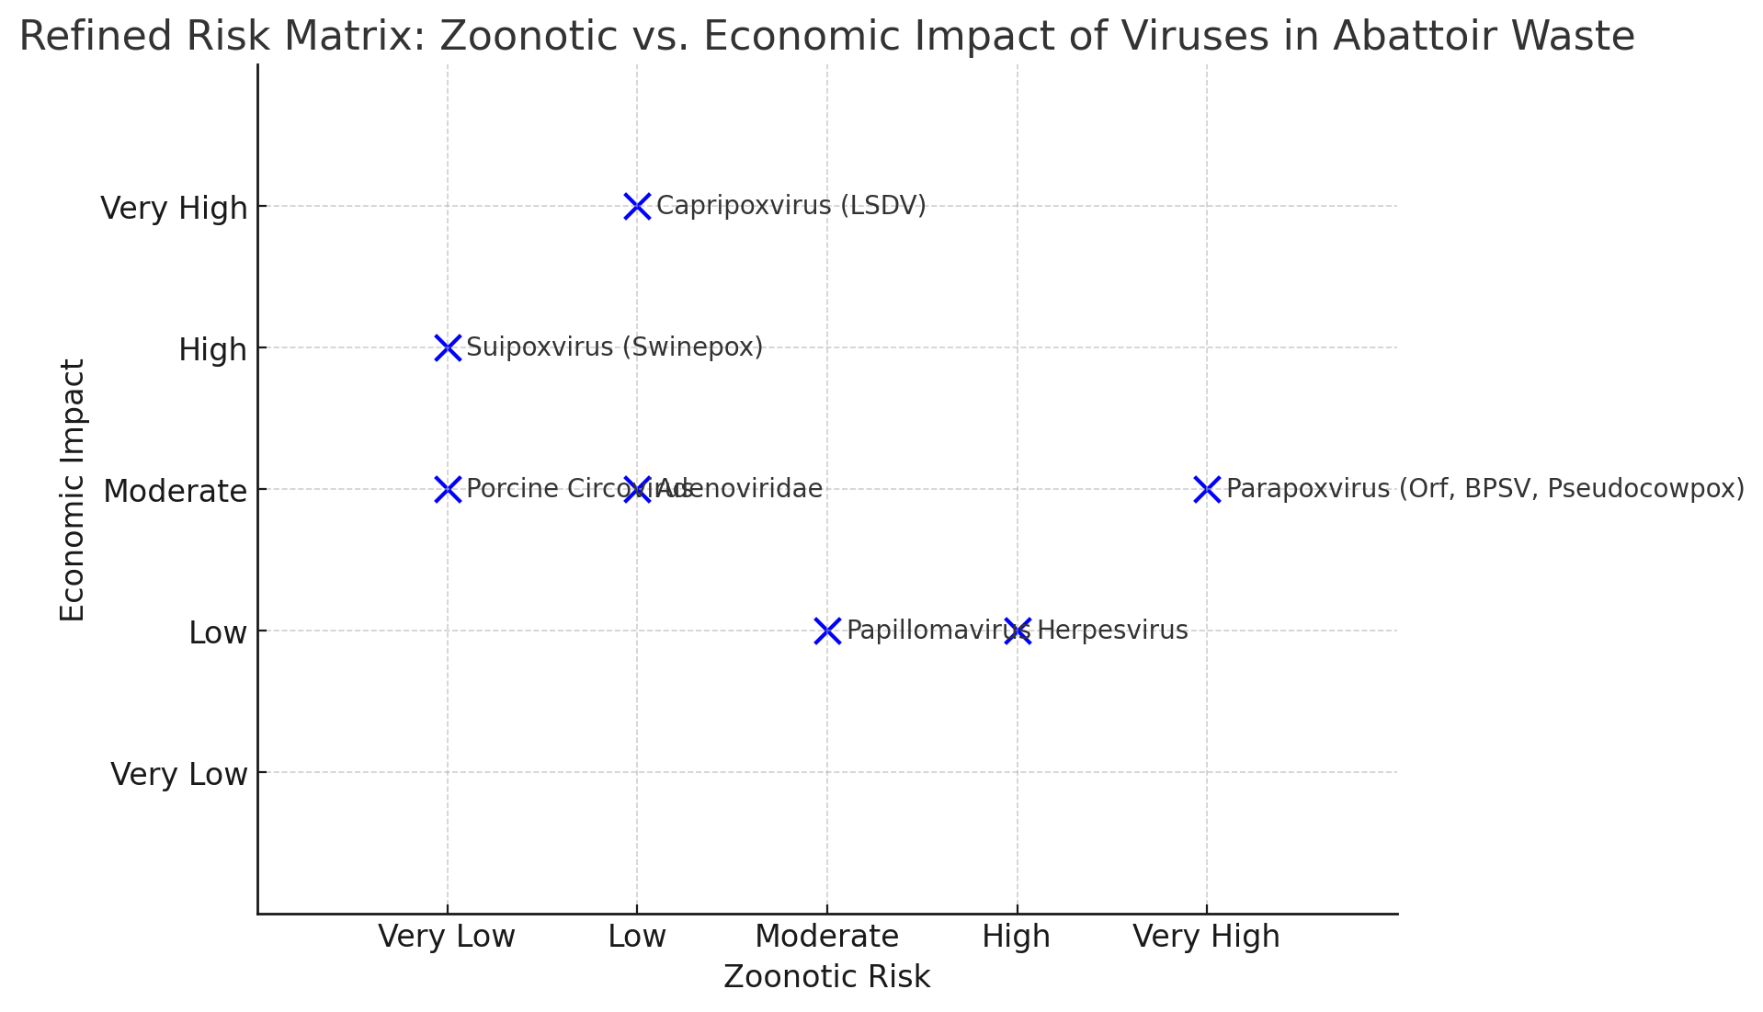
AI-generated risk matrix for interventions
Notes:
This risk matrix visually represents the relationship between zoonotic risk (potential for animal-to-human transmission) and economic impact of viruses found in abattoir waste. This data helps guide targeted interventions by prioritizing viruses that pose both public health and economic threats, ensuring resources are directed effectively. For example, Swinepox and LSVD have the highest economic impact, making them priority concerns for intervention. Their presence in abattoir waste suggests wider disease circulation in livestock populations, emphasizing the need for waste surveillance as an early detection tool to prevent outbreaks and economic losses.

Slide 15
Key takeaways
Waste (animal/human) is a key surveillance tool. It helps detect emerging zoonotic diseases and antimicrobial resistance early.
A One Health approach is essential. Linking human, animal and environment health improves disease prevention.
Untreated waste increases public health risks. 80% of wastewater flows untreated, heightening spillover threats.
Strengthen disease surveillance. Research in low- and middle-income countries informs policy and improves response strategies.

Slide 16
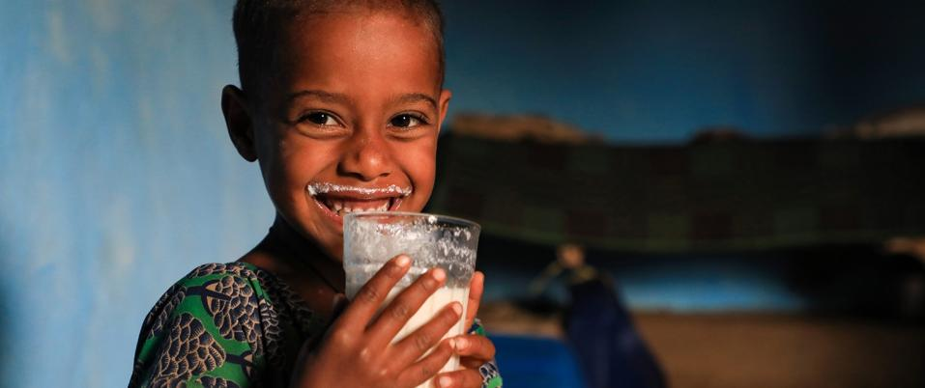
THANK YOU

