Slide 1

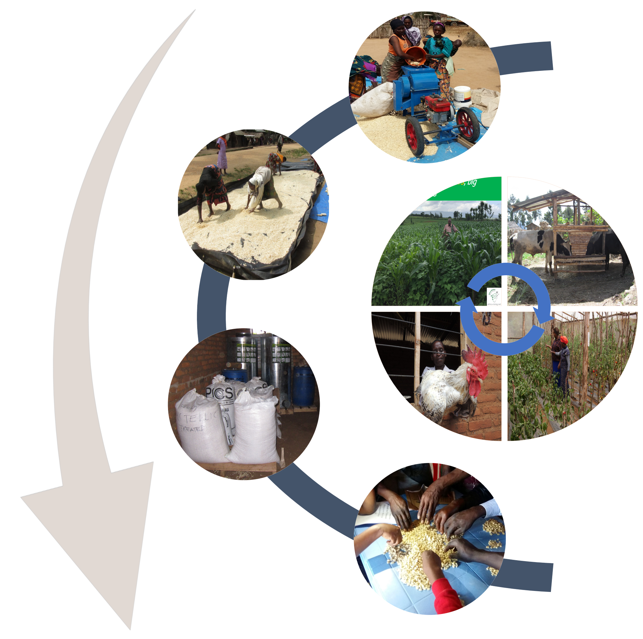
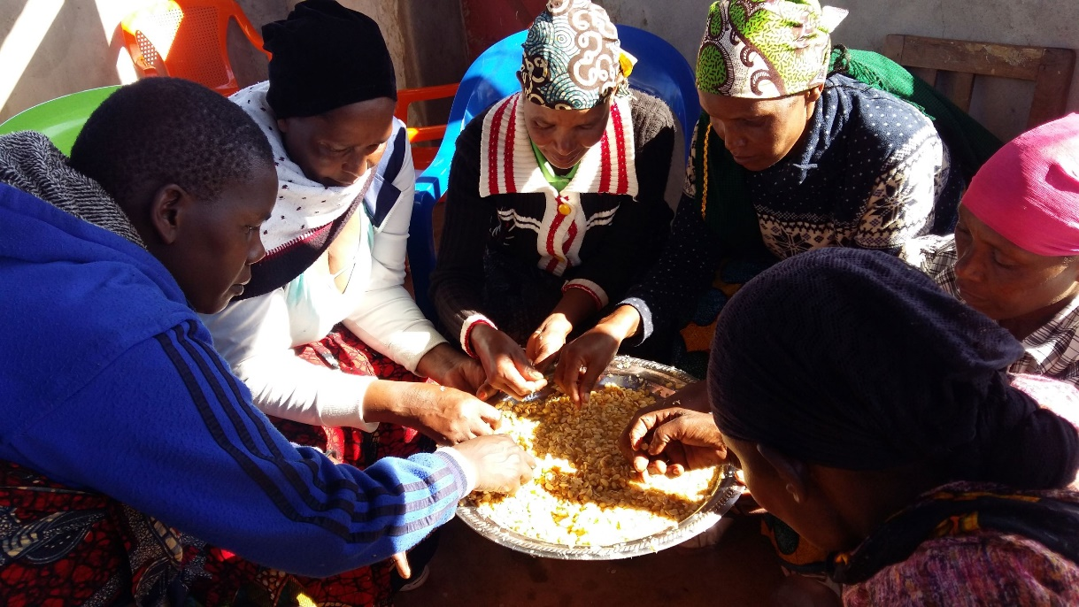
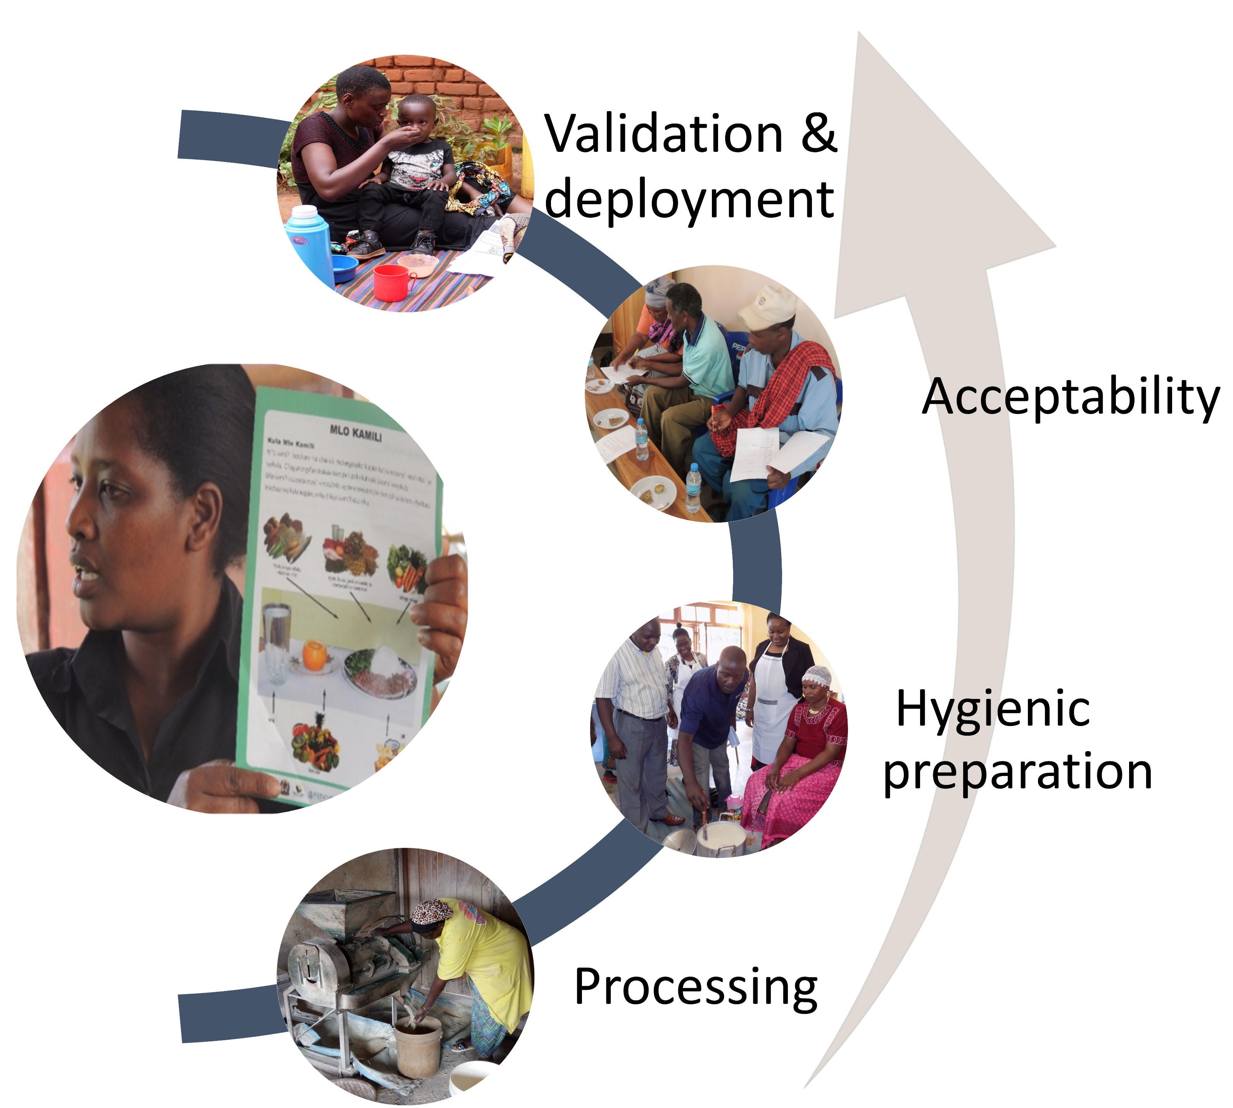
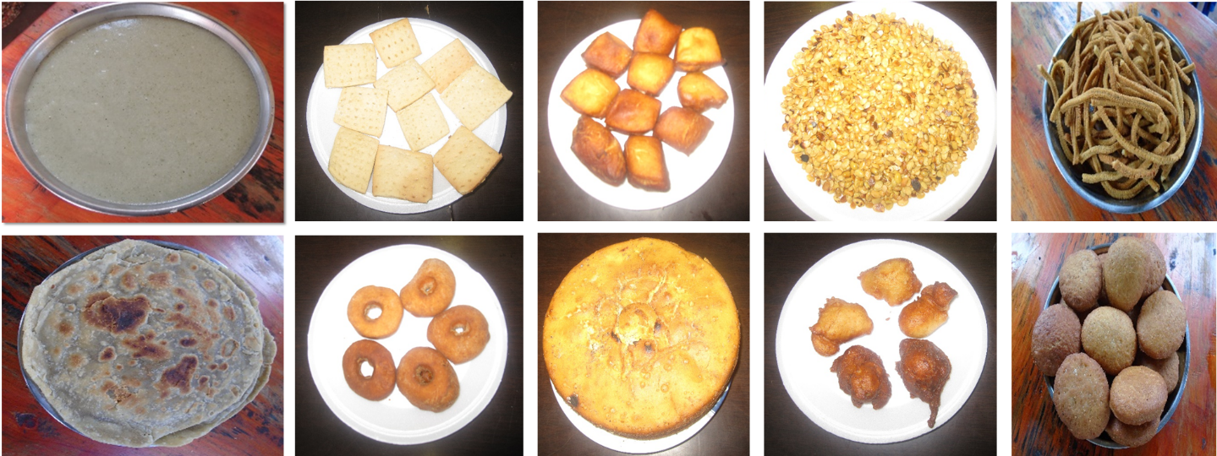





Implementing community-based nutrition intervention through farmer-to-farmer technology delivery
Christopher Mutungi¹, Audifas Gasper¹, Mateete Bekunda¹ and Adebayo Abass¹
¹International Institute of Tropical Agriculture (IITA)
The Challenge
Many households in Tanzania thrive on maize-based farming systems. Diets are predominantly rich in starch but low in protein and micronutrients. Low knowledge and inadequate skills to prepare safe and nutritious food are underlying cause of poor nutrition.
Africa RISING validated nutrient-dense diversified food ration for infants
Ingredient | Food group | Quantity | Key nutrients
Maize | Cereal | 100g | Calories
Soybean | Legume | 50g | Protein, unsaturated oils incl. Omega 3s,
Common beans* (or) | Legume | 50g | Protein/ calories/ Ca, Fe, Zn, B Vits
Pigeon pea* | Legume | 50g | Protein/ calories/ Ca, Fe, Zn, B Vits
Dried green leafy vegetables | Vegetables | 50g | Micronutrients (Ca, Fe, Vit. A)
Milk | Protein | 200 mL | Protein/ micronutrients
Eggs | Protein | 50g | Protein/ micronutrients
Sugar | Sweetener | 2 tbsp. | Calories
Water |  | 1000 mL
How challenge is being addressed
Through research, Africa RISING is introducing nutritious crops and animal products to households (Fig.1).
Households’ capacity to process and preserve the produce is built;
Confidence of caregivers to prepare hygienic, balanced, and acceptable dishes is enhanced through participatory education and training in village-based processing and nutrition centres (Fig. 2).
Sustainable intensification benefits of the nutrition-based research
Validated improvements
Productivity | Economics | Human condition | Social
Food diversity ↑ 10%: | Market participation ↑40% | Dietary diversity ↑150% Underweight ↓100 % Wasting ↓ 100% Aflatoxin exposure ↓66-82% | Acceptability: 82-94% Women autonomy in nutrition decisions ↑ Group cohesion ↑
Farmer- to-farmer delivery
Figure 1: Africa RISING nutrition-sensitive crop and livestock production arrangements are supported with validated post-harvest technologies to preserve produce and improve quality.
Partners
Figure 2: Farmers are educated and trained on how to process nutritious products and upgrade diets using local produce. New products are developed, tested, and validated.
This poster is licensed for use under the Creative Commons Attribution 4.0 International Licence. November 2019.
We thank farmers and local partners in Africa RISING sites for their contributions to this work. We also acknowledge the support of all donors who globally support the work of the CGIAR centers and their partners through their contributions to the CGIAR system

