Slide 1

Improving collaboration between research and the private sector to accelerate livestock innovation for sustainability into use: EMBRAPA experiences with sustainable partnerships
Fabiana Villa Alves, Empresa Brasileira de Pesquisa Agropecuária
Lightning presentation at a parallel session, 9th Multi-Stakeholder Partnership Meeting of the Global Agenda for Sustainable Livestock, Manhattan, Kansas, 9-12 September 2019

Slide 2
Introducing me!
Who I am
  FABIANA VILLA ALVES
My organization
  Brazilian Agricultural Research Corporation (Embrapa) / Brazilian Ministry of Agriculture, Livestock, and Food Supply
What my organization does related to public-private partnerships to deliver research innovation for sustainable livestock systems
  We are a technological innovation enterprise focused on generating knowledge and technology for Brazilian agriculture, through Technology Transfer (TT), Knowledge Exchange and Collective Knowledge-Building
#LivestockAgenda

Slide 3
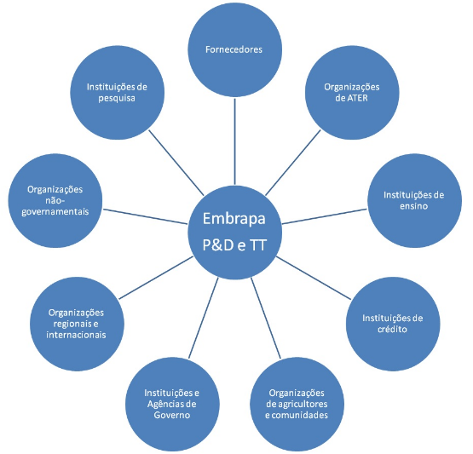
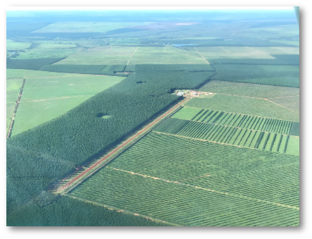
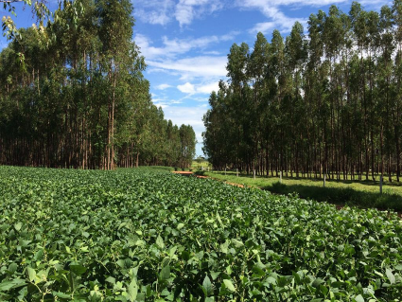
Embrapa Technology Transfer

Slide 4
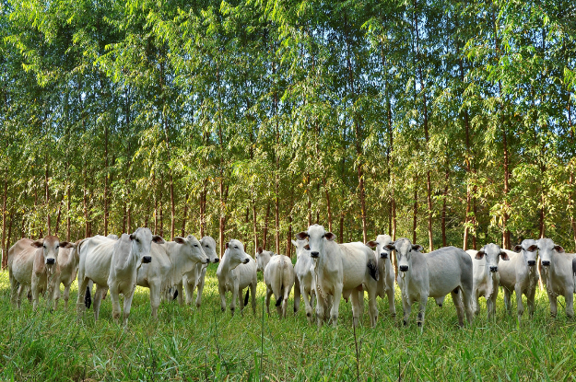




Public-private partnership Embrapa – Marfrig Foods
Carbon Neutral Brazilian Beef and Low Carbon Brazilian Beef
Strategic Alliance for Technology Development and Value Added to Agricultural Chain Products and Services
How was it successful?
  Technical and Financial Cooperation Agreement
  Commercial License Agreement for jointly developed technology solutions
Why?
  high impact research theme
  commercial brand based on scientific findings
#LivestockAgenda

Slide 5
Public-private partnership Embrapa – «Another food processing company”
Carbon Neutral Brazilian Beef and Low Carbon Brazilian Beef
Strategic Alliance for Technology Development and Value Added to Agricultural Chain Products and Services
How didn’t it work so well?
  Several meetings and no concrete action
  «Jealousy»
Why?
  Bureaucracy
  Poor strategic view
#LivestockAgenda

Slide 6

My ‘gems’ of advice
For investors
  Look for reliable partners and believe in them!
For implementers
  Choose a product/ program with a strong «story telling»
#LivestockAgenda

