Slide 1

Knowledge Management, Monitoring and Evaluation and Embedding Learning in Your Work
Unit 4 of the Knowledge management in agriculture and rural development (KM4ARD) course

Slide 2
Overview of Unit 4
Purpose:
• Understand how KM, M&E and learning are interlinked and how they can build on each other
• Understand how quantitative tools can help to measure the impact of KM
• Understand how qualitative techniques can help to evaluate KM
• Identify some monitoring tools and evaluation techniques, and methods to integrate learning

Slide 3
Learning
Is a process that people go through as they develop new knowledge
Two people doing the same action might learn different things, based on their own perspectives, and on what is important to them in the experience
It can both individual and collective
Notes:
Trainers notes
Link from last slide: .. let’s first start by defining our terms…
Those different facets of learning are important, there isn’t just one way to learn.

Slide 4
Knowledge Management
Can create a more adaptive, responsive, dynamic and flexible organisation to improve and accelerate learning
PKM can do the same on a more personal level
The Learning Organisation” (P. Senge): “an organisation that continually improves its capacity to create its future, where people are continually upgrading their skills to achieve the results which are desired, spreading new patterns of thoughts, ideas and growing collectively”
Notes:
Trainers notes
Link from last slide: … and as we know, KM can…
The Learning Organisation..: this definition from Peter Senge’s book The Fifth Discipline (1990) can be considered a KM book, although it actually predates the term.

Slide 5
Monitoring and evaluation
Should also be learning processes but learning is usually not the primary focus of M&E systems
Accountability still the driver, showing a good use of funds, efficiency, effectiveness etc.
Evaluation is experienced as punitive at worst or irrelevant at best by partners who usually have very different goals and perspectives than external donors
Notes:
Trainers notes
Link from last slide: … and, as we know, M&E should also be about learning…
Monitoring should really the mechanism for reflection and learning but it is often not done.

Slide 6

Effective learning approaches to M&E in ARD
Continual learning is essential for sustainable change
Involve multiple stakeholders in ways that balance their interests and priorities (including accountability)
Combine quantitative and qualitative methods which together lead to more comprehensive understanding
Using iterative, continual reflective feedback approaches to determine what is happening and why it is happening
Notes:
Trainers notes
Link from last slide: … but the thing is, learning is crucial to ARD because…
ARD should be at the forefront of integrating learning approaches because adapting and adaptation is central to the work.

Slide 7
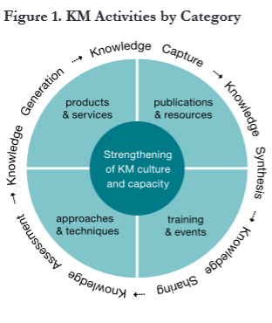
M&E and learning within KM initiatives
Different KM initiatives have different M & E methods
What can we measure? Quantitative
What can we assess? Qualitative
Both are important
Guide to Monitoring and Evaluating KM in Global Health Programs - Ohkubo, Sullivan, Harlan, Timmons and Strachan (2013)
Notes:
Trainers notes
Link from last slide: … so what about the KM initiatives themselves, how can we use M&E to learn from the KM activities?
Both are important: a combination of qualitative and quantitative ensures that the limitations of one type of results is balanced by the strengths of the other.
Figure 1: Global Health program example of a KM framework, with activities (lighter blue). For each activity, both qualitative and quantitative tools can be used to measure and assess effectiveness or impact.

Slide 8

Quantitative tools
Collect numerical data to measure impact
Particularly useful for understanding the prevalence or intensity of a given issue
Collect them to be able to answer questions linked to KM objectives or goals
Many tools exist but we will look at two:
  KM Indicators
  Web metrics
Notes:
Trainers notes
Link from last slide: … so let’s first look at how we can measure impact with quantitative tools
Collect them…: quantitative data can also be useful to defend or promote, as it is considered “hard” data and often much appreciated by management.

Slide 9

KM Indicators
Closely tied to context, the more an indicator is tailored to a specific project, the better it is
Advantage of indicators: allow you to make comparisons between projects (benchmarks)
Usefulness depends on its purpose and what one is aiming to measure, achieve or prove
Notes:
Trainers notes
Link from last slide: … the first tool is KM indicators…
Usefulness depends…: also, most useful indicators are often easy to use, clearly stated and quick to measure.

Slide 10
Examples of indicators for KM
# or % of staff who are able to provide an example of how knowledge activities contribute to the organisation achieving its objectives
# or % of staff/partners who believe this is a learning organisation
# or % of staff who can give an example of where learning from a partner improved a programme or policy
Notes:
Trainers notes
Link from last slide: … here are some concrete examples of indicator for KM…
Again, these need to be tied to your context and what you are trying to do in KM. Generic indicators rarely work well.

Slide 11

Web metrics
Website statistics
Metrics can help to indicate:
  Reach: if the site’s existing audiences are indeed the intended stakeholders
  Penetration: the extent to which the site is reaching – or not – the intended audience
  Engagement: stakeholders are coming back repeatedly, viewing more content and interacting with the site
  Content preference: what people are looking for
Notes:
Trainers notes
Link from last slide: … now web metrics is the second quantitative tool we will be looking at. They are basically…
(Stress once more that web metrics is only part of the story but a very useful one).

Slide 12

Web metrics tool example: Google Analytics
Free software that tracks which pages website visitors view, the amount of time they spend on the site, resources downloaded, the geographic origin of users, and whether the visitor is new or returning
http://www.google.com/analytics
Select what you want to track by adding code on your website
Notes:
Trainers notes
Link from last slide: … Google Analytics is a tool that you can use to collect web metrics. It is…
Google Analytics can help you to understand exactly what your visitors are doing on the site. You can create different types of reports.

Slide 13
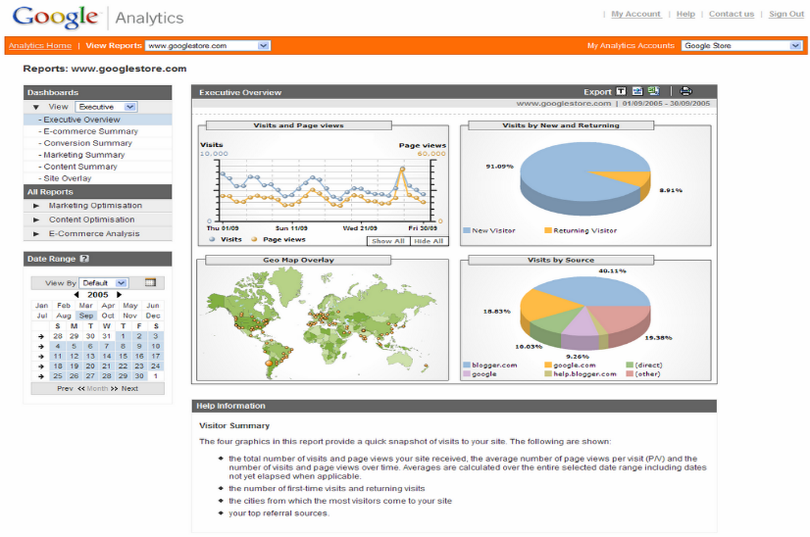
Google Analytics
Notes:
Trainers notes
Link from last slide: …to illustrate, here is a screen shot of the Google Analytics dashboard.
Here you can get a visual overview of the statistics that you are tracking.

Slide 14

Potential questions related to objectives
Over time and on average, is the site growing in audience reach and engagement?
How have our actions affected site traffic, either positively or negatively?
When people visit the site, do they find what they are looking for?
Are visitors returning?
Is the site attracting the number of new visitors we should expect given our efforts?
Notes:
Trainers notes
Link from last slide: … there are many things that you may want to track but they should be linked to your objectives, here are some examples…
Depending on your objectives, you can come up with a variety of different questions.

Slide 15

Qualitative techniques
Quantitative indicators can often tell what is happening but fail to answer the question ‘why?’
Qualitative is a way of describing things in a non-numerical way which provides a more nuanced understanding of results
Many techniques exist and are embedded in qualitative methods such as:
  Appreciative inquiry
  Most Significant Change
  Learning Histories
All either use interviews and/or stories
Notes:
Trainers notes
Link from last slide: … the second type of results you might want to collect is qualitative…
All either use…: so the objectives of these techniques is getting to the “why”, to understand better what is happening. And one good way of doing that is by asking questions.

Slide 16

Interviews
Semi-structured interviews with questions designed to elicit in-depth responses from participants
Advantage: provide detailed information and give the opportunity to ask follow-up questions
Can be face-to-face (individual or focus group) or telephone/Skype
Notes:
Trainers notes
Link from last slide: … one technique based on question is interviews…
Semi-structured…: this means, have a prepared framework of questions but don’t hesitate ask follow-up questions if some responses are particularly interesting.

Slide 17

Interview questions
Short, clear
Open-ended
Neutral, avoid leading questions
Non-threatening
Avoid double-barrelled, i.e. two questions into one
Notes:
Trainers notes
Link from last slide: … it’s important to ask good questions, which means…
Think through your questions very well to make sure that they observe these five points.

Slide 18
Guide to conducting interviews
Design:
  an interview framework comprised of open-ended questions arranged in a logical and natural sequence
  a summary form to capture the interview results
During the interview:
  use a variety of probing questions to help extract ideas and keep the talk focused
  ask follow-up questions when needed
  limit the length of the session to no more than an hour
Notes:
Trainers notes
Link from last slide: … it is important to prepare an interview well and design…
Limit the length: this last point is important, make sure that you don’t end up going too long. Interviews are quite intense for both the interviewee and the interviewer. Try to keep to the allotted time as much as possible.

Slide 19
Using stories to evaluate KM
Stories are narratives told or recounted in the form of a causally-linked set of events
Use in evaluating KM:
  To depict how people experience KM
  To understand KM outcomes
  To get insights into KM processes
Notes:
Trainers notes
Link from last slide: … a second technique that captures qualitative data is stories. They are…
Use in evaluating…: stories are used for a variety of purposes in the field of knowledge management. This is specifically how they can be used as a qualitative method for Monitoring and Evaluation.

Slide 20

Types of stories that can be useful
Within KM programs:
Something happened that was wonderful was...
The best/worst thing about the KM activity was...
Learning and change:
The biggest change I've ever made was . . . I learned something that changed how I work
The biggest change I've ever made was...
The most important thing I've ever learned was...
Notes:
Trainers notes
Link from last slide: … here are some examples of the type of probing that can elicit stories for specific uses.

Slide 21
Most Significant Change
Methodology to collect, analyse and evaluate stories that is increasingly being used in evaluating projects
3 basic steps in MSC:
  Decide the types of stories that should be collected (stories about what, for e.g. a change in practice)
  Collect the stories and determine which stories are the most significant
  Share the stories and discuss with stakeholders so that learning happens about what is valued
Uses both stories and interviews
Notes:
Trainers notes
Link from last slide: … a specific type of story that is collected is the “change story”. Most Significant Change is a…
Uses both stories…: the interview part is during the discussions to make sense of the stories and understand what have learned.

Slide 22

Exercise: capturing change stories
Individually, think of a story regarding your work that involves a change in (for e.g.):
  Decision-making skills
  National policy
  On-farm practice
  Profitability/productivity
  Any other significant change
Take turns telling your story at the table (please make it short!)
Notes:
Trainers notes
Link from last slide: … we will try our hand at telling and capturing change stories in the following exercise…
See Unit 4 Exercise note

Slide 23
Exercise: capturing change stories
Select one of the stories to work on 15 minutes for the exercise
One template, four roles:
  Storyteller – tells story
  Interviewer – asks questions
  Note-taker – fills template
  Observer(s) – observe(s), keeps time
Have you heard interesting stories? Does anyone want to share their story with the group?
Notes:
Trainers notes
See Unit 4 Exercise note

Slide 24
Questions? Comments?

Slide 25
Embedding learning in your work
Learning from experience is often an afterthought
Reflection time is not usually embedded in project cycle
Scramble at evaluation time to come up with lessons learned
Some simple, facilitated reflection processes can be done before starting a project/program, as well as during and after
Notes:
Trainers notes
Link from last slide: … we are now going to look at embedding learning in your daily work…
Some simple…: the idea is to embed this reflection and capture the results as we go.

Slide 26
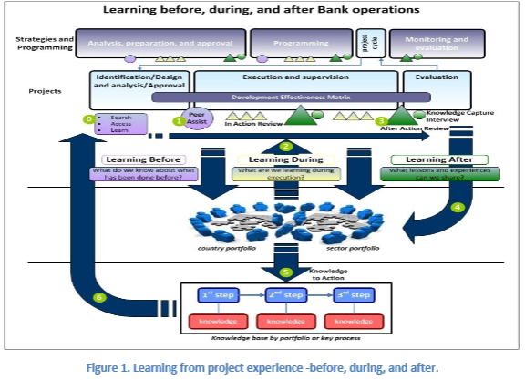
Example: learning before, during and after - IADB
Notes:
Trainers notes
Link from last slide: … here is a process that can help in doing this reflection and capture…
This is an illustration of learning before, during and after, as used at the Inter-American Development Bank. The line that is directly under the projects, with the circle and triangles, is where the reflective processes are.

Slide 27
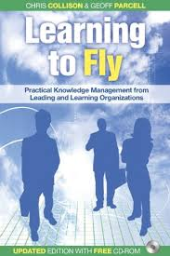
Learning before, during and after
Learning before: before we tackle any sizeable project, we ask who has done it before and what can we learn from them?
Learning during: at intervals during the project we pause, check if we are on course and ask what have we learned?
Learning after: at the end of the project , we take time to stop and capture our learning and present it in a way that a future user could find it and re-use it
Notes:
Trainers notes
Link from last slide: … more specifically, these are the questions behind each of the three elements…
This process comes from a KM book called “Learning to Fly” by Chris Collison and Geoff Parcell.

Slide 28

Learning before: peer assist
Link: www.youtube.com/watch?v=ObmQyW3EiiE
Notes:
Trainers notes
Link from last slide: … this short video explains the peer assist process, which can be used for “learning before”.
(Stop the video at 5:26).

Slide 29
Learning before: peer assist
Brings together a group of peers to gain feedback on a problem, project, or activity
Identify possible approaches or new lines of inquiry to deal with their challenge
Useful at the start of a project
Can also be used as one-off consultation (such as in the video) or in events or workshops
Any ideas on how can you use it in your work?
Notes:
Trainers notes
Link from last slide: … so to summarize the peer assist process, it…
During workshops, you can even do multiple concurrent peer assists, where participants rotate from one to another. This is the last part of the video, which we didn’t show.
Any ideas…: let’s do a 5-minute popcorn session, getting a few comments from the room.

Slide 30
Learning during: After-action review (AAR)
Group reflection to capture lessons
During a project (for e.g. midcourse) to reveal what has been learned, reassess the direction and review lessons
The AAR questions are:
  What was supposed to happen?
  What actually happened?
  What went well, and why?
  What can be improved and how?
  What would you do differently next time?
Notes:
Trainers notes
Link from last slide: … the second element is “learning during” and the technique that is linked with this is the after-action review. The AAR is…
During a project…: the AAR process can also be done during and after an event or workshop.

Slide 31

Exercise: After action review
You Tube: http://youtu.be/uD5sPgV61bw
Notes:
Trainers notes
Link from last slide: …in order to do an AAR, we will be watching a very old news clip. Listen carefully, as the sound quality isn’t optimal. If need be, we’ll watch it a second time. Then afterwards, we’ll do the AAR reflection
(Ask if people need to watch it again).

Slide 32
Exercise: After action review
At your table, take 20 minutes to go through the AAR questions:
What was supposed to happen?
What actually happened?
What went well, and why?
What can be improved and how?
What would you do differently next time?
Notes:
Trainers notes
Link from last slide: … let’s try doing an after-action review based on the clip that we’ve just watched.
See Unit 4 Exercise note

Slide 33
Learning after: Retrospect
Longer, more in-depth AAR that lasts one day or more
The Retrospect questions are:
Q1- What was(were) the objective(s) of the project?
  Circulate original terms of reference and any measurables before the meeting
Q2 - What did we achieve?
  Were deliverables delivered? Were deadlines met? Etc.
  Chart the process, what actually happened?
Notes:
Trainers notes
Link from last slide: … now the last element of the before, during and after process is the Retrospect. It is a…

Slide 34
Learning after: Retrospect
Q3 - What went well in this project?
  Successful steps towards meeting the objective(s)
Q4 – What could have gone better?
  What happened to make this sub-optimal?
  What was missing that meant this happened?
  How can we ensure that future projects go better?
Q5 - Looking back over the history of this project, how satisfied do you feel?
  Closure exercise - for the meeting and for the individuals
Notes:
Trainers notes
Link from last slide: … other questions in the Retrospect are…
This should be a facilitated process and the responses to the questions need to be captured by a rapporteur.

Slide 35
Experience capitalisation/ systematization
Participatory and multi-stakeholder learning initiative
Systematic way of documenting lessons learned in field projects with the intention of using those lessons to improve subsequent phases of your project
Both a process and a product
Different approaches, all built into projects (e.g. multi-stakeholder workshops)
Notes:
Trainers notes
Link from last slide: … another way of embedding learning in your work is through experience capitalisation, also known as systematization. This is a…
We will discuss more on capturing lessons learned in Unit 6.

Slide 36
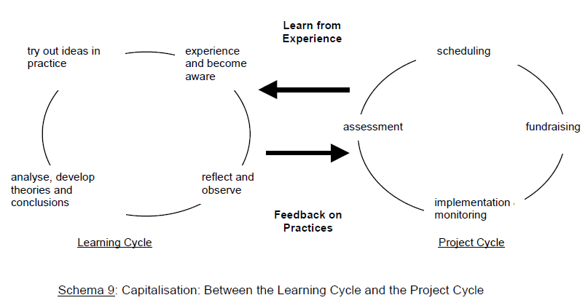
Experience capitalisation/ systematization
Villeval and Lavigne Delville. Learning and Sharing Experience Lessons for Learning Processes in NGOs. 2004
Notes:
Trainers notes
Link from last slide: … this graphic illustrates what experience capitalisation is.
Let’s start with the project cycle on the right. As we learn from experience in the project cycle, we set off the learning cycle, which feeds back into the project cycle. The two are linked together.
FAO is currently developing an IMARK self-learning module on experience capitalisation.

Slide 37
Questions? Comments?

Slide 38
Credits
This learning material was prepared by Lucie Lamoureux for CTA.
The Technical Centre for Agricultural and Rural Cooperation (CTA) is a joint international institution of the African, Caribbean and Pacific (ACP) Group of States and the European Union (EU). CTA operates under the framework of the Cotonou Agreement and is funded by the EU. For more information on CTA, visit www.cta.int
Disclaimer
This work has been made with the financial assistance of CTA. However, it remains under the sole responsibility of its author and never reflects CTA's nor the European Union's opinions or statements whatsoever. The user should make his/her own evaluation as to the appropriateness of any statements, argumentations, experimental technique or methods as described herein.
Copyright notice
Reproduction and the dissemination of these modules and supporting materials is encouraged under the terms of the Creative Commons Attribution License (https://creativecommons.org/licenses/by/4.0/legalcode), provided that appropriate acknowledgement is made:
  – of CTA's copyright, in accordance with the license Creative Commons 4.0, by including the name and the title of the article or chapter,
  – and that CTA's or the EU's endorsement of authors' views, products or services is not implied in any way, by including the disclaimer.
March 2015

