Slide 1

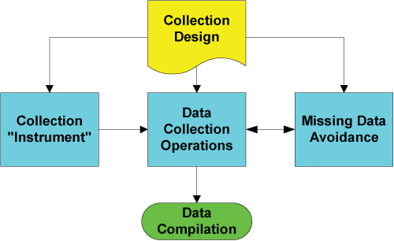
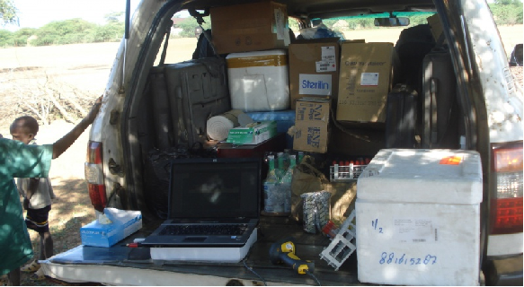
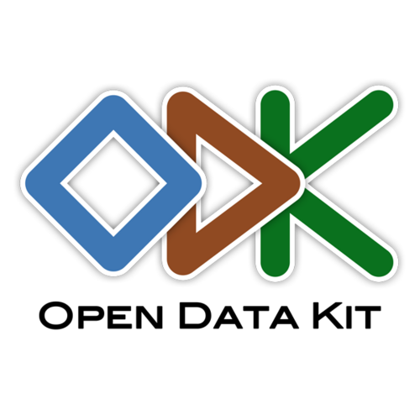
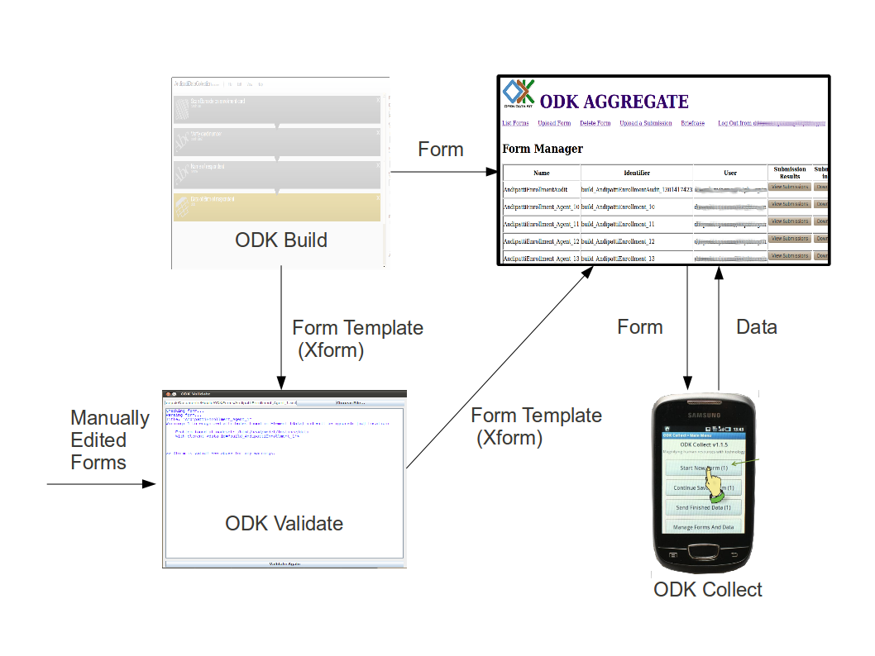
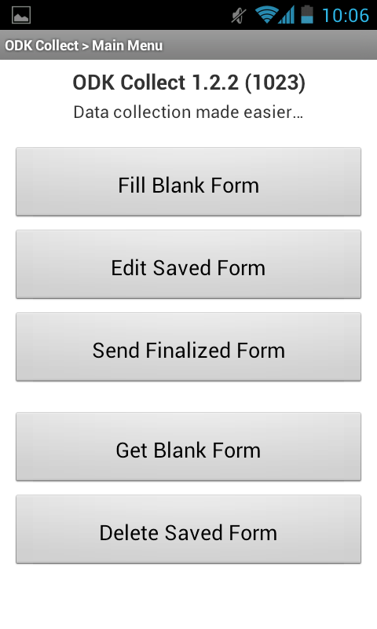
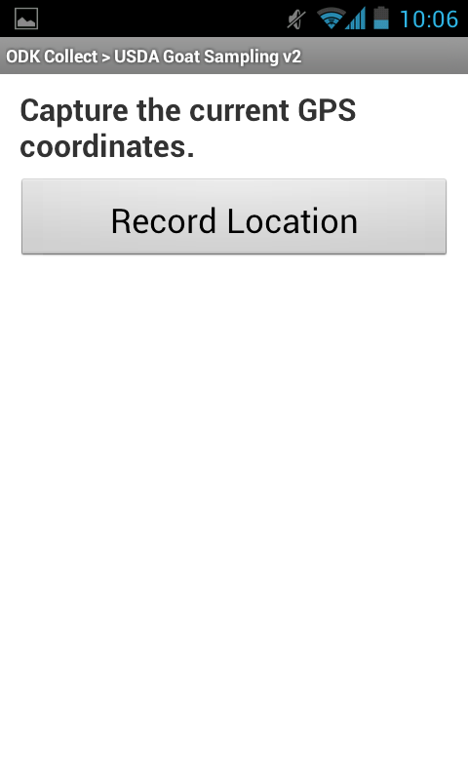
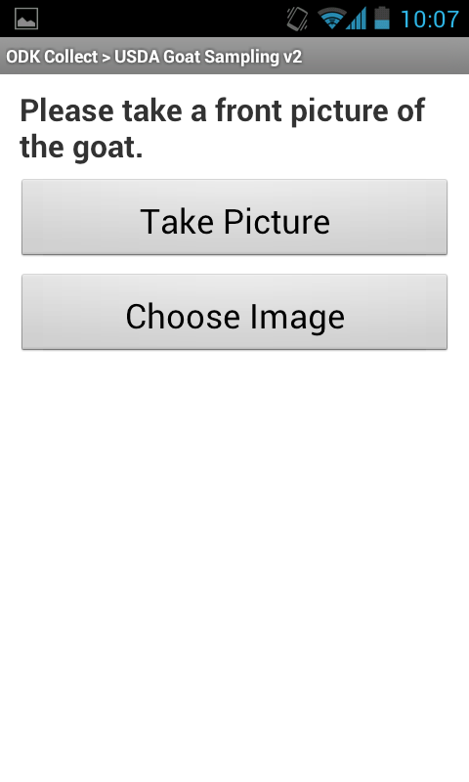
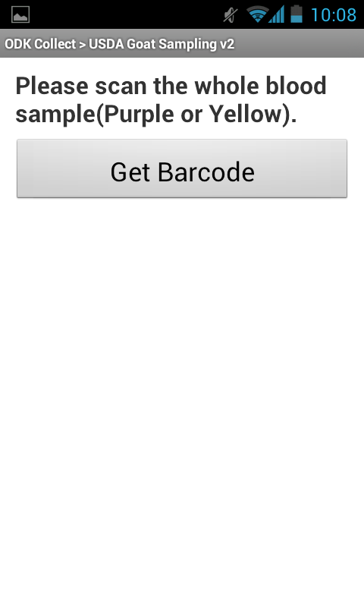
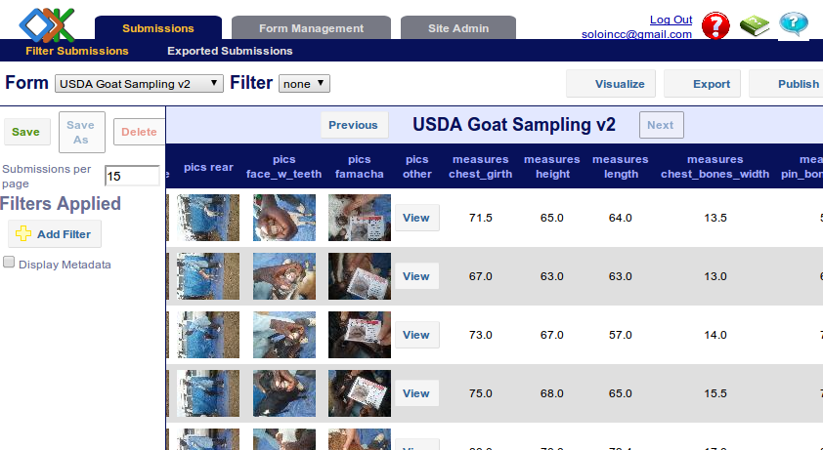



ODK - A premier sampling support tool
By Kihara Absolomon, Kemp Steve
Overview
Field sampling, an integral part of research, is a very expensive activity which is often unpredictable and can go awfully wrong if not properly planned. It usually marks the onset of the actual research activities and if it goes wrong, the downstream activities will be compromised.
The data associated with the collected samples is critical and is often neglected. It is imperative to get the data collection right for several reasons:
To maximize the understanding of the biology - different pieces of information about identical samples around the same time collected in the same region
To maximize the downstream return on expensive sampling trips
To provide a holistic picture of samples to assist in the downstream processing.
Field data collection can be quite complex depending on what is being collected, how it is being collected, the circumstances surrounding the exercise, the application being used for data collection among other factors. While most of the factors are beyond the data collectors’ control, the application should work flawlessly as it is a human creation that can be perfected.
An ideal data collection tool should be light and portable, in that it can be used right at the point of sample collection, intuitive, flexible and simple to use. It should at least support all of the different data types including pictures, barcodes, video, audio and the typical data, i.e. text, numbers, multiple select questions, etc, all tied with a simple and clear logic flow.
ODK to the rescue
Open Data Kit (ODK) is a free and open-source set of tools to help create mobile data collection services. The tools that are geared towards simple, effective and efficient data collection on mobile devices. The ODK suite is developed on the ideas that:
Use of mobile devices for field data collection
Data should be recorded as soon as it is entered (preferably not on a piece of paper)
Data recorded electronically is better than recording data on paper
The recorded data should be sent to the server as soon as it is entered
Data capture should be as detailed as possible
ODK Suite of tools
ODK Build and ODK Validate are used to design the questionnaires/forms and validate them for use on the phone
ODK Collect is the data collection application that is installed on the phone. ODK Collect renders forms into a sequence of input prompts that apply form logic, entry constraints, and repeating sub-structures.
ODK Aggregate is a server application that manages the saved form instances and provides some basic analysis. It provides a ready-to-deploy server and data repository to:
ODK Briefcase is a standalone application that is used instead of ODK Aggregate to gather and manage data in cases of no internet connectivity.
ODK Collect
ODK Aggregate
ODK Aggregate is a server application that manages the saved form submissions and provide some basic analysis of the data.
It is the main application that is installed on a mobile device and is used for the actual data collection.
Features
Mobile based. Compatible with any mobile device running Android OS
Questionnaire based. Looks and feels like a questionnaire
Open source and highly extensible (Free, not as in free beer)
Live upload of data as soon as it is collected
Supports GPS tagging, 1D and 2D Barcodes, Video, Audio, Pictures, etc
Lessons Learned:
Collect the data right at the point of capture
Use latest technologies to solve day to day problems e.g. Barcodes, RFID tags, etc
The alternative; manual data collection typically has 20% – 30% error rate.
Be as a lazy as humanly possible and automate routine data collection procedures
Automate, automate, automate
Acknowledgements:
The ODK Development team and ODK Community, http://opendatakit.org/
The Arbo Virus Incidence and Diversity Project (AVID) funded by http://google.org
The Genomics Team in the Animal Biosciences Group
Unlocking livestock development potential through science, influence and capacity development ILRI APM, Addis Ababa, 15-17 May 2013
This document is licensed for use under a Creative Commons Attribution-Noncommercial-Share Alike 3.0 Unported Lisence May 2013

