Slide 1

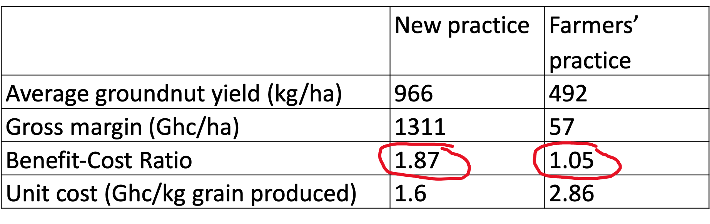
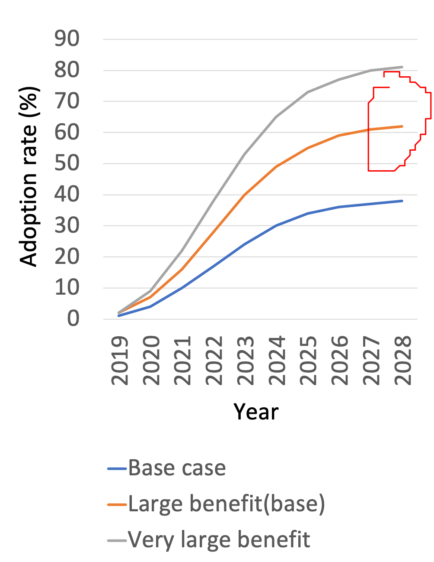
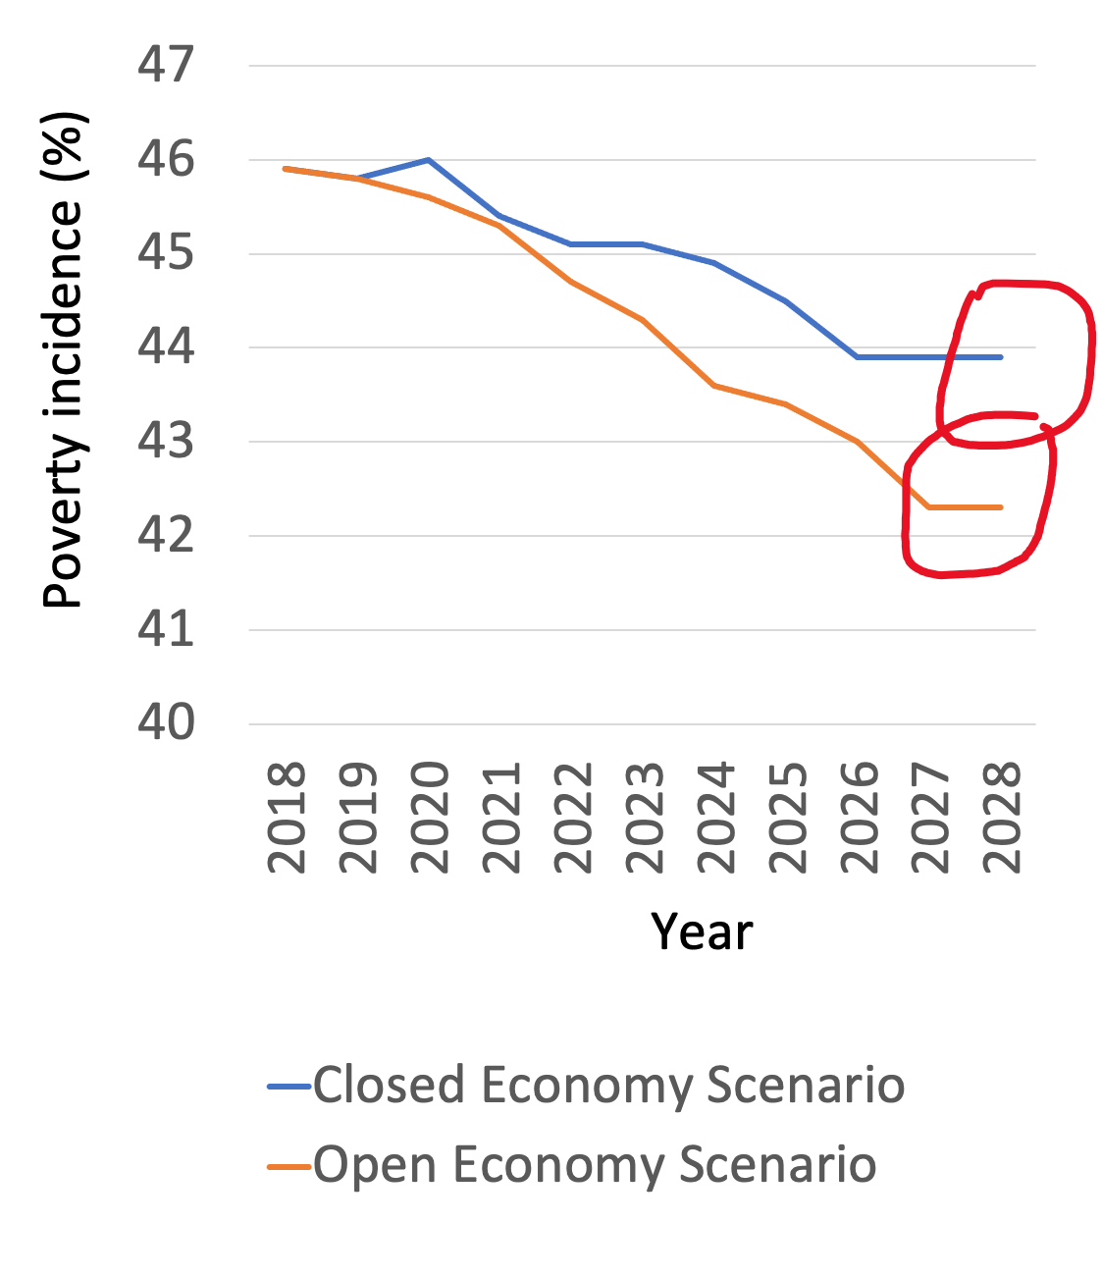
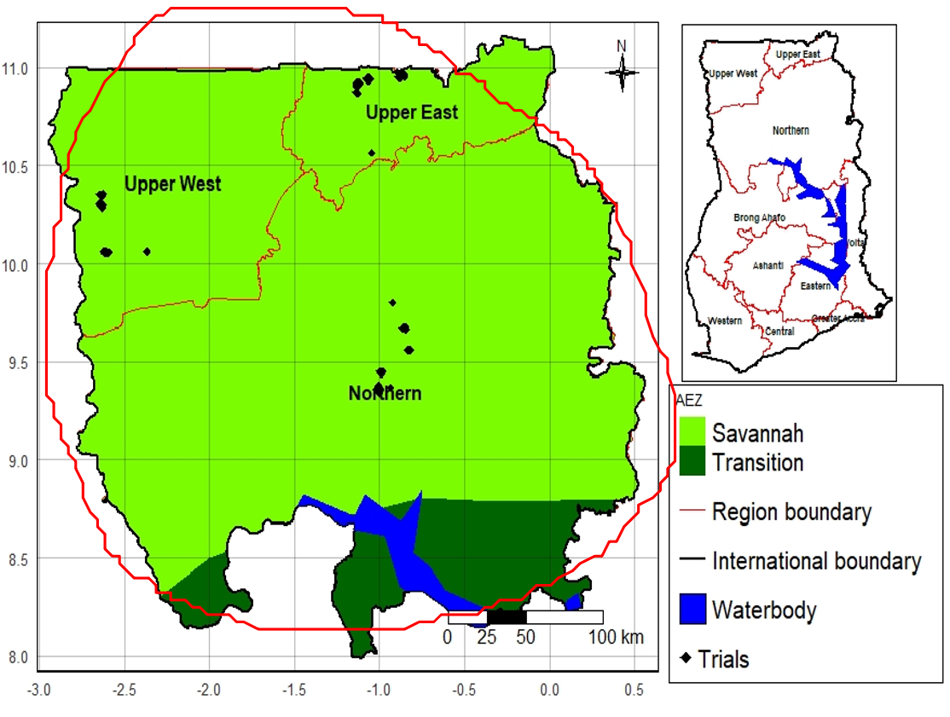





Potential impact of groundnut production technology on welfare of smallholder farmers in Northern Ghana
Bekele Hundie Kotu¹, Abdul Rahman Nurudeen¹, Francis Muthoni¹, Irmgard Hoeschle-Zeledon¹, Fred Kizito¹
¹International Institute of Tropical Agriculture
Contact: b.kotu@cigar.org
Introduction
Groundnut is a dominant legume crop in Ghana (55% of the total legume production).
Northern Savannah accounts for more than 90% of the total production
Farmers plant the seeds very sparsely (about 9 plants/m2) which becomes one of the causes for low yield
Recently a higher planting density (22plants/m2) has been introduced by the International Institute of Tropical Agriculture (IITA) under its project known as Africa RISING
This study (1) assesses the economic advantage of adopting the new technology, (2) predicts its potential adoption, and (3)assess its potential impacts on household poverty
Results
Table 1: Partial budget analysis of on-farm groundnut spacing trials
The study areas
The study was conducted in three regions of Northern Ghana, namely: Northern Region, Upper West Region, and Upper East Region (Fig. 1).
Figure 3: Predicted adoption rate
Figure 4: Impact on poverty
Figure 1: Location of the study areas in Tanzania
Conclusion and policy implications
The new technology is expected to be adopted by about two-third of the groundnut farmers within ten years
The adoption is expected to reduce poverty by 3.6% under an open market economic policy and by 2% under a closed market economic policy.
Improving farmers’ access to the international market while enhancing domestic market integration increases the impact of the technology
Data collection and analysis
We used data from on-farm experiments, focus group discussions, and a household survey. We compared a new planting density (22 plants/m2) with the farmers’ practice (9 plants/m2). We followed three steps in our analysis (Fig. 2). The impact estimations were done under the assumptions of open market economy and closed market economy.
Analysis
Cost-Benefit Analysis
Adoption prediction
Impact Estimation
References
Alston, J.M., Norton, W.G., Pardey, P.G., 1995. Science Under Scarcity: Principles and Practice for Agricultural Research Evaluation and Priority Setting. Cornell University Press, Ithaca, NY.
Kuehne, G., Llewellyn, R., Pannell, D.J., Wilkinson, R., Dolling, P., Ouzman, J., Ewing, M., 2017. Predicting farmer uptake of new agricultural practices: A tool for research, extension and policy Agricultural Systems 156, 115–125.
Partial budget analysis
ADOPT
(Kuehne et al., 2017)
Economic surp. model (Alston et al. 1995)
Method
Fig. 2: Procedures and methods of data analysis
We thank farmers and local partners in Africa RISING sites for their contributions to this work. We also acknowledge the support of all donors which globally support the work of the CGIAR centers and their partners through their contributions to the CGIAR system
This poster is licensed for use under the Creative Commons Attribution 4.0 International Licence. September 2020.

