Slide 1




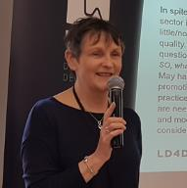



8th World One Health Congress
September 22, 2024
Gender considerations in One Health
Gender responsive One Health research: A framework for researchers (and others)
Prepared by Dr. Zoë Campbell and presented by Dr. Lian Thomas
International Livestock Research Institute (ILRI)
With contributions from
Alessandra Galiè, Anni McLeod, Nicholas Ngwili, and Zelalem Terfa

Slide 2
Why One Health and gender now?
One Health is expected to be gender-responsive
Gender
Gender
Gender
Gender
Gender
(FAO, OIE, WHO and UNEP, 2021)
Notes:
(FAO, OIE, WHO and UNEP, 2021) – One Health High Level Expert Panel
Building gender considerations into all of the work we do.
Recognizing that women and men, girls and boys may each have their own needs and priorities.
Recognising that social customs affect what each of us is able to do, the resources we can access and the decisions we can make – often this is dictated by gender.
Considering other characteristics such as age, health status, education, ethnicity and religion.

Slide 3
What motivates our partners?
  Progress towards gender equality
  More effective development interventions
  Do no harm – minimizing unintended negative consequences
Notes:
Gender customs and norms are an important part of social customs and norms

Slide 4
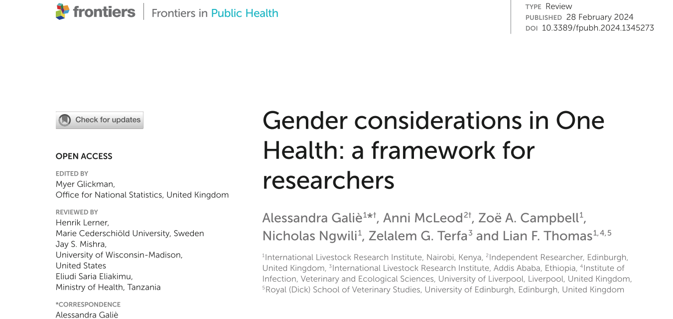
Notes:
https://www.frontiersin.org/journals/public-health/articles/10.3389/fpubh.2024.1345273/full

Slide 5
Gender and One Heath framework
1/
Analyze the existing situation
2/
Prioritize interventions to investigate
3/
Test interventions
4/
Frame recommendations
(designed for research for development projects)
To identify gender issues that need to be considered at each stage and help to design the gender approach that will work best.
INTEGRATED gender questions
Technical issue as entry point
strategic gender QUESTIONS
Gender equity as entry point
institutional support
The support needed to be able to include gender in research work
Notes:
Main points:
Importance of considering gender at EVERY stage of research
Importance of planning and building in the necessary institutional support

Slide 6


Using gender-sensitive research for gender-responsive interventions
1
ANALYZE EXISTING SITUATION
2
PRIORITIZE INTERVENTIONS
Gender-sensitive diagnostic research
Assess status quo:
INTEGRATED
Assess status quo with technical issue as entry point
STRATEGIC
Assess status quo with gender equity as entry point
Gender approaches
Activities that ‘respond’ to gender evidence
ACCOMODATIVE
Acts based on status quo
e.g. Provide info on animal health to those who look after sick animals
TRANSFORMATIVE
Acts that challenge status quo
e.g. Training for those who don’t make veterinary decisions but wish to
Focus of our Gender and One Health Framework

Slide 7
Rift Valley fever vaccination of livestock in East Africa

Slide 8
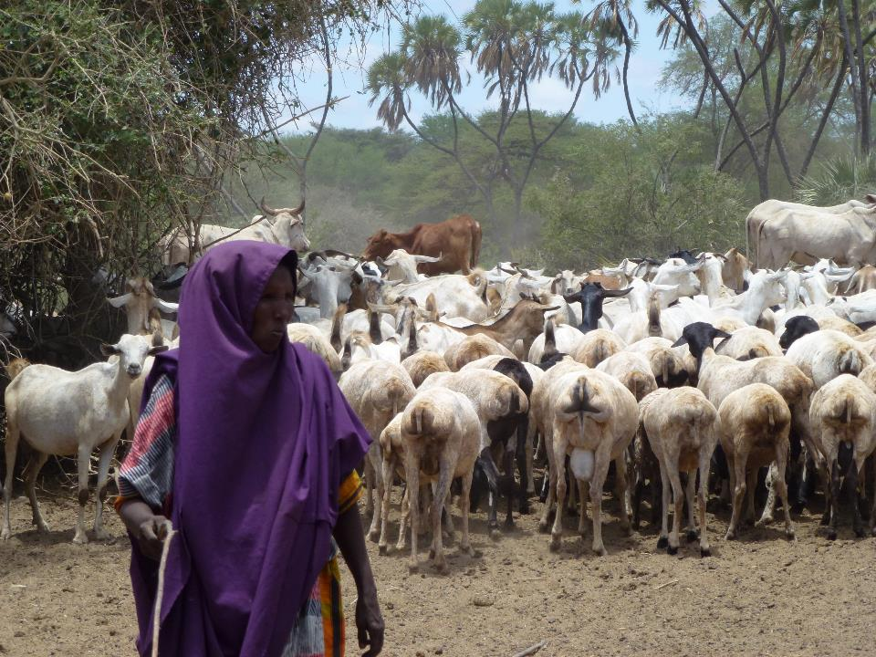
1/
Analyze the existing situation
ILRI/ Fiona Flintan
Notes:
Ewaso Nyiro river

Slide 9
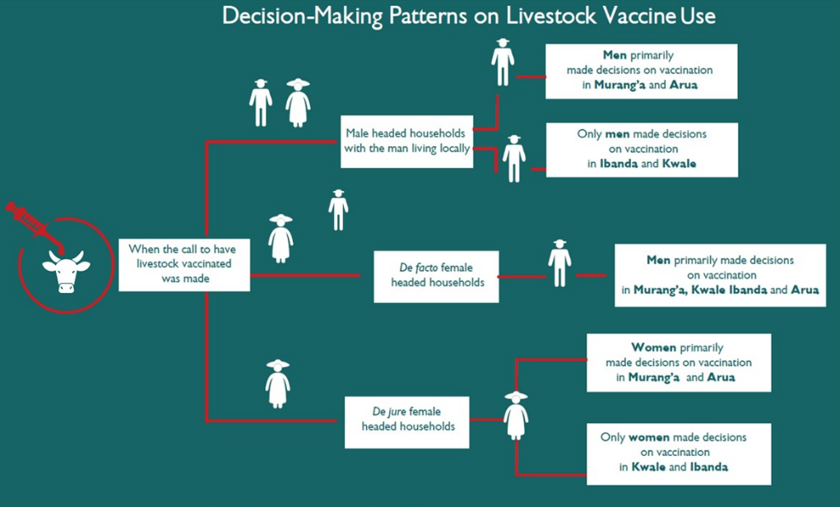
1/
Analyze the existing situation
Mutua, E., Namatovu, J., Campbell, Z., Tumusiime, D., Ouma, E., & Bett, B. (2024). A qualitative study on the effects of intra-household decision-making patterns on utilization of preventive and curative veterinary practices in communities affected by Rift Valley fever in Kenya and Uganda. Gender, Technology and Development.

Slide 10



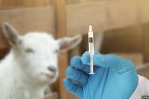
Barriers to women vaccinating for RVF
1/
Analyze the existing situation
Not receiving information in time
Moving animals and intimidation in the queue
Conflict with household responsibilities
Vaccinating is a man’s responsibility
Mutua, E., De Haan, N., Tumusiime, D., Jost, C., & Bett, B. (2019). A qualitative study on gendered barriers to livestock vaccine uptake in Kenya and Uganda and their implications on Rift Valley fever control. Vaccines.
Notes:
https://pubmed.ncbi.nlm.nih.gov/31398887/

Slide 11
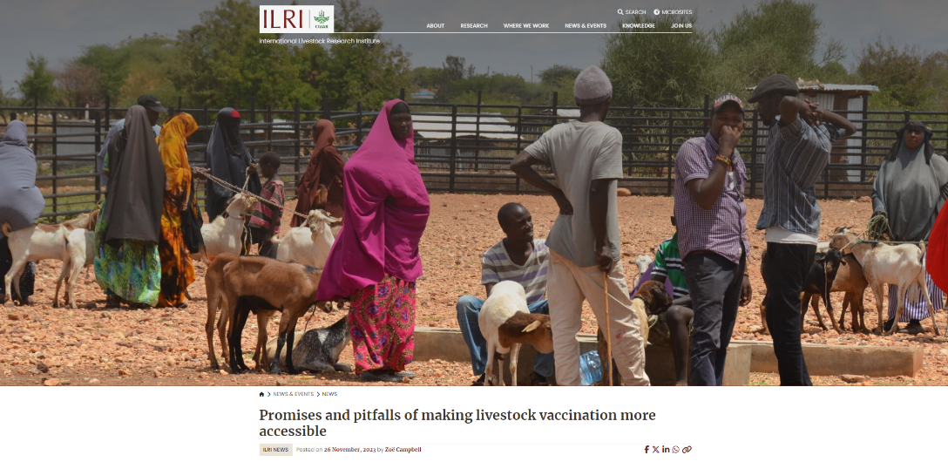
2/
Prioritize interventions to investigate
RVF vaccination campaign, Isiolo County, August 2023
Notes:
https://www.ilri.org/news/promises-and-pitfalls-making-livestock-vaccination-more-accessible

Slide 12
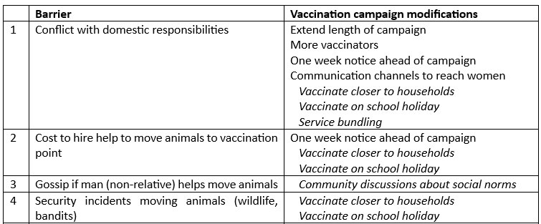
3/
Tst interventions
2/
Prioritize interventions to investigate

Slide 13
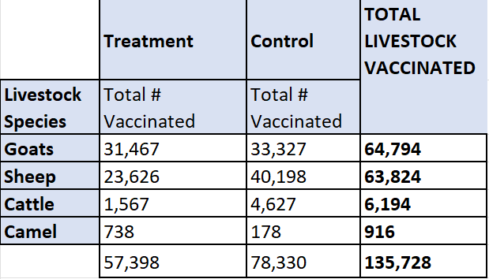
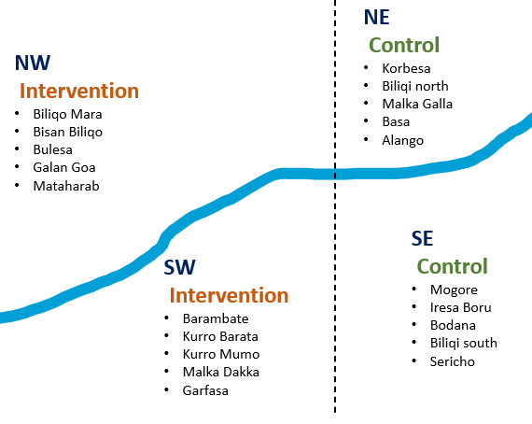

3/
Test interventions
No difference in any of the indicators that would suggest the intervention improved access for women livestock keepers
Notes:
9% of households (81) chose not to vaccinate some animals (average of 47) – mostly pregnant animals

Slide 14
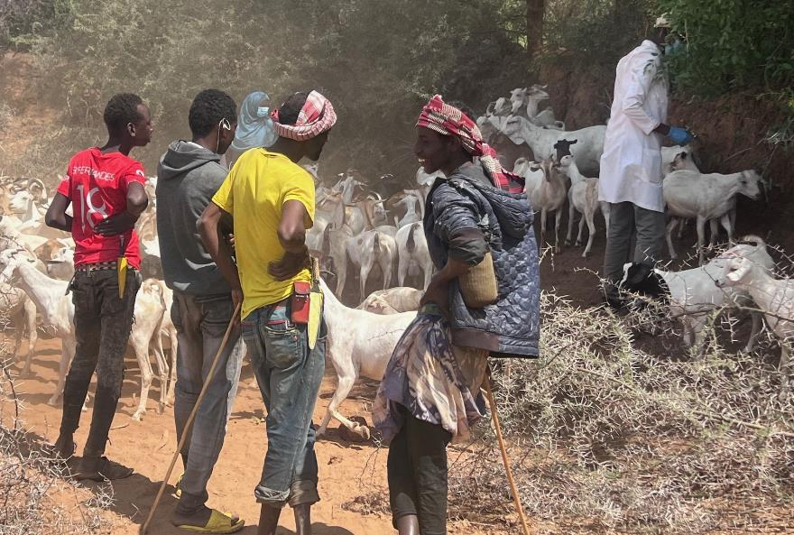
3/
Test interventions
ILRI/ Adan Abdi
51% of women contributed financially, contributions more likely when household heard through word of mouth

Slide 15
4/
Frame recommendations
Our gender ACCOMMODATIVE approach (acts based on status quo) didn’t address barriers caused by RESTRICTIVE GENDER NORMS.
A gender TRANSFORMATIVE approach (challenges status quo) would likely be more impactful.

Slide 16
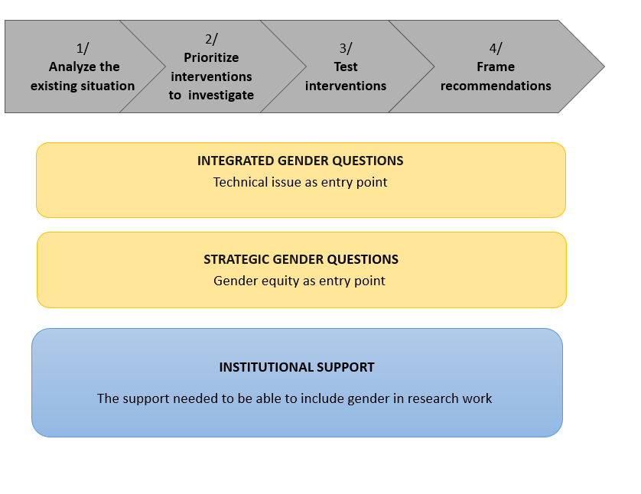

In summary…
  Why gender and One Health?
  Progress towards gender equality
  More effective interventions
  Do no harm
Gender-based disadvantage spirals across 3 health domains
Integrate gender throughout the project lifecycle
Notes:
Gender customs and norms are an important part of social customs and norms

Slide 17
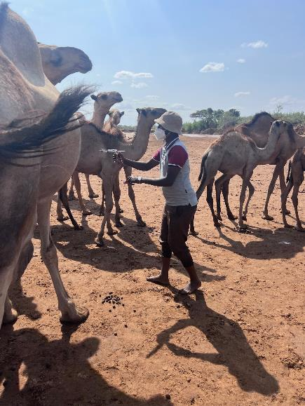




Thank you!
One Health and gender framework
Thanks to the German Federal Ministry for Economic Cooperation and Development through the One Health Research, Education and Outreach Centre in Africa (OHRECA); the Sustainable Animal Productivity for Livelihoods, Nutrition and Gender Inclusion (SAPLING) Initiative, and the One Health Initiative which are grateful for the support of CGIAR Trust Fund Contributors.
Rift Valley fever research
This research was funded by the United States Agency for International Development (USAID) and implemented in collaboration with the Isiolo County Government in Kenya.
ILRI/ Adan Abdi
Notes:
916 camels vaccinated

Slide 18
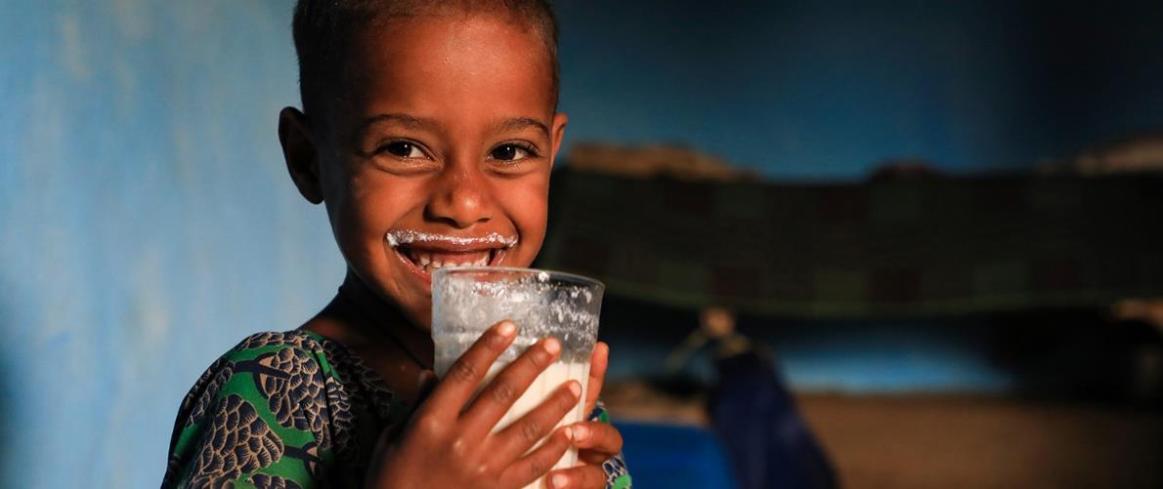
THANK YOU

