Slide 1
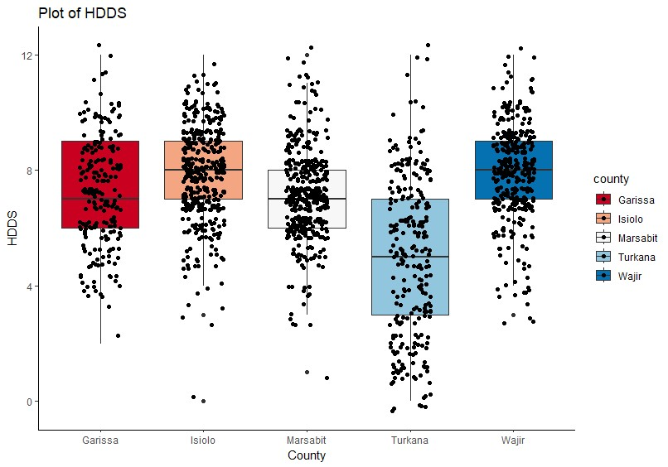
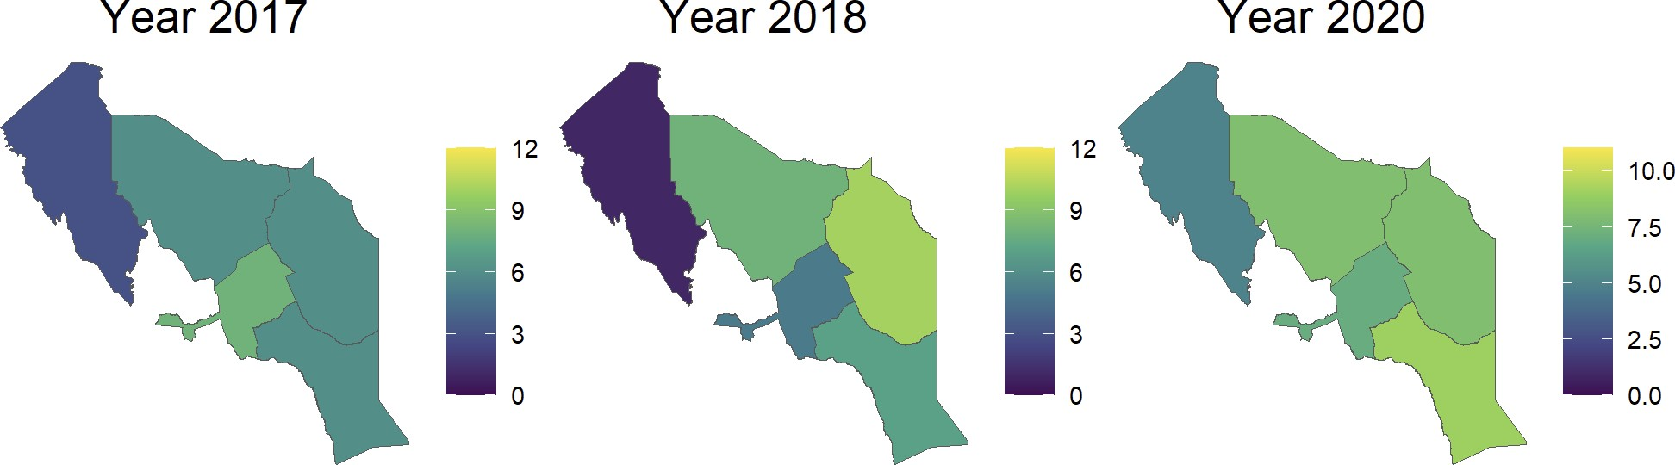


Diet intakes and implications on micronutrient adequacy among pastoralist communities in Kenya
Esther Omosa^{1,2} ; Bernard Bett²; Geoffrey Esekon²; Damaris Mulwa^{2,3}; Paula Dominguez-Salas^{2,4}; Inge Brouwer^{1,5}
Introduction
Results cont’
Pastoralists live in marginal landscapes where they keep livestock that they depend on for food and livelihood. Pastoralists are disproportionately affected by malnutrition. Poor dietary intake especially of nutrient dense foods such as animal sourced foods, fruits and vegetables is a major contributor to the poor nutrition outcomes. Using Household Dietary Diversity Scores (HDDS) and Minimum Dietary Diversity for women can assess the economic access to food by households and the micronutrient quality of diets for Women of Reproductive Age (WRA) respectively. Secondary data from a development project from 2017, 2018 and 2020 were analyzed to assess changes in food access for households in 5 pastoralist counties in Northern Kenya, and quality of diets in 334 women of reproductive age in Isiolo county, Kenya.
The poor diet quality of WRA, only 26.8% consumed a diet
of Minimum diversity
A large proportion consuming less nutritious foods- cereals, roots and tubers. A small proportion consuming-fruits, vegetables and eggs
HDDS was poor mean food groups consumed was 7.2 with over 70% consuming less than 7 food groups
HHDS was positively associated with number of livestock, livestock species kept and Agro-ecological zone
HDDS was negatively associated with age of the household head and aridity of the ecological zones
This could be a place for your pictures
Methodology
Surveys conducted
Qualitative 24-hr dietary recall household survey in 1574 households in 5 pastoralist counties (Turkana, Garissa, Wajir, Marsabit, Isiolo) of Arid and Semi Arid Northern Kenya
Multi-pass 24 hr dietary recall among WRA in Isiolo County, Kenya
Women of reproductive age were interviewed to collect diet consumption at individual and household level
Data Analysis
Spatial analysis conducted to assess the distribution of Household Dietary Diversity Score (HDDS)
Multivariate analysis determined the association between HDDS with households characteristics such as number and diversity of livestock species, age of household head and Agroecological zones.
Minimum Dietary Diversity Score for WRA and proportion of food group conusmption analysed
Prevalence Categories of HDDS status by year across the five counties
Results
Conclusion
Variable | Level | ℬ | SD | t | P
Intercept |  | 7.37 | 0.20 | 37.66 | 0.00
Age of the household head |  | -0.01 | 0.00 | -3.59 | 0.00
Livestock species | Species diversity | 0.84 | 0.15 | 5.42 | 0.00
 | Species diversity² | -0.26 | 0.06 | -4.15 | 0.00
Total number of livestock⁻¹⁰⁰ |  | 0.34 | 0.12 | 2.75 | 0.01
Agro-ecological zone | High to medium potential | 1.11 | 0.50 | 2.22 | 0.03
 | Semi arid | 0.34 | 0.15 | 2.28 | 0.02
 | Very arid | -0.15 | 0.12 | -1.24 | 0.22
 | Arid | 0.00
Poor access to food and low consumption of eggs, fruits and vegetables are likely compromising the micronutrient adequacy of pastoralist diets.
Interventions at food system level need to improve household food access to eggs, fruits and vegetables among pastoralist communities for better diet quality.
1-Wageningen University and Research
2-International Livestock Research Institute,
3-Sokoine University of Agriculture
4-University of Greenwich
5-International Food Policy Research Institute
Copyright © 2022 Esther Omosa Email: E.Omosa@cgiar.org

