Slide 1
Automated irrigation as a game-changer in sub-Saharan Africa: Is it enough?
Fred Kizito
International Institute of Tropical Agriculture (IITA)
2019 ASA-CSSA-SSSA International Annual Meeting
11 November 2019, San Antonio, Texas, USA

Slide 2
Sample technologies

Slide 3




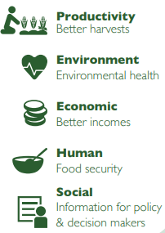
Threats and barriers
Degraded
soils
Poor quality seed and degraded soils
High labor input
Inefficient use of resources: water and fertilizers
Low capacity and big knowledge gaps
Low productivity
Low
research ability
Capacity
gaps
Opportunities
Productivity
Better harvests
Agronomy
Automated environmental monitoring
Technological innovation ICT
Capacity building: Human and Institutional
Environment
Environmental health
Economic
Better income
Human
Food security
Social
Information for policy and decision makers
https://cgspace.cgiar.org/handle/10568/76339

Slide 4
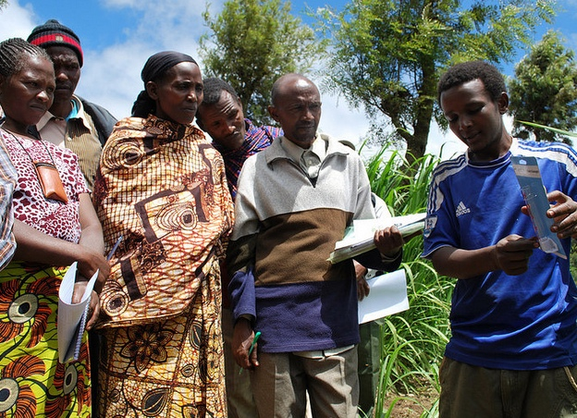
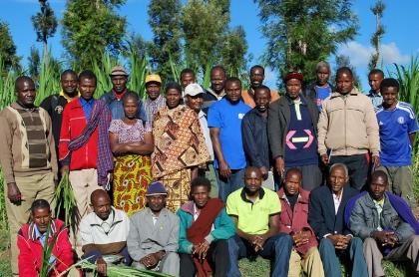
Methods: Participatory
Modified after Peters et al, 2001.
See: https://www.odi.org/sites/odi.org.uk/files/odi-assets/publications-opinion-files/5218.pdf

Slide 5
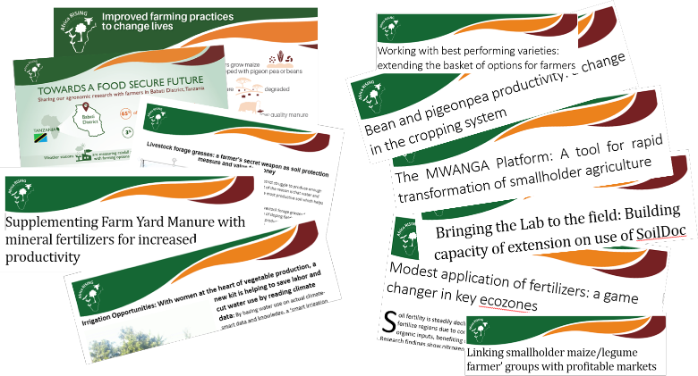
Methods: Information dissemination

Slide 6
Methods: Use of the cellphone

Slide 7
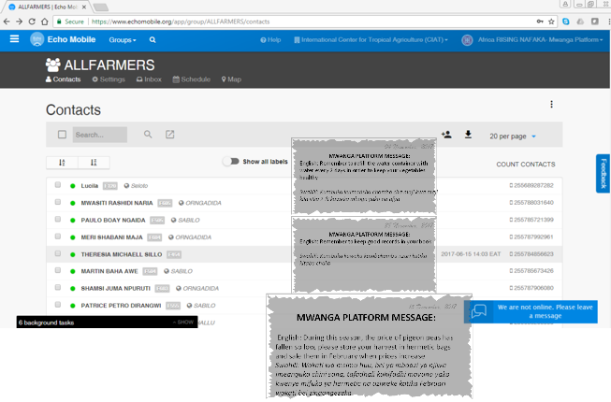
Methods: Power of messaging

Slide 8
Methods: Layout and metrics

Slide 9
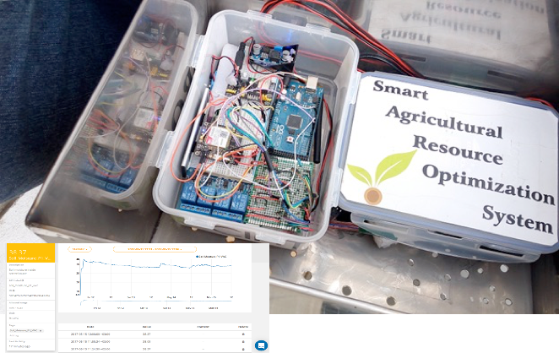
Methods: Instrumentation

Slide 10
Results: Evapotranspiration

Slide 11
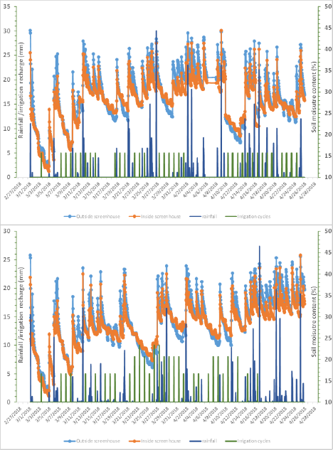
Results: Soil water trends
Seasonal soil water trends indicate that for both tomato and pepper supplemental irrigation was needed to avert drought stress even during the rain season.

Slide 12
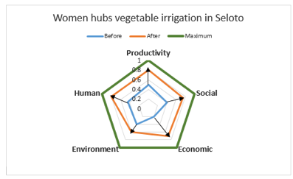

Results: Sustainable intensification

Slide 13
Results: Snapshot of moisture trends

Slide 14
Is automated irrigation enough?
The greatest gains from embracing the digital environment are realized when bundling is done.
The marketable yield was higher (+35%) under screen house management
Other gains compared to conventional methods: 25% higher gross returns; 35% labor savings, better soil protection from erosion, 30% water savings.
With the screen house, farmers only break even after the second year.

Slide 15
Thank You

