Slide 1
Overview of the Africa Dairy Genetic Gains (ADGG) Project
Training of Performance recording Agents on ADGG platform
18th -21st July 2022
Tick Hotel, Kampala

Slide 2
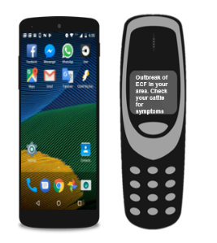

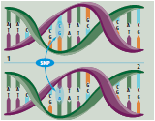
What is the African Genetic Gain Program about ?
Bridging the gap in information systems, productive performance and genomic information for dairy farming systems of Africa

Slide 3
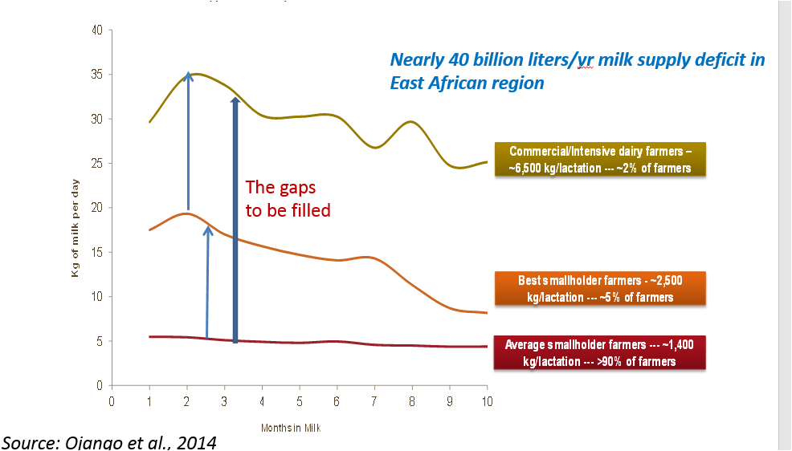
Challenges facing dairy producers in Africa
Farmers do not have access to productive and adapted livestock seedstock that best suit their production systems
Access to various services and inputs is inadequate, hence gains in productivity in one generation cannot be sustained in the next one
Farmers have very limited access to information to enable them extract optimum benefits for their dairy enterprises
No systematic and sustainable breeding or selection taking place
Huge differences in productivity in the different farming systems

Slide 4
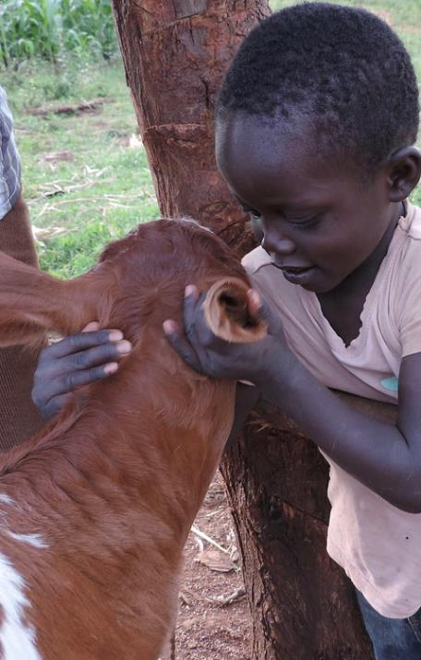
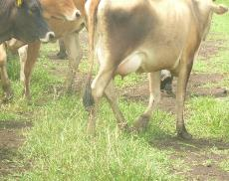
ADGG approach
Adapted, and Genetically superior “seed” animals for local production systems
Genotypes adapted to local agro-ecology
Target appropriate genotypes to the agro-ecology
Use young bulls with a focus on production & adaptation
Local feed/fodder resource use efficiency
Digital platforms for on-farm performance tracking
Decision-support and Farmer-to-Farmer performance benchmarking
Smart use of records & genomics tools for selection and AI service delivery
Economically Relevant Traits
Milk Yield/density
Adaptability Indices
Reproductive Performance
Heat tolerance
Survival rates
Lactation persistency
Mastitis incidences
Accelerate on-farm genetic gains

Slide 5
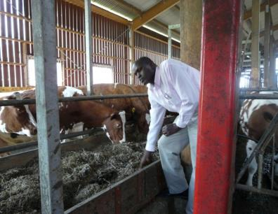
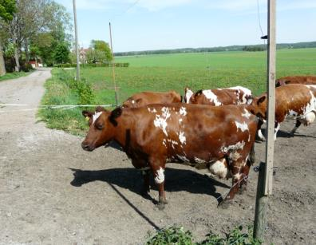
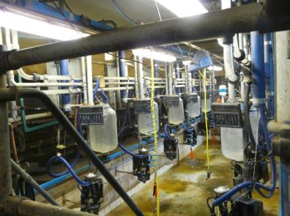
Unfortunately, We want to move
This Environment
This Animal
Notes:
5

Slide 6
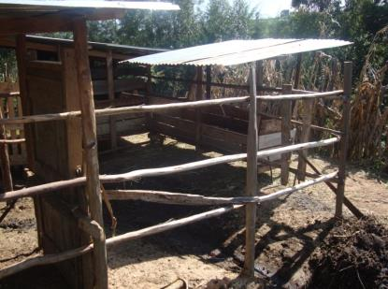
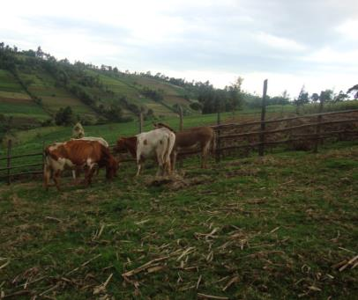
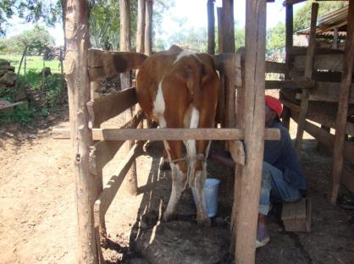
To this
Environment
Animal
Notes:
6

Slide 7
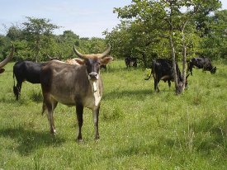
Conceptual framework of the ADGG data platform
Individual farmers
User management
National governments
Farm Data Capture
Livestock stakeholders
Extension personnel
Service providers
Big Data systems
Data Analytics
Mobile applications
ODK
API
i-Cow
ADGG
Designed apps
SRUC
Web applications
ADGG LSF
i-Cow
i-Cow
Data Validation
API
Interherd
API
System Administration
API Management
API
Data Extraction
API
Country Data platforms
Other Database integration
Data feedback systems
DATA PLATFORM
ADGG
KLBA, AVCD
i-Cow
i-Cow
Interherd
Cooperatives
API = Application Program interphase
Notes:
Data collected can also be filtered to show the different breeds of animals from which data is being captured
For example we have the well known European dairy breeds, and those that are called by indigenous names
Graphs are used to present the number of milk records in the database from each breed type. It is also possible to get a glimpse of the average daily milk production for a typical animal of a given breed type within each country

Slide 8
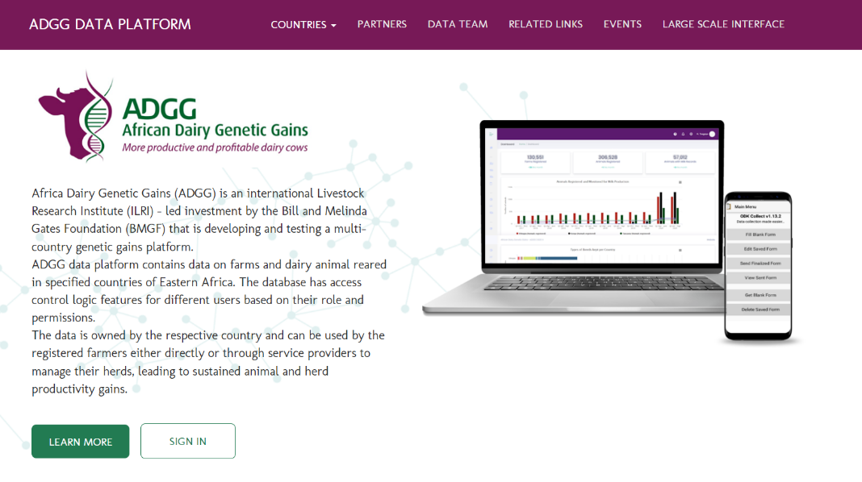
https://portal.adgg.ilri.org/
Notes:
You access the Africa Dairy Genetic Gains data platform through the link at the top of this slide
This is the landing page
On the top bar are options with drop down menus reflecting what is available through the platform

Slide 9
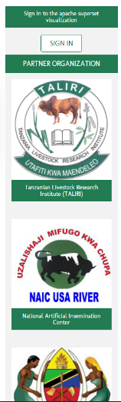
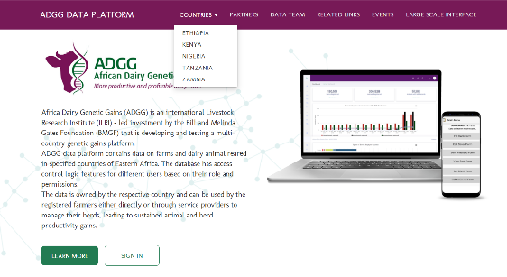
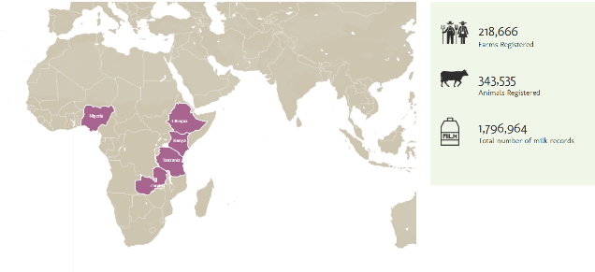
Country Access to ADGG Platform
Notes:
As you scroll down the front page you see which countries have their data recorded on the platform, and get a glimpse on the quantity of data available from each country

Slide 10
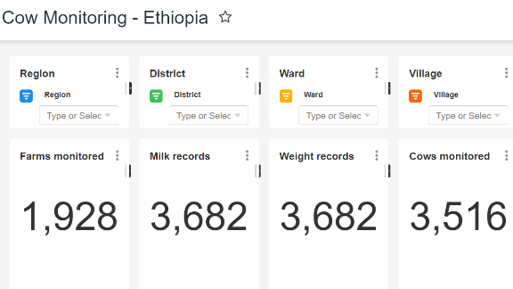
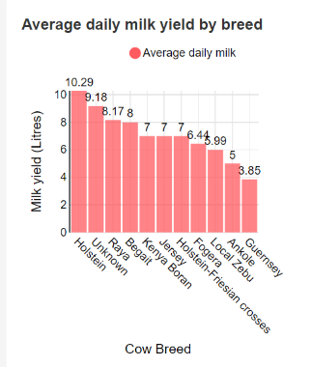
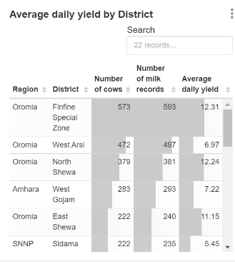
Filtering specific information in a country
Notes:
Data collected can also be filtered to show the different breeds of animals from which data is being captured
For example we have the well known European dairy breeds, and those that are called by indigenous names
Graphs are used to present the number of milk records in the database from each breed type. It is also possible to get a glimpse of the average daily milk production for a typical animal of a given breed type within each country

Slide 11
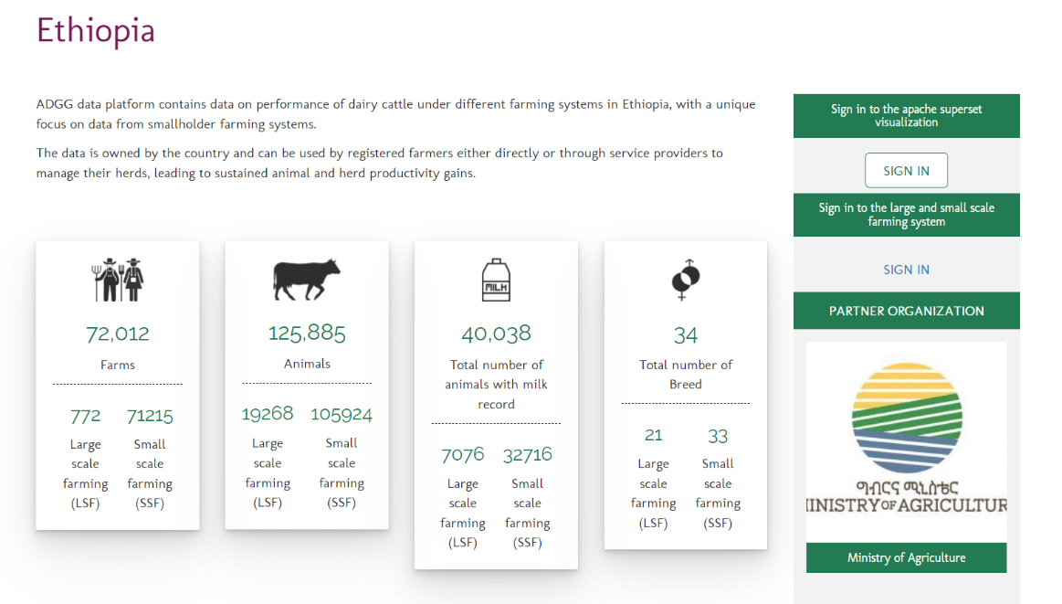

Slide 12
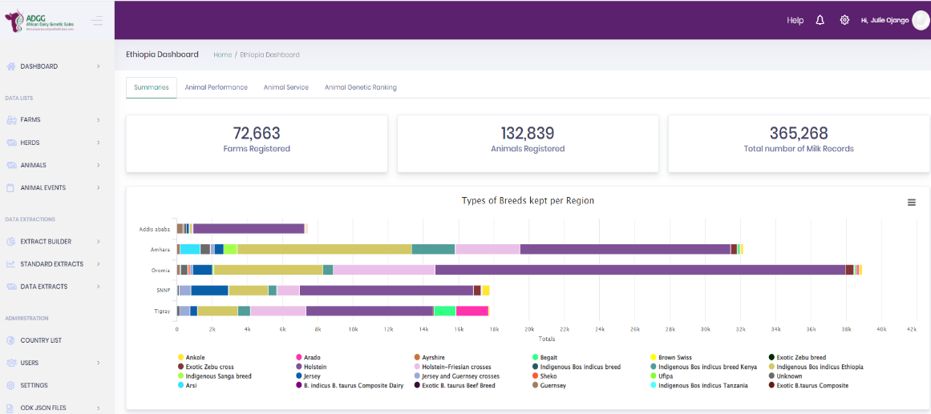

Slide 13
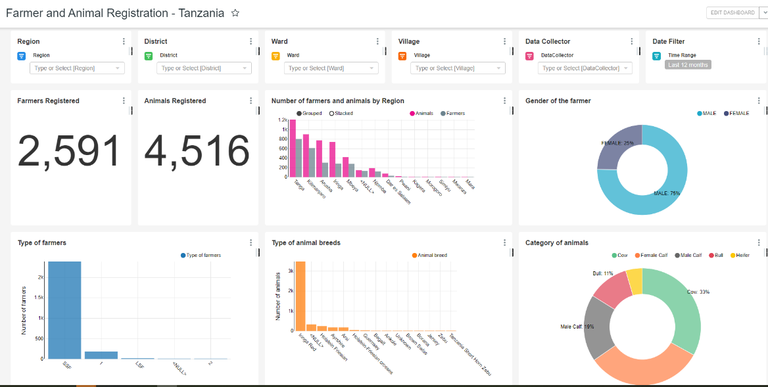
Example from Tanzania- 2 months

Slide 14
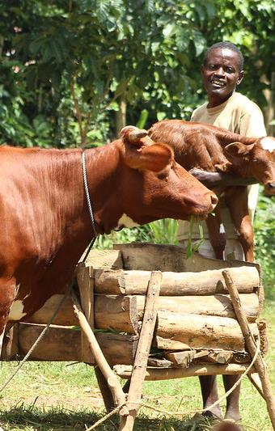
Achievements: Herds and animals registered in Ethiopia and Tanzania

Slide 15
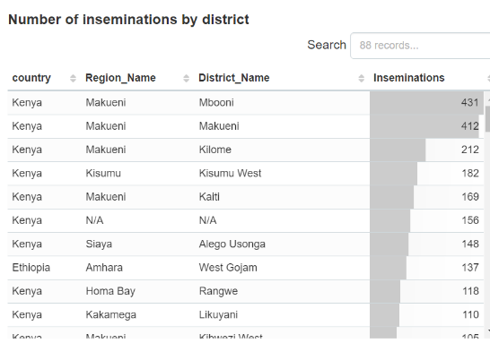
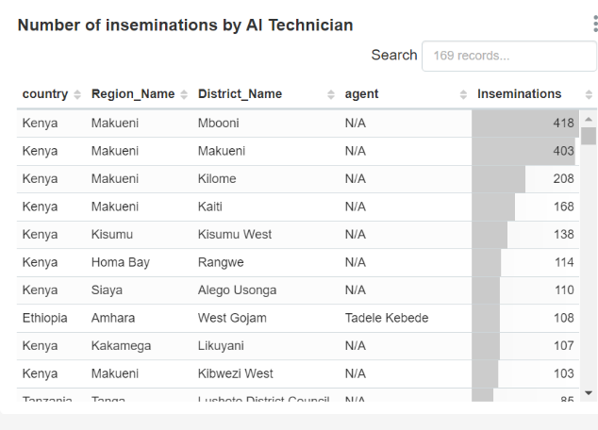
Monitoring Artificial Insemination services
Notes:
When monitoring the performance of those providing the artificial insemination service it is possible to get a quick overview of the number of services provided by each individual inseminator within each region on any given day

Slide 16
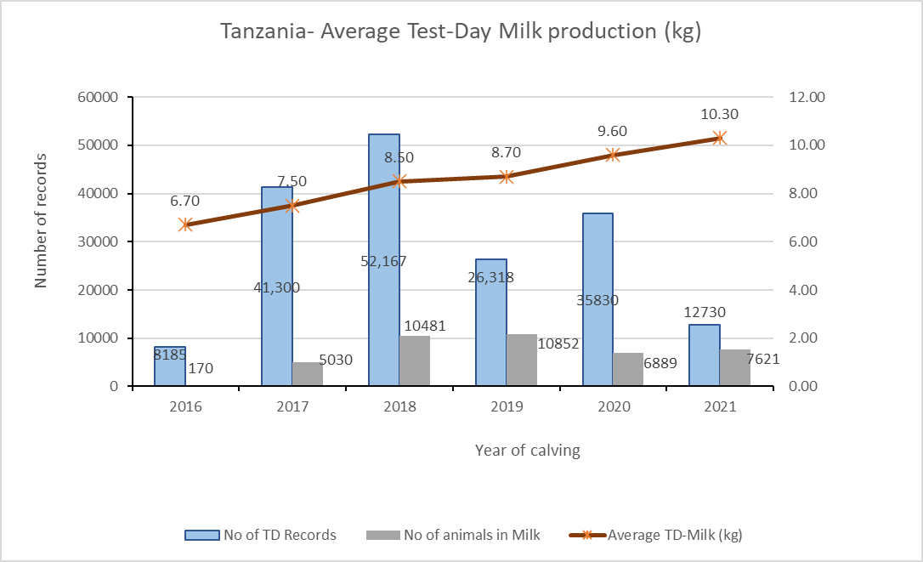
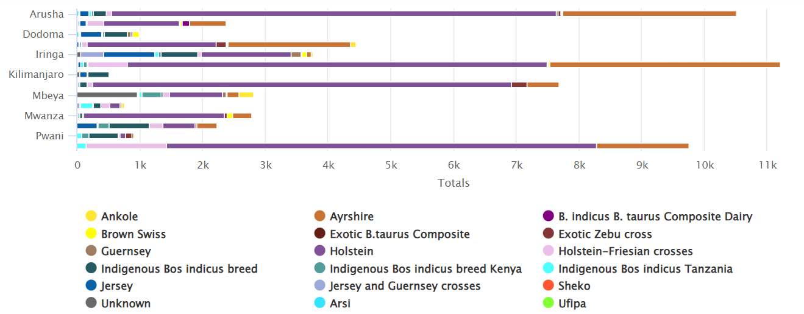
Breeds reared in different regions

Slide 17
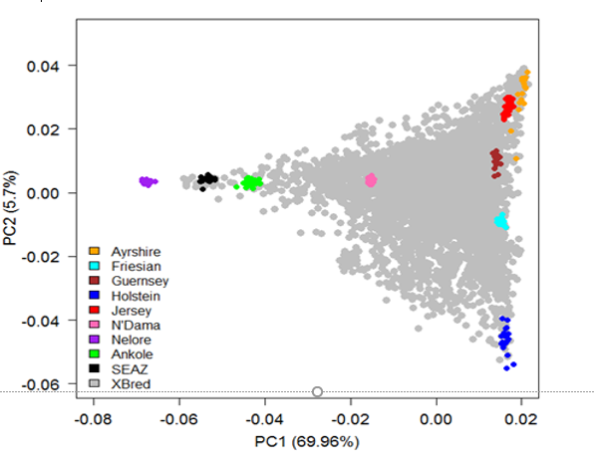
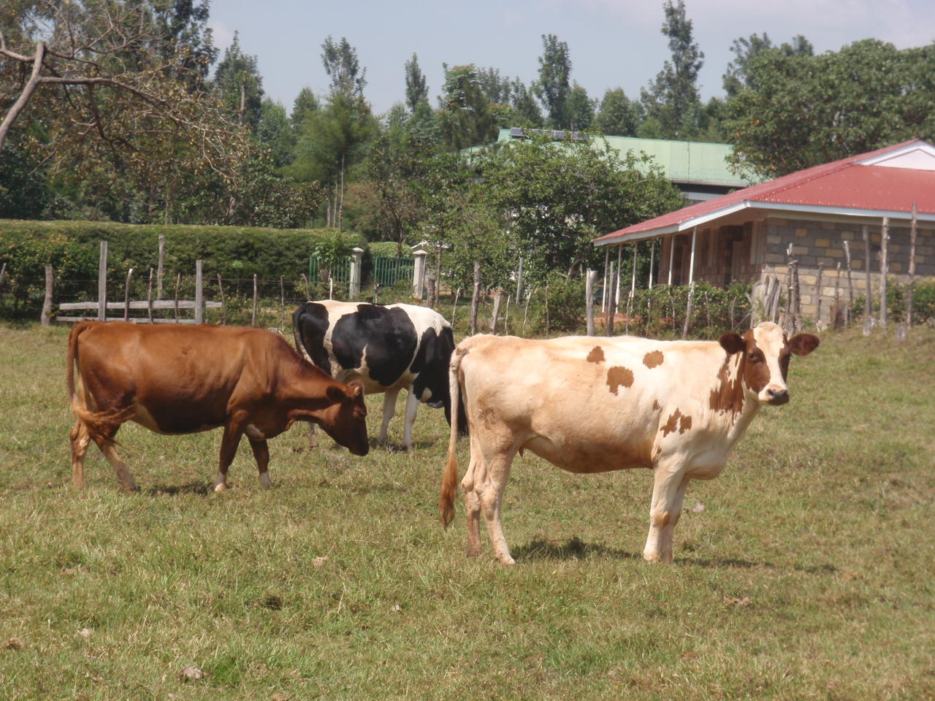
Genotyping
In 2018, about 5600 animals sampled
GeneSeek Genomic Profiler (GGP) Bovine 50K used for genotyping
40581 SNPs imputed to high density
In 2022 an additional 3000 animals sampled for genotyping per country
Index for selecting seed animals
Index developed using results from genomic evaluation to improve milk production without increasing body weight

Slide 18







Sustainability options
Integrated technologies, knowledge & services
Smallholder farmers own less than 3 milking animals
Programs promote innovation packages through DFAs
Dairy Farmer Assistant (DFA)
A shared manager - trains farmers/manages herds & catalyze technology demand
Core innovations
Breeding
Herd health
Feed &forage
Systems that support access to inputs & services (including DFA/extension service)
Input suppliers
Cooperatives
Capacity development
Enabling environment
Innovative Value Chain Financing – farm operational capital & input/service providers
Services, data, information
AI/AH Technician
Digitally Enabled Enterprises

Slide 19
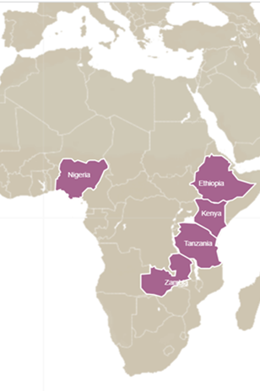
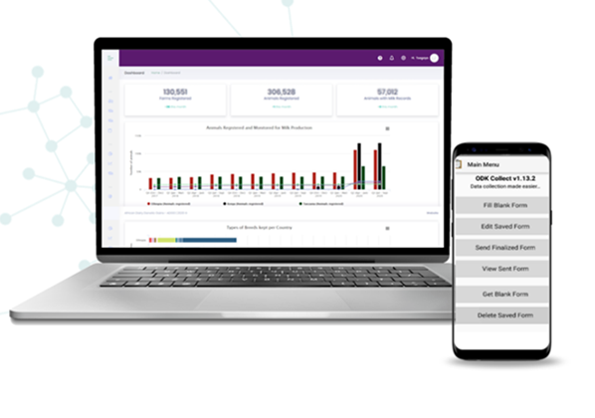
Conclusions
ICT technologies have provided a great opportunity to crowd source animal performance data from smallholder farmers in Africa
Genomic evaluation of animals in smallholder systems helps accelerate identification and use of superior animals
Digital farmer extension and feedback systems are catalyzing desired change in smallholder dairy production

Slide 20
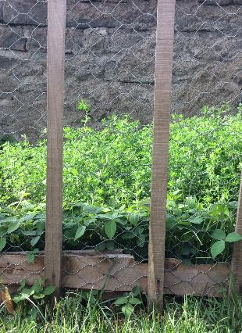
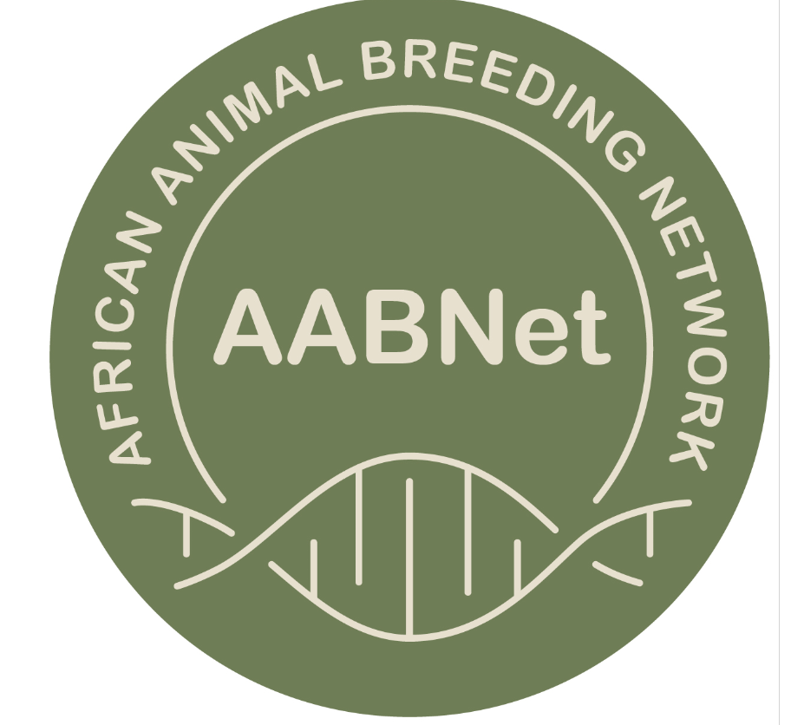




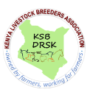








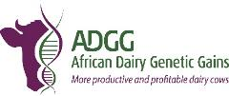
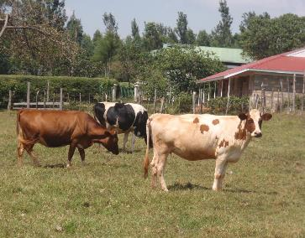





Partners
National/regional Institutions/govts.
Dairy Farmers & Farmer organizations
Notes:
Developing this platform and providing all this information is a collective effort of many partners, many institutions and the dairy Farmers.
Thank you to everybody who has contributed and enabled us to have data from all types of dairy farmers in Africa all in one portal.

Slide 21
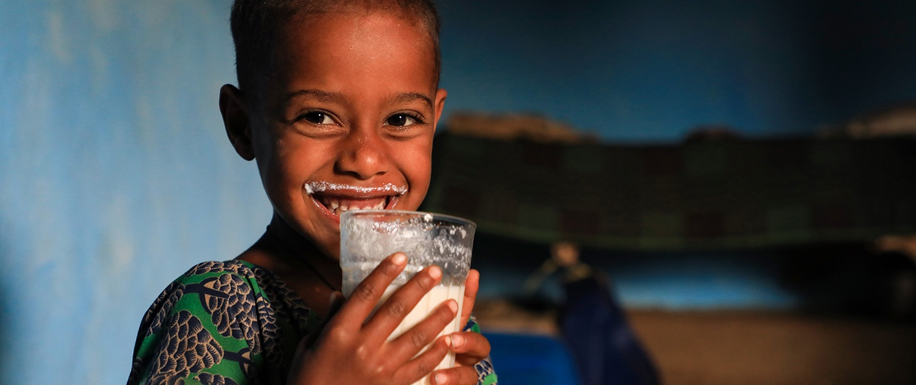
THANK YOU

