Slide 1
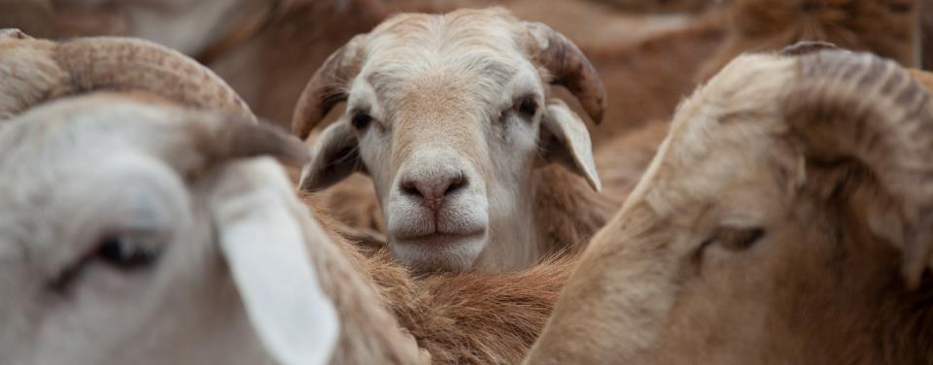
Health of Ethiopian Animals for Rural Development project: Public–private partnership models
Solomon Gizaw and Theo Knight-Jones
Africa public–private partnerships forum in the veterinary domain
Nairobi, Kenya
4 April 2024

Slide 2
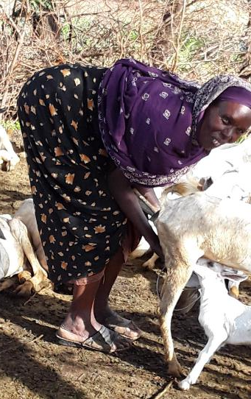
Animal health service delivery in Ethiopia
Health service delivery largely by the public sector
Vaccination exclusively by the public sector
Access to public services: 28.3–74.1%
Access to private services: 6.7–68.3%

Slide 3
Low access to services
Question: how service delivery can be improved by incorporating the private sector

Slide 4
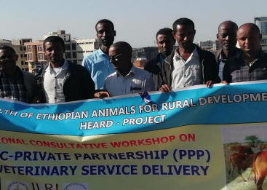
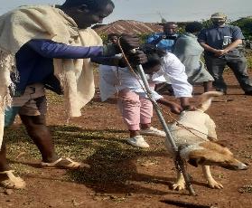
PPP development process
  National stakeholders’ workshop to introduce PPP concept in the veterinary domain
  Gap analysis: priority diseases and service gaps
  Consultative meetings with livestock keepers, private service providers and public offices
  PPP taskforce formation
  Designing alternative PPP models

Slide 5
PPP models
Eight models designed based on:
  Service type: Vaccination, community-based deworming, Mobile clinics,
  Partners involved and their relationships:
    Private service providers (regional, district, village level clinics, CAHWs, community women vaccinators)
    Public offices from village to region
Livestock keepers’ roles (cost-based service for public free services, voucher system)

Slide 6
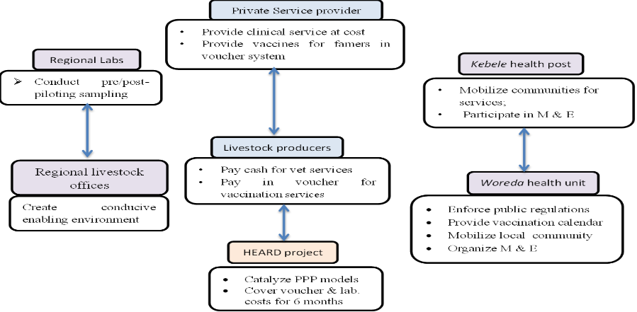
General framework of PPP models

Slide 7
models | Region | Services
Model I (private vaccination service) | Amhara, Oromia | Vax: rabies, anthrax, black leg, ovine and bovine pasteurellosis
Model II (sanitary mandate with district private sector) | Somali | Vax: Camel pox, ovine pasteurellosis
Model III (sanitary mandate with linked regional-woreda-kebele private sector) | Somali | Vax: camel pox, bovine pasteurellosis, shoat pox, CCPP
Model IV (mobile clinical service) | Oromia | Clinical service
Model V (clinical service by linked regional-woreda-kebele private clinics) | Somali | Clinical service
Model VI (community-based women vaccinators for Newcastle disease control) | Amhara | Vax: Newcastle disease
Model VII (strategic community-based endoparasite and ectoparasite control) | Somali, Oromia, Amhara | Camel and shoat ectoparasite control Cattle and sheep deworming service
Model VIII (leasing AHPs to unemployed veterinary graduates) | Amhara

Slide 8
Findings (mid-term evaluation and routine monitoring)
Sustainability indicators
A legal framework in place for PPP
All the three partners (public, private sectors and livestock keepers) expressed satisfaction with the PPP arrangements
Most successfully adopted models were private vaccination service, community-based deworming services, and mobile clinic service, also leasing of redundant public clinics to private vets
New service introduced: Rabies vaccination in rural areas, community-based deworming services
Need to bundle services for increased business viability

Slide 9
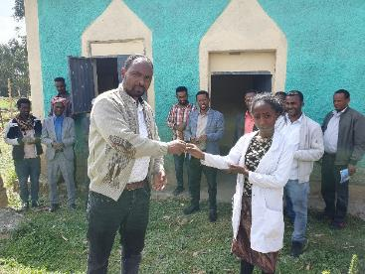
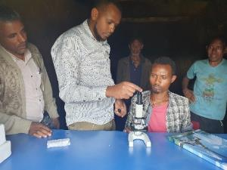
    PPP for privatizing public village clinics (Model VIII) is the most successful intervention

Slide 10
Challenges
The government policy for transboundary diseases vaccination (considered a public good)
The private partners are criticized for not being proactive in planning/organizing/mobilizing communities for vaccination services
Vaccine supply system yet to be revised; supply chain is aligned to public sector delivery

Slide 11
Recommendations
Livestock keepers’ willingness to subscribe to paid services (which some were provided free by the public sector) is key for sustainability of the PPPs
Community mobilization by the public offices is crucial to success of PPP arrangement
Strengthening the private service providers to be proactive in the PPP is needed
Sustainable vaccine supply chain (which currently is dependent on the public sector) is key for sustainability
Linking private clinics with drug wholesalers to alleviate the perceived or real high service charges, interaction with livestock keepers and service provider is important, including in service charge setting
Government to lift subsidized Rabies vaccination to create fair market for the private sector.

Slide 14
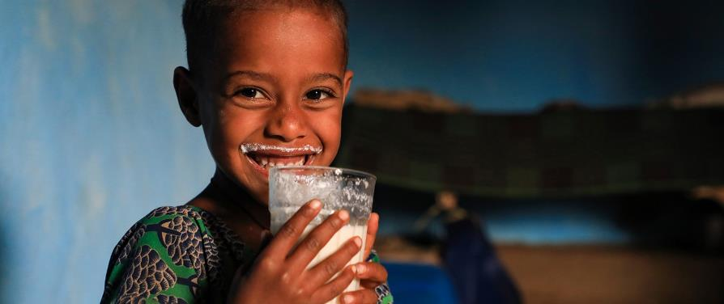
THANK YOU

