Slide 1
TH5.1 Lessons from dynamics of local normative climates (LNCs)
Patti Petesch, Doctoral student
Knowledge, Technology & Innovation, WUR
Patti.petesch@wur.nl

Slide 2

Aim of my talk
introduce you to lnc and what this concept offers as a research tool
Notes:
READ SLIDE

Slide 3
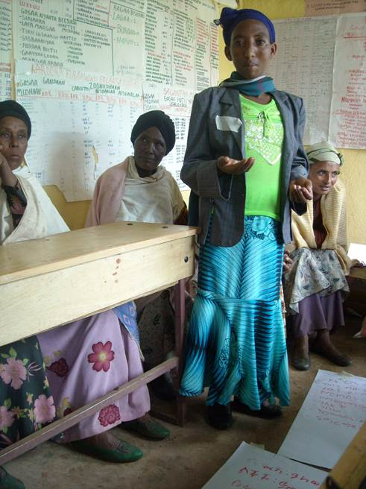
Research contexts for LNC’s Development
GENNOVATE Study
  Local normative climate shaping agency and agricultural livelihoods in sub-Saharan Africa
    Petesch, P., Bullock, R., Feldman, S., Badstue, L., Rietveld, A., Bauschspies, W., Kamanzi, A., Tegbaru, A., and Yila, J., (2018). J. of Gender, Agri. & Food Security
My PhD thesis (forthcoming – I sure hope!)

Slide 4
LNC springs from feminist & sociological Relational theories of norms
Gender norms
  “… differential rules of conduct” for women and men, including rules governing interactions between women and men.”
  (Pearse & Connell, 2016)

Slide 5
Local normative climate
prevailing?
set of norms?
“The prevailing set of gender norms in a community.”
in a community?

Slide 6
Theory underpinning LNC
LNC element | Underlying theory | Why important for LNCs’ analytic leverage?
 | Gender norms “move in multiple directions” Pearse & Connell, 2016 | Taking stock of norms provides a powerful interpretive lens on agency (Kabeer, 1999) while accounting for the fluidity of norms.
prevailing
Everyday processes of normative relaxation
  Gender norms are both valued yet contested. And sometimes impossible to comply with.
  Women and men alternately uphold -- and negotiate -- these confining, mundane rules.
  We do this by engaging either the common – or less common – interpretations, meanings, or performances of a norm.

Slide 7
‘Girls don’t go to the fields’.
‘Girls pick the cotton, cut crops, weeds, learn to give fertilizer, sow wheat. All of this work is learned at an early age’.
(Young women’s focus group, Rechak village of Sindh Province, Pakistan)
Everyday processes of normative relaxation may express as contradictory or confusing evidence.

Slide 8
Theory underpinning LNC
LNC element | Underlying theory | Why important for LNCs’ analytic leverage?
 | Gender norms are diverse and interact Nitya Rao, 2014, 2017 | Evidence about diverse norms improves interpretations of agency (Kabeer, 1999) and of the permeability of boundaries across the gendered social categories in a context (Tilly, 1998)
set of norms
Norms vary exquisitely by context!
Norms vary x generation, household position, socio-economic status, religion, ethnicity, caste, education, occupation, and countless other social categories ...
Gender intersects all these categories.
‘Young girls are not allowed to go out [to work], only older women work in the field’. (Young women’s FGD, Rechak village, Sindh Province, Pakistan)

Slide 9



Ladder of Power & Freedom x LNC
Ladder rankings express perceived agency and permeability of LNC
Ladder narratives express types of agency that are typical & appropriate in that social context (as well some contested norms)
‘[O]ur parents give us authority to take decisions because we have our own family now.’ (22-year-old father of two)
‘[E]ven I have no freedom to make any decision regarding myself or my child’…. ‘After marriage, you are in the husband’s home, and you only do the house chores and take care of the in-laws…’ (20-year-old mother with some university)
(Naidura Village, KP Province, Pakistan)
Young men’s FGDs most often chose step 3
Young women’s FGDs most often chose step 1
Ladder of Power & Freedom
(12 Pakistan village cases)

Slide 10
LNCs Most often generate inequality & EXCLUSIONARY TRAJECTORIES of social change & Development
Individual women and men can get ahead (and fall behind).
Yet an inequitable framework of norms continues to generate the village’s gendered categorical status differences.
How do gender norms change rather than just relax?
Restrictive norms
Relaxed norms that accommodate changing practices

Slide 11
Theory underpinning LNC
LNC element | Underlying theory | Why important for LNCs’ analytic leverage?
 | Gender norms operate among individuals who interact frequently with one another e.g., Cislaghi & Heise, 2020 | It takes a community to reproduce – and change – gender norms
in a community
Processes of normative change
  Diverse villagers are transgressing inequitable norms
  And under certain conditions (stay tuned!) their actions may open space to shift their village’s normative framework.
“We [women] need to work and take matters into our own hands and head our households. This has had a very strong impact on the economic activity of women.”
(Female key informant, Nodira village, Uzbekistan)

Slide 12


LNC encouraging agency & AGRI Innovation across diverse social categories in Nodira
ffffffffffffffffffffffffffffffffffffffffffffffffffffffff
“[Women] enjoy the same rights as men do. There is nothing bad about this. It’s good… All in all joint decision-making is good in cushioning some negative effects during unfavorable seasons. This helps the family to better manage available resources and control spending together, which is important in generating savings and creating some assets for buying a cow, building a barn, or even buying a home on mortgage. ”
  Focus group of low-income men, Nodira Village, Uzbekistan

Slide 13
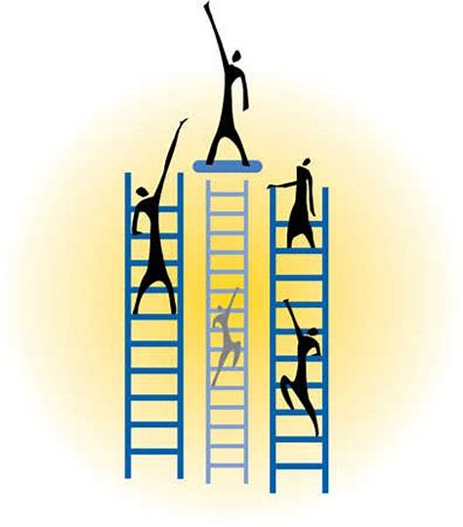
TRANSFORMING VILLAGES: inclusive & Accelerated trajectory of social change & Development
Growing gender equality
Expanded markets
Expanded Infrastructure
Men’s migration
Inclusive agri innovation processes
Strong & growing agency across categories
Poverty falling rapidly
Transforming village
All six social categories (FGDs) report empowerment or rapid poverty declines in their village

Slide 14
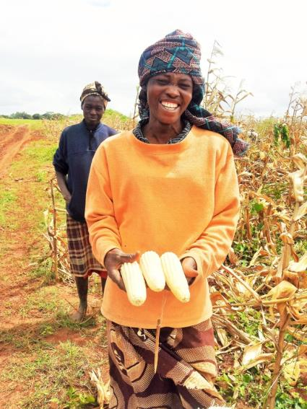
Diverse norms undergoing change in transforming cases
Compared to other villages, women from transforming cases are more likely to be:
engaged in paid work
moving freely in public
unmarried if young than18
innovating with their livelihoods
local leaders

Slide 15
Local normative climate
(Petesch, forthcoming)
The normative order of an agricultural community, and the extent to which this gendered framework of social rules encourages or discourages the freedom and agency of all community members to pursue the kind of lives that they value.

Slide 16
Can transforming cases encourage other agri villages to Empower their women (SDG 5) & speed an end to their poverty (SDG 1)?
Pilot R&D models that take SDG 1 & 5 forward by:
  Positioning empowerment, gender equality, and poverty escapes as causal influences rather than (hoped for) outcomes
  Building on agency x LNC theory & collaborative learning approaches
  Supporting villages to chart their own trajectories
  Encouraging reflexivity within agri-food & other institutions
  Testing multi-level learning innovations

Slide 17
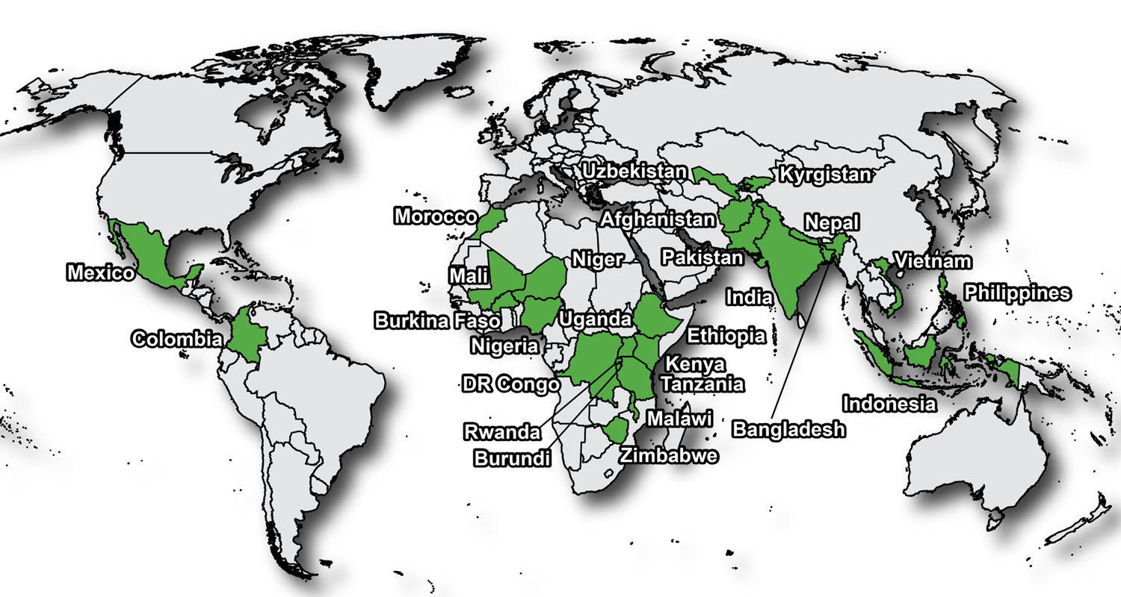
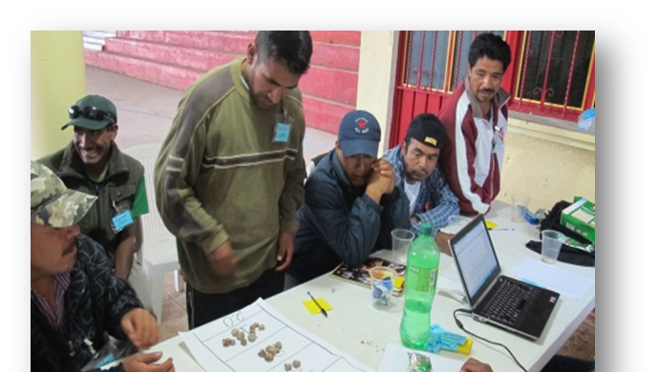
Annex on GENNOVATE
CONTEXT: The study produced 137 community case studies from 26 countries on interactions between gender norms, agency and innovation in agriculture & NRM
COMPARISON: Semi-structured data collection tools and coded dataset facilitate identification of broad cross-case patterns that remain contextually grounded in local realities
COLLABORATION: Across CGIAR institutions, many other international and local researchers, and approx. 7,500 community members
www.gennovate.org

