Slide 1
The Role of P-PD in Enhancing the Ethiopian Livestock Extension System
19.11.2024 Addis Ababa
LC WP1 Regional Stakeholder Engagement
Birgit Habermann, Tigist Worku, Elizabeth Getahun

Slide 2
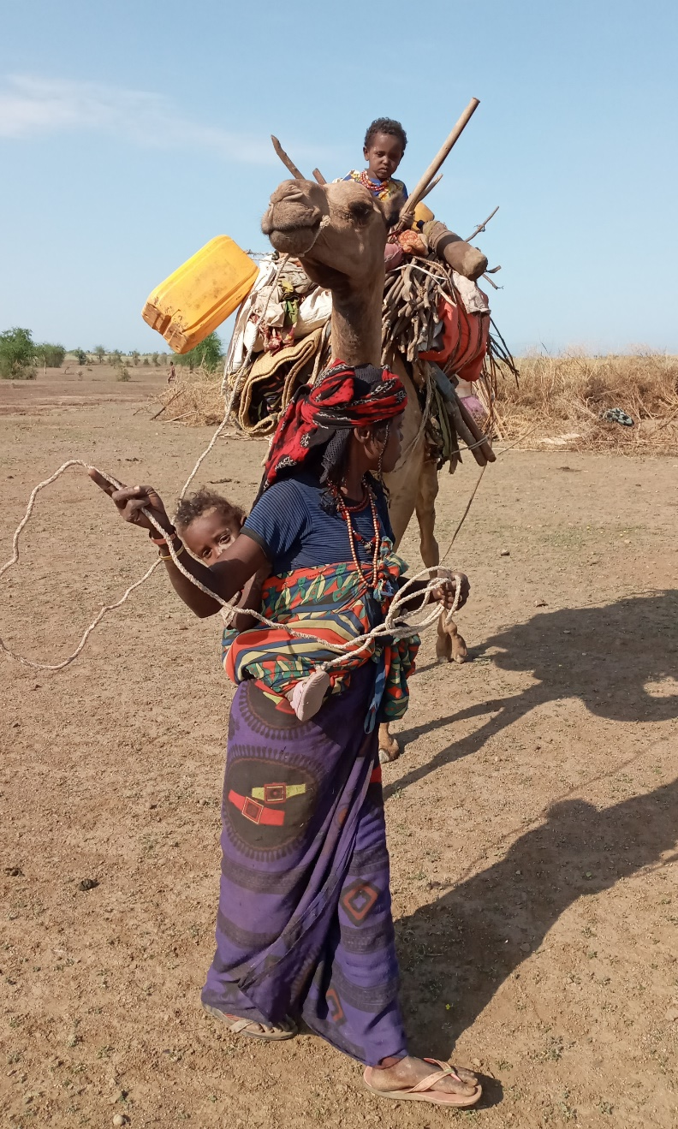
Challenges in Ethiopia’s Livestock Sector
Livestock traditionally not at the focus of extension
Resource and infrastructure limitations
Disease outbreaks
Climate variability
Highly context-specific knowledge required
A woman moving in Lekura kebele, Photo: Fuad Mohammednur Amin/ILRI

Slide 3
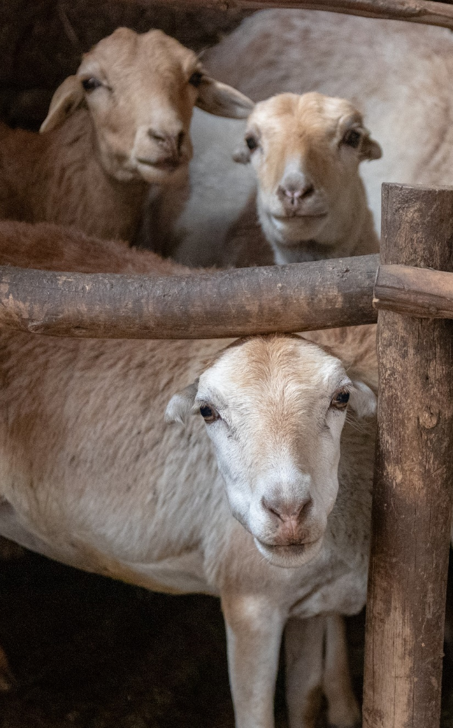
Opportunities in Ethiopia’s Livestock Sector
Livestock is an important part of agriculture in the Highlands for traction, assets and nutrition
  Potential in linkages between crop farming and livestock management
Livestock is an essential part of pastoralists’ livelihoods
  Pastoralists have high level of context-specific knowledge to respond to uncertainty and climate risks
Photo: Sonja Leitner/ILRI

Slide 4
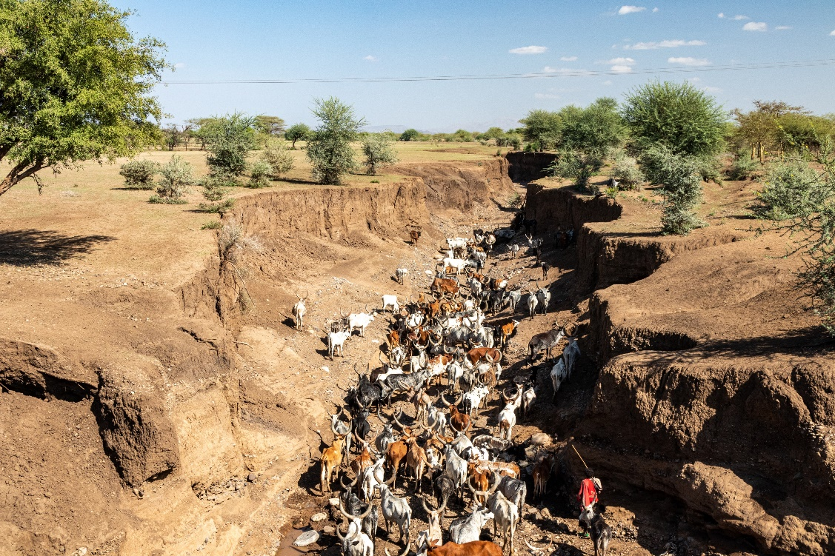
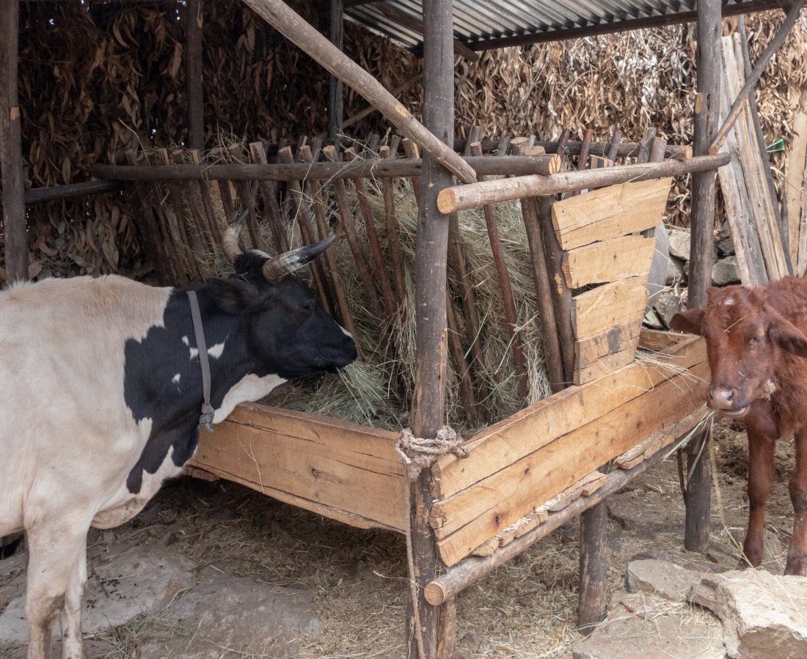
What can we do better in Livestock Extension?
Adapt extension approach to production systems and agro-ecological zones (AEZ)
Respond to high diversity
  in AEZ,
  in soil types,
  in crops and livestock in response to multiple livelihood needs,
  in people’s knowledge regarding adaptation for more climate resilience.
Photo: Afar. Sonja Leitner/ILRI
Photo: Debre Birhan, Sonja Leitner/ILRI

Slide 5
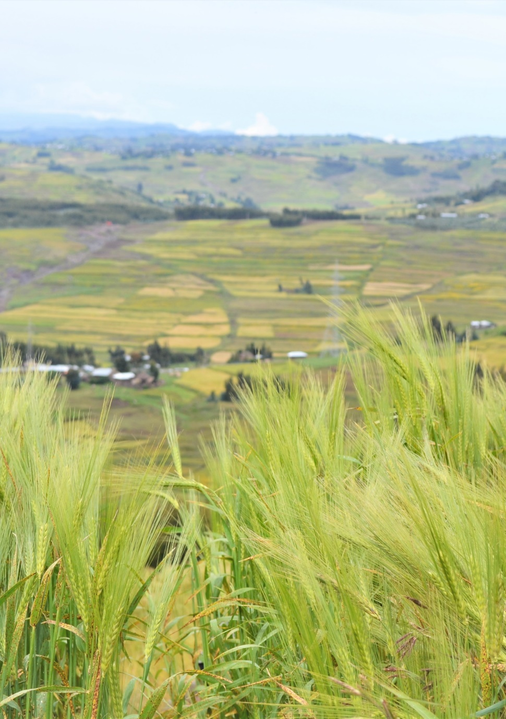
What can we do better in Livestock Extension?
Supplement existing extension system with
  promotion of more endogenous solutions.
  tools for testing such farmer-led solutions.
  more monitoring and follow-up to include lessons learnt from farmers to improve externally promoted practices,
  ……….>>>
Close to Tenagne’s farm in Gudoberet, North Shewa Zone, AR (Photo: Birgit Habermann/ILRI)

Slide 6
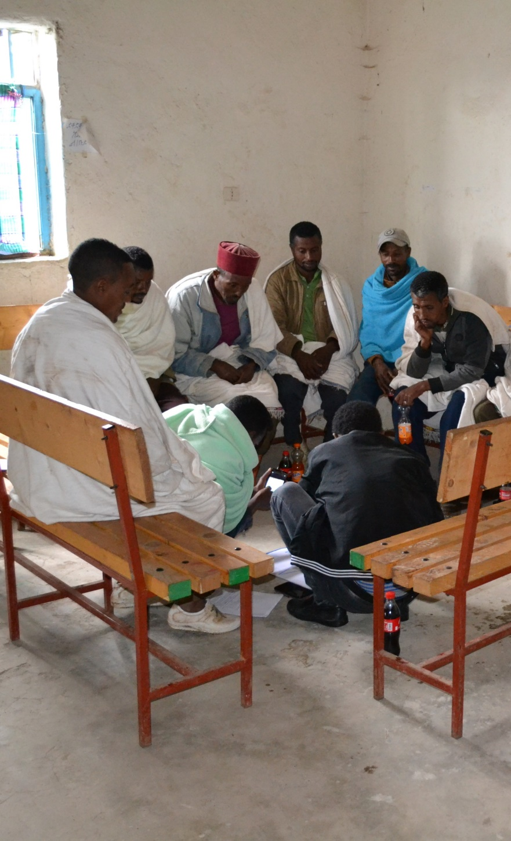
What can we do better in Livestock Extension?
Supplement existing extension system with
  more place-based, context-specific technologies,
  more F2F extension based on their own, adapted, productive, profitable and functioning livestock management practices,
  incentives for DAs to work with farmer-led innovations to create better working relations between farmers and DAs where necessary.
Group discussion in Tarmaber, North Shewa Zone, AR (Photo: Birgit Habermann/ILRI)

Slide 7
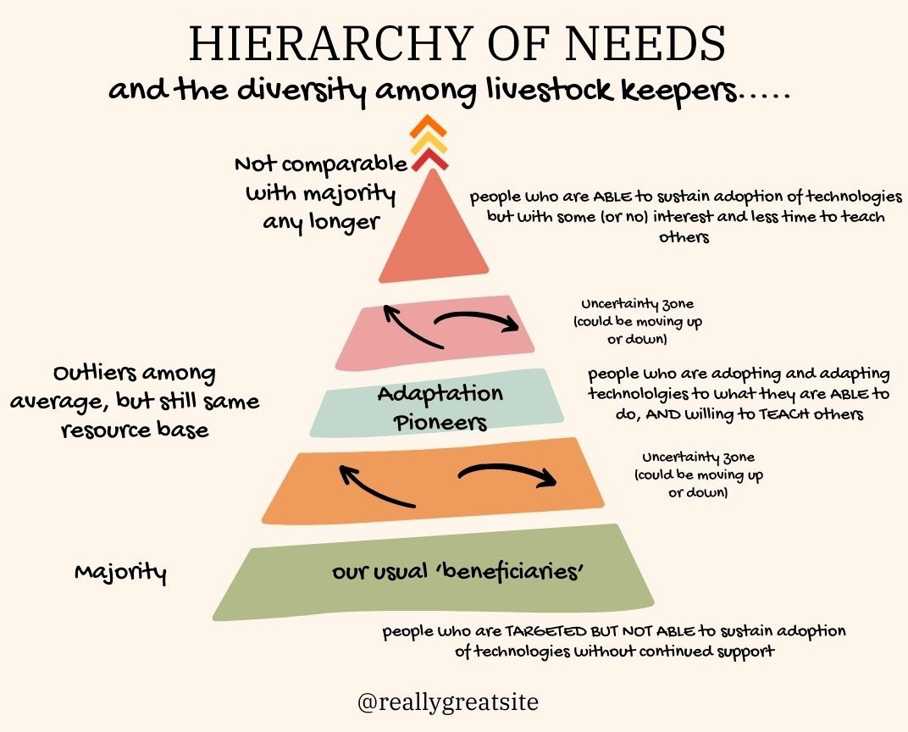
How can we align our work with people’s needs and capabilities?

Slide 8
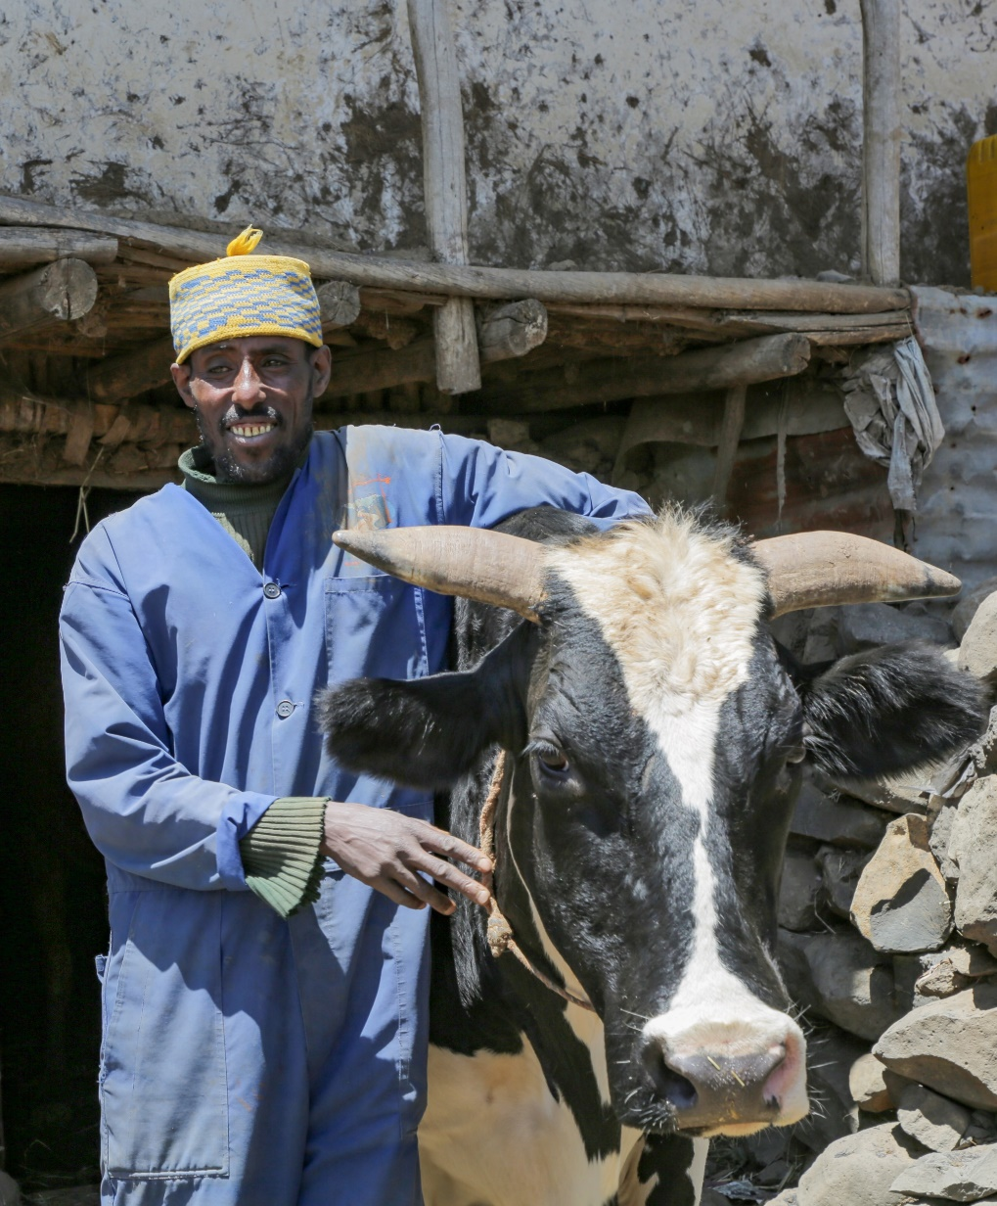
The Principles of Positive Deviance (PD)
Core principles of the PD approach:
Community ownership of the process.
All community members involved in the solution.
Focusing on discovering successful behaviors.
Emphasis on practice over knowledge.
Innovation and experimentation within the community.
Photo: Pioneer Farmer Admasu, Gudoberet, North Shewa, AR, Apollo Habtamu/ILRI

Slide 9
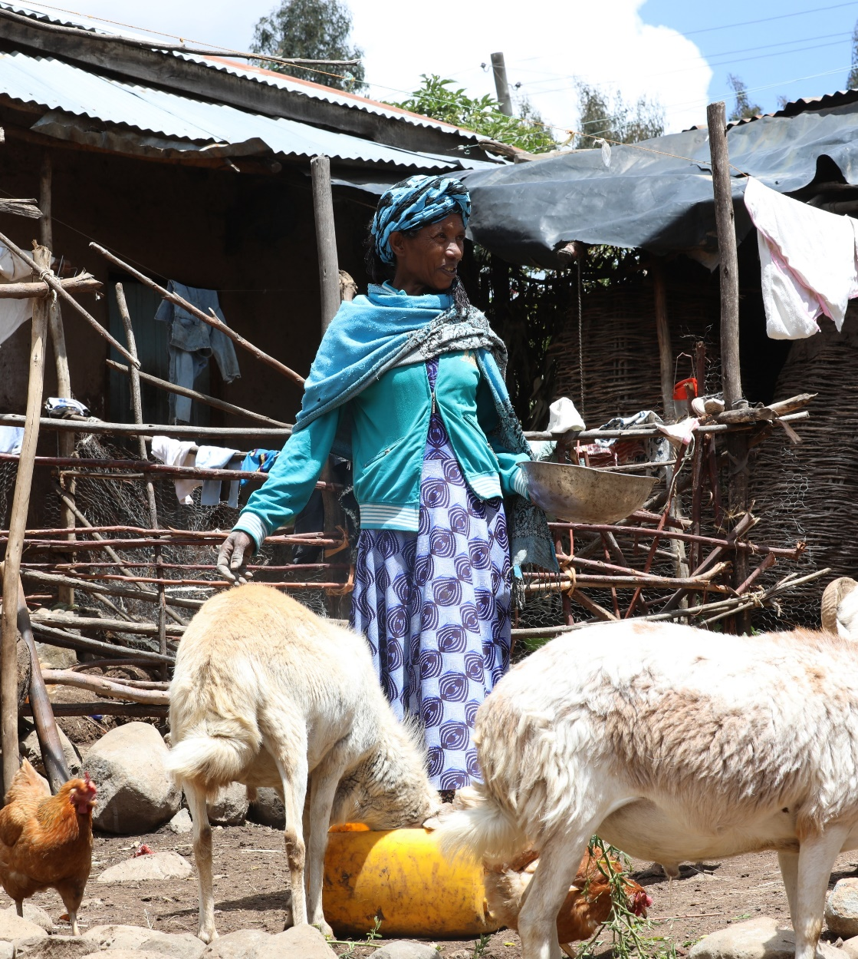
Pioneer-Positive Deviance (P-PD) with Adaptation Pioneer Households
Empowers local, farmer-led innovation.
Focus on "pioneer households" (households who succeed having despite similar challenges like others)
Promotes sustainable, low-cost solutions.
Builds peer-to-peer learning networks
Photo: Pioneer Farmer Tenagne in Gudoberet, North Shewa, AR, Apollo Habtamu/ILRI

Slide 10
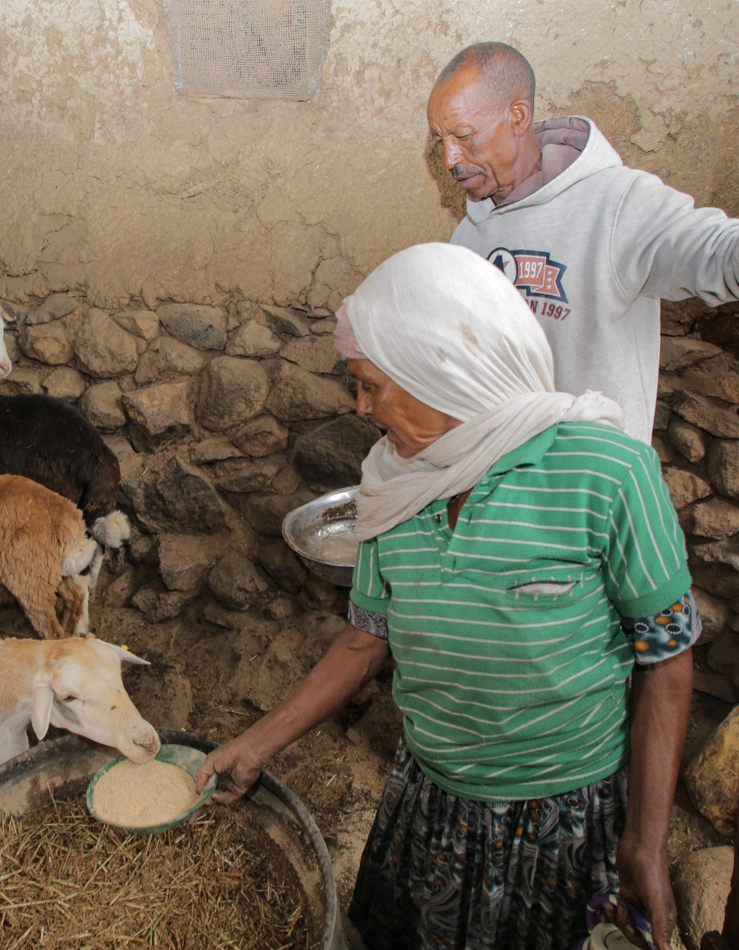
The Role of APHs in P-PD
Households who excel in managing livestock despite challenges.
APHs develop and implement practices in adaptation to climate stress.
Become change agents in their communities through F2F field days and forming knowledge networks.
Photo: Pioneer Farmer Kidane and Weleta in Tarmaber, North Shewa, AR, Apollo Habtamu/ILRI

Slide 11
The Role of APHs in P-PD
APHs are not necessarily lead / model farmers but are pioneers of adaptation practices.
Examples of APHs adapting to climate change:
  innovative feed management,
  breeding practices, and
  water conservation techniques.
Photo: Pioneer Farmer Kidane and Weleta in Tarmaber, North Shewa, AR, Apollo Habtamu/ILRI

Slide 12
The Role of APHs in P-PD
Innovate by using available resources in new ways
Often risk-takers, willing to experiment with new practices
Provide learning opportunities for other farmers
Improve livestock management while ensuring sustainability and profitability
Photo: Pioneer Farmer Kidane and Weleta in Tarmaber, North Shewa, AR, Apollo Habtamu/ILRI

Slide 13
Examples of P-PD Success: Kidane and Welete’s Story
Kidane and Welete’s story (Amhara Region):
Sheep fattening through zero-grazing and sheltering to protect animals from harsh weather
Innovative feed strategies developed using local crop residues
Demonstrates how smallholder farmers can adapt and thrive with the right practices
Success achieved despite limited resources and difficult climate conditions
From: Adapting to a new normal: Stories of livestock keepers navigating climate challenges. https://hdl.handle.net/10568/134622

Slide 14
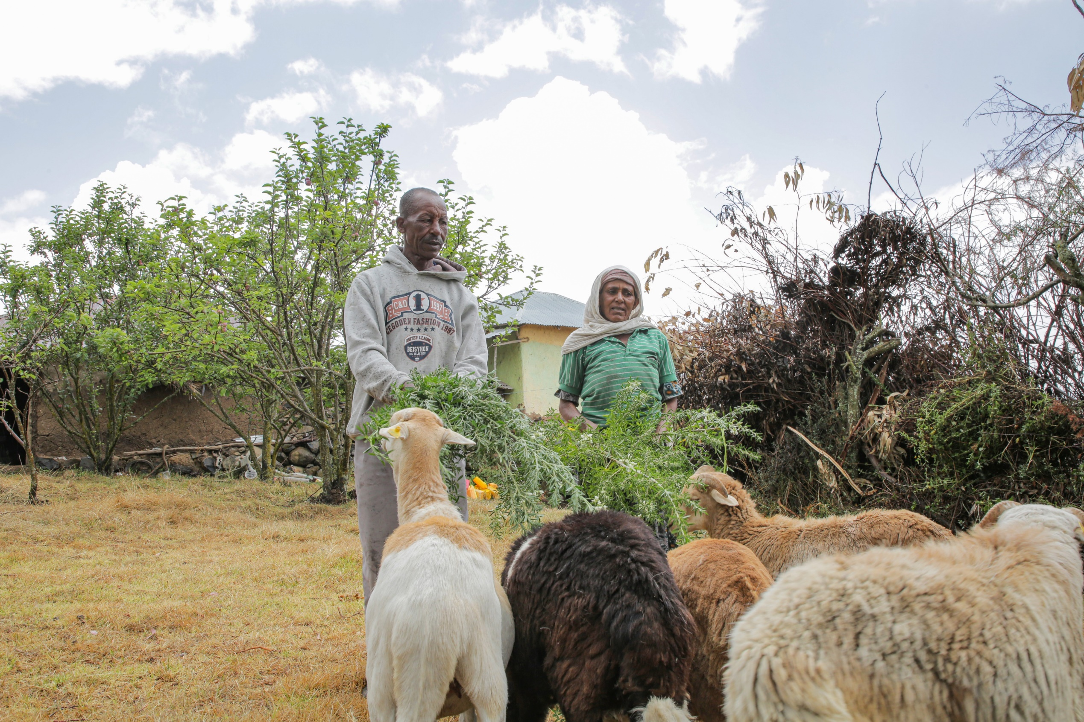
Photo: Pioneer Farmer Kidane and Weleta in Tarmaber, North Shewa, AR, Apollo Habtamu/ILRI

Slide 15
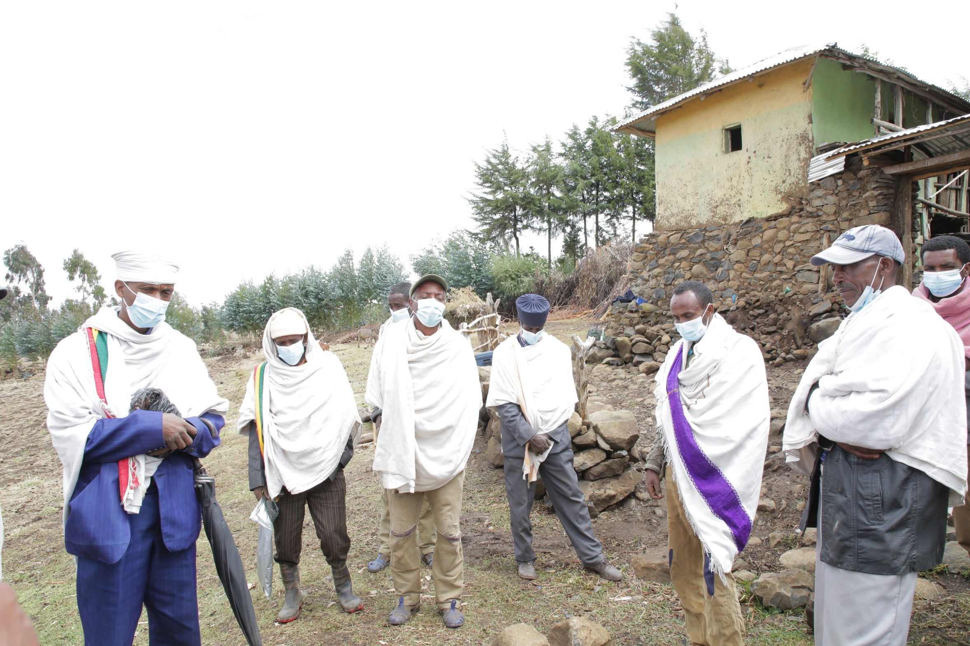
Photo: Pioneer Farmer Kidane and Weleta in Tarmaber, North Shewa, AR, Apollo Habtamu/ILRI

Slide 16
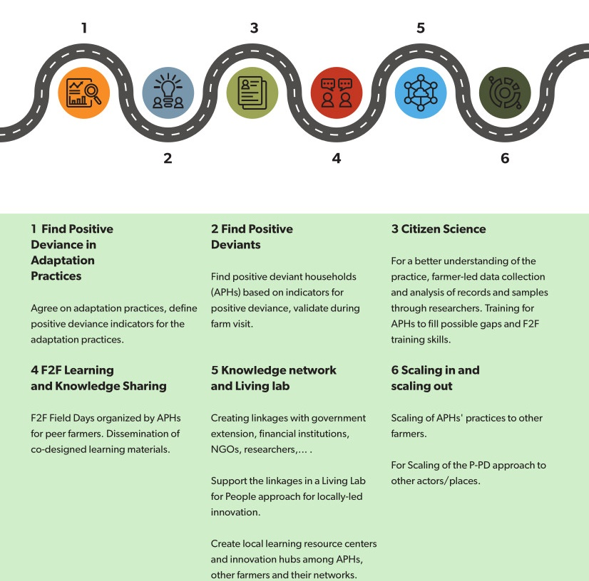
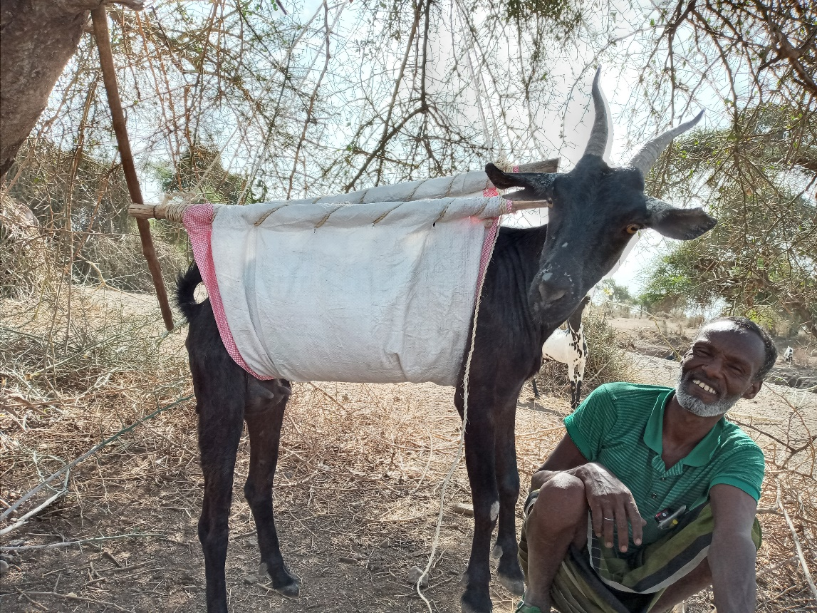
Adaptation pioneer Said Bahine weighing his goat, Afar Region/Ethiopia. Fuad Mohammednur Amin/ILRI

Slide 17
Scaling P-PD in Ethiopia’s Livestock Sector
Scaling strategies:
Use P-PD to identify and spread successful practices.
Encourage farmer-to-farmer learning through exchange visits and community events.
Work with extension agents to adapt P-PD to different areas.
Leverage media and digital tools to expand knowledge sharing.

Slide 18
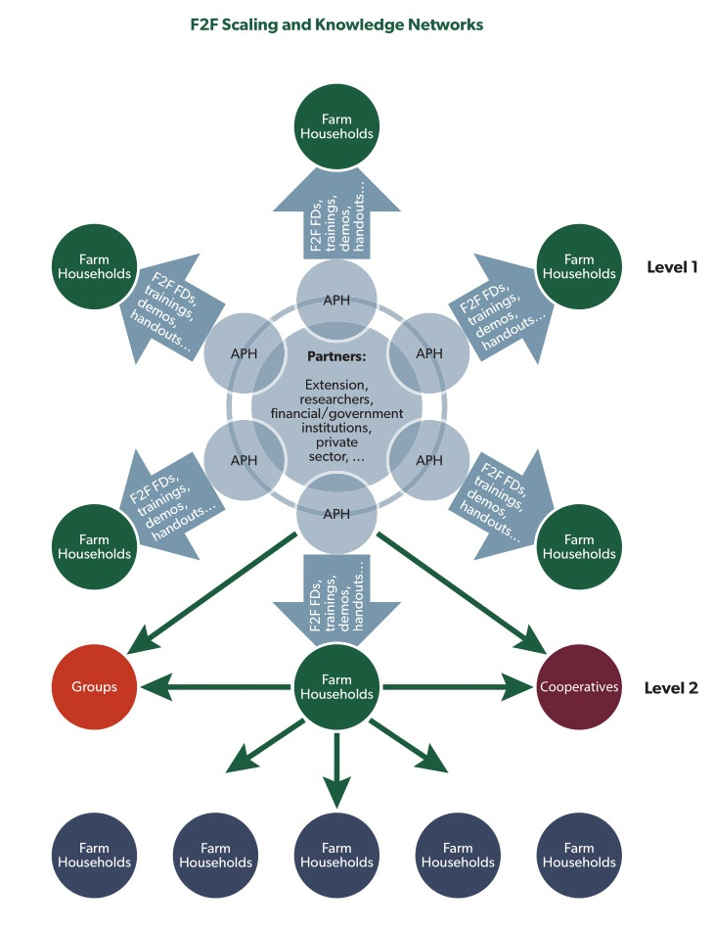
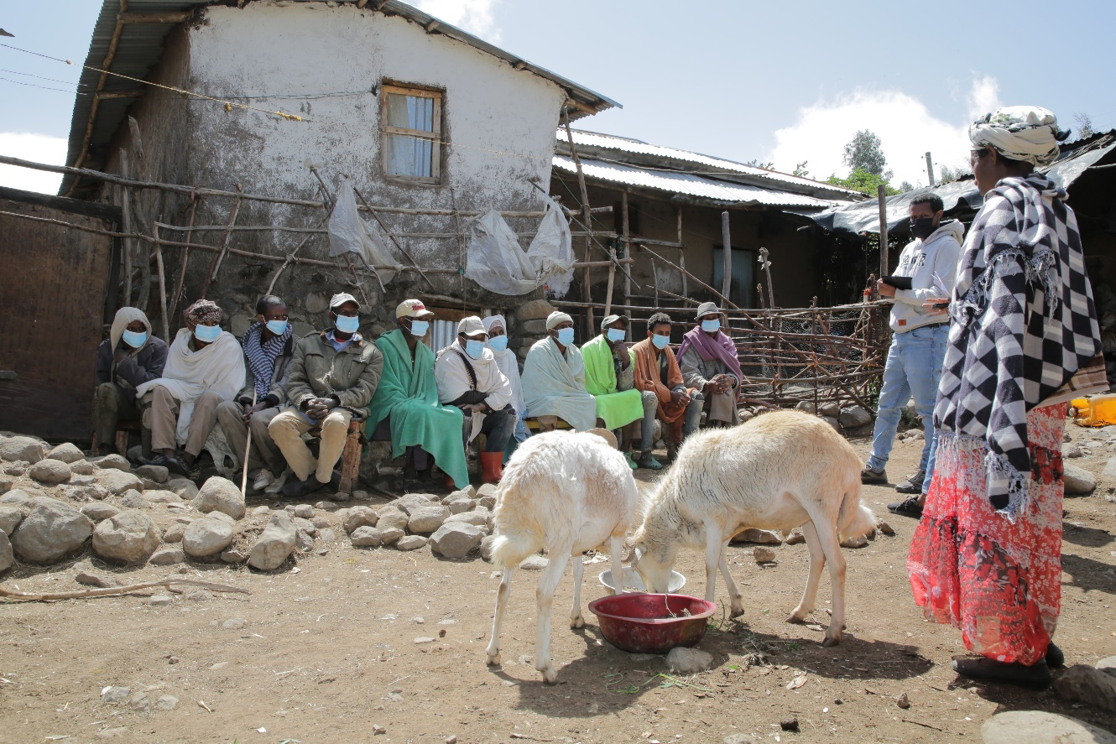
Photo: Pioneer Farmer Tenagne in Gudoberet, North Shewa, AR, Apollo Habtamu/ILRI

Slide 19
Benefits of P-PD in the Livestock Extension System
Sustainability: Local solutions that are easily adopted and scaled.
Empowerment: Farmers and (agro-)pastoralists lead their own development.
Increased Resilience: Better climate adaptation and improved productivity.
Cost-effective: Low-cost and low-risk innovations that can benefit resource-poor farmers and (agro-)pastoralists.
Improved collaboration: an improved working environment for development agents.

Slide 20
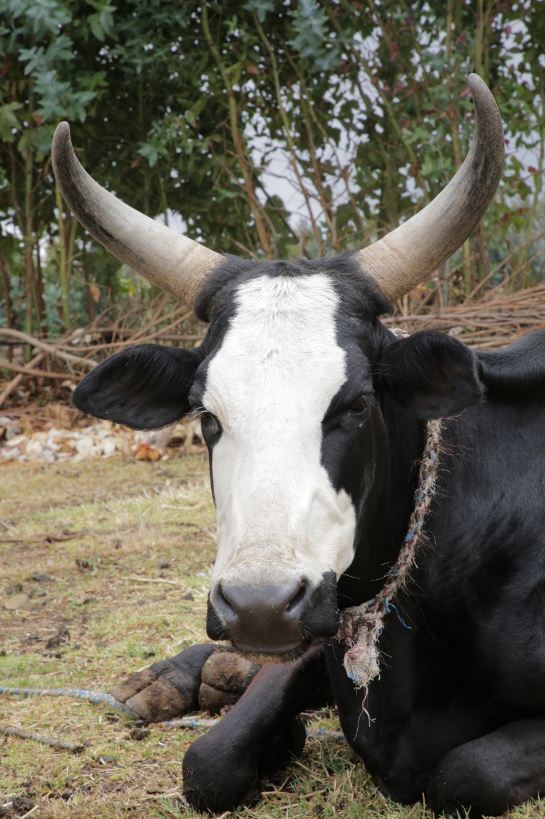
Conclusion and Outlook
Photo: Pioneer Farmer Kidane and Weleta in Tarmaber, North Shewa, AR, Apollo Habtamu/ILRI
P-PD offers a promising approach to improving Ethiopia’s livestock extension system.
Empowers farmers and (agro-)pastoralists through innovation, peer-to-peer learning, and adaptation to climate change
Scalable, sustainable, and adaptable to various contexts
Looking Ahead: Further implementation and adaptation of P-PD to more regions and communities in Ethiopia.

Slide 21


Acknowledgements
This work was conducted as part of the CGIAR Initiative Livestock and Climate and is supported by contributors to the CGIAR Trust Fund. CGIAR is a global research partnership for a food-secure future dedicated to transforming food, land, and water systems in a climate crisis.
This work has been partly financed by the Deutsche Gesellschaft für Internationale Zusammenarbeit (GIZ) commissioned by the Government of the Federal Republic of Germany (grant number: 2017.0119.2).

