Slide 1
African swine fever management planning: A practical approach
Ram Pratim Deka
Scientist, ILRI
Webinar presentation to the Ministry of Agriculture and Livestock Development, Nepal
12 March 2024

Slide 2
African swine fever (ASF)
A viral disease of pigs
Cause close to 100% mortality in pigs
No treatment
No commercially available vaccine until date
Not transmissible to human
Biosecurity is the mainstay of ASF control

Slide 3
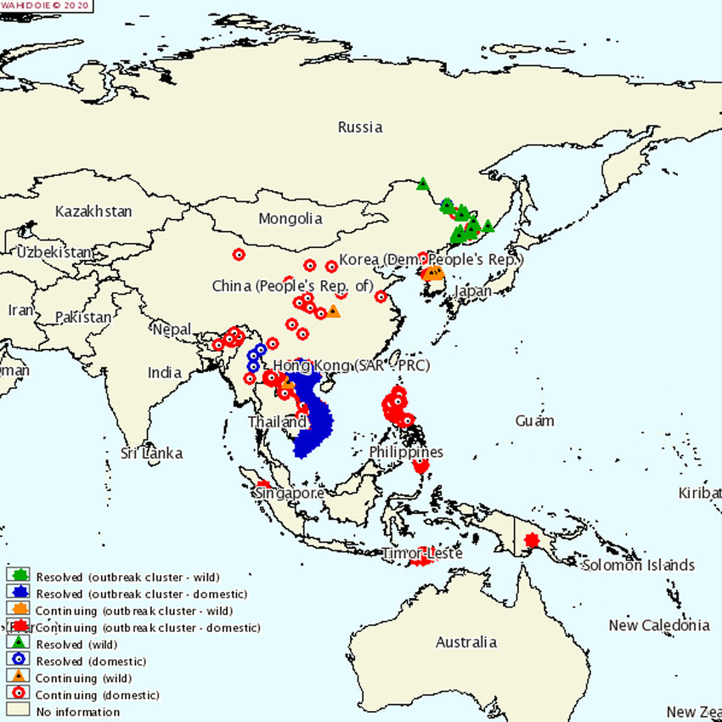
ASF timeline
Asia
China & South-East Asia including Myanmar
South Asia
Reported in several states from India, Bhutan & Nepal
Europe- Portugal
Spain
France etc.
1st described in Kenya
1921
1921-1957
1957-1960
1978-1984
2018-2020
April 2020
April 2022
Sub-Saharan African Countries
Dominican Republic & Haiti
India
1st reported from Assam & Arunachal Pradesh

Slide 4
Challenges in addressing ASF
Challenges
Collaborating with other departments and agencies & states needs time
Intra & inter departmental
Intra and inter- state
Standard practices adopted in other countries cannot be adopted without customization
Difficulty in culling & compensation
Fund allocation to a new activity is a time-consuming process
Administrative & socio- issues
Poor access to diagnostics & surveillance mechanism
Poor availability diagnostic & lab
Inadequate knowledge & capacity
Inadequate access to money, manpower & materials
Difficult to deal with exotic disease without advance planning & preparation
Unabated smuggling, slaughter & selling
Dominance of smallholder farming system
Poor biosecurity
Disease management approach
Guidelines remained static

Slide 5
ASF management & control measures
ASF management
  Diagnosis
  Surveillance
  Zoning
  Culling
  Compensation
  Disinfection
  Movement control
  Restocking
ASF Control
  Farming system change
  Biosecurity
  Knowledge and capacity building
  Networking with other agencies and states

Slide 6
Diagnosis
Complete the test (PCR) of each sample within 2 days after receiving
Send a small % of test positive & negative samples for confirmation
Test negative samples should be tested for other possible causes of death
Communicate the test results quickly
Collect samples within 12 hours following standard protocol

Slide 7
Outbreak investigation & surveillance
Do surveillance on sick/dead pigs, not on clinically healthy pigs.
Do surveillance in live animal markets and slaughter places.
Impart training to VOs & field staff on disease surveillance and epidemiology
Do the outbreak investigation quickly to track the infection
Collect the farm inventory within 48 hours in IZ after confirmation
Produce periodic surveillance report with GIS map

Slide 8
Introducing Zones
IZ should not be introduced based on theoretical perception of 1 km radius, should consider the geographically distinguishable landmark and prevailing farming system.
Propose to decrease the radius of the SZ from 10 km to 3 km for better surveillance.
Jurisdiction of IZ and SZ should be communicated to farmers and other value chain actors.
Do’s and don’t in IZ & SZ should be displayed and communicated to the concerned.
Update/ expand/introduce new zones based on surveillance report.

Slide 9
Lifting Zones
Restrictions in IZ & SZ shall not be applicable for indefinite period.
IZ shall be lifted after 60 days under certain conditions:
IZ shall be redesignated as SZ and farmers should be informed about the same
Disease free status after 3 years as per WOAH guidelines

Slide 10
Culling and disposal
Delay in culling process leads to failure of the actual objective of culling
Farms with good biosecurity present in IZ without any incidence of ASF should not be culled
Carcass disposal site in major pig belt areas should be identified in advance
Budgetary provision should be there for culling and disposal.

Slide 11
Compensation
Farmers should be compensated within 2 weeks of culling.
Farmers should be compensated based on nos. of pigs available at the time of outbreak investigation/survey, not based on nos. of pig alive at the time of culling.
A consent form should be signed with the farmers stating the compensation amount to be received and duties and responsibilities of the farmers to follow.
Farmers violating the clauses of the consent form should not be eligible for receiving compensation
Compensation rate should be revisited preferably in every year. Amount shall not be too high or too low.

Slide 12
Disinfection
Thorough cleaning & disinfection of the farm premise after culling & disposal operation is critical
Adequate budgetary provision is required for buying disinfectants, spraying machines etc.
In case of open ranging herd disinfection in the village may be considered
Disinfection should be considered until last herd is culled
Support from relevant departments like PHE may be sought

Slide 13
Movement control
Farms should be kept under lock and key to prevent entry of unauthorized men & animals
There shall be penalty for violators of movement restrictions as per the consent form signed with them
May allow movements of pigs originating from a commercial holding with proper biosecurity in the SZ after 15 days
Pig farmers in the SZ should be allowed to slaughter their pigs for home consumption, after notifying to AHVD
Smuggling or slaughtering of pigs from suspected herds shall be prohibited

Slide 14
Restocking
Restocking should be initiated after minimum six weeks from disinfection of the last premise.
Should collect samples for PCR testing after 15 days of restocking. Follow full repopulation if none of the sentinel pigs get sick/die within 30 days post-introduction.
Scavenging farms must meet minimum biosecurity requirements to restock
Non-scavenging backyard systems can only restock after restrictions in the SZ are lifted.
Restocking shall be initiated with due approval from local VOs

Slide 15
Farming system change and biosecurity
Scavenging system must need to be transformed to intensive to prevent ASF
An incentive scheme shall be initiated to support smallholders for farming system change
Commercial farms shall be supported/ guided to strengthen biosecurity infrastructure & practices
Govt. farms shall be strengthened to spear head the repopulation
Transport subsidy etc. could be introduce for sourcing piglets from disease free zones

Slide 16
Cooperation with other authorities & neighbouring states
Needs to have inter departmental coordination for collective action among AHVD, Environment & Forestry, PHE, civil and police administration
Harmonize IZ and SZ and unify state-level action plans mainly in bordering areas
Organize joint training events and regional workshops to harmonize control approaches for ASF
Establish an online platform for states to communicate and collaborate on ASF control plan

Slide 17
Training, extension and communication
Develop short, simple customised audio-visual messages for behavioural change
Organise training for field VOs, para vets and lab staff
Organise training for commercial pig breeders on biosecurity
Organise training for senior vet staff on ASF management process

Slide 18
Conclusion
Disease is inevitable
Lessons learnt from present outbreaks of ASF would help to address any emerging transboundary animal disease in future
Every passing day adds burden to disease management
Pace of every action is critical; needs to work timely and decisively
“Preparation through education is less costly than learning through tragedy”
-Max Mayfield
Acknowledgement: The presentation is prepared based on the lessons learnt under the World Bank–funded APART project of the Govt. of Assam, India

Slide 19

THANK YOU

