Slide 1


TOWARDS
A DIGITAL ONE CGIAR
Digital Capability Model & Proposed Digital Governance

Slide 2

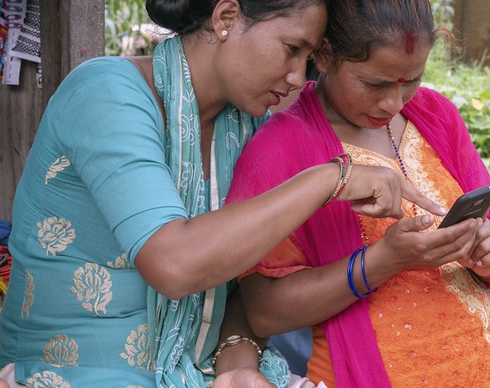
CONTENTS
KEY CONCEPTS
STRATEGY RESEARCH PROCESS AND DATA INPUTS
ORGANIZATIONAL CAPABILITY MODEL AND KEY SOURCES
DIGITAL CAPABILITY MODEL LEVEL 1-3
CAPABILITY DEFINITIONS
MATURITY OF CROSS-CUTTING DIGITAL CAPABILITIES
DIGITAL GOVERNANCE NEEDS & PROPOSED STRUCTURE
ROADMAP (PENDING)

Slide 3
KEY CONCEPTS
Organizational capability
Something the organization does (or should be able to do) in order to execute its strategy.
Digital capability
The ability of an organization to leverage data and digital technologies in support of some aspect of its strategy.
Organizational capability model
A granular model of the organization describing what it does (or should be able to do) to realize its objectives, providing a relatively stable map of the organization even if structures and roles may change.
Digital capability model
A description of the key digital capabilities needed to support or enhance the effectiveness of organizational capabilities and deliver on the organizational strategy.
Digital governance
The process and decision-making authorities by which data and digital technologies are chosen, developed, or eliminated by the organization.
Digital strategy
How the organization will use data and digital technologies most effectively to achieve its objectives.

Slide 4
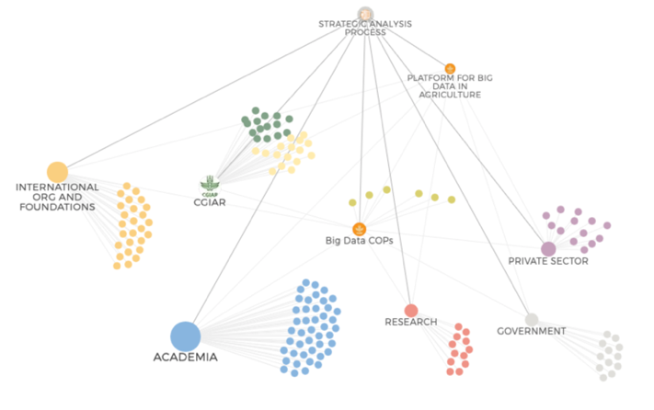
STRATEGIC ANALYSIS
Which digital trends could potentially transform agriculture in the next ten years?
1
What should an organization be able to do to navigate or leverage these trends effectively?
2
What roles should public interest actors like CGIAR play in digital agriculture?
ONLINE QUESTIONNAIRE
Internal + external
162
SEMI-STRUCTURED INTERVIEWS
Mostly external
83
FOCUS GROUP WORKSHOPS
Internal
10
LITERATURE REVIEW AND SYNTHESIS
3
Notes:
To examine the digital dimensions of the central strategic concepts of CGIAR (in particular the Research Strategy and draft One CGIAR organizational structure) we analyzed data from over 160 responses to a questionnaire targeting both internal and external participants, conducted 80 semi-structured interviews with a wide array of external stakeholders (we worked through the Big Data Platform International Advisory Board, Steering Committee, and Communities of Practice to identify a first list of experts, and then asked interviewees to recommend others to be interviewed, and in this way we filled out sample groups in private agri-food industry, development funding and finance, research organizations, and agtech startups. These efforts were guided by three key questions:
What digital trends have the potential to transform agriculture in the next ten years?
What should an organization be able to do to navigate or leverage these trends effectively?
What roles should public interest actors like CGIAR play in digital agriculture?
The team complemented this analysis with 10 internal focus group workshops with cross-cutting CGIAR Communities of Practice (Genebanks Platform; Monitoring, Evaluation and Learning; Communications; IT Managers; Excellence in Agronomy; Geospatial Analysis; Ontologies; Information and Data Managers; Crop Modeling; and the Gender Platform ). This analysis was further enriched through a review of the literature related to themes coming up in the interviews and focus groups.

Slide 5
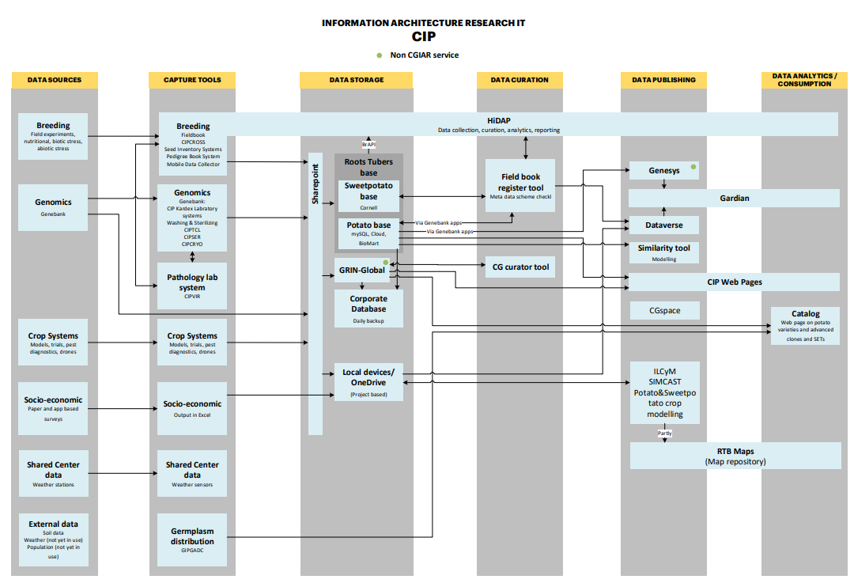
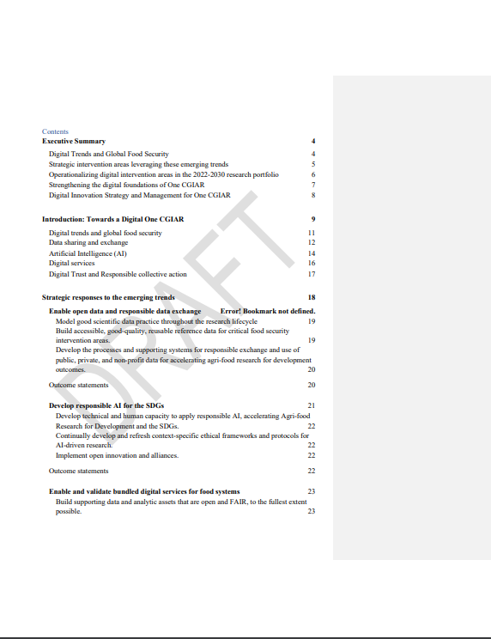
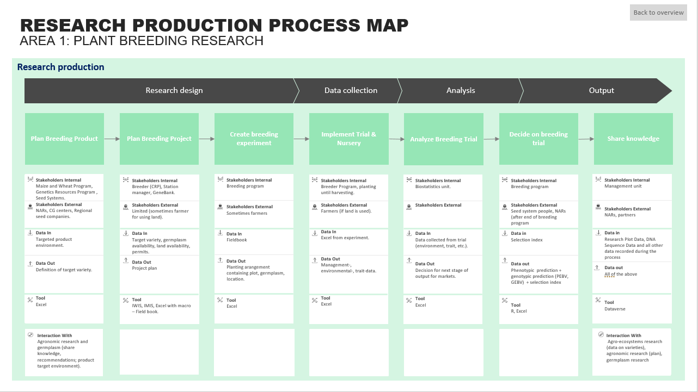
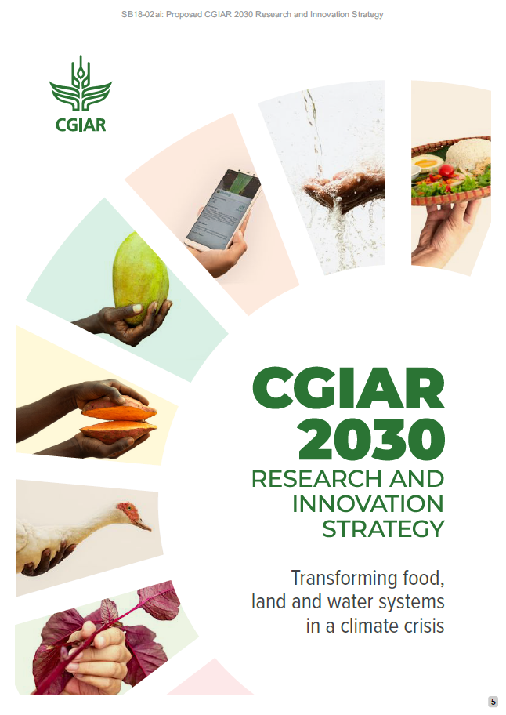
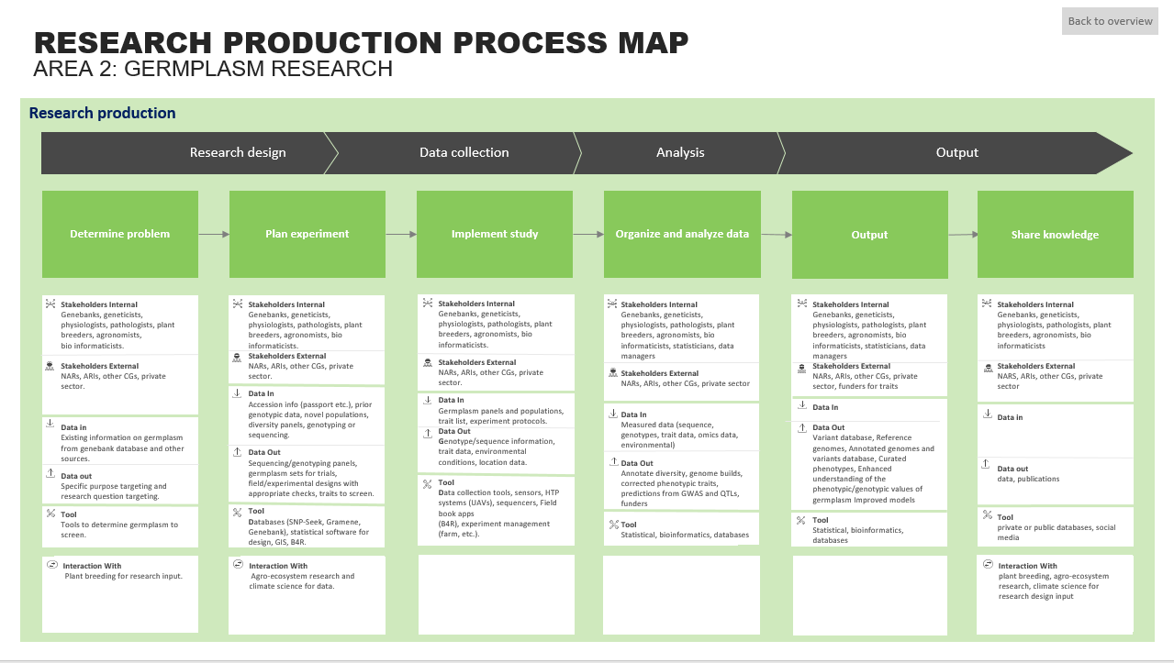
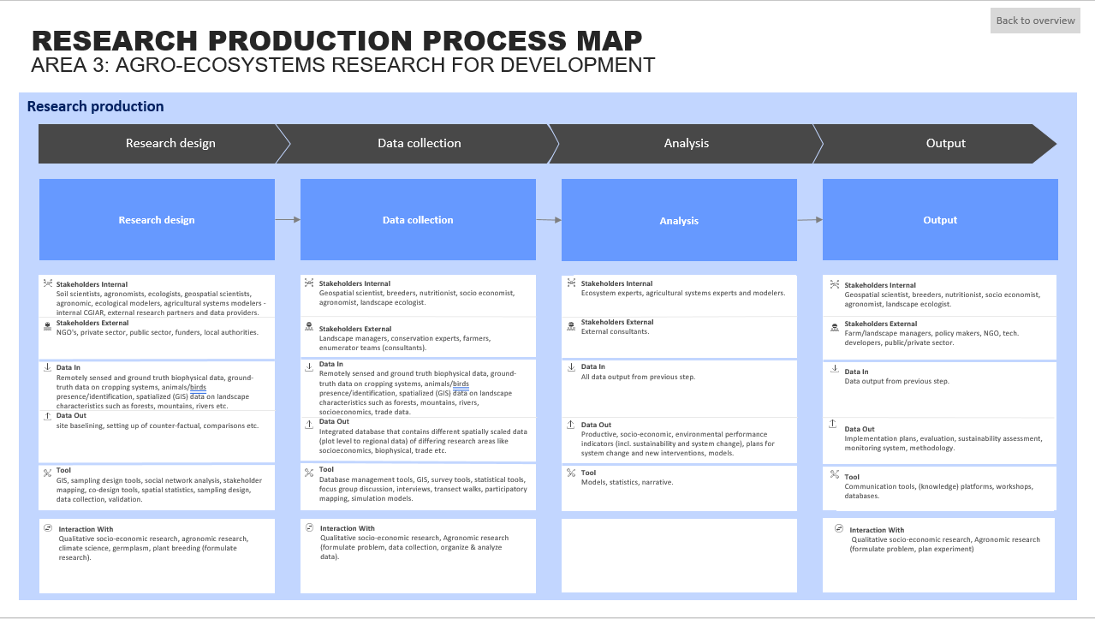
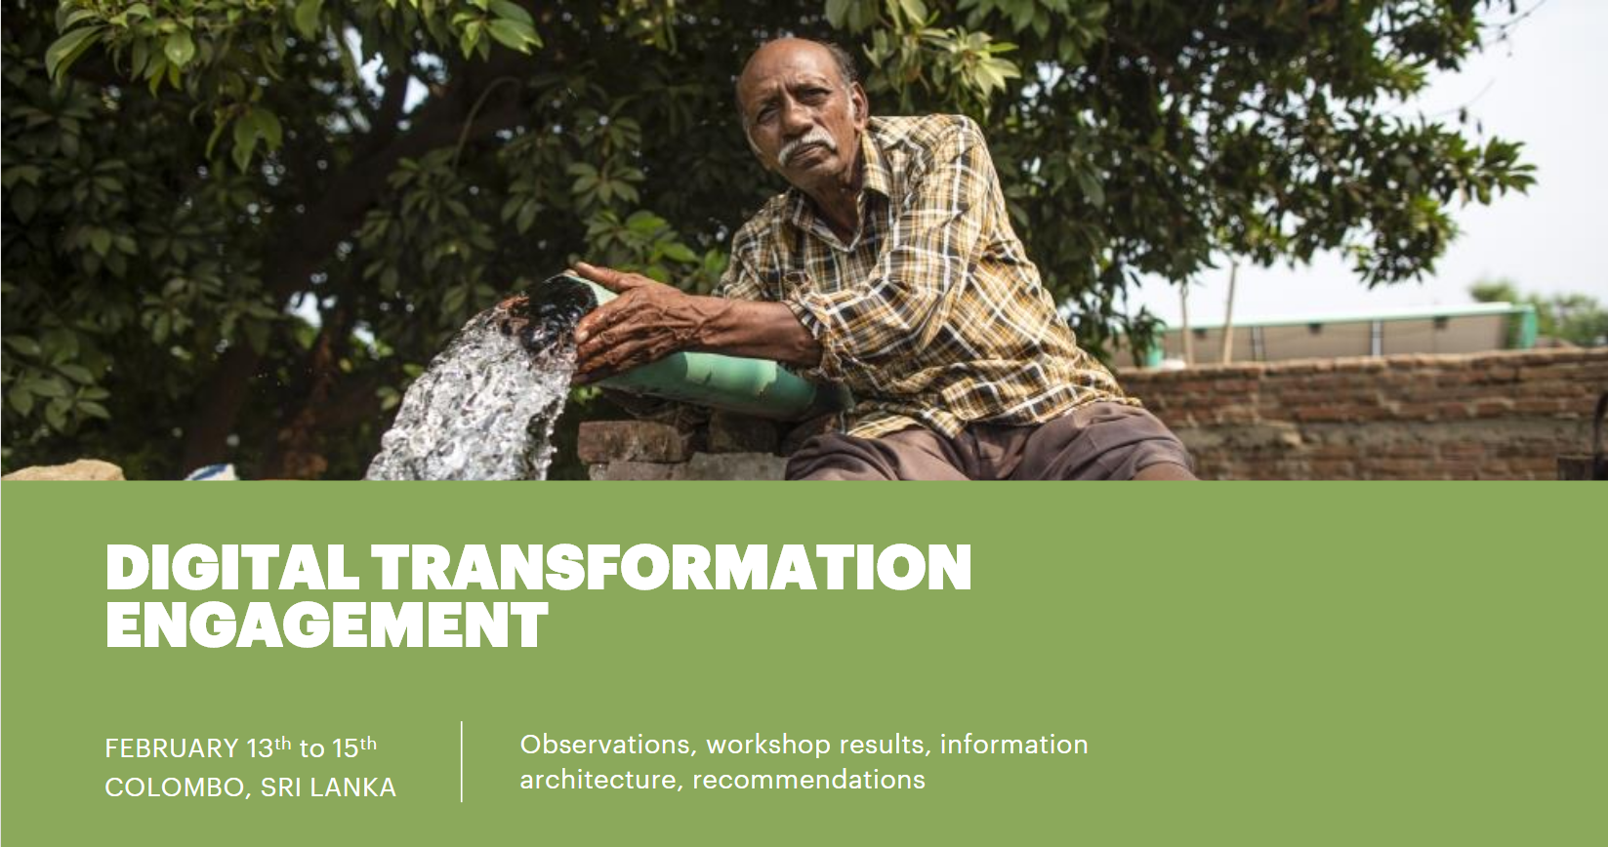
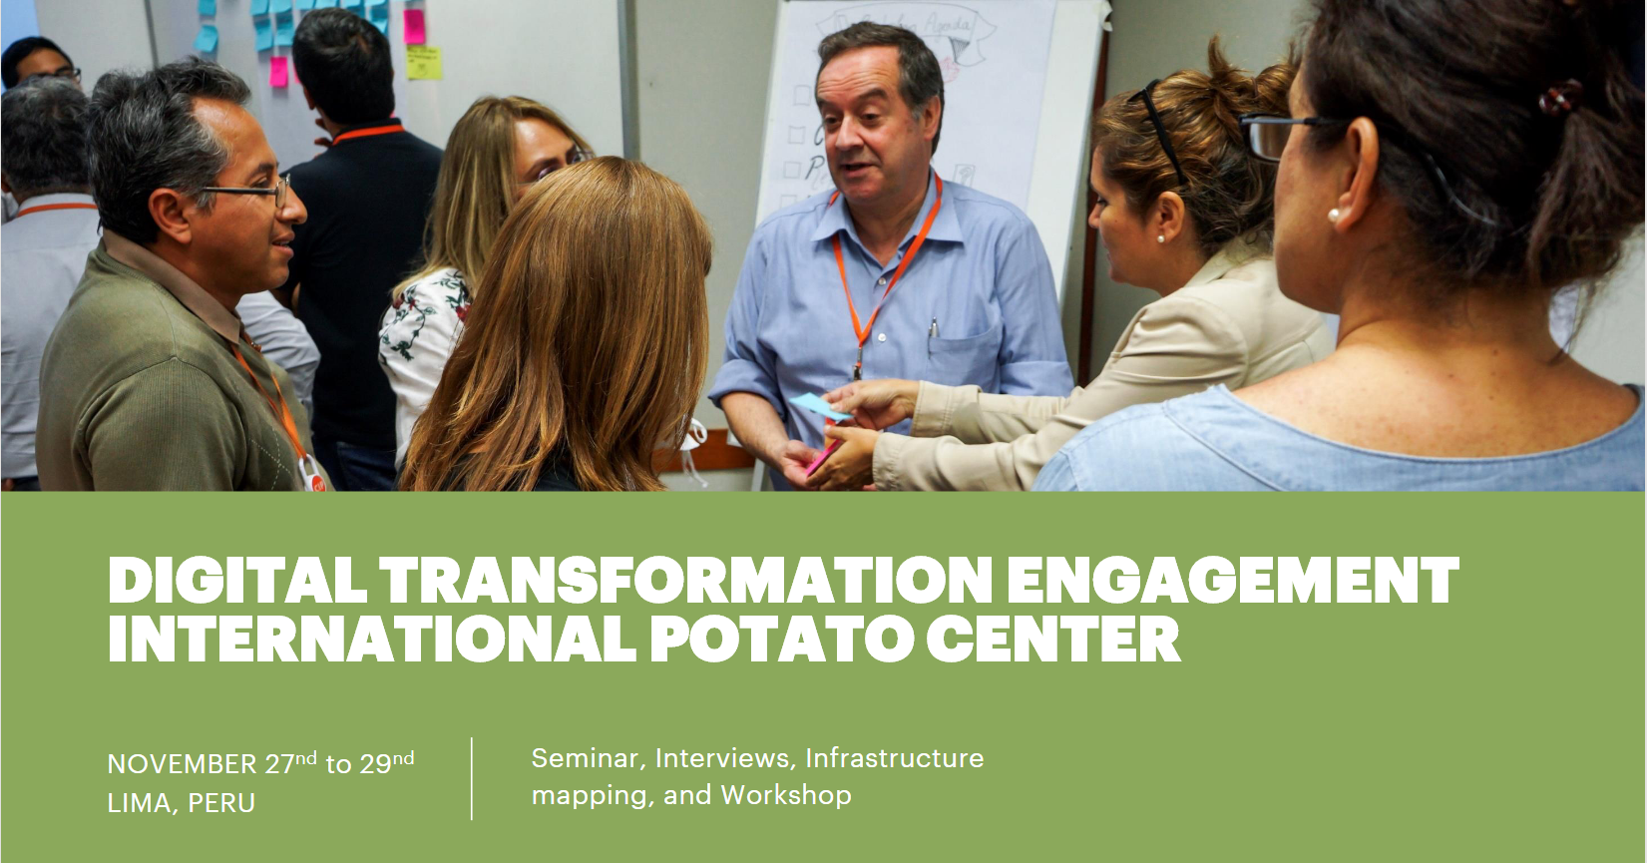
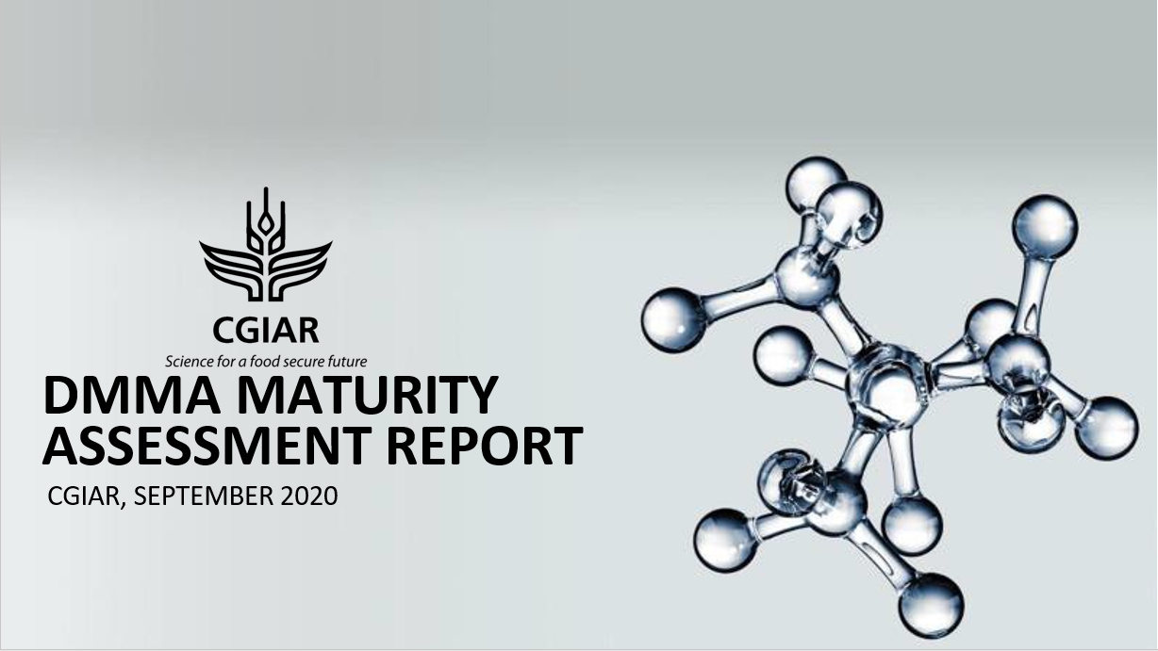
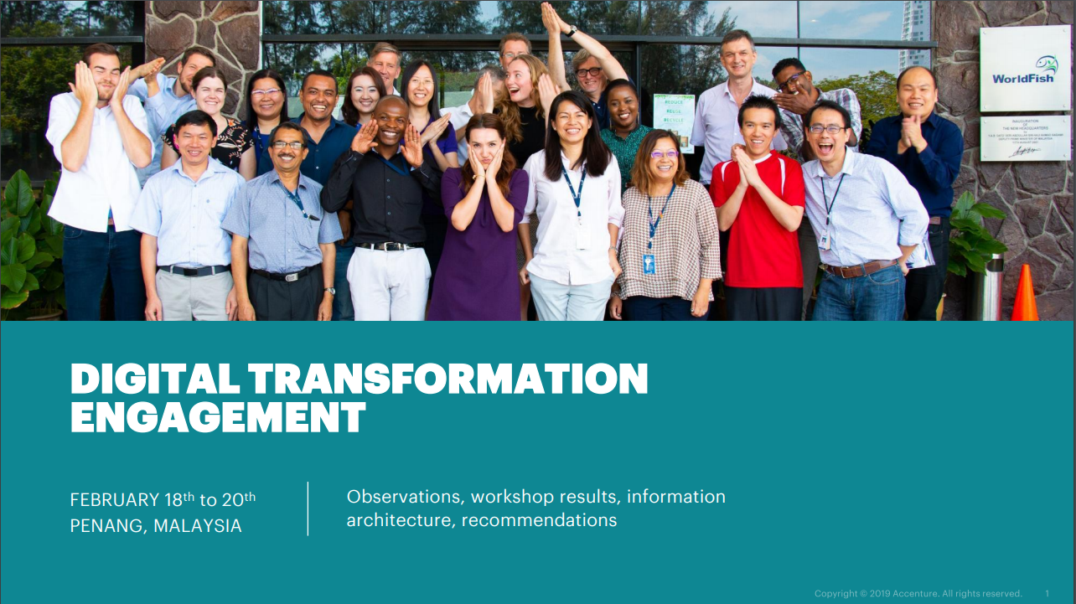
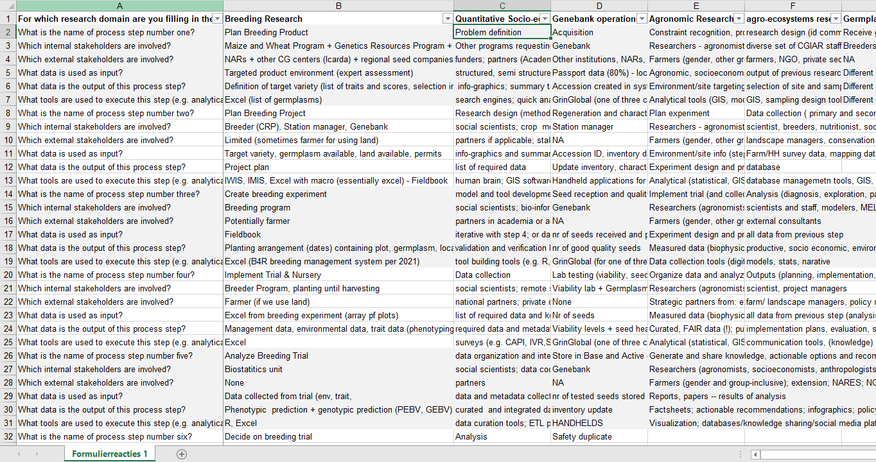
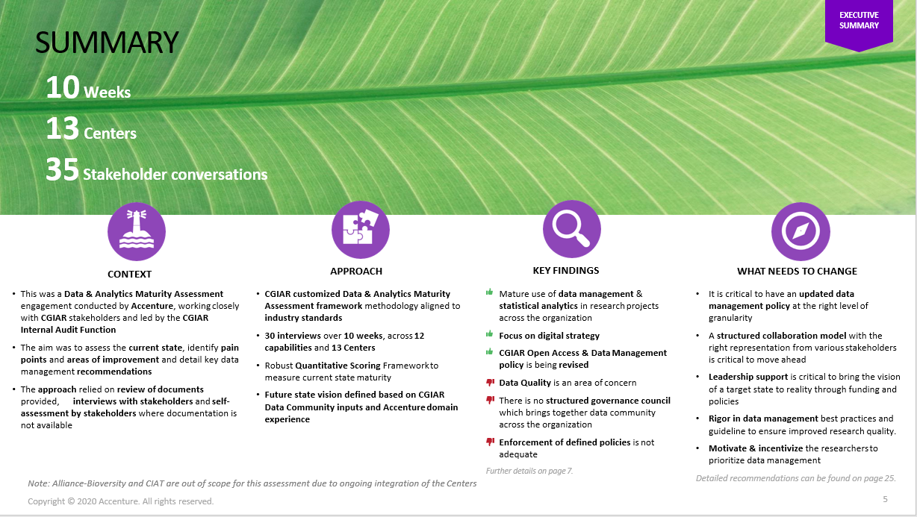
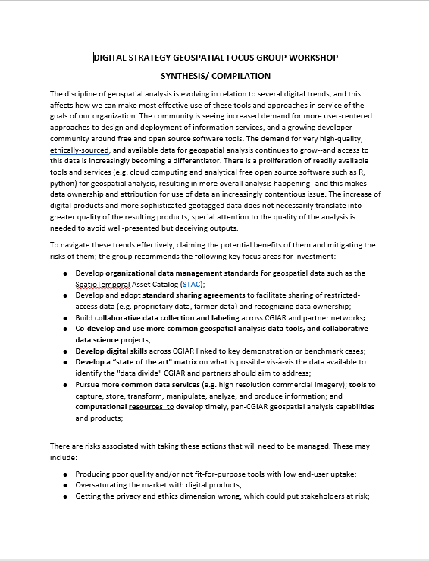
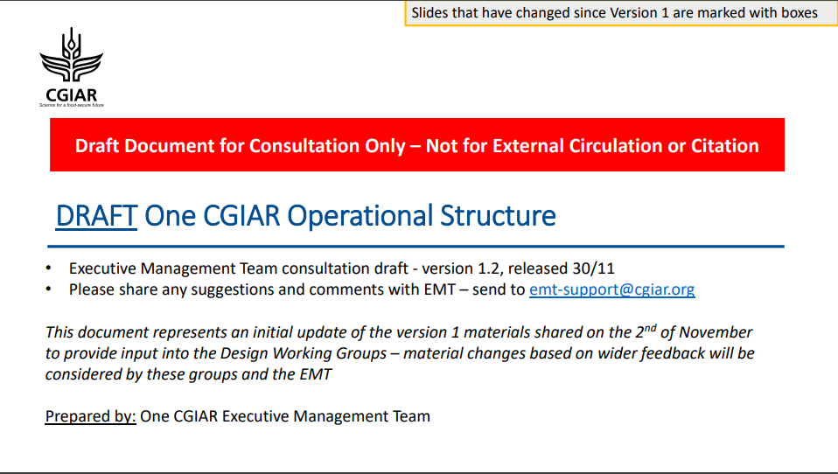
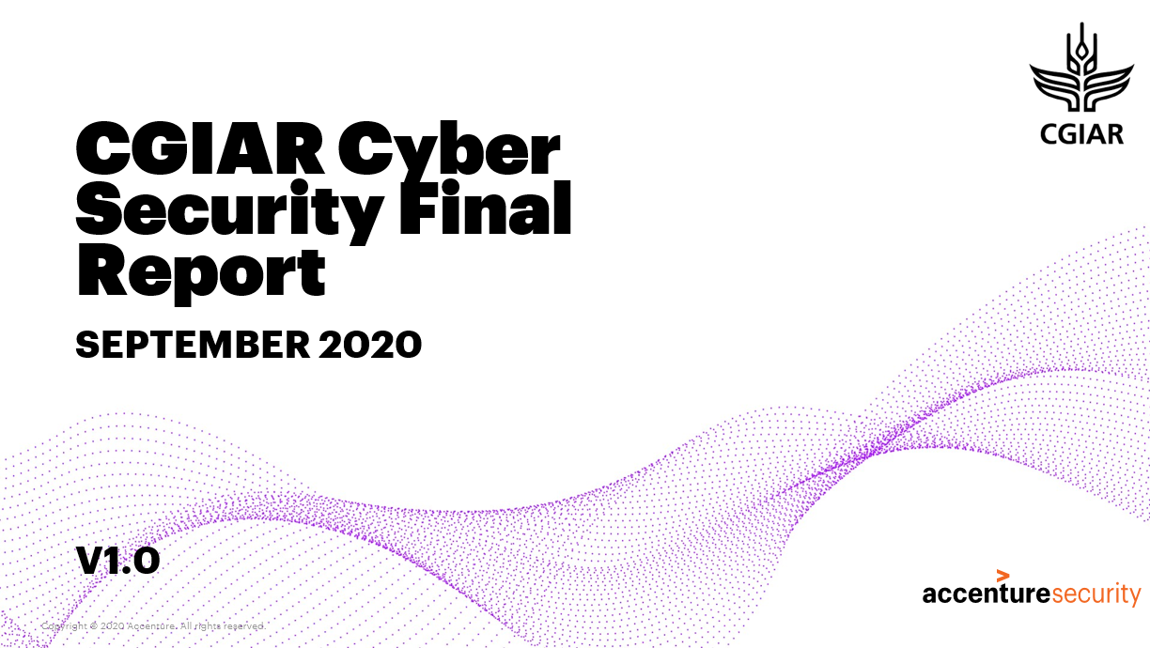
Overview of data inputs used to create the draft digital capability model and proposed digital governance
Research IT architecture maps for 7 centers
Two regional CGIAR research process mapping workshops
CGIAR 2030 Research Strategy and draft Digital Strategy
Digital transformation engagements at 7 centers
Data Management Maturity Assessment Report
Data from 162 survey responses and 83 semi-structured interviews
Summaries from workshops with 10 internal CGIAR focus groups
Cyber Security Review Report
Draft ONE CGIAR Operational Structure

Slide 6
ORGANIZATIONAL CAPABILITY MODEL LEVEL 0
LEADERSHIP & GOVERNANCE
FUNDRAISING
RESEARCH
FOR
DEVELOPMENT
PARTNERSHIP MANAGEMENT
&
COMMUNICATIONS
ENABLING ACTIVITIES
Notes:
Using the UCISA Capability Model for Higher Education (https://www.ucisa.ac.uk/Groups/Enterprise-Architecture-Group/UK-HE-Capability-Model) as a point of departure, workshop attendees identified key capabilities for an agricultural research for development organization.
By convention the capability model is made to be read from left to right, from budgetary or funding capabilities on the left, revenue-related capabilities more towards the right, with core business capabilities in the center.

Slide 7
MAPPING THE ORGANIZATION CAPABILITY MODEL TO A DIGITAL CAPABILITY MODEL & KEY SOURCES
CAPABILITY MODEL MAPPING
LEVEL 1 CATEGORY
KEY SOURCES
LINKS
System Leadership & Governance
1. Digital Strategy
& Organization
CGIAR Research and Innovation Strategy
CGIAR Research and Innovation Strategy
Fundraising
Research for Development
Partnership & Product Management & Communications
Draft Digital Strategy
Draft Digital Strategy
Focus group workshop summaries
Focus group workshop summaries
Pan-CGIAR Digital Strategy Assessment (2019)
Pan-CGIAR Digital Strategy Assessment (2019)
Enabling Activities
Surveys and semi-structured interviews (internal dataset)
Surveys and semi-structured interviews (internal dataset)
System Leadership & Governance
2. Technology
Capabilities
and Infrastructure
Draft Digital Strategy
Draft Digital Strategy
Fundraising
Research for Development
Partnership & Product Management & Communications
Focus group workshop summary- IT managers
Focus group workshop summary- IT managers
Cyber security review (internal document)
Cyber security review (internal document)
Data Management Maturity Assessment (DMMA)
Data Management Maturity Assessment (DMMA)
Enabling Activities
Research IT architecture maps from 7 Centers
Research IT architecture maps from 7 Centers
System Leadership & Governance
3. Organizational Data & Analytics
Data Management Maturity Assessment (DMMA)
Data Management Maturity Assessment (DMMA)
Fundraising
Research for Development
Partnership & Product Management & Communications
Focus group workshop summary- IT managers
Focus group workshop summary- IT managers
Focus group workshop summary- MEL
Focus group workshop summary- MEL
Enabling Activities
Focus group workshop summary- Communications
Focus group workshop summary- Communications
System Leadership & Governance
4. Research
Data & Analytics
Research process maps for key domains in the portfolio
Research process maps for key domains in the portfolio
Fundraising
Research for Development
Partnership & Product Management & Communications
Research IT architecture maps from 7 Centers
Research IT architecture maps from 7 Centers
Data Management Maturity Assessment (DMMA)
Data Management Maturity Assessment (DMMA)
Enabling Activities
Focus group workshop summaries
Focus group workshop summaries
System Leadership & Governance
5. Fundraising,
Communications
and Partnerships
Fundraising
Research for Development
Partnership Management & Communications
Focus group workshop summary- Communications
Focus group workshop summary- Communications
Focus group workshop summary- MEL
Focus group workshop summary- MEL
Enabling Activities
System Leadership & Governance
6. Digital Research
for Development
CGIAR Research and Innovation Strategy
CGIAR Research and Innovation Strategy
Fundraising
Research for Development
Partnership & Product Management & Communications
Draft Digital Strategy
Draft Digital Strategy
Focus group workshop summaries
Focus group workshop summaries
Enabling Activities
Surveys and semi-structured interviews (internal dataset)
Surveys & semi-structured interviews (internal dataset)
Notes:
The team mapped these broad CGIAR capability areas to a slightly modified version of a common framework for assessing digital capabilities in a digitally-enabled organization, and complemented with insights gained through strategy research to develop a draft One CGIAR digital capability model, attempting to describe the complete set of digital capabilities CGIAR will need to fulfill its mission. (Links work in ‘Slide Show’ mode.)

Slide 8
ORGANIZATIONAL DIGITAL CAPABILITY MODEL
1.2 Digital Governance
1.1 Digital Strategy
1.3 Digital Leadership
1.4 Digital Skills Development
1. Digital Strategy
& Organization
1.1.1 Development, validation, and management
1.1.2 Horizon scanning
1.2.1 Risk management
1.2.2 Compliance monitoring and reporting
2.2 On-Premise Infrastructure Provisioning and Support
1.2.5 Data governance
1.3.1 Research Innovation
1.3.2 Operational Excellence
1.5.1 Assessment
1.5.2 Skills management
2.6 Specialized
Research IT Services
2.8 IT Governance
2.2.1 Support and provisioning for network, applications, storage, and compute
1.2.3 Digital architecture adoption and promotion
1.2.4 Aligning digital investments and organizational goals.
1.2.6 Technology ethics
1.3.3 Digital culture
2.7 Enterprise Applications Support
2.1 Cloud Management
2.3 Data Warehousing
2.4 Operational Innovation
2.5 Cyber Security and Digital Identity
2.6.1 Software engineering review and support
4.3 Research Data Management and Governance
2.8.1 EA design and implementation
2.2.2 Support and provisioning for IT equipment
2.4.1 Process redesign
2.5.1 Enterprise IT security
2.6.2 Provisioning IaaS for research
2.7.1a Enterprise Resource Planning
2. Technology
Capabilities
and Infrastructure
2.1.1 Cloud competence
2.3.1 Data storage
2.8.2 Hardware standards and policies
2.1.2 Cloud migration
2.3.2 ETL
2.4.2 Software engineering/ DevOpps
2.5.2 Cyber defense
2.6.3 Research applications architecture
3.4 Enterprise Data Foundation
2.7.1b Performance Management
2.8.3 Software standards and policies
3.1 Enterprise Data Usage
3.2 Enterprise Data Management and Governance
3.3 Enterprise Data Insights and Analytics
2.5.3 IAM and data security
4.3.1 Policies, processes, and standards for research data
2.1.3 Cloud architecture
4.2 Research Management
5.2 Digital Communication
3. Organizational
Data & Analytics
3.1.1 Data driven business model
4.1 Research Analytics
3.1.2 Data driven organization
3.2.1 Data strategy and governance
3.2.2 Metadata management
3.3.1 Analytics strategy
3.3.2 Analytics and visualization
3.4.1 Data platform
3.4.2 Data architecture
3.2.3 Data quality
3.3.3 Performance monitoring
5.1 Digital Fundraising
5.3 Digital Partnerships Development and Management
4. Research Data &
Analytics
4.1.2 Data sharing
4.3.2 Data Ethics
4.1.1 Data collection
4.1.2 Data sharing
4.1.3 Data mgmt.
4.2.1 Breeding
4.2.2 Agro-ecosystem
4.2.3 Germplasm
4.2.4 Climate science
4.1.4 Data curation
4.1.5 Data analysis
4.2.5 Agronomy
4.2.6 Socioeconomic
4.2.7 Nutrition & Health
4.2.8 Animal science
4.3.1a Socio-economic
4.3.1b Agro-ecosystem
4.3.1c Geospatial
4.3.1d Phenotypic
4.3.1e Genotypic
4.3.1f Nutrition & Health
5.1.1 Proposal and agreement support
5.1.2 Monitoring funding opportunities
6.3 Bundled Digital Services
5.2.3 Research aggregation and promotion
5.2.5 Media aggregation and publication
5. Fundraising,
Communications
and Partnerships
6.2 Responsible AI
5.2.1 Web optimization
5.2.2 Social Media mgmt. and promotion
5.2.4 Media monitoring
6.4 Digital Collective Action
6.5 Digital Technologies and Innovation
5.3.1 Capacity partnerships
5.3.2 Impact partnerships
5.3.3 Product Management
6.1 Data Mobilization and Responsible Data Exchange
6.5.1 Fostering and stage-gating innovations
6.1.1 Public data sharing for research and impact
6.2.1 Analytics for the SDGs
6.4.1 Multi-stakeholder governance.
6.1.2 Responsible use and sharing of restricted data
6.2.2 AI Policy and ethics
6.3.1 Human centered design
6.3.3 Evidence and meta-analysis
6.4.2 Food, land, and water system intelligence
6.5.2 Innovation process and strategy
6. Digital Research
for Development
6.3.2 Digital extension/advisory
6.3.4 Digital financial services

Slide 9
LEVEL 1 DEFINITIONS
1. Digital Strategy
& Organization
The ability to develop, validate, and fully implement digital strategy across the organization in the context of the evolving strategic landscape and overall organizational strategy.
2. Technology
Capabilities
and Infrastructure
The ability to design, develop, and continually improve digital infrastructure in support of all other organizational capabilities.
3. Organizational
Data & Analytics
The ability to leverage organizational and operational data to its full potential for supporting operational excellence across the whole organization.
4. Research Data &
Analytics
The ability to leverage research data to its full potential for enabling and accelerating impactful research, bridging research domains and enhancing the whole portfolio.
5. Fundraising,
Communications
and Partnerships
The ability of the organization to leverage data, publications, and digital technologies to their fullest potential in fundraising, communicating, and developing and managing partnerships.
6. Digital Research
for Development
The ability of the organization to leverage data, digital technologies, and digital innovation with the potential to transform agriculture research for development to its full potential for research, research delivery, and greater impact.

Slide 10
LEVEL 2 DEFINITIONS
1. Digital Strategy and Organization
1.1 Digital Strategy
The activity of defining, validating, managing the execution, and periodically renewing the central, integrated concept for how CGIAR will use data and digital technologies most effectively to achieve its objectives.
1.2 Digital Governance
The activity of defining and implementing principles, processes, and decision-making guiding all aspects of how the organization will manage risk, align investments, and leverage data and digital technologies to their fullest potential achieve its objectives.
1.3 Digital Leadership
The activity—by senior management--of guiding digital research innovation, digitally-enabled operational excellence, and development of a pan-CGIAR digital culture that embraces the organizational strategy and is characterized by: data sharing; adoption and use of data and digital tools across the organization in business processes, research processes, and partnerships; and linking CGIAR to a wider digital innovation ecosystem.
1.4 Digital Skills Development
The activity of assessing current digital skills in the organization and managing the recruitment or upskilling needed to have the right skills to implement the digital strategy.

Slide 11
LEVEL 2 DEFINITIONS
2. Technology Capabilities and Infrastructure
2.1 Cloud management
The activity of guiding the organization towards more harmonized and effective use of cloud technologies in service of the organizational strategy.
2.2 On-Prem Infrastructure
Provisioning and Support
The ability to provision and support on-premise IT infrastructure services.
2.3 Data Warehousing
The activity of ingesting and storing the data and information assets of the organization for continued re-use.
2.4 Operational Innovation
The ability to source, foster, and stage-gate digital innovations in support of operational excellence.
2.5 Cyber Security and
Digital Identity
The ability to avoid loss of data, be resistant to cyber-attacks, and implement best practices with regards to data security.
2.6 Specialized Research
IT Services
The ability to provide digital infrastructure, appropriate standards, and services in support of key research areas.
2.7 Enterprise Applications
Support
The ability to provide technical assistance and support to key cross-cutting applications supporting more unified functioning of the organization.
2.8 IT Governance
The activity of developing and applying frameworks for establishing accountability, roles, and decision-making authority guiding development and renewal of the organization’s digital infrastructure.

Slide 12
LEVEL 2 DEFINITIONS
3. Organizational Data & Analytics
3.1 Enterprise Data Usage
The ability to leverage data to inform and guide overall business model of the organization, building data into all aspects of operations.
3.2 Enterprise Data Management
and Governance
The ability to control and manage organizational data assets so that they can be used easily, consistently, transparently, legally and ethically across the organization.
3.3 Enterprise Data Insights and
Analytics
The ability of providing the tools & approaches to integrate data-driven decisions across the organization - serves as the gateway to a data driven organization
3.4 Enterprise Data Foundation
The ability to integrate data across the organization in a structured way to provide faster access to trustworthy data.
4. Research Data & Analytics
4.1 Research Analytics
The activity and ability to collect, curate, share, analyze, and manage research data.
4.2 Research Management
The ability to leverage data and systems to manage research in key domains intersecting with the CGIAR portfolio, facilitating cross-domain analysis and coordination.
4.3 Research Domain
Data Management and
Governance
The activity of developing and implementing processes, policies, standards and ethical frameworks related to research data across key domains in the CGIAR portfolio.

Slide 13
LEVEL 2 DEFINITIONS
5. Fundraising, Communications and Partnerships
5.1 Digital Fundraising
The ability and activity of applying data and digital tools to support monitoring of funding opportunities and development and support of proposals and funding agreements.
5.2 Digital Communication
The ability to leverage digital media, tools, and services to most effect to make communications a key enhancement of the impact of CGIAR research and innovation.
5.3 Digital Partnerships
Development and Management
The ability to develop and manage digital partnerships to access new capabilities, develop new pathways to impact, and manage digital research products.
6. Digital Research for Development
6.1 Ethics and Responsible
Data Exchange
The ability of the CGIAR and its partners to share the necessary data (even restricted data) for agricultural analytics that can drive impact and progress towards the SDGs.
6.2 Responsible AI
The ability to leverage AI to its full potential in analytic methods for helping transform food, land, and water systems while developing and improving ethical frameworks for its use.
6.3 Bundled Digital Services
The ability of the organization to link its data and analytic capacity with digital products and services to reach millions of stakeholders, design these services in light of digital inclusion and complex livelihoods of stakeholders, and collate and validate the evidence of their effectiveness and impact—especially advisory services and digitally-enabled financial services.
6.4 Digital Collective Action
The ability of the organization to develop trusted data and analysis to help align public, private, and non-profit investments in support of global food security, and to participate in and facilitate the necessary multi-stakeholder governance needed to guide collective action.
6.5 Research Digital
Technologies and Innovation
The ability of the organization to stay abreast the rapid evolution of digital technologies; sourcing, fostering, and evaluating technologies in research and in service of research delivery and impact.

Slide 14
MATURITY OF CROSS-CUTTING DIGITAL CAPABILITIES
1.2 Digital Governance
1.1 Digital Strategy
1.3 Digital Leadership
1.4 Digital Skills Development
1. Digital Strategy
& Organization
1.1.1 Development, validation, and management
1.1.2 Horizon scanning
2.2 On-Premise Infrastructure Provisioning and Support
1.2.1 Risk management
1.2.2 Compliance monitoring and reporting
1.2.5 Data governance
1.3.1 Research Innovation
1.3.2 Operational Excellence
1.5.1 Assessment
1.5.2 Skills management
2.6 Specialized Research IT Services
2.8 IT Governance
1.2.3 Digital architecture adoption and promotion
1.2.4 Aligning digital investments and organizational goals.
1.2.6 Technology ethics
1.3.3 Digital culture
2.7 Enterprise Applications Support
2.1 Cloud Management
2.2.1 Support & provisioning for network, applications, storage, and compute
2.3 Data Warehousing
2.4 Operational Innovation
2.5 Cyber Security and Digital Identity
2.6.1 Software engineering review and support
4.3 Research Data Management and Governance
2.8.1 EA design and implementation
2.4.1 Process redesign
2.5.1 Enterprise IT security
2.6.2 Provisioning IaaS for research
2.7.1a Enterprise Resource Planning
2. Technology
Capabilities
and Infrastructure
2.1.1 Cloud competence
2.2.2 Support &
provisioning for IT equipment
2.3.1 Data storage
2.8.2 Hardware standards and policies
2.1.2 Cloud migration
2.4.2 Software engineering/ DevOpps
2.5.2 Cyber defence
2.6.3 Research applications architecture
3.4 Enterprise Data Foundation
2.7.1b Performance Management
2.8.3 Software standards and policies
3.1 Enterprise Data Usage
3.2 Enterprise Data Management and Governance
2.3.2 ETL
3.3 Enterprise Data Insights and Analytics
2.5.3 IAM and data security
4.3.1 Policies, processes, and standards for research data
2.1.3 Cloud architecture
4.2 Research Management
5.2 Digital Communication
3. Organizational
Data & Analytics
3.1.1 Data driven business model
4.1 Research Analytics
3.1.2 Data driven organization
3.2.1 Data strategy and governance
3.2.2 Metadata management
3.3.1 Analytics strategy
3.3.2 Analytics and visualization
3.4.1 Data platform
3.4.2 Data architecture
3.2.3 Data quality
3.3.3 Performance monitoring
5.1 Digital Fundraising
5.3 Digital Partnerships Development and Management
4. Research Data
& Analytics
4.3.2 Data Ethics
4.1.1 Data collection
4.1.2 Data sharing
4.1.3 Data mgmt.
4.2.1 Breeding
4.2.2 Agro-ecosystem
4.2.3 Germplasm
4.2.4 Climate science
4.1.4 Data curation
4.1.5 Data analysis
4.2.5 Agronomy
4.2.6 Socioeconomic
4.2.7 Nutrition & Health
4.2.8 Animal science
4.3.1a Socio-economic
4.3.1b Agro-ecosystem
4.3.1c Geospatial
4.3.1d Phenotypic
4.3.1e Genotypic
4.3.1f Nutrition & Health
5.1.1 Proposal and agreement support
5.1.2 Monitoring funding opportunities
6.3 Bundled Digital Services
5.2.3 Research aggregation and promotion
5.2.5 Media aggregation and publication
5. Fundraising,
Communications
& Partnerships
6.2 Responsible AI
5.2.1 Web optimization
5.2.2 Social Media mgmt. and promotion
5.2.4 Media monitoring
6.4 Digital Collective Action
6.5 Digital Technologies and Innovation
5.3.1 Capacity partnerships
5.3.2 Impact partnerships
5.3.3 Product Management
6.1 Data Mobilization and Responsible Data Exchange
6.1.1 Public data sharing for research and impact
6.2.1 Analytics for the SDGs
6.4.1 Multi-stakeholder governance.
6.5.1 Fostering and stage-gating innovations
6.1.2 Responsible use and sharing of restricted data
6.2.2 AI Policy and ethics
6.3.1 Human centered design
6.3.3 Evidence and meta-analysis
6.4.2 Food, land, and water system intelligence
6.5.2 Innovation process and strategy
6. Digital Research
for Development
6.3.2 Digital extension/advisory
6.3.4 Digital financial services
High: Digital capability well developed and well-diffused
and adopted through the organization as a cross-cutting capability.
Medium: Digital capability developed somewhere in the organization
but not yet well-diffused or widely adopted as a cross-cutting capability.
Low: Digital capability of limited
development and diffusion across the organization.

Slide 15
WHAT DIGITAL CAPABILITIES REQUIRE A GOVERNANCE FUNCTION?
1.2 Digital Governance
1.1 Digital Strategy
1.3 Digital Leadership
1.4 Digital Skills Development
1. Digital Strategy
& Organization
1.1.1 Development, validation, and management
1.1.2 Horizon scanning
2.2 On-Premise Infrastructure Provisioning and Support
1.2.1 Risk management
1.2.2 Compliance monitoring and reporting
1.2.5 Data governance
1.3.1 Research Innovation
1.3.2 Operational Excellence
1.5.1 Assessment
1.5.2 Skills management
2.6 Specialized Research IT Services
2.8 IT Governance
1.2.3 Digital architecture adoption and promotion
1.2.4 Aligning digital investments and organizational goals.
1.2.6 Technology ethics
1.3.3 Digital culture
2.7 Enterprise Applications Support
2.1 Cloud Management
2.2.1 Support & provisioning for network, applications, storage, and compute
2.3 Data Warehousing
2.4 Operational Innovation
2.5 Cyber Security and Digital Identity
2.6.1 Software engineering review and support
4.3 Research Data Management and Governance
2.8.1 EA design and implementation
2.4.1 Process redesign
2.5.1 Enterprise IT security
2.6.2 Provisioning IaaS for research
2.7.1a Enterprise Resource Planning
2. Technology
Capabilities
and Infrastructure
2.1.1 Cloud competence
2.2.2 Support &
provisioning for IT equipment
2.3.1 Data storage
2.8.2 Hardware standards and policies
2.1.2 Cloud migration
2.4.2 Software engineering/ DevOpps
2.5.2 Cyber defence
2.6.3 Research applications architecture
3.4 Enterprise Data Foundation
2.7.1b Performance Management
2.8.3 Software standards and policies
3.1 Enterprise Data Usage
3.2 Enterprise Data Management and Governance
2.3.2 ETL
3.3 Enterprise Data Insights and Analytics
2.5.3 IAM and data security
4.3.1 Policies, processes, and standards for research data
2.1.3 Cloud architecture
4.2 Research Management
5.2 Digital Communication
3. Organizational
Data & Analytics
3.1.1 Data driven business model
4.1 Research Analytics
3.1.2 Data driven organization
3.2.1 Data strategy and governance
3.2.2 Metadata management
3.3.1 Analytics strategy
3.3.2 Analytics and visualization
3.4.1 Data platform
3.4.2 Data architecture
3.2.3 Data quality
3.3.3 Performance monitoring
5.1 Digital Fundraising
5.3 Digital Partnerships Development and Management
4. Research Data
& Analytics
4.3.2 Data Ethics
4.1.1 Data collection
4.1.2 Data sharing
4.1.3 Data mgmt.
4.2.1 Breeding
4.2.2 Agro-ecosystem
4.2.3 Germplasm
4.2.4 Climate science
4.1.4 Data curation
4.1.5 Data analysis
4.2.5 Agronomy
4.2.6 Socioeconomic
4.2.7 Nutrition & Health
4.2.8 Animal science
4.3.1a Socio-economic
4.3.1b Agro-ecosystem
4.3.1c Geospatial
4.3.1d Phenotypic
4.3.1e Genotypic
4.3.1f Nutrition & Health
5.1.1 Proposal and agreement support
5.1.2 Monitoring funding opportunities
6.3 Bundled Digital Services
5.2.3 Research aggregation and promotion
5.2.5 Media aggregation and publication
5. Fundraising,
Communications
& Partnerships
6.2 Responsible AI
5.2.1 Web optimization
5.2.2 Social Media mgmt. and promotion
5.2.4 Media monitoring
6.4 Digital Collective Action
6.5 Digital Technologies and Innovation
5.3.1 Capacity partnerships
5.3.2 Impact partnerships
5.3.3 Product Management
6.1 Data Mobilization and Responsible Data Exchange
6.1.1 Public data sharing for research and impact
6.2.1 Analytics for the SDGs
6.4.1 Multi-stakeholder governance.
6.5.1 Fostering and stage-gating innovations
6.1.2 Responsible use and sharing of restricted data
6.2.2 AI Policy and ethics
6.3.1 Human centered design
6.3.3 Evidence and meta-analysis
6.4.2 Food, land, and water system intelligence
6.5.2 Innovation process and strategy
6. Digital Research
for Development
6.3.2 Digital extension/advisory
6.3.4 Digital financial services
Out of Scope
Maturity:
High
Medium
Low

Slide 16
What governance capabilities is the
Digital Services team well-positioned to execute today?
Organization | Description | Data Governance Responsibilities
Global Office |  | Executive Sponsorship Organization Alignment & Change Management Project Prioritization 1.2.1 Risk Management 1.2.2 Compliance Monitoring and Reporting | 1.2.4 Digital investments to org goals alignment (Enterprise) 3.1 Enterprise Data Usage and Value 6.1.2 Technology Ethics
Infrastructure & Operations | Support sourcing, maintenance, and harmonization of IT infrastructure (hardware, software and network) and support day-to-day user requirements | 2.1.2 Cloud Migration 2.5.2 Cyber Defense 2.8.1 Software standards and policies 2.8.2 Hardware standards and policies
Enterprise Architecture | Holistically lead enterprise-level digital service provision and upgrades | 1.2.3 Digital Architecture Adoption and Promotion 2.8.1 Enterprise Architecture Design and Implementation 3.2 Enterprise data management and governance | 3.4.1 Data Platform (Enterprise) 3.4.2 Data Architecture (Enterprise)
Information Security | Design and execute processes and methodologies to protect CGIAR information resources | 2.5.3 Identify and Access Management (IAM) and Data Security
Analytics & Data Mgmt. | Lead the collection and storage of data through development of appropriate policies and practices; execute and support digital analytics activities | 2.3.1 Data warehousing 3.2 Enterprise data management and governance | 3.3 Enterprise data insights and analytics 3.4.2 Enterprise data Architecture
Digital Solutions | Integrate and automate business processes; customize enterprise applications to improve performance and efficiency | 2.8.1 Software standards and policies 2.8.2 Hardware standards and policies 2.4.1 Software engineering/Operations Development 2.4.2 Process redesign | 3.4.1 Enterprise Data Platform
Business Partnership |  | 5.3.1 Capacity Partnerships

Slide 17
Where are there potential governance gaps?
Gap​ | Consideration​
1.2 Digital Governance (Research)​ 1.2.5 Data Governance (Research)​ 1.3.1 Digital Research Innovation​ | Decisions about what digital methods (e.g. remote sensing) and capabilities (e.g. defining scientific computing resources), and data standards to develop and apply require involvement of experts close to the relevant (and rapidly evolving) research domains.​ ​ The current proposed One CGIAR structure embeds digital innovation in the Science Groups and portfolio initiatives, that will require coordination and harmonization if Digital Services is to support or guide research informatics.​
4.1 Research Analytics​ 4.2 Research Management​ | Data and digital research governance functions are distributed across CGIAR centers and tended to by a variety of Platforms, Programs, and technical and functional Communities of Practice (CoPs) and their partners. These units have as yet no formal linkage to overall digital governance in the emergent One CGIAR structure. Without the coordination currently tended to by CoPs and others there is a risk of creating new digital silos in the organization and a potential proliferation of methodologies, standards, systems, storage, and data.​
4.4 Research Domain Data Management and Governance​ ​ 4.3.2 Data ethics​ | Today, data and digital research governance functions are distributed across CGIAR centers and tended to by a variety of Platforms, Programs, technical and functional Communities of Practice (CoPs) that have the technical depth required to guide the ethical and effective use of research domain data. These CoPs and other units have as yet no formal linkage to overall digital governance in the emergent One CGIAR structure. ​
6.1 Responsible Data Sharing and Exchange​ 6.1.1 Restricted data sharing for research and impact​ ​ | Data sharing in support of CGIAR research is driven by partnerships and research domain expertise as embodied in CoPs, Platforms, and Programs that do not yet have formal linkages into overall digital governance.​
6.2 Responsible AI​ 6.2.1 Analytics for the SDGs​ 6.2.2 AI ethics​ | Development of analytic methods leveraging AI responsibly is very domain and context-specific, requiring linkages of research domain experts with overall digital governance.​
6.5 Digital Technologies and Innovation in Research​ | One CGIAR is an opportunity to develop cross-cutting mechanisms for fostering digital innovations in research and its delivery and impact that enhance the whole CGIAR portfolio, that will benefit from being driven by research domain experts linking with overall digital governance. ​

Slide 18
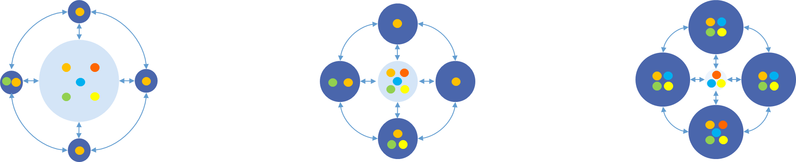
How do other organizations organize their digital capabilities and governance?
More Centralized
Less Centralized
Thick Hub | Linked Centers of Excellence (CoE) | Thick Spokes
Capabilities, including digital governance and delivery of data science services, are generally coordinated through a central IT organization that is accountable for all resource activity in the entire organization. Some light, self-service analytics and reporting capabilities may exist outside of the IT organization. | More autonomy in governance is shared with internal Centers of Excellence. These CoEs may be defined by line of business, thematic impact areas, or by specific capabilities such as research or service delivery. This model relies on well-defined governance to coordinate decision making across the wider organization. | This model is characterized by a distributed, or largely networked, organization that spans many market units and service offerings. Strong autonomy of each spoke organization may lead to redundancy in roles and skillsets, but this can be overcome by refining the focus on the outcomes required of each distinct spoke.

Slide 19
The One CGIAR vision aligns well with the
Linked Centers of Excellence model for IT and digital governance
Linked Centers of Excellence for Research Innovation would interface well with the linked, distributed model for Digital Services while empowering digital research teams across the portfolio and providing a forum for common data standards definition, establishment of best practices, and a mechanism for scaling useful investments in data science across the organization.
More Centralized
Less Centralized
Thick Hub | Linked Centers of Excellence(CoE) | Thick Spokes
Capabilities, including digital governance and delivery of data science services, are generally coordinated through a central IT organization that is accountable for all resource activity in the entire organization. Some light, self-service analytics and reporting capabilities may exist outside of the IT organization. | More autonomy in governance is shared with internal Centers of Excellence. These CoEs may be defined by line of business, thematic impact areas, or by specific capabilities such as research or service delivery. This model relies on well-defined governance to coordinate decision making across the wider organization. | This model is characterized by a distributed, or largely networked, organization that spans many market units and service offerings. Strong autonomy of each spoke organization may lead to redundancy in roles and skillsets, but this can be overcome by refining the focus on the outcomes required of each distinct spoke.
Notes:
“Organizational Principles for Placing Data Science and Machine Learning Teams” (https://www.gartner.com/doc/3803065) is one well-known resource.

Slide 20
Coordinating governance and shared responsibilities through a Global Practice on Digital in Research
We propose the formation of a governance model to coordinate digital capabilities spanning digital services, partnerships, operational innovation, and domain-specific research data analytics.
Partnerships & Advocacy
Climate Adaptation and Greenhouse Gas Reduction
Nutrition, Health and Food Security
Formalizing a Global Practice for Digital in Research will allow CGIAR to maintain a balance between digital services and data science leveraging with deep research domain expertise and establish a mechanism for centralized coordination to bring innovation to scale across organizational units and in each of the research Impact Areas.
Poverty Reduction, Livelihoods and Jobs
Gender Equality, Youth and Social Inclusion
Digital Services
Environmental Health and Biodiversity
Global Practice on Digital in Research

Slide 21
GLOBAL PRACTICE GOVERNANCE STRUCTURE
Executive Sponsor
Data Governance Lead
(Research)
Digital Innovation Officer (Research)
Data Governance Analyst
Data Governance Analyst
Nutrition, Health, and Food Security Champion
Gender Equality, Youth and Social Inclusion Champion
Poverty Reduction, Livelihoods and Jobs Champion
Environmental Health and Biodiversity Champion
Climate Adaptation and Greenhouse Gas Reduction Champion
NARES
Global Partnerships Interlock
Regional & Country Partnerships Interlock
Organizational
Analytics & Data
Mgmt. Interlock
Digital Procurement Interlock
Digital Solutions Interlock
Infrastructure & Security Interlock
Cross-cutting CGIAR Communities of Practice on technical and functional disciplines
LEGEND:
Research Delivery Organization
Global & Regional Engagement Organization
Institutional Strategy & Systems Organization

Slide 22
HIGH LEVEL GOVERNANCE STRUCTURE
ENTERPRISE DATA
RESEARCH DATA & DATA SCIENCE
5
Digital Services
Executive Sponsor
# | DESCRIPTION
1 | The Data Governance Lead (Research) reports to the Digital Innovation Officer and serves as an interlock with the Governance function of the Global Digital Office. The Research Data Lead and is tasked with ensuring research data of good quality, standards compliant, and well-represented and managed in overall One CGIAR data and information architecture.
2 | Data Governance Analyst(s) report to the Data Governance Lead (Research) and perform day-to-day functional and technical tasks such as data quality monitoring and liaising with domain experts on metadata definition and implementation, as well as data ethics.
3 | A Global Practice on Digital in Research comprised of cross-organizational representation is formed as a key governance body to guide and inform development of digital research innovation, developing supporting digital capabilities, and defining and promoting best practices.
4 | The Digital Innovation Officer (Research) would lead development of cross-cutting One CGIAR digital research capabilities and have shared accountability to the Governance function of Digital Services and to the Executive Sponsor for the Global Practice on Digital in Research. This role would convene the Global Practice and support it in day-to-day operations.​
5 | The Executive Sponsor would be a rotating responsibility among the Executive Management Team, that provides ultimate accountability and sign-off for digital in research-related functions and capabilities.
1
2
4
Global Digital Office
(Strategy, Governance, & Performance Management)
Data Governance Lead (Research)
Data Governance Analyst
Digital Innovation Officer
(Research)
Data Governance Analyst
Business Partnership
3
Digital in Research Global Practice
Infrastructure & Operations
Digital Solutions
Enterprise Architecture
Information Security
Data Management & Analytics
LEGEND
Digital Services Organization
Key Units
Proposed Roles (new)
Proposed Governance Entity

Slide 23
GLOBAL PRACTICE ON DIGITAL
IN RESEARCH ROLES & RESPONSIBILITIES
ROLE | RESPONSIBILITIES
Executive Sponsor | Approach functions with a strategic “One CGIAR” perspective. Responsible for championing improvement efforts, removing roadblocks & lobbying for goals/processes to support digital transformation of CGIAR organization, research, and research delivery. Ensures the regular and quorate holding of Global Practice meetings Final point of escalation for issue and decision resolution
Digital Innovation Officer (Research) | The Innovation Officer is responsible for allocating and tracking actions resulting from Global Practice initiatives/meetings Facilitates regular meetings of the Global Practice Serves as point of escalation for issue and decision resolution when Global Practice is not in session Responsible for formation and dissolution of standing and ad hoc digital Communities of Practice linking digital governance with domain expertise as needed
Data Governance Analyst(s) | Support specific initiatives and activities arising by the recommendation of the Global Practice, such as: data quality assessment, liaising with domain experts on data ethics or management issues, or integration of new data libraries with platform technologies
Research Delivery Organization Champions | Possess digital and data science expertise in the research domains in CGIAR’s Impact Areas Report on new digital research methods and key tools used and provide recommendations on best practices and scaling usage across CGIAR Represent the strategic portfolio interests of relevant Impact Areas Support the Global Practice to develop metrics for digital in Impact Areas and take responsibility for implementing them. Mainstream and help enforce governance policies and rules within the respective Impact Areas Ensure data ethics, responsibility, and quality standards are met within Impact Areas Help implement effective internal controls over sensitive data related to Impact Areas.
Engagement Organization Interlocks | Represent the breadth and depth of CGIAR digital capabilities, particularly where different partners and standards may affect the internal decisions of the Global Practice
Digital Services Interlocks | Advise on feasibility for adopting innovative tools and techniques at scale across CGIAR Inform on CGIAR-wide initiatives that may impact adoption of certain tools or models by data scientists Define business requirements and assess the operational implications of new recommendations as they are produced by the Global Practice Review risk levels and provide security advisory and privacy information associated with use cases, newly combined data sets and data ingestion into CGIAR data repositories Provide status updates on enterprise initiatives related to the building of One CGIAR performance and results reporting systems.

Slide 24
GLOBAL PRACTICE DRAFT CHARTER
Committee Name |  | Global Practice on Digital in Research
Purpose
Acts as the convener of domain-specific digital research across research areas across the portfolio and Digital Services, identifying shared value opportunities related to data asset management, data science best practices, digital innovation and partnerships, and common tool and technology stacks.
Decision Rights |  |  | Standard Agenda
Adoption of common data standards and definitions for research purposes Recommends discrete investment activities for data governance to be undertaken by the data governance analysts and leads Recommends Digital Services support for research informatics needs including enterprise-level adoption of specific tools, software and analytics practices to scale impact of data science beyond organization silos—where appropriate. |  |  | Best digital practices by research area and update on research informatics processes and roadmaps. Digital Services updates re: strategic and major initiatives, roadmap, and priorities Escalations, risk / issues and decisions New initiatives Communications
Inputs | Enterprise architecture vision and strategy Current budget and resource allocation Business cases Detailed escalation requests |  | Outputs | Defined data science initiatives and roadmap Consistent usage of data standards Implementation of specific data governance and quality tools Outcome of escalations Communications cascade (e.g., successes and decisions)
Escalation Point For | Data Science Champions in research |  | Escalation To | Research Data Governance Officer Digital Innovation Officer (Research) Executive Sponsor
Meeting Frequency & Duration | Monthly, 90 min | Stabilization | Bi-Weekly, 60 mins Run | Monthly, 90 mins
Measures of Success | e.g., 2021 Data Quality Metrics, Investment and Scaling KPIs, Organizational Ecosystem Impact

Slide 25
Roadmap
 | Q1 |  |  | Q2 |  |  | Q3 |  |  | Q4
 | Jan | Feb | March | April | May | June | July | Aug | Sept | Oct | Nov | Dec
Governance
Technology Infrastructure
Analytics
Data Management
Digital in Research

