Slide 1


Improving collaboration between research and the private sector to accelerate livestock innovation for sustainability into use
Slides from a parallel session organized by the CGIAR Research Program on Livestock and the International Livestock Research Institute, 9th Multi-Stakeholder Partnership Meeting of the Global Agenda for Sustainable Livestock, Manhattan, Kansas, 9-12 September 2019

Slide 2
Setting the scene
Tom Randolph, CGIAR Research Program on Livestock and Shirley Tarawali, ILRI
Introductory presentation at a parallel session, 9th Multi-Stakeholder Partnership Meeting of the Global Agenda for Sustainable Livestock, Manhattan, Kansas, 9-12 September 2019

Slide 3



Introducing Us
Shirley Tarawali
Assistant Director General
Tom Randolph
Director
Research for development: working for better lives through livestock in developing countries and contributing sustainable transformation of smallholder livestock system and the SDGs
Research on livestock health, genetics, feeds and forages; socio-economics, sustainable livestock systems, public health and nutrition
Co-hosted in Nairobi, Kenya and Addis Ababa, Ethiopia
Consolidates CGIAR livestock-related capacity at ILRI, ICARDA, CIAT together with Swedish Agricultural University and GIZ
Targets smallholder households and informal markets to increase access to animal source foods and create added-value and employment for rural and urban poor through livestock.
#LivestockAgenda

Slide 4
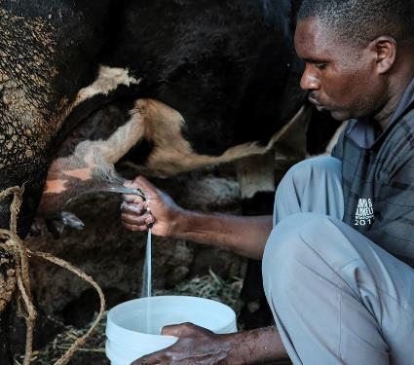
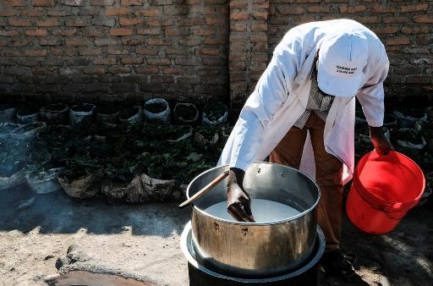
Motivation for this session
The POTENTIAL
Much animal-source food produced in smallholder livestock systems in LMIC
These systems can be key in meeting growing demand and achieving multiple SDGs (see GASL background paper on economic growth and livelihoods)
The private sector – including ‘hidden middle’ – has greatest capacity and reach to support smallholders in increasing productivity and efficiency, including innovation to promote sustainability
#LivestockAgenda

Slide 5
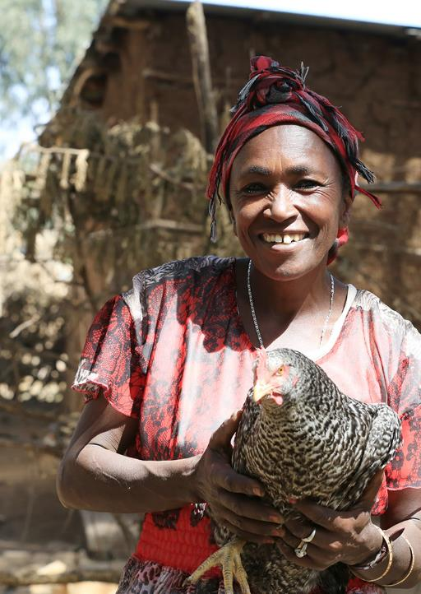
Motivation for this session
The CHALLENGE
Successful transformation will require linking research with private sector, but few, isolated examples of how this works
  Research ‘public good’ innovation may not offer incentives as a ‘private good’ for private sector
  Public-Private Partnership arrangements to create incentives face challenges
#LivestockAgenda

Slide 6
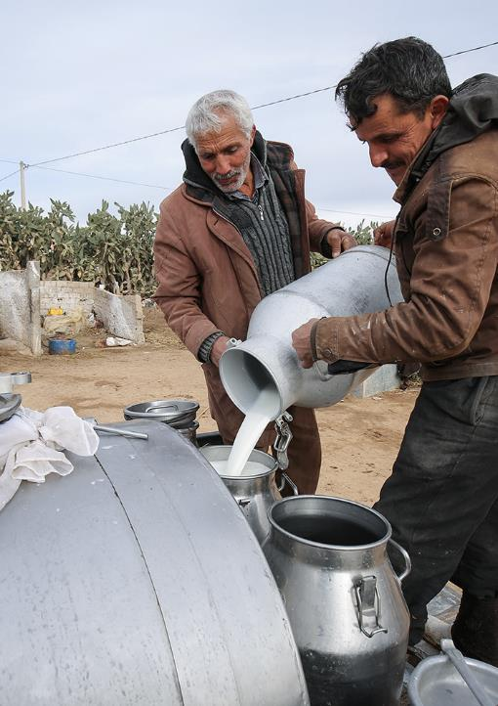
Framing the discussion
Specific subset of Public-Private Partnerships
Delivering innovation from research to enhance inclusive sustainable livestock systems
Demand-pull: private sector responding to opportunities needing innovation
Supply-push: research offering innovation to scale
As individual innovations (technologies, services, institutional arrangements) or as integrated packages
Range of private to public goods
#LivestockAgenda

Slide 7
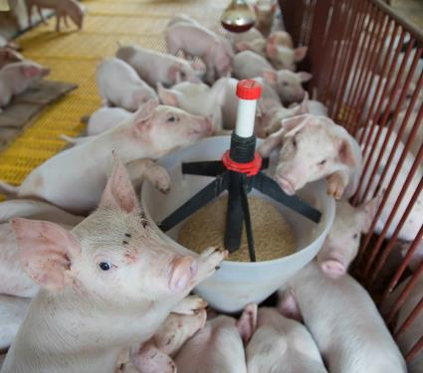
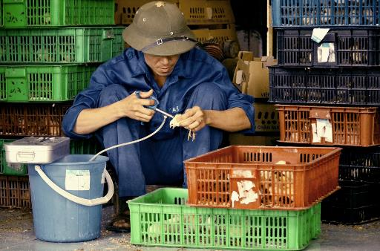
Framing the discussion
PRIVATE SECTOR:
3 main categories to consider
Multi-national companies
National and local commercial companies
Mostly informal small/medium scale enterprises
#LivestockAgenda

Slide 8
Broad lessons learned
Several reviews available (e.g. Rankin et al. FAO (2016). Public-Private Partnerships for Agribusiness Development: A review of international experiences)
Key messages for successful partnership
  Assess motivation of each partner and identify where objectives align
  Define roles
  Co-invest
  Cultivate trust
Seems simple, but tricky in application
  A number of good examples
  But many failed attempts and opportunities missed
GASL: the right place to explore this!
#LivestockAgenda

Slide 9

Flow of the session
We hear real-life examples where it has and hasn’t worked from 6 colleagues representing private sector and research, and their advice ‘gems’
  Margaret Munene, Palmhouse Dairies Ltd.
  Fabiana Villa Alves, EMBRAPA
  John Ellenberger, Land O’Lakes
We ask your help in teasing out key lessons
Then we ask a panel of investors to share their take
  Antonio Rota, IFAD
  Chris Brett, World Bank
Quick synthesis
  Shirley Tarawali, ILRI
Delia Randolph, ILRI
Martin Barasa, VSF-Germany
Sam Thevasagayam, Bill & Melinda Gates Foundation
  Belinda Richardson, Bill & Melinda Gates Foundation
  Andrew Bisson, USAID
  Donald Moore, Global Dairy Platform
WE INVITE YOU TO PARTICIPATE!
Audio capture of our discussions and your MENTI replies

Slide 10
Lightning Talks
(5 minutes each)
Improving collaboration between research and private sector to accelerate livestock innovation for sustainability into use
Meetings to prepare the 7th MSP in Addis Ababa, Ethiopia, 8 to 12 May 2016,
Tuesday, 10 September 2019

Slide 11
Presenter: Dr Martin Barasa
Position: Regional Head of Program, VSF Germany
Lightning Talk: Title: Delivering vaccines
Improving collaboration between research and private sector to accelerate livestock innovation for sustainability into use
Tuesday, 10 September 2019
Meetings to prepare the 7th MSP in Addis Ababa, Ethiopia, 8 to 12 May 2016,

Slide 12
Introducing me!
Who I am: Dr Martin Barasa, Regional Head of Programs at VSF Germany responsible for program development and programming strategies.
Our organization: VSF Germany mission is to support people in developing countries whose livelihoods depend on agriculture—especially livestock—in their endeavors to improve their living conditions actively. The organization currently works in 6 countries in the Horn of Africa.
What our organization does related to public-private partnerships to deliver research innovation for sustainable livestock systems
Piloting innovations in collaboration with product developers through humanitarian assistance and development aid model
#LivestockAgenda

Slide 13
My example of a public-private partnership that worked
Title of the initiative: Piloting the use of thermostable vaccine to control NCD disease among rural small holder poultry keepers in South Sudan.
Purpose: The purpose of the project was to empower rural poor women through increased income from indigenous poultry production by reducing disease mortality.
How was it successful?
One of the key challenges experienced with indigenous chicken production was high mortality associated with frequent outbreaks of Newcastle disease. The problem was exacerbated by lack of access to NCD vaccine due to poor cold chain insfrastructure for the thermo-sensitive live attenuated strains of NCD vaccines.
Why? The thermostable vaccine made it possible to plan and carry out vaccinations without the need for an elaborate cold chain
  Critical factor 1: Innovative research product readily available for use and in high demand
  Critical factor 2: VSF Germany field operational presence and networks of community animal health workers providing service as part of humanitarian assistance.
  Critical factor 3: VSF Germany subsidzed the cost of the vaccines and provided incentives to the service providers
#Livestock Agenda

Slide 14
My example of a public-private partnership that didn’t work so well
Title of the initiative: Improving livestock vaccines cold chain system through the use of solar powered fridges in hard to reach areas of South Sudan.
Purpose: The purpose of the initiative was to improve access to livestock vaccines for better livestock healthcare management.
How didn’t it work so well? The provision of solar powered fridges was acknowledged as an innovative solution for managing cost effective cold chain system at community level to achieve sustainability. Provisioning was arranged through a cost recovery system that dramatically failed as communities’ syndromic dependence on humanitarian assistance impaired cost-share plans on the account of high cost of solar powered fridges.
Why? The cost-share plan was not attractive to communities despite the need for the services as the solar fridges were perceived to be too expensive.
  Critical factor 1: Comprehensive product, consumer engagements on costs, ownership and benefits
  Critical factor 2: Innovative product roll-out requires stable and functional governance systems to succeed.
#LivestockAgenda

Slide 15
My ‘gems’ of advice
For investors
  Gem1: Align product development to critical technological need gaps for viable and sustainable solutions and design a fair user price to attract and sustain demand.
For implementors
  Gem2: Conduct comprehensive cost-benefit analysis to demonstrate clear and tangible benefits of products to potential users to establish sustainable demand.
#LivestockAgenda

Slide 16
Presenter: Delia Grace Randolph
Position: Health Program Lead (joint) at ILRI
Can the Private Sector Pay for Public Health?
    Delia Grace, Sinh Dang and Fred Unger
Improving collaboration between research and private sector to accelerate livestock innovation for sustainability into use
Tuesday, 10 September 2019
Meetings to prepare the 7th MSP in Addis Ababa, Ethiopia, 8 to 12 May 2016,

Slide 17
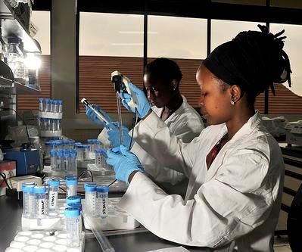
Introducing me!
Delia Grace Randolph
International Livestock Research Institute
ILRI & the private sector
  Long experience
  Wide range of partners
  Lots of promise; lots of high impact factor papers; little proven impacts
#LivestockAgenda
Notes:
Long experience with little to show for it

Slide 18
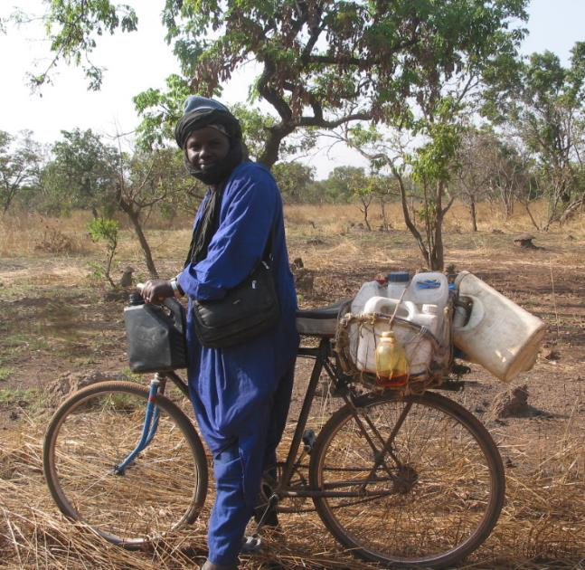
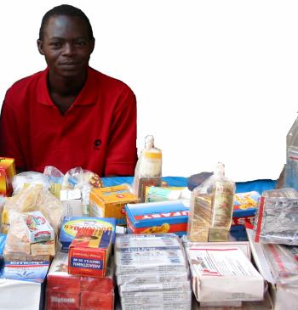
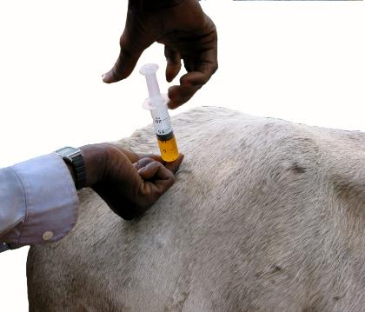
Rational Drug Use

Slide 19
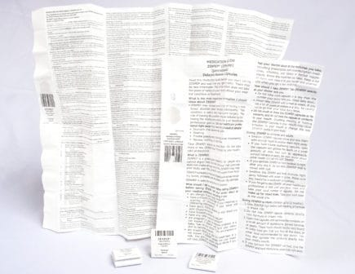
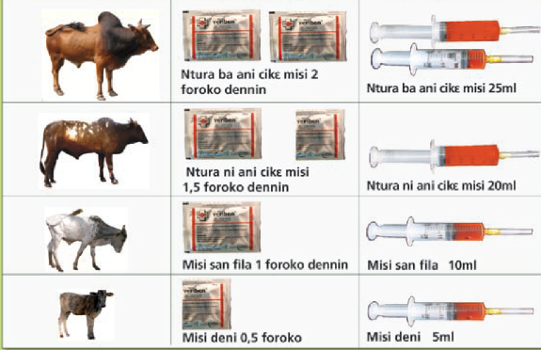
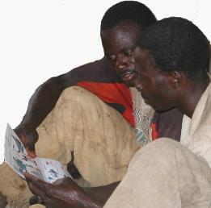
Rational Drug Use
BEFORE
DURING
AFTER
Gave 30% more correct dosages
Had 10% more successful treatments
Had 10% fewer injection side affects

Slide 20
PP partnership that worked, wasn’t taken up the the private sector, but may be
Rational Drug Use for Farmers
In LMIC most vet drugs are given by farmers (untrained personnel)
Giving simple, previously unobtainable, information on diagnosis, and dosage improved treatments and reduced drivers of drug resistance
Why? – the success of the intervention
  One of the rare cases when information does make a difference (genuine ignorance, desire to change behaviour and opportunity to act)
  Win-win: better drug use, minimal cost (simple change to package), less resistance: we assumed private sector would deliver
Why? – the failure of adoption
  Drug companies did not take forward – small market, no one cared, disabling policy environment
  Now AMR has become a big issue. Could this proven approach come back from the dead?
#LivestockAgenda

Slide 21
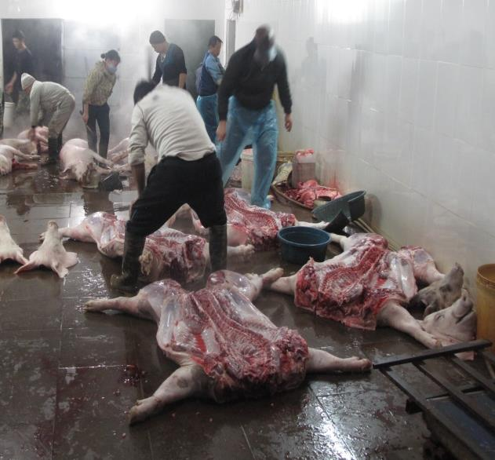
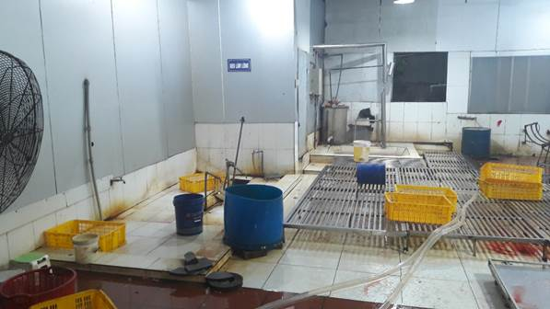
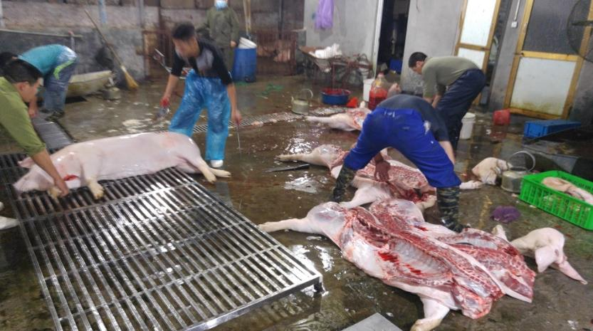
BEFORE
AFTER
DURING
LATER
lower faecal bacteria (p = 0.002) on the grid carcass surface
On GRID

Slide 22
PP partnership that worked, wasn’t taken up the the private sector, and then was
On the Grid: off-floor slaughter of pigs
Reduce the enormous burden of Food Borne Disease
Why success?
  Critical factor 1: Cheap, appropriate technology, tested effective
Why private sector initially failed to continue using?
  Extra work and incentive of safer pork and fewer sickness and death not compelling motivation
Why private sector started using and invested in 15 more grids & other infrastructure? (9-12months after pilot ended)
  Grids & other visible improvements (e.g. clean and dirty zone) attracted major companies supplying pork to their workers’ canteens
  Transition to higher scale (before 30-40, now 80-100 pigs/day) made investment easier and pork quality more a priority
#LivestockAgenda

Slide 23
Conclusions
For investors
  Research is still too supply driven
  Improving human health is not a powerful incentive for the private sector
For implementors
  It is not enough for interventions to be effective, low cost and acceptable
  The time may not be ripe now but may come for private sector investment
If I spend somebody else’s money on somebody else, I’m not concerned about how much it is, and I’m not concerned about what I get
Milton Friedman
#LivestockAgenda

Slide 24
Samuel Thevasagayam
Deputy Director, Agriculture Development, BMGF
Improving collaboration between public research and private sector to accelerate livestock innovation for sustainability into use
Lightning Talk:

Slide 25
Introducing me!
Responsible for the livestock portfolio of investments
At the Bill & Melinda Gates Foundation
Overall goal: Inclusive Agriculture Transformation and Economic growth of poor people depending on Animal Agriculture.
  Partner and invest in both public and private sectors - solutions needed by poor livestock owners realize the potential of their livestock assets ....through a government enabled, private sector led market oriented approach
  Believe public sector critical for research that cannot be fully justified based on ROI; private sector is best suited to address customer facing aspects and deliver solutions
  Connect and align the objectives of the producer, private sector and public sector for sustainability
#LivestockAgenda

Slide 26
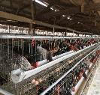
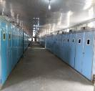
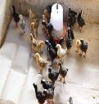
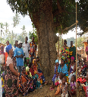

My example that worked: African Poultry Multiplication Initiative
Purpose: to enhance productivity, household income, improve household nutrition and empower women.
  Why?
        Critical factor 1: Incentives aligned across all stakeholders
        Critical factor 2: Brought together ‘best’ or ‘most suitable’ partners for each of the components
The model delivers sustainable value for all stakeholders
Amo: parent stock rearing
Amo: Incubation/ Hatching
Brooding & Vaccination
Farmer Training
Noilers in NG
Ethiochicken – independent evaluation:
>85 % household producers are women
DPP >2x productive vs indigenous chicken in eggs: 30-50% sold, rest consumed
Eggs = 20% higher price, 3.5x household income;
Chicken = 30% higher price, >2x household income
#LivestockAgenda

Slide 27


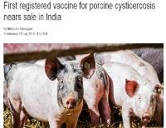
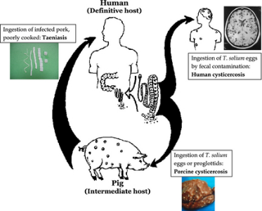
My example that hasn’t worked so well yet: Adoption of solution at scale for control of porcine cysticercosis
Cysticercosis - a public health issue
University of Melbourne (Prof Lightowlers)
Exceptionally effective vaccine
99.5% and 100% (Mexico)
100% (Cameroon)
99.5% (Peru)
99.3% (Honduras)
94 to 100% (China and Peru)
In 1993 it was identified as one of six potentially eradicable diseases
Joint FAO/ WHO Expert Meeting 2012: #1 of 24 food borne parasitic disease of global importance
Why?
  Critical factor 1: Didn’t fully anticipate market realities: who pays? who gains?
  Critical factor 2: Perhaps didn’t start with the end in mind and line up critical stakeholders to avoid delays in adoption at scale?
#LivestockAgenda

Slide 28
My advice for public research and private sector based innovations
For investors
  Be clear about Development efforts vs Humanitarian efforts (Solve vs Help)
  Ensure the partner who is critical to sustain the desired outcome is in the driver’s seat
For implementors
  Start with the end in mind
  Don’t try to do everything. Stick to your expertise, bring the best of you and connect with others who are best at what is needed.
#LivestockAgenda

Slide 29
Fabiana Villa Alves
Senior Researcher – Embrapa/ Brazil
Lightning Talk: Embrapa and its partners for a sustainable long-term partnership
Improving collaboration between research and private sector to accelerate livestock innovation for sustainability into use
Tuesday, 10 September 2019
Meetings to prepare the 7th MSP in Addis Ababa, Ethiopia, 8 to 12 May 2016,

Slide 30
Introducing me!
Who I am
  FABIANA VILLA ALVES
My organization
  Brazilian Agricultural Research Corporation (Embrapa) / Brazilian Ministry of Agriculture, Livestock, and Food Supply
What my organization does related to public-private partnerships to deliver research innovation for sustainable livestock systems
  We are a technological innovation enterprise focused on generating knowledge and technology for Brazilian agriculture, through Technology Transfer (TT), Knowledge Exchange and Collective Knowledge-Building
#LivestockAgenda

Slide 31
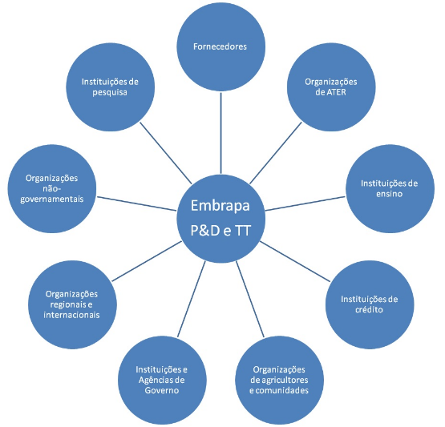
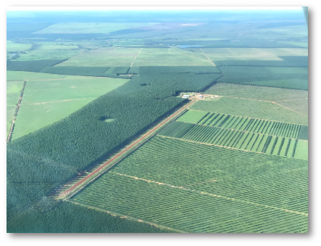
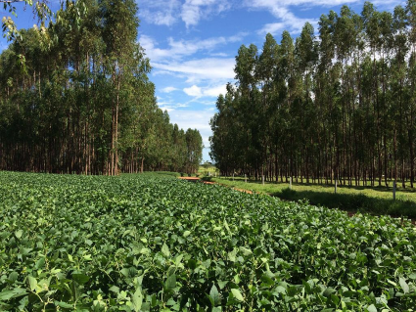
Embrapa Technology Transfer

Slide 32
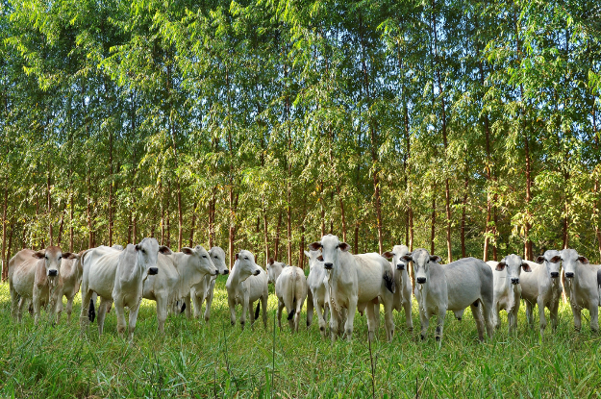




Public-private partnership Embrapa – Marfrig Foods
Carbon Neutral Brazilian Beef and Low Carbon Brazilian Beef
Strategic Alliance for Technology Development and Value Added to Agricultural Chain Products and Services
How was it successful?
  Technical and Financial Cooperation Agreement
  Commercial License Agreement for jointly developed technology solutions
Why?
  high impact research theme
  commercial brand based on scientific findings
#LivestockAgenda

Slide 33
Public-private partnership Embrapa – «Another food processing company”
Carbon Neutral Brazilian Beef and Low Carbon Brazilian Beef
Strategic Alliance for Technology Development and Value Added to Agricultural Chain Products and Services
How didn’t it work so well?
  Several meetings and no concrete action
  «Jealousy»
Why?
  Bureaucracy
  Poor strategic view
#LivestockAgenda

Slide 34

My ‘gems’ of advice
For investors
  Look for reliable partners and believe in them!
For implementers
  Choose a product/ programme with a strong «story telling»
#LivestockAgenda

Slide 35
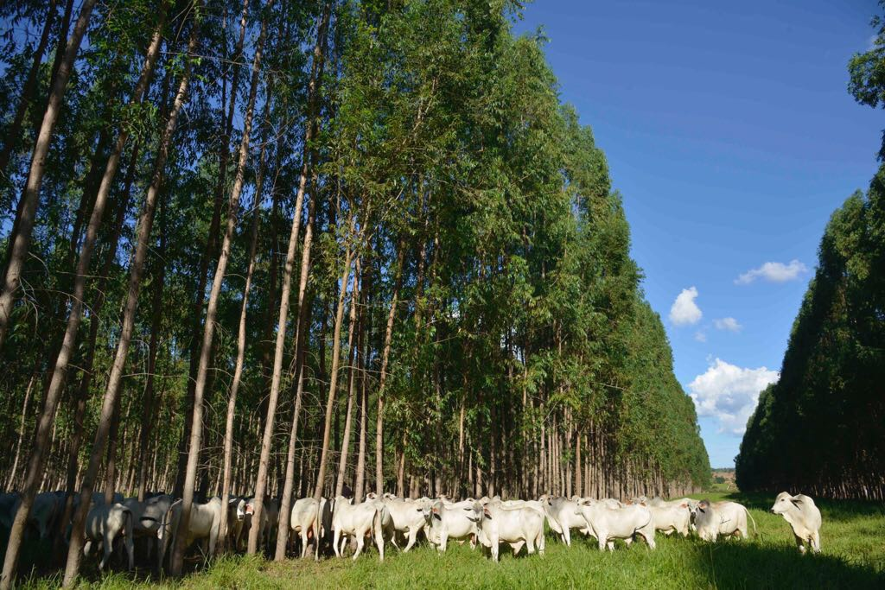

THANK YOU!
OBRIGADA!

Slide 36

Presenter
John Ellenberger,
Executive Director, Land O’Lakes Venture 37
Lightning Talk: Purina Experience with Public/Private Research
Improving collaboration between research and private sector to accelerate livestock innovation for sustainability into use
Tuesday, 10 September 2019

Slide 37



Public-Private Research That Worked
Innovation drives Feed:​
​
90+ PhDs and DVMs
95 years of continual animal nutrition research​
$32+MM investment in our 1,200 acre research farm in past 15 years
20,000+ nutrition research studies​
More than 130 patents granted
Land-Grant Universities
&
Purina uses basic research from the public-sector to support it’s new product research.
Bidco Land O’Lakes uses the “know-how” from Purina research to develop products for the Kenyan market
#LivestockAgenda
Notes:
Purina is the primary brand of our animal nutrition portfolio, which is focused on delivering nutrition solutions that enhance animal performance and well-being.
Purina uses basic public research which has been conducted by public-sector/land grant universities to support it’s private research for new product development.
In 2016, Land O’Lakes, Inc. combined forces with BIDCO Africa, a fast-moving consumer goods enterprise, and formed a partnership called BIDCO LAND O’LAKES LTD
Bidco Land O’Lakes uses the know-how gained from the Purina research to adapt products for the Kenyan Market. This also takes advantage of public investments that have been made in the dairy sector in Kenya such as the work by USAID to support livestock producers.

Slide 38
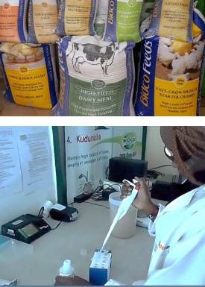
Introducing a new Calf Starter to the Kenyan Market
At Purina, we’re always asking…
What is reasonable? Matching the needs to the local level of management
What economic returns will this innovation provide to a farmer?
How can we deliver consistent formulation at the lowest price?
Education accompanies the Products
How to use the products
How to manage the animals that use the products
#LivestockAgenda
Notes:
Example – a new calf starter is ready to be introduced to the Kenyan Dairy Market. We did not take a calf starter from the US market, we took the know-how from the US and adjusted it to the conditions in the Kenyan market.
We ask ourselves and the market-
- What is reasonable? Matching the needs to the local level of management. This also was compared to our knowledge of the dairy system in Mexico and China. This ensured that a reasonable price was also discovered.
Which takes us into Education-------
Education
Without the know how, gaps develop and producers soon become dissatisfied with your products
Education under Purina and Bidco Land O’Lakes includes overall management practices, and health of the livestock

Slide 39
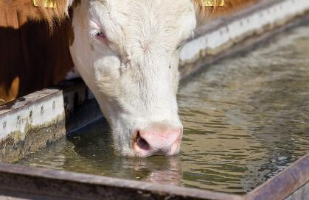
Public-Private Roles That Don’t Work as Well
Often a lack of government funding to support extension activities are the cause.
Extension Struggle
WATER !
Other Public Sector Roles that need attention
Development of support infrastructure (Water points)
Market facilities
Water and power utilities for value-added processing
#LivestockAgenda
Notes:
Ag Extension used to be under the public sector, more and more this support to producers fall to the private sector. It starts with the product support I mentioned in the previous slide.
Another situation we are experiencing with WATER
- Water is often the forgotten nutrient in livestock feeding
Re calf starter example, Just because calves drink milk, producers didn’t understand they need water as well. Therefore, our product information and messaging to farmers includes the need for calves to have access to clean water…”would you drink that water??”
- Water access also includes the need for wells, pumps and holding tanks and , and, and
- Access to hot water to clean equipment, esp in milk business is often overlooked.
Other Public roles that need attention
Develop of support infrastructure like water points or wells
Market facilities such as corrals & loading chutes, or health inspection before mkt trading
Utilities to support value-added processing, public private roles do not have to be ag to livestock, it can be livestock to energy or livestock to transport.

Slide 40
Next Steps to Support
Public-Private Partnerships
“Gems’
The Livestock sector and the resulting Animal Source Foods is complementary to the priorities of many donor agencies and national governments
New uses and forms of agro-processing by-products as animal feeds.
More forages adapted to low rainfall conditions are needed.
Producer level knowledge gaps continue to be a factor, more livestock curriculum in schools and more extension services are needed.
#LivestockAgenda
Notes:
Under the climate and Natural Resources session, the need for improved use of by products was mentioned. Specifically, we need pubic-private research to develop additional alternatives for livestock consumption of agro-processing by-products.
With changing climate conditions, the need for more pubic-private research on forages that have been adapted to low rainfall or limited water needs are needed.
The need for livestock extension continues, producer level knowledge gaps continue to be a factor. Additional livestock curriculum is schools and more public extension services are needed.

Slide 41
Discuss with your neighbor and choose your favorite on MENTI
Which ‘gem’ for investors do you think is the most critical? (4 minutes)
  Align product development to critical technological need gaps for viable and sustainable solutions and design a fair user price to attract and sustain demand.
  Ensure there is sincere demand for the innovation
  Don’t assume improving human health is a powerful incentive for the private sector
  Be clear about Development efforts vs Humanitarian efforts (Solve vs Help)
  Ensure the partner who is critical to sustain the desired outcome is in the driver’s seat
  Look for reliable partners and believe in them!
  The Livestock sector and the resulting Animal Source Foods should be complementary to the priorities of many donor agencies and national governments
Use your phone or laptop
Go to www.menti.com
Enter this code: 84 56 01

Slide 42
Your Thoughts!
What is your ‘gem’ of advice for establishing successful collaboration between research and private sector?
Post it on MENTI
(4 minutes)
Use your phone or laptop
Go to www.menti.com
Enter this code: 84 56 01

Slide 43
Investor Panel
  Critical success factors
  How do create more & better opportunities?
  Antonio Rota, IFAD
  Chris Brett, World Bank
  Belinda Richardson, Bill & Melinda Gates Foundation
  Andrew Bisson, USAID
Improving collaboration between research and private sector to accelerate livestock innovation for sustainability into use
Meetings to prepare the 7th MSP in Addis Ababa, Ethiopia, 8 to 12 May 2016,
  ANY REACTIONS?
  Post on MENTI during the session
Tuesday, 10 September 2019
Use your phone or laptop
Go to www.menti.com
Enter this code: 84 56 01

Slide 44
Summing up
  Shirley Tarawali, ILRI
  Donald Moore, Global Dairy Platform
  (3 minutes each)
Improving collaboration between research and private sector to accelerate livestock innovation for sustainability into use
Meetings to prepare the 7th MSP in Addis Ababa, Ethiopia, 8 to 12 May 2016,
Tuesday, 10 September 2019

