Slide 1
Photo report on the Tanzanian Team Experience Sharing Visits to the Land Management Intervention sites of the Africa RISING Project in the Ethiopian Highlands
20-25 Jan 2019

Slide 2
Introduction
Africa RISING Program Coordination Team (PCT) and chief scientists from the three Africa RISING projects in West Africa , East and Southern Africa and the Ethiopian Highlands paid an experience sharing learning visit in Tanzania in March 2018. During that visit the group were able to see the Africa RISING interventions in Mbeya, Iringa, Kongwa (Dodoma), Babati of East and Southern Africa project operational areas. The visiting team observed serious soil erosion particularly in Kongwa and Babati districts. The team suggested to organize experience sharing visits for some local decision makers, experts and influential farmers in areas where there are Soil and Water Conservation( SWC) success stories, and expose them to learn on collective actions, community mobilization and different approaches to halt land degradations. As a result, an experiences sharing visit was organized in Ethiopia from 20-25 Jan 2019 through the Africa RISING east and southern Africa project initiation. The Tanzanian team were composed of Agriculture Extension Officers (Jetrida Christian Kyekaka- DAICO Babati district and Jackson Shija- DAICO Kongwa district, and Erirehema Swai from Tanzanian Agricultural Research Institute-TARI). The Africa RISING team in Ethiopia arranged field visits in its two sites (Lemo and Basona) and facilitated discussions with extension offices, communities, watershed committee members and NGOs.

Slide 3
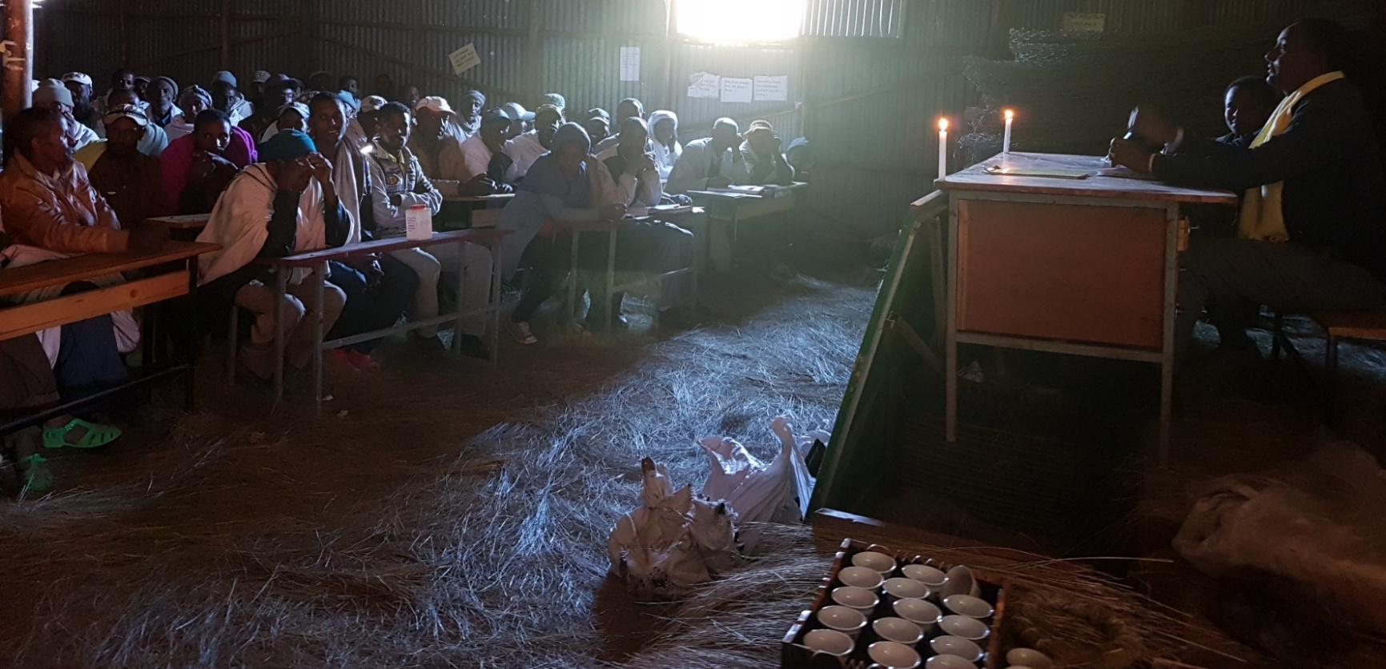
Representatives of farmers, religious leaders and extension office staff members in Gudo Beret research Kebele of Africa RISING are discussing watershed management –Soil and Water Conservation (SWC) plans for the year 2019. When farmers and extensions workers go back to their respective kebeles/ villages, similar discussion will be also held at village level to bring all at equal level. The plan will be initially pre-tested and finally implemented in the selected locations. The Tanzanian team had been introduced to this meeting and their mission briefed to meeting participants.

Slide 4
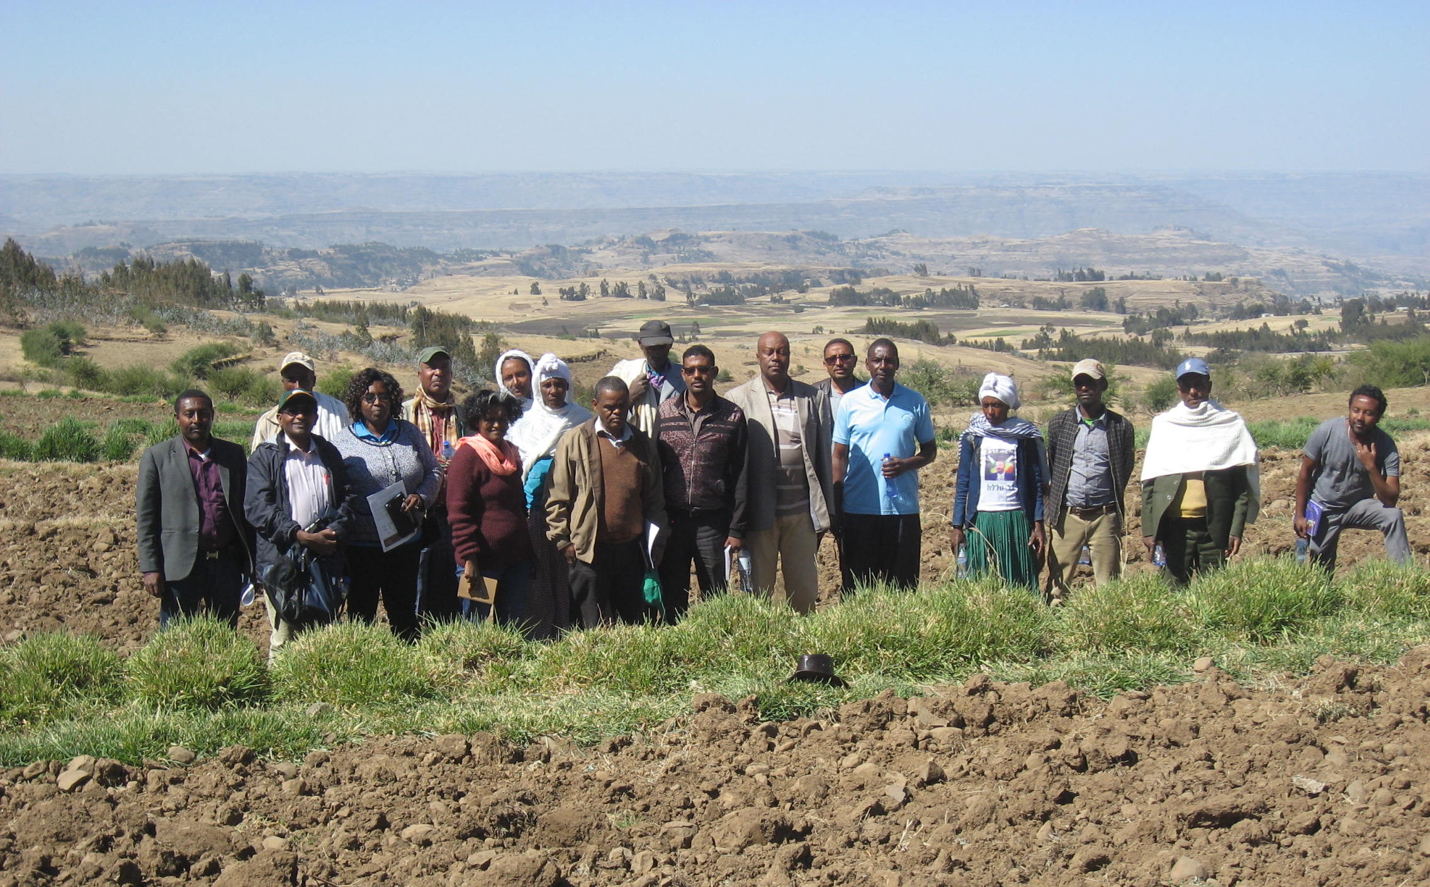
The Tanzanian team with watershed committee members, extension staff, University representatives and Africa RISING team in Gina Beret watershed. The Gina Beret watershed in Gudo Beret kebele and Geda watershed in Adisgie kebele constituted a bigger watershed in Basona Africa RISING site, Amhara region.

Slide 5
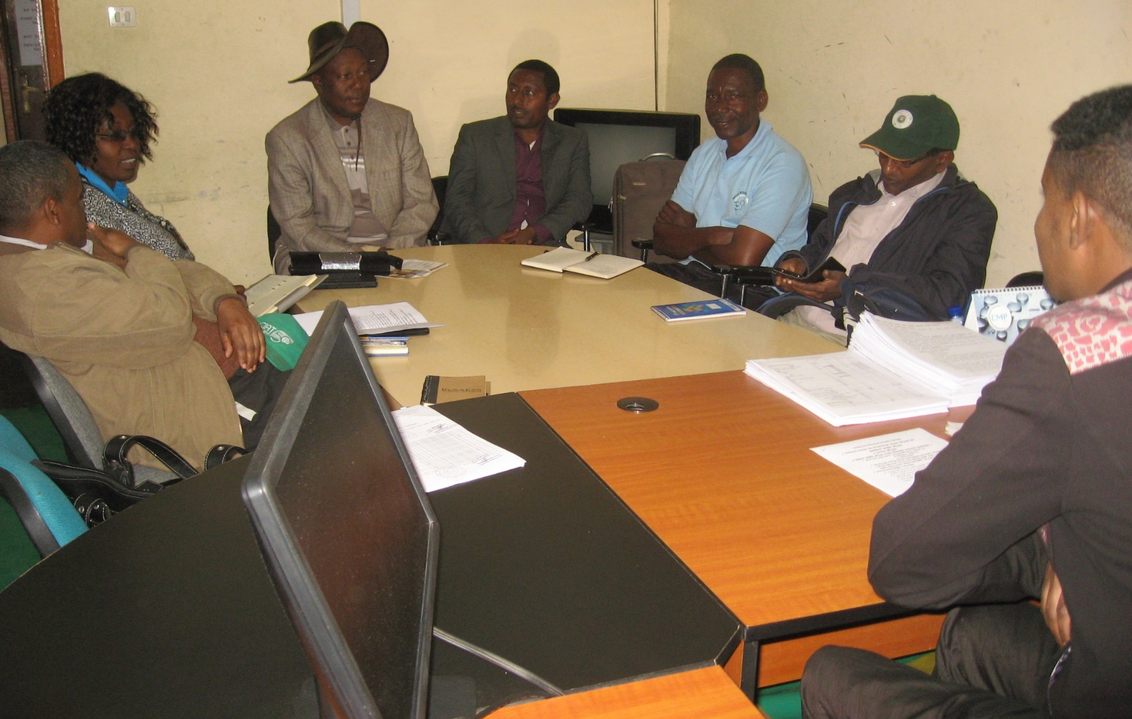
The Tanzanian team meeting with the Basona woreda office of Agriculture deputy head in Debre Birhan town. The team discussed institutional arrangements of the mass mobilization for landscape management/SWC, successes and challenges of the initiative.

Slide 6
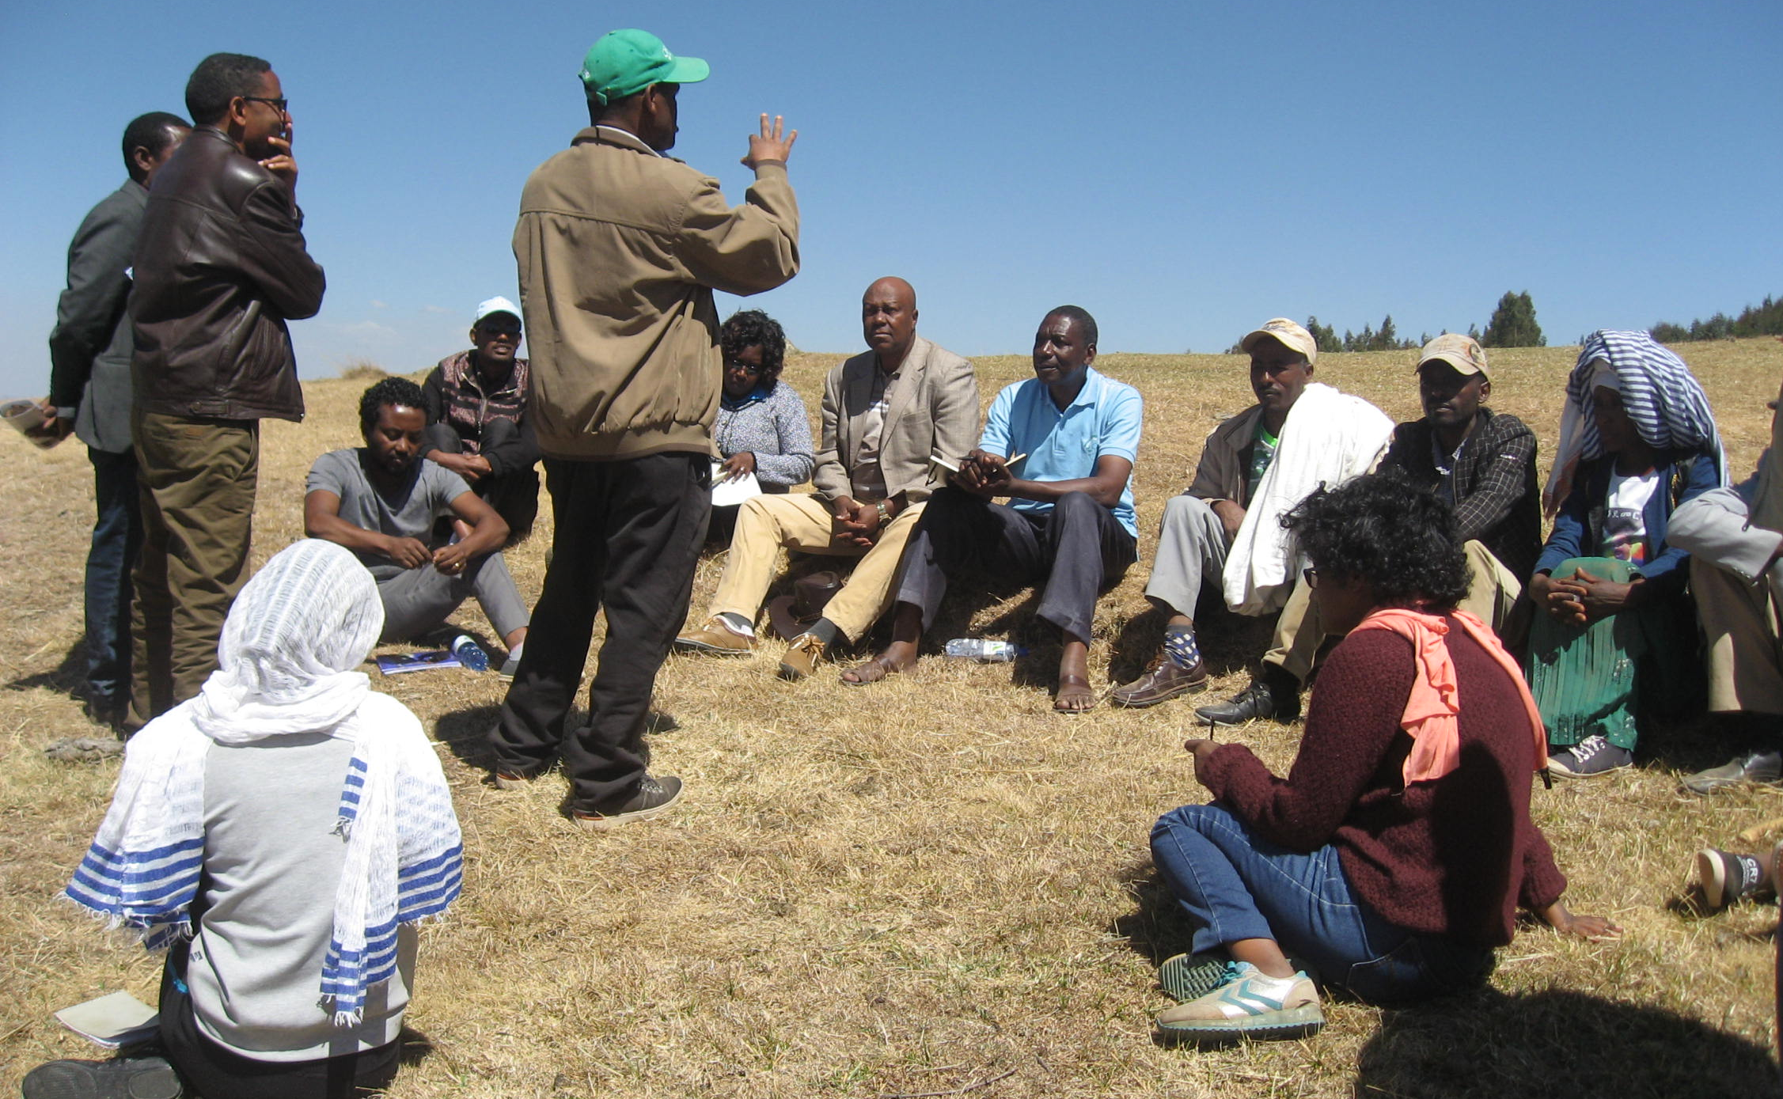
Lulseged Tamene (CIAT) is explaining to the visiting team how Africa RISING is supporting the extension in the watershed. He indicated evidence generation, capacity building/collective learning and introduction and validation of Sustainable intensification (SI) innovations as core contributions of the Africa RISING project.

Slide 7
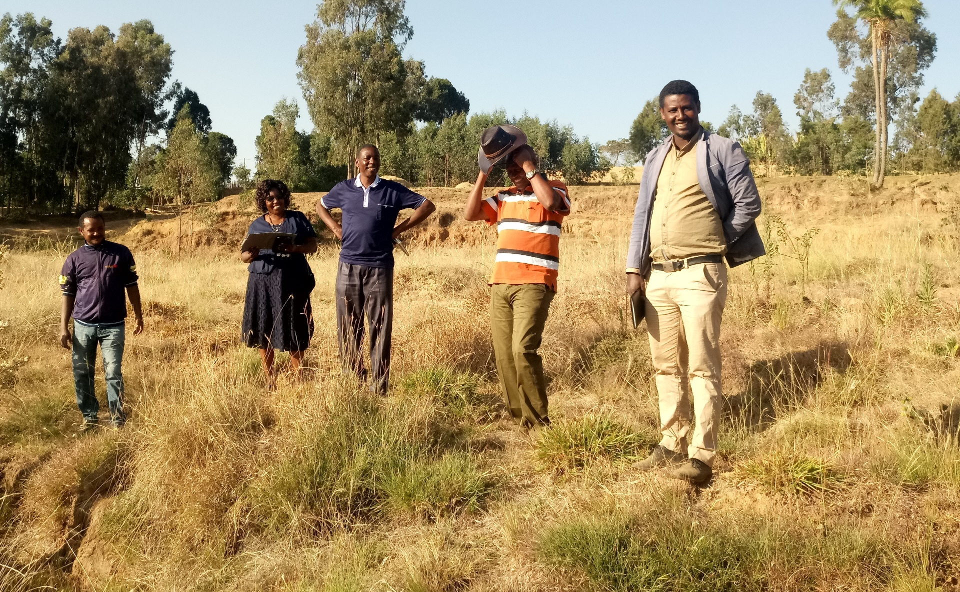
The Tanzanian team and Africa RISING local partners visiting degraded land rehabilitated by community engagement in Hayse kebele, Lemo Africa RISING site in SNNPR.

Slide 8
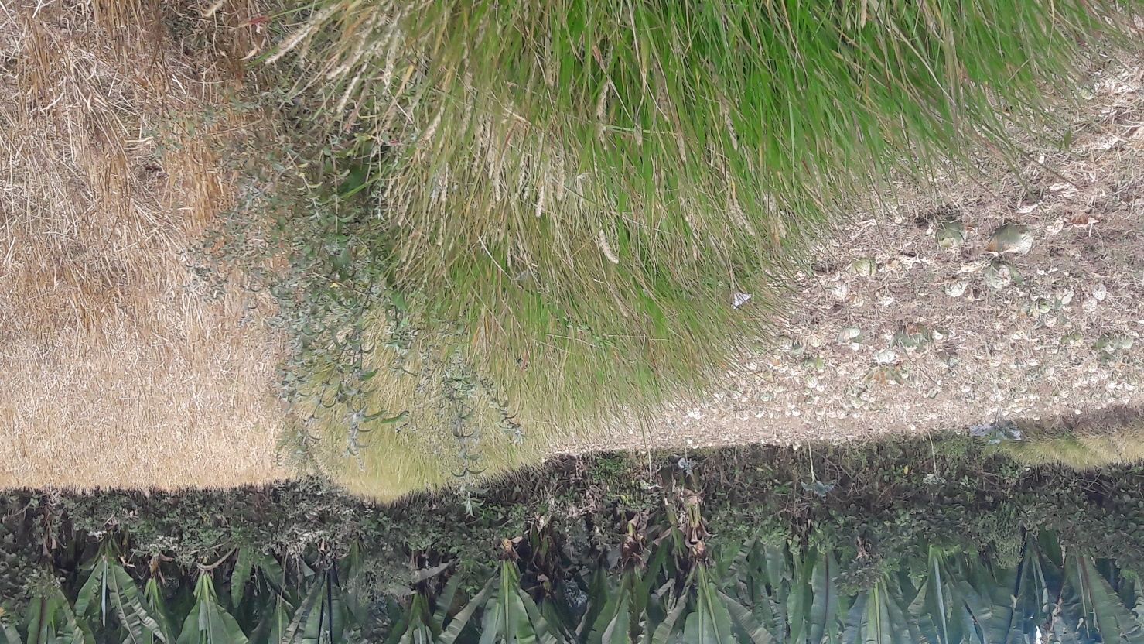
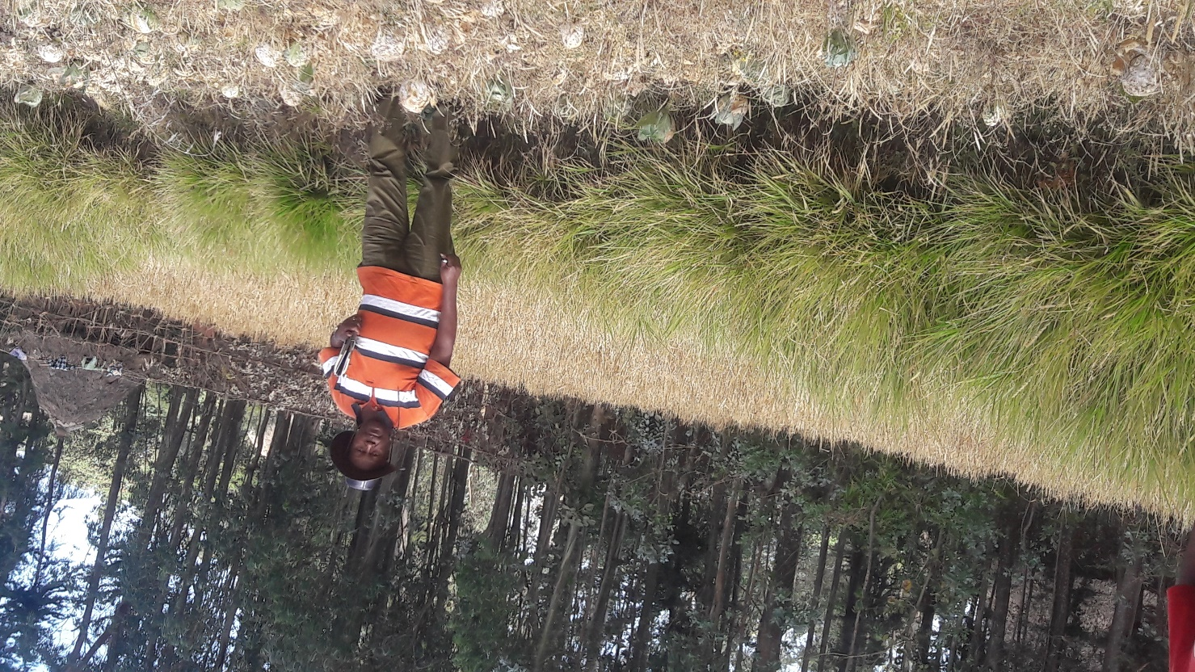
Soil bunds integrated with biological option aimed to provide multiple services such as reduce runoff and erosion, enhance soil fertility and provide feed for livestock. This successful intervention is widespread in Doyogena woreda, Kembata zone, SNNPR. InterAide France (International NGO), extension, communities and other local partners are jointly managing the interventions from planning to implementation.

Slide 9
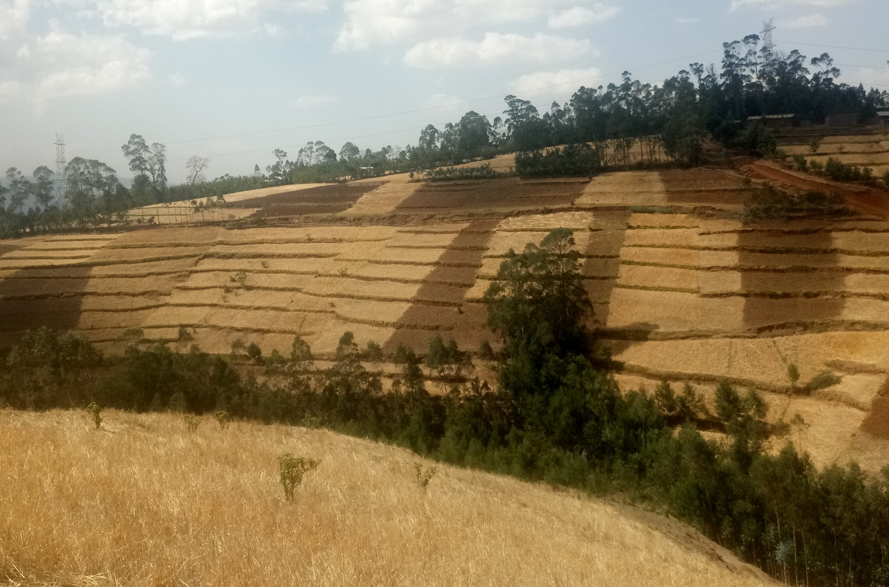
Landscape management using physical and biological interventions in Doyogena woreda, Kembata zone, SNNPR. InterAide France (International NGO), extension, communities and other local partners are jointly managing the watershed.

Slide 10
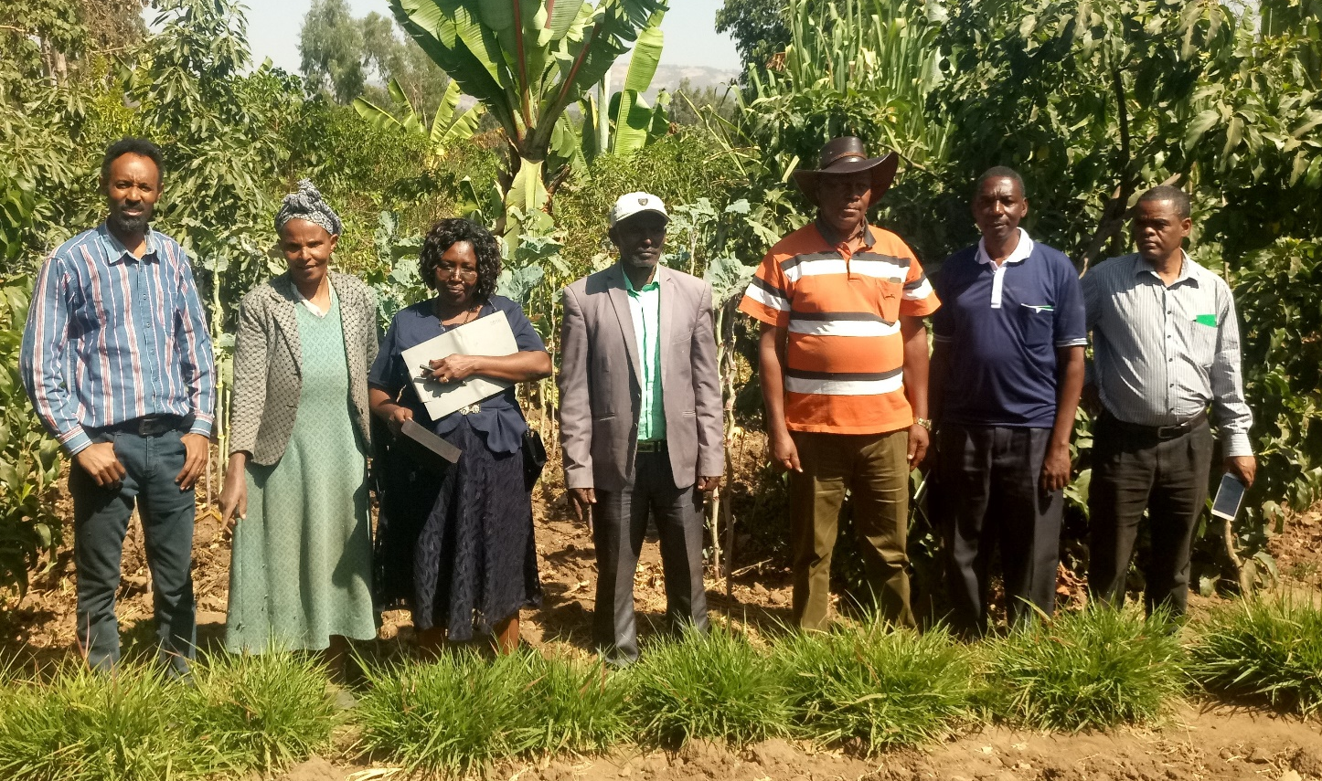
The team visited Bekelech’s farm in Jawe research kebele, Lemo, SNNPR. The owner of the farm (second left –wife and fourth left /right- husband). Bekelech is a model and innovative farmer. So far she has applied more than six Africa RISING validated technologies. The farm is a good learning site of integrated approach. It is also a potential site to conduct system research.

Slide 11
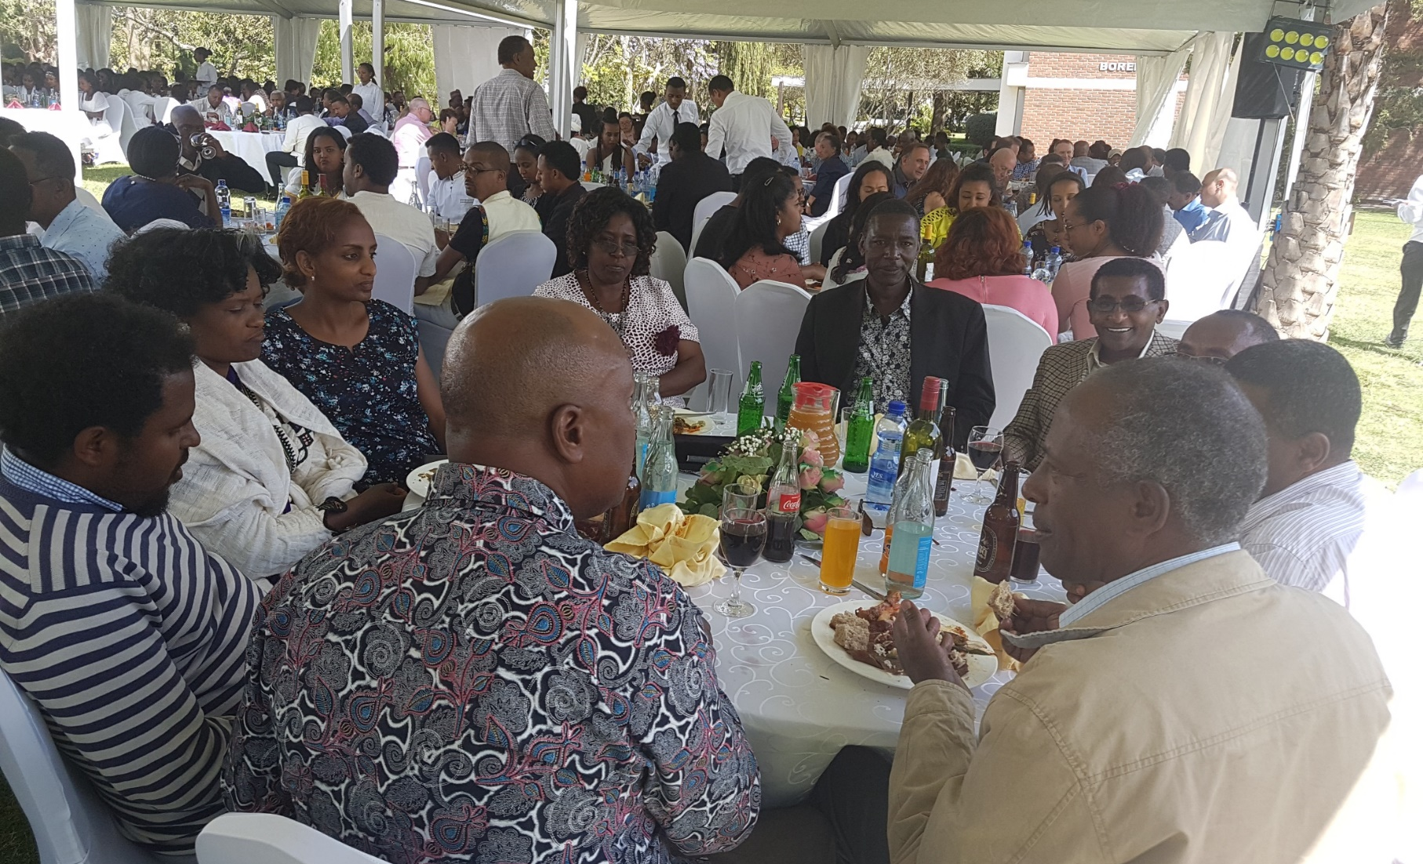
Luckily enough , the Tanzanian team were able to join the ILRI annual year end party organized at the Institute campus in Addis Ababa. The event was so useful for the team to see Ethiopian culture, music from different ethnic groups and to taste various Ethiopian dishes. The event also opened an opportunity to interact with different people from various countries.

Slide 12










Africa RISING CGIAR partners in Ethiopia
Notes:
Ethiopia

Slide 13

Credits
Produced by Africa RISING Project in Ethiopia
Compiled by Kindu Mekonnen (ILRI) and Lulseged Tamene (CIAT)
Photos: Kindu Mekonnen, Lulseged Tamene, Simret Yasabu and Workneh Dubale
Our appreciation goes to the site coordinators and local partners in Basona (Amhara) and Lemo (SNNPR) Africa RISING sites including farmers.

