Slide 1
Important!
This module is designed to potentially serve a wide variety of audiences (nutritionists and agronomists, policymakers, extension workers, farmers).
Not all of the material will be relevant to all audiences.
Please refer to the accompanying Facilitator’s Guide for guidance on how to adapt these materials to your audience and facilitation best practices.

Slide 2




Legend
Icon | Description
 | Expected Duration, minutes
 | Quick Review/Survey Questions
 | Brainstorming Session
 | Discussion Session
 | Group Activity
 | Animated Slide
 | End of Animation
Xm

Slide 3
Legal
Unless otherwise noted, all images copyrighted to International Potato Centre.
Attribution-NonCommercial-ShareAlike 2.0 Generic (CC BY-NC-SA 2.0)

Slide 4
Everything You Ever Wanted to Know About Sweetpotato
Topic 12: Monitoring, Learning, and Evaluation of Sweetpotato Projects

Slide 5
Introduction
Monitoring, Learning, and Evaluation of Sweetpotato Projects

Slide 6
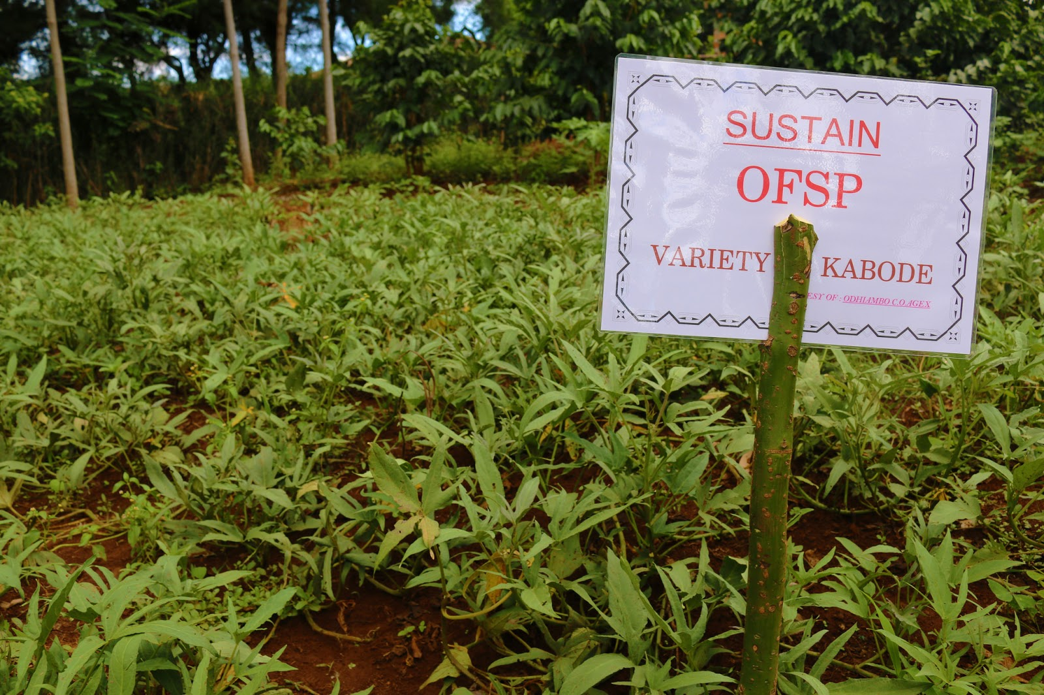
Welcome
During this session, we will examine reasons for monitoring and the differences between monitoring and evaluation, as well as a range of tools which can be used to monitor the dissemination, performance and use of sweetpotato planting materials.

Slide 7
Key Concepts and Terminology in Monitoring, Learning and Evaluation
Unit 1

Slide 8
Objectives
By the end of this unit, you should be able to:
Explain basic processes and criteria for monitoring and evaluating sweetpotato projects for efficacy (does it work?) and cost-effectiveness (does it use resources wisely?).
Explain the difference between evaluation and monitoring and their relationship to learning.

Slide 9
What Are They and How Do They Differ?
Monitoring
Evaluation
On-going systematic collection and analysis of information during project
Improves project design and functioning
Typically based on short term targets
Early indications of progress and achievement of goals
Focuses on measuring project outputs
Measure of change taken place due to project
Looks at actual impact on market and communities
Periodic assessment of data gathered by monitoring
Formative: Occurs during the life of project
Summative: Draws lessons from completed project

Slide 10
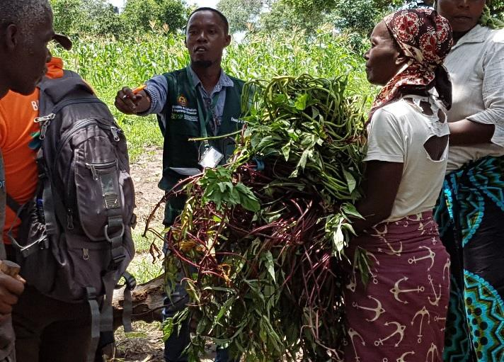
Reasons for Monitoring and Evaluation
Both Monitoring and Evaluation are about learning through experience:
  What you are doing
  How you are doing it
Using new knowledge to re-plan activities and inputs as needed
Saving money and resources long-term

Slide 11
Purpose of Monitoring and Evaluation
Ensuring Accountability
  Obligation for individuals and organisations to account for their activities and use of resources
  Routine reporting leads to efficiency in input utilization
  Assessing impact to ensure outputs are effectively delivered and objectives achieved
Enhancing Decision-making and Learning
  Processing data to find optimal solution to problems
  Improving implementation through corrective action
  Periodic review to assess the continued relevance of project objectives
  Improving planning based on lessons learned

Slide 12
What is the difference between monitoring and evaluation?
How do monitoring and evaluation improve decision-making?
Notes:
Answers
Monitoring: On-going systematic collection and analysis of information during project; Improves project design and functioning; Typically based on short term targets; Early indications of progress and achievement of goals; Focuses on measuring project outputs; Evaluation: Measure of change taken place due to project; Looks at actual impact on market and communities; Periodic assessment of data gathered by monitoring; Formative: Occurs during the life of project; Summative: Draws lessons from completed project
Processing data to find optimal solution to problems; Improving implementation through corrective action; Periodic review to assess the continued relevance of project objectives; Improving planning based on lessons learned

Slide 13
Key Points
Monitoring is a system of ongoing data collection throughout a project.
Monitoring ensures that short-term targets are being achieved.
Evaluation is a periodic assessment of data gathered through monitoring.
Evaluation is a longer-term view which measures the changes that have been caused by a project in the market and community.
Monitoring and evaluation are both ways of learning from experience.
Accountability is the obligation for individuals and organisations to account for their activities and use of resources.
Decision-making is the mental process of using data to find an optimal solution to problems.

Slide 14
Developing An ML&E System for A Sweetpotato Project
Unit 2

Slide 15
Objectives
By the end of this unit, you should be able to:
Explain the connection between a project’s logic and a meaningful ML&E system.
Describe the key components of a project’s logic.
Name the steps needed to develop an M&E system.
Explain why it is important to identify and understand project beneficiaries.

Slide 16
ML&E System
Invaluable management tools ensuring proper use of resources, such as staff, time, funds, equipment.
Designing meaningful ML&E system depends on clearly understanding each element.
ML&E should be systematized for every project, not just when a donor asks for it.
To design meaningful ML&E system you need to:
  Be familiar with project’s logic (logical framework)
  Know theory of change (the pathways that will turn desired outcomes into results)

Slide 17
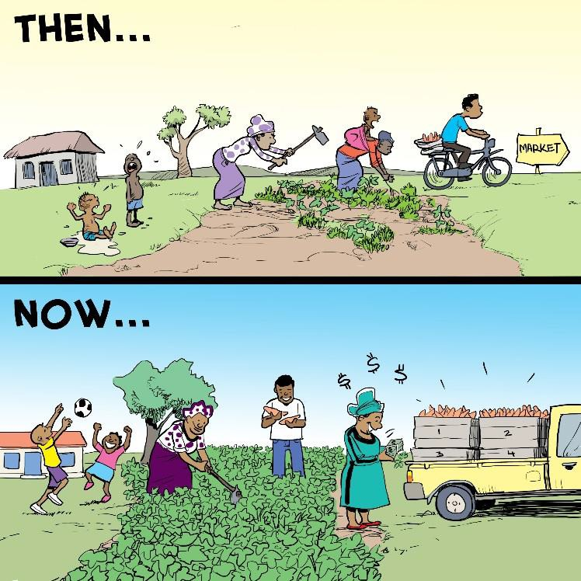
Project’s Logic
What are the intentions of the project?
Essential components:
  Inputs
  Activities
  Outputs
  Outcomes (Medium- and short-term goals )
  Impacts (Long-term goals and effects of a project)
ML&E systems focus on outcome level

Slide 18
Six Steps Setting Up Project ML&E System
Define scope and purpose
Finalize the ML&E framework (this includes baseline assessment)
Operationalise monitoring mechanisms
Operationalise remaining evaluation mechanisms
Plan timely and quality communication and reporting mechanism
Plan for critical reflection processes and events

Slide 19
Beneficiaries of A Project
It is important to understand beneficiaries both direct and indirect to measure short-term goals and long-term impact
  Direct: Household or individual comes into direct contact with set of interventions (goods or services) provided by project
  Indirect: Household or individual receives goods or services provided by project, but not through direct contact
Project “reach” can include:
  Information, e.g.:
    Best practices growing sweetpotato
    Using improved diseases/pest resistant, climate-adaptable varieties
  Direct benefits, such as access to improved varieties

Slide 20
What are the essential components of Project’s Logical Framework?
Can you think of an example of ‘indirect’ beneficiary of a project?
Notes:
Answers
Inputs; Activities; Outputs; Outcomes (Medium- and short-term goals ); Impacts (Long-term goals and effects of a project)
E.g. project involving raising awareness of OFSP nutritional value to address Vitamin A deficiency. Indirect beneficiaries could be sellers who will see increased demand.

Slide 21
Key Points
ML&E should be systematized for every project—not just when a donor asks for it.
Inputs, activities, outputs, outcomes (medium- and short-term goals), and impacts (long-term goals and effects of a project) are the essential components of a project’s logic. Designing a meaningful ML&E system depends on clearly understanding each element.
A theory of change describes the pathways that will turn desired outcomes into results.
The preliminary phase of designing and ML&E system is the time to set scope and purpose.
Baseline assessments are done during the second step, finalizing the M&E framework.

Slide 22
Key Points
In the third and fourth steps, project workers operationalise monitoring and evaluation mechanisms.
In steps five and six, we develop a plan for timely and quality communication and reporting, and then for critical reflection processes and events.
It is important to understand the beneficiaries of a project, both direct and indirect, in order to measure short-term goals and long-term impact.

Slide 23
Monitoring Mechanisms for a Sweetpotato Project
Unit 3

Slide 24
Objectives
By the end of this unit, you should be able to:
Name the range of monitoring mechanisms that are effective for sweetpotato projects.
Compare and describe lower-level indicators and higher-level indicators and their uses.
Explain SMART indicators and why they are important.
List and locate pre-made tools and sets of indicators that are available for sweetpotato projects.
Explain the crop-cut technique.
Tell why Data Quality Assessment is necessary and how it is performed.

Slide 25
Monitoring Mechanisms
The monitoring mechanisms provide up-to-date information by tracking project process.
Monitoring depends on knowing about information barriers to accurate information:
  For example, finding out how many farmers use piecemeal harvest techniques and making sure to record those harvests.

Slide 26
Designing effective monitoring mechanisms:
Agree with partners what, who, how and when for monitoring, reporting work-plans, and budgets
Develop tools to routinely gather information
Train staff, partners, beneficiaries how to use tools
Set up and operate efficient data collection, storage
Conduct quality assessments (DQA)
Implement progress reporting mechanism

Slide 27
Monitoring Tools
Interviews
  Note that in SSA women are less literate than men in some places. Equal gender perspective may require getting oral interviews as well as offering written records and surveys
Multi-stakeholder workshops
Photographs
Focus groups
Case studies

Slide 28
Project’s Logic
Inputs > activities > outputs > outcomes > impact
  Inputs – what we put in
  Activities – what we do
  Outputs – what we create
  Outcomes – what results are achieved
  Impact – what difference it makes

Slide 29
Indicators
Indicators are signs that something has been done or achieved.
Indicators help us understand what has been done when, where and at what cost, who was affected in what ways.
Lower level indicators measure or provide information at output level, e.g.:
  Number of male headed households and female headed households who have received vines
  Number of extension officers trained on nutrition
Higher level indicators are outcome or impact level indicators and mainly for evaluation.

Slide 30
What are the steps of designing effective monitoring mechanisms?
What are some of the monitoring tools?
Notes:
Answers
Agree with partners what, who, how and when for monitoring, reporting work-plans, and budgets; Develop tools to routinely gather information; Train staff, partners, beneficiaries how to use tools; Set up and operate efficient data collection, storage; Conduct quality assessments (DQA); Implement progress reporting mechanism
Interviews; Multi-stakeholder workshops; Photographs; Focus groups; Case studies

Slide 31
Key Points
A project’s logic: inputs (what we put in) > activities (what we do) > outputs (what we create) > outcomes (what results are achieved) > impact (what difference it makes).
Indicators are signs that something has been done or achieved, they help us understand what has been done when, where and at what cost, and who was affected in what ways.
Lower level indicators require regular tracking and are part of the monitoring system.
Higher level indicators are outcome or impact level indicators and mainly for evaluation.
The data on the indicators needs to be sex-disaggregated; it can also be useful to be able to disaggregate your data by age, wealth group, educational level, etc.

Slide 32
Key Points
Data on indicators needs to be sex-disaggregated. Can also be useful to disaggregate your data by age, wealth group, educational level, etc.
Monitoring depends on knowing about information barriers to accurate information, for example, finding out how many farmers use piecemeal harvest techniques and making sure to record those harvests.
As women are less literate than men in some places, an equal gender perspective may require getting oral interviews as well as offering written records and surveys.

Slide 33
Evaluation Mechanisms of a Sweetpotato Project
Unit 4

Slide 34
Objectives
By the end of this unit, you should be able to:
Explain the importance of vision and process vision in creating evaluation mechanisms for a sweetpotato project.
Tell why and how your list of indicators should be narrowed down.
Explain outcome counterfactuals.
Describe the process of sampling.
Explain the usefulness of Focus Group Discussions (FGDs) and describe the circumstances where sex-segregated FGDs are and are not practical.

Slide 35
Vision as Evaluation Mechanism
A clear vision should be developed in the early stages of planning a sweetpotato project
Vision helps identify and develop higher level indicators, e.g.
  Volumes and value of OFSP produced and/or sold
  Improvement diet quality
  Increased levels intake vitamin A
Vision helps build an idea of what lower level indicators are needed
Vision includes recognising problem areas you want to change and how you want them to look after the project

Slide 36
Developing a Process Vision
Process Vision is about how you want things achieved (the method).
To create a process vision, list outcomes and impact indicators covering all important causal chains in project’s logic.
If the list is long, prioritize, with final key indicators not exceeding 12-20.
Take into account the cost of recording and collecting the indictors.

Slide 37
Operationalising the Evaluation Mechanisms
Evaluations aim to demonstrate change compared to a control group.
Use baseline surveys to show where you are beginning from in terms of reaching project goals.
Conduct midterm evaluations to give a halfway guidepost.
If appropriate, use counterfactual outcomes – what would have happened if the program had not existed.
Use evaluation methods that could be used are:
  Appreciative inquiry
  Outcome mapping
  Most Significant Change (MSC) technique
If appropriate, use sampling to collect data

Slide 38
Sampling
Process of selecting units from the population to give a general idea of overall outcome by generalising that data to the population.
Sampling is crucial for setting up a good evaluation.
Sampling will help decide how confidently you can generalize your findings to entire population.

Slide 39
Focus Group Discussions (FGDs)
Focus Groups typically involve groups of 5-12 individuals knowledgeable about subject you want discussed.
It may be necessary to have sex disaggregated FGDs to capture views of both men and women.
  For example, some communities may have restrictions against women speaking in public or may not contradict men in public.
In some cases it may be necessary to disaggregate community by different wealth groups, age or ethnicity.
Focus Groups should be as representative of the population of the community as possible.

Slide 40
How could having a clear vision serve as an evaluation mechanism?
What are some of the evaluation methods that could be used?
Notes:
Answers
Vision helps identify and develop higher level indicators; Vision helps build an idea of what lower level indicators are needed; Vision includes recognising problem areas you want to change and how you want them to look after the project
Appreciative inquiry; Outcome mapping; Most Significant Change (MSC) technique

Slide 41
Key Points
Developing a clear vision in the early stages of planning a sweetpotato project helps identify and develop higher level indicators. You should know what problem areas you want to change and how you want them to look after the project.
These higher level indicators in sweetpotato projects often include common markers such as increases is income generated and improvement in diet quality and vitamin A intake.
Determining higher level indicators helps build an idea of what lower level indicators are needed. Final key indicators should not exceed 12-20.
The cost of recording and collecting indictors should be taken into account; here, as elsewhere, spend resources wisely.

Slide 42
Key Points
Evaluations should demonstrate change compared to a control group.
Baseline surveys show where you are beginning from in terms of reaching project goals. Midterm evaluations give a halfway guidepost.
Sampling is the process of selecting units from within the population to give a general idea of the overall outcome by generalising that data to the population.
FGDs are a great tool, and should be as representative of the population of the community as possible.

Slide 43
Gender and Diversity Aspects of Sweetpotato ML&E
Unit 5

Slide 44
Objectives
By the end of this unit, you should be able to:
Describe the gender and diversity issues surrounding sweetpotato ML&E.

Slide 45
Including Gender Issues in Development Projects
Development projects affect men and women, poor and wealthy, and young or old people differently.
Gender aspects should be included at the project design stage.
When baseline data is collected at a workshop or end of the project meeting is held, it is important to ensure stakeholders represent women’s interests and those of other vulnerable groups.
  For example, when inviting farmer organisations, do not assume that men and women farmers will be automatically included.

Slide 46
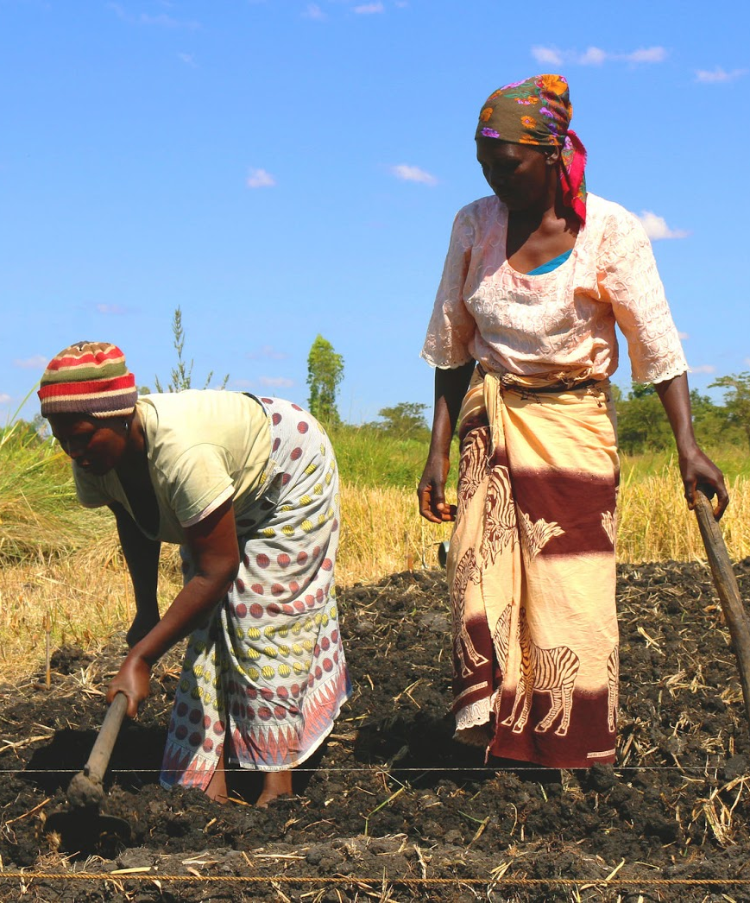
Project Data
It is essential to collect disaggregated data, so you can see whether the project design needs improving to prevent it having adverse effects on specific groups.
Measurement of progress towards gender impact should be undertaken at all stages.

Slide 47
Common Gender Challenges
Assumption that ML&E frameworks are gender neutral
Inadequate inclusion of gender aspects, initial project planning.
Limited gender awareness of ML&E staff.
Barriers to free and open participation by female respondents.

Slide 48
What are some of the ways gender issues could be included into the development projects?
What are some of the gender-related challenges in monitoring and evaluation?
Notes:
Answers
Gender aspects should be included at the project design stage; When baseline data is collected at a workshop or end of the project meeting is held, women should be invited; Disaggregated data should be collected throughout the project to analyse impact on specific groups
Assumption that ML&E frameworks are gender neutral; Inadequate inclusion of gender aspects, initial project planning; Limited gender awareness of ML&E staff; Barriers to free and open participation by female respondents

Slide 49
Key Points
Development projects can affect men and women, poor and wealthy, and young or old people differently.
It is essential to collect disaggregated data, so you can see whether the project design needs improving to prevent it having adverse effects on specific groups.
Gender aspects need including from the project design stage.

Slide 50
Where Did it Go?
Follow instructions from your facilitator.

