Slide 1


When is foot-and-mouth disease vaccination profitable in endemic settings?
T.J.D. Knight-Jones¹, N.A. Lyons^{2,3}, P. Motta², B.V. Ahmadi², J. Rushton³ and D.J. Paton⁴
¹International Livestock Research Institute; ²European Union Commission for the Control of Food-and-Mouth Disease, Food and Agriculture Organization of the United Nations; ³University of Liverpool; ⁴Pirbright Institute
EuFMD | Open Session special edition | #OS20se

Slide 2
Vaccination: does it pay?
Many FMD endemic countries are very reliant on vaccination for FMD control
Sometimes it is all or partly funded by the state
But the financial justification for FMD vaccination is often not fully considered
Essentially the decision maker (the one paying for vaccination) should know if vaccination is profitable – whether paid for by the state or the farmer
This is particularly true if the farmer pays as they are concerned about their own farm income, rather than wider population benefits

Slide 3
Vaccination cost-calculator
To assess when FMD vaccination increases farm income we developed a simple CATTLE farm cost-calculator
This partial budget calculator assessed FMD impact on farm income comparing a scenario where FMD vaccination was not performed to one where routine vaccination was performed
Inputs (Sources: literature, field investigations, expert opinion, sometimes not available)
  Farm-level: Number of cattle
  FMD: Probability of the farm experiencing an FMD outbreak per year (calculated from incidence data/estimates)
    Proportion of cattle with clinical FMD if no vaccination
  Vaccination: Number of doses each animal gets per year (default two, with single-dose primary course)
    Cost of vaccine per dose (vaccine and delivery costs)
    Vaccine effectiveness (if the farm has an outbreak what proportion of cattle are protected)

Slide 4
Vaccination cost-calculator
Inputs (Sources: literature, field investigations, expert opinion, sometimes not available)
  Average cost per head of cattle with clinical FMD
    Milk losses – Ave litres reduction in milk yield X price per litre of milk
    Deaths – Proportion of FMD cases that die X ave value of cattle
    Abortion – Proportion that abort X value of replacement calf
    Reduced fertility – Days delay to conception X cost per day of delayed calving
    Traction power – Proportion of cases that would be used for traction X cost of hiring a replacement
    Treatment costs – Ave treatment costs per head of cattle (antibiotic, anit-inflammatory, other)
    Delay in reaching finishing weight – Proportion of cases whose sale was delayed X length of delay (months) X value of cattle X cost of loaning that value per month
    Additional feed/keep costs from delayed sales - Proportion of cases whose sale was delayed X ave length of delay (days) X cost of feed/keep per day
    Distress sales/culling (sale of affected cattle to prevent further losses) – Proportion sold as distress sale X ave reduction in price compared to selling when healthy

Slide 5
Basic calulation
For a production system in a specific settings compare…
Ave income lost from FMD for a herd WITHOUT vaccination per year =
Probability of herd experiencing outbreak X if herd affected proportion of herd with clinical FMD X ave costs per case
Vs
Ave income lost from FMD for a herd WITH vaccination per year
Same as above but Proportion of herd with clinical FMD is reduced by the vaccine effectiveness (proportion of cases prevented by vaccination)
+ vaccination costs
Output: 1) Change in income per head of cattle if you vaccinate
2) Ratio of benefit to vaccination costs (BCR)

Slide 6
Assumptions and (over) simplifications
No two-dose primary course included (typically needed for effectiveness and would increase vaccination costs, maybe by 10-15%??)
Sometimes no data obtained for certain minor costs
Not yet a stochastic model with uncertainty intervals
Incidence data sometimes not available [could estimate from seroprevalence]
Results are for an average herd (herd impact will vary with size) – but cost per animal is unaffected
Clinical disease may be milder in vaccinated animals
Uses a single value for vaccine effectiveness, protection increases with multiple doses
Probability of a herd outbreak is not affected by vaccination, just outbreak size (important)
Only considers farm-level effects not population herd-immunity effect on incidence
  This is the case in many countries in PCP stage 0-2, where incidence and exposure remains high

Slide 7
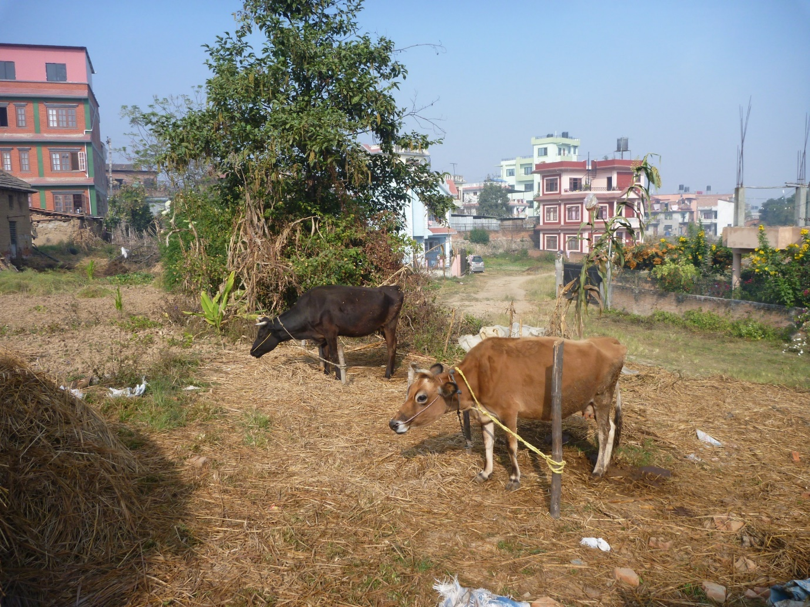
Nepal – Small-holder dairy
- Data collected by questionnaire during EuFMD training courses in 2017-19
- 5 separate village studies visiting 49 households
- High mortality in cows (~10%) and calves (~46%)

Slide 8
Nepal – Data from field exercises, opinion
Average cost per case | Inputs |  | Inputs
Milk loss per case | $201 | Number of cattle per herd | 2.6
Death | $154 | Herd incidence if not vaccinated | 70%
Treatment | $65 | Probability of herd outbreak per year | 10%
Total cost | $422 | Vaccine effectiveness | 70%
Vaccine costs | $1.3 | Doses per year | 2

Slide 9
Nepal – Data from field exercises, opinion
Average cost per case | Inputs |  | Inputs
Milk loss per case | $201 | Number of cattle per herd | 2.6
Death | $154 | Herd incidence if not vaccinated | 70%
Treatment | $65 | Probability of herd outbreak per year | 10%
Total cost | $422 | Vaccine effectiveness | 70%
Vaccine costs | $1.3 | Doses per year | 2
Result:
Vaccinating saves US$47 per year per herd
That’s US$18 per head of cattle
Per US$1 spent on vaccination save US$8

Slide 10
Nepal – Data from field exercises, opinion
Average cost per case | Inputs |  | Inputs
Milk loss per case | $201 | Number of cattle per herd | 2.6
Death | $154 | Herd incidence if not vaccinated | 70%
Treatment | $65 | Probability of herd outbreak per year | 10%
Total cost | $422 | Vaccine effectiveness | 70%
Vaccine costs | $1.3 | Doses per year | 2
Result:
Vaccinating saves US$47 per year per herd
That’s US$18 per head of cattle
Per US$1 spent on vaccination save US$8
Break even (cost neutral):
- 10% vaccine effectiveness – why?
- High cost per case and cheap vaccine
- High susceptibility/morbidity

Slide 11
Nepal – Data from field exercises, opinion
Average cost per case | Inputs |  | Inputs
Milk loss per case | $201 | Number of cattle per herd | 2.6
Death | $154 | Herd incidence if not vaccinated | 70%
Treatment | $65 | Probability of herd outbreak per year | 10%
Total cost | $422 | Vaccine effectiveness | 70%
Vaccine costs | $1.3 | Doses per year | 2
Result:
Vaccinating saves US$47 per year per herd
That’s US$18 per head of cattle
Per US$1 spent on vaccination save US$8
Break even (cost neutral):
- 10% vaccine effectiveness – why?
- High cost per case and cheap vaccine
- High susceptibility

Slide 12
Nepal – Data from field exercises, opinion
Average cost per case | Inputs |  | Inputs
Milk loss per case | $201 | Number of cattle per herd | 2.6
Death | $154 | Herd incidence if not vaccinated | 70%
Treatment | $65 | Probability of herd outbreak per year | 10%
Total cost | $422 | Vaccine effectiveness | 70%
Vaccine costs | $1.3 | Doses per year | 2
Result:
Vaccinating saves US$47 per year per herd
That’s US$18 per head of cattle
Per US$1 spent on vaccination save US$8
If herd outbreaks are from single virus introductions that are blocked by vaccination with probability = Vaccine effectiveness
Vaccination saves $24 per head of cattle (c.f. $18)
Per US$1 spent on vaccination reduces FMD impact by US$10

Slide 13
Other studies in smallholder dairy
Ethiopia Small-Medium dairy farms Data from Asfenafi, 2012 MSc Wageningen
edepot.wur.nl/240465
Very similar results – for same reasons
South Vietnam Data dairy but mostly beef from Truong et al., 2018 doi.org/10.3389/fvets.2018.00026
Also similar positive results – same reasons plus high value of cattle and higher mortality

Slide 14
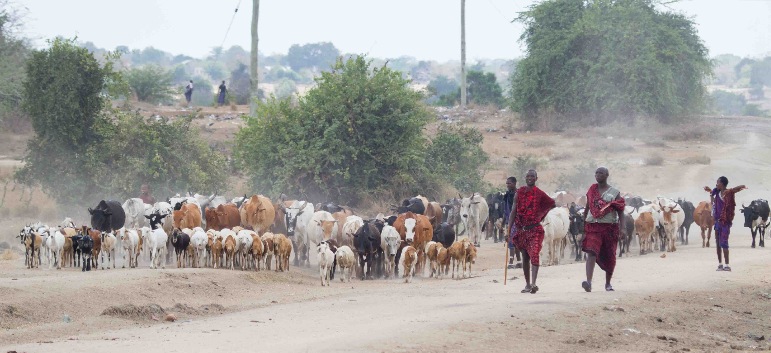
Tanzania – Pastoralist
High risk area
Casey-Briars et al. 2018 Nature Ecol Evol
doi.org/10.1038/s41559-018-0636-x
Bastola 2015 Thesis Washington State Uni
Barassa et al. 2008 TBED
doi.org/10.1111/j.1865-1682.2008.01042.x
Haesler et al. 2017 CBA FMD Tanzania

Slide 15
Tanzania – Data from field exercises, opinion
Average cost per case | Inputs |  | Inputs
Milk loss per case | $5.4 | Number of cattle per herd | 85
Death | $1.5 | Herd incidence if not vaccinated | 44%
Abortion | $1.5 | Probability of herd outbreak per year | 75%
Treatment | $5 | Vaccine effectiveness | 50%
Delayed growth | $0.3
Distress sale/cull | $12.5
Reduced fertility | $5
Total cost | $31
Vaccine cost | $3 | Doses per year | 2

Slide 16
Tanzania – Data from field exercises, opinion
Average cost per case | Inputs |  | Inputs
Milk loss per case | $5.4 | Number of cattle per herd | 85
Death | $1.5 | Herd incidence if not vaccinated | 44%
Abortion | $1.5 | Probability of herd outbreak per year | 75%
Treatment | $5 | Vaccine effectiveness | 50%
Delayed growth | $0.3
Distress sale/cull | $12.5
Reduced fertility | $5
Total cost | $31
Vaccine cost | $3 | Doses per year | 2
Result:
Vaccinating reduces income by - US$76 per year per herd
That’s - US$1 per head of cattle
Per US$1 spent on vaccination reduces FMD impact by US$0.85

Slide 17
Tanzania– Data from field exercises, opinion
Average cost per case | Inputs |  | Inputs
Milk loss per case | $5.4 | Number of cattle per herd | 85
Death | $1.5 | Herd incidence if not vaccinated | 44%
Abortion | $1.5 | Probability of herd outbreak per year | 75%
Treatment | $5 | Vaccine effectiveness | 50%
Delayed growth | $0.3
Distress sale/cull | $12.5
Reduced fertility | $5
Total cost | $31
Vaccine cost | $3 | Doses per year | 2
Break even:
- $2.5 per dose or
- 60% vaccine effectiveness – why?
- Lost cost per case
- Lower susceptibility/morbidity
- Despite frequent outbreaks
Result:
Vaccinating reduces income by - US$76 per year per herd
That’s - US$1 per head of cattle
Per US$1 spent on vaccination reduces FMD impact by US$0.85

Slide 18
Tanzania– Data from field exercises, opinion
Average cost per case | Inputs |  | Inputs
Milk loss per case | $5.4 | Number of cattle per herd | 85
Death | $1.5 | Herd incidence if not vaccinated | 44%
Abortion | $1.5 | Probability of herd outbreak per year | 75%
Treatment | $5 | Vaccine effectiveness | 50%
Delayed growth | $0.3
Distress sale/cull | $12.5
Reduced fertility | $5
Total cost | $31
Vaccine cost | $3 | Doses per year | 2
Result:
Vaccinating reduces income by - US$76 per year per herd
That’s - US$1 per head of cattle
Per US$1 spent on vaccination reduces FMD impact by US$0.85
If vaccination also reduces probability of a herd-outbreak (vaccine effectiveness)
Vaccination increases income by $2 per head of cattle (c.f. -$1)
Per US$1 spent on vaccination reduce FMD impact by US$1.3

Slide 19
Rushton, 2008 OIE Sci Tec Rev Economic aspects of foot and mouth disease in Bolivia
Found negative farm-level return on vaccine based FMD control in extensive beef systems in Bolivia

Slide 20
Conclusions
In some endemic settings farmer investment in FMD vaccination delivers high returns
But in some settings the cost of vaccination may be greater than the resulting reduction in FMD impact (low disease impact, low incidence)
Considering this can identify how to target FMD control to sectors where it is most profitable
It will also show where public funding will be needed due to a lack of farmer incentives to invest in FMD control

Slide 21

THANK YOU

