Slide 1
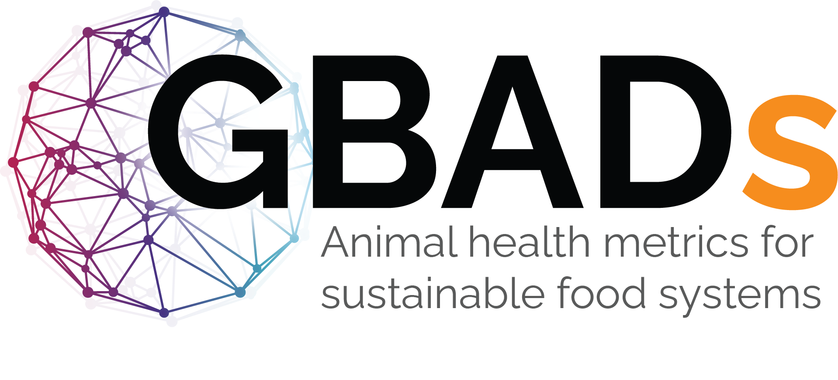

Economic burden of foot-and-mouth disease outbreaks on farmers and national economies
Theo Knight-Jones^{1,2}, Wudu Temesgen^{1,2} and Jonathan Rushton^{2,3}
¹International Livestock Research Institute (ILRI)
²Global Burden of Animal Diseases Program
³The Roslin Institute, University of Edinburgh

Slide 2
Economic burden of FMD
Annual economic burden of FMD in endemic countries was put at US$6.5-21Billion
  Direct and vaccination costs only
  Impact in free countries can be massive
  Ave US$1.5billion/yr (Knight-Jones & Rushton, 2013)
  UK 2001 outbreak >$15Billion [2007 >US$300million]
  Australia predicted $4-6.5billion for a 12 month outbreak
  Germany single outbreak 2025 quoted as costing US$1Billion
But most of the ongoing impact is in endemic countries
  75% of world FMD susceptible livestock live in endemic countries

Slide 3
Which systems are most affected?
Biggest impact on dairy and pigs…especially intensive sectors
Also livestock export sector is greatly impacted
  But some endemic countries have successful export markets
    E.g. India top 3 beef exporter in the world
Control costs are mostly captured by the state in many countries
In endemic countries perceived impacts in extensive sectors may be low…but ongoing losses can be vast but are poorly recognised
In these settings costs and feasibility of control are often a barrier

Slide 4
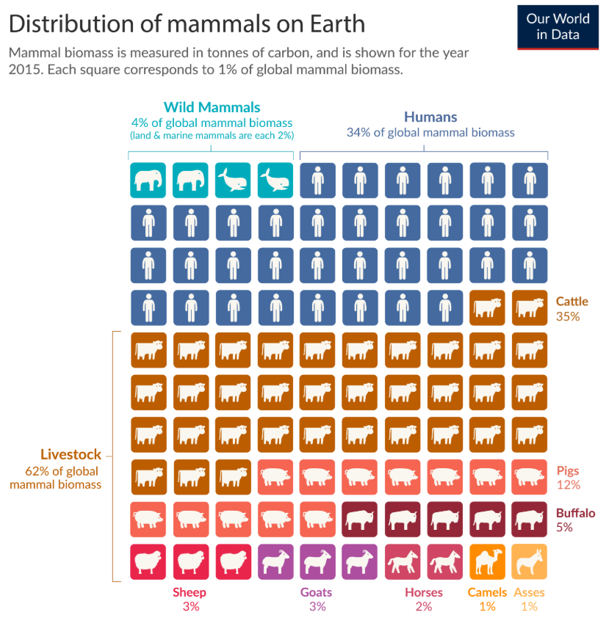
The dominance of cattle
Cattle and buffalo make up 40% of
mammalian biomass on earth
Shoats make up 6%
-This reflects the overall economic
importance of cattle (dairy yes, but it is pigs and chickens that provide meat)
-But sheep and goats are the priority
in harsher agro-ecologies and have
higher female ownership

Slide 5
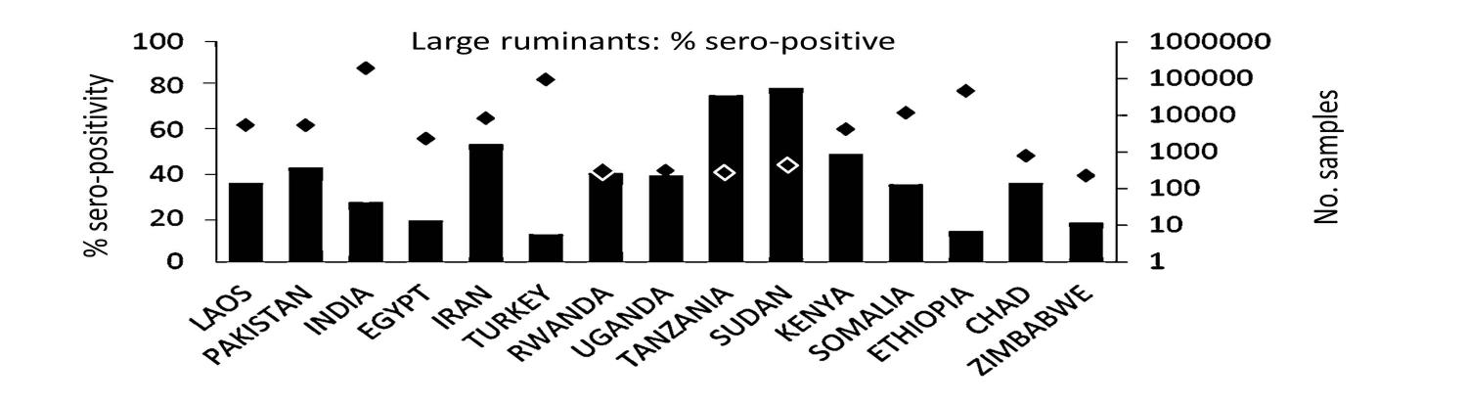
High prevalence in endemic countries
FMD Sero-prevalence studies
Approx. 45% cattle infected per year - % with clinical disease?
(McLaws et al., 2014)
After outbreak 10-60% of annual farm income lost (Shankar 2012, Nampanya 2015) and half of value of livestock assets (critical as livestock are the family bank)
FMD Ranked as top 3 priority livestock disease by governments and producers in LMICs

Slide 6
High burden but low investment in control
Whilst massive progress in FMD control has been made in some regions, notable Europe and South America, in many endemic countries FMD remains neglected
  Results in ongoing burden in endemic countries that are a source of incursions and outbreaks in FMD-free countries
Global Burden of Animal Diseases programme
  Ethiopia case study
  About 50% of potential livestock productivity lost to livestock disease
  But only 1% of loss is due to expenditure on controlling disease

Slide 7
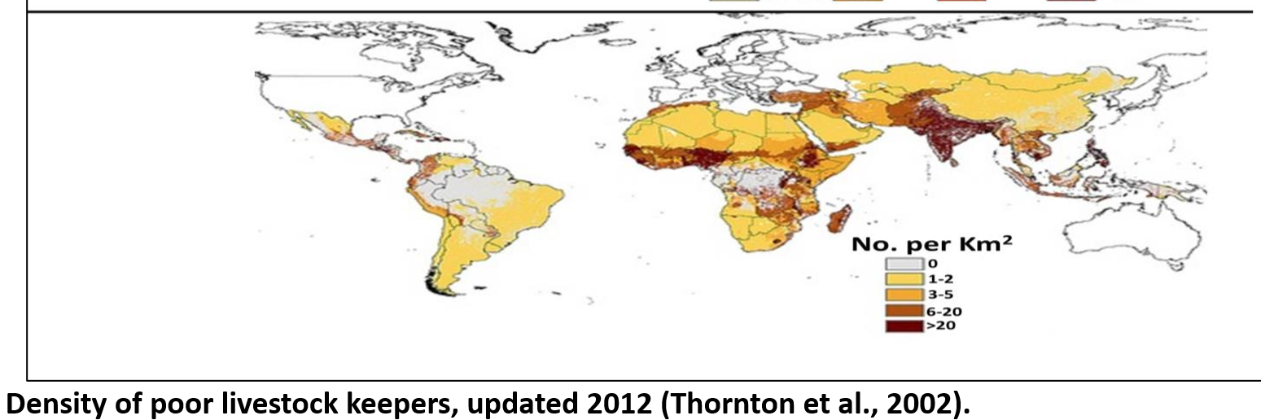
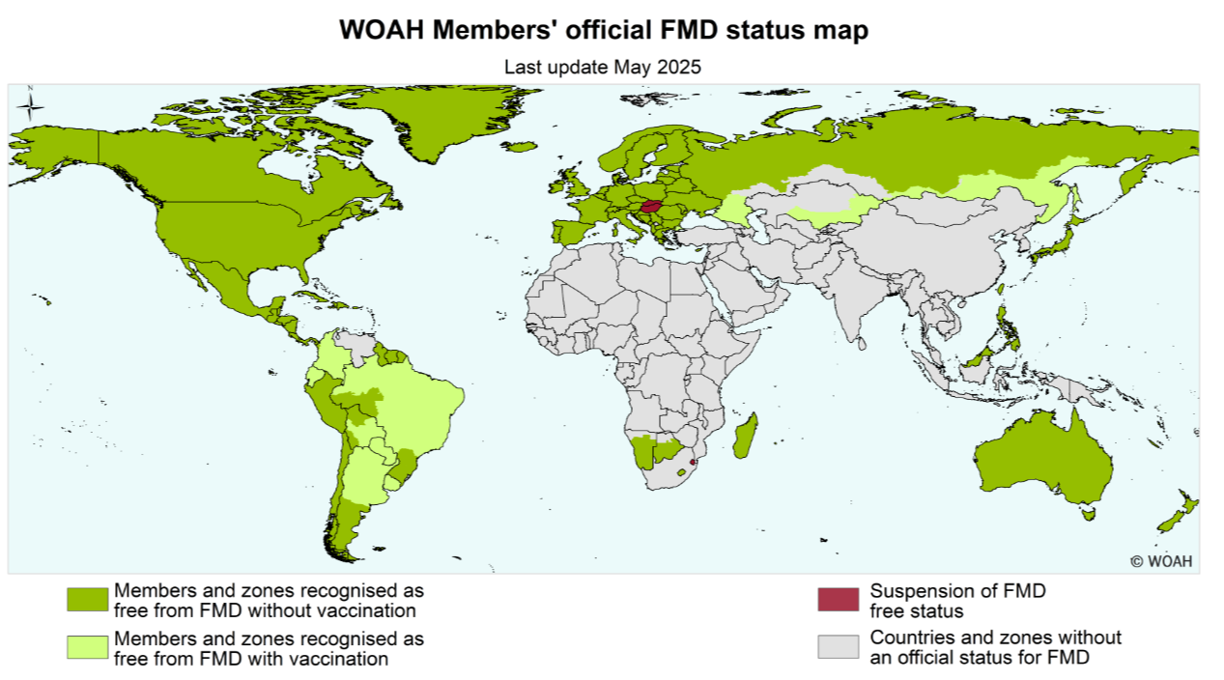

Slide 8
What are the impacts of FMD outbreaks
Increasingly we recognise the impact of livestock disease beyond the farm – negative externalities which have no market and are not valued in society
“Economic analysis for progressive control of foot-and-mouth disease and other transboundary animal diseases” McLaws et al. 2025

Slide 9
Livestock Disease Impact
Farm level
Direct
Indirect
Societal impacts
Visible Losses
Invisible Losses
Additional Costs
Revenue Foregone
Societal impacts
•Loss of milk production
•Loss of draught power
•Reduce weight gain
•Dead animals
•Reduced fertility
•Inefficient herd structure
•Delay in sale of animals and/or products
•Vaccines
•Vaccine delivery
•Movement controls
•Diagnostic tests
•Treatments
• Disinfection
• Culled animals
•Impacts outside livestock sector (tourism,etc.)
•Impacts on other value chain actors
•Use of less productive breeds
•Denied access to local and international markets
•Impacts outside the livestock sector (tourism,etc.)
•Impacts on other value chain actors
•Ecological/GHG/ pollution impact
•Wildlife/conservation impact •Access to education
•Food insecurity
•Mental health
•Antimicrobial resistance
•Food drug residues
•Animal welfare

Slide 10
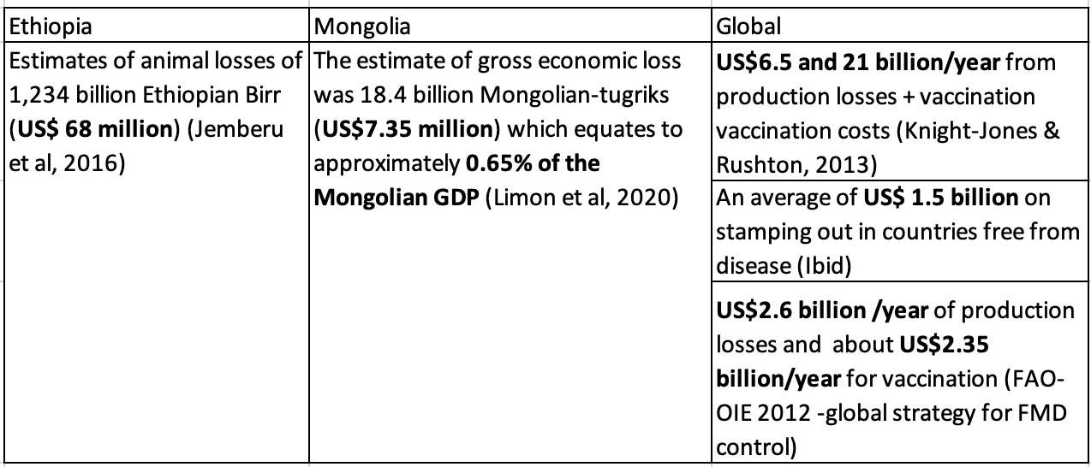
National and global impacts of FMD

Slide 11
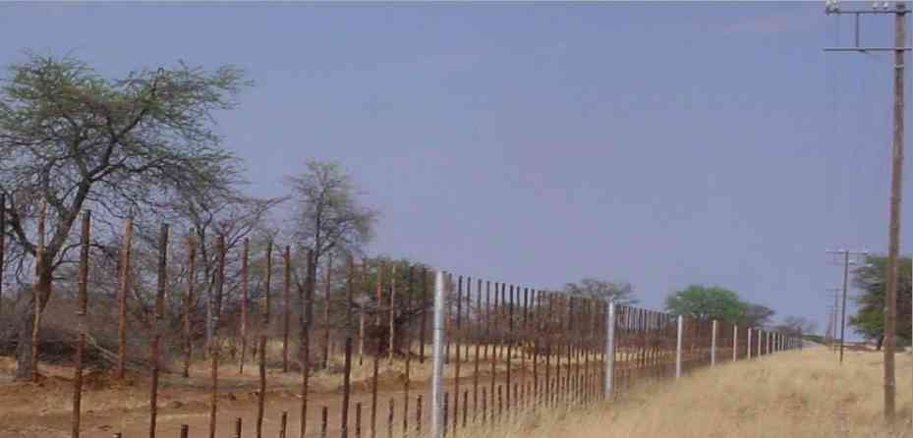
Livestock Disease Impact
Impacts go far beyond the farm
Direct
Indirect
Societal impacts
Visible Losses
Invisible Losses
Additional Costs
Revenue Foregone
Societal impacts
•Loss of milk production
•Loss of draught power
•Reduce weight gain
•Dead animals
•Reduced fertility
•Inefficient herd structure
•Delay in sale of animals and/or products
•Vaccines
•Vaccine delivery
•Movement controls
•Diagnostic tests
•Treatments
• Disinfection
• Culled animals
•Impacts outside livestock sector (tourism,etc.)
•Impacts on other value chain actors
•Use of less productive breeds
•Denied access to local and international markets
•Impacts outside the livestock sector (tourism,etc.)
•Impacts on other value chain actors
•Ecological/GHG/ pollution impact
•Wildlife/conservation impact •Access to education
•Food insecurity
•Mental health
•Antimicrobial resistance
•Food drug residues
•Animal welfare
Livestock responsible for 15% of human derived GHG emissions (45% in Ethiopia) – improving animal health is important for reducing this
Affects the movement of livestock, wildlife, wealth and people

Slide 12
Who benefits from reduced animal disease burden – GBADs Ethiopia case study
Animal health burdens affect consumers and value chain actors more than producers
A shift in animal health burdens will generate benefits across society and in particular urban consumers
Tom Marsh, Golam Shakil, Dustin Pendell
Notes:
Policies needed to ensure that producers are not negatively impacted

Slide 13
Investment in control is not a one of payment
Investment in control is not a one-off payment
High farmer-level impact of disease
Shift to high control costs experienced by tax payer
France - FMD outbreaks and vaccination.
Lombard et al, OIE, Rev. sci. tech., 2007.
Improved farmer revenue – less disease & better market access
But farmers may also experience costs of movement controls
And export market access can be unpredictable and political
>30 years of vaccination
The Netherlands - FMD outbreaks and vaccination. Dekker, A. Foot-and-mouth disease vaccine induced protection. (2010).

Slide 14
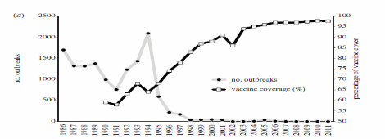
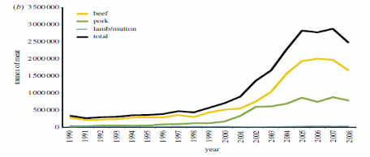
Investment in control is not a one off payment
FMD and exports – South America
Difficult to achieve such long-term commitment in low-income countries dependant on donor funded projects
Brazil - FMD outbreaks and vaccination.
Naranjo & Cosivi, Proc Roy Soc B, 2013
South America – Export of meat from FMD-susceptible species
If motivated by export market access – what other barriers are there to trade, other diseases, food safety, quality, price, politics…

Slide 15
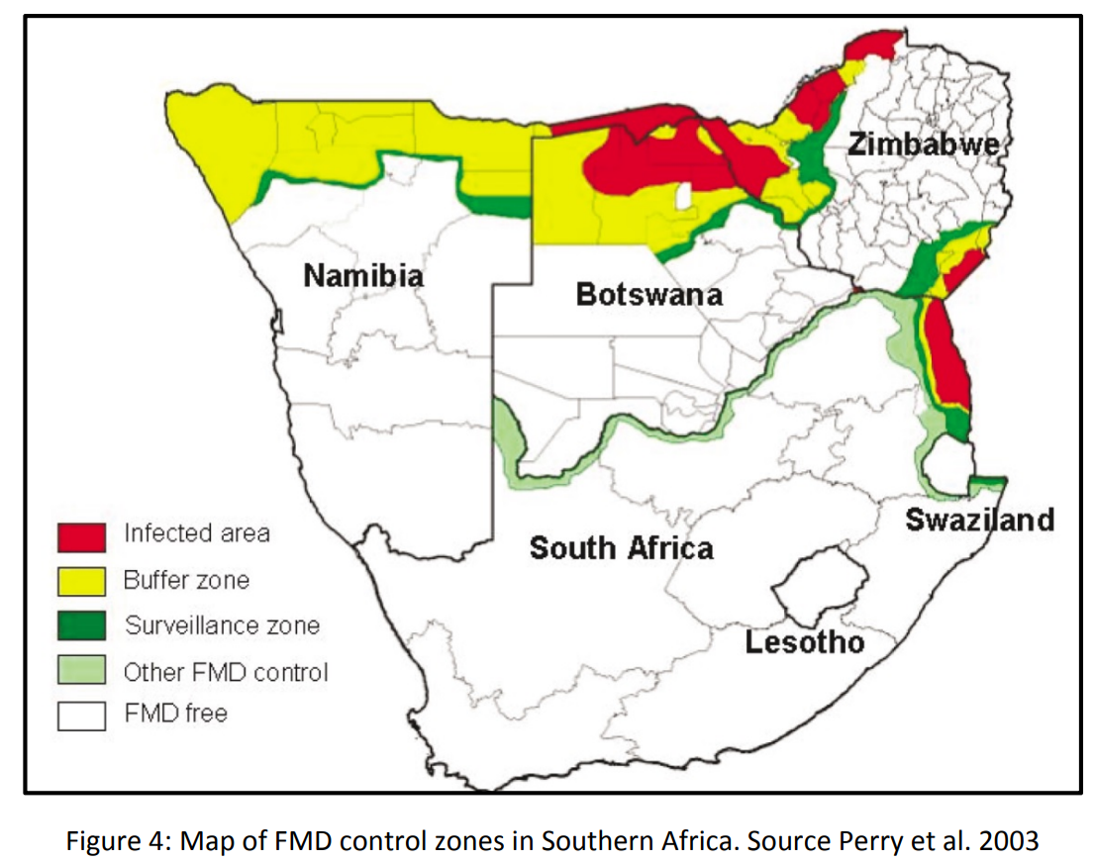
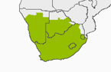
Sustainable, coordinated control is required
Sustainability depends in-part on ability to access export markets – repeated incursions will undermine the economic viability of maintaining free-status
– requires coordinated regional control
Previous free zones in Zimbabwe
Outbreaks spread to neighbouring countries with loss of market access
Now loss of free zones in other countries in region – Complicated by endemic wildlife
Controlling FMD is challenging and requires strong public services and an incentivized livestock sector
Are public services able to control FMD, if not what is economically the best approach?
Some producers benefit more from FMD control than others – but those with limited benefit may still experience costs of control
2000
2020
2025

Slide 16
Conclusion
Although a disease of low mortality FMD has a high global burden due to its high incidence in much of the world and the high impact of sporadic outbreaks in free countries
FMD is particularly important for those with large livestock export economies
Dairy and pig sectors are most affected
Disease impacts and costs experienced by different sectors of society and the economy are varied and change depending on the stage of FMD control – how this is managed will affect progress
Sustained investment, strong governance, strong incentives and coordinated control are required for successful FMD control

Slide 17
Final thought - Should we be considering FMD in isolation?
Disease specific programmes are needed – especially if using vaccines
But FMD and disease control is an element of sustainable development of the livestock sector and there are many other aspects of the livestock economy that must be factored in
Consider the bigger picture – TADs free countries are experiencing HPAI, PPR, FMD, ASF, LSD… outbreaks – can we address the underlying drivers
  Probably war and unrest, populations shifts – what does the future hold?
  Is this the new normal and Should we adopt a damage limitation approach?

Slide 18

