Slide 1
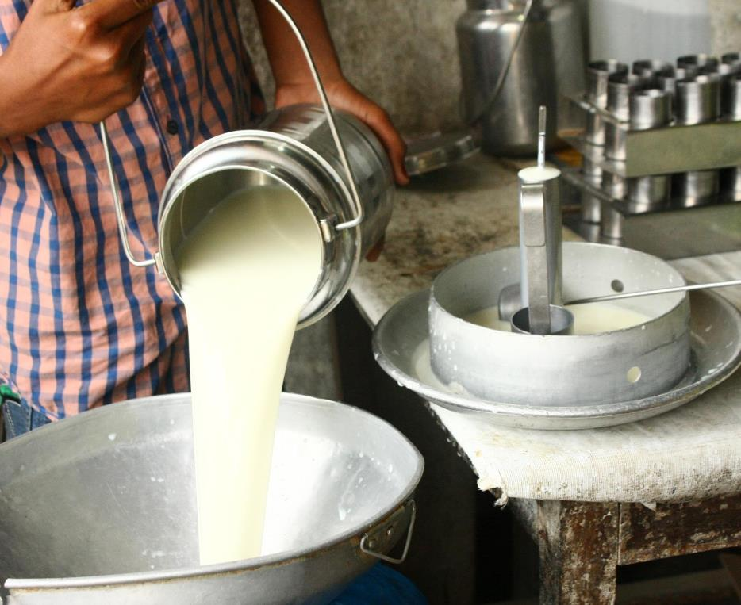
MoreMilk Workshop
Making the Most of Milk
Facilitator’s Guide

Slide 2





© 2019 International Livestock Research Institute (ILRI)
ILRI thanks all donors and organizations which globally support its work through their contributions to the CGIAR Trust Fund
This publication is copyrighted by the International Livestock Research Institute (ILRI). It is licensed for use under the Creative Commons Attribution 4.0 International Licence. To view this licence, visit https://creativecommons.org/licenses/by/4.0. Unless otherwise noted, you are free to share (copy and redistribute the material in any medium or format), adapt (remix, transform, and build upon the material) for any purpose, even commercially, under the following condition:
ATTRIBUTION. The work must be attributed, but not in any way that suggests endorsement by ILRI or the author(s).
NOTICE:
For any reuse or distribution, the licence terms of this work must be made clear to others.
Any of the above conditions can be waived if permission is obtained from the copyright holder.
Nothing in this licence impairs or restricts the author’s moral rights.
Fair dealing and other rights are in no way affected by the above.
The parts used must not misrepresent the meaning of the publication.
ILRI would appreciate being sent a copy of any materials in which text, photos etc. have been used.
Citation
ILRI (International Livestock Research Institute). 2019. MoreMilk workshop: Facilitator’s guide. Nairobi, Kenya: ILRI.
Production of this material has been funded by the Bill & Melinda Gates foundation, the CGIAR Research Program on Agriculture for Nutrition and Health, and UK aid from the UK government. However, the views expressed do not necessarily reflect the official policies of these institutions.

Slide 3
Workshop Overview
The MoreMilk Workshop is divided into five sessions, each one intended to last 2.5 hours (without any breaks)
  Session 1: Milk Hygiene
  Session 2: Milk Hygiene in the Supply Chain
  Session 3: Customers and Milk Hygiene
  Session 4: Planning a Business
  Session 5: Selling More Milk to Your Customers
Ideally the sessions would be scheduled 1 day to 1 week apart to give participants time to apply the principles from each session in their day-to-day business.

Slide 4
Materials
To facilitate the MoreMilk Workshop, you will need:
  The Facilitator’s Guide (this book)
  Copies of the Participant’s Guide for each participant
  Visual aids
    If you have a computer and a projector, you can use the PowerPoint slide deck
    If you do not have a computer and projector, use the Presentation Book and show the various pages to the audience when prompted by the Facilitator’s Guide
  The agenda spreadsheet (to help you keep track of time during sessions)
  The supplies and equipment listed on the next page (for activities)

Slide 5
Supplies and Equipment
Session 1
  Timer
  Clear jar
  Sack of dried beans
  0.5 litres milk in clear jar
  2 metal spoons
  Heat source, such as candle, burner
  Vessel for dirty spoons
  1-2 small clear jars
  Bottle of alcohol, 68-70%
  Measuring device, such as measuring cup or syringe
Session 2
  1kg sack of flour
  Wipes to clean flour off hands
Session 3
  Snacks / beverages
Session 4
  No equipment required
Session 5
  Communication materials
  Training certificates
  Feedback survey

Slide 6
How to Facilitate This Workshop
The MoreMilk workshop was designed to be delivered as an activity and discussion based training program
While some material is presented as a traditional lecture, most of the training should focus on activities where participants do hands-on tasks to learn skills and discussions where the facilitator’s job is to guide the conversation and help participants discover key principles on their own and relate them to their day-to-day work.
This approach has been shown to be more effective for adult learners, however time management can be a challenge for activity and discussion based training.
In this introduction we will review some tips and best practices for facilitating activity and discussion based workshops.

Slide 7







Types of Activities
Symbol | Meaning | Symbol | Meaning
 | Group Discussion |  | Survey
 | Activity |  | Resources
 | Breakout Groups |  | Time Estimate
 | Check for Understanding Quiz |  | Animated Slide / End of Animation
Each page/slide in the workshop materials has been marked with the symbol for the type of activity it describes. Anything without a symbol should be delivered as a lecture.

Slide 8
Ask prompting questions then encourage participants to share thoughts.
Questions are not a “test” – they are meant to inspire conversation.
Facilitator’s notes will indicate the responses sought (if any).
  Use follow-up questions to guide group towards the desired responses.
  Only lecture/explain as a last resort.
Be mindful of time
  Set expectation that not everyone will answer every question
  If conversation goes over, summarise what’s been said and move on.

Slide 9


Challenging Participants
SLEEPWALKERS
TALKERS
SNAILS
Avoid participation
Specifically call on them to answer questions.
Give them a partner to reduce pressure (“Jasmine – can you demonstrate this? Sophia – help her out.”)
Dominate conversations
Thank them for input then direct questions to others
If they persist OK to ask them to let someone else contribute.
Slow down group.
Follow up with them after sessions to review their questions, but keep class moving forward.
If entire class is not grasping the material, that is a problem.

Slide 10
This refers to activities done by the entire group, together.
For role plays, be prepared to play either role, yourself
Do not do the activity for participants, yourself
Make sure you bring all necessary equipment, materials to session
Leave time for debriefing at end
Be mindful of time

Slide 11
This refers to activities that participants do individually or in small groups
For each activity, follow instructions in facilitator guide
For role plays, be prepared to play either role, yourself
Can change to “whole group” activity to make up for time if running behind
Make sure you bring all necessary equipment, materials to session
Allow time for transitions into / out of groups, debriefing
Be mindful of time

Slide 12
When making a breakout group a “whole group” activity, adhere to the following steps:
Choose volunteers
Assign roles
Give background information (to whole class, not just volunteers)
Start the role play
Coach towards responses sought (for whole class, not just volunteers)
End role play when objective is achieved

Slide 13
Quick question to confirm whether participants are following the material
This is not to “test” participants, but rather to test the facilitator and whether we are doing a good job of explaining concepts
If majority of class fail, might need to review last section
There are no checks for understanding in the course materials but you might want to make up your own and ask periodically.
Discussion questions can double as checks for understanding

Slide 14
These are quick “show of hands” polls of the audience.
Surveys are not intended as open-ended discussion questions
Can convert discussions to surveys if you are running short on time.
Can convert checks for understanding to surveys to test entire group
  Be mindful if people are watching each other’s responses

Slide 15
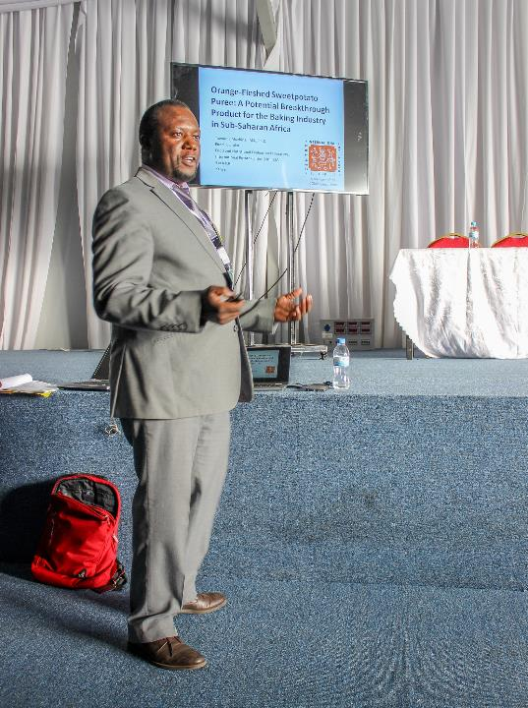
Using PowerPoint Slides
We have included a PowerPoint slide deck to guide presentation
PowerPoint slides can be helpful to help you remember the flow of the session, but over-reliance on slides can reinforce
bad presentation habits

Slide 16
PowerPoint Pros and Cons
Benefits
Problems
Serves as an outline for the facilitator to follow
Helps audience know / remember important points
Can help facilitator remember details they may have forgotten
Show helpful charts, graphs and visual aids
Staring at the screen instead of looking at audience
Reading from slides word-for-word (or telling audience “just read the slide”)
Not reviewing deck in advance (facilitator being surprised by own slides)

Slide 17

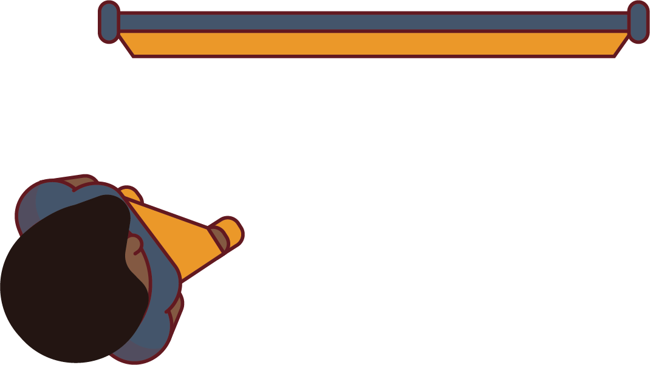
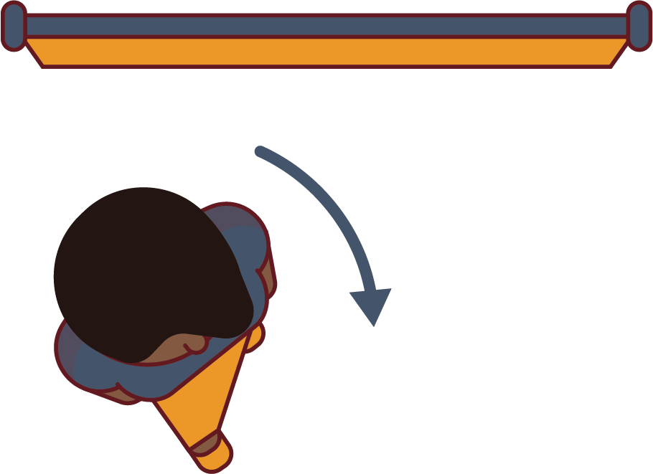
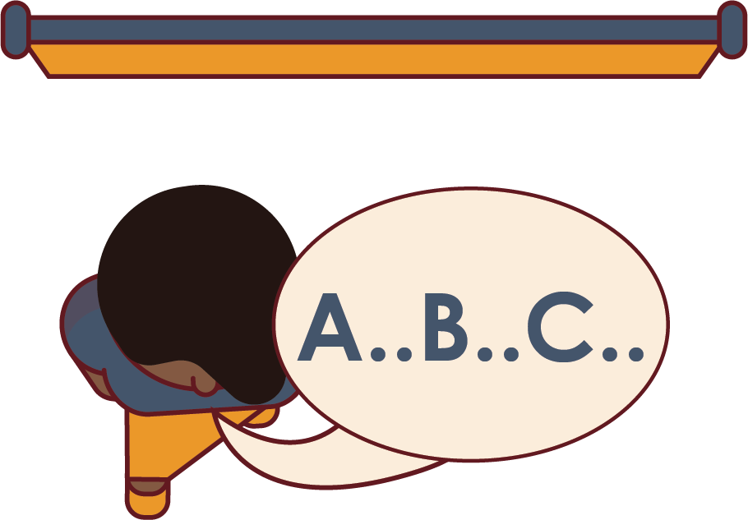
The “PowerPoint Dance”
1
Scan the slide
Pause to think
2
3
4
Turn, look at the audience
Speak
Repeat…

Slide 18
As Early As Possible Before Session
Study the materials
Adapt if necessary (to follow best practices)
Rehearse for time
Review list of attendees
  What do you know about their specific learning needs?
  Do materials need to be adapted for this specific audience?

Slide 19
Before and After Session
Prior to Session
  Confirm availability of facilities 1 week or more in advance
  Confirm that room has been properly set up evening before
  Get any necessary materials collected / printed in advance
After Session
  Distribute feedback survey
  Share contact details for follow-up questions
  Remind the participants of upcoming sessions, events

Slide 20
As Soon As Possible After Session
Follow up on any issues raised during the session
Follow up with ‘snails’ who may have been struggling and ‘sleepwalkers’ who might not have appeared to be ‘tuned out’
Review results of feedback surveys
Provide feedback to curriculum designer(s)

Slide 21
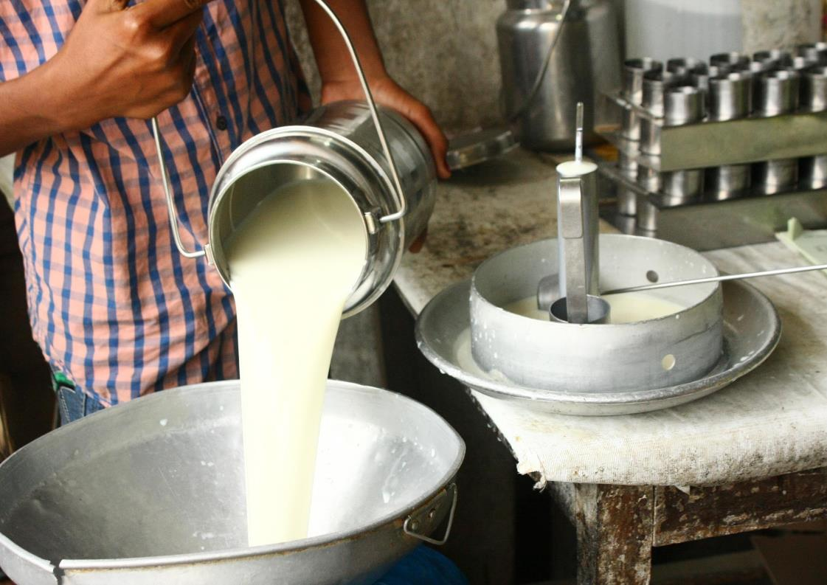
Milk Hygiene
a
1

Slide 22
Welcome
This workshop is about how to sell more, high-quality milk
First session in a series of 5
Will share tips, recommendations, etc.
Will ask YOU to share your experiences
Everyone will have opportunity to speak, but not for every activity / discussion
Phones off please

Slide 23
Housekeeping
[Review logistics for your specific meeting – times, facilities, infectious disease prevention protocols (as required), etc.]

Slide 24
Introduction
15m
Please share:
  Your name
  Where you sell
  Type of business
  (shop, cart, etc.)
  Fun fact
Introduce yourself
Group introduces self one at a time
For fun fact, choose ONE from the following:
  Favourite musician
  Favourite sports team
  Favourite thing to do with free time

Slide 25
Your Business
5m
Raise your hand if…
Milk sales are important to your business
You are interested in increasing the amount of milk you sell
You have lost customers due to spoiled milk
Responses sought:
  Honest answers

Slide 26
Series
Series Objectives
At the end of this series, you should be able to:
Buy clean and good quality milk
Conduct milk tests to determine quality
Handle milk hygienically so it does not get contaminated
Identify and use food grade milk handling containers
Make sure your customers handle milk safely, so it doesn’t get contaminated after they buy it
Educate your customers about the health benefits of milk so they’ll want to buy more of it for their families
Run a more profitable business so that you make more money
Promote your business within your community

Slide 27
Session Objectives: Milk Hygiene
Why safety and hygiene matter in the milk industry
Basics of milk hygiene
What happens when milk goes bad
General causes of bad milk

Slide 28
Foodborne Diseases
10m
How would it impact your business if a customer drank your milk and had an upset stomach?
What if they drank your milk and got so sick that they couldn’t go to work for several days?
Would they tell their friends? How many people would hear about it?
Responses sought:
  Honest answers
Key Points:
  Remind participants that foodborne diseases are preventable
  Customers unlikely to buy milk from a vendor who has sold spoiled/unsafe milk
  Preventing foodborne illness is about protecting public’s health – and protecting your income

Slide 29
Foodborne Diseases
Foodborne diseases result from consuming food contaminated by bad bacteria or chemicals
If milk is spoiled, does not always mean it carries foodborne illness
Contamination can occur from poor handling by producer, vendor or customer
Symptoms range from mildly uncomfortable to fatal
  Chills / fever
  Dehydration
  Cramping
  Diarrhoea
  Infertility, abortion
  Joint pain
  Liver inflammation

Slide 30
Foodborne Diseases Cont’d
Foodborne diseases transmitted through milk include:
  Brucellosis
  Tuberculosis
  Cholera
  Typhoid

Slide 31
Preventing Foodborne Disease
Foodborne diseases harmful to customers and your business profits
Serious, but preventable by practicing good hygiene
Can’t always tell by looking / tasting / smelling if milk is safe
Must buy from source that practices good hygiene

Slide 32
Bacteria
Bacteria are small organisms, too small to see
All around us, can only be seen with a microscope
Most bacteria good
  In milk, good bacteria makes cheese, yogurt, mala
Some bacteria bad, also referred to as “germs”
  In milk, bad bacteria causes illness, disease, spoilage
Milk is nutritious for people, but bacteria like it as well

Slide 33
Bacteria and Milk
Bacteria grow by diving in two
Some bacteria divide in two every 15 minutes.
When milk first contaminated by bacteria, the amount can be very low for the first few hours
As time passes, bacteria can multiply more rapidly
Growth of bacteria is preventable

Slide 34
How Bacteria Multiply
10m
Let’s explore how bacteria multiply…
Imagine this bean is one bacterium, one germ. Let’s see what happens over time.
  What do you think would happen over a full day?
Materials needed:
  Timer
  Clear jar
  Dried beans, or similar, to represent bacteria
Place bean in jar, set timer for 15 seconds
Have participant place two more in jar, restart timer
Continue doubling after 15 second increments for 2 -3 min

Slide 35
Preventing Bacteria Growth
Boiling and pasteurisation kill bacteria
  Bacteria grow back faster in boiled/pasteurised milk than raw milk
Refrigeration, keeping milk cool slow bacteria’s ability to multiply
Freezing milk stops bacteria from growing
  Effective way to preserve milk

Slide 36
Pasteurisation
5m
Raise your hand if…
You buy already pasteurised milk
You take your milk to a hub to get pasteurised
Quick show of hands…
Which do you think is more effective for killing bacteria: boiling or pasteurisation?
Responses sought:
  Honest answers, will review next slide

Slide 37
Pasteurisation
Pasteurisation is a process in which milk is treated with mild heat
Usually less than 100 degrees C (or 212 degrees F) for a specified length of time
Compulsory by Kenyan law for milk sold in urban areas
Does not affect nutritive value of milk
Less effective than boiling for killing bacteria
Pasteurised milk should be kept separate from raw milk
Pasteurisation usually done by a distributor / hub, should not be attempted at home

Slide 38
Cleaning vs Disinfecting
Hygiene extremely important when handling milk
Good hygiene keeps milk safe / fresh
Customers also judge milk quality by cleanliness of seller and shop
Customers who see a dirty shop may buy elsewhere

Slide 39
Cleaning vs. Disinfecting
5m
What’s the difference between “clean” and “disinfected”?
Responses sought:
  Cleaning removes dirt and bacteria
  Disinfecting kills bacteria/germs

Slide 40
Cleaning vs. Disinfecting
Can buy special products to disinfect milk equipment
  Kill bacteria but expensive
Will review two cheaper ways to disinfect
Show bottle of Bactergent or equivalent commercially available product for cleaning if you have it

Slide 41
Disinfecting with Bleach Solution
10m
See Participant Guide
First, scrub area with soap, or detergent and warm water with a clean brush
Rinse
Make a bleach and water solution; one part regular, unscented household bleach to nine parts water
Let bleach and water solution contact surface for 10 min
Then rinse and let dry upside down completely in sun
Refer to image 1.1 in Participant’s Guide
Refer to image 1.1 in Presentation Book
Tell participants that sun is a great disinfectant
Note that participants may not have access to brush like in the graphic, they should use what is locally available

Slide 42






1.1 Disinfecting with Bleach Solution
1
2
3
Soap
Rinse
1 Part Bleach
9 Parts Water
4
5
6
7
10 min Surface Contact
Rinse Again
Sun-Dry
Dry Upside
Down

Slide 43
Disinfecting with Boiling Water
If you cannot make a bleach solution:
First, scrub area with soap, or detergent and warm water with a clean brush
Rinse
Then rinse with boiling water, or submerge in boiling water
Let dry completely, preferably in the sun
Dry containers upside down
Refer to image 1.2 in Participant’s Guide
Refer to image 1.2 in Presentation Book
Remind participants that sunlight is a great disinfectant
Note that participant’s may not have access to brush like in the graphic, they should use what is locally available

Slide 44
1.2 Disinfecting with Boiling Water (No Bleach)
1
2
3
Soap
Rinse
Boiling Water
4
5
Sun-Dry
Dry Upside Down

Slide 45
Testing Milk
Can’t always tell if milk is good quality / safe just by looking.
Must be able to test milk ourselves
Testing milk helps determine if milk is contaminated before we spend money on it - and before it ends up in hands consumer
Even if milk is pasteurised, you must test

Slide 46
Testing Milk
5m
Who here knows methods of testing to see if milk is safe?
Do you often do these tests?
Do you know if your distributors do these tests?
Responses sought:
  Sight and smell test (organoleptic)
  Clot on boiling test
  Alcohol test
  Lactometer (for adulteration)

Slide 47
Sight and Smell Test
10m
One of the most common ways to test milk is by sight and smell.
Here is some milk, we’re going to pass around, look at it, smell it
Look for clumping, discolouring, visible dirt
Smell for foul odour
Materials needed:
  Jar of milk
  If possible, have jar of good milk and jar of bad milk to compare
Pass around jars and encourage participants to make observations using sight/smell
Key point:
  If milk smells / looks bad, vendors should not buy

Slide 48
Clot on Boiling Test
10m
Another effective way to determine if milk is safe is the clot on boiling method
Need one volunteer
With this method, we take a small amount of milk and boil it over a heat source
If the milk shows signs of clumping, or if flakes appear in the milk, or if it coagulates, the milk is not good quality and should be refuse
Materials needed
  Two metal spoons
  Milk from previous test
  Burner: could be a candle that can burn up to five minutes
Coach volunteer through test
Take less than a spoonful of each milk, a whole spoon will boil over
Hold spoon over flame till milk boils
Dispose of boiled milk

Slide 49
Alcohol Test
10m
Another way to test for quality is the alcohol test
Need one volunteer
In this test, take equal parts milk and alcohol and mix together
Look for clumping, clotting, flaking
If the milk shows these signs, you should refuse it
Materials needed:
  2 clear jars that close to pour milk and alcohol into
  Measuring vessel or scale for milk/alcohol
  Good and bad quality milk, can use the same from before
  Alcohol 68%-70%
Coach volunteer through test
Measure equal parts alcohol / milk into jars
Agitate so it mixes

Slide 50
Debrief
15m
We are almost at the end of our time.
Do you have any questions?
Did you learn anything new today?
How might you use it before the next session?
Responses sought:
  Honest answers

Slide 51
Next Session
5m
Next session will review milk hygiene in the supply chain
Try to put some of the practices we learned about today into action
[Next time and location]
Remember to bring back your Participant’s Guide!
Looking forward to seeing you again!
Share details (if known) of when/where next session is.

Slide 52
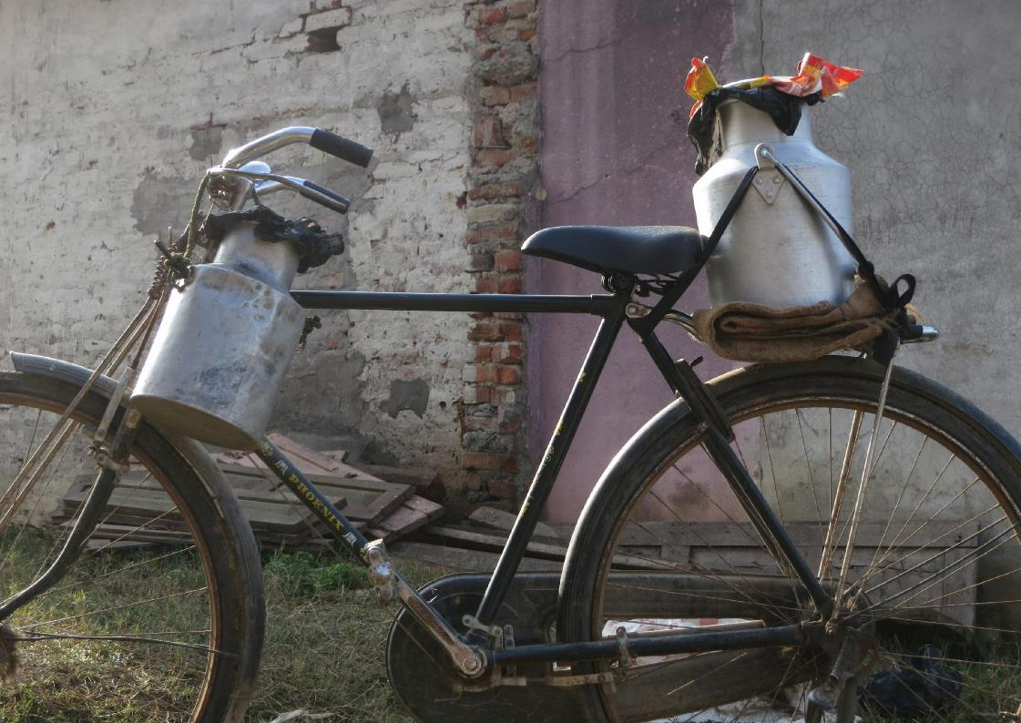
Milk Hygiene in the Supply Chain
a
2

Slide 53
Welcome
This workshop is about how to sell more, high-quality milk
Second session in a series of 5
Will share tips, recommendations, etc.
Will ask YOU to share your experiences
Everyone will have opportunity to speak, but not for every activity / discussion
Phones off please

Slide 54
Housekeeping
[Review logistics for your specific meeting – times, facilities, etc.]

Slide 55
Session 1 Recap
10m
Were you able to use anything from last session?
Did you conduct any milk tests?
How did it go?
Responses sought:
  Honest answers
Probe for use of milk testing
  Alcohol
  Clot on boiling
  Sight and smell

Slide 56
Milk Hygiene in the Supply Chain
Very important to keep milk safe / hygienic during journey from farm to shop
Contamination is serious concern
Contamination caused by bad bacteria / chemicals

Slide 57





Session Objectives
How to prevent contamination along the supply chain
The Farm
The Distributor
In Transit
In Storage
During Handling

Slide 58
Buying Milk
5m
Raise your hand if…
You buy your milk directly from a famer
You get it from a distributor/middleman
You’ve had a farmer or distributor try to sell you bad milk
You’ve bought milk and then later suspected it was of bad quality, perhaps because a customer complained
Responses sought:
  Honest answers

Slide 59
Buying Better Milk
Important to sell customers good safe milk
Negotiate with distributors if you think you are not receiving good quality
Work with distributors to make sure milk not contaminated
Good safe milk means customers happy / will buy more

Slide 60
Adulteration vs Contamination
Adulteration is adding another substance to milk to increase volume (flour, water, eggs)
Adulteration not the same as contamination
Adulteration can result in contamination if bad bacteria / germs are introduced
Adulteration robs consumer, is illegal
It is possible to test for adulteration with lactometer
Refer to image 2.1 in Participant’s Guide
Refer to image 2.1 in Presentation Book
Note: It may be extremely difficult for participants to obtain a lactometer, but important that they know it exists

Slide 61
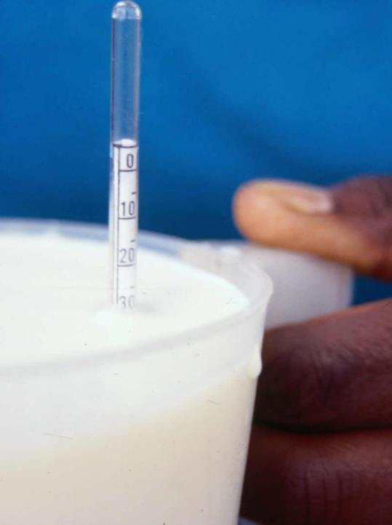
2.1 Lactometer Test
Lactometer measures milk density
Drop lactometer instrument in container of milk and read numbers on side
Depending on how high / low number is, lactometer can tell if there is adulteration
Good milk between lactometer reading of 26 and 32

Slide 62
Milk Contamination
10m
Does anyone know how milk might be contaminated by a farmer or distributor?
Responses sought:
  Contaminated feed
  Unhealthy cows
  Unclean animal / udder
  Sick / unhygienic milker
  Unsanitary milk environment
  Dirty containers / storage
  Long storage without refrigeration
Discussion cont’d on next page
Notes:
Responses sought (also displayed on next slide):
At the farm:
Unhealthy animal – e.g., mastitis
Unclean animal and udder
Sick or unhygienic milker
Unsanitary [unclean] milking environment
Dirty containers/storage
Long storage without refrigeration
Add water, flour, or other substances to the milk to increase volume (adulteration)
By a distributor/transporter/middlemen
Poor transportation practices
Milk not stored correctly, particularly in high temperatures
Use of containers that are not food grade
Poor personal hygiene
Equipment is not cleaned and sanitised
Adulteration
Poor packaging

Slide 63
Milk Contamination Cont’d
Does anyone know how milk might be contaminated during transportation?
Responses sought:
  Poor transportation practices
  Milk not stored correctly, particularly in high temperatures
  Containers that are not food grade
  Poor personal hygiene of handler
  Equipment not cleaned and sanitised
  Poor packaging
Key Point:
  -There are many places where milk can get contaminated on the supply chain

Slide 64
Farm Facilities
Ideal facility has animals in area that are completely dry and clean
Facility should have clean, dry sleeping area
Animals hooves should be clean
Look for warnings signs that standing and laying areas are wet/boggy with lots of faeces
Refer to images 2.2 and 2.3 in Participant Guide

Slide 65


2.2 Shed Cleanliness (Standing Area)
Completely dry
No faeces/mud on ground
Hoofs remain clean
Mainly dry some wet patches
Less than 1cm faeces/mud on ground
Hoofs on hard ground
Wet
1- 3 cm of faeces/mud on ground
Hoofs sink a little in ground
Boggy
More than 4 cm faeces/mud on ground
Hoofs sink deeply in ground

Slide 66
2.3 Shed Cleanliness (Lying Area)
Completely dry and clean
Mainly dry and clean, some faeces
Damp bedding with trodden in faeces
Wet and filthy bedding area

Slide 67
Communicating with Producers
Negotiate / speak up if you see poor hygiene practices / facilities
Negotiating for better hygiene good for public health / business
If you see poor hygiene practices:
  Reassure producer you want to keep buying milk
  You will source milk elsewhere if problems continue
  Provide producer hygiene checklist
  Offer to walk through checklist with producer
Always test milk
Producers more likely to be motivated to follow hygiene suggestions if:
  We communicate quality requirements
  We pay promptly

Slide 68
Milk Hygiene Flyer
5m
Let’s review sample milk hygiene flyers in your Participant’s Guide you could offer to farmers and / or distributors….
You can make copies of these and share them with your distributor.
Make sure you go through the checklist with them so they understand.
Refer to images 2.4 and 2.5 in Participant’s Guide
Refer to images 2.4 and 2.5 in Presentation Book
Review each item and picture individually

Slide 69




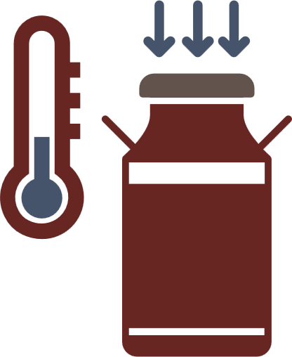


2.4 Checklist for Farmers
Clean hands before milking
Do not milk if sick
Clean, dry shelter for animals
Use appropriate / clean containers
Keep milk cool
and covered
Milk healthy cows

Slide 70

2.5 Checklist for Distributors
Clean hands before handling
Buy from trusted farmers
Clean facilities
Do not handle milk
if sick
Keep milk cool
and covered
Use clean / appropriate containers

Slide 71
Negotiation Skills
20m
Let’s practice communicating with producers…
You will need your checklists for farmers /distributors
Split into groups of 2
  One person play vendor
  One person plays distributor
Refer to Participant Guide for notes
Coach participants (see following slide for notes)
Responses sought:
  Vendor should refuse the milk
  Reassure that they want to continue buying from them
  Offer to educate the distributor with the flyer/checklist

Slide 72
Negotiation Skills
Vendor:
Last week you received complaints of illness from customers who bought your milk.
Now you are at the distribution centre to buy milk.
You decide to test the milk before buying with the clot-on-boiling method. You see flakes and clumps in the milk.
The distributor comes to collect payment. What do you say to them?
Distributor:
Vendor is not your biggest customer, but they are regular
You occasionally have vendors complain about the milk, but rarely do they test your milk
When vendors complain, you insist that your milk is very high quality
If the vendor mentions the test, ask to see results
Offer a different container of milk
Accept the flyer if offered

Slide 73
Negotiation Skills
We’re going to walk through another scenario.
If you were the vendor last time, you will be the farmer this time.
If you were the distributor last time, you will be the vendor this time.
Refer to your participant guide for notes.
Coach participants (see following slide for notes)
Responses sought:
  Vendor should buy milk
  Vendor should mention the state of stalls
  Vendor should offer flyer / checklist

Slide 74
Negotiation Skills
Vendor:
You are at the farm you buy your milk from.
Before buying, you conduct the alcohol test. The milk appears to be high quality, it does not clump or flake.
However, you can see that the cows are lying down in stalls that appear to be full of faeces.
The farmer approaches to collect payment. What do you say to them?
Farmer:
Vendor buys milks from you regularly.
You are very proud of your farm, but this month it has been hard to keep up with the chores.
You see the vendor conducting the test.
You are proud that the test revealed the milk was good.
You don’t understand why the vendor wants to talk about the stalls when the milk was good. You need a good explanation.
Accept the flyer if offered

Slide 75
Men and Women in Negotiation
10m
Do think most producers will treat men and women vendors the same if they try to negotiate?
How should a vendor respond to a challenge communicating with a producer?
Responses sought:
  Honest answers
Prompt (if necessary)
  When responding to a challenging producer, vendors should test milk, be assertive but polite, insist on high quality milk
Key Point:
  Men and women need same skills, but reality is they may be treated differently

Slide 76
Keeping Records
Update records every time you purchase milk from a distributor
Keep track of:
Name of supplier
Volume of milk supplied
Date and time milk was supplied
Price paid
Whether or not milk was pasteurised
Results of test conducted
Refer to image 2.6 in Participant Guide
Refer to image 2.6 in Presentation Book

Slide 77
2.6 Purchase Record
NAME | VOLUME | DATE | TIME BOUGHT | PRICE PER LITRE | PASTEURISED | TEST RESULT
Aasir's Farm | 5 litres | 20/6/19 | 9:30am | XX.XX | Yes | No clotting

Slide 78
Maintaining Milk Quality During Transport
Milk travels to get to your place of business
During transport, hygiene and quality must be maintained
  Keep distance as short as possible
  Keep temperature as low as possible (consider time of day and container)
  Use a sealed container with no cracks, rust, etc.
Always test milk before accepting it
Refer to image 2.7 in Participant’s Guide
Refer to image 2.7 in Presentation Book

Slide 79



2.7 Maintaining Milk Quality During Transport
Short
Distance
Low
Temperature
Sealed
Containers

Slide 80
Acceptable Transportation Containers
Examples in Participant Guide
Containers approved for milk (e.g., Mazzican container)
Containers with no seams, smooth sides, wide opening, no cracks or rust
Containers that close properly (open containers can increase chance of contamination)
Never use improper containers
If you see producers using improper containers, speak up, negotiate
Refer to images 2.8, 2.9, 2.10 in Participant’s Guide
Refer to images 2.8, 2.9, 2.10 in Presentation Book

Slide 81
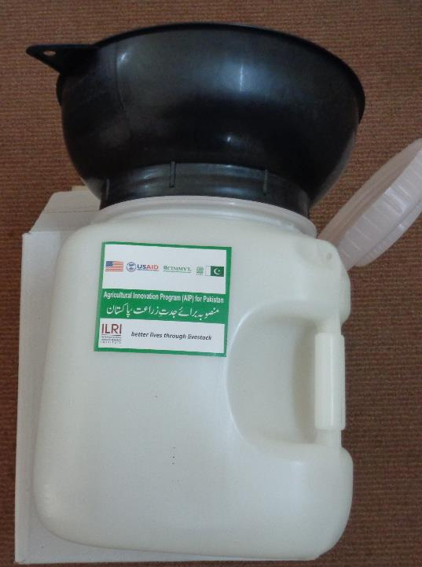
2.8 Mazzican
10 litres
Made of food grade plastic
Comes with milking funnel

Slide 82
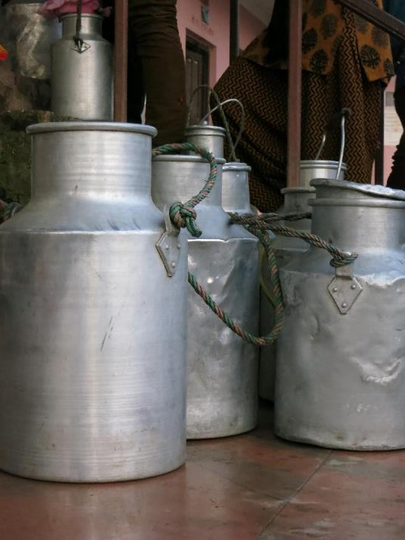
2.9 Other Acceptable Containers (Milk Cans)
Smooth sides
Aluminum or stainless steel
Must have lid that closes all the way

Slide 83
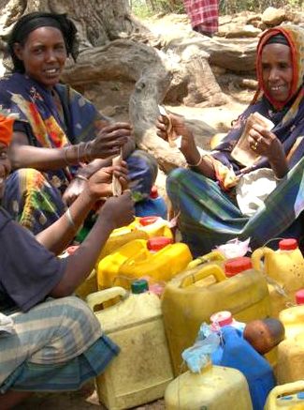
2.10 Unacceptable Container
Non food grade plastic
Container that previous stored something else, possibly chemicals

Slide 84
Milk Storage Best Practices at Your Shop
Keep facilities clean / disinfected, use clean, dry rags
Keep milk cool (refrigerator, out of sun, cool / dark spot)
Use acceptable containers
Address pest problems quickly
If milk left at end day, keep cold / ferment to mala / boil and seal / freeze
Label milk:
  Purchase date
  Pasteurised or no
Keep pasteurised milk separate from raw milk
If milk is purchased in non-hermetically sealed bags, take extra care with temp and cleanliness

Slide 85
Safe Milk Handling – Personal Hygiene
Customers more likely to buy milk from vendor who appears clean / hygienic
Hygienic vendors means safer milk, less chance of illness, less spoilage, less profit loss
  Don’t smoke
  Cover your head or pull back hair
  Wash hands
  Keep nails trimmed
Refer to image 2.11 in Participant’s Guide
Refer to image 2.11 in Presentation Book

Slide 86




2.11 Safe Milk Handling
Personal Hygiene and Health
Don’t Smoke
Head Covered
Hands Washed
Trimmed Nails

Slide 87
Personal Hygiene
10m
Let’s explore how easy it is to spread germs, just by shaking hands…
I’m going to cover my hands in [substance using] to represent germs.
Let’s go around and shake hands to see how quickly the germs spread
Materials needed:
  Flour, or similar substance
  Something to clean hands with, such as wet wipes
Facilitator covers hands in flour to represent bad bacteria.
Facilitator begins shaking hands and instructs participants to shake hands
See how long it takes for the substance to spread through the whole group.
Offer wipes to clean up

Slide 88
Hand Washing
5m
We’re going to learn the best way to wash our hands. See your Participant’s Guide for instructions, and follow along
  Roll up sleeves
  Rinse hands and forearms
  Wash with soap
  Pay attention to fingertips and under fingernails
  Rinse
  Dry hands
Refer to image 2.12 in Participant’s Guide
Refer to image 2.12 in Presentation Book
Demonstrate hand washing
Instruct participants to follow along
Key Point:
  Washing hands correctly can greatly decrease risk of contamination in milk

Slide 89
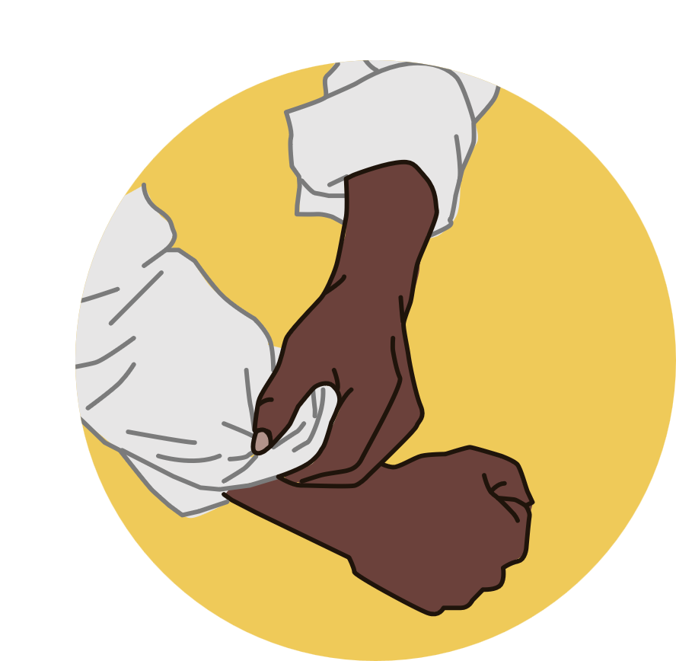






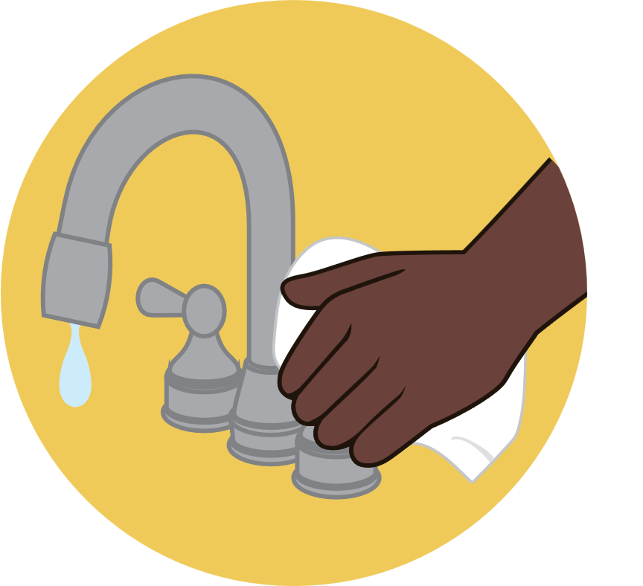
2.12 Correct Way to Wash Hands
1
2
3
4
Pull sleeves up
Rinse
Wash hands
with soap
Wash forearms with soap
5
6
7
8
Brush hands
and nails
Rinse to
remove soap
Dry with paper towel
Use a paper towel
to turn of tap

Slide 90
Debrief
15m
Do you have any questions?
Did you learn anything new today, and if so, how might you use it before the next session?
Responses sought:
  Honest answers

Slide 91
Next Session
Next session we will be learning about milk hygiene and customers.
Try to put some of the practices we learned about today into action
[Next time and location]
Remember to bring back your Participant’s Guide!
Looking forward to seeing you again!
Share details of next session (when, where) if known

Slide 92
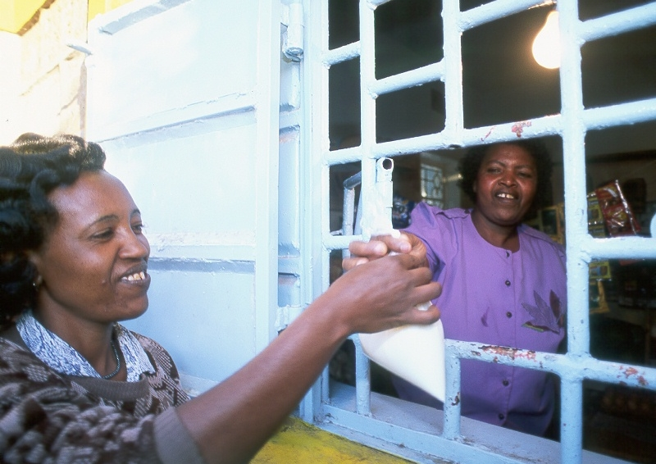
Customers and Milk Hygiene
a
3

Slide 93
Welcome
This workshop is about how to sell more, high-quality milk
Third session in a series of 5
Will share tips, recommendations, etc.
Will ask YOU to share your experiences
Everyone will have opportunity to speak, but not for every activity / discussion
Phones off please

Slide 94
Housekeeping
[Review logistics for your specific meeting – times, facilities, etc.]

Slide 95
Session 2 Recap
10m
Were you able to put anything you learned from last time into use yet?
Did you have any conversations with your milk provider(s)? Did you change how you interact with them?
Responses sought:
  Honest answers

Slide 96
Series Recap
In the previous two sessions, we discussed:
How to make sure your milk is safe and of good quality
How to negotiate with distributors and farmers for safer, better quality milk

Slide 97



Session Objectives
How to ensure your customers are handling your milk hygienically once they leave your shop
Educate Your Customers
Handle Complaints
Hygiene
Action Plan

Slide 98
Case Study: Zawadi and Jaali
We’re going to hear a case study about milk hygiene and customers. Pay attention to moments when the customer could make the milk less safe.
Read case study aloud
If levels of literacy are high, trade off reading sections by having participants follow along in their Guide

Slide 99
Case Study: Zawadi and Jaali
Case Study: Zawadi and Jaali
  Zawadi, a milk vendor, has worked very hard to improve the quality of her milk. She has begun testing milk before accepting it and negotiating with her supplier for better product. She has identified containers that need to be replaced to store milk, and has begun being very mindful about cleaning disinfecting containers and surfaces she uses. She washes her hands before and after handling milk, makes sure her shop is swept and very clean. She does not have a fridge, but she always makes sure to store her milk in a cool area, and to keep the containers tightly closed at all times.

Slide 100
Case Study Cont’d
On a hot, sunny day, a new customer, Jaali, comes to purchase milk from Zawadi, because he noticed how nice her shop was looking. Before entering, he opens his container and shakes out the few drops of remaining water from when he rinsed it out that morning with cold water. He enters the shop and Zawadi is quick to help him. She pours the milk into his container. Jaali reaches deep into his pocket to find the right coins to pay her with, and then he purchases the milk. Zawadi thanks him and tells him that she hopes he will become a repeat customer. He leaves the shop and, wanting a taste of the milk, opens the top and dips a finger in for a taste, holding the lid to the container in his other hand.

Slide 101
Case Study Cont’d
As he’s tasting the milk, a friend approaches him in the street. Jaali’s happy to see him, and the two talk for about 15 min. Jaali’s friend eventually says goodbye, Jaali puts the lid back on the container and goes to get his bike. He straps the container of milk to the back of the bike and starts to ride home. Jaali always takes a short cut to get home, which gets him there faster, but takes him over a very bumpy section of the street. Jaali gets home to find his wife putting their new baby down for a nap. He puts the milk on the table, and notices that some has dribbled out the top during the ride. He takes the top off and grabs a rag that’s on the table. He wipes the rim of the milk container with the rag, screws the top on, and goes in to check on his baby son. Jaali and his family do not own a fridge.

Slide 102
Case Study: Zawadi and Jaali
10m
Are you concerned about what happened to the milk after it left Zawadi’s shop?
Can you identify moments in the story where things went wrong?
Responses sought:
Jaali’s milk container was rinsed only with cold water. Could have had contaminated milk in it.
His milk container was wet. Bacteria love water. Milk containers should be dry.
Jaali put his finger in the milk after handling money, which can have a lot of bacteria on it.
Jaali had the lid off the milk while he was talking to his friend for 15 min.
Cont’d on next page

Slide 103
Case Study:
Jaali did not take his milk straight home. Customers should buy milk last and not carry it round while doing other errands.
The day is warm and sunny, increasing the likelihood of spoilage.
When Jaali got home, some milk had dribbled out the top, meaning the lid wasn’t screwed on very well.
Jaali grabbed the closest rag to wipe the rim of the container, there’s no indication that the rag was clean and disinfected.
Jaali does not own a fridge, meaning there’s a higher likelihood of spoilage.

Slide 104
Customers and Milk Hygiene
5m
Raise you hands if…
You think that most of your customers know how to handle milk hygienically
You know that your milk will be kept cool once it leaves your shop
Responses sought:
  Honest answers

Slide 105
Milk Hygiene and Customers
Why it’s important
Promoting good hygienic handling practices good for business
Also good for public health
Customers who believe milk is safe come back, buy more
Even if you practice good hygiene, customers may not
Regardless of fault, customers will have bad impression of your product if they get sick

Slide 106
Demonstrating Hygiene to Customers
10m
What can you do to demonstrate that your business is hygienic?
How can you show that you take milk safety seriously?
Responses sought:
  Honest answers
  Personal hygiene
  Clean looking shop
Make sure to address shop vs cart
Key Point:
  You must clearly show to customers that you practice good hygiene

Slide 107
Demonstrating Hygiene to Customers
Be cleaned, well groomed, wear clean clothes
Keep store visibly clean
  Remember, clean is not the same as disinfected, but it does help!
Display licenses, certifications
Refrigerate or store milk properly
  If you don’t have fridge, keep milk cool in shade, or put container in basin of water
Show you are committed to milk safety

Slide 108
Five Keys to Safer Milk
Displaying checklists / milk safety guidelines increases consumer confidence
Customers who believe you are committed to milk safety more likely to purchase your milk
Refer to image 3.1 in Participant’s Guide
Refer to image 3.1 in Presentation Book

Slide 109

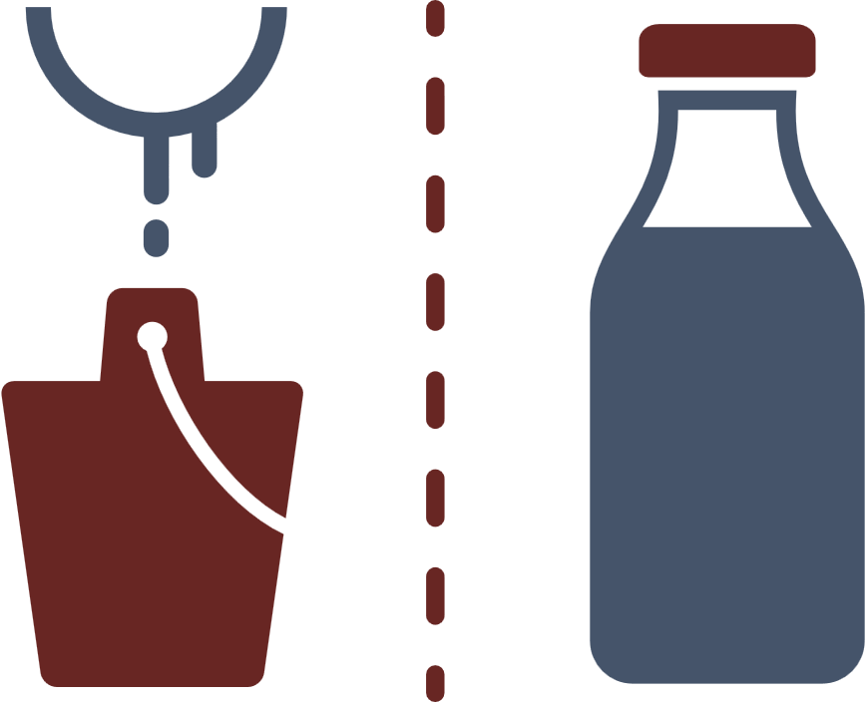



3.1 Five Keys to Safer Milk
1
2
3
Sell unadulterated milk
Separate raw and pasteurised
Maintain cool
temperature
4
5
Track purchase dates
Practice personal
hygiene

Slide 110
How to Improve Customers’ Milk Hygiene
Show customers how to clean / dry their milk containers to prevent contamination
Educate customers on milk safety / hygiene
  Use completely dry and clean containers
  Container should close completely
  Customers should consume milk same day bought
Educating customers on products leaves them with good impression, builds trust
Be respectful, particularly with mothers

Slide 111
Handling Customer Complaints
Acknowledge grievance and determine facts of situation
Assure customer they have right to buy safe milk from your shop
Assure you are committed to quality products
Communicate your milk hygiene / safety practices
If you sold bad milk, replace for free
Be friendly, but assertive if you need to be
Politely tell customers who are harassing you to leave
Easier to prevent problems through educating your customers than dealing with problem after it has happened.

Slide 112
Handling Complaints
15m
Let’s practice handling complaints
You’ll need your 5 Keys to Safer Milk
Split into groups of 2
  One person play vendor
  One person plays customer
Refer to Participant Guide for notes
Coach participants (see following slide for notes)
Responses sought:
  Acknowledge grievance
  Assure customer that s/he is committed to milk safety
  Share 5 Keys and inform customer that milk should be consumed the day it is bought

Slide 113
Handling Complaints
Vendor:
A customer comes to your store.
She appears upset.
She tells you that she bought milk from you two days ago and this morning it smelled sour.
What do you say to her?
Customer:
You mostly buy your milk from this vendor, but have used others in the past.
You’ve never been told by any vendor when you should consume your milk.
You are very busy with work and family.
You do not own a refrigerator.
You don’t like wasting money, and discovering that your milk was sour was upsetting.
Respond positively if the vendor acknowledges you grievance.

Slide 114
Handling Complaints
Switch roles for the next scenario
Refer to Participant Guide for notes
Coach participants (see following slide for notes)
Responses sought:
  Acknowledge grievance
  Assure customer that s/he is committed to milk safety
  Assure customer he has a right to buy good milk from you
  Replace the milk

Slide 115
Handling Complaints
Vendor:
It’s the end of the business day.
A customer comes in who you recognise from earlier that day.
He tells you that he took your milk home and when his wife began to heat it up, the milk clumped.
He tells you that he knows this is a sign of bad quality.
What do you tell him?
Customer:
You know that when milk is heated up, it shouldn’t clot.
You have a young child at home and do not have time to be running back to the store.
Also, your wife is very worried about giving the child unsafe milk.
Respond positively when the grievance is acknowledged.
Accept the offer to get replacement milk.

Slide 116
Handling Complaints
10m
Based on the activity we just did, what seems to work well when handling complaints?
What might not work well?
What will happen to a customer if they feel they are being disrespected by a vendor who feels like they know everything?
Responses sought:
  Honest answers
  Be respectful at all times
  Offer to share information
Key Point:
  Happy customers are our best marketing tool

Slide 117
Being a Smart Businesswoman
Recommendations for Mothers
Common for women vendors to have children at work
If children play near milk, milk may appear less clean to customers
If possible, have someone watch children while at
or
Have children stay away from milk or keep it somewhere they can’t reach
Help child keep his/her hands, face and body clean while he/she is in the shop.

Slide 118
Hygiene Action Plan
We’ve brought some snacks to celebrate being over halfway done
So far we’ve covered:
  Hygienic milk practices
  Negotiating for better milk with suppliers and farmers
  Working with customers to ensure your milk stays good
Now, we will work on creating a hygiene action plan for your business…
Adapt to whatever treat / snack is provided

Slide 119
Hygiene Action Plan
10m
Let’s discuss how we can implement what we’ve learned
Split into groups of 3-4 and discuss the following:
  What can you do this week to improve the quality of your milk?
  What can you do this month?
  What can you do over the course of the year?
We will share after
Circle around and keep participants on track.
After participants have had time to discuss, have each group share what they decided.

Slide 120
Hygiene Action Plan Debrief
10m
What ideas did your group come up with?
  What you can do this week to improve the quality of your milk
  What you can do this month
  What you can do this year
If you hear an idea that you also want to implement, raise your hand
Have class reconvene and discuss ideas they shared in breakout groups
Ask group to share what they planned for
  This week
  This month
  This year
Key Point:
  -Hygiene is an ongoing process that takes planning for short and long term

Slide 121
Debrief
15m
Any questions?
Did you learn anything new today? If so, how might you use it before the next session?
Responses sought:
  Honest answers

Slide 122
Next Session
Next session we will be learning about planning a business
Try to put some of the practices we learned about today into action
[Next time and location]
Remember to bring back your Participant’s Guide!
Looking forward to seeing you again!
Share details of when and where if known

Slide 123
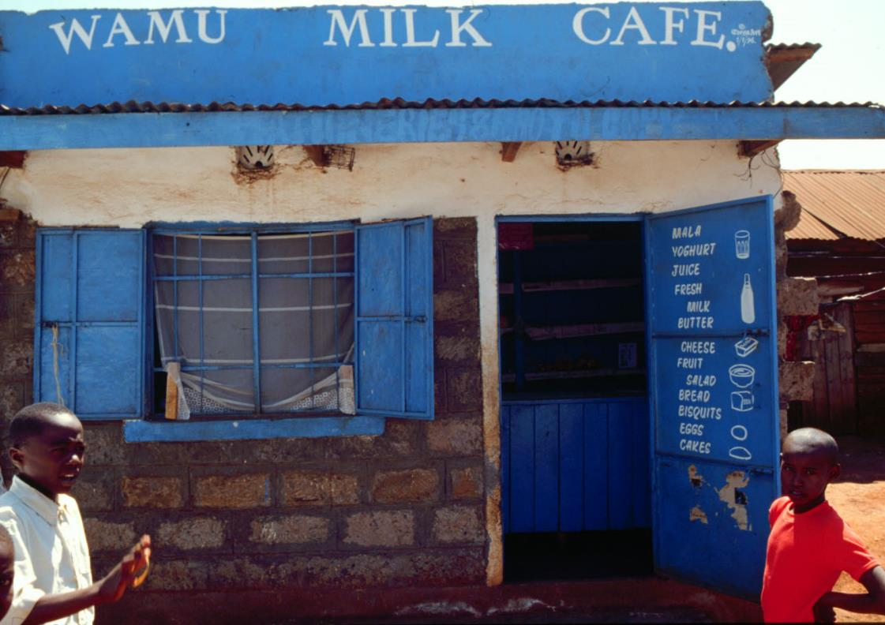
Planning a Business
a
4

Slide 124
Welcome
This workshop is about how to sell more, high-quality milk
Fourth session in a series of 5
Will share tips, recommendations, etc.
Will ask YOU to share your experiences
Everyone will have opportunity to speak, but not for every activity / discussion
Phones off please

Slide 125
Housekeeping
[Review logistics for your specific meeting – times, facilities, etc.]

Slide 126
Session 3 Recap
10m
Were you able to put anything you learned from last time into use yet?
Have you made any changes to your milk storage or handling practices?
Have you changed anything about the way you interact with your customers?
Responses sought:
  Honest answers

Slide 127
Series Recap
In the previous three sessions, we discussed:
How to make sure your milk is safe and of good quality
How to negotiate with distributors and farmers for safer, better quality milk
How to ensure your customers are handling your milk hygienically once they leave your shop

Slide 128
Session Objective
How to plan a business

Slide 129
Case Study: Absko’s Shop
We’re going to take a look at a case study of a milk vendor. Pay attention to what the vendor is doing to make his business more successful.
Read case study aloud
If levels of literacy are high, trade off reading sections by having participants follow along in their Guide

Slide 130
Case Study: Absko’s Shop
  Absko is a milk vendor. He had been selling milk in his shop for about a year, and while he was meeting his basic living needs, he wasn’t making any profit and therefore could not grow his business. Absko knew that he wanted a more successful business and he was willing to put in the work to make it a reality. He began keeping track of every sale he made and compared it to what his costs for operating the business were. He discovered that though he sold a lot of milk, he did not make much profit, because his costs were also high. He knew he had to do something.

Slide 131
Case Study Cont’d
  Absko knew he could not increase the price of his milk because customers would go somewhere else. He decided he needed to sell more and better milk to attract more customers. Then the small profit he made on each sale of milk would add up to a big amount. He began negotiating with his suppliers more and only bought the best milk he could. When customers came in, he was able to tell them that he only sold milk he had tested himself. He tested his milk in front of them to show how clean it was. He made sure his shop is very clean and inviting, he posted his licenses clearly in the business. He was welcoming when people came in the shop. He also began offering a bargain for people who bought a lot of milk at once; for every litre they bought, they would receive a free cup.

Slide 132
Case Study Cont’d
  And so Absko began to develop a reputation for having high quality milk. Soon, more people realised they would like to buy milk from Absko knowing their milk was safe than risk getting sick.
  With Absko’s good record keeping he began noticing that he was more likely to lose money during certain times of the month because he had too much left over milk. He thought about decreasing the amount of milk he bought from suppliers, but he was afraid of what would happen if he ran out of milk. He had worked hard to earn the trust of his customers. He didn’t want to disappoint them.

Slide 133
Case Study Cont’d
  Eventually Absko decided that he would keep his milk order the same but begin fermenting left over milk to make lala made with his two favourite types of lala. He had never made lala but he followed the instructions carefully and made nice lala.
  He got some egg-cups and made sure they were clean. When customers were not in too much hurry he would give them an egg-cup of free lala to taste. Soon, Absko was selling milk and different types of lala. His customers were excited that there were new things in his shop, though when Absko looked at the records, he saw that one of his lala sold much better than the other. Eventually, he decided to focus on selling the lala people liked, since it was more likely to make him money. He also gave people recipe ideas to cook with lala such as ugali-lala, and mango-lala.

Slide 134
Case Study Cont’d
  After a year of keeping records and growing his business, Absko was able to see a record of everything he had sold in a year. He also was pleased to see that there was leftover money. He thought about renting a nicer home, but then decided to invest the money in a good fridge which would extend the shelf life of his milk.
  He also used his records of sales for that year to set a goal to sell more the next year.
  Today Absko has a cooler for his milk, is selling both milk and lala and is considering hiring an employee to help his business grow. Once a month he compares his sales to his goal for the year to make sure he is on track.

Slide 135
Case Study: Absko’s Shop
10m
What were some of the things Absko did that were smart business choices?
Responses sought:
Kept records and set annual sales goal
Used leftover milk to create a new product
Advertised and promoted his new product
Invested profits back into the business
Communicated to customers the value of his product (it had been personally tested by him)
Introduced a bargain to the customer to encourage them to buy larger quantities of milk

Slide 136
Business Basics
Let’s take a look at some business basics….
Refer to image 4.1 in Participant Guide
Refer to image 4.1 in Presentation Book

Slide 137
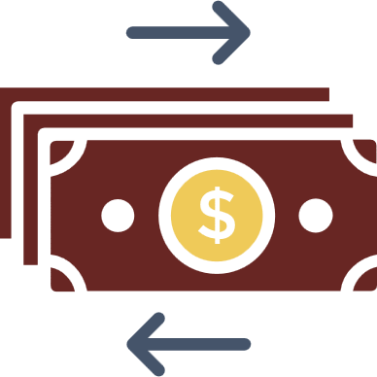






4.1 Business Basics
Manage Money
Keep Records
Have Strategy
Improve Products
Promote Business
Comply Regulations
Aim for Customer
Satisfaction

Slide 138
The Importance of a Budget
What is a budget?
A budget is the amount of money we think we will earn and spend in our business over a given period of time.
A budget can help you:
Manage costs
Grow business
Reinvest profits in the business
Plan for major purchases (e.g., a fridge, storage equipment)
Even if you don’t have one now, it’s never too soon to think about setting goals

Slide 139
Record Keeping
5m
Raise your hand if…
You keep records for your business
You write them by hand
You use a computer/app
You keep the money from your business separate from your personal money
Responses sought:
  Honest answers

Slide 140
The Importance of Record Keeping
Records protect you and everyone else in the supply chain, including customers
Keep records of every purchase / sale made
Records can be used to see available cash your business has
Records allow you to track success of one product over another
Records help you:
  Know how much you are making (cash in)
  Know how much you are spending (cash out)
  Find ways to make more and/or spend less

Slide 141
Financial Records
Cash In
Cash Out
Sales
Customer credit
  Names
  Contact info
  Amount due
Milk, other products, supplies
Employee wages
Debt
Rent
Electricity
Fees to service providers
Licenses and taxes

Slide 142
Cash Flow Statement
10m
We’re going to fill out a cash flow statement together
Don’t worry if you don’t know exact details
First, let’s look at 4.2…
Next, let’s look at 4.3, just record name and how much they owe you…
Finally, let’s look at 4.4…
  How much spent on milk / employee wages / rent / etc.
Refer to images 4.2, 4.3, 4.4 in Participant’s Guide
Refer to images 4.2, 4.3, 4.4 in Presentation Book
Can be group activity or use one volunteer
Coach participants to begin filling out 4.2 with total cash in per day
Coach participants to fill out 4.3 with NAME and AMOUNT OWED only
Coach participants to fill out 4.4 according to cash out expenses listed on Financial Records page

Slide 143
4.2 Cash In (Sales Record)
MONTH:
DATE | TOTAL SALES
20/6/19 | Sh.XX.XX
TOTAL

Slide 144
4.3 Cash In (Customer Credit)
MONTH:
NAME | CONTACT INFO | DATE PURCHASED | PAYMENT DUE DATE | DATE PAID | AMOUNT OWED
Ashura | +254 701 123456 | 20/6/19 | 27/6/19 | 27/6/19 | Sh.XX.XX
TOTAL

Slide 145
4.4 Cash Out
MONTH:
EXPENSE | DATE | AMOUNT
Milk, other products, supplies | 27/6/19 | Sh.XX.XX
TOTAL

Slide 146
Cash Flow Statement
10m
Refer to the cash flow statement you created. Are there areas where you are losing money?
Is there anything you can do increase your earnings or cut your costs?
Would you be able to afford payments on a loan?
How long would it take you to save for something like a refrigerator?
Responses sought
  Honest answers
Key Point:
  Keeping good financial records will help you grow your business

Slide 147
Loans
Loans may help business, but risk involved
You must pay back loan amount plus interest
Interest rate is percentage of loan, accumulates over time
Ask before taking on a loan:
  What is the interest rate?
  When do I have to pay back?
  Is this realistic for my business?
  How will I pay back?

Slide 148
Reasons to take out a loan
Good
Bad
Capital improvements
Expansion
To bridge temporary cashflow problems
To stay in business when you aren’t making money

Slide 149
Accessing and Managing Loans
10m
What kinds of loan / credit could you access?
What are the pros and cons of your options?
Are there particular challenges for women?
Responses sought:
  Banks (involves lots of paperwork)
  Micro finance loan
  Phone loans (high interest rates)
  Government (takes long time to receive money)
  Informal lenders (family / friends)
    Poor record keeping can lead to distrust, consider create a record
Key Point:
  Consider all options when deciding on loan

Slide 150
The Five Forces that Impact a Business
We’re going to look at the five forces that impact a business
Bargaining power of customers
Bargaining power of suppliers
Rivalry with competitors
New entrants into the market
Alternative/substitute products
Refer to image 4.5 in Participant’s Guide
Refer to image 4.5 in Presentation Book

Slide 151







4.5 The Five Forces that Impact a Business
1
Customers’ Power
2
Suppliers’ Power
3
Competitors
4
New Entrants into the Market
5
Alternative Products

Slide 152
Five Forces
5m
Raise your hand if…
Your customers can go elsewhere if they don’t like what you offer
You can find cheaper milk suppliers or negotiate better prices
You have competition in the market
You know of more people considering becoming vendors
Responses sought:
  Honest answers

Slide 153
Your Business
10m
How can you make people want to buy from you instead of your competitors?
If a larger store opened in your area, would you be in trouble? How could you compete?
Is there anything else you could offer at your business to make it more appealing to the consumer?
Responses sought:
  Honest answers
Key Point:
  Consider how the 5 forces impact your business

Slide 154
Licenses and Laws
There is one more force that impacts business: government
You must abide by laws and have appropriate licenses

Slide 155
Licenses
15m
What licenses do you have?
If you’re missing any (and that’s okay to say here), what’s stopping you from getting them?
What do you need to do to get the proper license?
Responses sought:
  Honest answers
Stress that you must comply with laws, get your license, pay your taxes
Discuss why it is important to pay taxes
Discuss what are the benefits of complying with law

Slide 156
Debrief
15m
Any questions?
What did you learn/takeaway from the other vendors in the group?
Did you learn anything new today? How can you put it into effect immediately?
Responses sought
  Honest answers

Slide 157
Next Session
Next session we will be learning about how to sell more milk to your customer.
Try to put some of the practices we learned about today into action
[Next time and location]
Remember to bring back your Participant’s Guide!
Looking forward to seeing you again!
Share details of when/where next session is if known

Slide 158
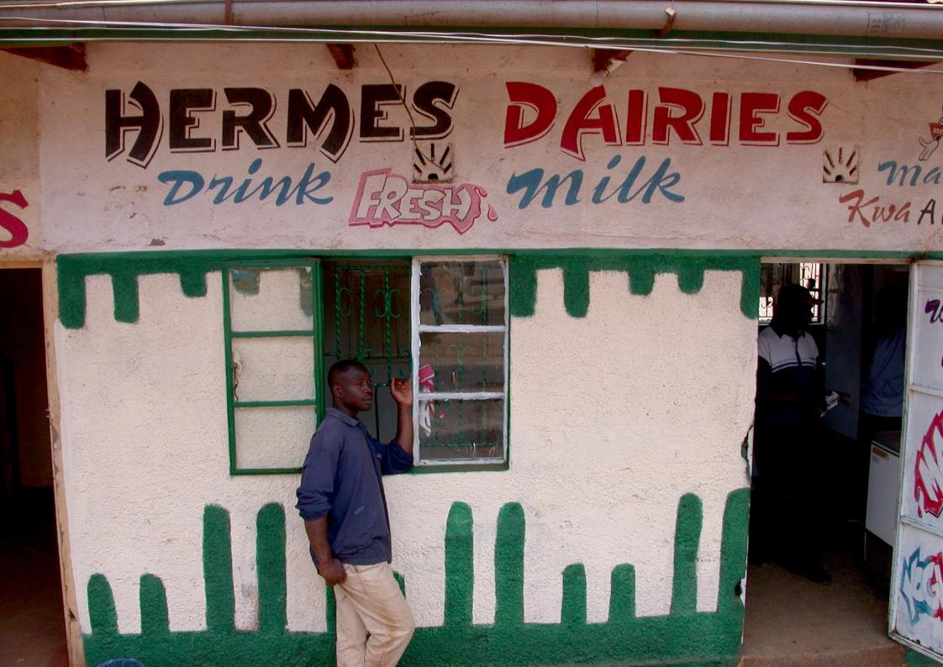
Selling More Milk to Your Customers
a
5

Slide 159
Welcome
Welcome
This workshop is about how to sell more, high-quality milk
Fifth session in a series of 5
Will share tips, recommendations, etc.
Will ask YOU to share your experiences
Everyone will have opportunity to speak, but not for every activity / discussion
Phones off please

Slide 160
Housekeeping
[Review logistics for your specific meeting – times, facilities, etc.]

Slide 161
Session 4 Recap
10m
Were you able to put anything you learned from last session into use yet?
Have you thought about how to improve your business in any way?
Responses sought:
  Honest answers

Slide 162
Series
Series Recap
In the previous four sessions, we discussed:
How to make sure your milk is safe and of good quality
How to negotiate with distributors and farmers for safer, better quality milk
How to ensure your customers are handling your milk hygienically once they leave your shop
How to plan a business

Slide 163



Session Objectives
How to Sell More Milk
Product and Price
Where to Sell
Promotion

Slide 164
Why Customers Should Buy Milk
Milk is highly nutritional
Great alternative to juice / soda, which are high in sugar and don’t have as many vitamins / minerals
Good for strong bones and teeth
Calcium, vitamin D
Helps children grow
Boosts energy, helps kids study (protein and B vitamins)
Share any communication materials you have with participants to take home to shop

Slide 165
Why Customers Should Buy Milk Cont’d
Improves skin and vision (vitamin A)
Warm milk helps relax / reduces stress
Fresh milk is less expensive than packaged milk

Slide 166
The Value of Milk
15m
Let’s practice interacting with customers and educating them on the value of milk…
Split into groups of 2
  One person play vendor
  One person plays customer
Refer to Participant Guide for notes
Coach participants (see following slide for notes)
Responses sought:
  Vendor should be extremely respectful
  Vendor should share what they do to make sure their milk is safe
  Vendor should stress that packaged milk is twice as expensive as fresh, a mother could provide a child with twice as much fresh milk

Slide 167
The Value of Milk
Vendor:
You are selling milk from a cart.
You see a woman and her young daughter eyeing the cart.
You offer to sell her some milk
She tells you that she’s heard that prepackaged milk is safer than fresh milk.
What do you say to her?
Customer:
Your daughter is small for her age and you worry that an illness she had as a baby has affected her growth.
You are very concerned with milk safety, but don’t know a lot about it.
You know that milk is good for children
You’ve heard that packaged milk is much safer than fresh milk.
Respond positively to respectful vendors.
Buy milk from the vendor if they explain how they keep milk safe.

Slide 168
The Value of Milk
Switch roles for the next scenario
Refer to Participant Guide for notes
Coach participants (see following slide for notes)
Responses sought:
  Vendor should share that milk is very good for bones, so excellent for football players
  Milk boosts energy, helps children grow, helps them study in school
  Soda has a lot of sugar with little to no nutritional value

Slide 169
The Value of Milk
Vendor:
A regular customer comes to your milk cart to buy milk.
You ask him how his family is and he tells you that his 10 year old son loves football and is very good at it.
You ask him if his son drinks milk and the father laughs and says that he prefers soda.
What do you say to him?
Customer:
You have been buying milk from this vendor for a long time.
You are proud of your son’s football abilities.
You are worried that he has some trouble studying in school.
Respond positively to respectful advice.

Slide 170
How to Get Customers to Buy Your Milk
Communicate that your milk is safe and of good quality
  Use Five Keys to Safer Milk as reference
Communicate milk safety / hygiene practices to customers
Label products with information about your milk (pasteurised or not)
Maintain hygienic and clean-looking premises
Offer additional products, such as fermented milk products

Slide 171
Making Fermented Milk Products
Helps you get more value from milk
Keeps longer
Gives customers more options from your store
Less waste
Added nutrition

Slide 172
Making Fermented Milk Products Cont’d
There are lots of products that can be made from milk
  Cultured buttermilk (sour milk)
  Yogurt
  Mala (see Participant Guide 5.1 for recipe)
  And much more
Best practices for selling milk products
  Use milk that would otherwise be wasted
  Stock a variety of products
    Attracts more customers, sets you apart from competition
  Keep detailed records of your sales so you can accurately determine how profitable each type of product is

Slide 173
TIPS FOR INCREASING MILK SALES
Pricing
10m
How do you decide on your prices?
Do you think your customers would abandon you if you charged slightly more?
Do you know what your competitors are charging? Do they have the same quality milk? Do they offer products you don’t?
Responses sought:
  Honest answers
Key Points:
  There may not be much room to change prices, but vendors should consider it, even if it’s only a small amount
  Main goal is to make profit

Slide 174
2. Offering Credit to Customers
Consider offering credit to customers
Customer might be able to buy more milk if they can pay later
Consider charging different rate for buying on credit
Refer to Participant’s Guide (4.3)
  Name
  Contact info
  Date of purchase
  Amount owed
  Payment due date
  Date paid

Slide 175
3. Location
5m
Raise your hand if…
You sell from a set place
You have a mobile business
Response sought
  Honest answers
Prompt participants who are mobile to consider if there is a better location

Slide 176
4. Amenities
Making your place of business a clean, comfortable place will attract more customers and give you a good reputation
Turn your business into a community hub - a place where people can relax, gain information, and socialise while finding good products
Consider:
  Benches
  Extended Shade
  Music
  Having daily newspapers

Slide 177





5.2 Customer Desires
Quality
Value
Cleanliness
Milk Safety
Trust

Slide 178
5. Communication Tips
Be friendly
  Talk to customers and get to know them
  Smile
Be knowledgeable, helpful and honest
Ask customers what milk products they’d like to buy that you don’t have
If you have employees who work for you, make sure they practice your standards for customer service
Happy customers are your best marketing tool.

Slide 179
6. Professionalism
5m
Raise your hand if…
You have the same business hours every day
Your customers know when they can expect to be able to buy milk from you
You think you are a good communicator with your custumers
Responses sought
  Honest answers
Point out that your business might benefit from regular hours

Slide 180
7. Promotion
Promotions can encourage customers to buy from you
Promotions can include:
  Loyalty programs (e.g., punch cards)
  Free items
  Sales
  Coupons
  Sampling of new products
Before offering promotion, determine if financially possible
Might offer a promotion 1x a month, everyday might be financial burden

Slide 181
Why Your Milk Matters
Importance of milk in national development
Four important aspects of Kenya’s national development
Food security
Affordable healthcare
Affordable housing
Expand manufacturing sector

Slide 182
Why Your Milk Matters
10m
How do milk vendors support Kenya’s national development?
Expand manufacturing sector
Affordable housing
Affordable healthcare
Food security
Responses sought:
  Honest answers
Help by keeping farmers and distributors in business, and creating a healthier community
Remind participants that selling good milk is not just good for their business, it’s good for the country
Milk vendors contribute to Kenya’s progress and growth

Slide 183
Debrief
15m
Do you have any questions about today’s session?
Any questions about the series in general?
Responses sought
  Honest answers

Slide 184
Handouts and Graphics Review
Disinfecting with Bleach
Disinfecting with Boiling Water
Lactometer Test
Shed Cleanliness (Standing Area)
Shed Cleanliness (Lying Area)
Checklist for Farmers
Checklist for Distributors
Purchase Record
Maintaining Milk Quality During Transportation
Mazzican

Slide 185
Handouts and Graphics Review Cont’d
Acceptable Containers
Unacceptable Containers
Safe Milk Handling
Correct Way to Wash Hands
Five Keys to Safer Milk
Business Basics
Cash Flow Templates
Five Forces that Impact a Business
Mala Recipe
Customer Desires

Slide 186
Series
Series Objectives
By now you should be able to:
Buy clean and good quality milk
Conduct milk tests to determine quality
Handle milk hygienically so it does not get contaminated
Identify and use food grade milk handling containers
Make sure your customers handle milk safely, so it doesn’t get contaminated after they buy it
Educate your customers about the health benefits of milk so they’ll want to buy more of it for their families
Run a more profitable business so that you make more money
Promote your business within your community

Slide 187
Housekeeping
5m
Training certificates
[Any further information that needs to be shared]
Your Participant’s Guide is yours to keep, use it!
Thank you!

Slide 188
Photo credits
Cover: ILRI/Jules Mateo
Slide 15: International Potato Center
Slide 21: ILRI/Jules Mateo
Slide 53: ILRI/Susan MacMillan
Slide 61: ILRI/Dave Elsworth
Slide 81: ILRI/Mohamed Ibrahim
Slide 82: ILRI/Susan MacMillan
Slide 83: ILRI/Ranjitha Puskur
Slide 92: ILRI/Brad Collis
Slide 123: ILRI/Dave Elsworth
Slide 158: ILRI/Dave Elsworth

