Slide 1

WE2.4: Gender Dimension and Nutritional Patterns on Healthy Food Demands in Argentina.
An Approach from Household Survey Analysis
Daniel Maceira, Ph.D.
Valeria Iñarra
Alen Jimenez
Cultivating Gender Equality Conference
12-15 October 2021
danielmaceira@cedes.org
www.danielmaceira.com.ar

Slide 2
Agenda – guiding research questions & methods
Can household surveys help in:
Identifying differential patterns between men and women in food purchasing decisions and responses to price changes?
Answering how do gender and economic differences interact at the moment of choose healthy/non-healthy food?
Finding how women participation in labor markets impact on households food demands?
Methods:
Literature Review / Household Survey descriptive statistical analysis and econometric estimations of price elasticities of demand.
Own price elasticity of demand: how responsive are purchasing patters to changes in prices, by type of foods, controlled by income and household

Slide 3
SAMPLE CHARACTERIStics
Source: National Household Expenditure Survey (ENGHo) 2012-2013 -National Institute of Statistics and Censuses (INDEC), Argentina.
66% of households declared that they had a male head, while the remaining 34% had a female head of household (HH).
First stage, total of households were segmented between:
    Female HH,
    Male HH, with at least one adult woman >18 years old,
    Male HH, without adult woman at home.
Second stage, focus on individual behavioral outcomes at male and female unipersonal households.

Slide 4
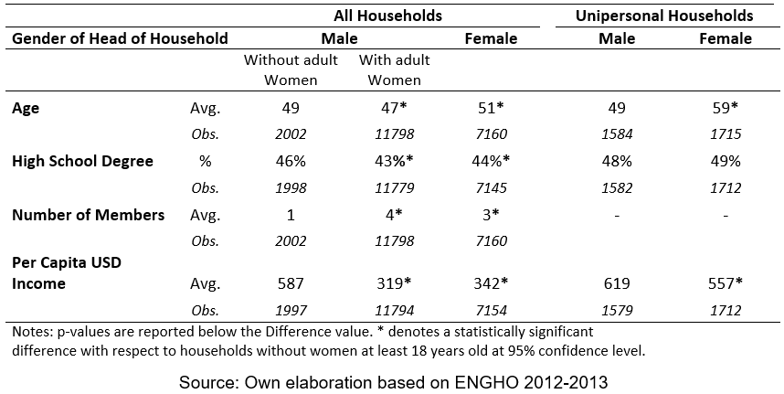
population Characteristics
Female HH are older, especially in unipersonal environments.
Minor differences in educational achievements.
Female Unipersonal HH show lower income level.

Slide 5
GENDER AND DEMAND FOR HEALTHY FOODS
DEFINITIONs OF HEALTHY AND UNHEALTHY FOODs
Consumptions were classified according to three set of criteria:
Alimentary Guidelines for the Argentine Population (GAPA, 2016):
  groups: “to promote”, “to moderate” and “to limit”.
NOVA’s classification:
  Groups: “non-processed/fresh”, “processed”, “ultra-processed”.
Kilocalories profiles:
  Groups: low, medium and high kilocalories content based on kilocalorie/100 grms.

Slide 6
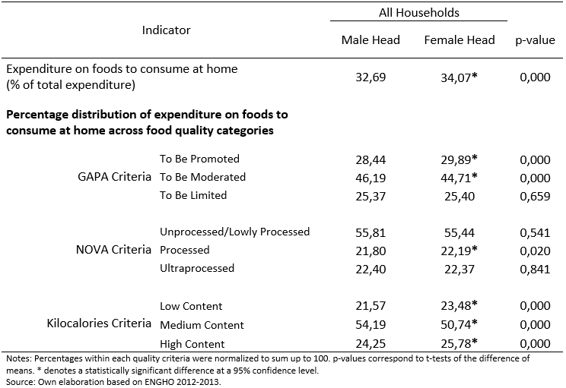
GENDER AND DEMAND FOR HEALTHY FOODS
DOES THE HH GENDER MATTER?
Differences on Food Expenditures across HHs –if any- are statistically significant but quantitatively small.
Demand patterns do not show strong differences (head of household may not imply purchasing decisions)

Slide 7
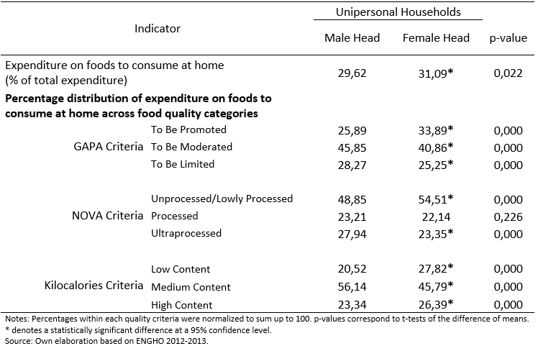
GENDER AND DEMAND FOR HEALTHY FOODS
CLOSER INSPECTION: INDIVIDUAL BEHAVIOUR OF MEN AND WOMEN
Move to cases where gender differences can be identified
Stronger differences but…
Unipersonal households are richer than multipersonal ones: Relevance of income factor?
  Do scale of household (#children) matters? (TBA)

Slide 8
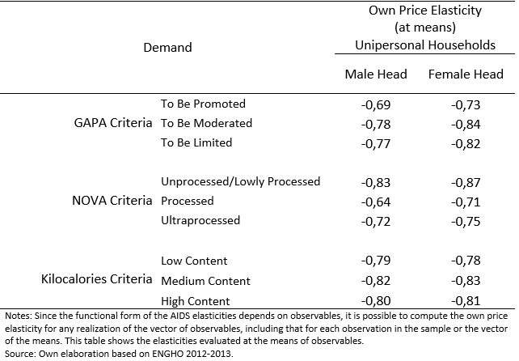
GENDER AND RESPONSE TO PRICE CHANGES
ELASTICITIES ESTIMATION FOR INDIVIDUAL HOUSEHOLDS
Almost Ideal Demand System (AIDS) is the most popular method used in the literature to estimate demand price elasticities (Deaton and Muellbauer, 1980).
Women seem more sensitive (elastic) than men when prices change, independently of food quality
Kilocalories are not strong criterion to differentiate consumption across gender characteristics
<
<

Slide 9
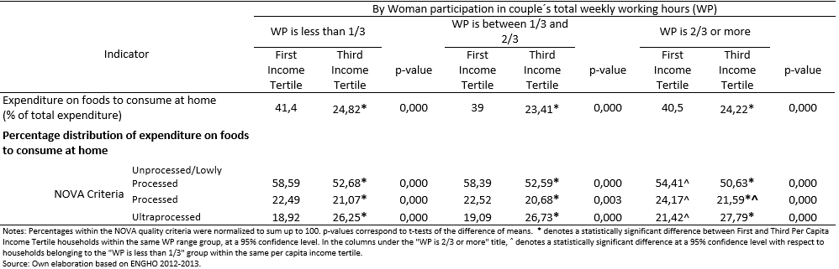
WOMEN LABOR MARKET PARTICIPATION AND DEMAND FOR HEALTHY FOODS
NUCLEAR HOUSEHOLDS WITH CHILDREN
Correlation between nuclear households with higher female labor hours and worse alimentary consumption.
Income and healthy consumption are negatively correlated. Higher differences when women labor market participation is lower.

Slide 10
Key conclusions
Household survey shows that:
Head of household gender differences do not seems relevant in explaining decisions over healthy/non-healthy food baskets.
The analysis of unipersonal households sheds light on behavioral discrepancies across genders, but should not be used to infer general conclusions over population as a whole.
Women are more reactive to prices, suggesting a more flexible (cost-effective?) purchasing approach.
The intensity of women participation in the labor markets is linked to different (poorer) levels of food quality demanded. In particular, in households in which women spend more time at work, the consumption of processed and ultra-processed foods is higher and the consumption of fresh foods is lower.
Among income tertiles, the divergences become more evident: for any level of women's labor participation, the first tertile spends a greater proportion on unprocessed or lowly processed foods, followed by processed foods, while in the third tertile participation of ultra-processed items increases significantly.

Slide 11
Policy debate and next steps
Household surveys are an imperfect instruments to analyze gender implications on healthy/non-healthy consumption.
Detailed information about food purchasing and preparation would bring light about “true” purchasing decisions regardless formal roles as head of households.
Women participation in labor markets has not been always growing together with development of: (i) reallocation of roles within households and (ii) better access to healthy products, affecting total numbers of hours worked by women (market+non-market), affecting quality of meals.
Next steps: use recently released household survey to update calculations / finalize paper for publication

