Slide 1


Development and validation of a food safety system performance tool for African countries
Silvia Alonso, Ana R.S. Oliveira, Rodolphe Mader, Maria Francesca Iulietto, Ian Dohoo, Thinh Nguyen, Hung Nguyen-Viet and Delia Grace
16th International Symposium of Veterinary Epidemiology and Economics
Halifax, Canada, 8 August 2022

Slide 2



Food safety in low- and middle-income countries
2015 WHO publication on foodborne disease health burden
  Burden similar to malaria, TB or HIV
  Most burden falling on African countries and children under 5
2019 WB publication on foodborne disease
economic burden in LMIC
2019 GFSI publication on food safety investments
in Africa

Slide 3



Food safety system performance
2014 world ranking food safety performance (Le Vallée and Charlebois)
The food safety barometer
Africa Food Safety Index

Slide 4
Methods
FSPT development
  Identification of LMIC suitable indicators (expert elicitation)
    Available as secondary data
    Representing the food systems reality in LMIC
  Data gathering
  Computation
Evaluation
  Cronbach’s alpha
  IRT model
Validation
  Comparison with AFSI and HDI

Slide 5
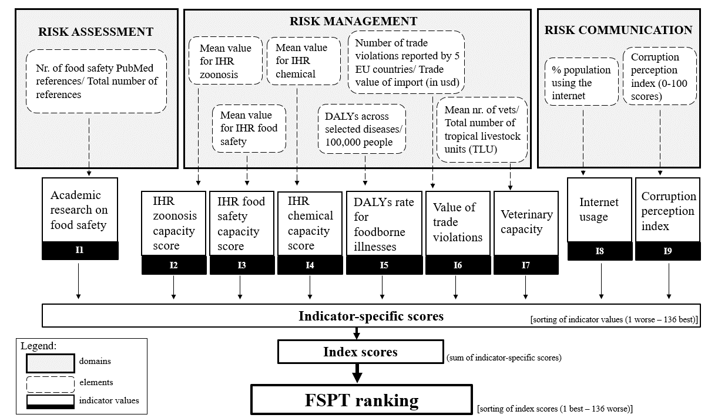
FSPT

Slide 6

Important remarks
Rank based
Final score is not an absolute value of food safety performance
No weighing of indicators
Scoring of indicators could
be done differently

Slide 7
Evaluation
Consistency (Cronbach’s alpha)
“How do indicators come together to form a reliable scale”
Reliability (factor analysis and IRT models)
“How well the scale works in measuring one single underlying latent variable (food system performance)”
  Items discrimination
    “Degree to which an item in a scale (i.e. each indicator in the FSPT tool) differentiates between countries with different performance levels”
  Items difficulty
    “Level of underlying trait required to rank better”

Slide 8
Evaluation
Cronbach’s alpha = 0.73
Factor analysis - Unidimensional scale
IRT:
A simplified scale with 4 indicators works better:
  I2: International Health Regulations zoonosis capacity.
  I3: International Health Regulations food safety capacity.
  I4: International Health Regulations chemical events capacity.
  I8: Internet usage

Slide 9
Methods
FSPT development
  Identification of LMIC suitable indicators (expert elicitation)
    Available as secondary data
    Representing the food systems reality in LMIC
  Data gathering
  Computation
Evaluation
  Cronbach’s alpha
  IRT model
Validation
  Comparison with AFSI and HDI

Slide 10

Conclusions
A good first step to a LMIC-specific FSPT!
May need to reconsider
  Scoring/computation
  Some of the indicators
Validation remains a challenge
More details on
upcoming publication…
“Assessment of food safety systems performance
in low- and middle-income countries:
A food safety performance tool”

Slide 11
Thank You!

Slide 12

THANK YOU

