Slide 1
Important!
This module is designed to potentially serve a wide variety of audiences (nutritionists and agronomists, policymakers, extension workers, farmers).
Not all of the material will be relevant to all audiences.
Please refer to the accompanying Facilitator’s Guide for guidance on how to adapt these materials to your audience and facilitation best practices.

Slide 2




Legend
Icon | Description
 | Expected Duration, minutes
 | Quick Review/Survey Questions
 | Brainstorming Session
 | Discussion Session
 | Group Activity
 | Animated Slide
 | End of Animation
Xm

Slide 3
Legal
Unless otherwise noted, all images copyrighted to International Potato Centre.
Attribution-NonCommercial-ShareAlike 2.0 Generic (CC BY-NC-SA 2.0)

Slide 4
Everything You Ever Wanted to Know About Sweetpotato
Topic 5: Sweetpotato Seed Systems

Slide 5
Introduction
Sweetpotato Seed Systems

Slide 6
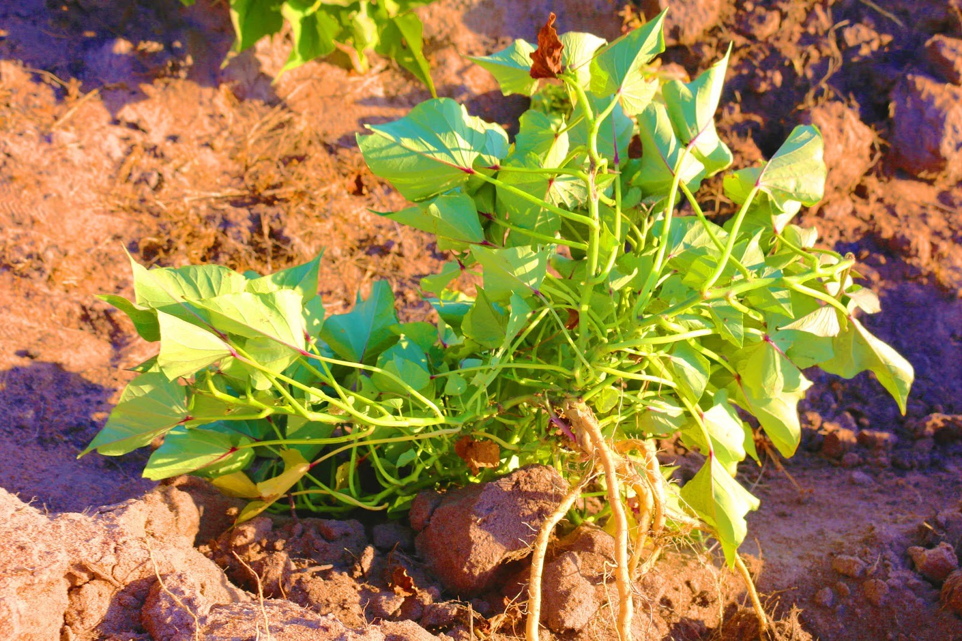
Welcome
During this session, we will examine different types of seed systems in terms of the seed production and different actors involved.

Slide 7
What Do We Mean by the Term “Seed”?
Unit 1

Slide 8
Objectives
By the end of this unit, you should be able to:
Discuss what is meant by seed in the context of vegetatively propagated crops.
Explain the methods African farmers use to obtain their sweetpotato planting materials from the vines of a growing crop or from vines from the sprouts of storage roots.
List the different classes of sweetpotato seed in your country.

Slide 9
What is a Seed?
In the context of vegetative crops such as the sweetpotato, “seed” usually means the cuttings from vines that are generally used to create new plants in sweetpotato cultivation.
Seed is also referred to as ‘planting material’.
“True seed” is produced by fertilising the flower of a sweetpotato plant, usually with pollen from another plant.
  A sweetpotato grown from true seed will be genetically different from any other sweetpotato plant.
  True seed is hard, 3-5 mm in diameter, with prolonged dormancy
Repeat harvesting, called ratooning, can create multiple vines from same mother plant.

Slide 10
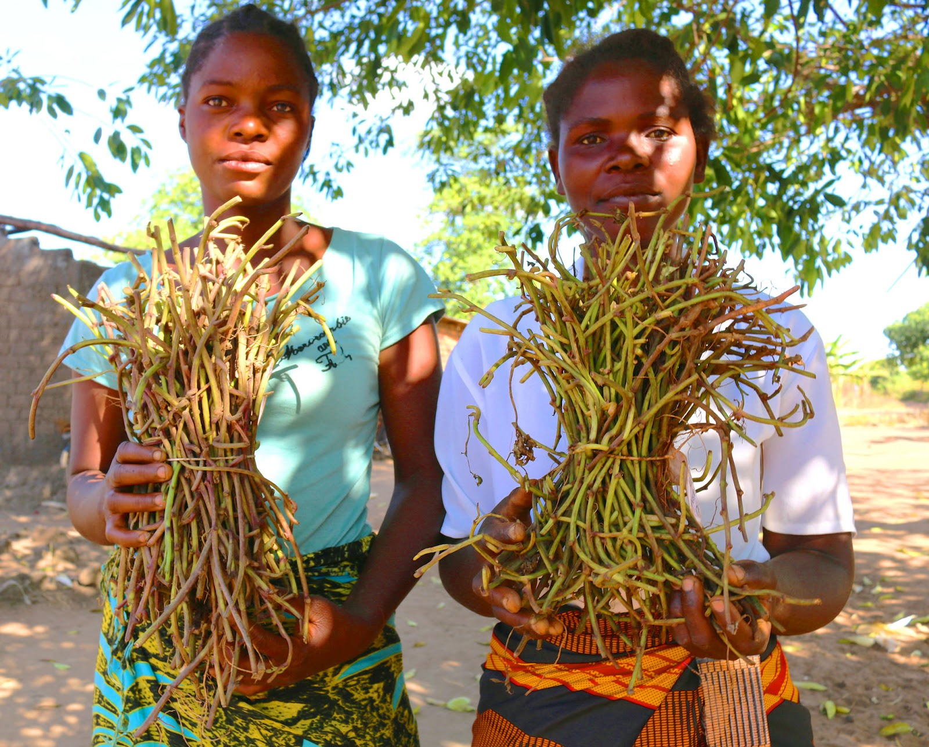
Two Methods of Obtaining Vine Cuttings
From growing plants—in field grown for crops or especially for this purpose.
Taking sprouts that grow from storage roots.

Slide 11
What is a ‘seed’?
What is a ‘true seed’?
Notes:
Answers
The cuttings from vines that are generally used to create new plants in sweetpotato cultivation.
True seed is produced by fertilising the flower of a sweetpotato plant, usually with pollen from another plant

Slide 12
Key Points
Sweetpotato seed or planting materials are cuttings from vines; they can be planted and are genetically identical to the mother plant.
Plant breeders can also produce ‘true seed’ by fertilising a sweetpotato flower with pollen from another sweetpotato plant. When planted, this ‘true seed’ will produce a genetically unique sweetpotato plant.
Vines can be harvested more than once from a plant; this repeat harvesting is called ratooning.

Slide 13
Seed Systems: Description and Diagnosis
Unit 2

Slide 14
Objectives
By the end of this unit, you should be able to:
Explain the differences between farmer-based and formal seed systems.
Discuss how agro-climatic conditions influence the seed system.
Describe and provide examples of why it is important to analyse the existing seed system from different user perspectives, before intervening in it.

Slide 15
Signs of Effective Seed Systems
Producing high quality seeds of a range of varieties.
Seeds are available in right quantities to right stakeholders at right times and places.
Seed are affordable
Seed systems work for different climate variations and are tailored to regions that have bimodal/unimodal growing cycles.
There is capacity to breed new varieties of seed.
Effective disease and pest management is in place.

Slide 16
Differences between seed systems
Farmer based:
Formal seed systems:
Farmers control their own planting material.
May be more vulnerable to disruption by drought and other shocks.
There is a need to better understand current farmer-based practices and opportunities for improvement.
More flexible and less vulnerable to shock.
Require coordination.
Could be centralised or local.
Could be commercial or cooperative.

Slide 17
Multi-Stakeholder Framework
CGIAR developed a “Multi-stakeholder framework for intervening in RTB seed systems” tool to support the systematic analysis of seed availability, access, and quality from the perspectives of different stakeholders.
The framework can be used to plan a future intervention or to analyze the recent history of one:
  When used as pre-intervention, the framework helps to study existing seed systems, identify bottlenecks and key actions for the intervention.
  When used to monitor an on-going intervention, the framework can help to plan the evolution of activities, scope, theory of change, objectives, and impacts.
The framework helps stakeholders to think about RTB seed systems in a holistic way and to account for differences and even contradictions in perspectives of multiple stakeholders.

Slide 18
Gender differences
When farmer-based planting material fails, women face more difficulty finding more planting materials than men.
Women have limited access to labour, cash, other resources.
Women are less mobile and less literate, which contributes to difficulties finding replacement planting materials.
Women’s access to planting materials is a major productivity constraint in SSA sweetpotato growing.

Slide 19
What are some of the characteristics of Effective Seed Systems?
What is the purpose of “Multi-stakeholder framework for intervening in RTB seed systems” tool?
Notes:
Answers
Producing high quality seeds of a range of varieties; Seeds are available in right quantities to right stakeholders at right times and places.; Seed are affordable; Seed systems work for different climate variations and are tailored to regions that have bimodal/unimodal growing cycles; There is capacity to breed new varieties of seed; Effective disease and pest management is in place
To support the systematic analysis of seed availability, access, and quality from the perspectives of different stakeholders; To plan a future intervention or to analyze the recent history of one

Slide 20
Key Points
Sustainable seed systems are able to provide sufficient and well-timed planting materials for all growers in the region.
Seed systems exist from the scale of individual farmers managing their own yearly planting to national companies or systems.
Bimodal climate areas enjoy two rainy seasons per year, unimodal, as along the Tropics of Cancer and Capricorn, only one. Planting materials in unimodal systems can be lost during the long dry period.
Women who lose seed find more difficulty replacing seed or planting material than men.

Slide 21
Where to Source Healthy Planting Materials?
Unit 3

Slide 22
Objective
By the end of this unit, you should be able to:
Explain the importance of starting with clean (pathogen-tested, weevil-free) planting materials from a known source.
Describe how laboratory and tissue culture techniques can produce cleaned-up virus-free plantlets, and how these plantlets are hardened off before they are planted out.
Discuss the advantages and disadvantages of different sources of planting material.

Slide 23
Virus Vulnerability of Crops
Vegetative crops are vulnerable to disease spread.
As planting materials are often exchanged directly from farmer-to-farmer, they may be infected with viruses or infested with pests and are seldom subject to any formal quality standard checks.
Starting with healthy vines is essential. Healthy vines are:
  Pathogen tested
  Weevil free
Diseases can reduce yields of root crops and waste field space and labour.

Slide 24
Lab Methods to Reduce Viruses
Tissue based culture methods (often combined with thermotherapy) are used to reduce viruses. This process is commonly referred to as ‘clean up’.
After the ‘clean up’ the plant is tested using virus indexing to determine presence of any viruses.
Once the plant has tested negative for viruses, tissue culture methods are used for micro-propagation.
When the plant is well established, and growing, cuttings can be harvested as pre-basic seed.
Tissue culture method is gaining wider use, but remains very expensive and is a challenge for small farmers.

Slide 25
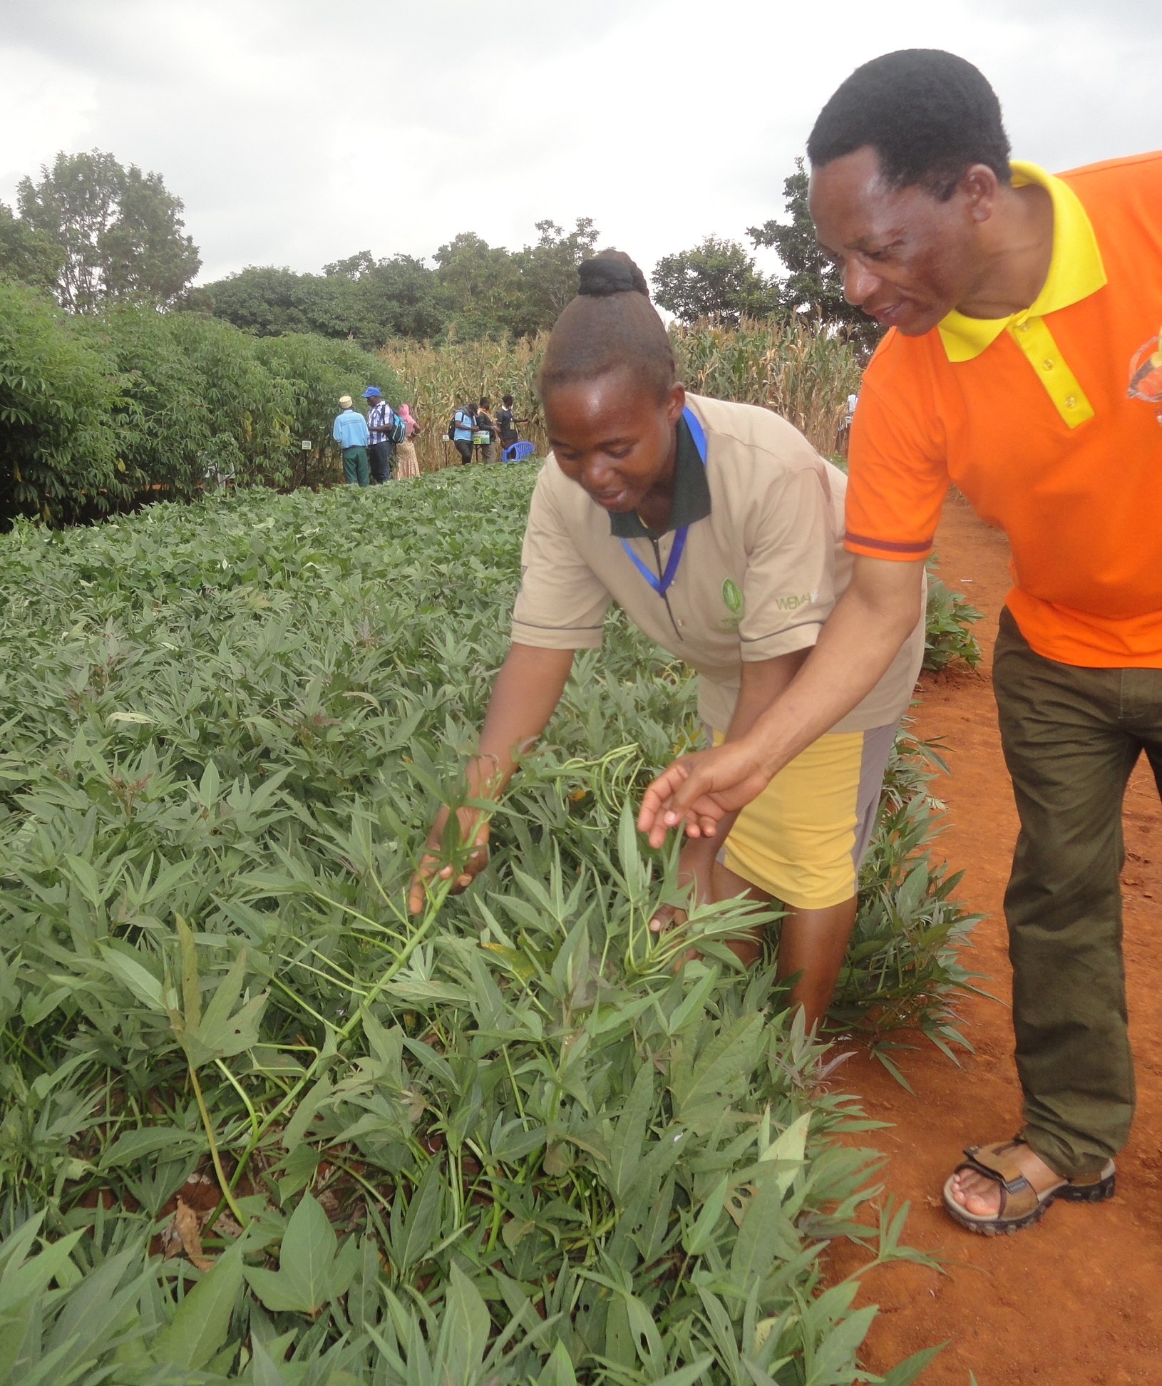
Sources of Healthy Seeds
Sweetpotato seed producers should obtain their starter material from a known source, e.g. a National Agricultural Research Institute (NARI) or a private sector seed enterprise producing pathogen tested pre-basic or basic seed.

Slide 26
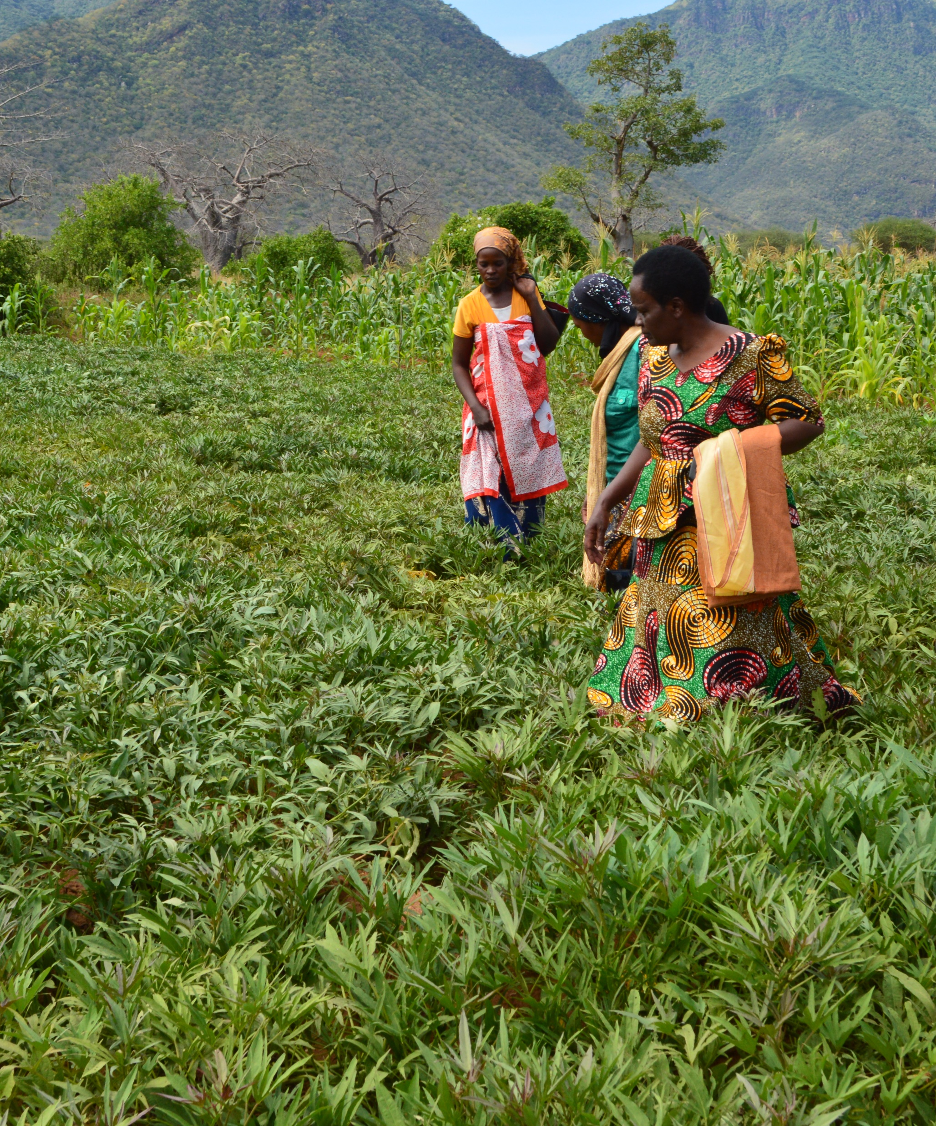
Sources of Healthy Seeds Cont.
Sweetpotato root producers should source quality planting material and new varieties from a trained multiplier or farmer group (e.g. DVMs) who obtained their starter material from a NARI or private seed enterprise. Ensures that the root producer has access to improved varieties, healthy seed and other agronomic information.

Slide 27
Why does exchanging planting materials from farmer to farmer help spread viruses?
What is tissue-based culture method?
What are the recommended sources of healthy seeds?
Notes:
Answers
Planting materials not tested
Lab process to remove viruses, ‘clean up’ of viruses
NARI, private sector seed enterprise producing pathogen tested seed, trained multiplier or framer groups who obtained their starter materials from NARI

Slide 28
Key Points
Virus infection can decrease the yield of popular sweetpotato varieties.
Tissue culture techniques can be used to remove viruses and produce ‘cleaned-up’ planting materials.
Tissue culturing is a specialised technique requiring highly trained staff and well-equipped facilities. The plantlets are thus expensive and fragile.

Slide 29
How to Identify and Multiply Your Clean Planting Materials
Unit 4

Slide 30
Objectives
By the end of this unit, you should be able to:
Describe the characteristics of healthy planting materials.
Explain why and how to use the rapid multiplication technique.
Describe how planting materials should be handled after harvest.
Explain where, when, how and why rapid multiplication technique (RMT) should be used.

Slide 31
Obtain and Select Planting Materials
Growers should use healthy planting materials to limit disease transmission:
  Cut from vigorous looking plants
  Make sure they are free of disease symptoms
Use top portion of vine: 3-4 nodes long
In bimodal areas use still-growing vines
In unimodal areas use Storage in Sand and Sprouting (Triple S) method to maintain planting materials between seasons.
Use Rapid Multiplication Technique (RMT) to quickly reproduce pathogen tested cuttings.

Slide 32
Preparing and managing an RMT nursery
How to prepare and manage an RMT nursery.
Site selection and preparation:
  Requires water source for irrigation, sandy loam soil
  Field that has not been used for sweetpotato for two seasons (to avoid virus contamination)
Equipment: Usual agricultural equipment, plus irrigation equipment.
Bed size and preparation: 1m wide by 5m long
  Adjust height to soil (depending on whether it is sand or clay) to accommodate runoff or moisture retention needs.
Fertility management
  Need nitrogen for vine production, e.g. urea, compost, manure, NPK

Slide 33
Preparation and Planting
Prepare 50 cuttings per square metre you plan to plant.
Light irrigation is needed prior to planting.
Use thorny bushes or fencing to protect planting.
Use signs to date plantings
Management post-planting
  Hand-remove weeds
  Rogue (pull) diseased-looking vines
  Make sure cuttings are well covered with soil

Slide 34
Dual-Purpose System
Some farmers strictly grow roots.
Others strictly grow planting materials for other farmers.
Third option is dual-purpose: Farmers who grow roots and grow enough planting material for sale.
  Should only harvest 1/3 of vines from each plant
  To optimize root and vine harvest, do vine harvest only once from each field, one month prior to root harvest.

Slide 35
What methods of obtaining and selecting planting materials are used in bimodal areas vs. unimodal areas?
What is an RMT Nursery?
How much harvest is it recommended to collect for farmers who grow both roots and planting material for sale?
Notes:
Answers
In bimodal areas use still-growing vines; In unimodal areas use Storage in Sand and Sprouting (Triple S) method
Rapid Multiplication Technique (RMT) Nursery is used to quickly reproduce pathogen tested cuttings
No more than 1/3 of vines from each plant

Slide 36
Key Points
Planting materials which contain pests and diseases such as, virus or weevils will produce low-yielding plants and act as a source of contamination to other healthy plants.
Only use vine cuttings that are from vigorous virus-free plants.
Use the top/apical portion of the vine for planting materials, each cutting should be at least 3-4 nodes long (~20-30 cm).
In areas with a long dry season, healthy roots can be stored in sand, and then planted out and watered prior to the rains – this system is known as Triple S.
If the market for healthy planting material is minimal, farmers can use a dual purpose system to ensure they have planting materials.

Slide 37
Key Points
RMT can be used to speed up and increase the quantity of planting materials produced.
It can be done during the dry season, if there is a reliable source of water, adequate fertilizer, and good pest and disease management.
It uses shorter cuttings (3 nodes (~10-20 cm long)) and closer spacing than normal vine multiplication practices.
Farmer multipliers have found that cuttings of at least 3-4 nodes (~20cm length) with the leaves left on, survive better than short ones and sprout faster.
A dual-purpose system should: use wider spacing than 15 cm between plants, rogue regularly; and only harvest ⅓ of the vines from each plant.

Slide 38
Harvesting and Post-Harvest Management
Unit 5

Slide 39
Objectives
By the end of this unit, you should be able to:
Explain the process of sweetpotato vine harvesting.
Compare the first and second cuttings. Explain the concept of ratooning.
Describe best post-harvest practices.

Slide 40
The Vine Harvest
Vine harvest can begin 6-8 weeks after planting.
Harvest in the morning or late afternoon to avoid shocks and wilting of vines.
Do not cut right down to ground—higher sections of vine are free of pathogens.
Ratooning: 45 days after the first harvest, a well maintained bed can be re-harvested.
Record Keeping: Record how many cuttings are obtained from one square metre at each harvest. Use this estimate to create business plans.

Slide 41
Packing and Shipping Vines
Packing vines:
  Air flow is key
  Jute sacks are preferable to grain (polypropylene) sacks
  Do not overfill sacks
Shipping vines:
  Shipping distance should be minimised
  Shipping time should be minimised
  50 cuttings should weigh roughly 1 kg
Labelling vines:
  Clearly label variety
  Include contact information, date of harvest

Slide 42
How long after planting can the first harvest begin?
What is the key factor in packing vines?
Notes:
Answers
6-8 weeks
Air flow - using jute sacks, not overfilling sacks

Slide 43
Key Points
Harvesting of sweetpotato vines can begin after 6-8 weeks into growth.
Keep a record of the cutting yield per square metre, and you can use the information to optimise your business plan.
To protect against weevils, don’t cut the plant down to the root.
Care must be taken in cutting, packing, and transporting vines.

Slide 44
How Farmers Can Preserve Planting Materials During the Dry Season
Unit 6

Slide 45
Objectives
By the end of this unit, you should be able to:
Describe two methods farmers can use to preserve sweetpotato planting materials during the dry season.
Explain step-by-step how to set up a Triple S seed system.
Describe what opportunities Triple S can bring farmers, and which aspects they need to pay attention to maintain the quality of the stored roots.

Slide 46
Two Methods for Preserving Seed
Conservation and multiplication of vine planting materials
  Select healthy planting materials after the harvest
  Plant vines in a swampy area or under shade
  Use wet but not flooded area
  Plant near homestead for security
  Monitor regularly for virus infection
Dry season preservation of sweetpotato roots in dry sand: Storage in Sand and Sprouting (Triple S System)
  Select undamaged roots
  Use container with layers of sand
  Plant out roots 6-8 weeks before rains are expected
  Harvest vines
  Plant out cuttings

Slide 47
Monitoring Triple S Roots
Short Dry Season vs Long Dry Season:
  Longer dry seasons require de-sprouting of cuttings
  Sprouts deplete nutrients stored in roots
  Over 4 month dry season: break off sprouts by hand
    If dry season is 5 months, de-sprout at 2 months
    If dry season is >5 months, de-sprout at 3 months
All Triple S roots should be monitored every month
Pre-planting/Pre-growing season:
  Prepare root bed 6-8 weeks before rains
  When rains are 1-2 weeks away, stop watering to help vines harden

Slide 48
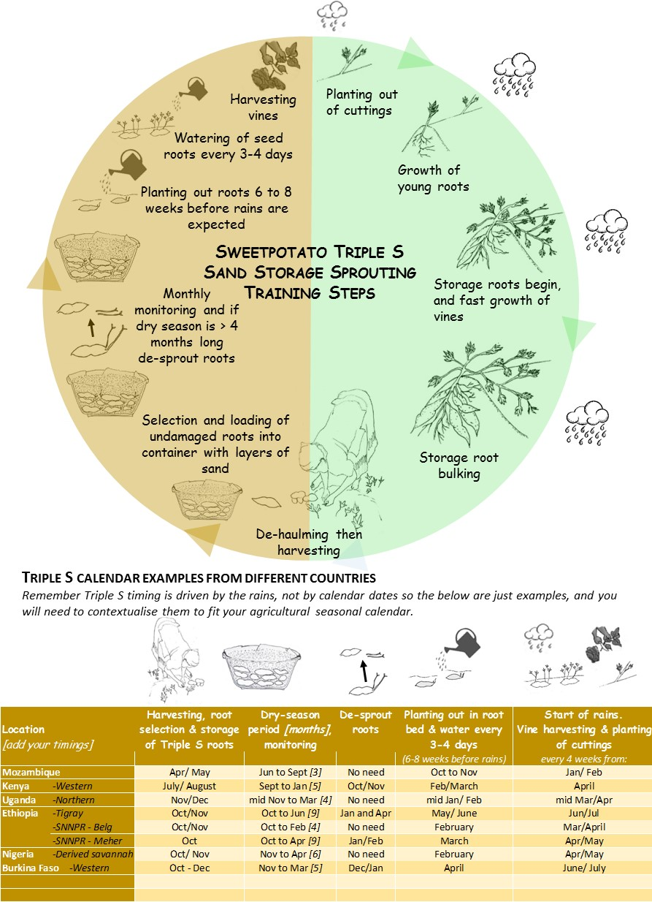

Slide 49
What are the two methods of preserving seed?
How is seed preserved in longer dry seasons?
Notes:
Answers
Conservation and multiplication of vine planting materials; Dry season preservation in dry sand (Triple S System)
By de-sprouting of cuttings

Slide 50
Key Points
At harvest, healthy planting materials can be selected and moved to a dry season plot, (e.g. a swampy area, by a water point, under a shady tree, in the backyard), so they can be looked after during the dry season.
Triple S provides smallholder farmers in areas with a long dry season with a means of preserving and producing sufficient sweetpotato planting materials in time to plant at the start of the rains.
Triple S involves placing layers of undamaged small to medium-sized roots in a basin lined with newspaper and filled with cool dry coarse sand, storing the basin in a cool dry low light place and monitoring the roots monthly.
About 6-8 weeks before the rains start.

Slide 51
Choosing Your Planting Material Multiplication and Dissemination Strategy
Unit 7

Slide 52
Objectives
By working through this section, you will be able to:
Explain the factors to consider when deciding on an appropriate multiplication and dissemination strategy.
Discuss the advantages and disadvantages of centralised and decentralised planting material multiplication and dissemination strategies.
Determine whether your project should use a single-shot or on-going planting material distribution strategy.
Identify whether a centralised or decentralised planting material multiplication and dissemination strategy would work best in your project .
Explain how vouchers can be used as part of a planting material dissemination strategy.

Slide 53
Deciding on the Multiplication and Dissemination Strategy
Achieving nutritional impact at scale requires strategy.
The main concern is how to get the most sweetpotato nutrition to the most people, but different conditions preclude one-size-fits-all solutions.
Vine multipliers can be centralised or decentralised
Vine multipliers can be local or regional/national
Challenges in recruiting VMs:
  Many criteria required of VMs exclude women and poor people.
  Farmers’ WTP (willingness to pay) for vines determines the market conditions.

Slide 54
VMs: Centralised vs Decentralised?
Centralised:
Decentralised:
Pros:
  Easier control of planting material
  Specialist management
  Large scale distribution in a relatively short time
Cons:
  Higher risks of widespread loss to disease, other disasters and disputes
  Timing may work badly for individual farmers
  High transport costs
Pros:
  Closer to recipients, reduces vine loss
  Locally tailored
  Good communication between VMs and farmers
Cons:
  High initial training costs
  VM work does not often pay as well as vegetable farming
  More investment in small scale irrigation equipment

Slide 55
Factors that Influence Strategy
Multiple factors influence your planting material multiplication and dissemination strategy, including:
  The agro-ecology and climate
  The existing seed system
  The socio-economics and demographics
  Varietal preferences and suitability
  Policies and institutions
  The project’s aims and design
  The national development context
Subsidy systems can be used to make farmers more amenable to systems of buying clean vines.

Slide 56
Dissemination Approaches
Single-Shot Dissemination Approach
Ongoing Access Dissemination Approach
One-off distribution of planting materials to the target community
Often used in response to an emergency
Also used for the dissemination of a new variety
Work well in situations where the dry season is not prolonged
Annual or repeated/ ongoing distribution of planting materials to the target community
Can range from being 100% subsidised to 100% commercial
Necessary for some years in areas with a prolonged dry season

Slide 57
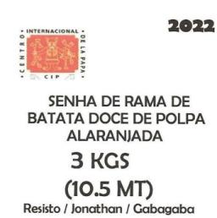
Voucher Definition
A voucher is a printed form that entitles someone to receive planting material.
A voucher can be given a monetary value or can be subsidized entirely or partially.

Slide 58
Using Vouchers for Dissemination
Vouchers are useful if you want to:
  Target certain groups, e.g. women with young children
  Provide access to vines at a location different from where the vines are growing
  Provide an incentive for farmers to try a new variety
  Encourage farmers to learn where the vine multiplier is located, so that they know where to go in the future
  Have an easy way to capture data e.g.: when vines are picked up for planting; where they are likely to be planted; how many and which type of beneficiaries used their vouchers

Slide 59
What are the advantages of decentralised Vine Multipliers?
When is single-shot dissemination approach most often used?
What are some of the reasons to use vouchers for dissemination?
Notes:
Answers
Closer to recipients, reduces vine loss; Locally tailored; Good communication between VMs and farmers
In emergencies
Target certain groups; Provide access to vines at a location different from where the vines are growing; Provide an incentive for farmers to try a new variety; Encourage farmers to learn where the vine multiplier is located, so that they know where to go in the future; Have an easy way to capture data

Slide 60
Key Points
Careful planning of material multiplication and dissemination is necessary to have a meaningful impact on sweetpotato growing communities.
Multiplication and dissemination strategies for sweetpotato must consider agro-ecological and climactic factors as well as existing seed systems and demographic/social factors. What are the constraints on a social level in your area? Is rainfall bimodal?
Varietals that are available or preferred must be taken into consideration as well.
National development strategies and key stakeholders should be consulted in any sweetpotato material multiplication and dissemination strategy.

Slide 61
Key Points
Organizations like NGOs and private sector companies should be considered in sweetpotato planning.
Centralised planting material multiplication offers more expert advice and widespread control of various factors, but decentralised planting material multiplication is less risky, as planting materials remain under local control and are less subject to large-scale losses.
Single shot dissemination processes are most often used in emergency situations.
Many factors will influence the planting material multiplication and dissemination strategy to use
Understand the existing seed system before planning any seed system interventions.

Slide 62
Constructing Your Multiplication and Dissemination Plan
Unit 8

Slide 63
Objectives
By the end of this unit, you should be able to:
Calculate how many cuttings of each variety need to be planted how many months in advance to obtain the targeted amount of planting material at the start of the rains.
Explain the importance of the multiplication rate in determining how much planting material will be produced.
Create a work plan describing which activities need to be done when, how and by who and what they cost in order to achieve a planned planting material multiplication and dissemination strategy.

Slide 64
Considerations for Planning
Plan must link to local agricultural calendar.
Make sure to talk to local farmers.
Consider the following aspects when planning:
    When and why individual farmers plant
    Typical sweetpotato managing practices
    Preferred varieties and characteristics
    Local sweetpotato value chain
    Number of households involved and how much each intends to plant
Advanced planning is required for the long time periods it can take to produce sufficient planting material.
Local soil, water, field management conditions have an impact on planning.

Slide 65
Vine Multiplication Rates
Different varietals have different multiplication rates. Some of the factors are:
  Soil type
  Irrigation schedule
  Temperature/climate
  Growing season length
Understanding different multiplication rates helps to:
  Create a calendar
  Assess how much each vine multiplier can and needs to contribute to production

Slide 66
Creating a Work Plan
Identifying target communities
Agreeing on the scale of distribution
Creating a calendar showing when and where the multiplication activities are needed
Implementing multiplication
Pre-distribution activities:
  Raising community awareness on OFSP
  Group meeting to organise who will receive planting materials and when, & setting communication strategy.
  Transport arrangements
  Community meetings
Distribution
Monitoring
Learning and future planning

Slide 67
What are the important aspects to consider when creating a multiplication and distribution plan?
What are some of the factors impacting multiplication rates?
Notes:
Answers
Linking to local agricultural calendar; talking to local farmers; understanding when and why individual farmers plant, typical sweetpotato managing practices, preferred varieties and characteristics, local sweetpotato value chain, number of households involved and how much each intends to plant; Local soil, water, field management conditions have an impact on planning
Soil type; Irrigation schedule; Temperature/climate; Growing season length

Slide 68
Key Points
Your multiplication and dissemination plan needs to link to the local agricultural calendar.
The production of large quantities of healthy planting materials can take a long time and significant advanced planning is required.
Multiplication rates of planting materials differ by variety, soil type, field and water management and it is best to field the focal varieties and then use those figures in your calculations.

Slide 69
Sweetpotato Seed Standards and Inspection Procedures
Unit 9

Slide 70
Objectives
By the end of this unit, you should be able to:
Describe the importance of QDS/ QDPM for enhancing farmer access to good quality planting materials and hence increasing their productivity.
List and describe the types of sweetpotato seed.
Explain Quality Declared Planting Material (QDPM). Describe its standards and how they can be adhered to.

Slide 71
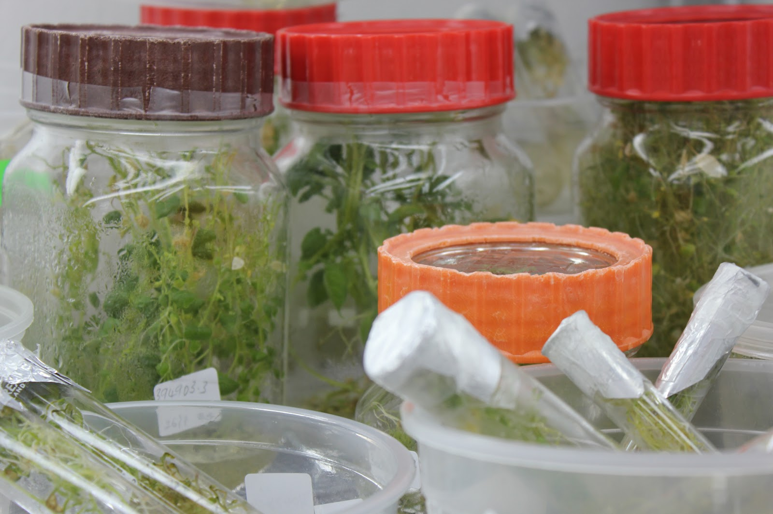
Three Types of Sweetpotato Seed
Pre-basic seed is produced by research stations and private seed companies.
Basic and certified seed is produced by medium to large scale commercial seed producers.
Quality declared seed (QDS) produced by DVM’s and farmer groups, it is a seed category not a class.

Slide 72
Quality Standards for Seed
Vegetatively propagated crops are more susceptible to diseases and pests.
The production of vegetatively propagated crops and their “seed systems” are becoming more commercialised.
Advanced technologies are now available to support the production of disease-free materials.
Seed control and plant health regulatory bodies are concerned with:
  increasing farmer awareness about the benefits of using quality planting material;
  protecting farmers from unscrupulous seed traders; and
  minimizing the spread of diseases through planting materials

Slide 73
Quality Declared Planting Material
Quality Declared Planting Material (QDPM) is also called QDS (Quality Declared Seed).
Refers to a system of quality and disease control in planting materials to monitor tolerance levels for pests and disease.
Different countries in SSA are in different stages of approval of the QDPM system for sweetpotato.
QDPM/QDS still requires inspection to ensure the agreed standards are being met.
Inspection is conducted twice, first at 4-6 weeks after planting, and then 2 weeks before harvest to check whether pests and diseases are within the tolerance level.

Slide 74
What are the three types of seed?
What is QDS?
Notes:
Answers
Pre-basic seed is produced by research stations and private seed companies; Basic and certified seed is produced by medium to large scale commercial seed producers; Quality declared seed (QDS) produced by DVM’s and farmer groups, it is a seed category not a class
Quality Declared Seed - a system of quality and disease control in planting materials to monitor tolerance levels for pests and disease

Slide 75
Key Points
We need to help farmers become more aware of the importance of using quality planting materials to increase their productivity and reduce their pest and disease problems.
QDPM/QDS still requires inspection to ensure the agreed standards are being met, this is typically done twice, first at 4-6 weeks after planting, and then 2 weeks before harvest to check whether pests and diseases are within the tolerance level.
Free planting material can help in an emergency, but used on a regular basis it distorts and weakens the market for planting material.
Different classes of seed

Slide 76
Seed Multiplication as a Business
Unit 10

Slide 77
Objectives
By the end of this unit, you should be able to:
Explain how a seed entrepreneur can benefit from using a business plan as a tool.
Explain why a business plan that includes sweetpotato seed and root farming requires SMART objectives.
Describe the attributes and uses of a strong business plan, and list the steps to developing a plan.
Estimate the costs of supporting a planting material multiplication and dissemination strategy by completing the template for calculating the costs.

Slide 78
Business Essentials
All farms are businesses. Farm owners need to understand basic business principles and planning tools.
A business plan that includes sweetpotato seed and root farming requires forward thinking and entrepreneurial drive.
The business plan is a tool which the seed entrepreneur can use to:
  Analyse whether the enterprise will be profitable in his/her specific context;
  Run the business successfully;
  Understand how profitability might be improved.

Slide 79
SMART objectives for Farms
SMART objectives are Specific, Measurable, Achievable, Realistic, and Timebound.
Setting SMART objectives also includes marketing analysis, understanding level of investment required and financial viability over time.
Setting SMART objectives and business planning:
  Helps farmers keep clear goals in mind
  Helps understand external and internal factors that help or inhibit success
  Understand customer demand
Business environment is dynamic: Goals must be clear, but methods must be flexible.

Slide 80
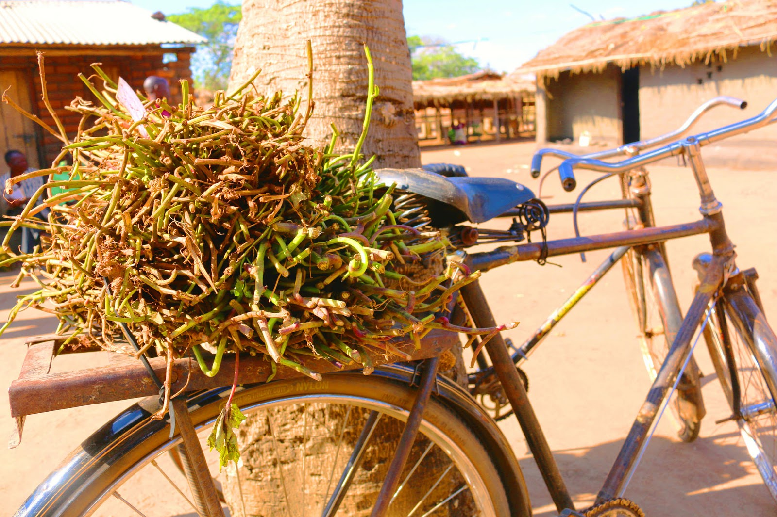
Creating a Business Plan
Seed entrepreneurs should plan production activities around vine and root production calendar for their location.
To create an effective plan, seed entrepreneurs should estimate production cost / determine selling price and perform financial analysis.

Slide 81
Record Keeping
Record keeping is key to tracking success
For budgeting and financial analysis, seed entrepreneurs need data to know profit level and plan improvements.
For budgeting effectively:
  Create budget sheets with categories for inputs, labour, marketing and outputs
  Divide budget calculation sheet into purchasing data and what each expense is used for
Budget calculation sheets and examples are available in the manual.

Slide 82
Marketing and Community Action
Depending on the business size, entrepreneurs should also track marketing channels.
OFSP initiative leaders and larger vine multiplication operations should also account for the costs of multiplication and dissemination activities, such as:
  Activities raising community awareness
  Rent of land
  Establishing multiplication plot for the planting material
  Maintenance of the multiplication sites
  Monitoring of the multiplication sites

Slide 83
What is a business plan used for?
What are SMART objectives?
Why is keeping records critical for running a business effectively?
Notes:
Answers
Analyse whether the enterprise will be profitable in his/her specific context; Run the business successfully; Understand how profitability might be improved
Specific, Measurable, Achievable, Realistic, and Timebound
For budgeting and financial analysis, seed entrepreneurs need data to know profit level and plan improvements

Slide 84
Key Points
Learning business principles and planning tools is a valuable skill for all community members.
A SMART business plan needs clear objectives that are Specific, Measurable, Achievable, Realistic, and Timebound.
Running a business means accounting for both external and internal factors.
Understanding vine multiplication and planning planting and harvesting activities in advance is necessary in any sweetpotato farming business.

Slide 85
Gender and Diversity Aspects of Sweetpotato Seed Systems
Unit 11

Slide 86
Objectives
By the end of this unit, you should be able to:
Describe some of the gender and diversity dimensions of the existing seed system.
Analyse how women and men DVM’s could be supported to produce better quality planting material and reach more clients.

Slide 87
DVMs Criteria
Vine Multipliers need to be:
  Landowners
  Literate
  Able to purchase or provide labour
  Able to attend time consuming trainings
In some areas these requirements exclude women
These criteria also often exclude the poor

Slide 88
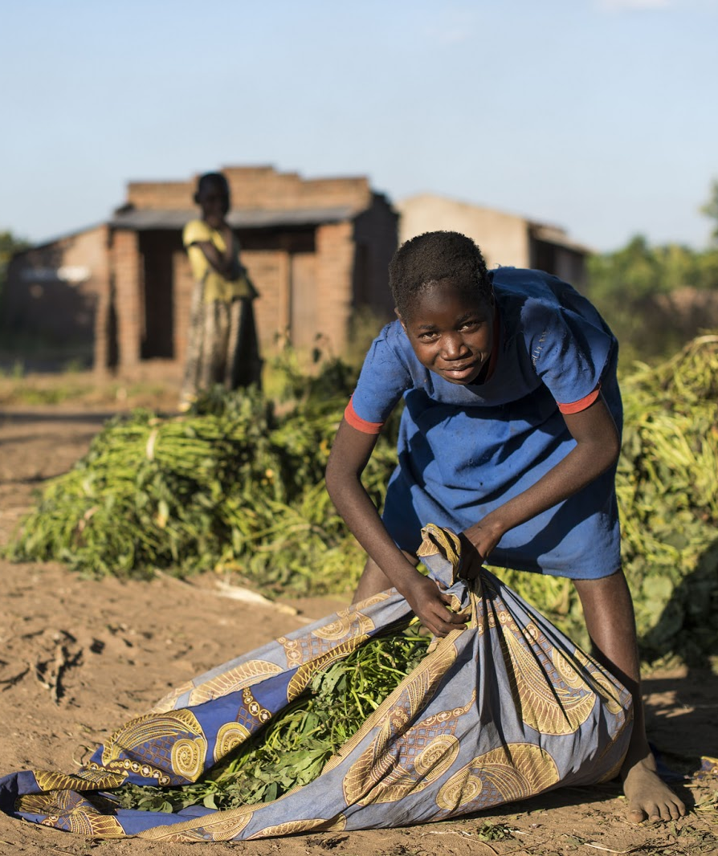
Ensuring diversity
To ensure diversity in vine multipliers, consider:
  Do men and women have different ideas of what makes a good DVM?
  Do men and women have different access to resources?
  How can women/the poor/ethnic and religious minorities gain access?

Slide 89
What are some of the criteria for vine multipliers?
How could those criteria affect women or the poor in some areas of SSA?
Notes:
Answers
Landowners; Literate; Able to purchase or provide labour; Able to attend time consuming trainings
Women are often less literate than men in some areas of SSA, poor people may not own land or be able to attend trainings

Slide 90
Key Points
Access to and control over resources such as land, water, labour, transport, training may differ between male and female farmers and can effect planting material multiplication.
A gendered seed system analysis is required to best understand how seed systems can be supported to best meet their clients demands and the project’s aims.

Slide 91
Scaling Sweetpotato Seed Systems
Unit 12

Slide 92
Objectives
By the end of this unit, you should be able to:
Discuss key components of the innovation package that should be in place to scale sweetpotato seed systems.
Explain the best times in a project to discuss scaling.
Define a theory of scaling and list the steps involved in creating one.

Slide 93
Scaling Seed Systems
Scaling involves thinking strategically about the capacities, resources and types of partners required.
To ensure scaling is successful, remember:
  There is no one-size-fits-all approach
  Seed systems have multiple components, each must be dealt with and accounted for
  Monitoring and learning helps assess when it is necessary to adapt the scaling strategy
  Set realistic expectations for the scaling efforts
Information gathering is critical for effective scaling:
  Talk to target groups
  Assess changes in context and conditions
  Identify bottlenecks

Slide 94
Theory of Scaling
Theory of Scaling is the framework for how scaling can be achieved.
The steps involved to prepare a theory of scaling include:
  Analyze components that make seed system function
  Assess scaling readiness: Do the components work? Can the components be used in a wider context?
  What components are high in readiness and use?
  Partnership and Intervention Strategy: Who are scaling partners?
  Monitoring, Evaluation, and Learning (MEL): How do we recognise movement toward desired state?

Slide 95
What is the Theory of Scaling?
What are the steps of preparing Theory of Scaling?
Notes:
Answers
Theory of Scaling is the framework for how scaling can be achieved.
Analyse components that make seed system function; Assess scaling readiness; What components are high in readiness and use? Partnership and Intervention Strategy; Monitoring, Evaluation, and Learning (MEL).

Slide 96
Key Points
There is no one-size-fits-all approach to scaling.
A seed system is not a single piece of technology, but a system into which many components feed and contribute.
Theory of Scaling is the framework for how scaling can be achieved.

Slide 97
Vines for Planting: Clean and Multiplied
This activity is designed to be carried out in the field.
Follow the instructions from your facilitator.

Slide 98
The Triple S System: Storing in Sand and Sprouting
Follow the instructions from your facilitator.

Slide 99
Planning Your Multiplication and Dissemination Strategy
In your groups, discuss and plan your strategies for the scenarios provided by your facilitator.
You have 3 hours.

Slide 100
Working with DVMs
Follow the instructions from your facilitator.

