Slide 1
Africa Dairy Genetic Gain Project-Uganda
E-Learning tools on best practices for dairy production
Jennifer Gitau (ILRI)
Livestock Genetics , ILRI biosciences
Training Performance Recording agents on data capture tools
22nd July 2022
Tick Hotel, Uganda

Slide 2
Background
The e-tools are mobile based training tools that run on a Progressive Web App (PWA).
The tools are aimed at helping users in the dairy value chain on best practices for sustainable and profitable dairy enterprise.
The content of the E-learning tools was developed by scientists from ILRI in collaboration with farm ink developers .
Training content is turned into fun, interactive lessons and quizzes using Farm Ink's Course Builder tool.
The tools are available in multiple languages i.e., English ,Swahili and Amharic.

Slide 3
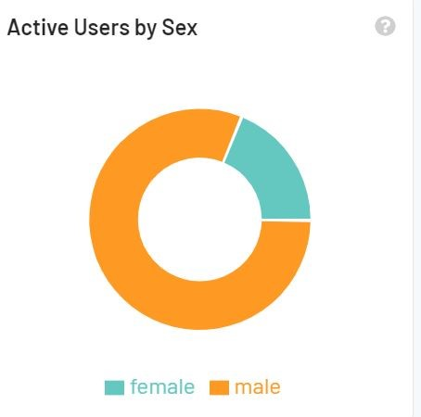
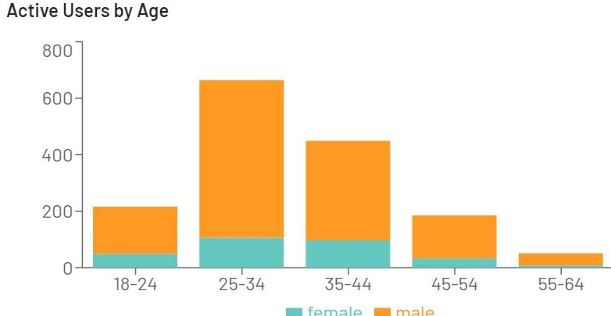
Measuring Impact and Usage
The adoption and use of the modules is monitored in real time and statistics generated.
The information generated includes number of users, demographics and basic location.
Users take baseline and endline quizzes to measure percentage improvement in learning.

Slide 4
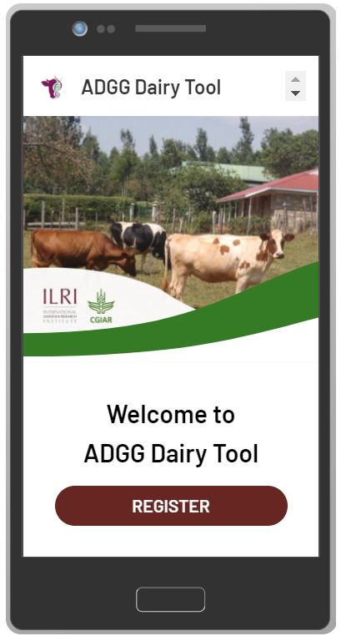
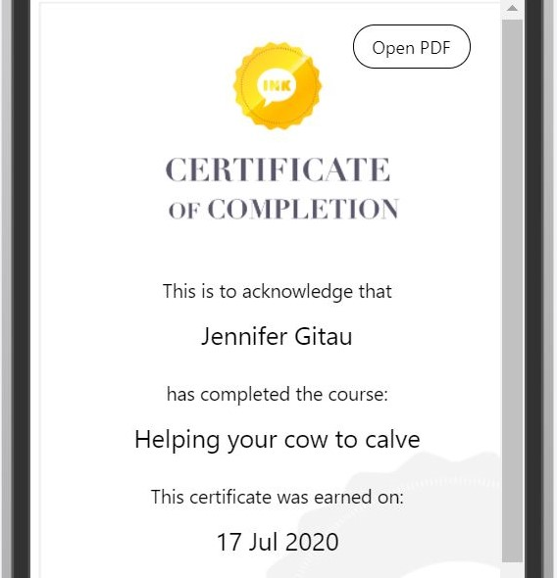
Getting started
On your browser , type the URL https://m.learn.ink/ilri
Click Register and provide necessary information.
A list of courses will be displayed.
Select course and begin the learning process!
On completion, a certificate is issued to learners.

Slide 5
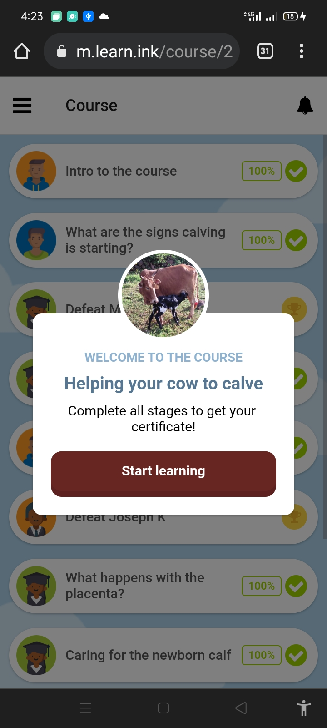
Helping a cow to calve
The course highlights on managing the calving process.
Clinical signs of calving
Assisting the cow during calving
What to do in case of a retained placenta
https://m.learn.ink/course/219ccf98-a46c-4d6a-8dcc-a15685a65643

Slide 6
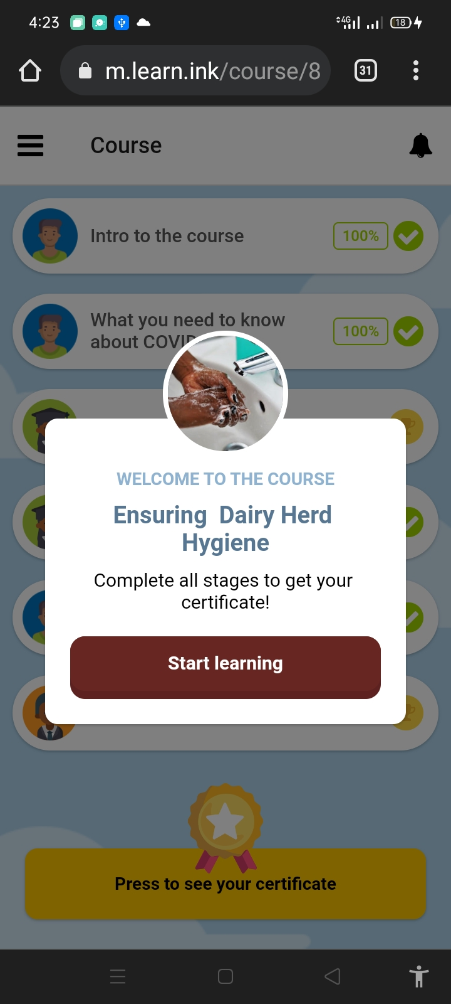
Ensuring Dairy herd hygiene
Course content
Tips of improving milk hygiene
How to look after the milking shed
What you need to know about covid -19.
https://m.learn.ink/course/8773682a-2c0c-4571-a429-ea9bdc56ca11

Slide 7

Raising healthy calves- Feeding & Housing.
Principles of calf management.
Proper feeding and well managed housing for calves improves health and reduce risk of sickness and death.
https://m.learn.ink/course/9d6f16b6-3caa-4f4a-ad0b-3a790ac46db0

Slide 8

Raising Healthy Calves 2- Routine Practices.
Course content
Calf health and common calf ailments.
Routine management practices vaccination, dehorning, identification, castration etc.
https://m.learn.ink/course/68dbeca2-660a-484f-a6d8-ff93d59e8198

Slide 9
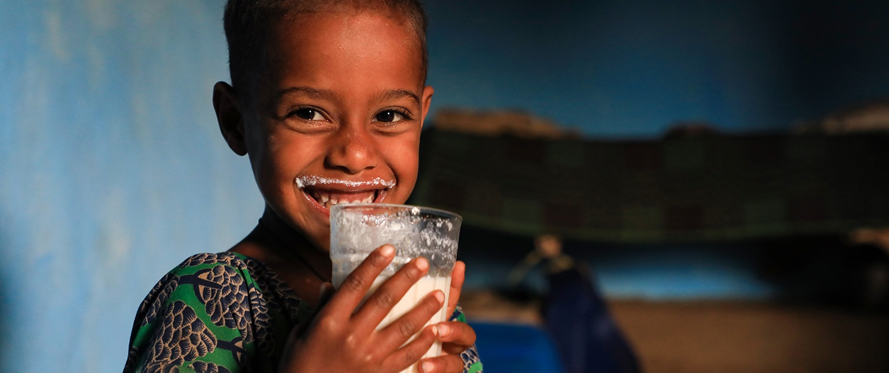
THANK YOU

