Slide 1
Overview of the 2023 Breakthrough Agenda findings: Areas to drive food systems transformations
25th July, UNFSS
Session: Science and innovation for people, planet and nature
Dr. Aditi Mukherji
Director, CGIAR Climate Change Impact Platform

Slide 2

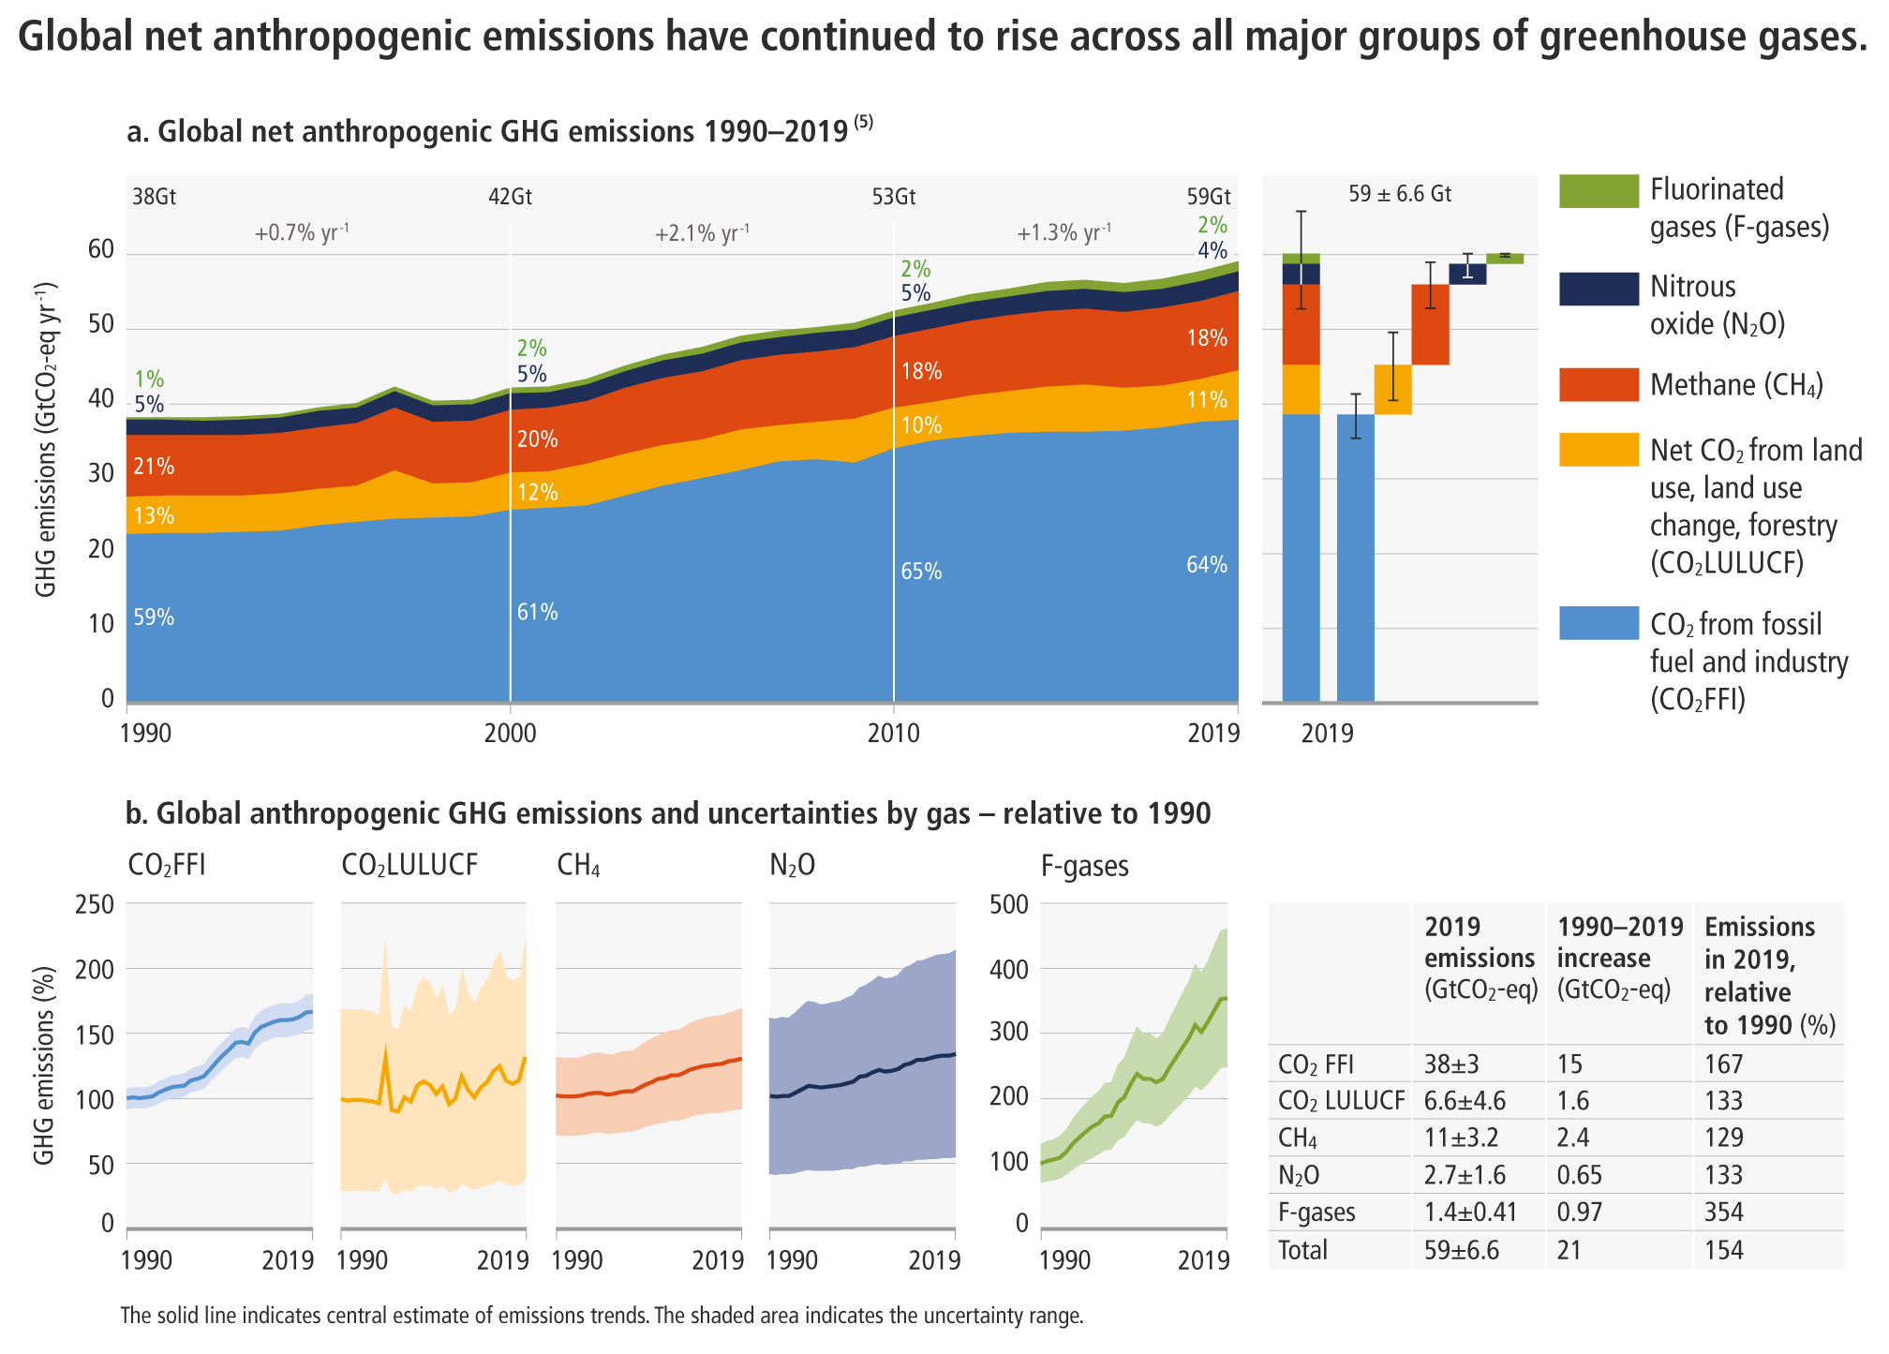
Emissions are at their highest level in human history
Agri-food sector
~30% of global
GHG emissions
[IPCC WGIII Figure SPM.1; Chapter 2, Figure 2.4; Chapter 12.4]
Notes:
In the next 20 minutes we will set out our key findings, showing where we are in terms of greenhouse gas emissions, where we are headed, and what action we can take to limit global warming.
[CLICK]
The reality is that greenhouse gas emissions, which are causing global warming, are at their highest levels in human history.
[NEXT SLIDE]

Slide 3
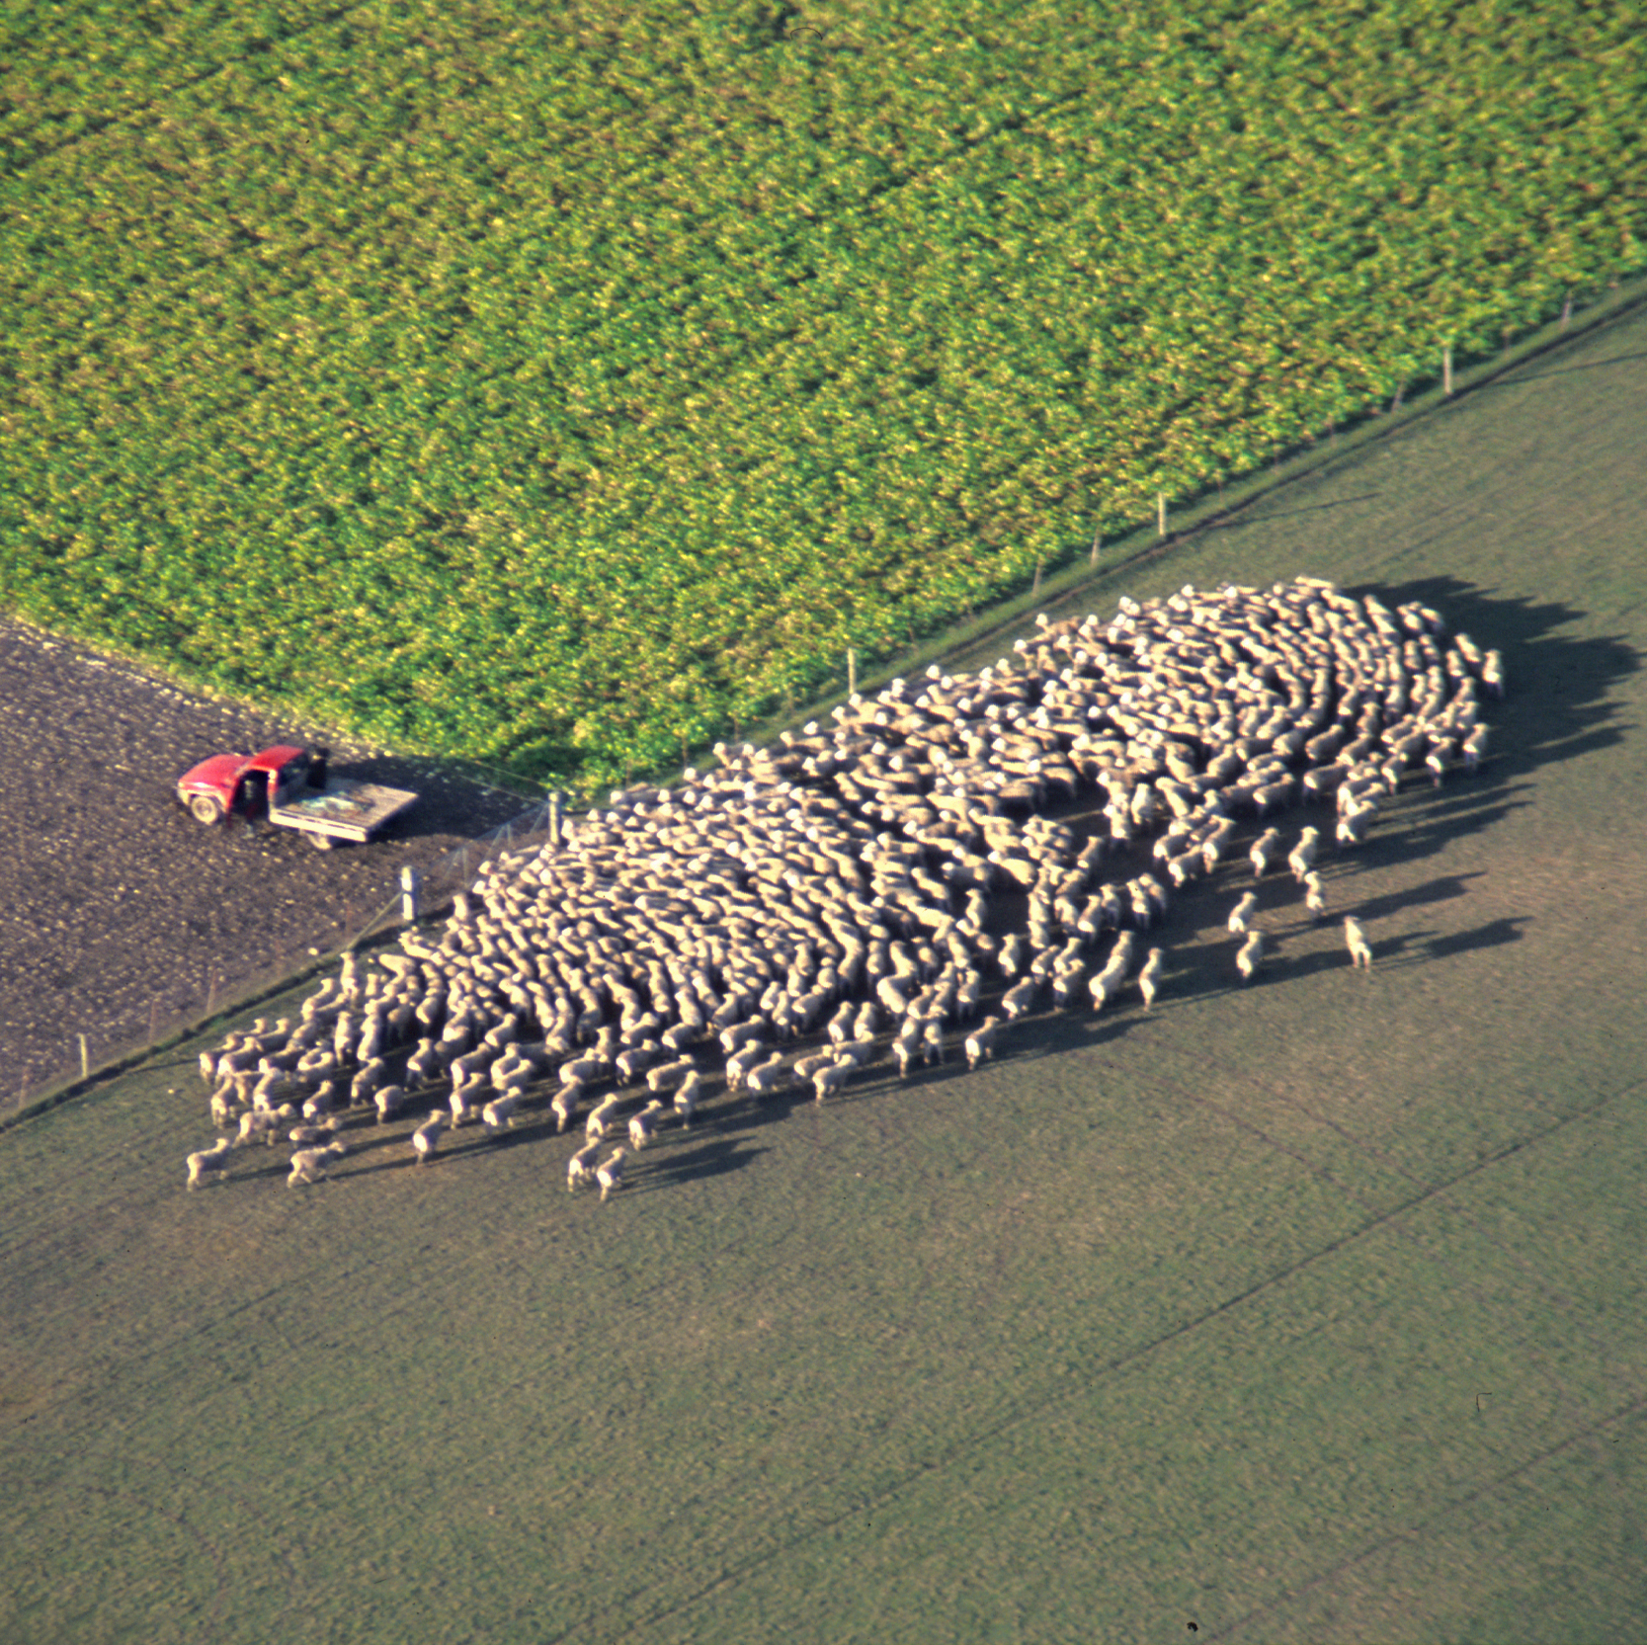

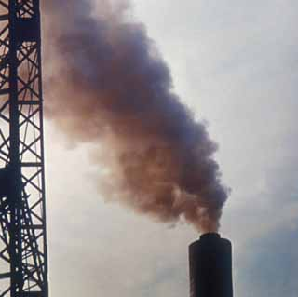
Agri-food system emission sources
Production, processing, distribution, consumption of food and management of food system residues; estimated 23-42% of all global GHG emissions
  Agriculture
Direct emissions from livestock and crop production systems; 6.3 Gt CO₂-eq
  Land-use change
Land use, land-use change and forestry, including peatland drainage; 4.0 Gt CO₂-eq
  Energy, industry, waste
Processing, transport, storage, preparation, food waste;
6.5 Gt CO₂-eq
The share of energy, industrial process and waste emissions occurring as part of the food system has grown from ~28% in 1990 to ~38% in 2018
WGIII Chapter 12.4

Slide 4
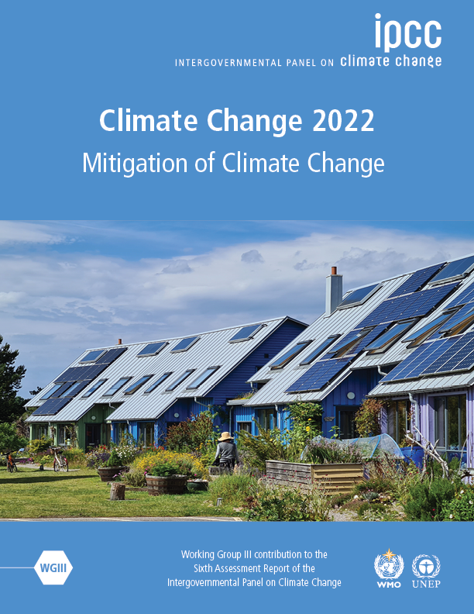
Unless there are immediate and deep emissions reductions across all sectors (including agri-food systems), 1.5°C is beyond reach.
[Matt Bridgestock, Director and Architect at John Gilbert Architects]
Notes:
In the next 20 minutes we will set out our key findings, showing where we are in terms of greenhouse gas emissions, where we are headed, and what action we can take to limit global warming.
[CLICK]
The reality is that greenhouse gas emissions, which are causing global warming, are at their highest levels in human history.
[NEXT SLIDE]

Slide 5
However, stringent mitigation to keep within 1.5-2°C will lead to severe food insecurity in Sub Saharan Africa and South Asia
Robust finding is that by 2050, stringent climate mitigation
policy, if implemented evenly across all sectors and regions,
would have a greater negative impact on global hunger and
food consumption than the direct impacts of climate change
Hasewaga et al. Nature Climate Change, 2018
https://www.nature.com/articles/s41558-018-0230-x#citeas
Land based mitigation actions like energy crop expansion,
non-CO2 emissions reduction in agricultural sector and
afforestation lead to lowered availability of calories,
increase in population at risk of hunger,
higher agricultural commodity prices
Fujimori et al. 2023, Nature Food
https://www.nature.com/articles/s43016-022-00464-4#citeas

Slide 6
We have a catch-22 situation here
Mitigate we must to keep global warming levels within Paris agreed goals of 1.5 to 2ºC to keep the climate impacts at its minimum
But mitigation at needed scale may lead to hunger and food insecurity for people in the Global South unless it is done carefully and by understanding the trade-offs and synergies well
All of us need to play an important role in ensuring:
“That technological and policy breakthroughs lead to just transitions in agri-food sector”

Slide 7
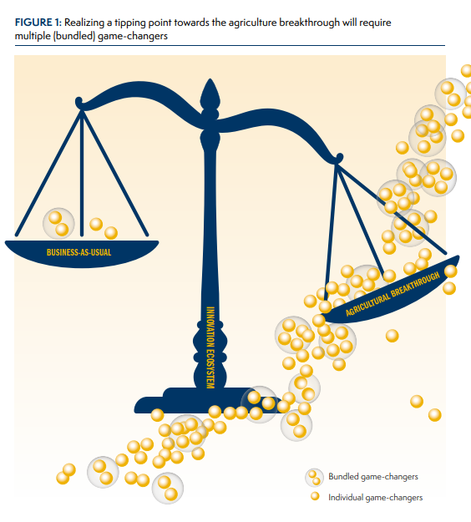
What constitutes a breakthrough?
There are four dimensions of ‘climate-resilient, sustainable agriculture’ established by first (2022) report:
Sustainably increase ag productivity and incomes;
Reduce GHG emissions;
Safeguard soil, water and natural ecosystems
Adapt and build resilience to climate change
“The diversity of the agricultural sector demands multiple “game-changing” innovations to escape a business-as-usual path… Synergistic interactions… in hundreds of national and local agricultural systems will cumulatively transform global agriculture.”
Merrey DJ, Loboguerrero AM, Zeppenfeldt L. 2023. An Enabling Innovation Ecosystem to Accelerate Agriculture Breakthroughs. Utrecht, the Netherlands: Clim-Eat. https://cgspace.cgiar.org/handle/10568/130059

Slide 8
Breakthrough Agenda Report 2023
Seven ‘breakthrough technologies’ (identified in the 2022 report)
Reduced emissions from fertilisers
Alternative proteins
Reduced food loss and waste
Crop and livestock breeding
Reduced methane emissions from livestock
Agro-ecological approaches
Digital services
Agricultural Chapter: 8 pages summarizing recommendations for international actions
Technical annex: 60 pages with details of interventions in these “technological areas”
Five (5) recommendation themes:
Increasing levels of international climate finance in high potential transformative technology areas
Develop evidence and shared learning on public policies and successful innovation programs that support a transition to clean technologies and sustainable solutions.
International collaboration to develop agreed indicators, metrics and standards on adaptation and key sector decarbonization indicators
Higher levels of investments in agriculture research, development and demonstration (RD&D)
Higher levels of engagement with market actors on production, consumption and trade of products in the breakthrough technology areas.
Noe: This presentation represents a pre-draft of Breakthrouh Agenda Report thinking.
Notes:
Steering Group will co-own the chapter’s independent recommendations

Slide 9
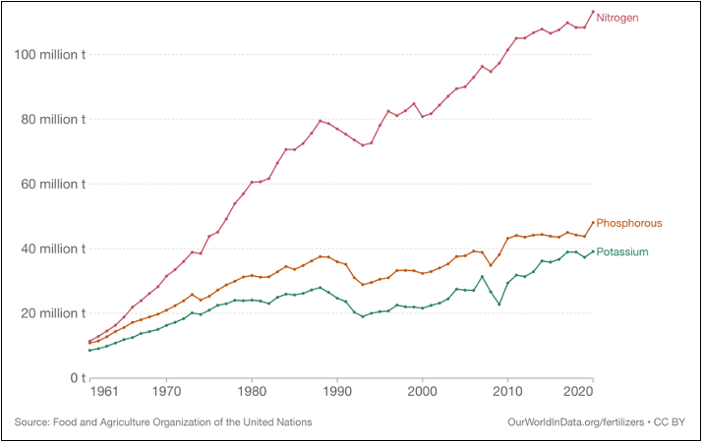
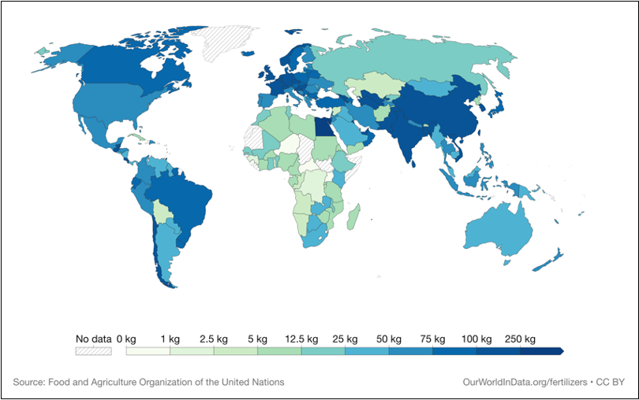
Reducing emissions from fertilisers : Importance
Fertilizer use increased since 1960s, with commensurate food security benefits
Fertilizer use unequal across regions
Higher global warming potential of N₂O than CO₂
More efficient use of fertilizers in high-use regions will allow for optimum use in low-use areas

Slide 10
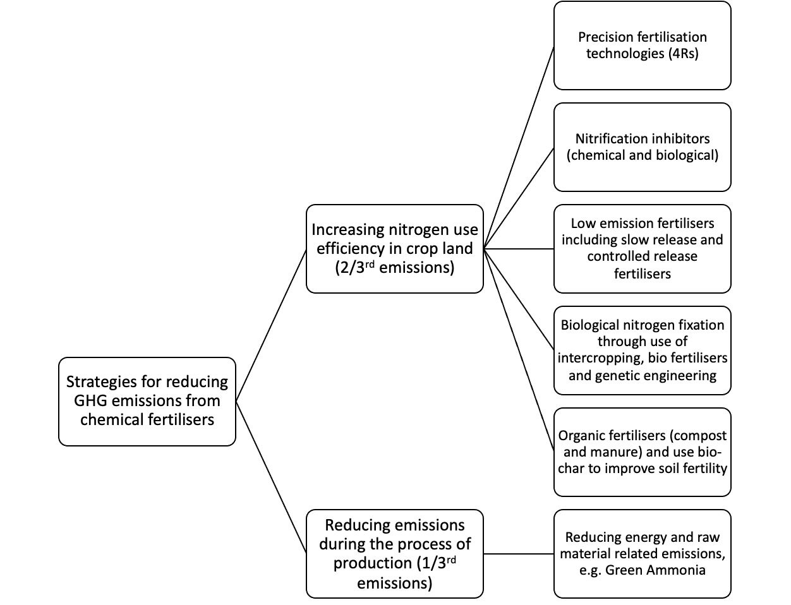
Reducing emissions from fertilisers: State of science
Production of mineral based fertilizers = 1/3 of fertilizer-based emissions
Use : improving nitrogen efficiency essential part of strategy, through precision fertilization, low emissions fertilizers, etc.

Slide 11
Fertilizers
Five (5) recommendation themes:
Climate finance
Public policies and innovations
Develop agreed indicators and standards
RD&D
Markets
Recommendation Wording | Themes
The advanced research institutes should form an international research collaboration to fill gaps in knowledge that prevents adoption of scalable fertilizer technologies. This should form the basis of international knowledge networks closely linked with national research and extension agencies. | 4
The Policy Dialogue on Transition to Sustainable Agriculture (PDTSA), launched concurrently and co-led by the WBG and UK, should prioritize formulation of concrete pathways for repurposing subsidies to transition to low emissions/cleaner fertilizers and associated Guidelines. Action could include international collaborative research/policy dialogue develops white paper on repurposing subsidies for transitioning to cleaner fertilizers, under various policy and socio-economic contexts. It should also recommend ways of overcoming cost barriers through regulatory reforms and invite scientists to look at cost-reducing technologies. | 2
Capacity building and knowledge networks: International knowledge networks and capacity building workshops with advanced research institutes, and country NARES to strengthen extension services for farmers and extension agencies. Concrete examples of these capacity building events could be: promote farmers' awareness of fertilizer technologies, support NARES to breed crop varieties for increased nutrient use efficiency, explore innovative technologies for nutrient recycling, and developing advanced sensor technologies to accurately measure soil nutrient levels for real-time fertility management | 2, 4
There should be international harmonization of regulation and market standards for products like new low emissions fertilizers (e.g. Green Ammonia, but not just limited to it). | 3

Slide 12
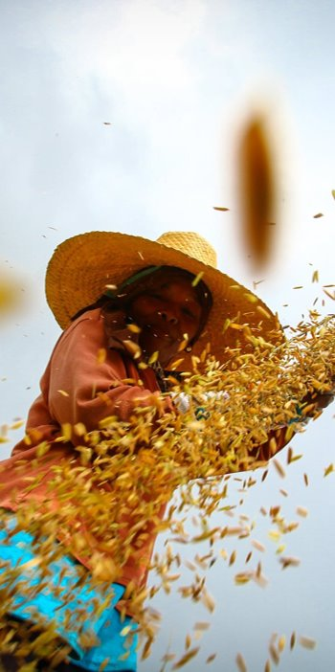
Thank you on behalf of CGIAR Author team
Aditi Mukherji (CGIAR), Claudia Arndt (ILRI), Jacobo Arango (Alliance for Bioversity and CIAT), Fiona Flintan (ILRI), John Derera (CGIAR), Wendy Francesconi (Alliance for Bioversity and CIAT), Sarah Jones (Alliance for Bioversity and CIAT), Ana Maria Loboguerrero (Alliance for Bioversity and CIAT), Douglas Merrey (Consultant), Jonathan Mockshell (Alliance for Bioversity and CIAT), Oscar Ortiz (CGIAR) Marcela Quintero (Alliance for Bioversity and CIAT), Daniel Girma Mulat (ILRI), Claudia Ringler (IFPRI), Loraine Ronchi (CGIAR), Manuel Ernesto Narjes Sanchez (Alliance for Bioversity and CIAT), Tek Sapkota (CIMMYT), Shakuntala Thilsted (CGIAR)
Acknowledgment: Agriculture Chapter Steering Committee
FAO Chief Scientist Ismahane Elouafi
UN Climate High Level Champion: Rebecca Brooks
CGIAR Managing Director: Johan Swinnen
Acknowledgment: Funding support
FCDO

