Slide 1



Silvopastoralism and welfare of farmed animals in Ethiopia
Gezahegn Alemayehu, Tsega Berhe, Eyob Gelan, Mulugeta Mokria and Rebecca Doyle
Training and knowledge exchange workshop on animal welfare
Halaba, Ethiopia
1–2 September 2021

Slide 2
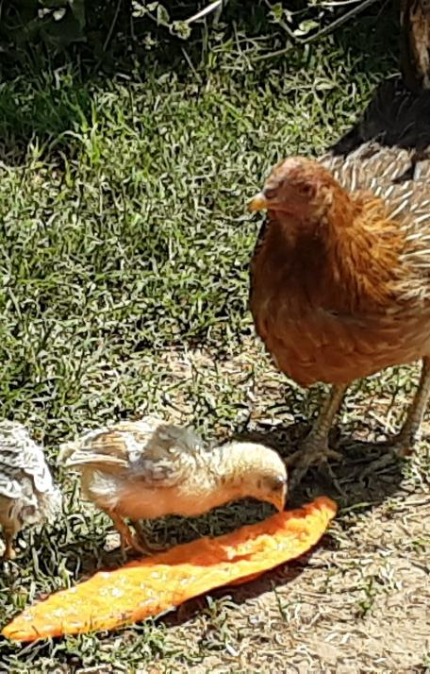
Improved farmed animal welfare for one wellbeing
Protecting the welfare of farmed animals has entered the public policy mainstream in many countries.
Formal animal welfare legislation remains largely absent in many countries including Ethiopia.
Animal welfare is increasingly recognized as important ‘beyond animal’.

Slide 3
Improved farm animal welfare cont.
There is a strong link between animal welfare, human wellbeing and the environment.
The academic, advocacy and policy debates on these issues have remained notably disconnected.
Policy debates mainly revolve around the concepts of animal health and welfare but not on their synergies between these important societal priorities.
Notes:
“One welfare” in which the health or welfare of humans, ecosystems and individual animals are viewed as one
The world’s cows, sheep, goats, pigs, poultry and other farm animals are essential to the well-being of some one billion people living in chronic poverty, hunger and undernutrition.
Unsustainable livestock production systems can degrade lands and waters, speed global warming and put public health at risk.

Slide 4
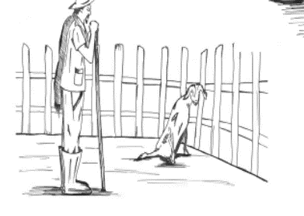
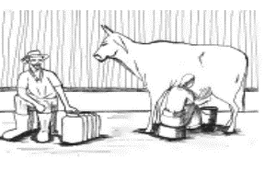
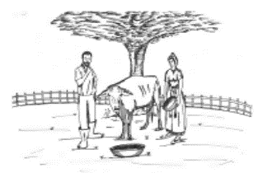
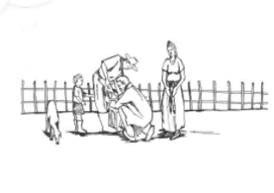
The 5 freedom for Animals
Freedom from hunger, thirst and malnutrition
Freedom from fear and distress
Freedom from discomfort and exposure
Freedom from pain, injury and disease
Freedom to express normal behaviour

Slide 5
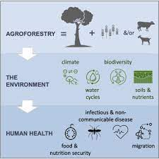
Synergizing animal welfare with agroforestry for sustainable development
Agroforestry has proven potential to improve animal welfare and human wellbeing

Slide 6
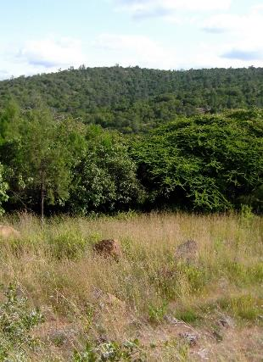
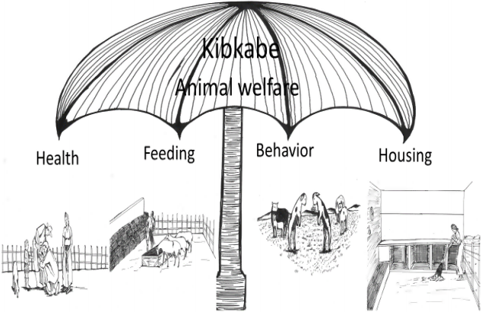
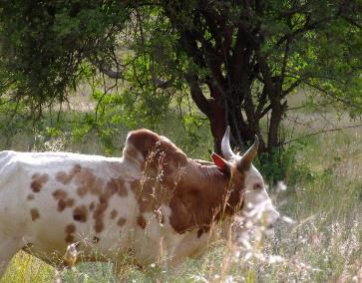
Farm animal welfare challenges in Ethiopia
Agro-silvopastoralism is getting a global recognition as it directly contributes to the four principles of animal welfare:

Slide 7
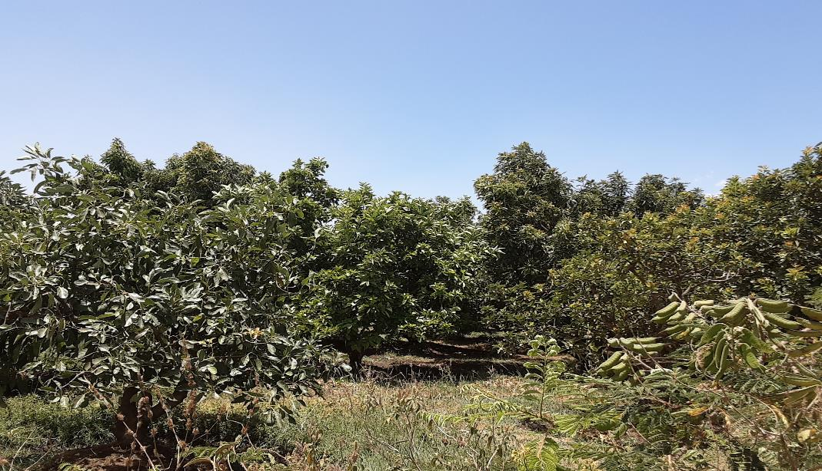
Generating evidence
Advocating good welfare
Welfare improvement intervention
Scaling up
Behaviour change
Investing in good welfare

Slide 8
Generating evidence: Welfare assessment
Resource-based indicators
Feed and water resources
Animal-based indicators
Youngstock mortality
Social withdrawal
Housing
Husbandry practices
Health services
Environmental
Excessive itching
Wool cleanliness
Body Condition Score
Lameness
Respiratory problems
Welfare indicators

Slide 9
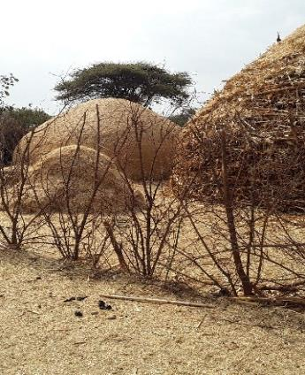
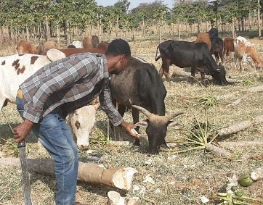
Feed resource
Freedom from malnutrition?

Slide 10
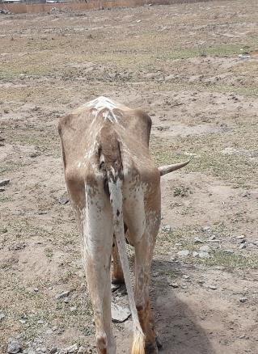
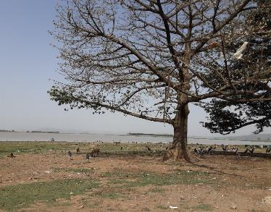
Husbandry

Slide 11
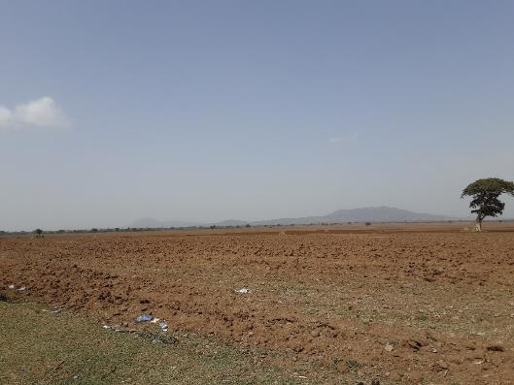
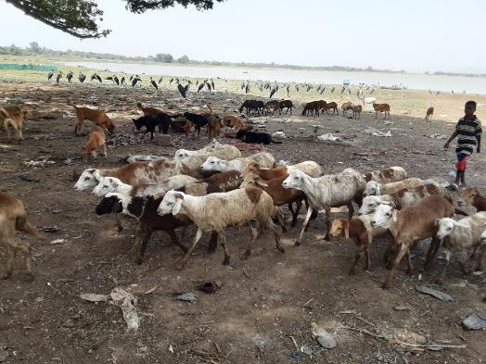
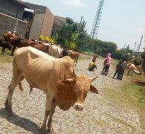
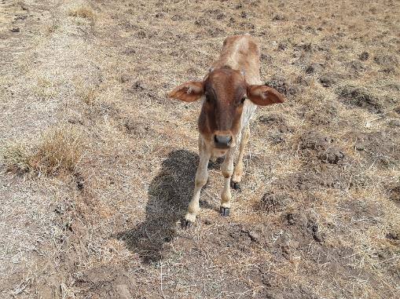
Private and communal grazing areas are taken by crop farming

Slide 12
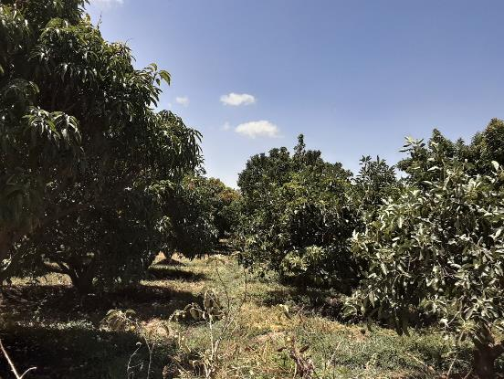
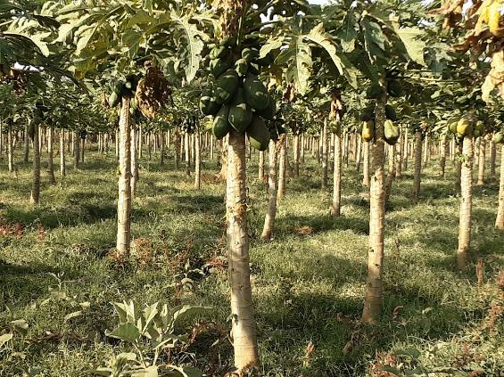
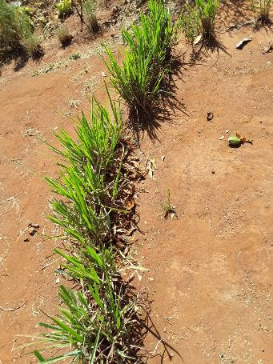
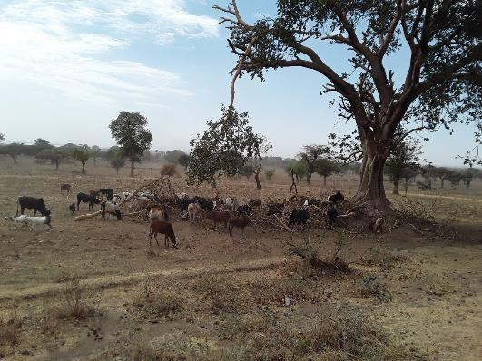
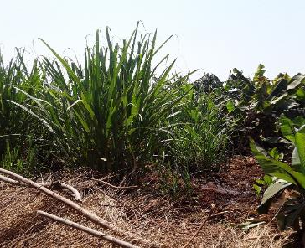

Slide 13
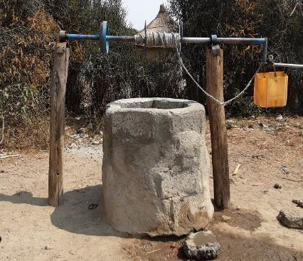
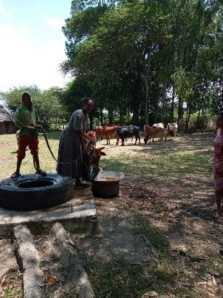
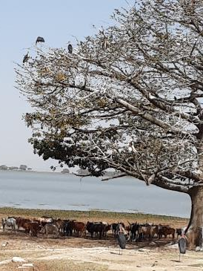
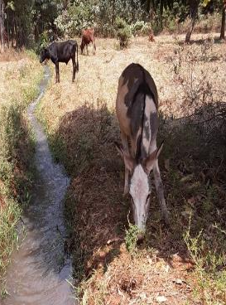
Water sources

Slide 14
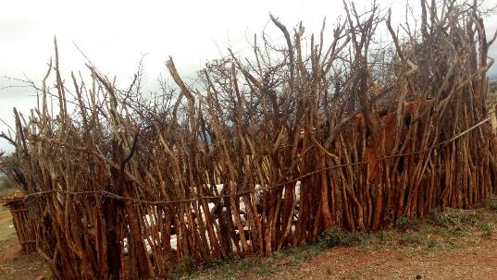
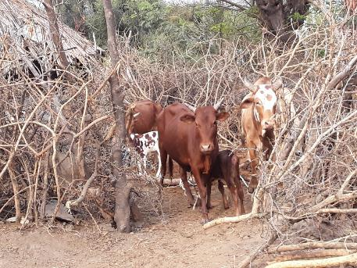
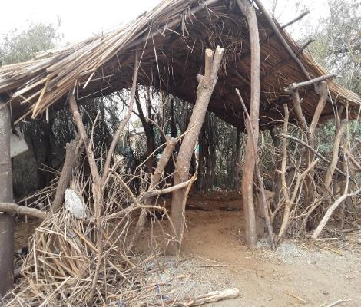
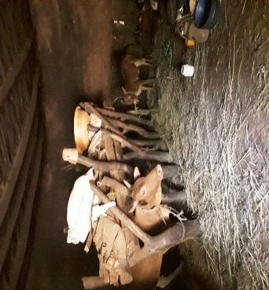
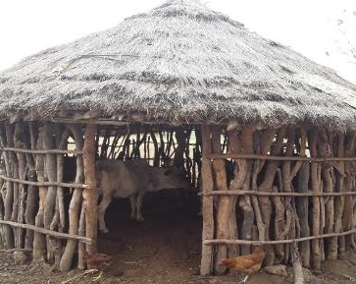
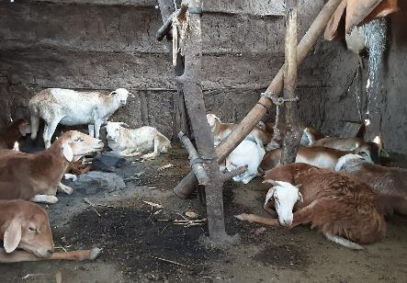
Housing
Notes:
Most of the houses are built to protect from predators not bad weather conditions

Slide 15
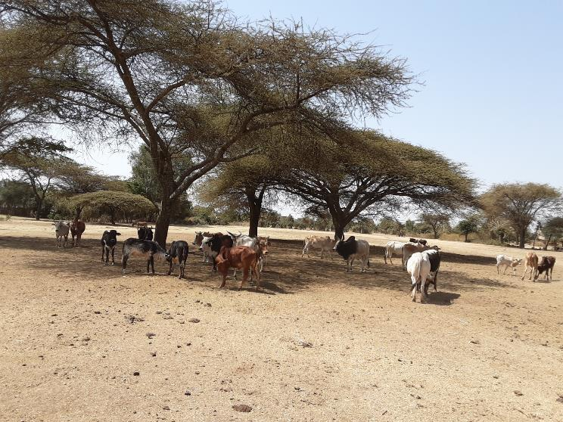
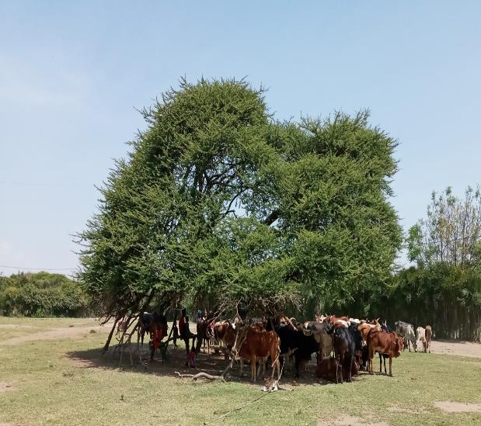
Environment

Slide 16
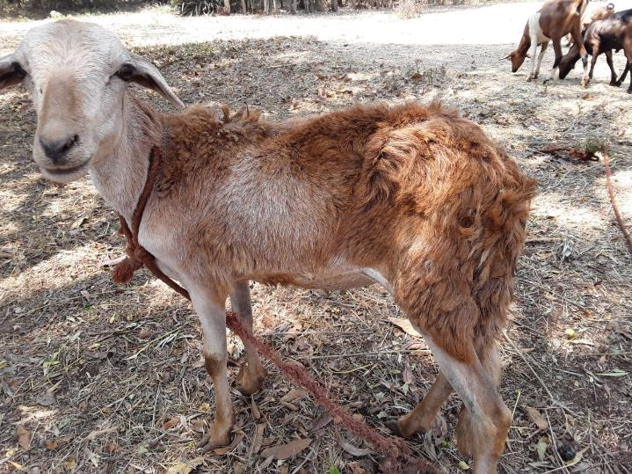
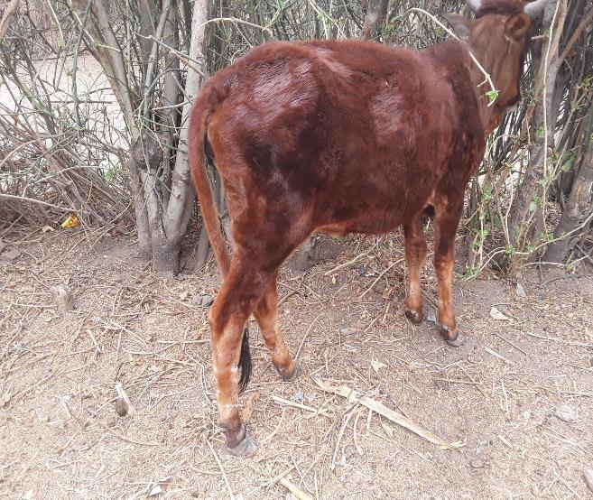
Environment
50%, 40%, 27% and 43% of farmers tethered cattle, sheep, goats and donkeys, respectively

Slide 17
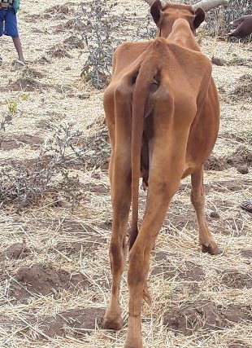
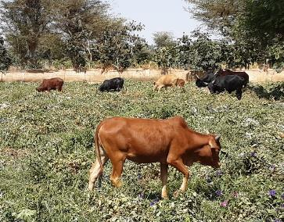
Animal based indicators: Mixed system (cattle)

Slide 18
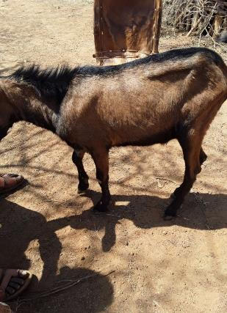
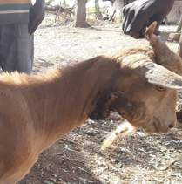
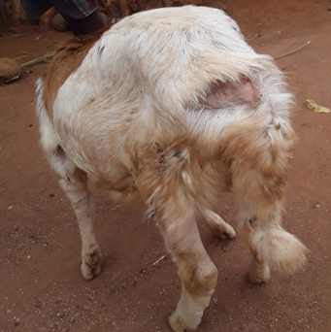
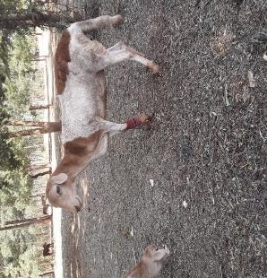
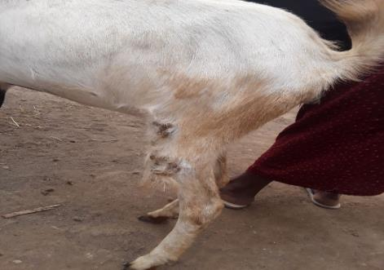
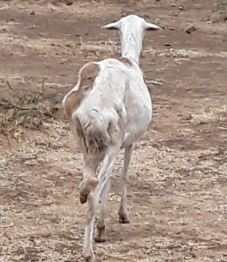
Animal based indicators: Sheep and goats

Slide 19
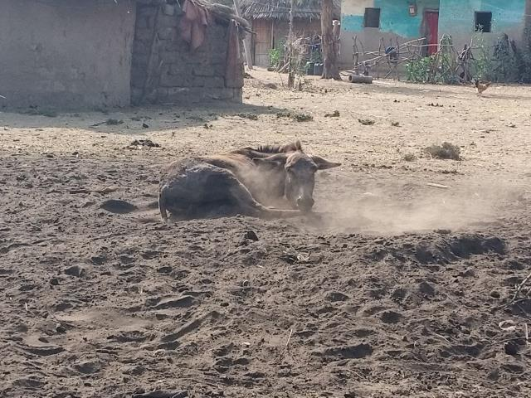
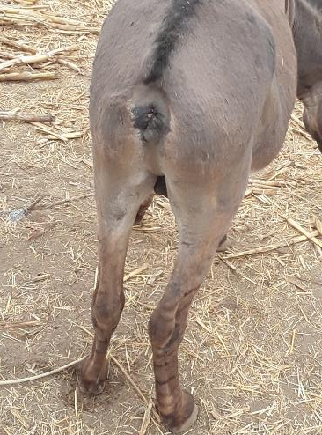
Animal based indicators: Donkeys

Slide 20
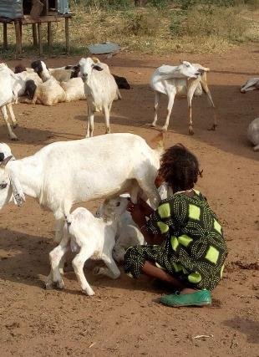
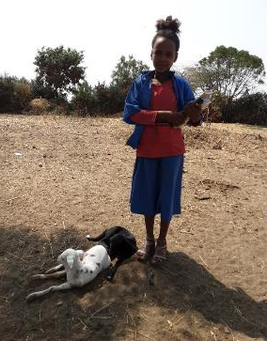
Human well-being

Slide 21
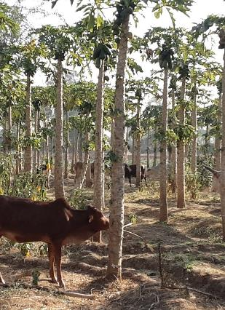

Income source

Slide 22
Knowledge, attitude and practice

Slide 23
Knowledge, attitude and practice

Slide 24
Knowledge, attitude and practice

Slide 25
Advocating for good animal welfare
Advocating for good animal welfare among professionals, students, farmers and policy-makers to foster positive attitudes.
The welfare of farmed animals needs to be mainstreamed in public policy and integrated in the current government green legacy tree-planting project.
Animal welfare legislation needs to articulate the emergent concerns for the relationship between human and animal health and welfare.

Slide 26

Behaviour change
Training of experts and extension agents
Community conversation
Famers’ days to visit best practices
Animal welfare working group
Community of practice at lower level

Slide 27


Investing in good animal welfare
Farmer-centered knowledge and skill hub
Context-specific, evidence-driven, practice-oriented and cost-effective innovation to improve farmed animal welfare
Extension system structure and policy framework/roadmap
Option by context and objective-based regreening and agroforestry practices in all development endeavours

Slide 28


Scaling up
Documenting best practices and cost-effectiveness of the intervention
The opportunities and trade-offs of silvopastoralism systems can be promoted in a way that ensures benefits to animals, farmers and the environment
Scaling up to other potential sites
Imbedded into the national extension system

Slide 29
Concluding remarks
Animal welfare oriented
Feeding and nutrition
Poor housing/shelter
Animal health service
Stresses
Context-specific, evidence-driven, practice-oriented solutions for all development intervention
Objective-based restoration or regreening practices
Silvopastoralism has potential to promote agroforestry and restoration of degraded areas for sustainable animal welfare and productivity
By using
Livelihood oriented
Poverty and hunger
Inequity (rights, gender, access)
Malnutrition and human health
Energy scarcity
Landscape (environment) oriented
Land degradation and climate change
Deforestation and habitat loss
Water scarcity
Biodiversity loss

Slide 30

Thank you!

