Slide 1









The pandemic and women in agribusiness in Myanmar and Vietnam
Insights from in-depth-interviews with small- and medium-scale entrepreneurs
Presented by Nozomi Kawarazuka (CIP)
Agri4D Conference, 28 September 2021
The team: Esther Achandi (ILRI), Arunima Hakhu (IWMI), Deepa Joshi (IWMI), Cynthia McDougall (WorldFish), Loan Pham (ILRI), Surendran Rajaratnam (WorldFish) (alphabetical order)

Slide 2


Theoretical background: Feminist critique
In neoliberal capitalism, crises reinforce gender and social inequalities: Structural transformation is required (Griffin, 2015)
COVID-19 has exposed structural issues - has had disproportionate impacts on working class people, people of colour, women, migrants; has also reinforced South-North divides (Stevano et al. 2021a, 2021b)
The dominant methodologies of entrepreneurship cannot explore women’s ethics and value: alternative methodologies are required – social reproduction
(Ahi, 2006; Hamilton, 2013; Gustavsson, 2021)
"Women empowerment” in development: fixing women into the existing masculine system rather than fixing the system to represent women’s needs
(Chant et al., 2012; Cornwall 2018)
Women’s agribusiness world
Invisible non-material factors shape women’s business
relationships of trust - kinship networks
time constraint
ethics
hard working
Harassment
interpersonal skills
recognition
Personal philosophy
husband
domestic work
brothers
In-laws
children
confidence

Slide 3
Key research question (for this presentation)
What are gender-based social and structural barriers
women entrepreneurs face and
how do they navigate them in their agri-businesses
in the time of COVID-19?

Slide 4
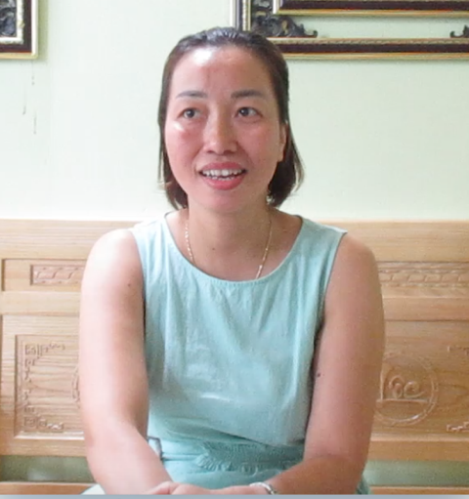
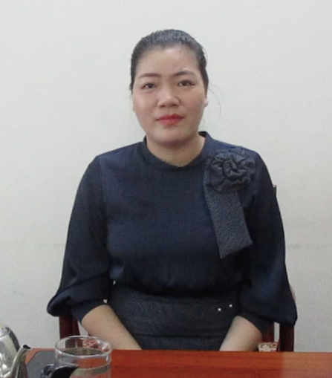
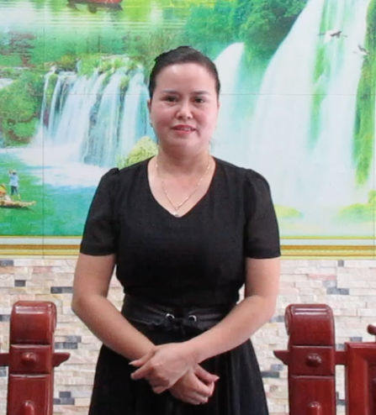
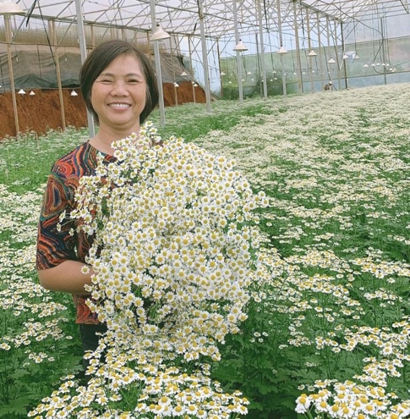
Medium-scale women entrepreneurs in formal agri-food systems
Barriers they face:
Childcare and negotiations with their in-laws, struggling with their identity as a mother
Communication and negotiation with male dominant clients
How they navigate them:
A relationship of trust, which enable women to have reciprocal support in times of crisis
Pretend to be playing a secondary role in their business
Men supporters essential for their business, but not necessarily their male kin
All of them preferably employ female workers.
*Respondents agreed with their photos to be in public
Pig & chicken
corporative
Fish and animal feed
import and export
Fish eggs import
Horticulture export
Notes:
Barriers are pre-COVID and worse during the COVID
A relationship of trust with clients
Pretending to be a secondary person to their husbands

Slide 5
Small-scale female entrepreneurs in informal agri-food systems, Vietnam
Barriers they face:
COVID-19 hit their business very hard, and they sacrificed their time and labour to compensate for reduced incomes or simply give up earning during the lockdown
Very limited support from the government as compared to formal enterprises
How they navigate:
Both women’s informal business and care roles are deeply embedded in inter-generational reciprocal support within kinship networks - by providing productive and reproductive labour, financial support in times of crisis, and knowledge, skills and connections required for their business
Being a part-time entrepreneur (livelihood diversification) as a strategic choice
It is “informality” of informal systems that enables female entrepreneurs to cope with/expand their business (e.g., based on social networks rather than individual financial capacity)

Slide 6
Small & medium scale entrepreneurs in informal agri-food systems, Myanmar
Barriers they face:
COVID-19 impacted them negatively: they sacrifice their time and labour to compensate for reduced incomes or simply give up earning.
Difficulties in procuring and selling fish due to low amount of fish being caught and mobility restrictions - strict control by the government.
People need travel permits to travel out of their village, otherwise they can be arrested. Travel permits are only given to one person per house - women face difficulties to trade fish without support.
Illegal fishing nets – reducing number of fish available
How to navigate:
Being a part-time entrepreneur or labour (livelihood diversification in low value activities) as a strategic choice (both pre-COVID and during the COVID)
The flexibility is great for coping…but the informality is a double-edge sword/has weaknesses that reinforce gender-based hierarchies in the sectors, given that women are predominantly involved in informal work
Notes:
How they navigate
Work as a labour in paddy fields to remove weeds, planting and harvesting
Sells betel nut in a small store at their house
Engage in low value fisheries activities – eg. collecting crabs (as it is valued lower than it was previously)
Not many alternative livelihood activities available in their villages.
Informality and social networks – women fish traders buy fish from each other as a form of support when needed.

Slide 7
References
Ahl, H. (2006). Why research on women entrepreneurs needs new directions. Entrepreneurship theory and practice, 30(5), 595-621.
Chant, S., & Sweetman, C. (2012). Fixing women or fixing the world?‘Smart economics’, efficiency approaches, and gender equality in development. Gender & Development, 20(3), 517-529.
Cornwall, A. (2018). Beyond “empowerment lite”: Women’s empowerment, neoliberal development and global justice. cadernos pagu.
Griffin, P. (2015). Crisis, austerity and gendered governance: a feminist perspective. Feminist Review, 109(1), 49-72.
Gustavsson, M. (2021). The invisible (woman) entrepreneur? Shifting the discourse from fisheries diversification to entrepreneurship. Sociologia Ruralis.
Hamilton, E. (2014). Entrepreneurial narrative identity and gender: A double epistemological shift. Journal of Small Business Management, 52(4), 703-712.
Stevano, S., Mezzadri, A., Lombardozzi, L., & Bargawi, H. (2021a). Hidden Abodes in Plain Sight: the Social Reproduction of Households and Labor in the COVID-19 Pandemic. Feminist Economics, 27(1-2), 271-287.
Stevano, S., Franz, T., Dafermos, Y., & Van Waeyenberge, E. (2021b). COVID-19 and crises of capitalism: intensifying inequalities and global responses. Canadian Journal of Development Studies/Revue canadienne d'études du développement, 42(1-2), 1-17.

