Slide 1
Interactive voice response for dissemination of agronomy technologies in Malawi- the opportunities and pitfalls
Regis Chikowo, Emy Smith, Brian King and Sieg Snapp
Michigan State University (MSU)
2019 ASA-CSSA-SSSA International Annual Meeting
13 November 2019, San Antonio, Texas, USA

Slide 2
An ultimate goal of sustainably intensified smallholder farming in Africa is increased resilience

Slide 3
Resilience
Focuses on risk reduction by increasing the adaptive capacity of people and the agriculture ecosystems on which they depend, enabling farmers to meet current and future food needs while coping with uncertainty and change.
….. requires fundamentally building and restoring the ability of farming/ecosystems to buffer change.

Slide 4
The current reality…low productivity

Slide 5
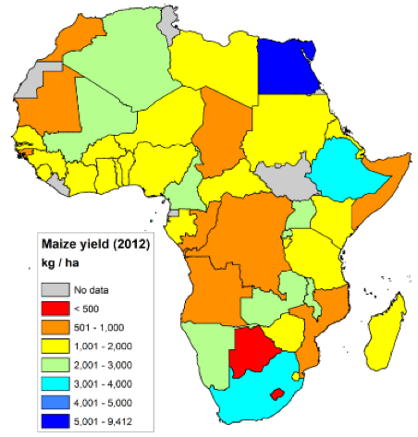
Maize yields poor for much of Africa
World average = 4.92 t ha-1

Slide 6
Alarming crop yield gaps

Slide 7
Reducing crop yield gaps is part of the pathway towards breaking the vicious poverty trap

Slide 8
How to communicate this message effectively…..

Slide 9
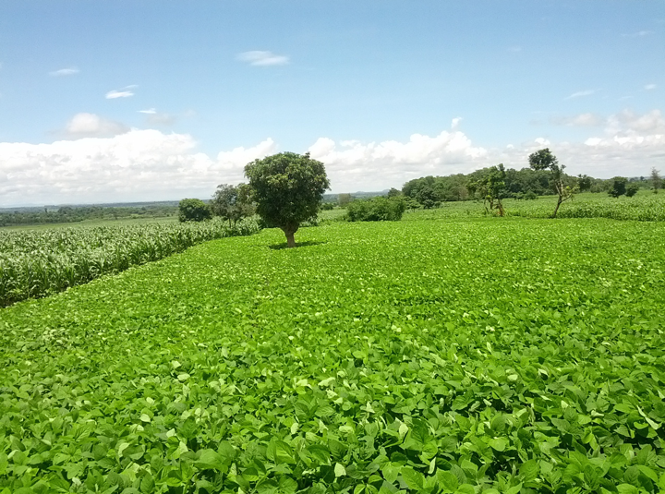
With appropriate technology dissemination, intensification on smallholder farms is possible

Slide 10
The challenge…….

Slide 11
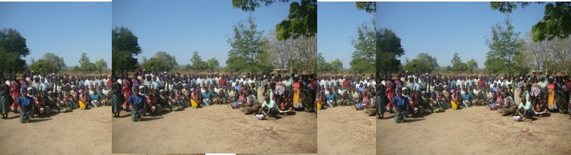
1 extension worker : 2000 farmers
(several communities)

Slide 12
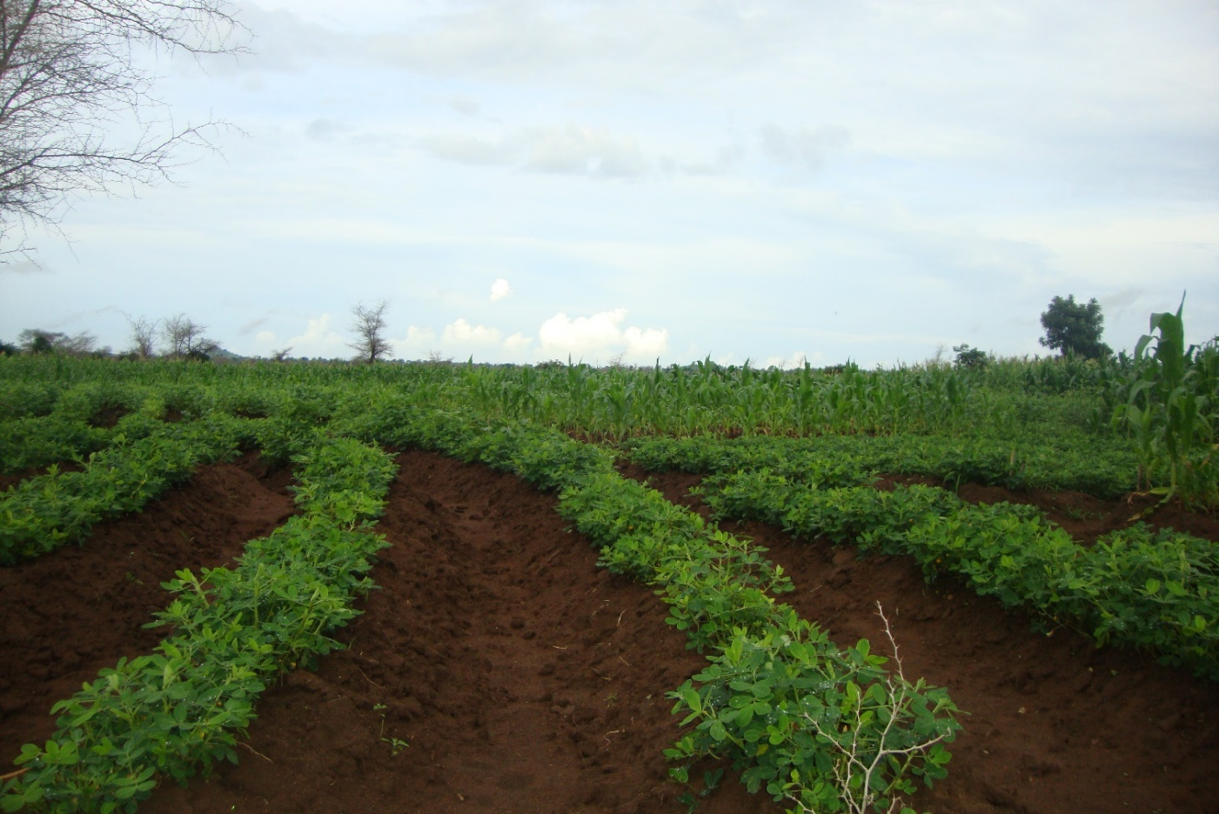
Evidence:
Sub-optimal plant populations =poor yields

Slide 13
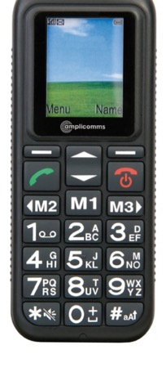
A ray of hope…
20-30 % of farmers now own simple mobile phones that they can use to access information.
Hypothesis: access to targeted agronomy messages through interactive voice response (IVR) leads to better decision making on farms, leading to increased resource use efficiencies, increased productivity

Slide 14
What is Interactive Voice Response (IVR)
a system that uses pre-recorded audio in order to provide information to farmers or to ask questions via their mobile phones.
Users listen to prerecorded audio and respond to questions by interacting with their keypad, in order to record their responses onto the platform.
Scope for IVR technology to support extension for transformation

Slide 15
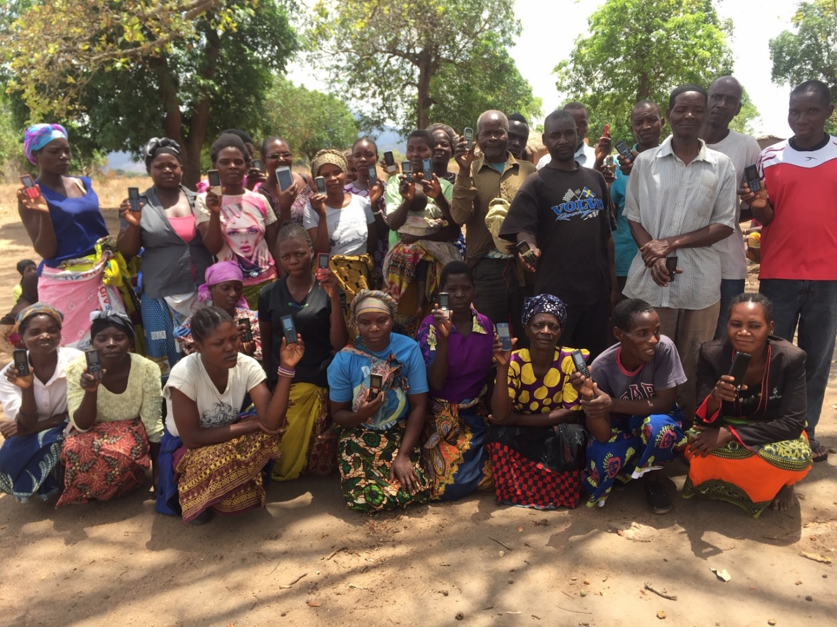
A possible game changer in each farmer’s hand….
IVR technology has worked well in resource-rich domains
It is necessary to contextualize and adapt this technology for smallholder farming context

Slide 16
The VIAMO treatment: targeted IVR maize agronomy
Land preparation/plant populations
Correct seed/variety selection suitable for different agroecologies
Better targeting of maize cropping (e.g avoid striga infested fields)
Right timing of application (and placement) of urea and NPK fertilizers
Better weed management

Slide 17
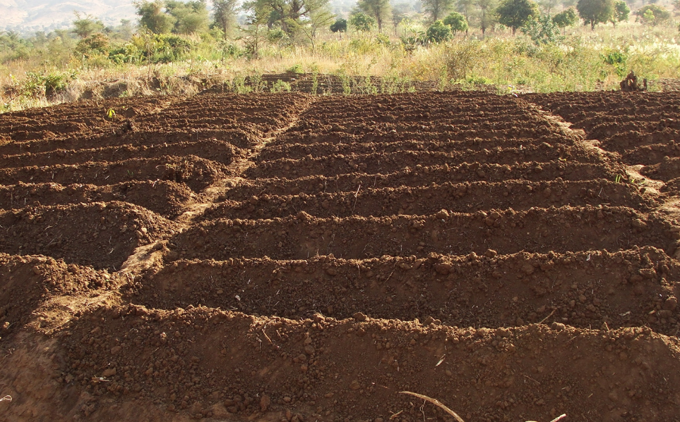

Slide 18
Fertilizer applied correctly has demonstrable results!

Slide 19
Common poor practice in fertilizer use
Farmers applying phosphorus fertilizers 2-3 weeks after germination
BUT phosphorus is required early for root development
The early nutrient stress is associated with a large yield penalty

Slide 20
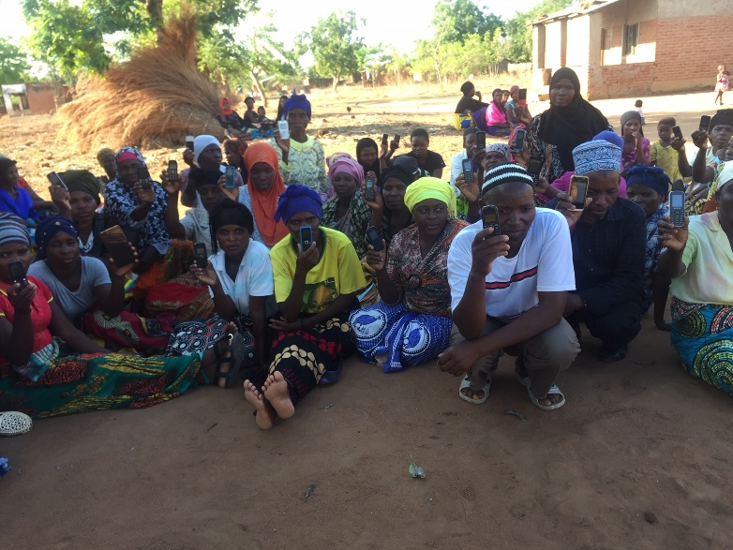
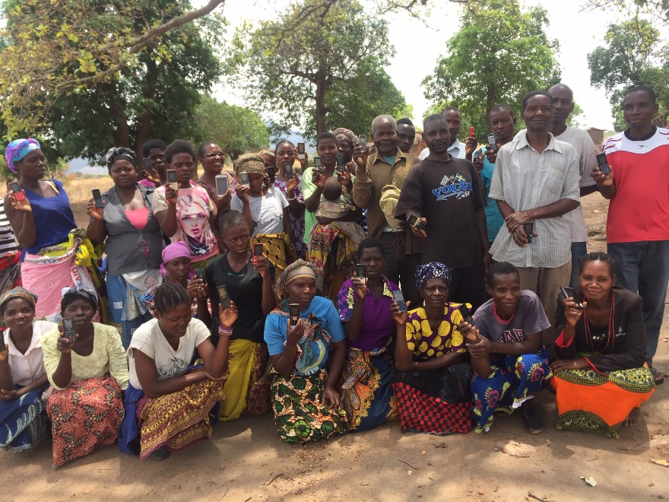
What we did….
140 control farmers from 4 communities
140 treated farmers from 4 communities

Slide 21
Control farmers | Treated farmers
Accessed the general 321 voice message on Airtel only This platform has several themes difficult to navigate for mostly literate farmers | Accessed both the 321 platform and IVR maize agronomy Messages repeated a few times Delivered on appropriate times during the cropping season

Slide 22
Early insights into efficacy of IVR

Slide 23
Urea fertilizer management
 | Treated | Control
Applied urea at planting | 25% | 40%

Slide 24
Urea fertilizer management
 | Treated | Control
Applied urea at planting | 25% | 40%
Both groups doing badly, but there is a HUGE LEAP in the right direction

Slide 25
Weeding intensity
 | Treated | Control
% of farmers who had weeded twice by peak maize vegetative stage | 64% | 42%

Slide 26
Timing of planting
 | Treated | Control
Early planting | 71% | 57%
Very late plating | 2.6 | 8.6%

Slide 27
Lessons learnt
On IVR evaluation, the call pick up rate averaged 75% but completion rate was a low 34%
  Apparently typical for electronic surveys but we could get a better outcome by reducing the number of options on possible responses.

Slide 28
Next steps
For Year 2 (2019/2020 cropping season), we are testing IVR on maize agronomy with a larger sample size (700 farmers).
We will conduct a maize yield productivity survey to quantify yield benefits.

Slide 29


