Slide 1

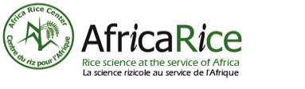

CLIMATE-RELATED RISKS TO COCOA PRODUCTION AND POTENTIAL FOR IRRIGATION IN WEST AFRICA
Scaling Solarized Irrigation in Ghana’s Cocoa Sector: Partnerships for Sustainability Workshop,
Date: 12 October 2024
Venue: IWMI GHANA
Salomon Obahoundje, Seifu A Tilahun, Moctar Dembele
International Water Management Institute – West Africa

Slide 2
OUTLINE
GENERALITY
KEY CLIMATE INDICES
RESULTS
CONCLUSION
2

Slide 3
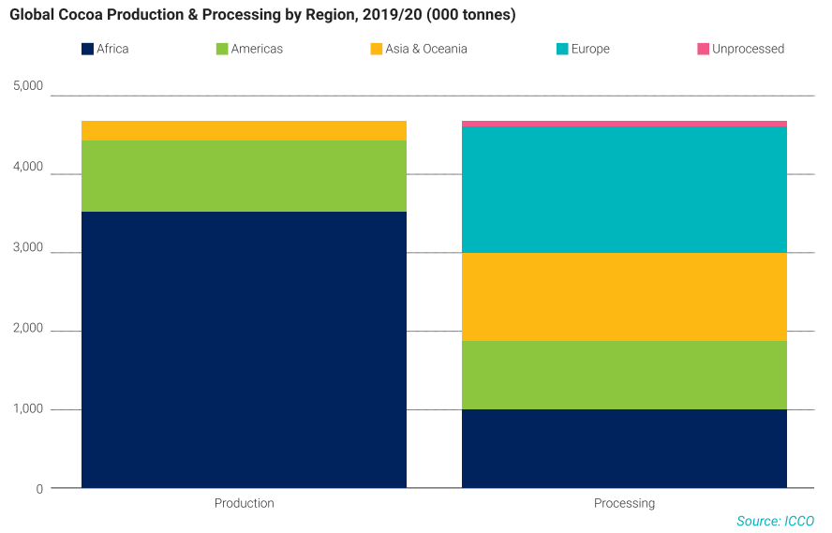
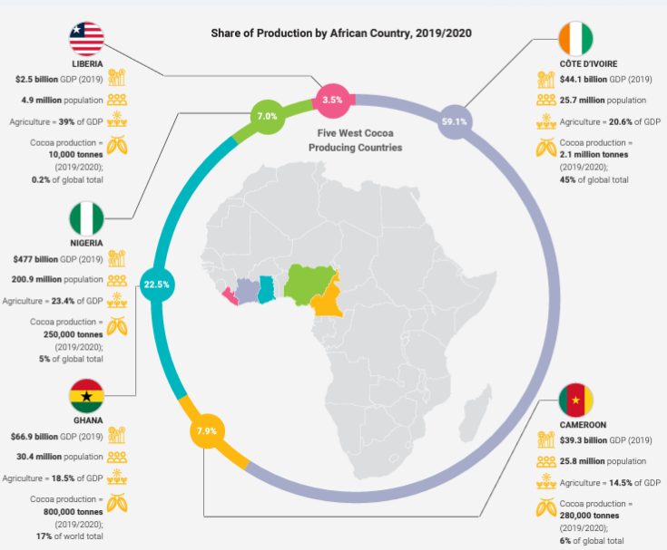
GENERALITY
More than 80% of the cocoa's global production come from Africa
More than 60% from Cote d’Ivoire and Ghana
Contributing more to the national GDP (African Economic Outlook, 2016)
~3.15% of Ghana’s 2023 GDP
3

Slide 4
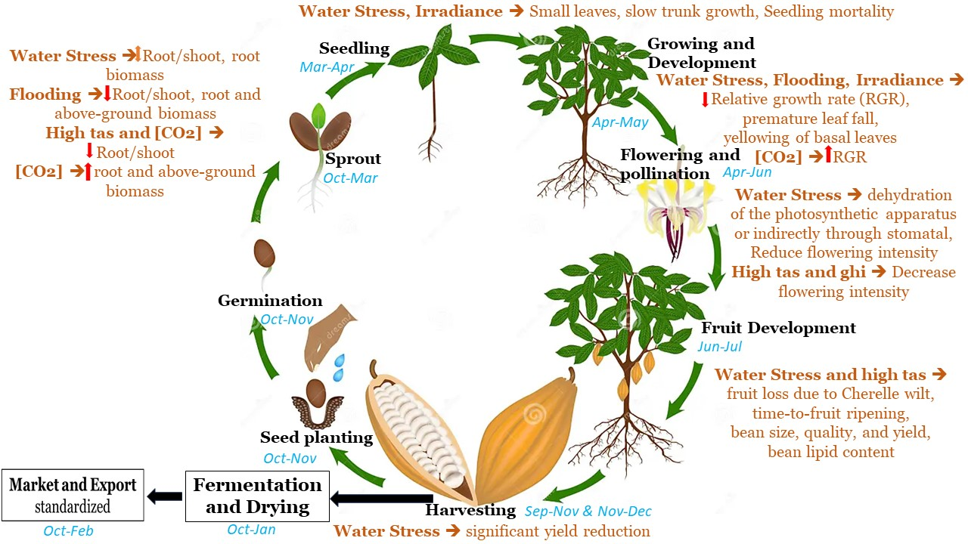
GENERALITY
However, this sector remains extremely sensitive to climate change, especially precipitation and temperature (Ofori-Boateng & Insah, 2014; Bomdzele & Molua, 2023) due to Rainfed agricultural practices.
Climate change poses significant challenges to the cocoa sector, particularly in terms of water scarcity (Gateau-Rey et al., 2018).
The frequent drought and flooding associated with rising surface temperature affect cocoa physiology, including leaf-level and whole reproductive parameters (Lahive et al., 2019).
How do changes in precipitation distribution and rise in temperature affect cocoa farming in West Africa?
3

Slide 5
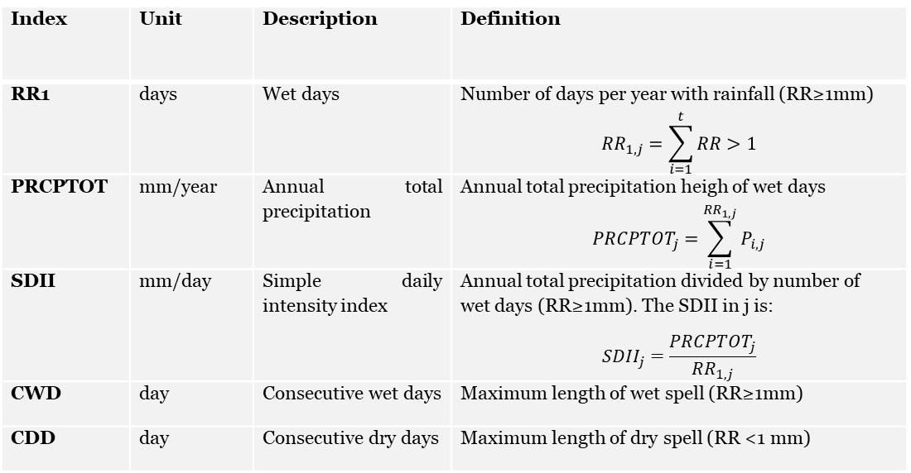
KEY CLIMATE INDICES
Precipitation extremes indices
Index | Unit | Description | Definition
RR1 | days | Wet days | Number of days per year with rainfall (RR≥1mm) $${RR}_{1,j}=\sum_{i=1}^{t}{RR>1}$$
PRCPTOT | mm/year | Annual total precipitation | Annual total precipitation heigh of wet days $${PRCPTOT}_{j}=\sum_{i=1}^{{RR}_{1,j}}{P_{i,j}}$$
SDII | mm/day | Simple daily intensity index | Annual total precipitation divided by number of wet days (RR≥1mm). The SDII in j is: $${SDII}_{j}=\frac{{PRCPTOT}_{j}}{{RR}_{1,j}}$$
CWD | day | Consecutive wet days | Maximum length of wet spell (RR≥1mm)
CDD | day | Consecutive dry days | Maximum length of dry spell (RR <1 mm)
DROUGHT
SPI thresholds (Svoboda et al., 2012)
Values | Description
Less or equal -2 | Extremely dry
-1.99 to -1.5 | Severely dry
-1.49 to -1 | Moderately dry
-0.99 to 0.99 | Near normal
1 to1.49 | Moderately wet
1.5 to1.99 | Very wet
Greater or equal 2 | Extremely wet
Time frame: 1981-2022
Ref: 1981-1990
D1: 1991-2000
D2: 2001-2010
D3:2011-2022
Trend detecting: Mann Kendall test
Change detecting: Wilcoxon test
4

Slide 6
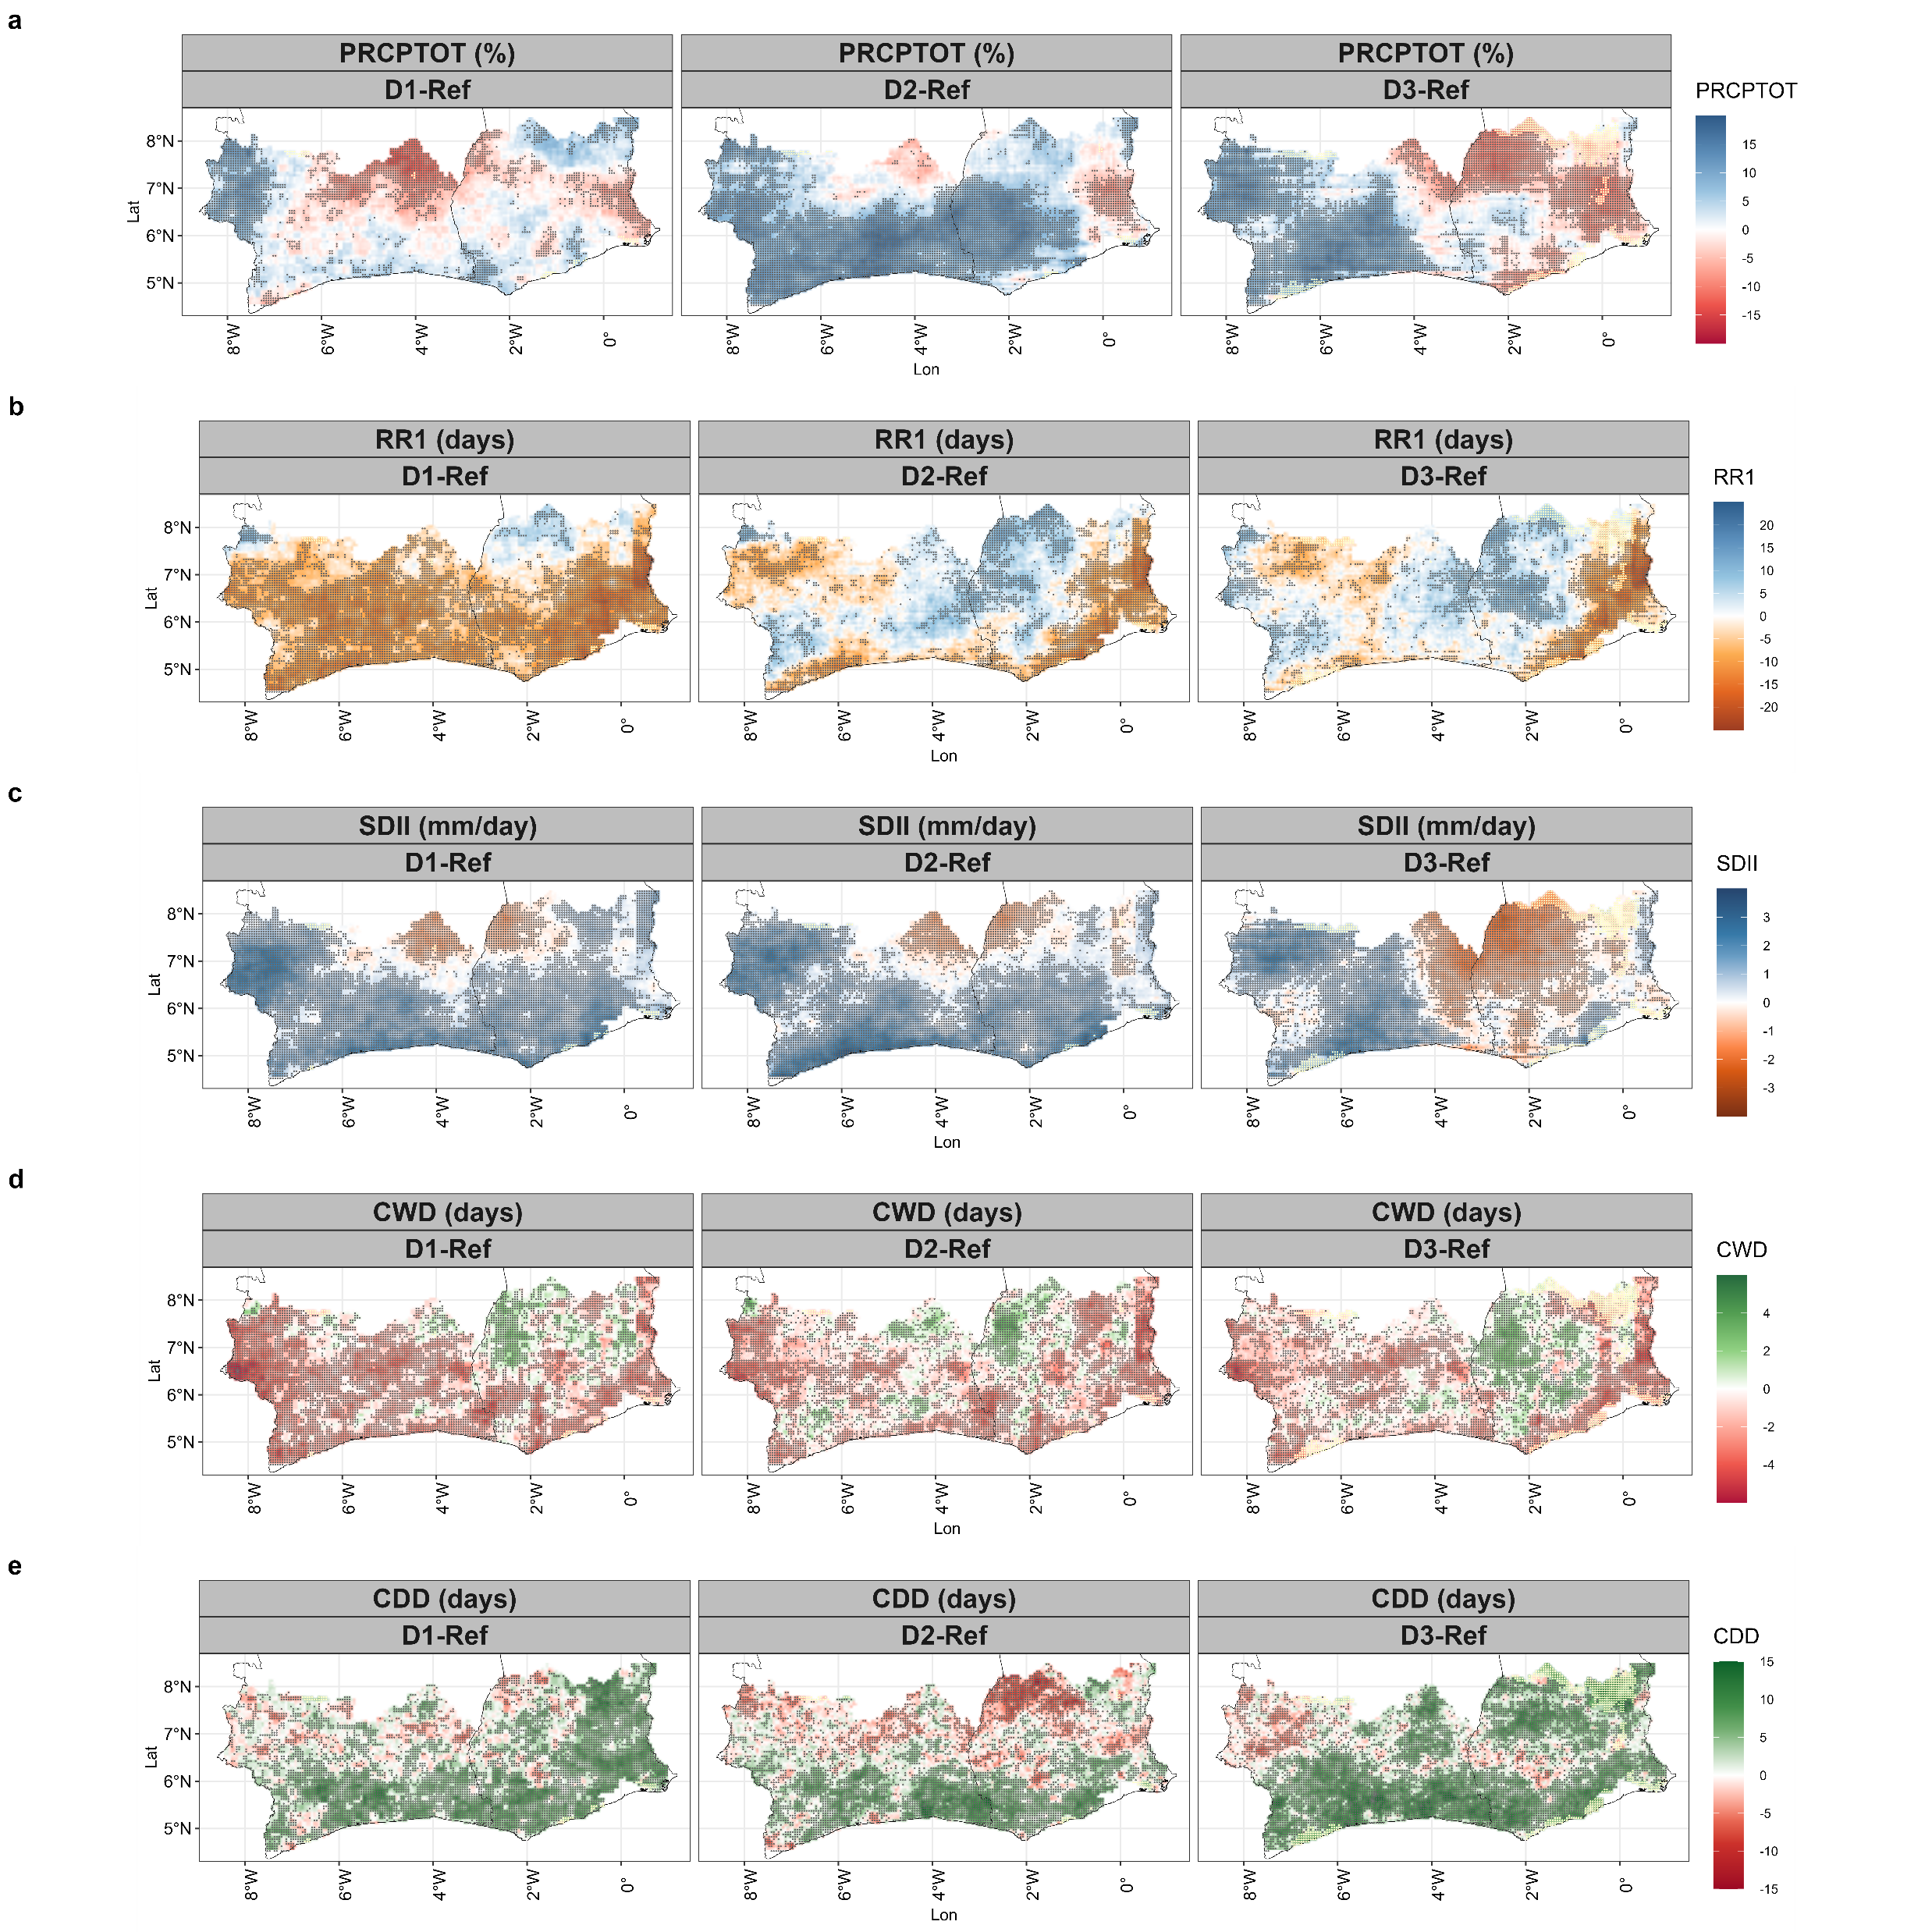
SPATIO-TEMPORAL PRECIPITATION VARIABILITY
1991-2000
2001-2010
2011-2022
Ref: 1981-1990
The decadal change varies from decade, indices, and geographical location
PRCPTOT has decreased significantly in large parts of GHA associated with a decrease SDII (2011-2022 vs 1981-1990)
In contrast, a significant increase in PRCPTOT, was attributed to a considerable rise in SDII.
The CDD (CWD) has increased(decreased) significantly these recent decades, especially in the GHA part➔ of water stress
5

Slide 7
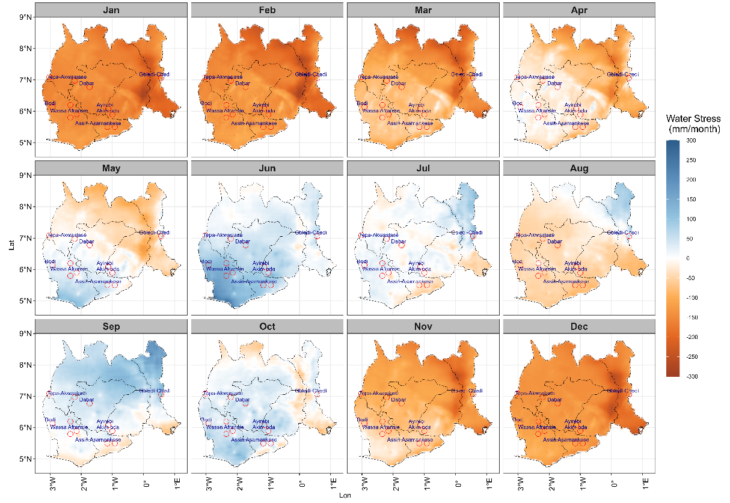
WATER STRESS (1983-2016)
Seasonal Water Stress Variability
Regional Differences in Water Stress
The impact of water stress on cocoa development varies depending on the specific stage of its growth cycle.
Critical Periods for Cocoa: June to October exhibits favorable water conditions with less stress except Aug which potentially impacts cocoa yield and development.
The water stress from Nov-Apr ➔ cocoa seedling development
6

Slide 8
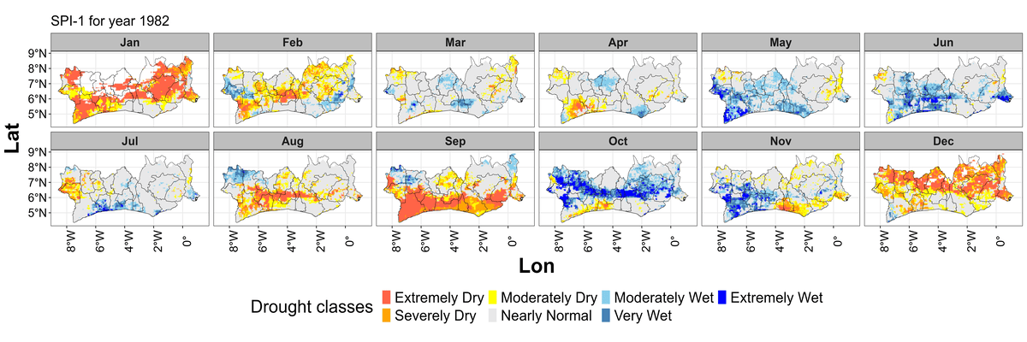
SPATIO-TEMPORAL DROUGTH VARIABILITY
Extreme events (precipitation deficit and excess) have become more frequent in the cocoa farming zones (April-October)
The magnitude varies according to the year and the geographical location, which has implications for the cocoa development cycle.
This could negatively affect cocoa maturation and therefore the quantity and quality of the beans.
7

Slide 9
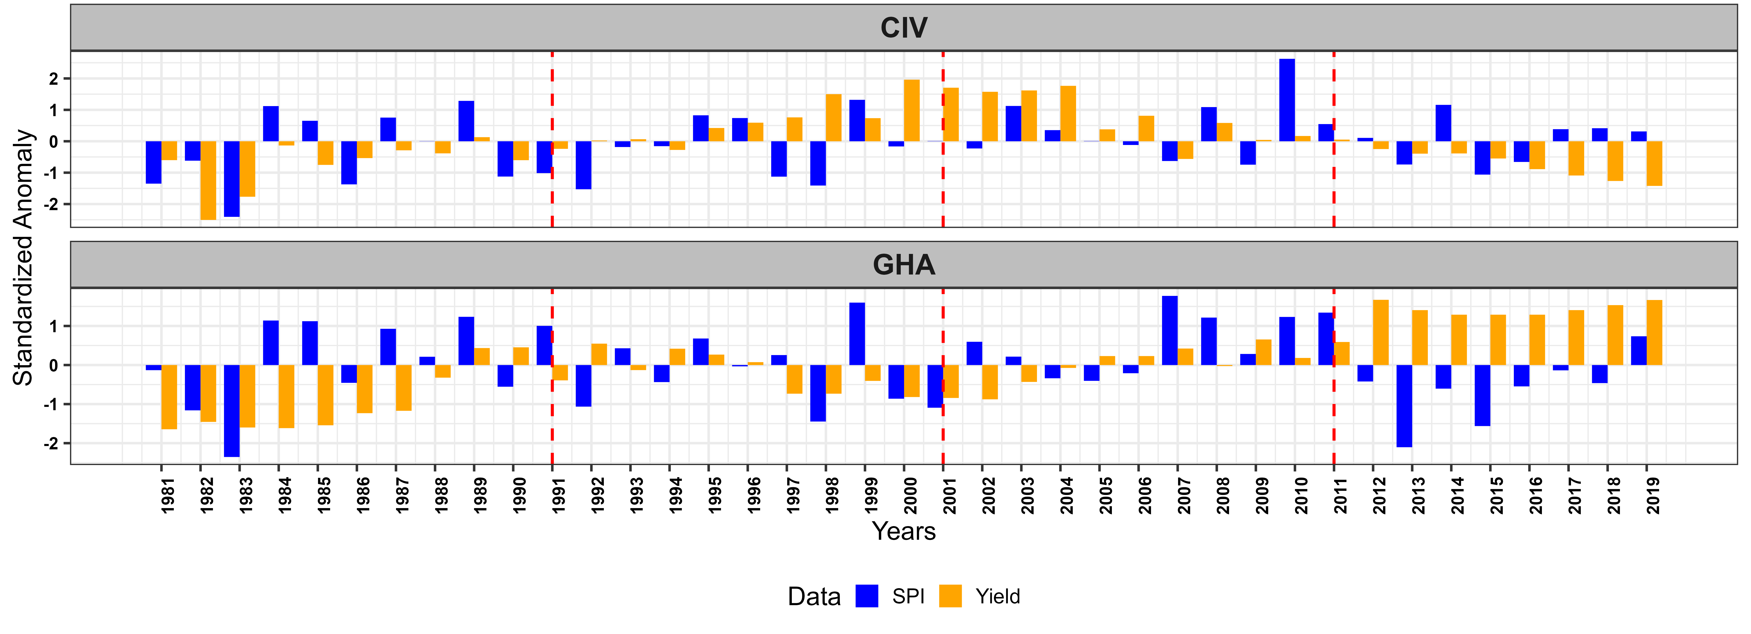
COCOA YIELD RESPONSE TO DROUGHT
The Standardized yield index and SPI are linked
The yield did not follow the same pattern as SPI
The yield is also highly dependent on agricultural management practice
Dry years lead to deficit yield
Extremely and very wet years lead to a decline or steady yield index
8

Slide 10
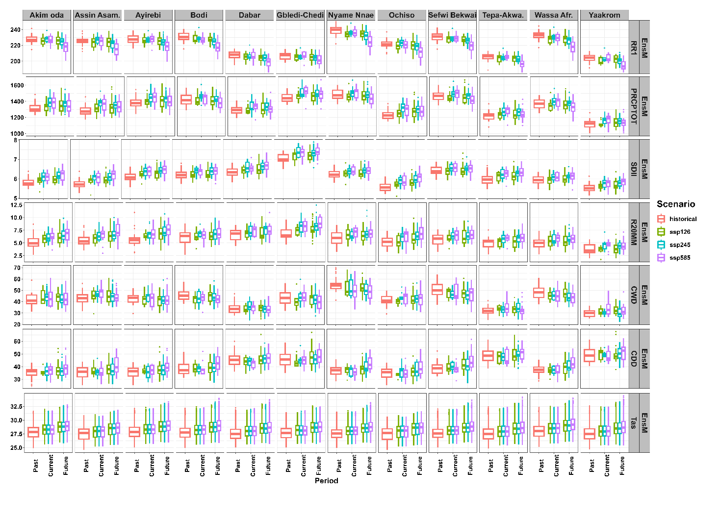
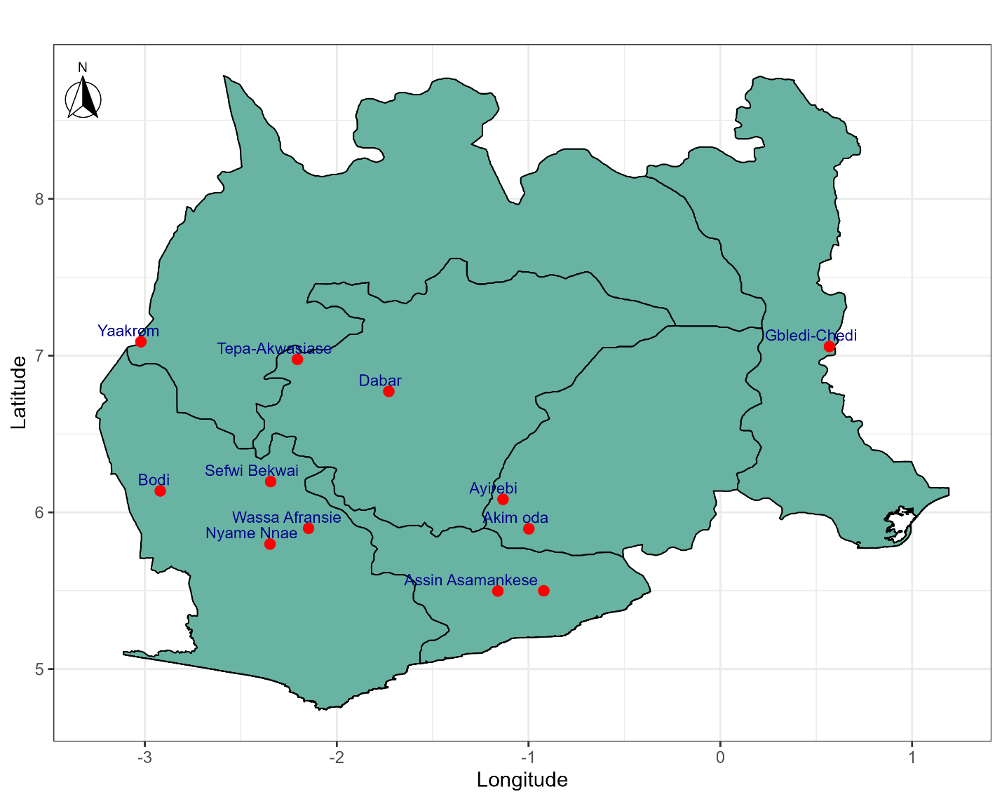
PROJECTED CLIMATE INDICES
Ensemble Mean of 7 CMIP6 models
PRCPTOT uncertain
Decrease in RR1, CWD
Increase in SDII, R20MM, CDD
Rise in mean temperature (Tas)
past (1985-2014), current (2015-2025), and future (2026-2055)
9

Slide 11
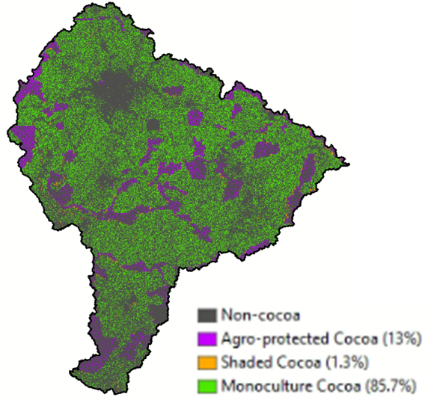
Water Accounting of Cocoa in the Pra basin
Consumed water (ET) represents 88% of the basin rainfall.
Cocoa accounts for 30% of water consumption in the basin (8.8 km³/year) shared between monoculture cocoa (84%), agro-protected cocoa (14%) and shaded cocoa (2%).
Cocoa represents 36% of beneficial water consumption in agriculture and 10% of the overall basin (2.9 km³/year).
biodiversity conservation
1.22 km³/year of unauthorised water consumption due to encroachment by cocoa farms in protected areas.
Dembélé et al, in prep.
¼ of water in protected areas is consumed by cocoa, suggesting dire implications for biodiversity conservation.
Water productivity of cocoa is low and varies between 0.02 kg/m3 and 0.06 kg/m³.
11

Slide 12
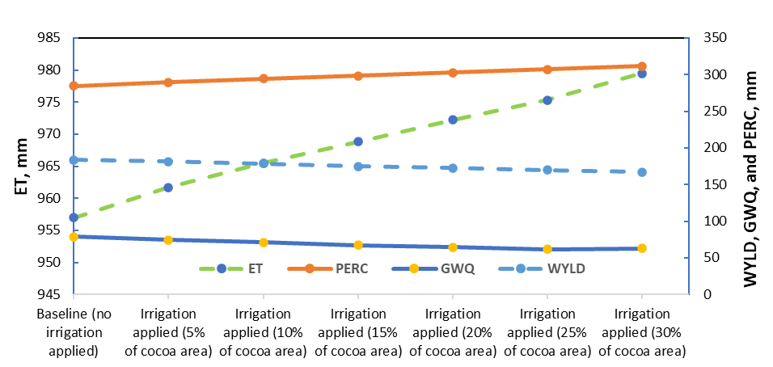
Hydrologic responses of the Upper Offin sub-basin for Cocoa supplemental irrigation
Supplemental irrigation could be applied to at least 5% of the cocoa area (4,760 ha), without notably affecting groundwater resources.
3ha/households➔1875 households
This could be extended to 30% of the cocoa area (28,540 ha/more than 10000 households) without significantly reducing catchment water yield.
These irrigation practices also support environmental demands for groundwater use, as R. van der Meulen et al. (2020) indicated.
The potential of irrigated cocoa production can be realized through optimized use of irrigation practices, which plays a key role in enhancing cocoa productivity while maintaining the sustainability of water resources.
In the Upper Offin sub-basin of Ghana, there is a significant opportunity to boost cocoa production through supplemental irrigation.
10

Slide 13
CONCLUSION
Precipitation has changed in distribution, amount, and extremes in the past
Leading to water deficit and stress in cocoa growing zones in West Africa
The magnitude of deficit and stress depends on the geographical location and the months of the year with implications on cocoa yield
In the future, the frequency and severity could be amplified with negative implications for cocoa development
Supplementary water irrigation could be an alternative option to sustain cocoa production under climate change conditions
12

Slide 14
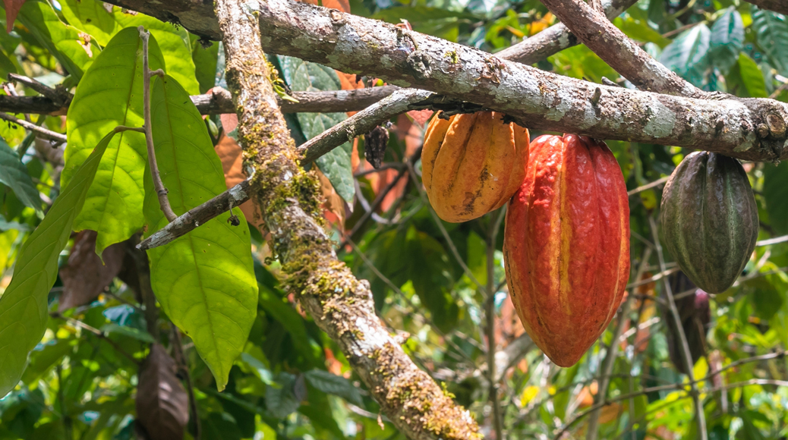
THANK YOU

