Slide 1
Reflections and Learnings from CCAFS
What do we know about gender and CSA
Sophia Huyer, April 5, 2022
Developing a Learning Agenda on Gender and CSA, Nairobi

Slide 2
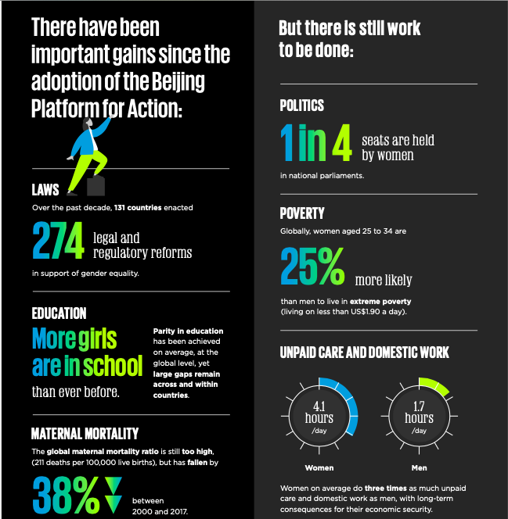
Gender and social inclusion in 2021: Good news and bad news

Slide 3
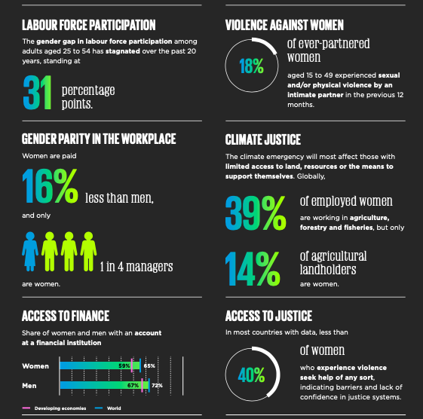

Slide 4
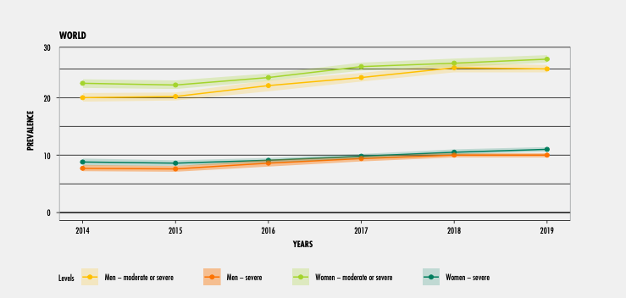
Global food insecurity rates by gender
Women experience high rates of food insecurity than men, both severe and moderate
Notably the rates for women have increased while men’s have remained steady

Slide 5
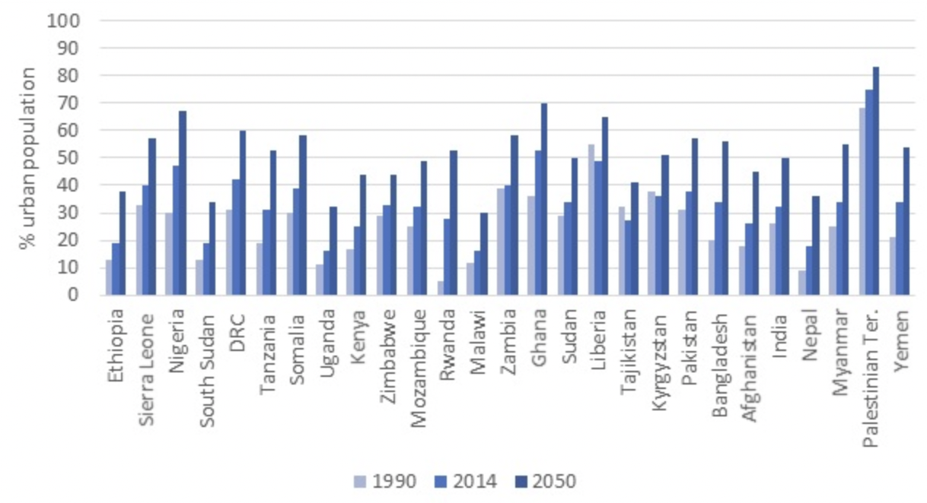
Urbanisation: proportion of population living in urban areas: 1990, 2014, 2050

Slide 6
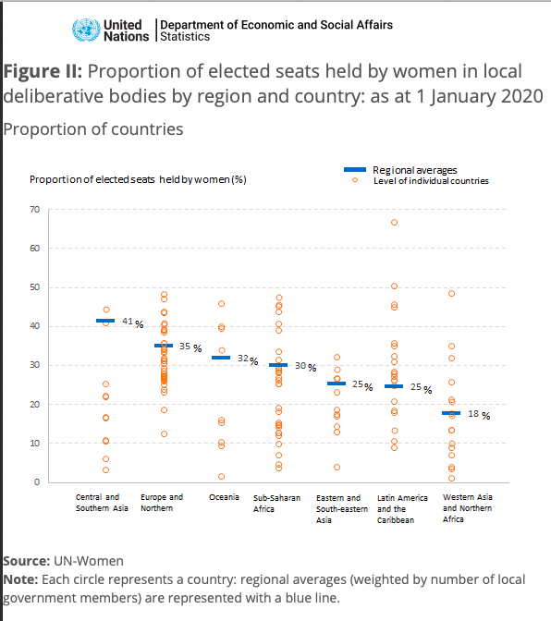
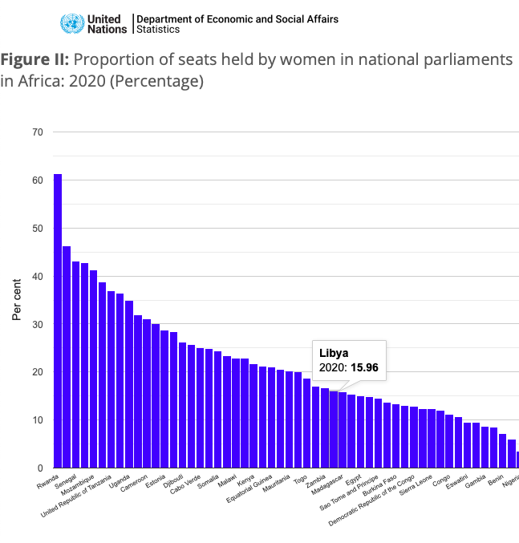
Gender gaps in decision making
Gender gaps in decision making
Gender gaps in decision making decision making
World’s Women 2020

Slide 7
Women’s work in natural-environment based communities
Food procurement, including food gathering and production;
The protection of life, property and territory, including the collection of water, energy sources and fodder; and
Childbearing and rearing, including the maintenance of basic health standards and collection of medicinal plants.
In most of these tasks, women play a predominant role and in performing these they interact directly with the natural environment.
Climate change has varied effects on women and men, since they are exposed to different climate shocks and experience different impacts related to their gender-differentiated roles, rights, and opportunities
Dankelman, Irene, and Willy Jansen. 2010. “Gender, Environment and Climate Change: Understanding the Linkages.” In Gender and Climate Change: An Introduction, London: Earthscan.
Kakota et al, 2011; Gender vulnerability to climate variability and household food insecurity, Climate and Development

Slide 8
Gender effects of climate change
Example: Climate variability impacts on women farmers in Malawi
Climate impacts in Chikhwawa and Ntcheu districts, in southern and central Malawi include direct and indirect impacts: droughts, increased temperatures, late rains, floods and low rainfall levels. Direct impacts are mainly caused by disasters that cause physical harm or stress while indirect impacts are felt through in activities and livelihoods. Increased temperatures have cause heat stress, increased cases of health problems such as malaria and increased demand for water at the homestead. This puts increased stress on human labour in farming and income-generating activities. Reduced rainfall, floods, droughts, late rains and short rain caused crop failure and destruction. Water quality and quantity were affected, with some rivers and wells drying up, reduced firewood supply, and increased cases of water-related diseases. Women carry most of the farming activities and households chores in the area, so that they are the most affected by these effects of climate variability and become most vulnerable to food insecurity.
Source: Kakota et al, 2011

Slide 9
Gender and climate change:
Key concepts
Vulnerability: exposure to climate risks (such as extreme weather events, losses in agricultural productivity, and alterations in hydrological patterns) and capacity to adapt. It is characterized by interrelations between ecological and, increasingly, social sys- tems, such as weather impacts, viability of natural resources, access to markets, and societal safety nets.
Resilience / adaptive capacity: the capacity of communities or house- holds to resist, cope with, or recover from shocks and stresses (Ulrichs et al. 2015) and arrive at a state of reduced or diminished vulnerability (see Perez et al. 2015).
Women’s agency in relation to climate resilience is the ability to access and act on (make choices based on) information and to participate in decisions that affect their lives.
Definition of empowerment: Ability to enhance agency, or the ability to define one’s goals and act upon them along with the power to influence the environment and have power over one’s own life through control of resources, decision making at household or community levels (Kabeer, 1999; Rothman, et al, 2019)

Slide 10
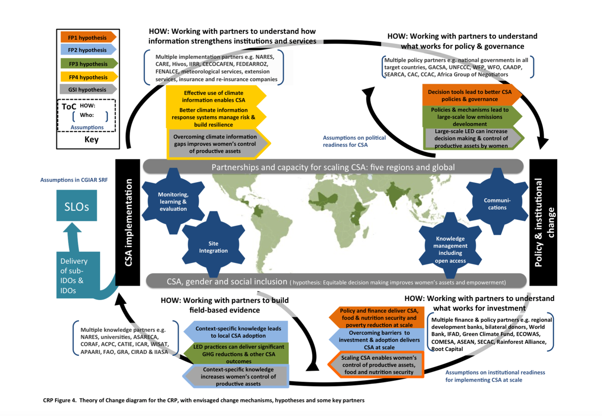
Climate-smart agriculture for food security:
Nature, Lipper et al, 2014

Slide 11
Gender and Climate-smart agriculture
(1st stage)
Increase local institutional effectiveness
Foster coherence between climate & agricultural policies
Close gender and social inequalities in access, use and benefit from institutions and services
Promote women’s enhanced voice in policy-making and governance at all levels; integrate climate, agriculture and gender policies
CSA implementation
Policy & institutional change
Field-based evidence on what works for gender equality, social inclusion and women’s empowerment
Build mechanisms to engender inclusive finance
Link climate and
agricultural finance
Build evidence on what works in CSA

Slide 12
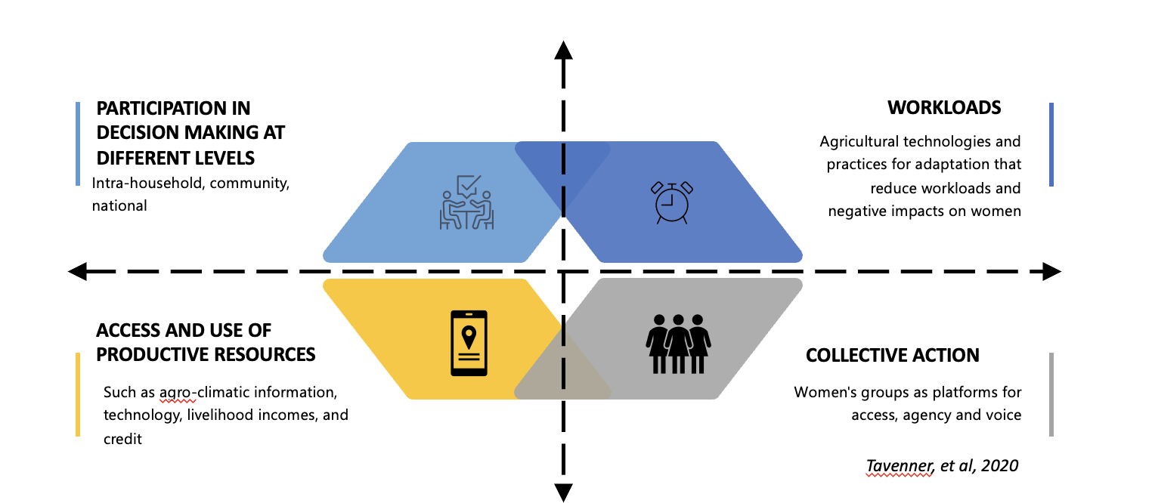
Four gender inequality dimensions of climate resilience
Stage 2: Gender inequality dimensions of climate resilience
Research on CCAFS experience in the last 5 years found 4 key dimensions for promoting gender equality in the context of climate resilient agriculture:
Participation in decision making and exercise of agency at the household, community, national and global levels
Access and control of productive resources such as agro-climatic information, technology, credit and income
Decreased workloads that free up time and ease physical burdens
Collective action as a platform for women to share information and resources, support each other, express their voice, and participate in community decision making
Gender Equality: equal rights, responsibilities and opportunities of women and men and girls and boys; the interests, needs and priorities of both women and men are taken into consideration, recognizing the diversity of different groups of women and men.
From Huyer et al, 2021

Slide 13
1. Gender differences in access and control of resources
Five most common changes made by men and women to adapt to climate change
Women and men tend to have different adaptation strategies and practices
Different preferences in crops and uses for crops
Fewer resources and less decision making power affect their options for adaptation practices
May use a mixture of own labour and new technologies/practices
Mutenje, M. J., et al. 2019.
Twyman, J et al. 2014

Slide 14
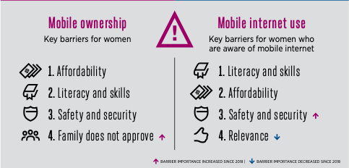
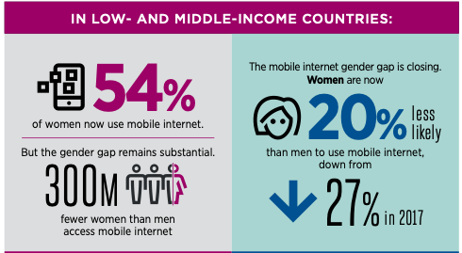
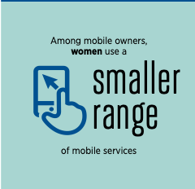
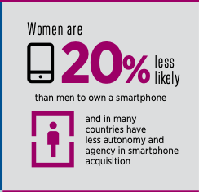
Gender digital gap
Gender digital gap
The digital gap in mobile access is closing, although not in rural areas
Men use higher quality digital technologies for more sophisticated uses including internet access
Affordability is a big barrier for women – technology as well as access costs
Gender norms also play a role in lower rates of ownership
GSMA, 2020

Slide 15
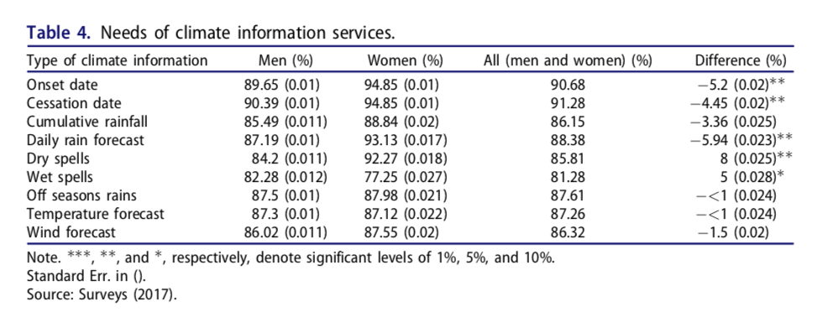
Differences in information priorities
Differences in information priorities
Differences in information priorities
This table indicates the gender differences in preferences for climate information, based on women’s and men’s differing production activities. For example, if HH labour is prioritized for men’s land and crops, then women’s crops will be sowed or harvested at different times in the planting season and they may need different climate information.
Diouf, Ndeye Seynabou et al. 2019.; Gumucio et al, 2020; GSMA, 2012

Slide 16
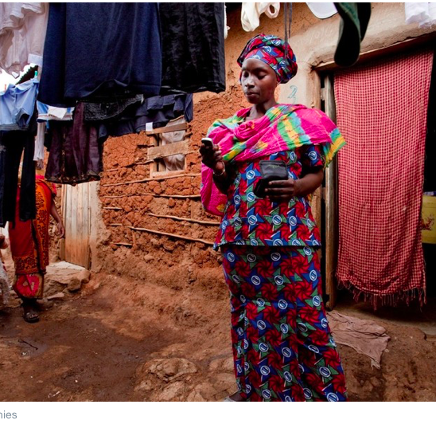
Digital finance is inclusive
Inclusive climate finance
Still an elusive goal
Few models: index insurance; mobile money?
Ndiaye, 2013; Suri & Jack, 2016

Slide 17
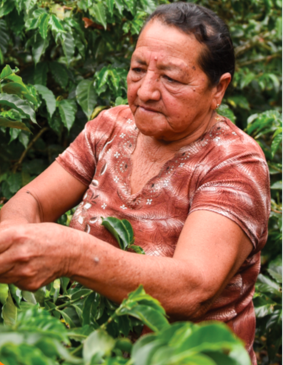
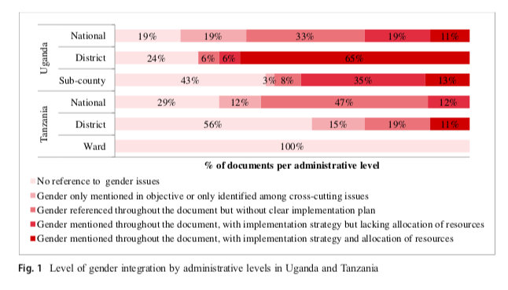
2. Decision making in climate-resilient agriculture agriculture
At the household level – CSA can lead to greater empowerment; greater empowerment leads to CSA adoption
Integration of gender issues is low but increasing in national and global policy but steadily decreases down to the local level
Ampaire et al, 2020
Experience working with stakeholders on gender and climate policy: Mulema et al, 2021
Gumucio et al, 2017

Slide 18
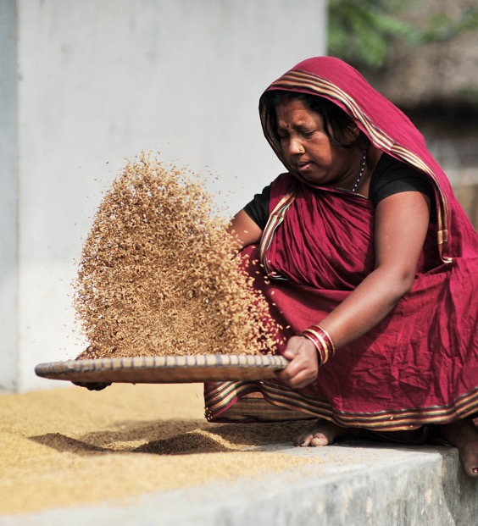
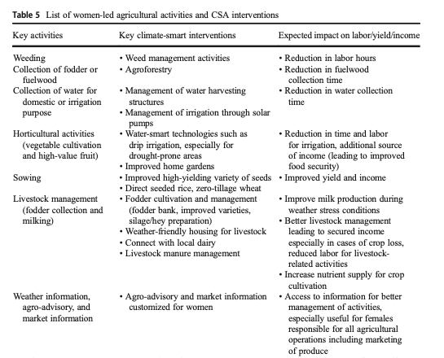
3. Reducing workloads: gender-responsive technologies
3. Reducing workloads
In many regions, women have insufficient access to technologies, energy and labour for their agricultural production
Women are often expected to contribute their labour to new CSA activities (weeding, processing, etc)
Women will choose a balance of labour-intensive CSA technologies and labour-reducing technologies for reasons of cost (substituting their labour)
Migration trends leave women with increased workloads at home and in the fields
Mutenje et al, 2019
Murray et al, 2016
Khatri-Chhetri et al, 2020
Notes:
FAO; Huyer, 2016; Murray et al, lack of access to technology

Slide 19
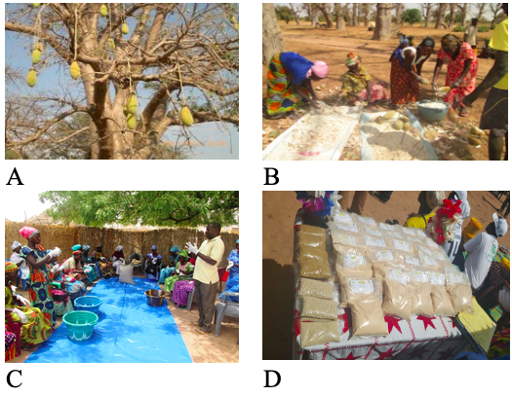
4. Collective action for equality in Daga Birame, Senegal
CSA Women Groups in Senegal
Women’s control over forest resources and participation in community decision increased through establishment ofa women’s CSA group for fruit processing
Women and men participated equally on a community environment committee
A women-run microenterprise processed and sold baobab fruit powder from local baobab trees.
Marketing and income management were carried out by the women-run enterprise
A village savings pool was set up to invest in community resilience activities
Agricultural production increased and natural resource management improved
Ouédraogo, Mathieu et al. 2018.

Slide 20
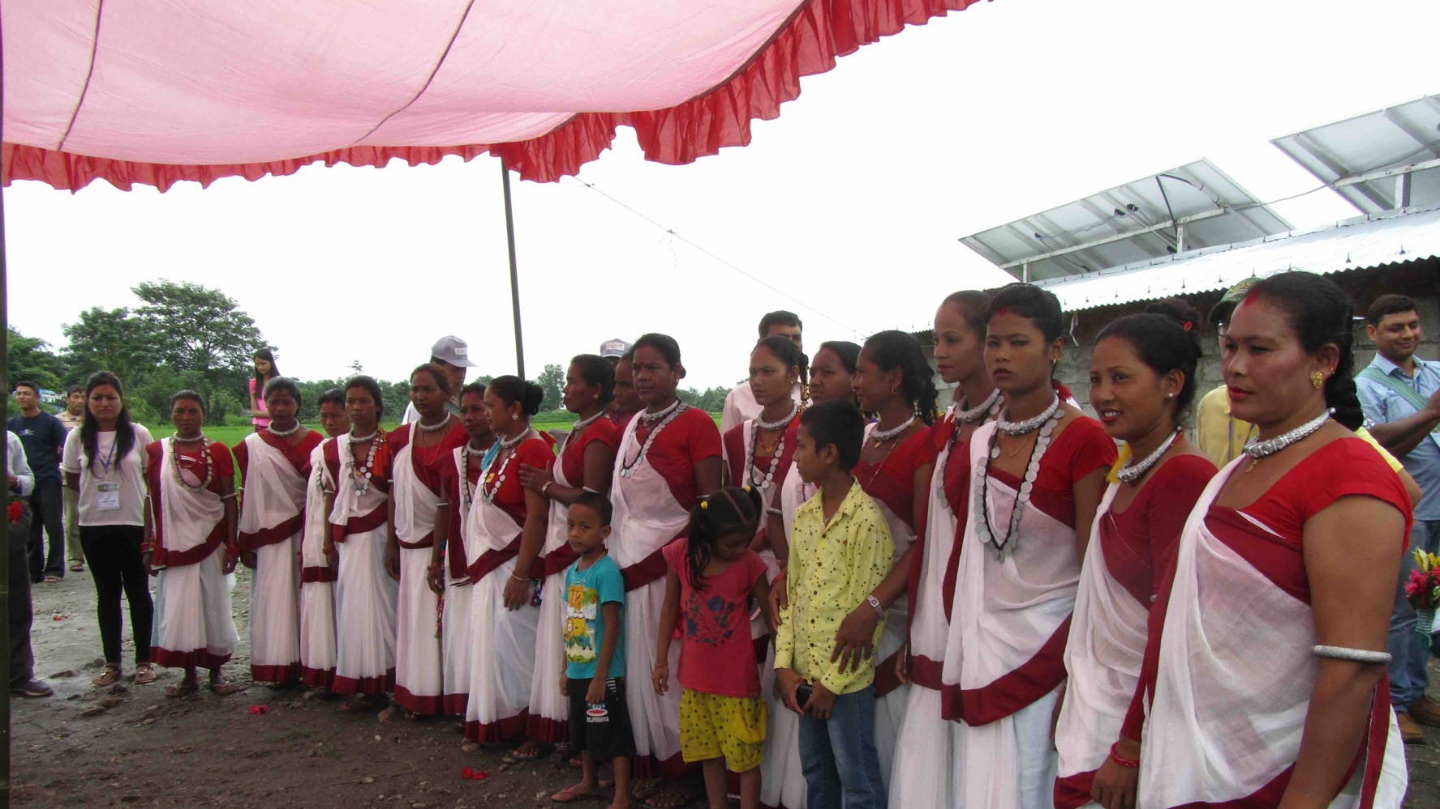
Solar irrigation management through women’s organizations in Nepal
Solar irrigation management through women’s collectives in Nepalwomen’s
Empowering Women farmers for Climate Chanage Adaptation in Nepal
Notes:
Photo: Sophia Huyer, CCAFS

Slide 21
4. Gaps and opportunities looking forward
CSA Women Groups in Senegal
What technologies work for women? Reductions in workload, increases in income, priorities and benefits
The importance of agro-climatic information to women: benefits, potential for empowerment, ability to benefit from digital technologies
How to increase the participation of women and men in formulation of climate policy; models for better gender content in climate policy
How to really do intersectional research
How to do masculinities research? How to integrate men into gender and social inclusion?

