Slide 1



Tropical Poultry Genetic Solutions (TPGS) : Delivering farmer preferred, productive and ecologically adapted poultry to smallholders
Tadelle Dessie (ILRI)
CTLGH Virtual Development Meeting
2-3 December 2021

Slide 2
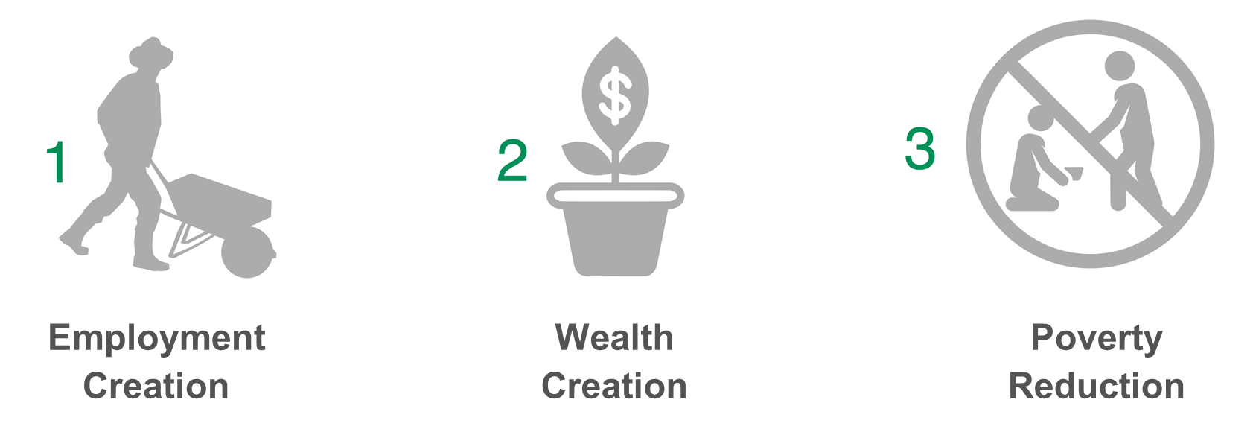
The three cardinal aims of TPGS–outcomes

Slide 3
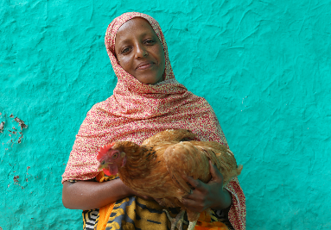

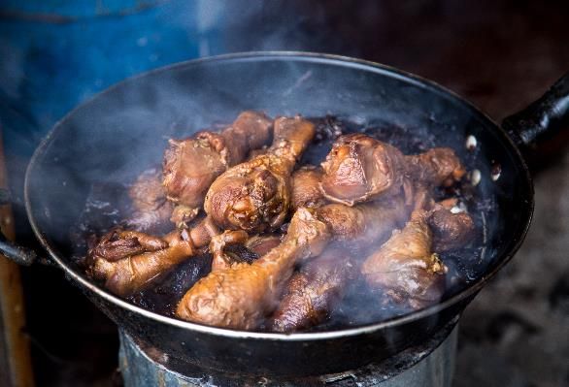




TPGS: Objectives
1
Characterize chicken ecotypes and farmer preferences
2
Develop partnerships and breeding approaches
3
Develop and test dissemination mechanisms
4
Improve the policy and regulatory environment and track program
impacts
5
Establishing the Tropical Poultry Platform (TROP)

Slide 4
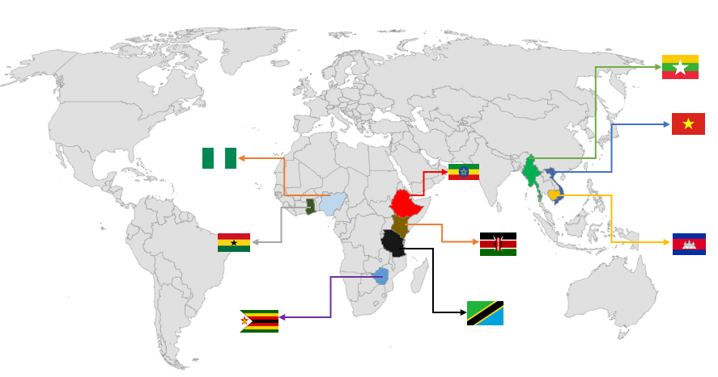

Slide 5
TPGS - Few activities 2022 and beyond –Examples

Slide 6
Lines/breeds/crosses that are under on-farm test in Ghana, Kenya and Zimbabwe
Country | Breeds under testing
Ghana | Kuroiler
 | Hubbard 1 - RIRJA (JA57)
 | Hubbard 2 -REDJA (JA57)
 | Local
Kenya | Hubbard 1 - RIRJA (JA57)
 | Hubbard 2 -REDJA (JA57)
 | Kuroiler
 | KARLO line one
 | KARLO line two
Zimbabwe | Sasso * Sussex
 | Rainbow T (TR)
 | Ruby C (C44)
 | Boschveld Local

Slide 7
Fig 1. Week six body weight (Mean± SD) of RIRJA, REDJA Hubbard lines as compared to locals measured under on-farm conditions of Kenya

Slide 8
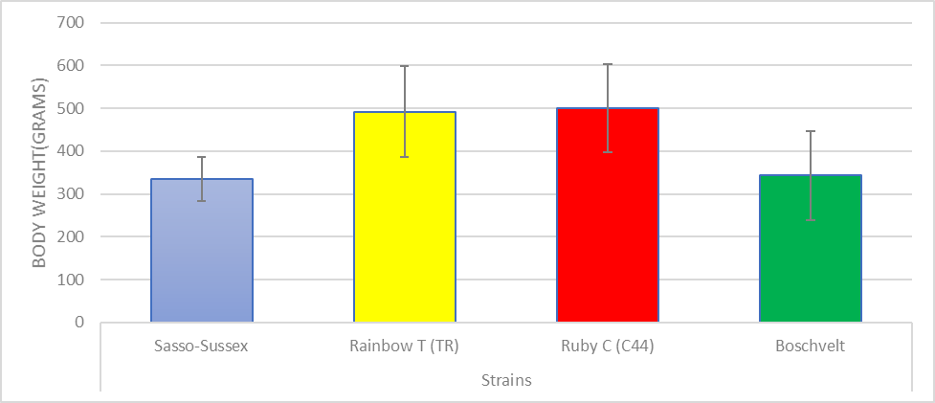
Fig 2. Week six body weight (Mean± SD) of mixed-sex Sasso-Sussex, Rainbow T(TR) and Rubby C (C44) strains as compared to locally developed Boschvelt measured under on-farm conditions of Zimbabwe

Slide 9
On-going indigenous chicken breeding programs in sub-Saharan Africa (example)
Three ongoing programs: Naivasha, Kenya (KALRO 1 and 2 lines), Bahir Dar, Ethiopia (Tilili chicken) and Mtwara, Tanzania (Horasi chicken)
        Ecotypes selected based on prior studies and priorities of respective countries
Breeding goal: Body weight, egg number, Age at first egg and survival
Target: achieve at least 1500 grams at week 16 on both sexes, and 200 eggs /year on the females
BLUP to be employed once parameters estimates will be ready

Slide 10
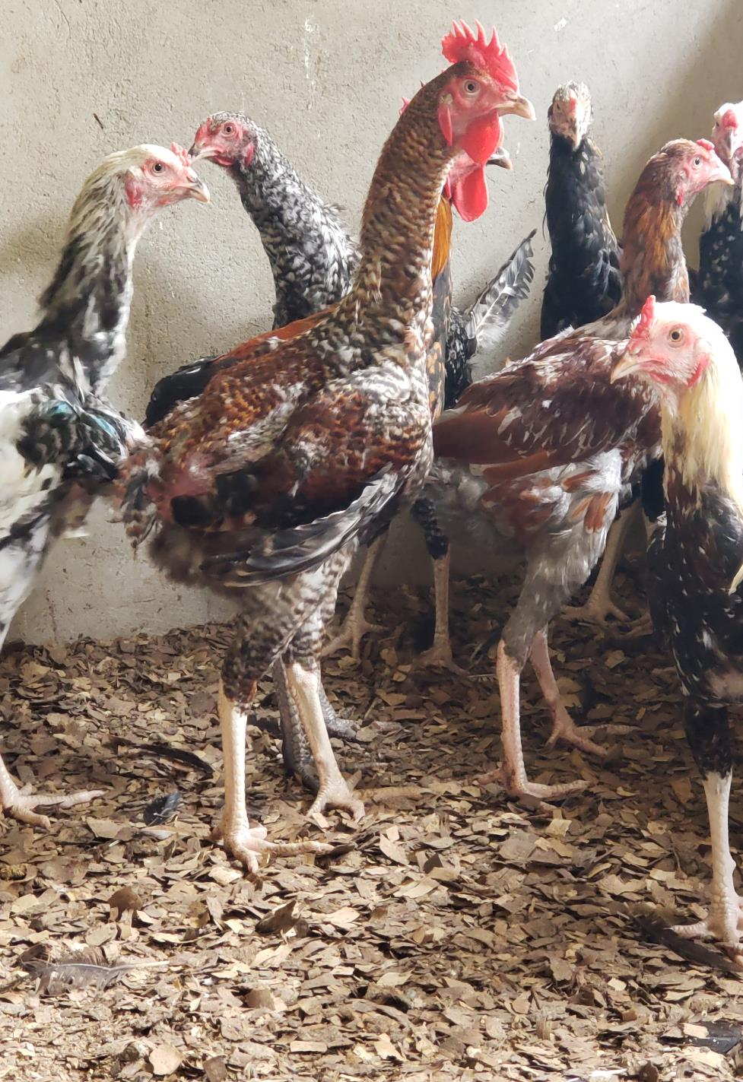
Mean (SD) body weight of Un-selected and Selected Horasi males at Week 16 (G0) at Mtwara, Tanzania

Slide 11
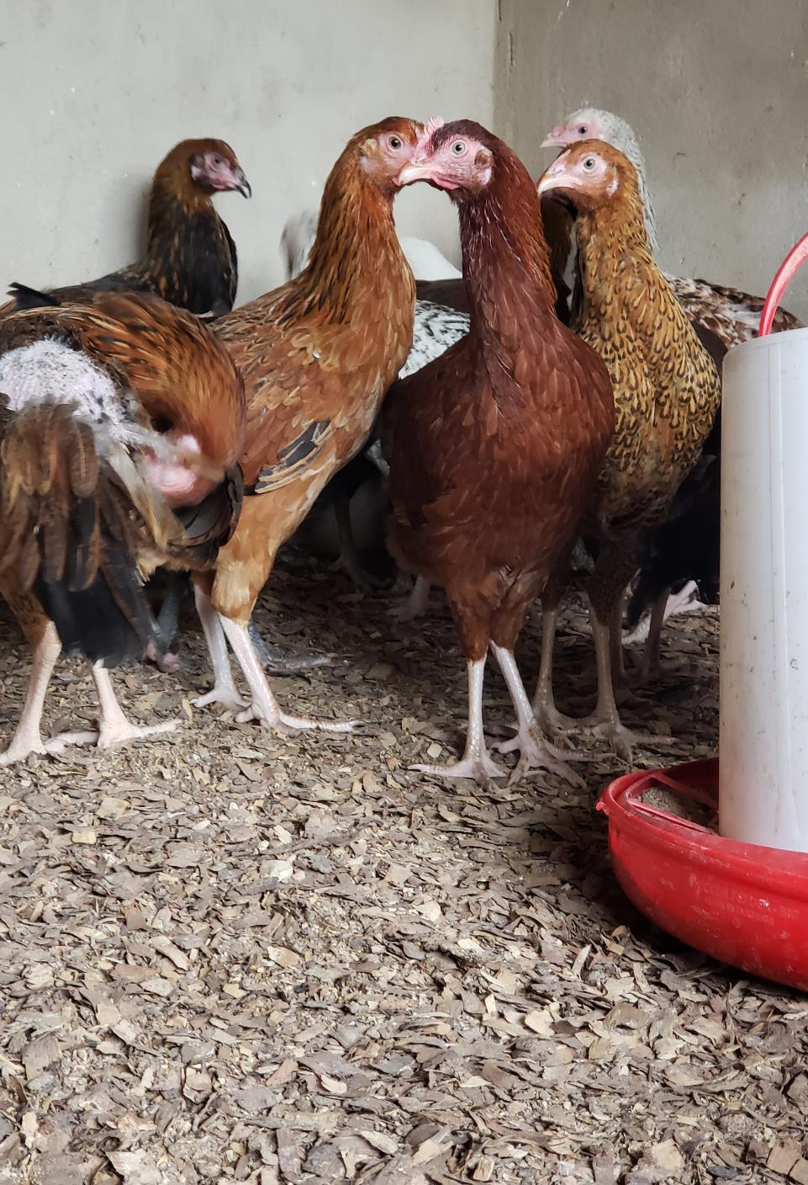
Mean (SD) body weight of Unselected and Selected Females at Week 16 (G0) at Mtwara, Tanzania

Slide 12
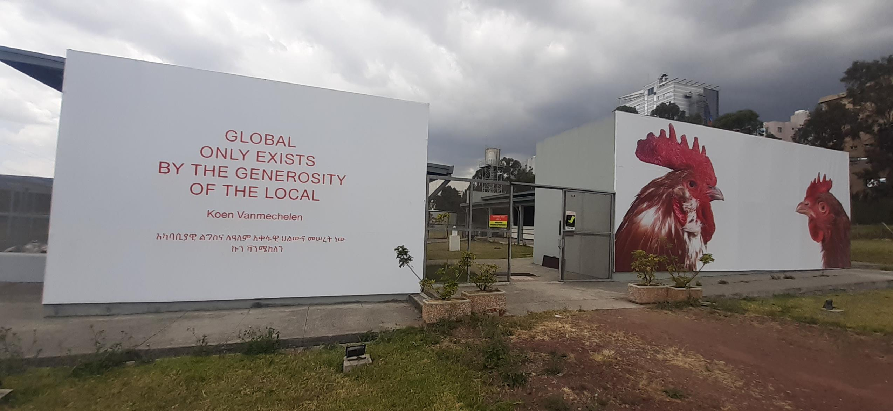
ILRI AA poultry facility

Slide 13
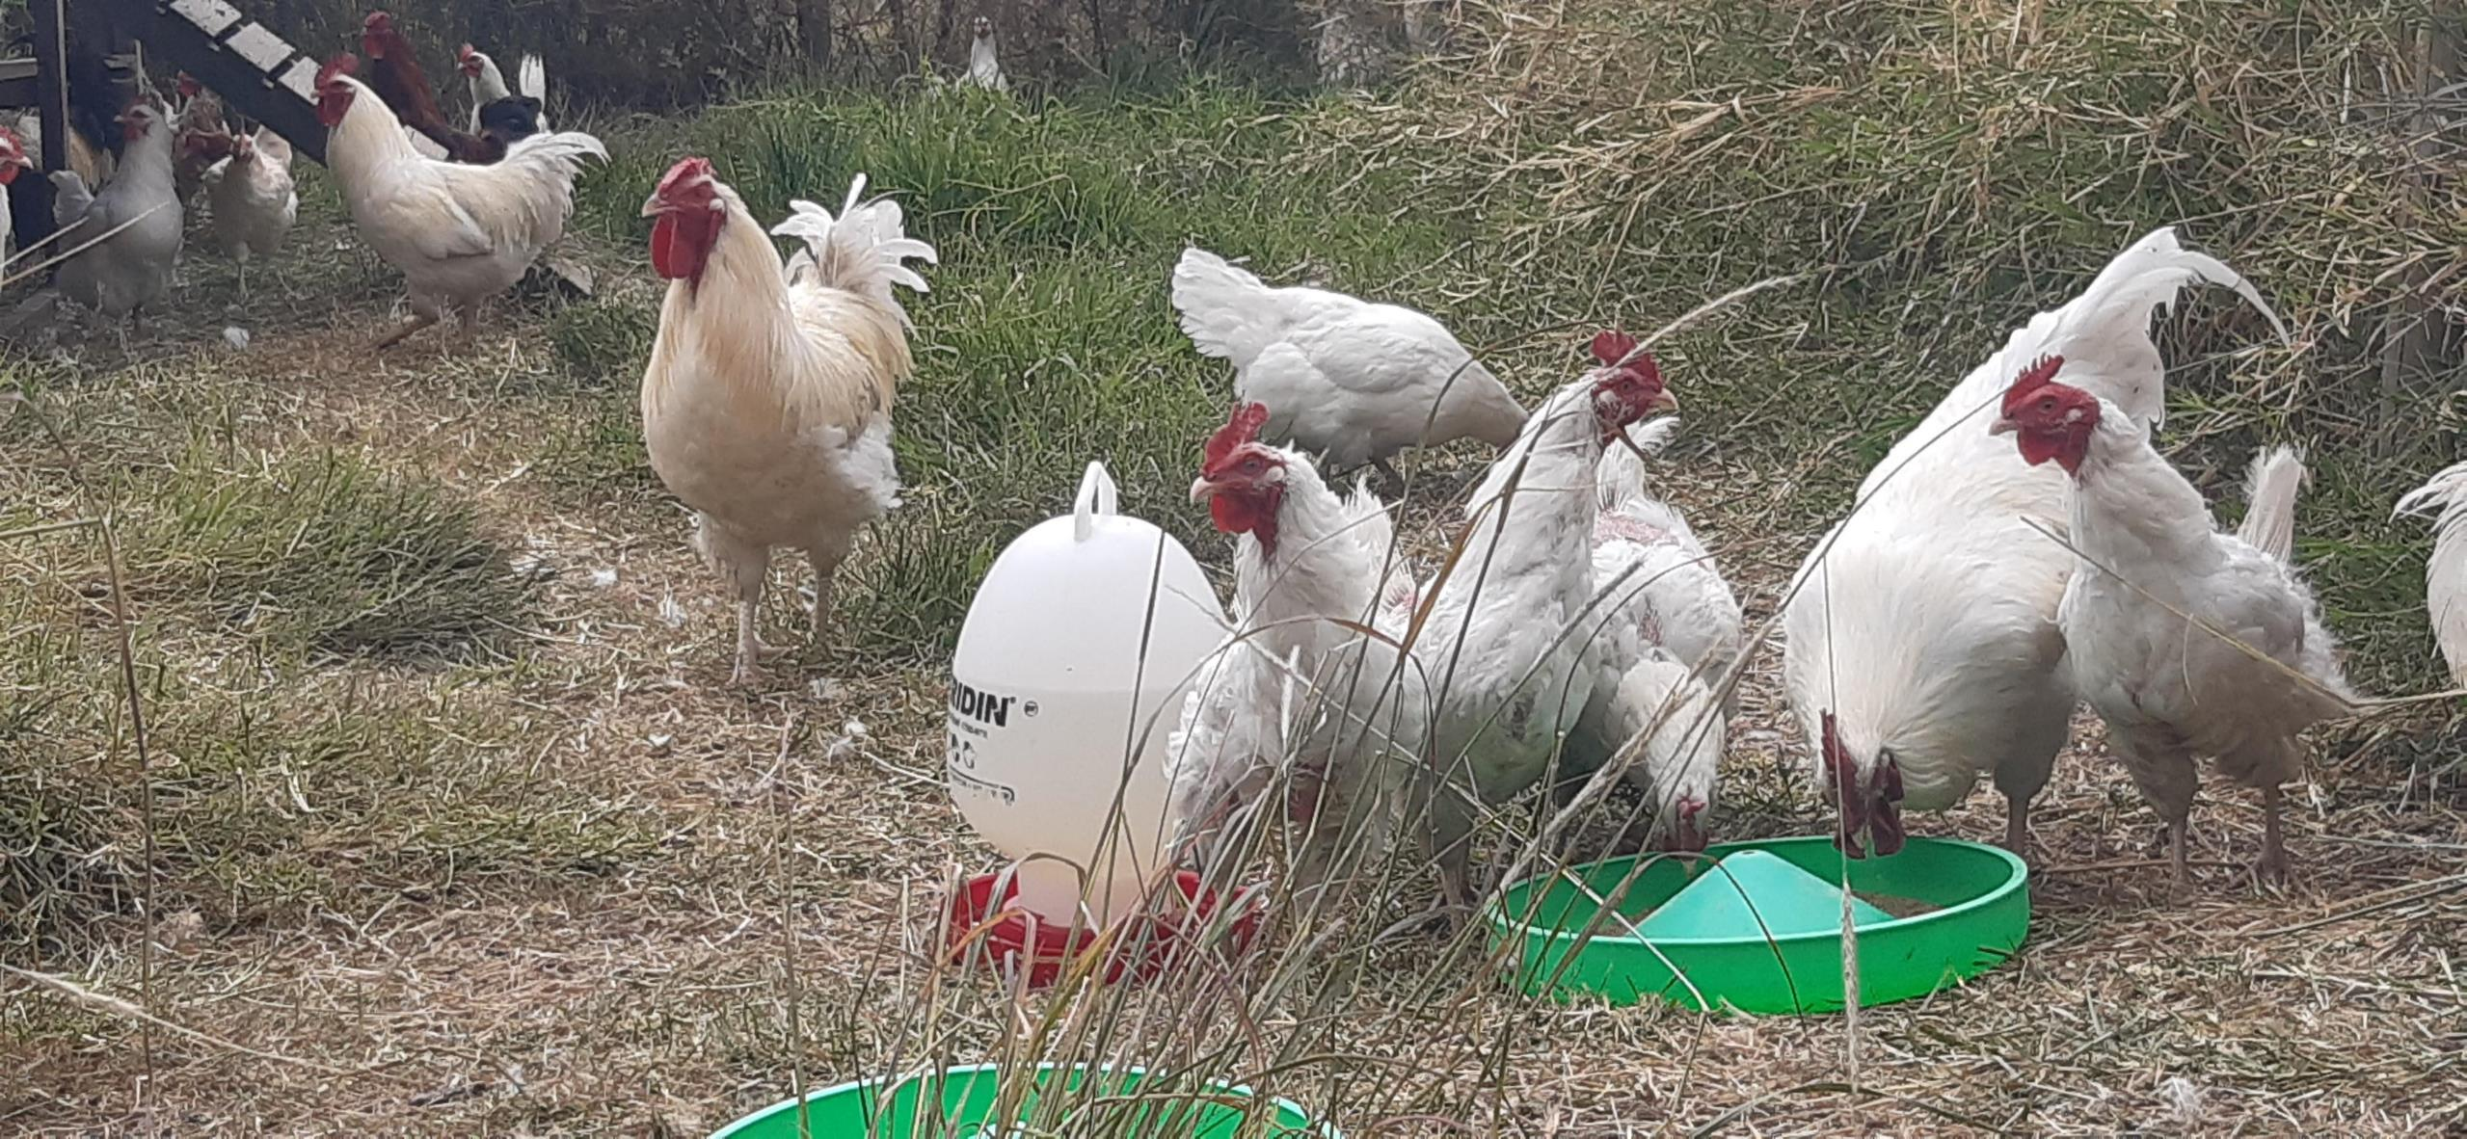
Scavenging/grazing ground in AA Poultry facility

Slide 14
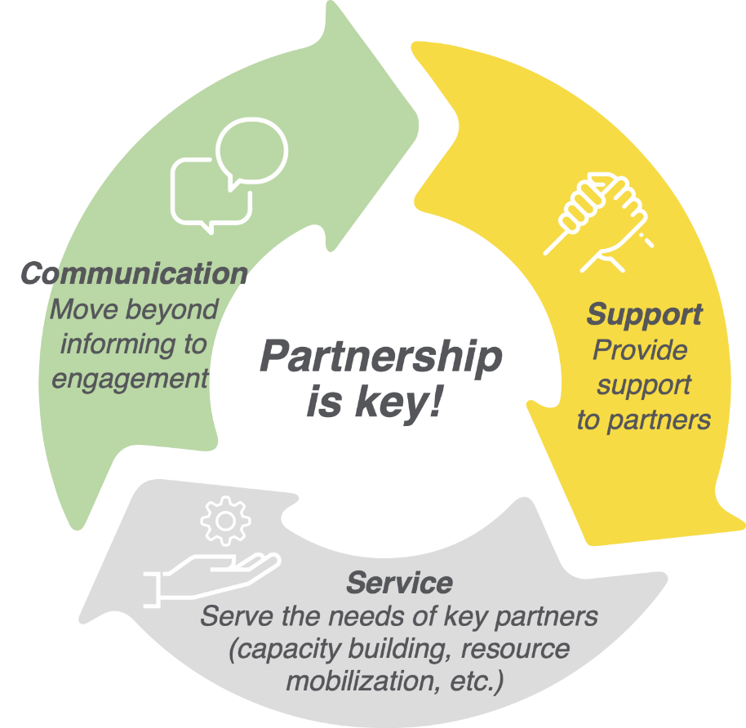

Partnerships– integrated into TPGS’s core business

Slide 15
TPGS- Partnership - Important categories of partners
Genetics companies
(Int & Nat)
National
Systems
(Res & Dev)
TPGS
Advanced Research Institutes
Input and services providers

Slide 16
TPGS – What we offer to CTLGH
1
On-station breed improvement and test (Addis facility) – Individual birds, pedigreed data etc
2
On-farm data – group data with a possibility to get data points from individual birds in few
household, environmental data
3
Blood/tissue samples/DNA
4
Feedback on the performance of lines and preference of farmers in different geographies
and agro-ecologies
5
Functioning partnerships in different level and data collection infrastructure

Slide 17
TPGS- What we need from CTLGH
Help to identify, define and measure of environmental resilience and adaptation traits on farm but also ex-situ (novel approaches) –build database
Help to identify genes/markers and that are important to smallholder chicken producers in terms of resilience, environmental adaptability and productivity
Help address the interface between health – nutrition – genetics
Help in the design/implementations of NARS breeding improvement programs in the areas of genomic selection and in running effective breeding programs
Fellowship support for African/Asian graduate fellows with a sandwich training program (taking place both in Africa/Asia and the UK) on CTLGH areas as well TPGS ones with co-CTLGH institution supervision.

Slide 18
Thank you very much!
THANK YOU

