Slide 1
Food safety research evidence for action: Experiences from Ethiopia
Kebede Amenu, Silvia Alonso, Florence Mutua, Sinh Dang-Xuan, Theo Knight-Jones and Delia Grace
United States Agency for International Development Resilience Learning Activity quarterly learning meeting
25 June 2024, Addis Ababa, Ethiopia

Slide 2
Contents
Foodborne disease burden in Ethiopia
Food safety research at ILRI and Ethiopia
Food safety research: evidence generation and use (Cases)
  Pull-Push Project
  EatSafe Project
  FtF Livestock Systems Innovation Lab (Borana milk project)
Recommendation

Slide 3
Who is working on what, related to food safety?
Dairy
Meat (red or white)
Fish and sea foods
Vegetables and fruits
Tubers
Cereals and/or grains
Processed foods
Drinks (beverages)

Slide 4
Foodborne disease burden in Ethiopia (three pathogens)
 | Incidence (illness) | Death | DALYs
Salmonella | 2,800,000 | 704 | 62,600
Campylobacter | 1,070,000 | 1,170 | 91,300
Enterotoxigenic E. coli (ETEC) | 1,110,000 | 1,420 | 101,000
Total | 4,980,000 | 3,294 | 254,900
 | ~1/20 | 3,300 | 260,000
Havelaar AH, Sapp AC, Amaya MP, Nane GF, Morgan KM, Devleesschauwer B, Grace D, Knight-Jones T, Kowalcyk BB. Burden of foodborne disease due to bacterial hazards associated with beef, dairy, poultry meat, and vegetables in Ethiopia and Burkina Faso, 2017. Front Sustain Food Syst (2022) 6:1024560. https://doi.org/10.3389/fsufs.2022.1024560

Slide 5
Cost of foodborne disease in Ethiopia based on WHO estimates updated to 2017
Three pathogens, all foods: 723 million Int$₂₀₁₇
0.9% of Gross National Income
  productivity losses 513 million (70%)
  deaths 192 million (29%)
  pain and suffering 18 million (4%)
“ In Ethiopia, costs caused by NTS and CAMP in chicken meat (192 million) were nine times higher than those caused by NTS and ETEC in tomatoes (21 million)”.
Van Wagenberg CPA, Havelaar AH. Economic costs related to foodborne disease in Burkina Faso and Ethiopia in 2017. Front Sustain Food Syst (2023) 7: 1227430.
https://doi.org/10.3389/fsufs.2023.1227430

Slide 6
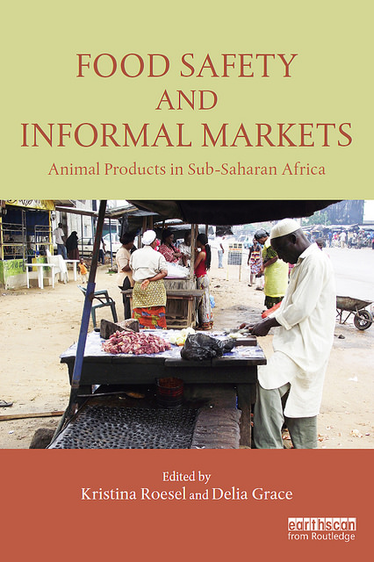
Food safety research at ILRI, Approach
Health first: Better address the health of domestic consumers dependent on informal markets.
Risk-based: Build capacity for well-governed, evidence-and risk-based food safety systems.
Market-led: Harness marketplace drivers of progress on food safety.
Notes:
Our research is oriented towards improving the health of the domestic consumer, who depend on informal markets.
Our research is based on the principles of risk-based approaches, including working with local partners to grow capacity on this.
Our work is market-led, putting the local market as a primary focus of our work.

Slide 7
Evidences to actions: Interventions?
“Our study identified unhygienic practices both at the slaughterhouses and retail shops that can predispose the public to meat-borne infections, which could be improved through training and implementation of quality control systems”.
Time gaps between research evidence generation and actions!
Time
An example of common scientific paper recommendation

Slide 8
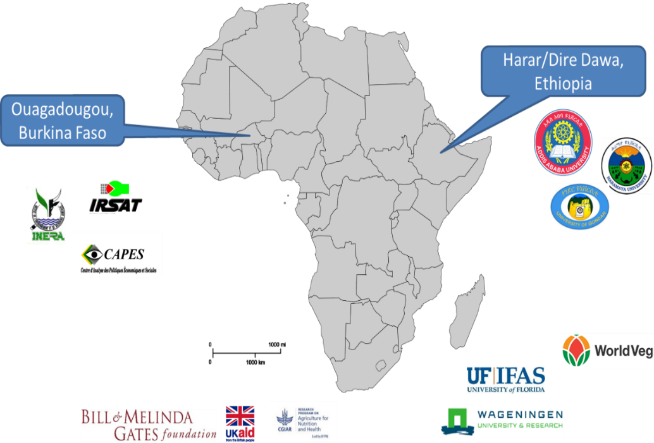
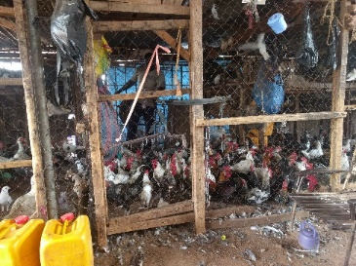
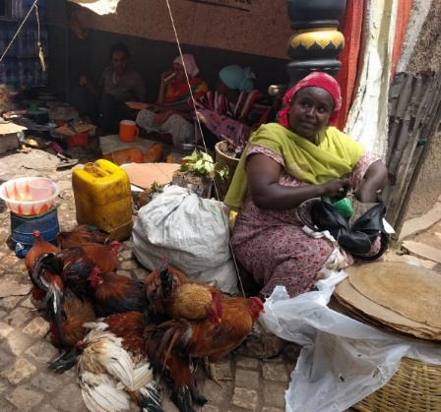
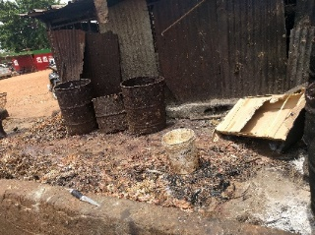
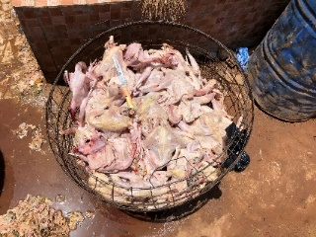

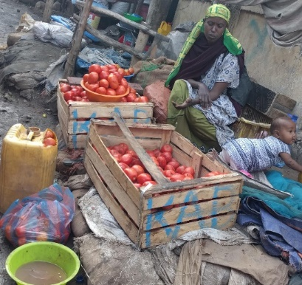
Pull-Push: Urban food markets in Africa
Incentivizing food safety using a Pull–Push approach
Chicken
Salmonella spp. and Campylobacter spp.
Vegetables
Salmonella spp. and enterotoxigenic E. coli
Key question: “Can consumer demand be harnessed to drive better food safety in African urban food markets?”
2019-2023
Focus on chicken and vegetables
Focus on key disease agents that cause much of the burden
Notes:
Note hygiene in these value chains is very poor, with poor infrastructure and facilities
Practices that cause massive microbial contamination are routinely performed

Slide 9
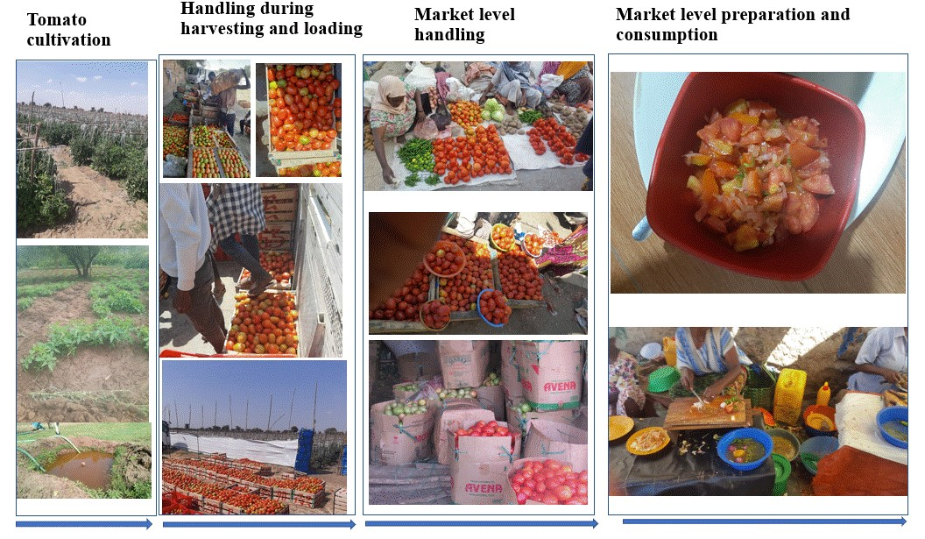
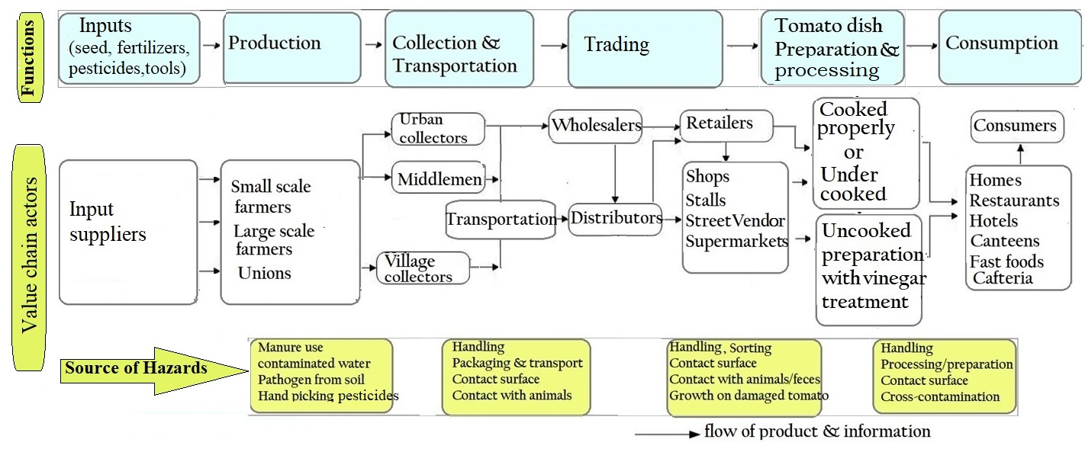
Complex vegetable value chains

Slide 10
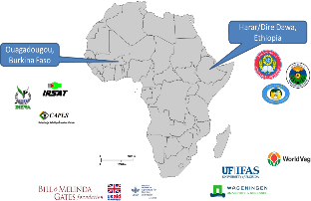

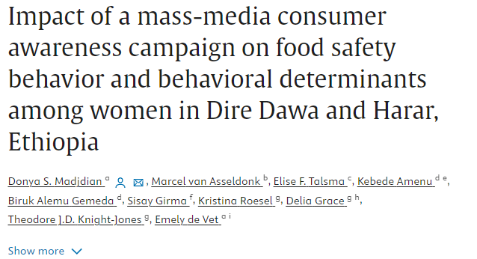
Pull-Push: Urban food markets in Africa
Incentivizing food safety using a Pull–Push approach
Understanding food value chains
Foodborne disease burden estimates and economic costs
Key results
Complex value chains and risky hygienic practices
330,000 cases, 320 deaths, 24,000DALYs: NTS & ETEC vegetables
Economic cost of three pathogens: US$723 m/year (1% of GDP in Ethiopia)
Design of interventions: Communication campaign and use of plastic crates for bulk tomato transport
Consumer campaign significantly changed consumer behaviour (comparing before-after evaluations)
Use of reusable plastic crates significantly reduced damage of tomatoes
Implement and evaluate interventions

Slide 11
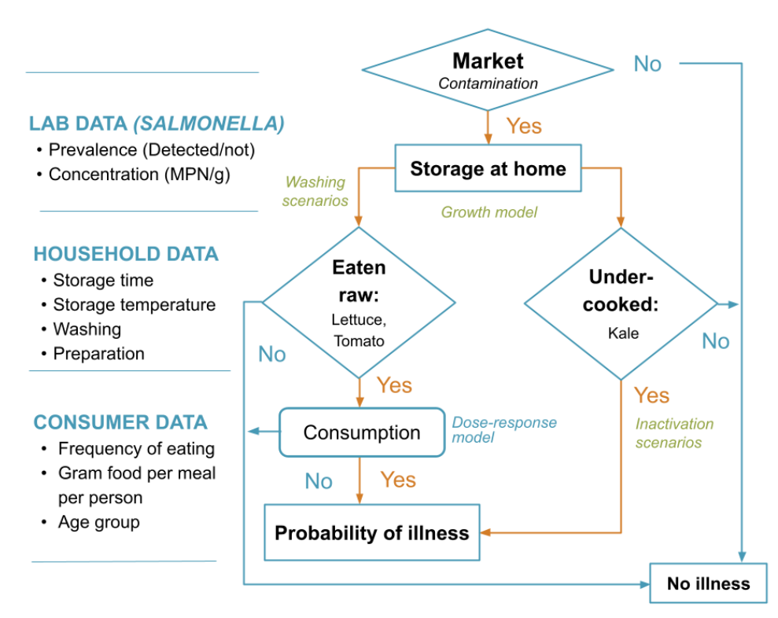
EatSafe: Evidence and Action Towards Safe, Nutritious Food
Evidence ‘integrated’
Salmonella transmission model from retail to consumption
Food Safety Hazards and Risk Associated with Fresh Vegetables: Assessment from a Traditional Market in Southern Ethiopia (gainhealth.org)

Slide 12
Evidence integrated
Daily and annual incidence of salmonellosis of the key commodities, by age group
AGE GROUP | LETTUCE |  | TOMATO |  | KALE
 | MEAN | 5%-95% RANGE | MEAN | 5%-95% RANGE | MEAN | 5%-95% RANGE
Daily incidence of salmonellosis (illness cases per 10,000)
Children (< 5 years old) | 0.4 | 0 - 2.3 | 0.1 | 0 - 0 | 0.04 | 0 - 0
Youth (6-15 years old) | 3.3 | 0 - 15.3 | 0.6 | 0 - 0.6 | 0.9 | 0 - 0.7
Adult (16-60 years old) | 5.9 | 0 - 24.6 | 0.9 | 0 - 1.4 | 1.3 | 0 - 1.6
Older adult (>61 years old) | 0.1 | 0 - 0 | 0.1 | 0 - 0 | NA | NA
Overall daily incidence | 4.54 | 0 - 18.1 | 0.8 | 0 - 1.2 | 1.0 | 0 - 1.8
Annual incidence of salmonellosis (%)
Children (< 5 years old) | 1.2 | 0 - 8.5 | 0.2 | 0 - 0 | 0.1 | 0 - 0
Youth (6-15 years old) | 9.2 | 0 - 42.8 | 1.0 | 0 - 2.2 | 1.8 | 0 - 2.5
Adult (16-60 years old) | 15.0 | 0 - 59.3 | 1.6 | 0 - 4.9 | 2.5 | 0 - 5.6
Older adult (> 61 years old) | 0.2 | 0 - 0 | 0.2 | 0 - 0 | NA | NA
Overall annual incidence | 11.7 | 0 - 44.4 | 1.3 | 0 - 4.1 | 1.9 | 0 - 6.1
Food Safety Hazards and Risk Associated with Fresh Vegetables: Assessment from a Traditional Market in Southern Ethiopia (gainhealth.org)

Slide 13
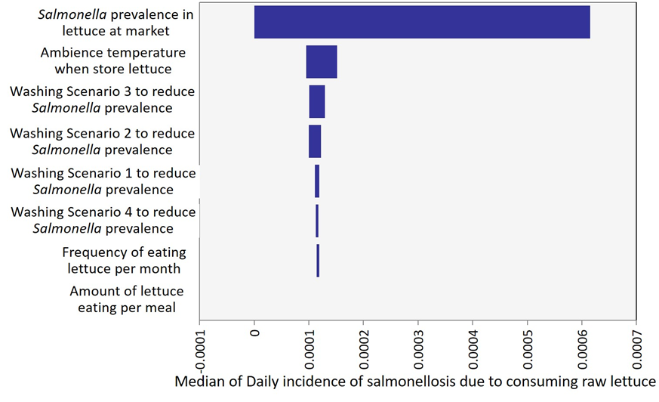
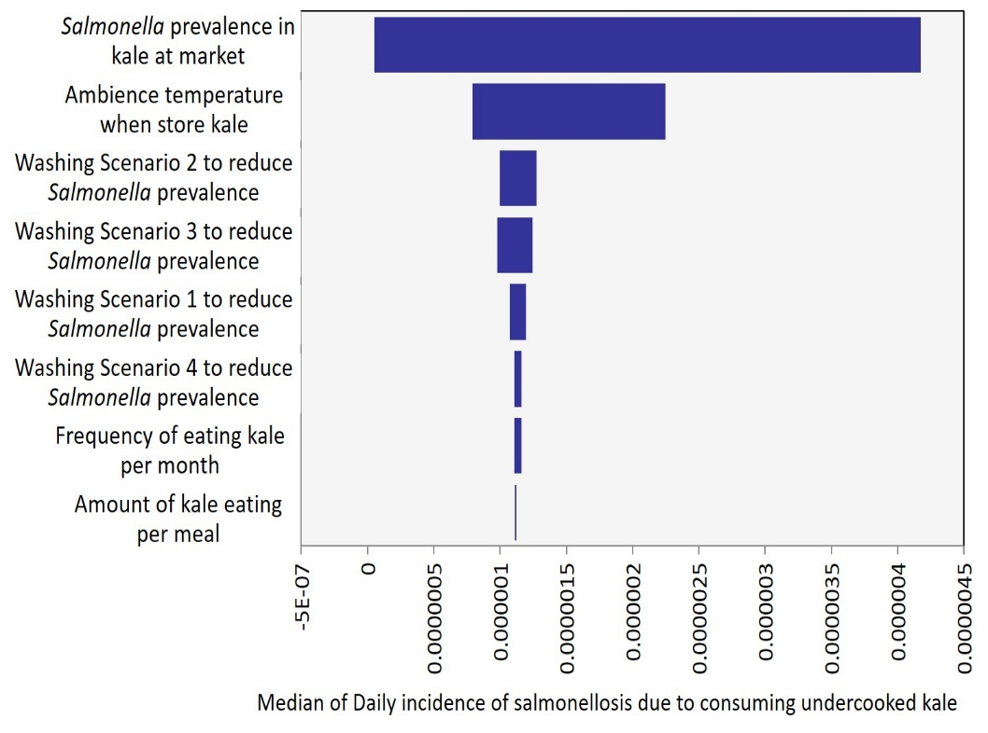
Evidence integrated
Factors affecting risk from consuming contaminated food and priorities for intervention
(A)
(B)
Sensitivity analysis: factors affecting risk from consuming raw lettuce (A) and undercooked kales (B).
Food Safety Hazards and Risk Associated with Fresh Vegetables: Assessment from a Traditional Market in Southern Ethiopia (gainhealth.org)

Slide 14
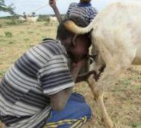
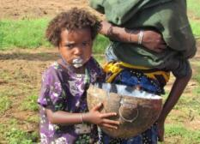

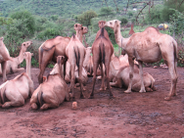
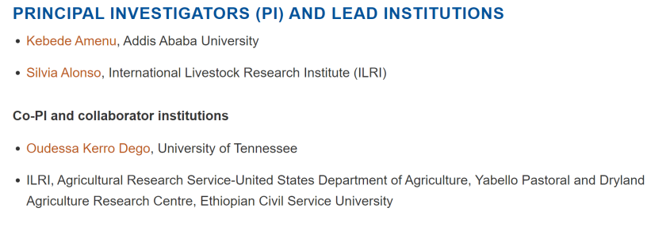
Improving Handling Practices and Microbiological Safety of Milk and Milk Products in Borana Pastoral Communities, Ethiopia

Slide 15
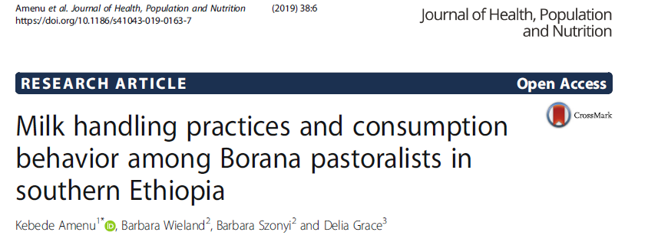
Risky Milk Consumption

Slide 16
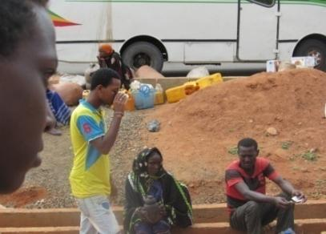
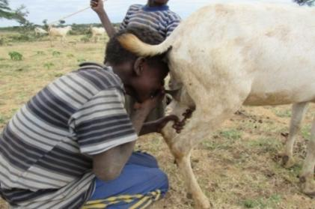
Risky milk consumption…
High raw milk consumption:
-the perception that “boiling of milk destroys vitamins”,
-“boiled milk is considered dead” ➔boiling of milk reduces the nutritional quality of milk
Children consume fresh goat milk during herding directly from udder (luugoo)

Slide 17
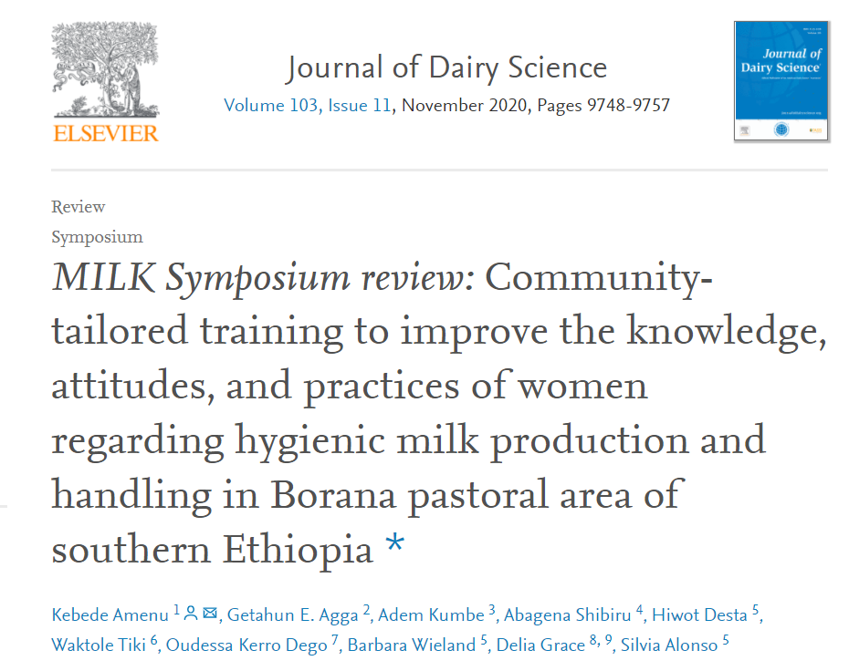
Milk hygiene training intervention
The intervention improved knowledge, attitudes and practices on milk hygiene compared to the baseline, several participants still continued to have negative attitudes and wrong practices after the training

Slide 18
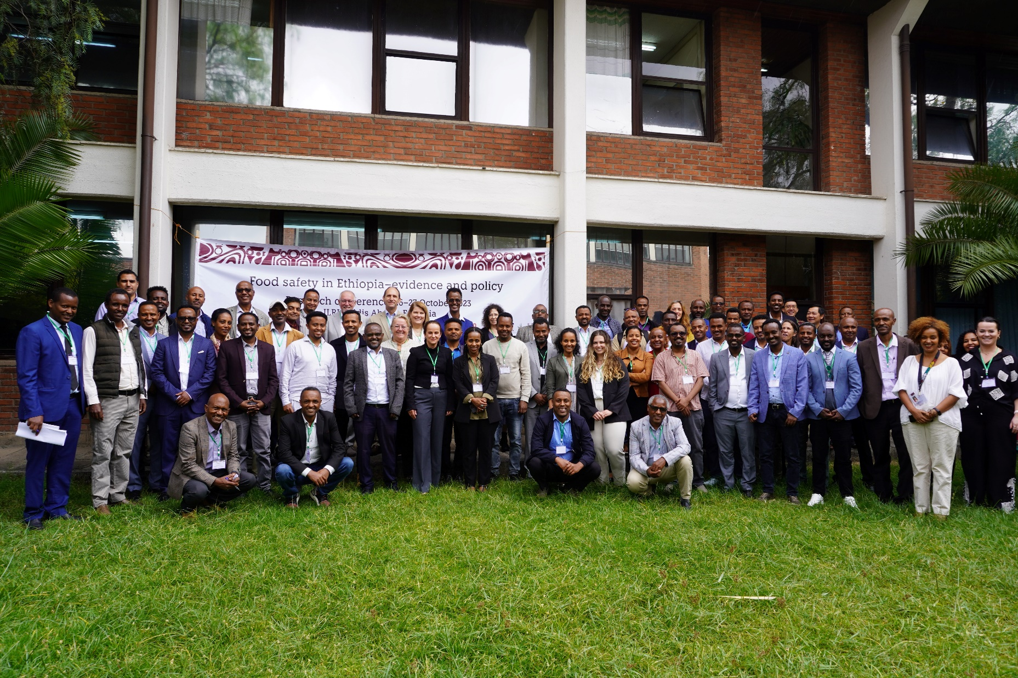
Food Safety Research Conference (Oct 2023)

Slide 19
Food Safety Research Conference (Oct 2023)
Pull-Push: Urban food markets in Africa Incentivizing food safety using a Pull–Push approach.
TARTARE: The Assessment and Management of Risk from non-typhoidal Salmonella, Diarrheagenic Escherichia coli And Campylobacter in Raw Beef and Dairy in Ethiopia
CAGED: Campylobacter Genomics and Environmental Enteric Dysfunction
EXCAM: Assessing Young Children’s Exposure to Enteric Pathogens in Rural Ethiopia”.
FOCAL: FOCAL - Foodborne Disease Epidemiology, Surveillance and Control in African LMIC
ENSURE: Ensuring the Safety and Quality of Milk and Dairy Products Across the Dairy Value Chain in Ethiopia, Ethiopia
EatSafe: Evidence and Action Towards Safe, Nutritious Food
Evidence generation (burden, prevalence, exposure)
Modelling
Food safety intervention
Capacity building
Stakeholder engagement

Slide 20
Recommendations from Oct 2023 food safety research conference
Establishing an inclusive and accessible database and data visualization tool
Presenting evidence to policy makers in plain language (for example, policy briefing with innovative ideas and interventions)
Engaging policy makers/stakeholders in the research process
Food safety research should relate to human health
Strengthening the use of One Health approach

Slide 21
Remark
Food safety is complex and not yet well investigated
Coordinated efforts are needed
Evidence for actions
Sustainable positive impacts Strategies for engaging stakeholders

Slide 22
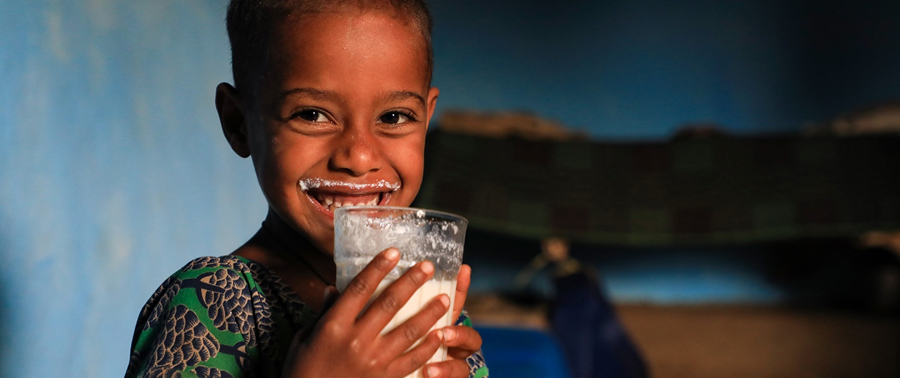
THANK YOU

