Slide 1
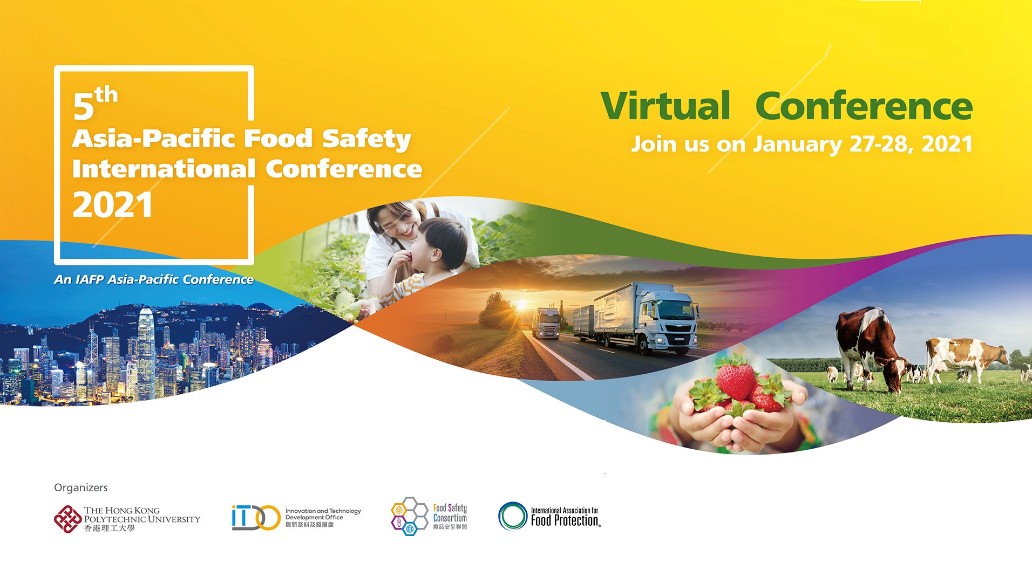
Food safety research and training in informal/wet markets in Southeast Asia
Hung Nguyen, Co-leader, Animal and Human Health program, International Livestock Research Institute
Contribution: Fred Unger, Sinh Dang-Xuan, Phuc Pham Duc, Pham Van Hung, Sothyra Tum, Chhay Ty, Rortana Chea, Delia Grace
28 January 2021

Slide 2
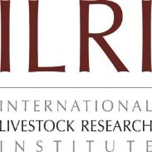



















CGIAR and the International Livestock Research Institute
Reduce poverty
Improve natural resources and ecosystem services
Improve food and nutrition security
Livestock contribute to all 17 of the SDGs and directly to at least 8 of the goals.
ILRI’s mission is
to improve food and nutritional security
and to reduce poverty in developing countries through research for
efficient, safe and sustainable
use of livestock —
ensuring better lives through livestock.

Slide 3
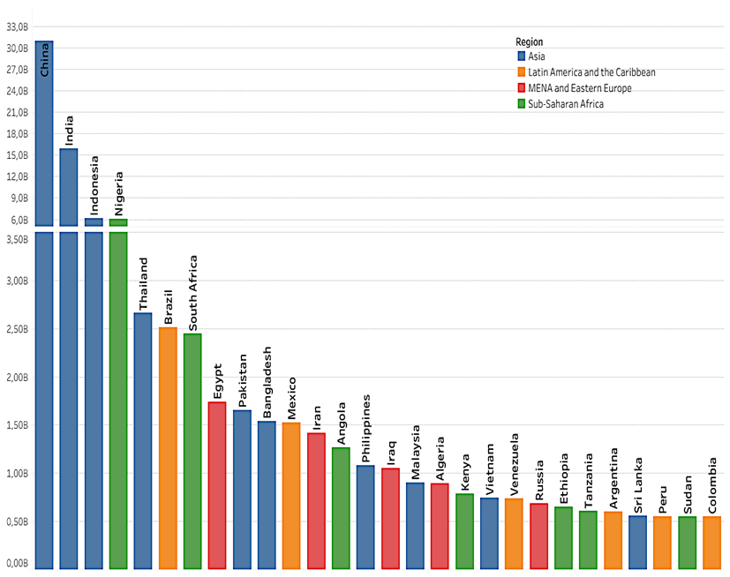
FBD: a new priority – most probably from animal-source food
Millions DALYs lost per year (global)
31 hazards
600 mio illnesses
420,000 deaths
33 million DALYs
Domestic costs may be 20 times trade costs
Burden LMIC
Cost estimates for 2016 : > US$ 115 billion
Productivity loss | 95
Illness treatment | 15
Trade loss or cost | 5 to 7
Havelaar et al., 2015

Slide 4
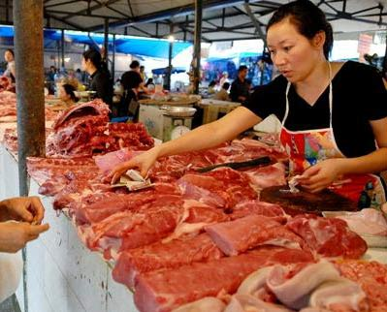
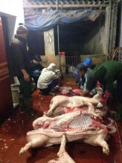
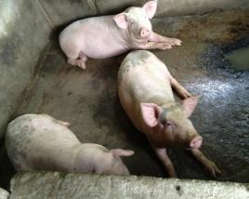
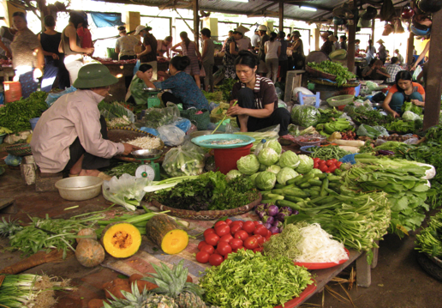
Food value chains and informal markets

Slide 5
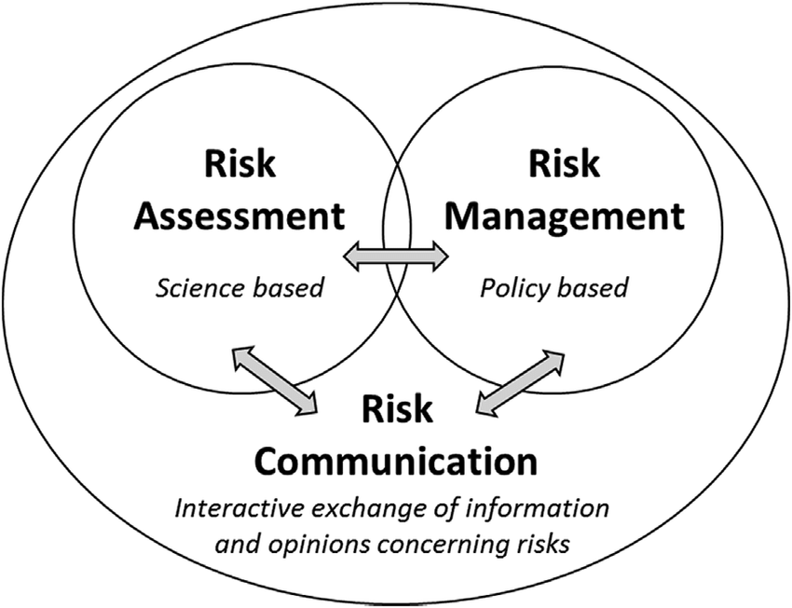
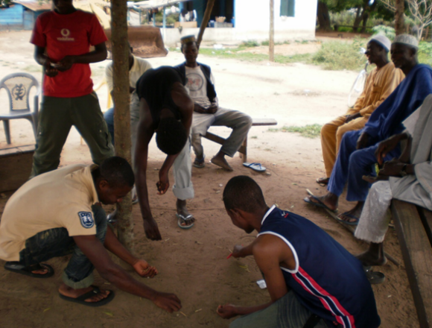
Research approach: what do we do to understand and improve food safety?
Situational analyses of food safety
Capacity building on risk-based approaches
Proof of concept: participatory risk assessment
Pilot testing interventions

Slide 6
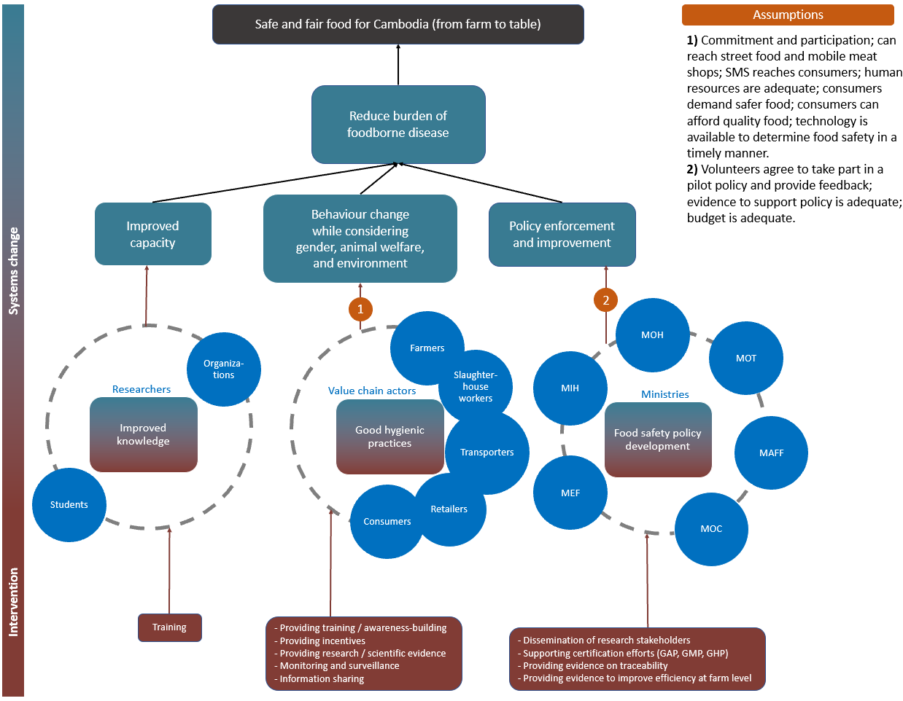
Theory of Changes

Slide 7
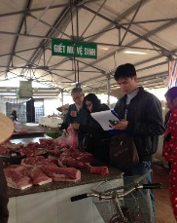
PigRISK: Pork safety in Vietnam (2012-2017)
Microbial and Chemical Risk Assessment
Salmonella risk pathways developed for producers, slaughterhouse and consumers, quantitative microbial risk assessment (QMRA) risk for consumer
Chemical risk assessment: antibiotic residues, banned chemicals, heavy metals
Farm
Transportation to SH
Slaughterhouse
Retailer
Consumers
Feed in bags, remaining feeds at the cages, environment
Liver
Kidney
Pork
Consumption survey
1,275 samples (farms, slaughterhouse, market) collected during 1 year

Slide 8
PigRISK – QMRA for salmonellosis
Age and gender groups | Estimated annual salmonellosis incidence rate (Mean (90% CI)) (%)
Children (under 5 years old) | 11.18 (0 – 45.05)
Adult female (6-60 years old) | 16.41 (0.01 – 53.86)
Adult male (6-60 years old) | 19.29 (0.04 – 59.06)
Elder (over 60 years old) | 20.41 (0.09 – 60.76)
Overall | 17.7 (0.89 – 45.96)
94 million people
Cases of foodborne diseases by Salmonella in pork at 17%: 16 million get sick
Cost $ 107 to treat a case: $ 1,709 million (0.8% GDP)
Dang Xuan Sinh et al, 2016, IJPH

Slide 9
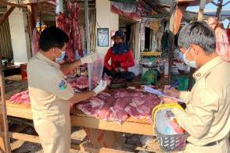
Safe Food, Fair Food for Cambodia (2018-2021)
A nationwide multi-hazard survey in markets in Cambodia found the prevalence in meat (pork and chicken) of Salmonella was 43% and of Staphylococcus was 31%.
The cost of illness of foodborne diarrhea was $63 USD per case.
Cost | National Hospital (n=44) | Referral Hospital (n=60) | Regional Hosp. (n=100) | Community Clinic (n=62) | Overall (n=266)
Direct medical cost
[usd] | 125.77 | 9.42 | 27.85 | 4.19 | 34.38
Direct non-medical cost
[usd] | 40.64 | 8.36 | 26.33 | 0.30 | 18.58
Indirect cost
[usd] | 21.43 | 6.38 | 10.89 | 3.08 | 9.80
Total cost [usd] | 185.88 | 24.16 | 65.07 | 7.57 | 62.76

Slide 10
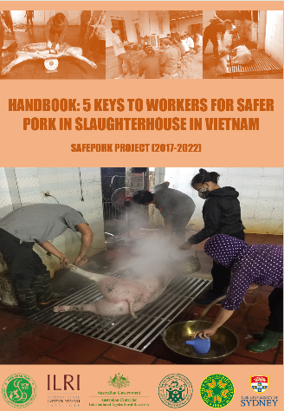
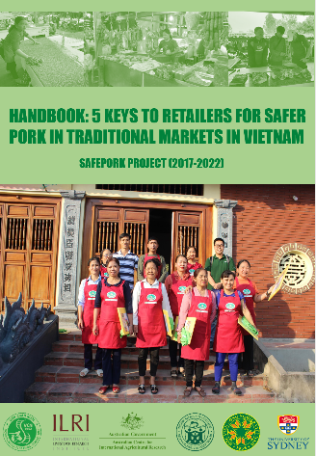
Food safety intervention at slaughterhouse and retail (2018-2022)
INTERVENTION
Development of Instruction & Training materials
Approach:
Participatory risk-assessment
Supportive formative research with model retailers
Risk communication
Key content*:
-Grid slaughter
-Frequent washing (and disinfection)
-Training
-Separation clean/dirty
-Branding
Key content:
-Easy to clean surface
-Frequent washing (and disinfection)
-Separation (fresh/cooked)
-Training
-Hygienic cutting board
-Branding
Handbooks
*only Vietnam

Slide 11
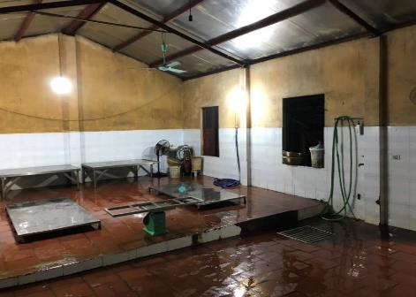
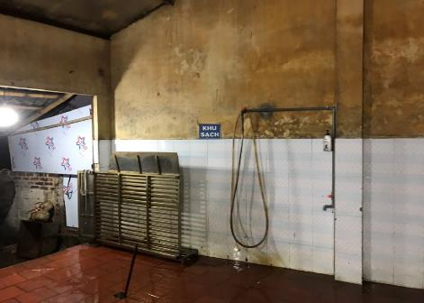
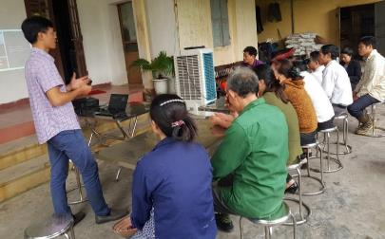
Food safety intervention at slaughter - example
INTERVENTION
Results at SH
Hand disinfection liquid
Re-organized water and electrical system
Installed grid
Grid
Faucet
Training for SH owners & workers
Photo credit: Sinh Dang Xuan/Chi Nguyen ILRI 2020

Slide 12
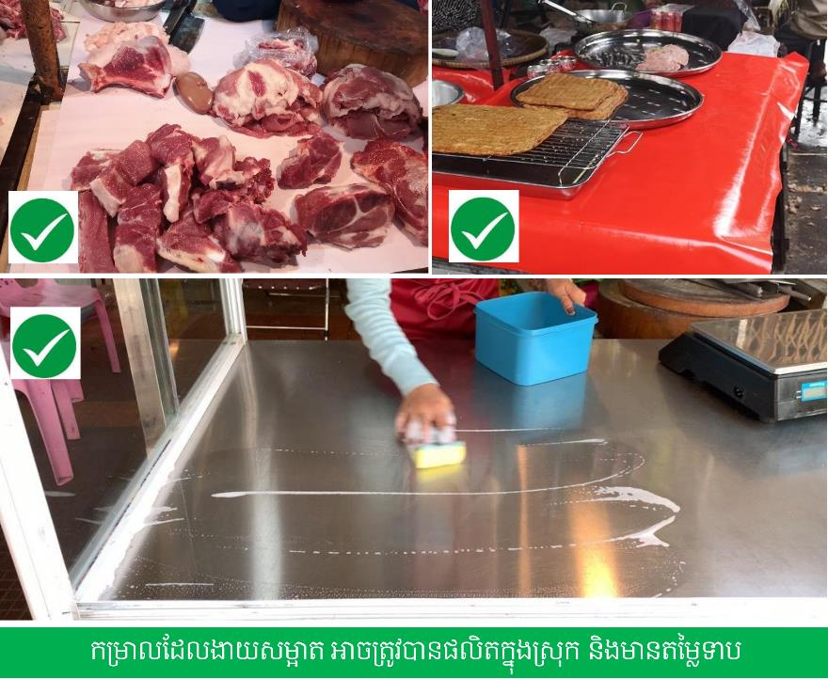
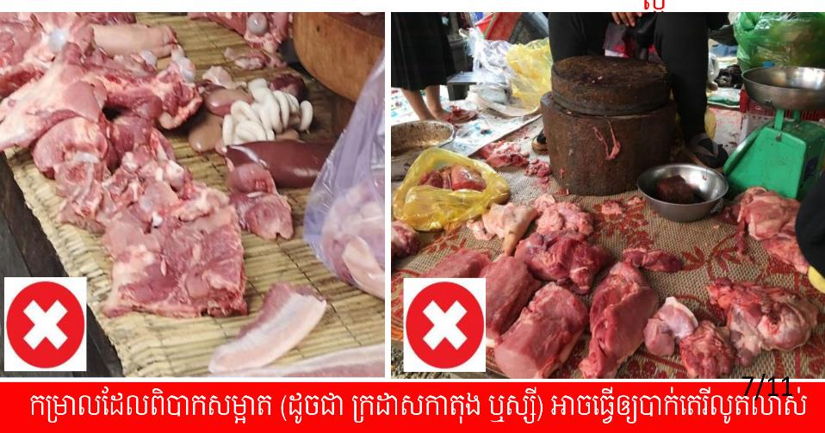

Slide 13
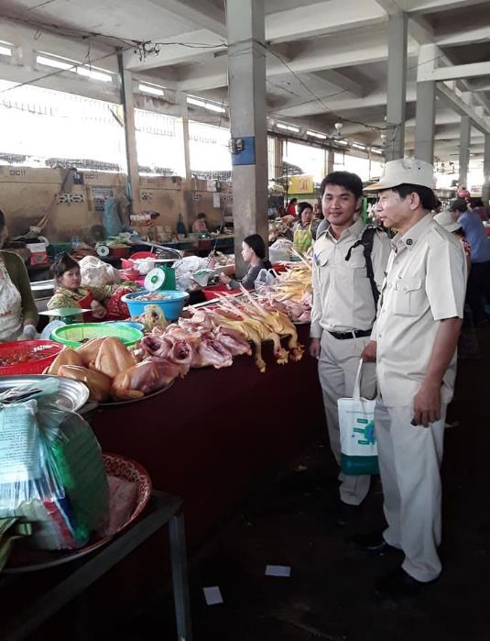
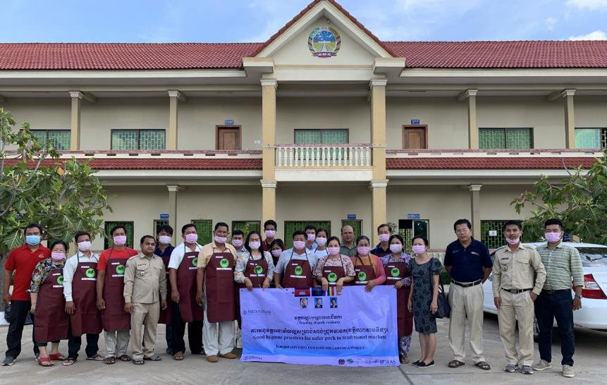
Key stakeholders to ensure GOOD IMPLEMENTATION OF MARKET interventions
National GDAHP
Provincial animal health workers
Market managers
Retailers

Slide 14
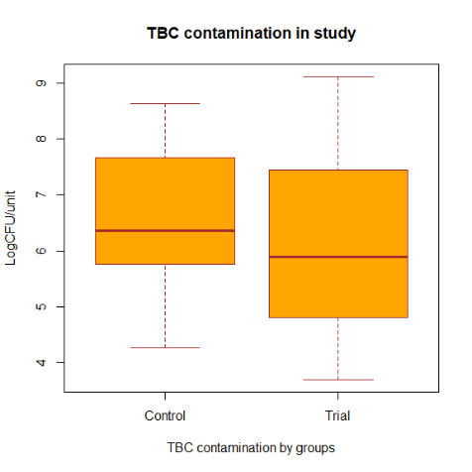
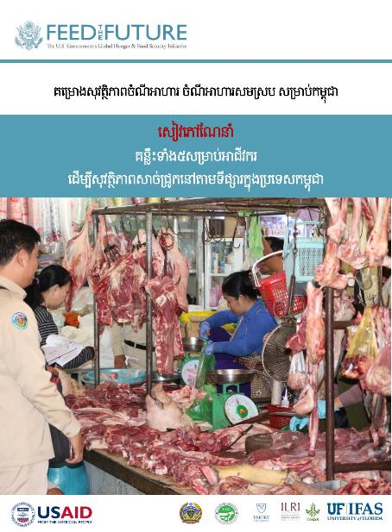
From evidence generation to TCM interventions to improve food safety in wet markets
Key content:
-Easy to clean surface
-Frequent washing (and disinfection)
-Separation (fresh/cooked)
-Training
-Hygienic cutting board
-Branding

Slide 15
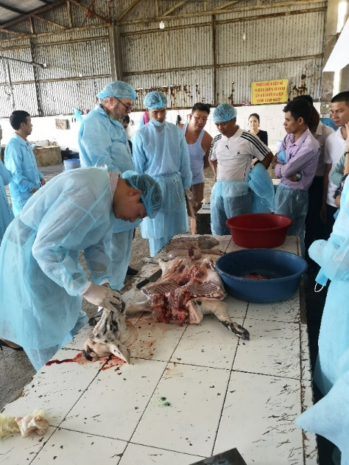
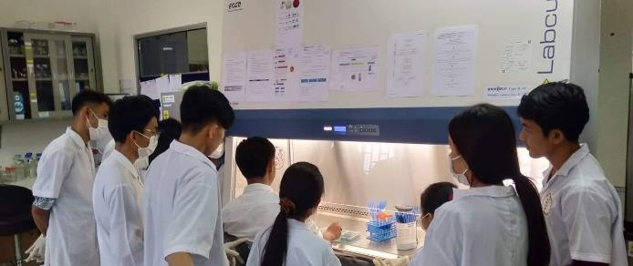
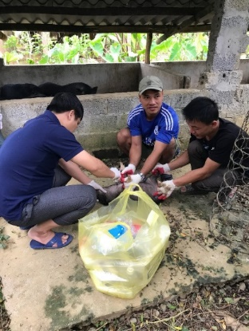
Next generation of food safety workers
Capacity building in meat inspection in Vietnam, Laos, Cambodia

Slide 16
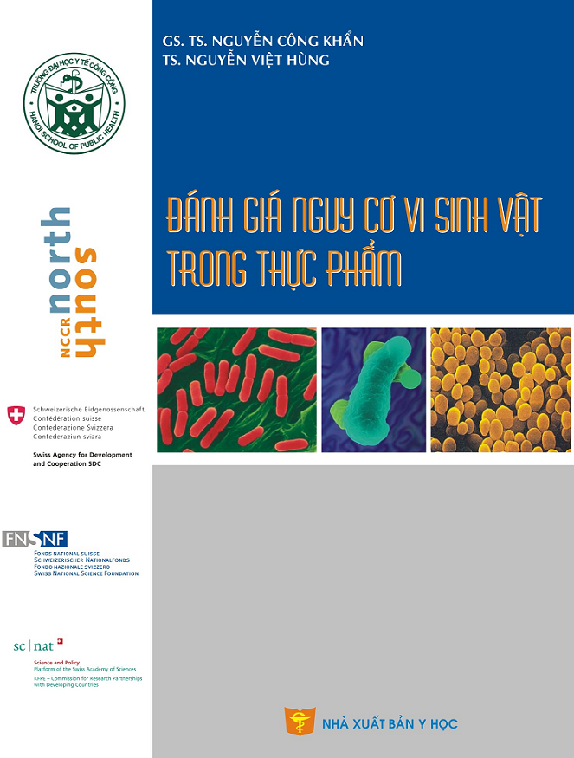
Universities and professional trainings
INTERVENTION
Development of Instruction & Training materials
Risk assessment guidelines on food safety related to biological and chemical hazards
Food safety curriculum developments

Slide 17
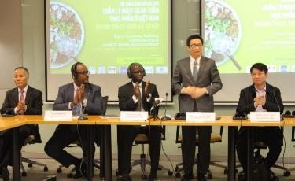
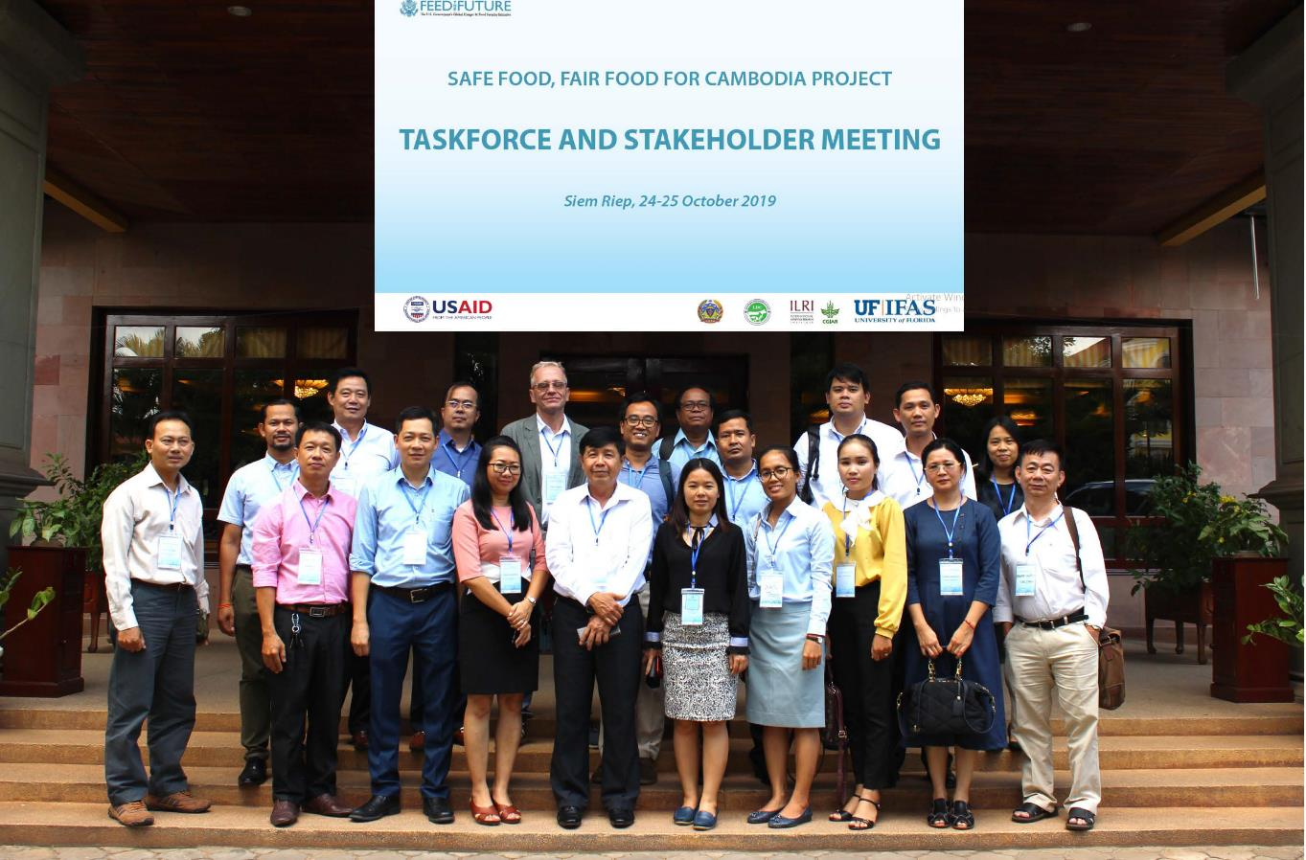




Policy impact: translational research for interventions in modernizing food system
CGIAR/ILRI niche - risk assessment and policy / regulatory analysis for fresh foods in domestic markets
World Bank convenes overall support to government: ILRI led technical works
Upcoming projects based on WB report we led will improve food safety for 20 million people in major cities of Vietnam

Slide 18
Key messages
Food safety in informal/wet markets: high level of microbial contamination along the value chains and of public concerns
Risk based approach (hazard vs. risks) helps identify targeted interventions and key stakeholders to improve food safety
Capacity building: trainings at different levels are key to improve food safety
Strong engagement of high level ‘taskforce’, and other actors (animal health workers, market managers, retailers) made intervention implementation successful

Slide 19
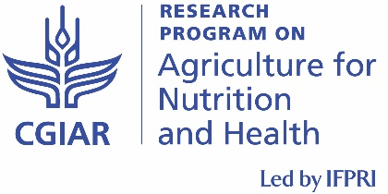
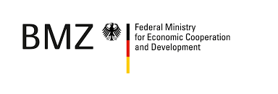


Acknowledgements
ILRI team: Kristina Roesel, Silvia Alonso, Johanna Lindahl, PigRISK and SafePORK team
Melissa Youth and SFFF Cambodia team
BMZ project team
Funding: ACIAR, CGIAR Research Program on Agriculture for Nutrition and Health, World Bank, BMZ, USAID through LSIL, IAFP

