Slide 1
Climate Change Impact Platform
Dr. Aditi Mukherji
Director, CGIAR Climate Change Impact Platform
2nd June, 2023

Slide 2

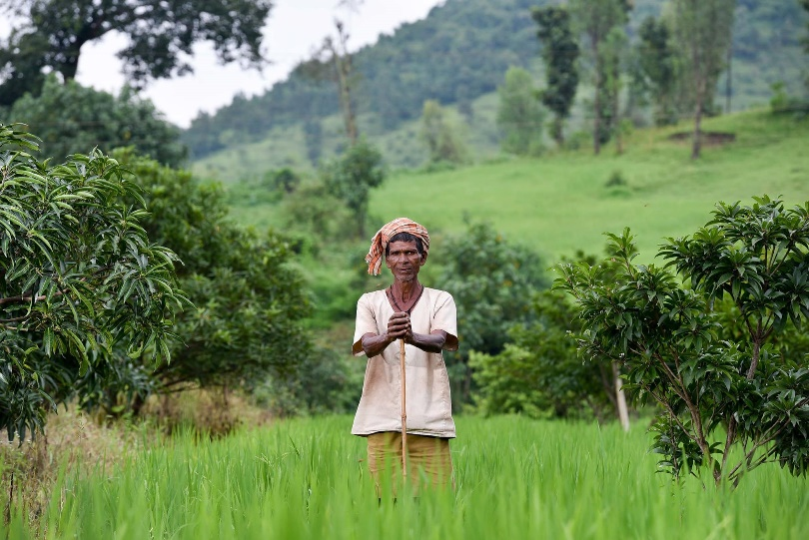





[Purpose] Climate Impact Platform: Bringing Together CGIAR’s Climate Research
Convene community of practice
CoP: CGIAR & Beyond
Deepen CGIAR and Partner Capacity
Facilitating research on gaps
Amplify external profile
Collaborate with leading climate voices
Advise portfolio level management and strategy
Track initiative outcomes
Primary Impact Area
Climate Adaptation & Mitigation

Slide 3



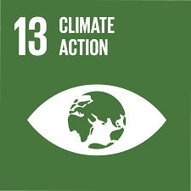


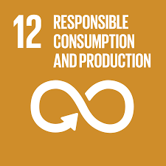

To help achieve CGIAR’s Climate adaptation & mitigation in CGIAR strategy
Turn agriculture and forest systems into a
net sink for carbon by 2050, with emissions from agriculture decreasing by 1Gt per year by 2030 and reaching a floor of 5 Gt per year by 2050
Equip 500 million small-scale producers to be more resilient to climate shocks, with climate adaptation solutions available through national innovation systems
Implement all National Adaptation Plans and Nationally Determined Contributions to the Paris Agreement
Building up from
previous work
2

Slide 4
[Approach] Module 1: Expertise and Themes
Expertise and themes
Searchable database of climate scientists at CG and NARES
Thematic insights showcasing policy implications of best available science
Trainings for CG and NARES scientists
10-12 thematic climate groups based on interest and expertise

Slide 5
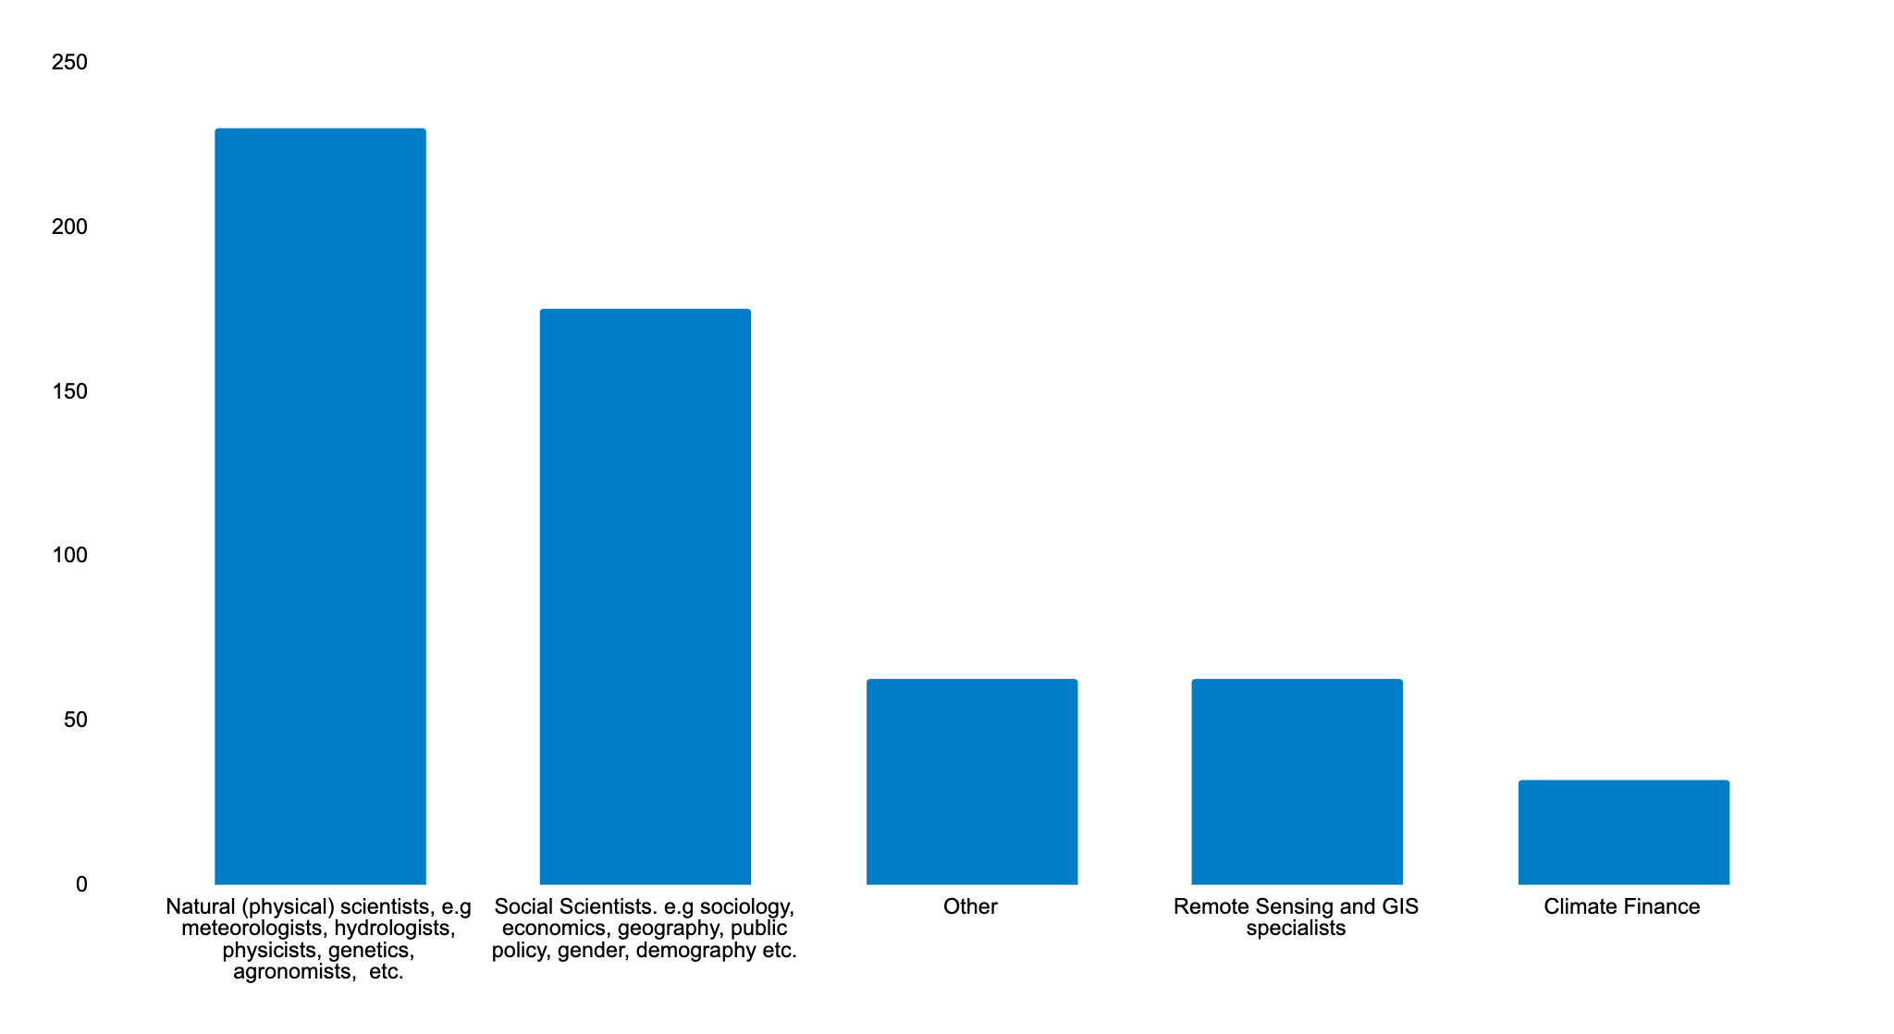
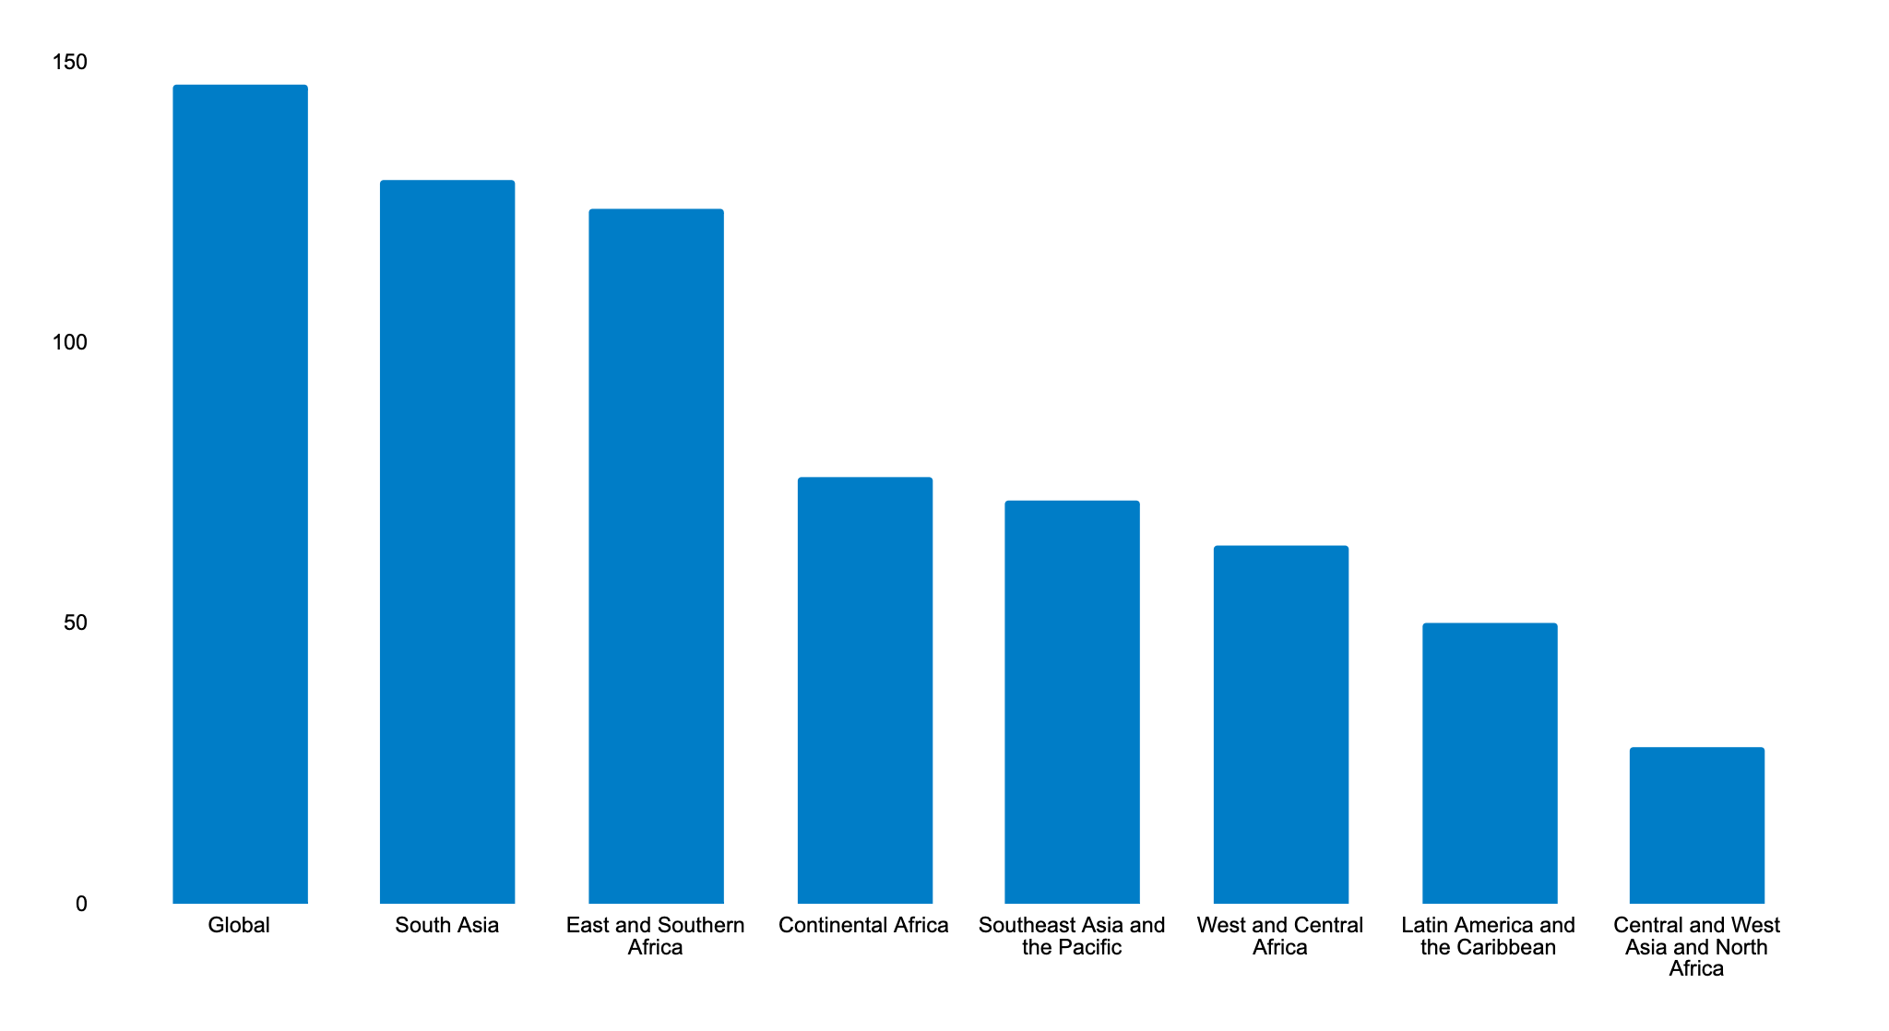
Examples: Climate expertise at CGIAR – A database of ~500 scientists and growing to serve several purposes
Scientists by discipline of expertise
Scientists by geographical area of expertise

Slide 6
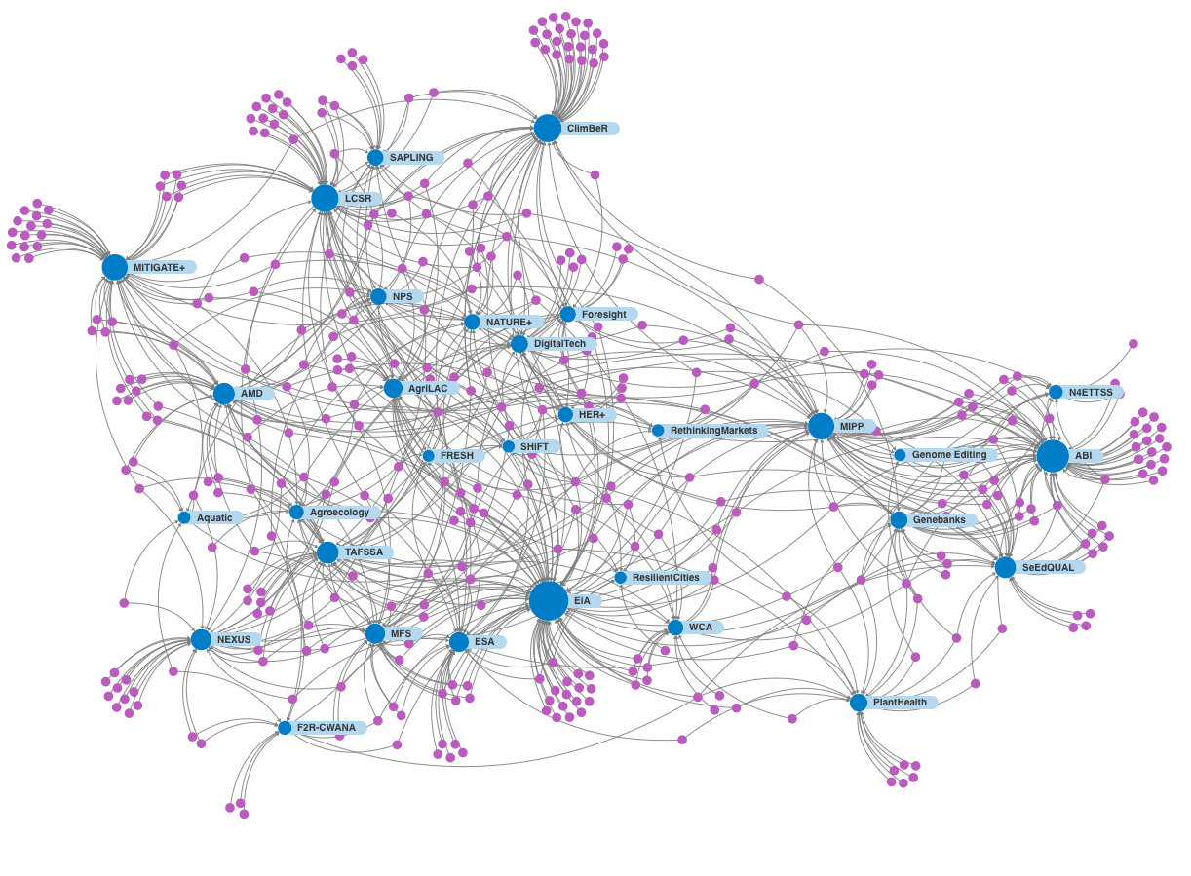
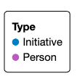
Scientist to Initiatives Network
Sized by In Degree and Coloured by Type (Labels)

Slide 7
Examples of activities: Expertise and themes
CGIAR Climate Offer Document, the current and the future directions of CGIAR’s climate Portfolio
Demand driven workshops and meetings
on various technical topics – downscaling of climate scenarios, mitigation technologies, adaptation options
Lead or contribute to special reports, chapters on various global products, e.g. Breakthrough Report of AIM4C, IPCC/ IPBES assessments
Notes:
Roster of consultants for NDC consultants – link with country convener, and Regional Directors

Slide 8
Questions for Module 1:
Identify activities that the Platform could potentially do under the Module 1 and prioritize top 5 activities to be done in Year 1-2?
If we had to organize ourselves into 8-10 thematic areas (smaller communities of practice for ease of collaboration, ideation), what would those themes be?

Slide 9
[Approach] Module 2: Methods and Metrics
Methods and Metrics
Repository of innovative methods on all aspects of climate science
Metrics on how do we measure progress of climate action in agri-food systems
CGIAR’s Annual Report on the State Agri-Food Systems under a Changing Climate

Slide 10
Possible Examples of activities: Repository of innovative methods and metrics
Measuring effectiveness of adaptation in reducing climate risks and which adaptation remains effective at higher warming levels?
Tracking adaptation finance and its efficacy in reducing climate risks
Quantifying losses and damages in food systems with attribution to climate change
IPCC, WGII, Ch 4 &17, IPCC, WGII SPM
Notes:
Issues Brief

Slide 11
Questions for Module 2:
Given the Platform is tasked with curating metrics and methods, we need your help with:
Identifying climate change related metrics and/or methods:
  that already exists within the CGIAR;
  are being developed now;
  should be developed because it does not exist.
Suggestion:
  You might want to get into thematic buckets here and think in terms of methods and metrics in themes like adaptation, mitigation, breeding crops and livestock for resilience, migration, physical aspects of climate change etc.

Slide 12
[Approach] Module 3: Synthesis and Gaps
Synthesis and Gaps
Rigorous evidence synthesis/meta reviews on climate topics with high policy interest
Identification of gaps in knowledge
Facilitating gap filling research through bringing in diverse voices together

Slide 13
Examples of Impacts of Climate Action Investments
Projected benefits and examples of adaptation from CGIAR plant breeding and crop management in key climate hazard areas
Improved fisheries assisted 20,966 people (45% women) out of poverty in Bangladesh; and 121k hectares of freshwater area are under improved management
500k Mexican farmers with 50% yield gains by using better agronomy and CGIAR-related improved varieties
Crowdsourcing improved seeds benefitting 1.3m Ethiopian farmers (53% women)
Scaling climate forecast-based agronomic advisories in benefitting 7.4m rural people in Senegal
600k hectares of rice planted earlier in Vietnam to avoid risk of salinity intrusion due to El Niño
1m farmers in Maharashtra using CGIAR-informed insurance schemes
500k farmers in LAM managing crops better through CGIAR-informed agro-advisories
Climate-smart valleys: low-cost, participatory approaches resulted in 94% increase in rice yields in West Africa, benefitting over 14,000 households
Total number of people in rural areas projected to benefit from One CGIAR work on climate adaptation
< 500k
between 500k and 1.5 million
between 1.5 and 5 million
between 5 and 10 million
above 10 million
Stress tolerant CGIAR-related maize seeds benefitting 64.8 million people in 13 countries in sub-Saharan Africa
23

Slide 14
Examples of activities: Synthesis and Gaps
Rigorous meta reviews of promising climate innovations in agri-food systems
Select those innovations from across CGIAR and beyond and do rigorous meta-reviews on scale, scope, relevance, benefits, trade-offs
CGIAR’s Climate Portfolio analysis
Evidence synthesis of CGIAR’s climate work
Gaps that needs filling in next round of initiative
How does overshoot beyond 1.5 degrees affect land, water and food and land’s ability to remain a sink ?
IPCC, WGII, Ch 4 &17, IPCC, WGII SPM
Notes:
Issues Brief

Slide 15
Questions for Module 3
List top 8-10 climate science or policy related synthesis products we should be doing in the next 1-2 years? Synthesis products could be:
    Rigorous systematic reviews of evidence
    Forward looking agenda setting thought piece
List top 4-5 climate science/policy related gaps where the Platform can play a convening role in the next 1-2 years and bring in various stakeholders (internal or external to CGIAR) to deliberate on a new topic.

Slide 16
Module 4: Influencing Global Climate Processes
Influencing Global Climate Processes
Facilitating CGIAR wide submissions to Climate COPs, CBD COPs etc.
Knowledge and synthesis products to feed into and influence global processes

Slide 17
Examples: Engaging with Global Climate Processes
Submissions on Koronovia/Sharm-el-Sheikh work Program on agriculture
Submissions on Global Goals on Adaptation
Submissions to Global Stock take
CGIAR’s State of the Climate and Agri-Food Systems to inform COP debates
Breakthrough Report Agriculture Chapter to influence AIM4C/COP 28 discussions
Support and coordinate technical proposals for fund raising from various climate funders by matchmaking and helping identify experts from our pool of CGIAR wide climate experts
16

Slide 18
Questions for Module 4
Which climate negotiation process (e.g. Global Goals on Adaptation, Loss and Damage, Finance etc.) should CGIAR participate and why?
What can CGIAR bring in through such participation (for ourselves and for the countries) which others can’t? What is CGIAR’s unique value proposition at COP and SBSTA?
Anything else that the Platform should be doing apart from the 4 modules described above?

Slide 19
Status: Starting out, early days
Ambition > Resources
Building up on earlier insights from CCFAS and Centre led Climate work
CGIAR Climate Community of Practice is in place ~500 scientists and growing
Workplan for the Platform to be co-created at this workshop
Positions to be advertised – but the Platform will be lean (not more than 4-6 core staff)– will rely on existing pool of scientists for expertise

Slide 20
Staffing ambition
Platform Manager
Executive Assistant
Comms lead (will be shared with other Platforms)
Global Policy Process Engagement Officer (to work closely with P&A, C&O and scientists for strengthening CGIAR’s role in international climate processes)
Science and policy research officers (50% time each) to help with synthesis/gap filling research etc.
Consultants as needed from time to time

Slide 21
Ambition: Climate Platform will be the go to place where:
Latest policy relevant science created by CGIAR and others on climate change and agri-food systems is curated
  Helping CGIAR to play global thought leadership role on climate and food systems
Climate experts within CGIAR and NARES find an intellectual home
  Helping tap into diverse expertise and matchmaking with various demands, and keep themselves updated
Global climate policies on agri-food are influenced by CGIAR science
  Helping shape global climate and food systems agenda for a warmer world

Slide 22
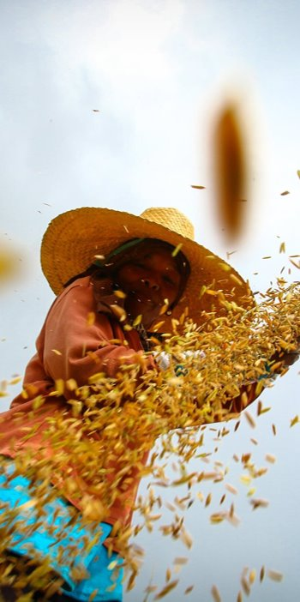
  Thank you
  a.mukherji@cgiar.org
23

